Slide 1
Section 5.3
Solving Linear Systems of Equations in Two Variables

Slide 2
Helpful Hint 1
Systems of equations are considered consistent if they have either one or infinitely many solutions in common. They are considered inconsistent if they have no solution in common.

Slide 3

Example 1: Verifying the Point of Intersection of Two Lines—Slide 1
Determine if the point $\left(2\text{, }3\right)$ is the point of intersection for the given lines. In other words, is $\left(2\text{, }3\right)$ the solution to the system of equations?
​
Solution
In order to determine if a point is a solution to a system of equations, we must substitute the x- and y-coordinates into each equation and verify that both are satisfied.

Slide 4

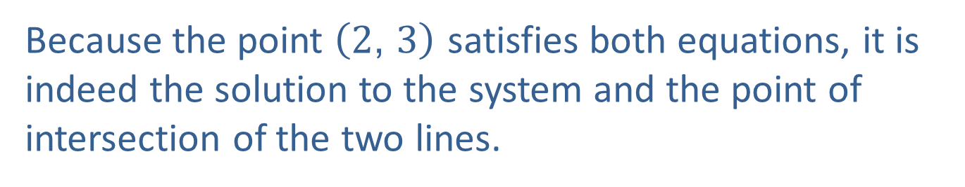
Example 1: Verifying the Point of Intersection of Two Lines—Slide 2
Verifying the 1st Equation:
​$\text{Verifying} \text{the} \text{2}\text{nd} \text{Equation}\text{: }$
Because the point $\left(2\text{, }3\right)$ satisfies both equations, it is indeed the solution to the system and the point of intersection of the two lines.

Slide 5

Skill Check 1
Determine if the point $\left(2\text{, }4\right)$ is the point of intersection of the lines y = 5x − 6 and 3x − 0.1y = 1.
Answer: $(2,4)$ is not the point of intersection.

Slide 6
Definition: Solving a System of Linear Equations by Substitution
1.​ Solve one of the equations for one of the variables.
2. Substitute the expression found in Step 1 into the other equation and solve for the remaining variable.
3. ​Re-substitute the value found in Step 2 into the original equation from Step 1 to find the corresponding coordinate.

Slide 7
Example 2: Solving a System of Linear Equations—Slide 1
Solve the following linear system of equations algebraically. Check your answer using a graphing calculator.
Solution
Step 1:
Since the first equation given is already solved for y, we can move on to step 2.

Slide 8
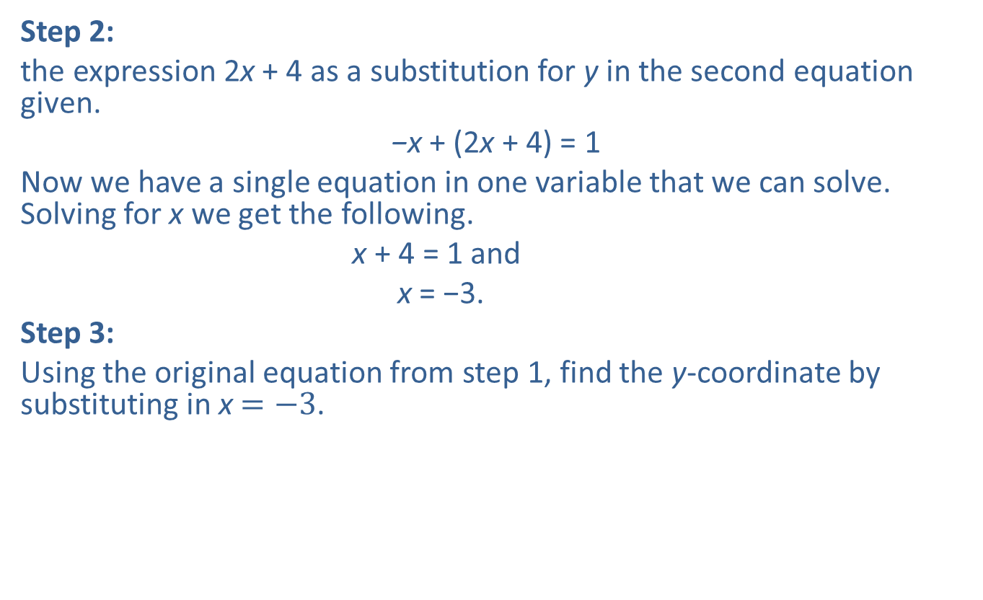
Example 2: Solving a System of Linear Equations—Slide 2
Step 2:
the expression 2x + 4 as a substitution for y in the second equation given.
−x + (2x + 4) = 1
Now we have a single equation in one variable that we can solve. Solving for x we get the following.
x + 4 = 1 and
x = −3.
Step 3:
Using the original equation from step 1, find the y-coordinate by substituting in x $=−3$.
​

Slide 9
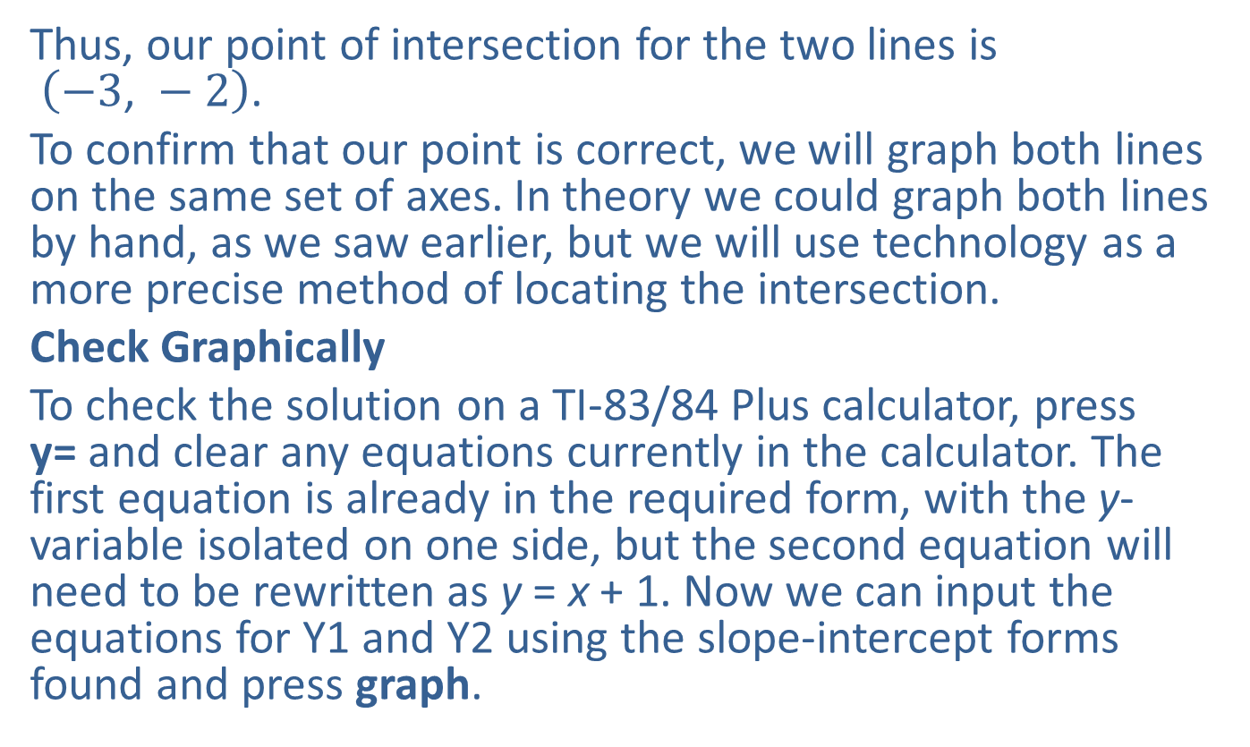
Example 2: Solving a System of Linear Equations—Slide 3
Thus, our point of intersection for the two lines is $\left(−3\text{, }−2\right)$.
To confirm that our point is correct, we will graph both lines on the same set of axes. In theory we could graph both lines by hand, as we saw earlier, but we will use technology as a more precise method of locating the intersection.
Check Graphically
To check the solution on a TI-83/84 Plus calculator, press y= and clear any equations currently in the calculator. The first equation is already in the required form, with the y-variable isolated on one side, but the second equation will need to be rewritten as y = x + 1. Now we can input the equations for Y1 and Y2 using the slope-intercept forms found and press graph.

Slide 10
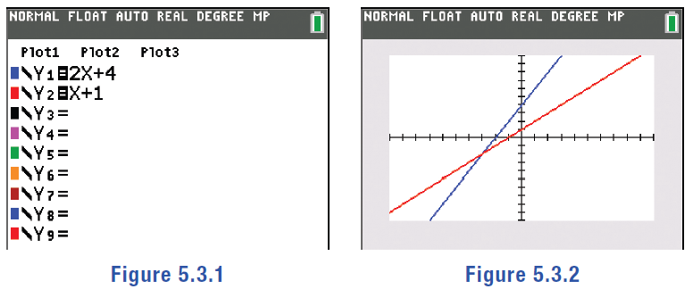
Example 2: Solving a System of Linear Equations—Slide 4
Figure 1
Figure 2
Once the lines are graphed, to find the intersection of the lines, press 2nd trace and select intersect. You'll see a blinking cursor along the first line. Press enter, and there should now be a blinking cursor on the second line. Press enter again, and you'll see Guess? at the bottom of the screen. Press enter a third time, and at the bottom of the screen the calculator will display its best approximation of the intersection of the two lines.

Slide 11
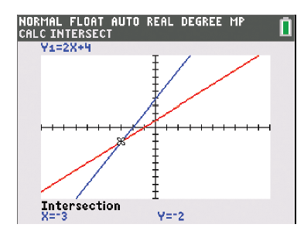

Example 2: Solving a System of Linear Equations—Slide 5
The calculator confirms that the point of intersection is $\left(−3\text{, }−2\right)$.
Figure 3

Slide 12
Tech Tip 1
Pressing window or zoom will allow you to adjust the display window on the calculator.

Slide 13
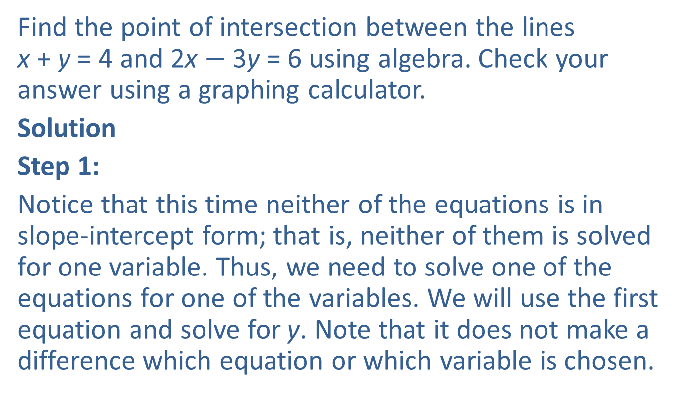
Example 3: Solving a System of Linear Equations—Slide 1
Find the point of intersection between the lines x + y = 4 and 2x $−$ 3y = 6 using algebra. Check your answer using a graphing calculator.
Solution
Step 1:
Notice that this time neither of the equations is in slope-intercept form; that is, neither of them is solved for one variable. Thus, we need to solve one of the equations for one of the variables. We will use the first equation and solve for y. Note that it does not make a difference which equation or which variable is chosen.

Slide 14
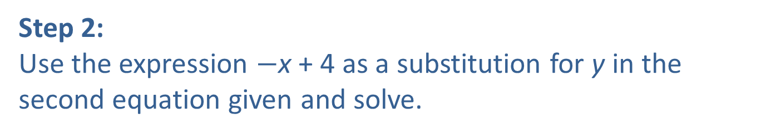
Example 3: Solving a System of Linear Equations—Slide 2
Solve the First Equation for y
​​
Step 2:
Use the expression $−$x + 4 as a substitution for y in the second equation given and solve.

Slide 15
Example 3: Solving a System of Linear Equations—Slide 3
Step 3:
Using the original equation from step 1, find the y-coordinate by substituting in
​
Thus, the point of intersection is
We can now use the calculator to check our answer.

Slide 16
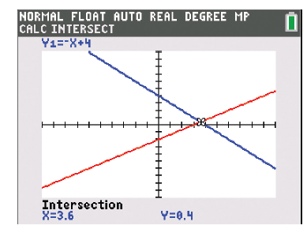
Example 3: Solving a System of Linear Equations—Slide 4
Check Graphically
Press y= and clear any equations currently in the calculator. Using the slope-
intercept form of each equation
input the equations for Y1 and Y2 and press graph. Press 2nd trace and select intersect and press enter three times. At the bottom of the screen, the calculator gives the point of the intersection in decimal form. This confirms our findings, as
Figure 4

Slide 17
Example 4: Solving a System of Linear Equations—Slide 1
Find the point of intersection for the lines y = −4x + 3 and
8x + 2y = 10. Check your answer using a graphing calculator.
Solution
Step 1:
Since the first equation given is already solved for y, we can move on to step 2.
Step 2:
Use the expression −4x + 3 as a substitution for y in the second equation given and solve.

Slide 18
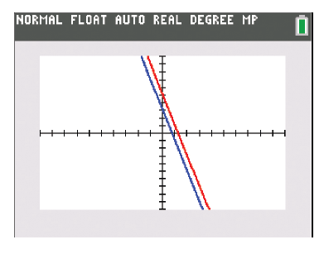
Example 4: Solving a System of Linear Equations—Slide 2
Because we have a false statement, we can stop. A false statement means that there is not a point of intersection between the lines. Thus, the lines are parallel.
Check Graphically
Press y= and clear any equations currently in the calculator. Input the equations for Y1 and Y2 using the slope-intercept forms found and press graph.
Figure 5

Slide 19
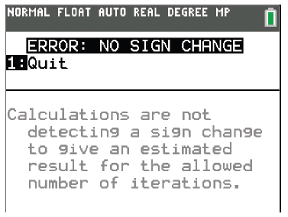
Example 4: Solving a System of Linear Equations—Slide 3
The two lines appear to be parallel; that is, no point of intersection is visible. To confirm this, press 2nd trace and select intersect. As in the previous examples, press enter three times. Instead of returning a point of intersection, the calculator returns an error. This is because the lines never intersect. So, we've confirmed they are parallel.
Figure 6

Slide 20
Tech Tip 2
When you graph equations that are the same line on a TI-83/84 Plus calculator, it draws the first line, then draws the second line over the first. If you're not careful, you might see what looks like one line even though both have been graphed.

Slide 21

Skill Check 2
Find the point of intersection between the lines 2y = −6x − 20 and 3x $−$ y = −10 using algebra. Check your answer using a graphing calculator.
Answer: (2, 4) is not the point of intersection

Slide 22
Example 5: Modeling with Linear Systems—Slide 1
As a recruitment officer, Asher is responsible for planning outings for his university organization. For the next outing, he's considering The Escape Station, which charges $135 plus $15 per person to rent out the space. The organization guidelines indicate that he can charge at most $20 per person for the trip. Asher needs to determine how many people would need to go on the trip to make it viable for him to rent The Escape Station if he charges $20 per person.
Write two linear functions, one for the cost of renting The Escape Station, C(x), and one for the amount of money Asher will collect, R(x). Use the functions to find out how many people need to go on the trip in order for Asher to not lose any money.

Slide 23
Example 5: Modeling with Linear Systems—Slide 2
Solution
We can begin to help Asher with his question by setting up two linear functions to model the scenario. As we did in a previous section, we will begin by introducing variables to represent the unknowns. We will let x be the number of people attending the outing. The function C(x) represents the cost of renting The Escape Station and the function R(x) represents the amount of money that Asher collects.
We know that Asher will collect $20 for each person that attends. So the function for the money he receives is R(x) = 20x. This is often referred to as the revenue function.
At the same time, we know the cost of the rental space will be $15 per person plus $135 for the room. The function that connects Asher's total cost with the number of attendees is then C(x) = 15x + 135. This is often referred to as the cost function.

Slide 24
Example 5: Modeling with Linear Systems—Slide 3
Now that we have both functions, we can find their point of intersection, which is called the break-even point. This point represents when the cost of the trip and the revenue Asher will collect are equal to one another, and hence will tell us the number of people he needs to make the trip viable.
We set the functions equal to each other and solve for x.
​

Slide 25
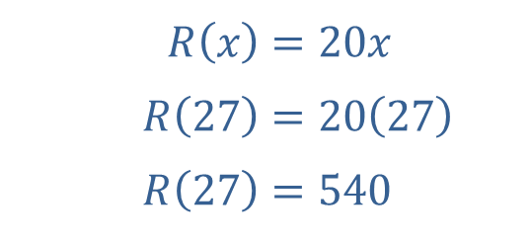
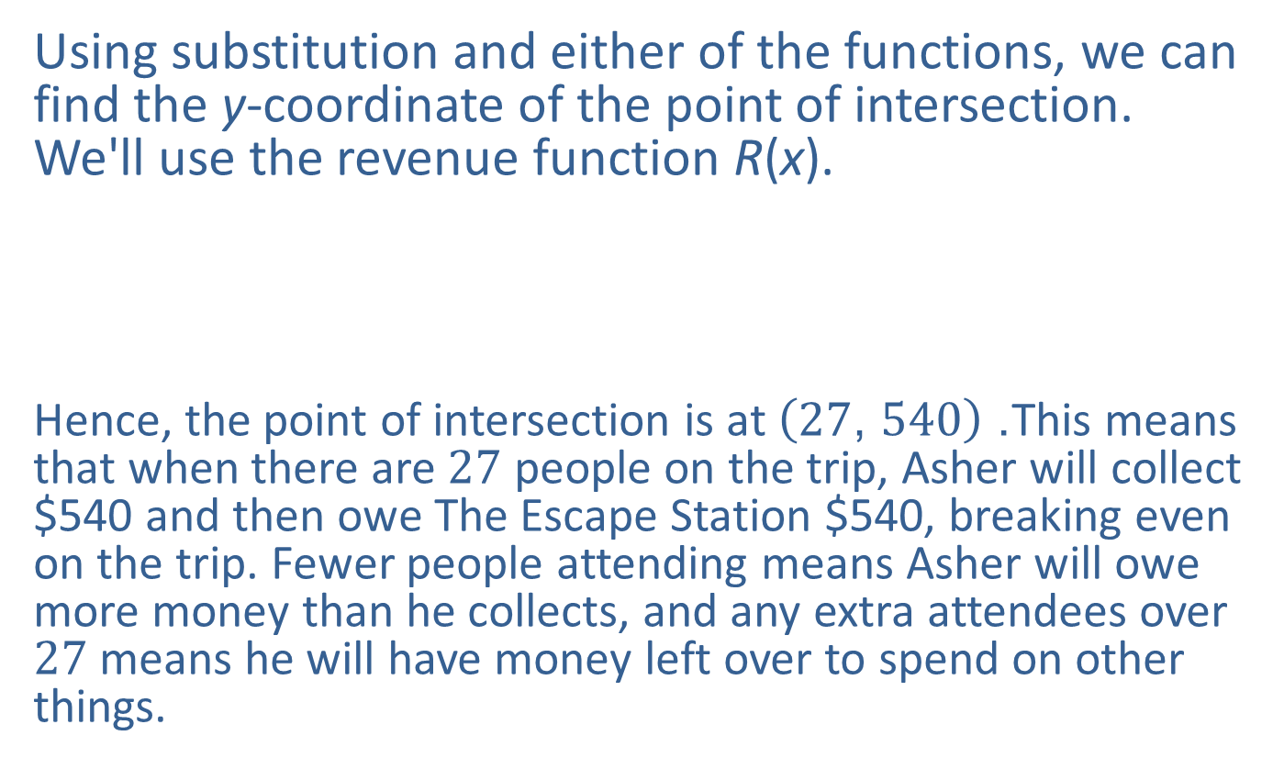
Example 5: Modeling with Linear Systems—Slide 4
Using substitution and either of the functions, we can find the y-coordinate of the point of intersection. We'll use the revenue function R(x).
Hence, the point of intersection is at $\left(27\text{, }540\right)$. This means that when there are 27 people on the trip, Asher will collect $540 and then owe The Escape Station $540, breaking even on the trip. Fewer people attending means Asher will owe more money than he collects, and any extra attendees over 27 means he will have money left over to spend on other things.​
​$R⁡\left(x\right)$ | ​$=20x$
​$R⁡\left(27\right)$ | ​$=20\left(27\right)$
​$R⁡\left(27\right)$ | ​$=540$

Slide 26
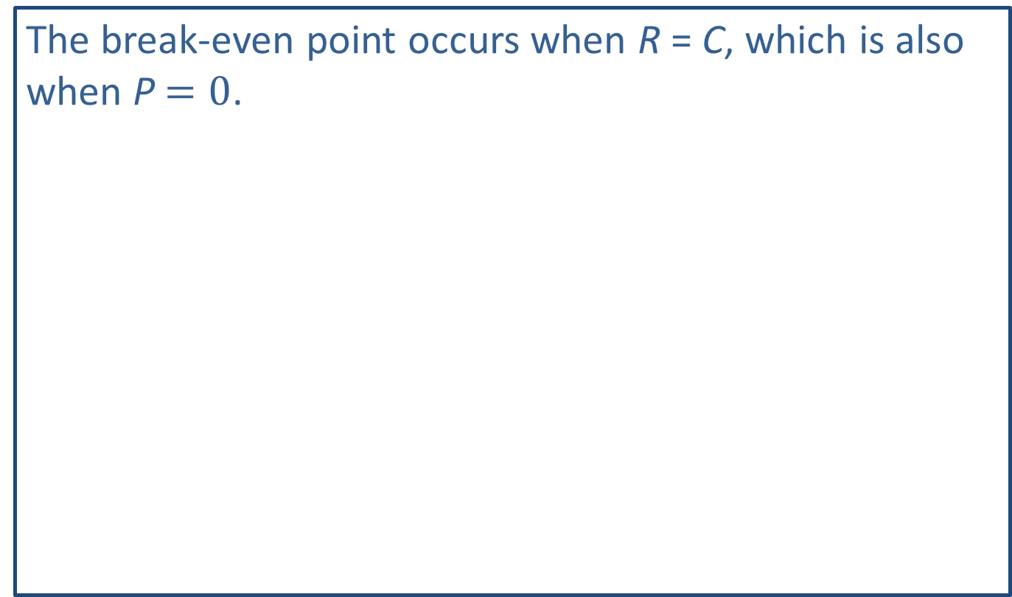
Helpful Hint 2
The break-even point occurs when R = C, which is also when P$=0$.

Slide 27
Definition: Business Modeling Functions
Cost Function (C)
The cost function calculates the total cost C of producing x units; it is equal to the original fixed cost plus the production cost for each unit multiplied by the number of units x.
Revenue Function (R)
The revenue function calculates the revenue received R; it is equal to the price per unit multiplied by the number of units sold x.
Profit Function (P)
The profit function calculates the amount of profit P created for x number of units made and sold and is found by subtracting the cost from the revenue.
P = R − C
Break-Even Point
The quantity of units to be produced and sold so that the cost of production equals the revenues for a product is called the break-even point.

Slide 28
Example 6: Determining the Break-Even Point—Slide 1
Harley is drawing up a business plan to produce and sell a new in-store price scanner. She has determined that the initial start-up cost will be $18,000, and it will cost her $14 to produce each scanner. Harley plans to sell each scanner to stores for $30. Let x be the number of scanners produced.
a.​ Write the cost function for producing the scanners.
b.​ Write the revenue function for selling the scanners.
c. ​Write the profit function for Harley's business.
d.​ Determine the break-even point for Harley's new scanner business.
e.​ If Harley sells 2500 scanners, what profit can Harley expect to make?

Slide 29
Example 6: Determining the Break-Even Point—Slide 2
Solution
a.​ The cost function includes the fixed cost, which is $18,000, plus the cost for each scanner to be produced. The production cost per scanner is $14 multiplied by the number of scanners produced, x.
​Cost Function
​C(x) = 18,000 + 14x
b. The revenue function consists of the sale price of each scanner, $30, multiplied by the number of scanners sold, x.
​Revenue Function
​R(x) = 30x

Slide 30
Example 6: Determining the Break-Even Point—Slide 3
c. ​The profit function is determined by subtracting the cost function from the revenue function, P(x) = R(x) – C(x).
​Profit Function
d. The break-even point is found by solving the system of equations consisting of the cost and revenue functions. The intersection will happen when the cost is equal to the revenue. Therefore, we need to set the two equations equal to one another and solve for x.

Slide 31
Example 6: Determining the Break-Even Point—Slide 4
Therefore, the break-even point for Harley is when she produces and sells 1125 scanners.
e.​ To determine the profit Harley will make if she sells 2500 scanners, we need to substitute 2500 into the profit function found in part c.
Therefore, Harley will make a profit of $22,000 when she sells 2500 scanners.

Slide 32
Skill Check 3
Suppose you are planning to manufacture a new board game that requires an initial cost of $5000 and an additional $11 for each game produced. You plan to then sell each board game for $28. Write the cost function and the revenue function for this venture. Then, find the break-even point for your board game business.
Answer:
C(x) = 5,000 + 11x; R(x) = 28x; The break-even point is approximately 294.12, which rounds up to 295.

