Slide 1
Section 5.4
Linear Inequalities in Two Variables

Slide 2
Definition: Inequalities—Slide 1
Inequality Symbol
An inequality symbol is a relation used between two expressions that are not strictly equal.
< less Than ≤ less than or equal to
> greater than ≥ greater than or equal to

Slide 3
Definition: Inequalities—Slide 2
Linear Inequality
A linear inequality in the variable x can be written in one of the following forms
where a, b, and c are numbers and a ≠ 0.

Slide 4
Helpful Hint 1
Common Inequality Phrases
> | < | ≥ | ≤
More than | Fewer than | At least | At most
Above | Below | No fewer than | No more than
Exceeds | Up to

Slide 5
Helpful Hint 2
Recall that vertical lines are of the form x = a and horizontal lines are of the form y = b.

Slide 6
Definition: Boundary Line
A boundary line is a line that separates those points that satisfy an inequality from those that do not. It is a representation of the equation created when the inequality sign is replaced with an equal sign.

Slide 7
Procedure: Steps to Graphing Linear Inequalities
1.​ Graph the boundary line.
​The line will be solid if the inequality is ≥ or ≤.
The line will be dashed if the inequality is > or <.
2.​ Determine which side of the line to shade by using a test point.
3.​ Shade the half-plane that contains the solution set.

Slide 8
Think Back
The slope-intercept form of an equation is y = mx + b, where m is the slope and b is the y-intercept.

Slide 9
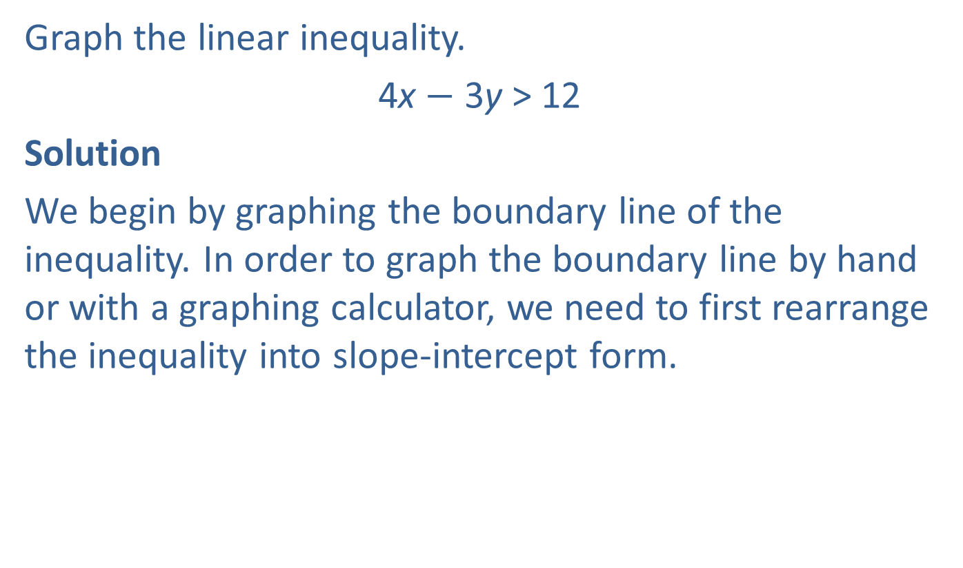
Example 1: Graphing a Linear Inequality—Slide 1
Graph the linear inequality.
4x $−$ 3y > 12
Solution
We begin by graphing the boundary line of the inequality. In order to graph the boundary line by hand or with a graphing calculator, we need to first rearrange the inequality into slope-intercept form.

Slide 10
Helpful Hint 3
When solving inequalities, dividing or multiplying both sides by a negative number requires that the inequality sign change direction.

Slide 11

Example 1: Graphing a Linear Inequality—Slide 2
By Hand
Replacing the inequality sign with an equal sign gives us the boundary line for the graph.
Boundary Line Equation
We can now graph the boundary line by plotting the y-intercept $\left(0\text{, }−4\right)$ and then counting the slope
Because the original inequality does not contain equality, we will use a dashed line for the boundary line. This indicates inequality.

Slide 12
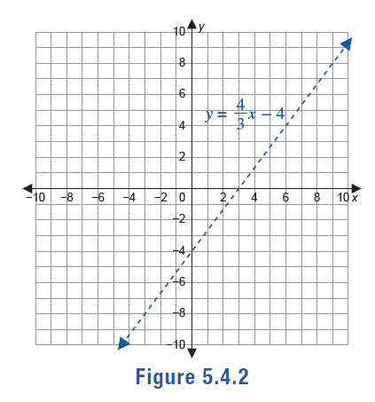
Example 1: Graphing a Linear Inequality—Slide 3
Figure 2

Slide 13


Example 1: Graphing a Linear Inequality—Slide 4
Now, use a convenient test point to determine which side of the line needs to be shaded. When choosing a test point, we want to choose a point that is obviously not on the boundary line. Since $\left(0\text{, }0\right)$ is not on the line, we can use it as our test point and substitute it back into the original equation.
Testing the Point $\left(0\text{, }0\right)$
Since the point $\left(0\text{, }0\right)$ does not make the inequality true, we know that the origin is not in the solution set and hence should not be in the shaded area on the graph. So, we shade the other half-plane.

Slide 14
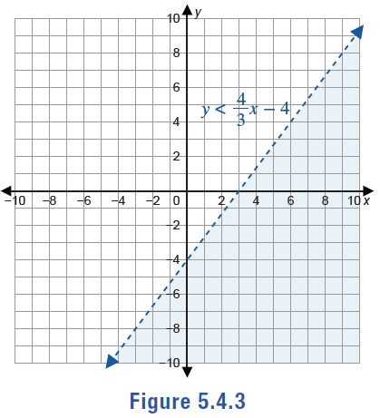
Example 1: Graphing a Linear Inequality—Slide 5
Figure 3

Slide 15
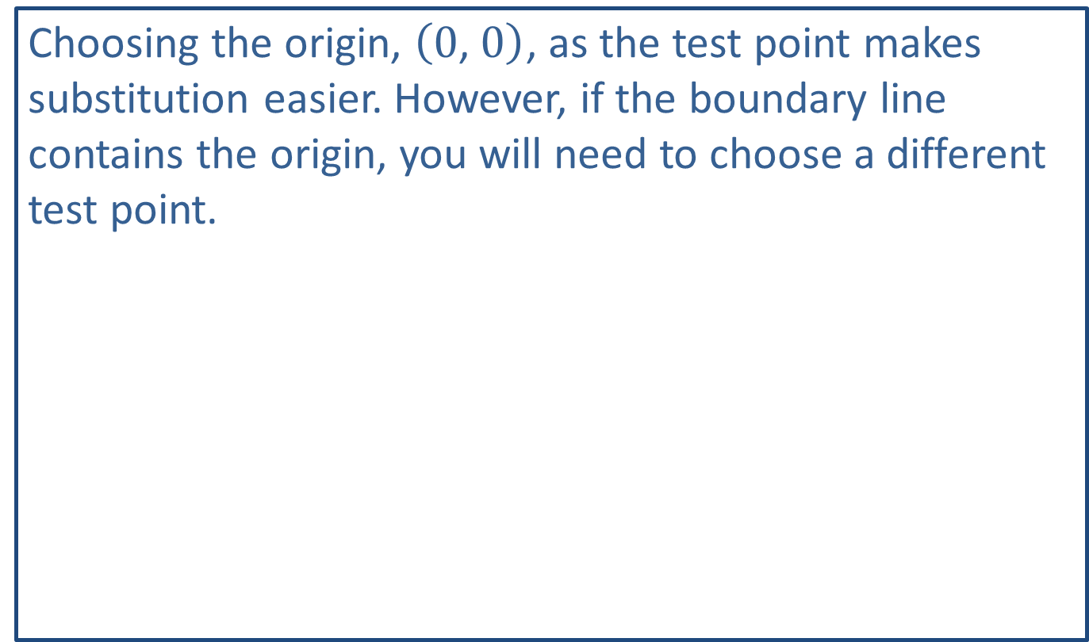
Helpful Hint 4
Choosing the origin, $\left(0\text{, }0\right)$, as the test point makes substitution easier. However, if the boundary line contains the origin, you will need to choose a different test point.

Slide 16
Example 1: Graphing a Linear Inequality—Slide 6
TI-83/84 Plus
The TI-84 Plus CE has a built-in application that can be used to graph inequalities. To run this app, press apps and select Inequalz. When prompted, press any key. Enter the right-hand side of the inequality
for Y1. Then press the left-arrow key until a blinking rectangular box appears around the Y1 =. Press enter and move the cursor down next to the equal sign. Use the right- and left-arrow keys to change the symbol from = to <. Highlight OK and press enter. Then press graph.

Slide 17
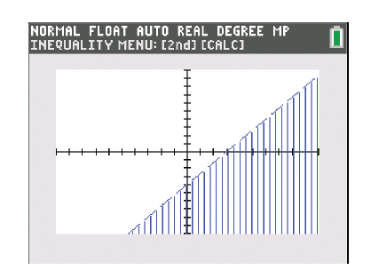
Example 1: Graphing a Linear Inequality—Slide 7
Figure 4
The calculator shows a graph with shading underneath a dotted boundary line.
Therefore, the solution set consists of all points below the line, but not actually on the line.

Slide 18
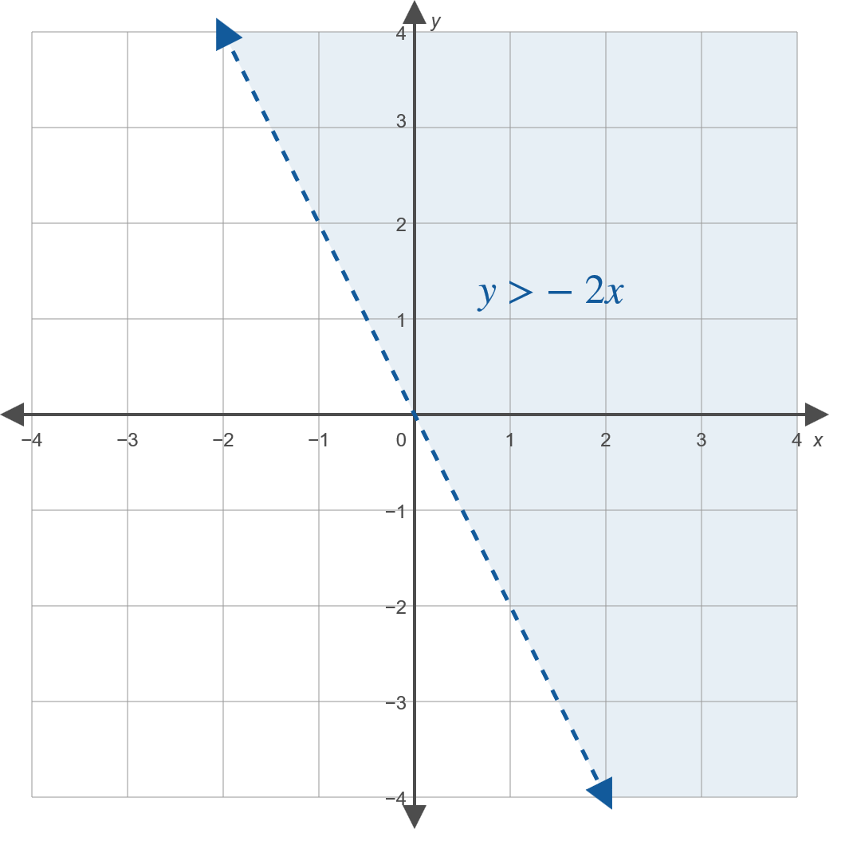
Skill Check 1
Graph the linear inequality 2x + y > 0.
Answer:

Slide 19
Example 2: Modeling Using a Linear Inequality—Slide 1
Ivy walks dogs and house-sits pets for the pet sitting service Happy Petz. She earns $20 per 30-minute dog walk and $40 per night for house sitting. Ivy needs to decide if she wants to do this full time over the summer when she'll need to make $1200 per month.
a.​ Model this situation using a linear inequality. Let x represent the earnings for dog walking and y represent the earnings for house sitting.
b.​ Can Ivy meet her monthly budget needs if she has 40 dog walking appointments and 5 nights of house sitting during a month?

Slide 20
Example 2: Modeling Using a Linear Inequality—Slide 2
c.​ The table below shows Ivy's bookings over the last six months. Do you think Ivy should feel confident that she will be able to meet her budget with the income from Happy Petz?
​
Table 1: Ivy's Happy Petz Bookings
 | Number of Walking Jobs | Number of Nights House Sitting
Month 1 | 53 | 7
Month 2 | 45 | 10
Month 3 | 40 | 6
Month 4 | 35 | 8
Month 5 | 50 | 8
Month 6 | 25 | 6

Slide 21
Example 2: Modeling Using a Linear Inequality—Slide 3
Solution
a.​ To model Ivy's earnings, multiply each job's variable by the amount she earns when doing that job: 20x + 40y. We know that these earning need to be at least $1200, so we use the ≥ symbol. Thus, we have the following inequality model for Ivy's needed minimum monthly income.
20x + 40y ≥ 1200

Slide 22

Example 2: Modeling Using a Linear Inequality—Slide 4
b. ​In order to determine if 40 dog walking appointments and 5 house sitting appointments will meet the monthly budget, we can substitute the coordinate pair $\left(40\text{, }5\right)$ into the inequality and see if they make it true.
​
Because the point does not make the inequality true, we know that dog walking 40 times and house sitting 5 times is not enough to meet Ivy's budgetary needs for a month.

Slide 23
Example 2: Modeling Using a Linear Inequality—Slide 5
c. ​One way to determine if the last six months are a positive indicator for Ivy to meet her monthly budget is to substitute each data point into the inequality as we did in part b. However, if we graph the linear inequality given, we can see all the possible combinations of house sitting and dog walking that will provide Ivy with the income that she needs per month. This will give her a better picture of her possibilities.
​The first step in graphing the inequality is to graph the boundary line. To do so, solve the inequality for y, arranging it into y-intercept form.
​
​

Slide 24
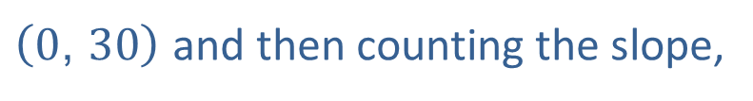
Example 2: Modeling Using a Linear Inequality—Slide 6
​By Hand
Replacing the inequality sign with an equal sign gives us the boundary line for the graph.
Boundary Line Equation
We can now graph the boundary line by plotting the y-intercept,
$\left(0\text{, }30\right)$ and then counting the slope,
Because the original equation contains equality, we will use a solid line for the boundary line. This indicates that points on the boundary line are included in the solution set for the inequality.

Slide 25
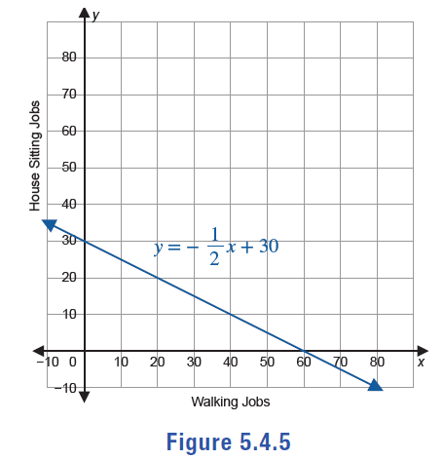
Example 2: Modeling Using a Linear Inequality—Slide 7
Figure 5

Slide 26

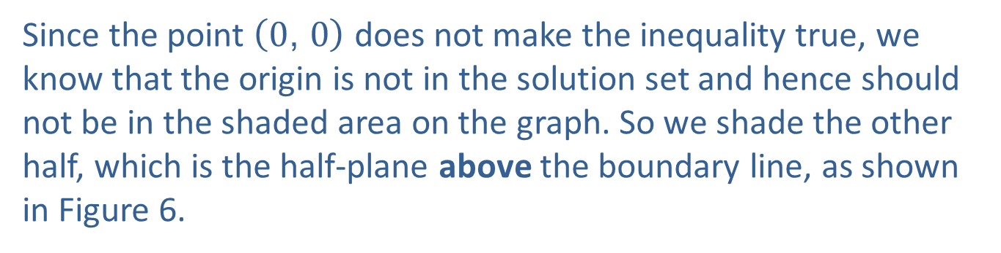
Example 2: Modeling Using a Linear Inequality—Slide 8
Since $\left(0\text{, }0\right)$ is not on the line, we can use it as our test point and substitute the values back into the original inequality.
Testing the Point $\left(0\text{, }0\right)$
Since the point $\left(0\text{, }0\right)$ does not make the inequality true, we know that the origin is not in the solution set and hence should not be in the shaded area on the graph. So we shade the other half, which is the half-plane above the boundary line, as shown in Figure 6.

Slide 27
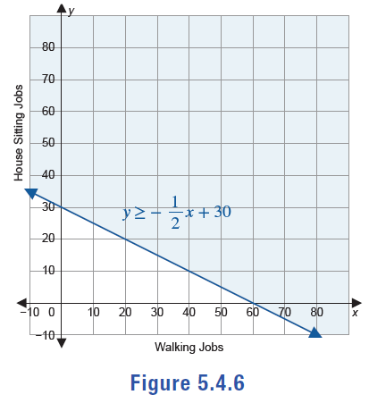
Example 2: Modeling Using a Linear Inequality—Slide 9
Figure 6

Slide 28
Example 2: Modeling Using a Linear Inequality—Slide 10
TI-83/84 Plus
If the Inequalz app is not running, press apps and select Inequalz. When prompted, press any key. Press y= and enter
the right-hand side of the inequality
​​
for Y1. Then press the left-arrow key until a blinking rectangular box appears around the Y1=. Press enter and move the cursor down next to the equal sign. Use the right- and left-arrow keys to change the symbol from = to ≥. Move the cursor down to highlight OK and press enter. Then press graph.
The calculator shows a graph with shading above a solid boundary line. Therefore, the solution set consists of all points above the line and on the line.

Slide 29
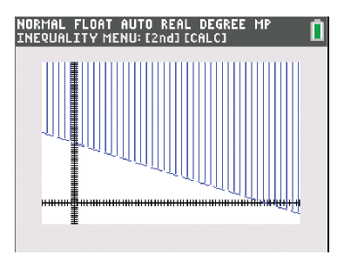
Example 2: Modeling Using a Linear Inequality—Slide 11
Figure 7

Slide 30
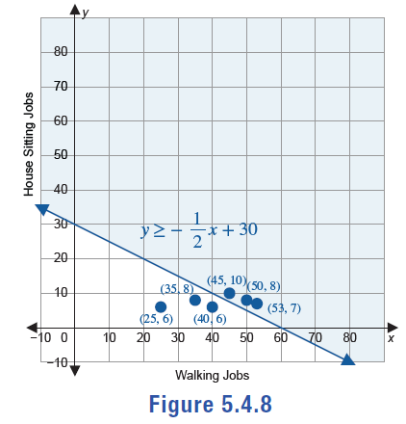
Example 2: Modeling Using a Linear Inequality—Slide 12
​Now that we have graphed the inequality, we can plot each of the last six months on our graph.
​
Figure 8

Slide 31
Example 2: Modeling Using a Linear Inequality—Slide 13
​As we can now see, Ivy has only surpassed her budget goal in 3 out of the last 6 months, or half of the time. Based on this data, Ivy should not depend on meeting her budget goal every month only working for Happy Petz. However, she can use this graph to help her determine the various ways she can meet her goal each month. For instance, if Ivy has 51 walking jobs one month, she only needs 5 house sitting jobs that month to meet her goal.

Slide 32
Procedure: Steps to Graphing Systems of Linear Inequalities
1.​ Graph the boundary line for each inequality.
​The line will be solid if the inequality is ≥ or ≤,
​The line will be dashed if the inequality is > or <.
2. ​Determine which side of the line to shade for each inequality by using a test point.
3. ​Lightly shade the half-plane that contains the solution set for each individual inequality.
4. ​The solution region for the system of inequalities is the intersection of the shaded half-planes from Step 3.

Slide 33
Systems of Linear Inequalities
Table 2: Guidelines for Graphing the Point of Intersection of Linear Inequalities
Both symbols include equality: ≤ or ≥ | Closed Circle | Indicates the intersection point is included in the solution set.
At least one symbol is a strict inequality: < or > | Open Circle ○ | Indicates the intersection is not included in the solution set.

Slide 34
Example 3: Graphing a System of Linear Inequalities—Slide 1
Graph the solution set of the following system of linear inequalities.
Solution
First, we need to have the equations in slope-intercept form so that we can graph them. Begin by rearranging each inequality into the correct form to obtain the boundary lines.

Slide 35
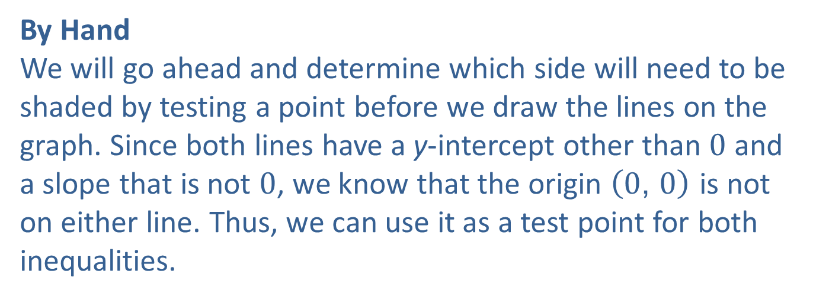
Example 3: Graphing a System of Linear Inequalities—Slide 2
First inequality
Second inequality
By Hand
We will go ahead and determine which side will need to be shaded by testing a point before we draw the lines on the graph. Since both lines have a y-intercept other than 0 and a slope that is not 0, we know that the origin $\left(0\text{, }0\right)$ is not on either line. Thus, we can use it as a test point for both inequalities.

Slide 36
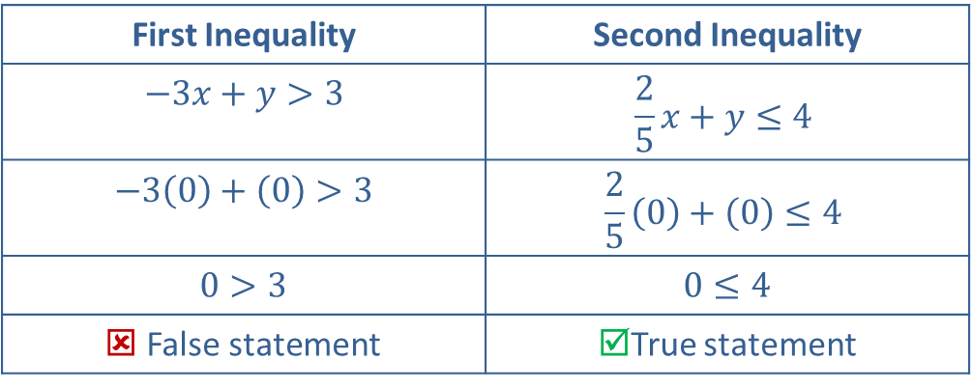
Example 3: Graphing a System of Linear Inequalities—Slide 3
Table 3: Testing the Point (0,0)
First Inequality | Second Inequality
​$−3x+y>3$ | $$\frac{2}{5}x+y≤4$$
​$−3\left(0\right)+\left(0\right)>3$ | $$\frac{2}{5}\left(0\right)+\left(0\right)≤4$$
​$0>3$ | ​$0≤4$
☒ False statement | ☑True statement
This indicates that shading will be above the boundary line for the first inequality and below the boundary line for the second inequality.

Slide 37
Example 3: Graphing a System of Linear Inequalities—Slide 4
Now, graph the boundary line for each inequality. Note that the first boundary line should be dashed and the second one should be solid since the inequality contains the equal sign.
y = 3x + 3 Boundary line equation (use dashed line, shade above)
Boundary line equation (use solid line, shade below)

Slide 38
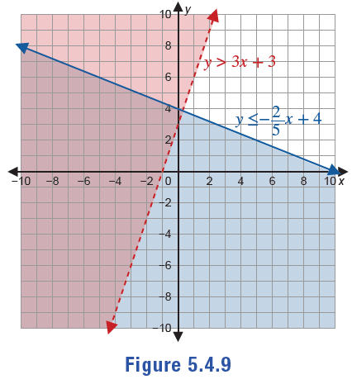
Example 3: Graphing a System of Linear Inequalities—Slide 5
Figure 9

Slide 39
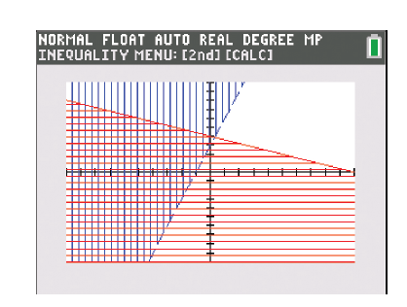
Example 3: Graphing a System of Linear Inequalities—Slide 6
TI-83/84 Plus
If the Inequalz app is not running, press apps and select Inequalz. When prompted, press any key. Press y= and enter the right-hand side of the first inequality for Y1 and the right-hand side of the second inequality for Y2. Change the inequality for Y1 to > and change the inequality for Y2 to ≤. Then press graph.
Figure 10

Slide 40
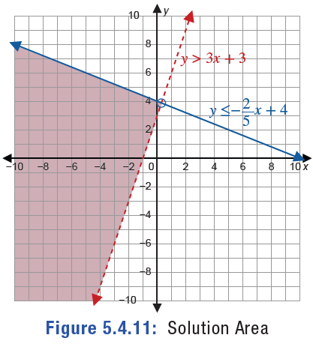
Example 3: Graphing a System of Linear Inequalities—Slide 7
The solution set for the system of inequalities lies where the shading overlaps. So our solution set is the region of the graph that is shaded in Figure 11. Since the first inequality does not include the equal sign, we must draw an open circle to indicate that the point of intersection is not included in the solution set.
Figure 11: Solution Area

Slide 41
Skill Check 2
Determine if the point of intersection for the given system of linear inequalities should be an open circle or a closed circle.
​
Answer: Closed circle at the point of intersection

Slide 42
Example 4: Modeling using a System of Linear Inequalities—Slide 1
In order to make as much money as possible this summer, Elisha has taken on two summer jobs. He works at a local fast-food restaurant chain and as a bellman at a hotel. He knows he can work at most 70 hours next week and needs to make at least $260. Elisha earns $9.11 per hour at the fast-food chain and $11 per hour at the hotel. Graph the solution set to determine the number of hours he'd need to work at each job to earn $260 in one week. Find at least one combination of hours Elisha could work at each job to meet his goal.

Slide 43
Example 4: Modeling using a System of Linear Inequalities—Slide 2
Solution
Begin by defining the variables that will be needed.
x = number of hours Elisha works at the fast-food restaurant
y = number of hours Elisha works at the hotel
We can then write an inequality that represents the number of hours he is able to work and an inequality representing the pay he needs to receive.
Elisha can work at most 70 hours in the week between the two jobs; so the hours added together must be less than or equal to 70; that is, x + y ≤ 70.

Slide 44
Example 4: Modeling using a System of Linear Inequalities—Slide 3
Earning $9.11 an hour at the restaurant plus $11 an hour at the hotel, Elisha needs to earn at least $260 in the week. Each hourly rate multiplied by their respective variable and added together must be more than or equal to 260; that is, 9.11x + 11y ≥ 260.
Graph each inequality by rewriting it in slope-intercept form and determine the boundary equations. Round to the nearest thousandths.

Slide 45
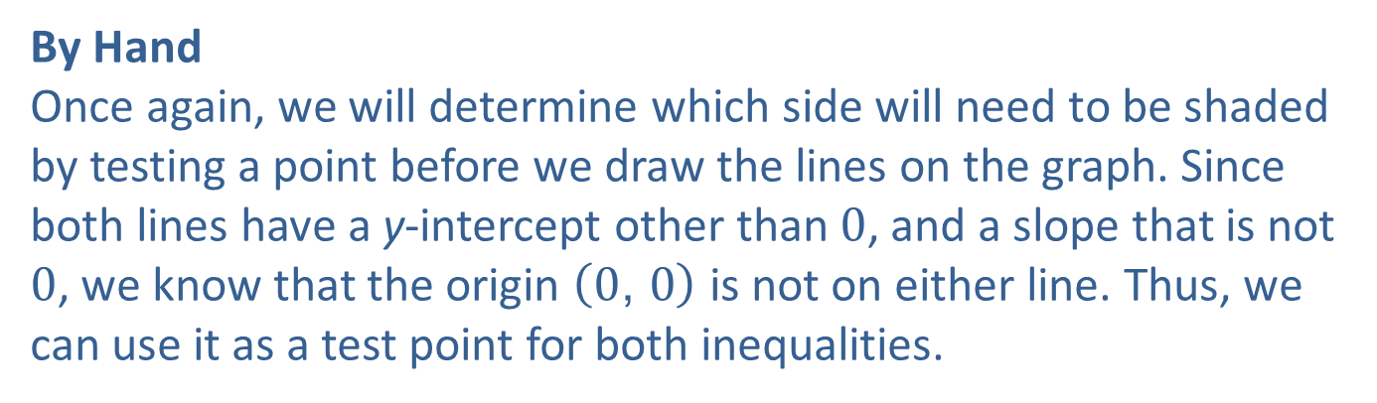
Example 4: Modeling using a System of Linear Inequalities—Slide 4
Hours
Earnings
By Hand
Once again, we will determine which side will need to be shaded by testing a point before we draw the lines on the graph. Since both lines have a y-intercept other than 0, and a slope that is not 0, we know that the origin $\left(0\text{, }0\right)$ is not on either line. Thus, we can use it as a test point for both inequalities.

Slide 46
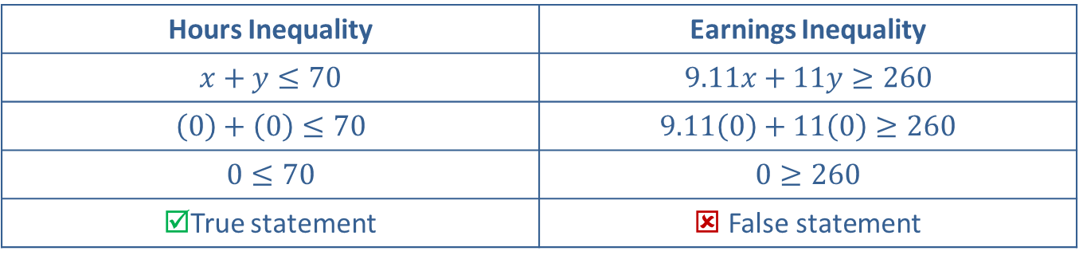
Example 4: Modeling using a System of Linear Inequalities—Slide 5
Table 4: Testing the Point (0,0)
Hours Inequality | Earnings Inequality
​$x+y≤70$ | ​$9.11x+11y≥260$
​$\left(0\right)+\left(0\right)≤70$ | ​$9.11\left(0\right)+11\left(0\right)≥260$
​$0≤70$ | ​$0≥260$
☑True statement | ☒ False statement
This indicates that we shade below the boundary line representing the hours inequality and above the boundary line representing the earnings inequality. Since the number of hours Elisha needs to work can only be a positive number, we only need to focus on the portion of the graph where both x and y are positive; that is, the first quadrant.

Slide 47
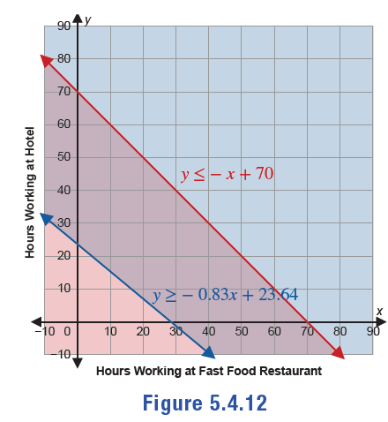
Example 4: Modeling using a System of Linear Inequalities—Slide 6
Figure 12

Slide 48
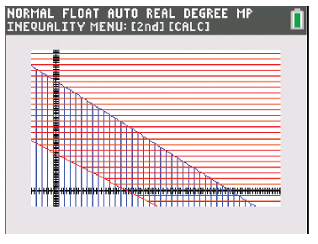
Example 4: Modeling using a System of Linear Inequalities—Slide 7
TI-83/84 Plus
If the Inequalz app is not running, press apps and select Inequalz. When prompted, press any key. Press y= and enter the right-hand side of the first inequality for Y1 and the right-hand side of the second inequality for Y2. Change the inequality for Y1 to ≤ and change the inequality for Y2 to ≥. Then press graph.
Figure 13

Slide 49
Tech Tip
If you do not see the two lines and shaded regions on your calculator screen after pressing graph, you'll need to adjust the minimum and maximum of your x- and y-axes. Press window and set Xmin and Ymin to-10, then set Xmax and Ymax to 90.

Slide 50
Example 4: Modeling using a System of Linear Inequalities—Slide 8
Notice that the area where the shaded regions overlap is the solution to the number of hour combinations that Elisha could work at the two jobs. We will only look at the first quadrant of the graph since, practically speaking, the number of hours that Elisha can work must be either 0 or positive.
Note that the point of intersection is included in the solution set and is graphed as a closed circle since both lines are solid. However, the point of intersection will not be shown in either Figure 12 or Figure 13, or Figure 14 since we are only focusing on the first quadrant.

Slide 51
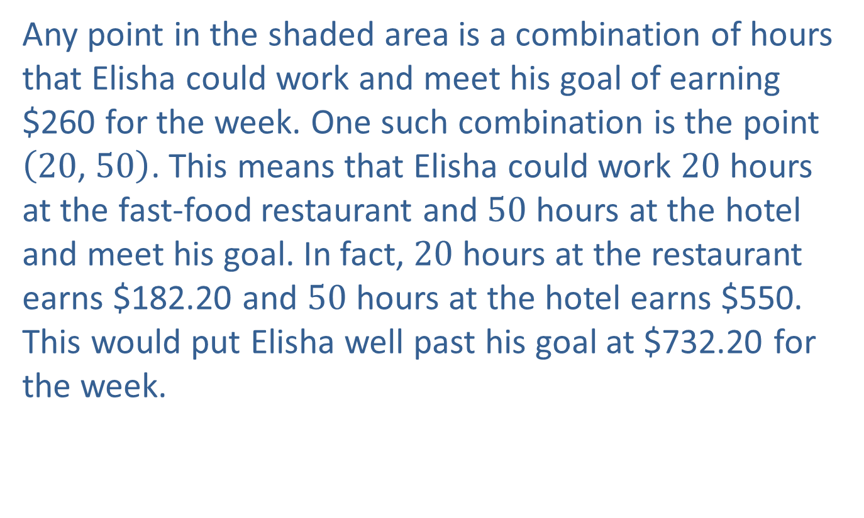
Example 4: Modeling using a System of Linear Inequalities—Slide 9
Any point in the shaded area is a combination of hours that Elisha could work and meet his goal of earning $260 for the week. One such combination is the point $\left(20\text{, }50\right)$. This means that Elisha could work 20 hours at the fast-food restaurant and 50 hours at the hotel and meet his goal. In fact, 20 hours at the restaurant earns $182.20 and 50 hours at the hotel earns $550. This would put Elisha well past his goal at $732.20 for the week.

Slide 52
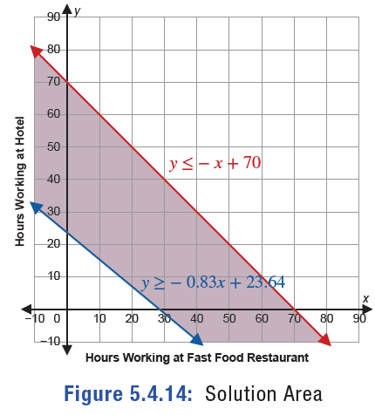
Example 4: Modeling using a System of Linear Inequalities—Slide 10
Figure 14: Solution Area

