Slide 1
Section 5.5
Linear Programming

Slide 2
Definition: Linear Programming
Linear Programming
The mathematical process of linear programming is a method to optimize a particular quantity in a mathematical model constrained by linear inequalities.
Objective Function
An objective function, or optimization function, is a function that expresses the quantity that is to be optimized.
Constraints
Constraints in linear programming are the linear inequalities that express the limitation of each variable or combination of variables.

Slide 3
Example 1: Writing an Objective Function—Slide 1
A nutrition specialist is designing a meal plan for a hospital patient where protein, carbohydrates, and fats need to be monitored. The patient needs a fat-free diet where protein counts for at most 20% of their daily calories while the remaining 80% is from carbohydrates. To maintain the patient's body weight, the nutritionist needs to maximize their overall daily calorie intake.
Let x represent the weight in grams of protein and y represent the weight in grams of carbohydrates. If a gram of protein and a gram of carbohydrate each provide four calories, write the objective function that describes the patient's daily calorie intake.

Slide 4
Example 1: Writing an Objective Function—Slide 2
Solution
We're told some of the constraint information that guides the makeup of the patient's diet. To construct the objective function, we need to concentrate our attention on what values need to be maximized (or in some cases minimized). In this case, the total daily calorie intake needs to be maximized. Each gram of protein and each gram of carbohydrate that the patient eats will provide 4 calories of energy. Hence, the objective function that models their total calorie intake can be found by multiplying the calories by each variable. We introduce a new variable z to represent the calories that will be optimized.
Caloric Objective Function
z = 4x + 4y

Slide 5
Theorem: Fundamental Theorem of Linear Programming
The maximal and minimal values of a linear function over a convex polygonal region are found at the corners of the region.

Slide 6
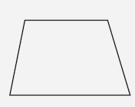
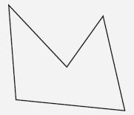
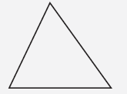
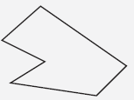
Helpful Hint 1
A convex polygon is a polygon in which all vertices point away from the interior of the shape. A concave polygon is a polygon that is not convex.
Table 1: Convex and Concave Polygons
Convex Polygon | Concave Polygon

Slide 7
Definition: Feasible Region
The feasible region is the set of all possible points that satisfy the constraints of an optimization problem.

Slide 8
Helpful Hint 2
Maxima and minima are the respective plurals of maximum and minimum. The minimum and maximum values are referred to as extrema values.

Slide 9
Procedure: Steps for Solving an Optimization or Linear Programming Problem
1.​ Define the objective function.
2. ​Define the constraints using linear inequalities.
3.​ Graph the constraint inequalities.
4.​ Identify the vertices of the feasible region; that is, the polygon formed by intersection of the lines.
5. ​Identify any maximum or minimum values of the objective function by finding the values of the objective function at each of the vertices.

Slide 10
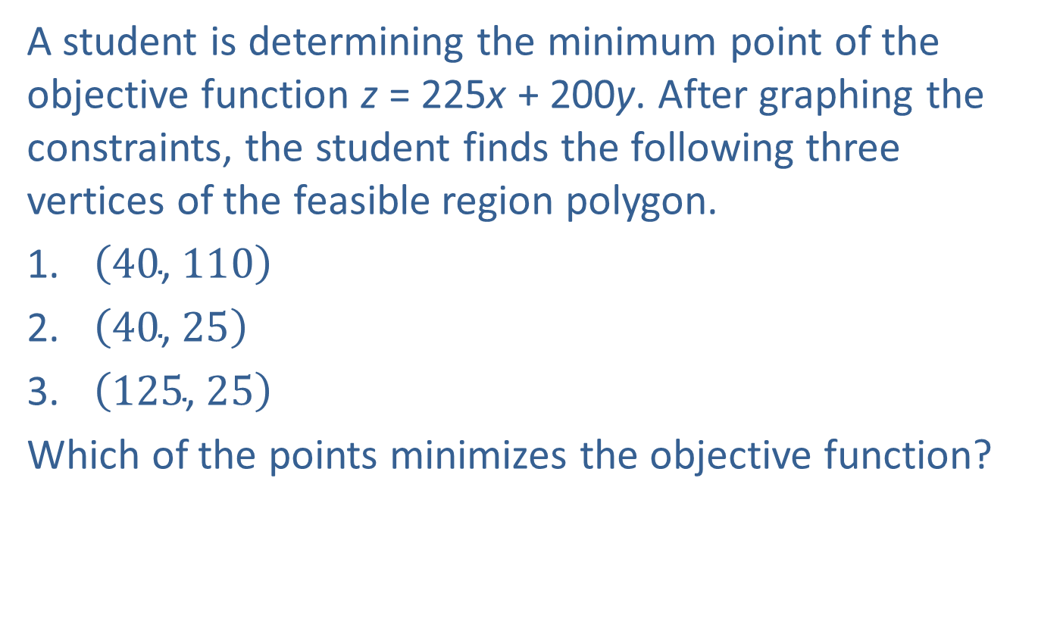
Example 2: Determining Maximum or Minimum Points—Slide 1
A student is determining the minimum point of the objective function z = 225x + 200y. After graphing the constraints, the student finds the following three vertices of the feasible region polygon.
1.​ $\left(40\text{, }110\right)$
2.​ $\left(40\text{, }25\right)$
3.​ $\left(125\text{, }25\right)$
Which of the points minimizes the objective function?

Slide 11
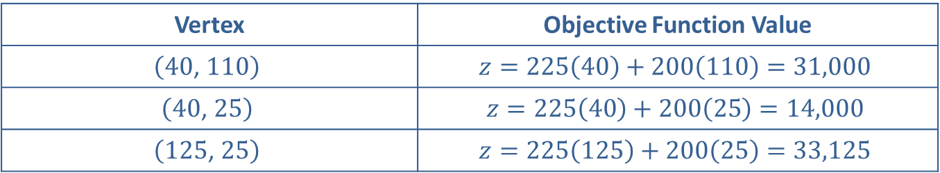
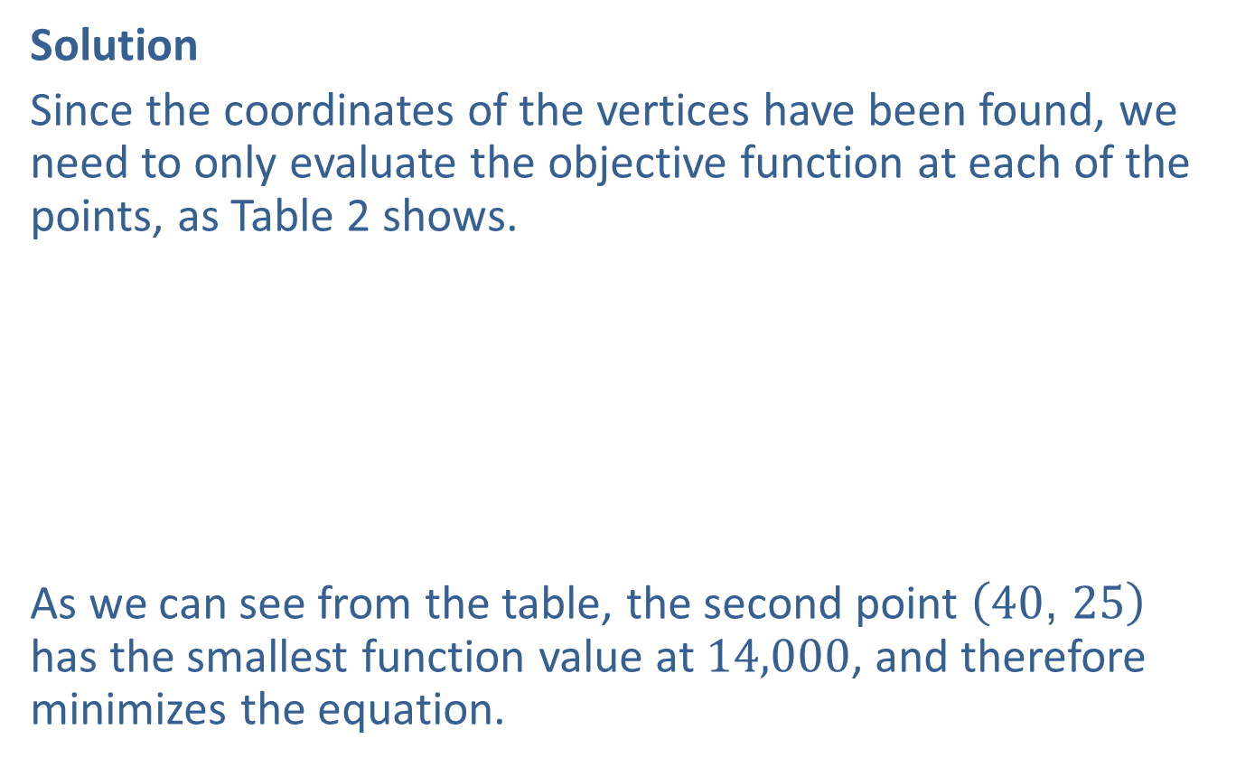
Example 2: Determining Maximum or Minimum Points—Slide 2
Solution
Since the coordinates of the vertices have been found, we need to only evaluate the objective function at each of the points, as Table 2 shows.
As we can see from the table, the second point $\left(40\text{, }25\right)$ has the smallest function value at 14,000, and therefore minimizes the equation.
Table 2: Evaluating the Objective Function
Vertex | Objective Function Value
$$\left(40\text{, }110\right)$$ | $$z=225\left(40\right)+200\left(110\right)=31,000$$
$$\left(40\text{, }25\right)$$ | $$z=225\left(40\right)+200\left(25\right)=14,000$$
$$\left(125\text{, }25\right)$$ | $$z=225\left(125\right)+200\left(25\right)=33,125$$

Slide 12
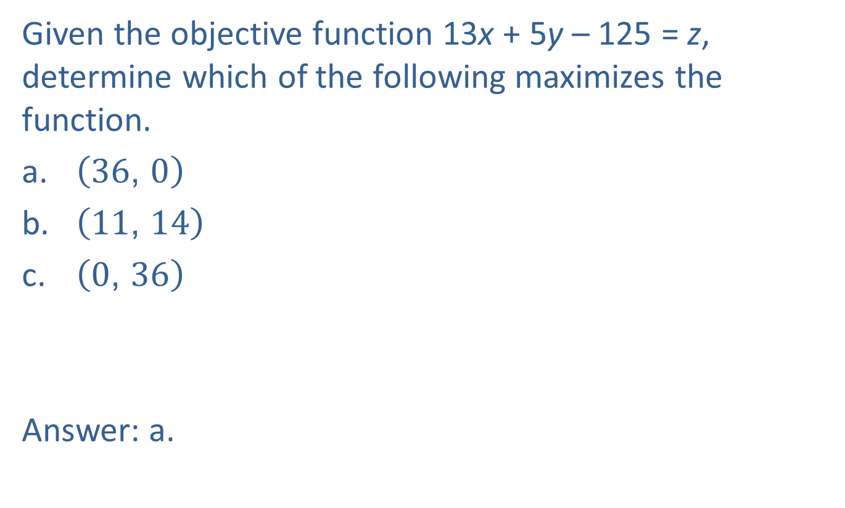
Skill Check 1
Given the objective function 13x + 5y – 125 = z, determine which of the following maximizes the function.
a. ​$\left(36\text{, }0\right)$
b. ​$\left(11\text{, }14\right)$
c.​ $\left(0\text{, }36\right)$
Answer: a.

Slide 13
Example 3: Finding the Maximum Value of an Objective Function—Slide 1
The objective function z = 3x + 4y is subject to the following constraints.
​
Find the maximum value of z.

Slide 14
Example 3: Finding the Maximum Value of an Objective Function—Slide 2
Solution
Since we are given the objective function as well as the constraints in the form of linear inequalities, we will start the process of finding the maximum by graphing the inequalities. As we know, graphing these inequalities by hand or by the calculator requires that the inequalities be written in slope-intercept form. So the first step is to rearrange each of the constraints into this form. They are listed for you here. (We leave this for you to check on your own.)

Slide 15
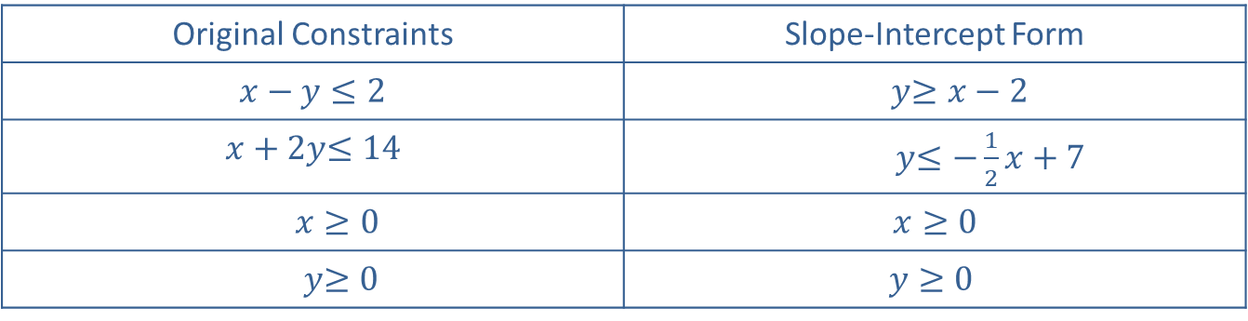
Example 3: Finding the Maximum Value of an Objective Function—Slide 3
By Hand
In Table 3, we identified each of the necessary pieces of information needed to graph each of the inequalities by hand. Remember to use a test point to determine which half plane to shade. We list each shaded region as "above" or "below" or "to the right" of the line.
​Original Constraints | Slope-Intercept Form
​$x−y≤2$ | ​$y$​$≥x−2$
$x+2y$​$≤14$ | $y$​$≤−\frac{1}{2}x+7$
​$x≥0$ | ​$x≥0$
$y$​$≥0$ | $$y≥0$$

Slide 16
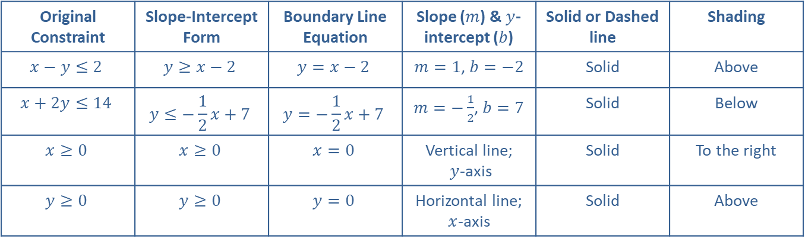
Example 3: Finding the Maximum Value of an Objective Function—Slide 4
Table 3
Original Constraint | Slope-Intercept Form | Boundary Line Equation | Slope ($m$) & $y$-intercept ($b$) | Solid or Dashed line | Shading
$$x−y≤2$$ | $$y≥x−2$$ | $$y=x−2$$ | $m=1$, $b=−2$ | Solid | Above
$$x+2y≤14$$ | $$y≤−\frac{1}{2}x+7$$ | $$y=−\frac{1}{2}x+7$$ | $m=−\frac{1}{2}$, $b=7$ | Solid | Below
$$x≥0$$ | $$x≥0$$ | $$x=0$$ | Vertical line; $y$-axis | Solid | To the right
$$y≥0$$ | $$y≥0$$ | $$y=0$$ | Horizontal line; $x$-axis | Solid | Above

Slide 17
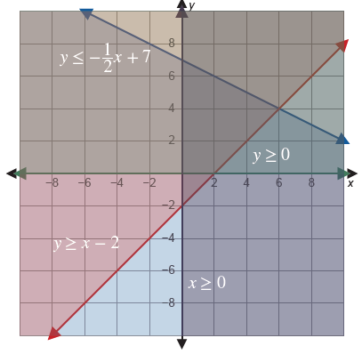
Example 3: Finding the Maximum Value of an Objective Function—Slide 5
Figure 2 shows each constraint inequality with its appropriate shading.
Figure 2: Graphed Constraints

Slide 18
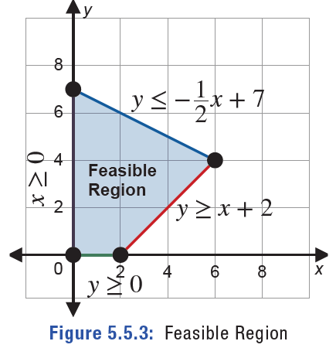
Example 3: Finding the Maximum Value of an Objective Function—Slide 6
The intersection of all of the shaded areas forms the feasible region, as shown in Figure 3.
Figure 2: Feasible Region

Slide 19
Example 3: Finding the Maximum Value of an Objective Function—Slide 7
We know that the maximum of the objective function will happen at one of the vertices of the polygon. To find the coordinates of each vertex, we need to solve a system of equations for each pair of constraints by setting them equal to one another. In some instances you may be able to "eyeball" the coordinates for each of the vertices; however, using algebra will always produce a precise answer even when you don't have a precise graph. The first vertex we will find is between the first two lines.

Slide 20
Example 3: Finding the Maximum Value of an Objective Function—Slide 8

Slide 21
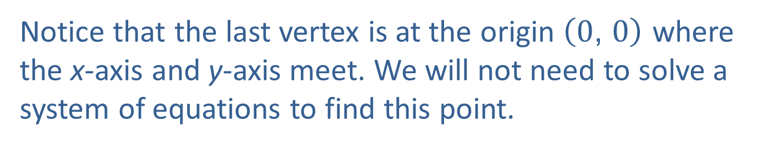
Example 3: Finding the Maximum Value of an Objective Function—Slide 9
We can do the same process for each of the other two pairs of equations.
Notice that the last vertex is at the origin $\left(0\text{, }0\right)$ where the x-axis and y-axis meet. We will not need to solve a system of equations to find this point.

Slide 22
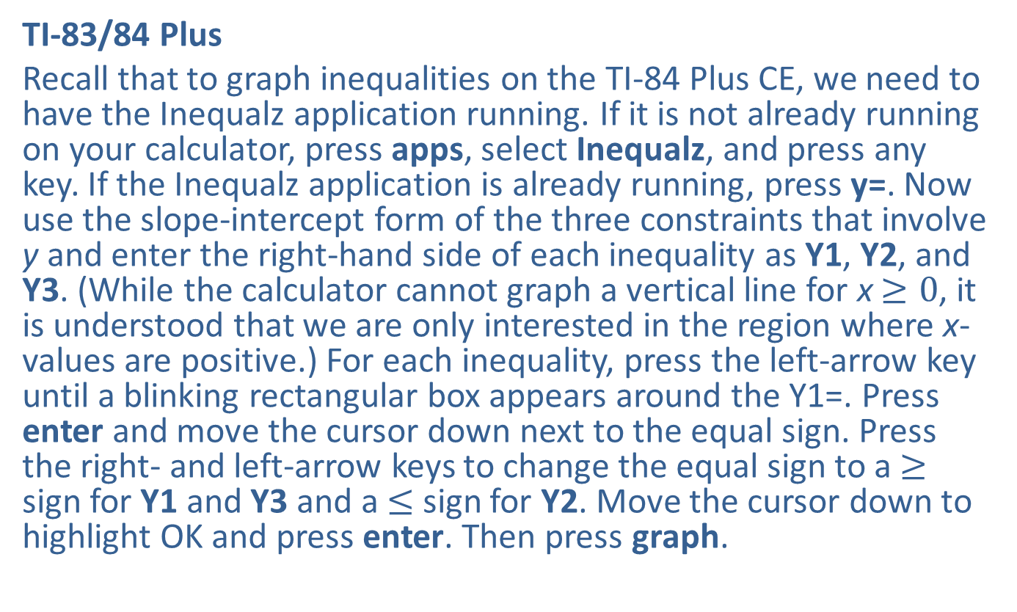
Example 3: Finding the Maximum Value of an Objective Function—Slide 10
TI-83/84 Plus
Recall that to graph inequalities on the TI-84 Plus CE, we need to have the Inequalz application running. If it is not already running on your calculator, press apps, select Inequalz, and press any key. If the Inequalz application is already running, press y=. Now use the slope-intercept form of the three constraints that involve y and enter the right-hand side of each inequality as Y1, Y2, and Y3. (While the calculator cannot graph a vertical line for x $≥0$, it is understood that we are only interested in the region where x-values are positive.) For each inequality, press the left-arrow key until a blinking rectangular box appears around the Y1=. Press enter and move the cursor down next to the equal sign. Press the right- and left-arrow keys to change the equal sign to a ≥ sign for Y1 and Y3 and a ≤ sign for Y2. Move the cursor down to highlight OK and press enter. Then press graph.

Slide 23
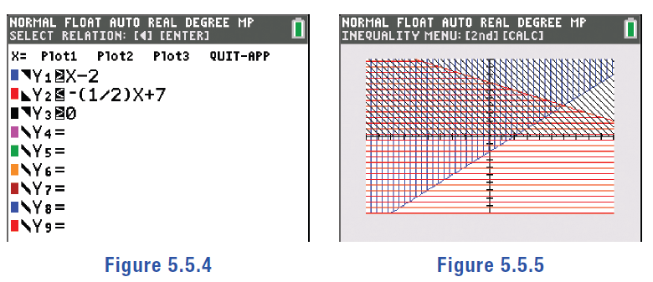
Example 3: Finding the Maximum Value of an Objective Function—Slide 11
Figure 4
Figure 5

Slide 24
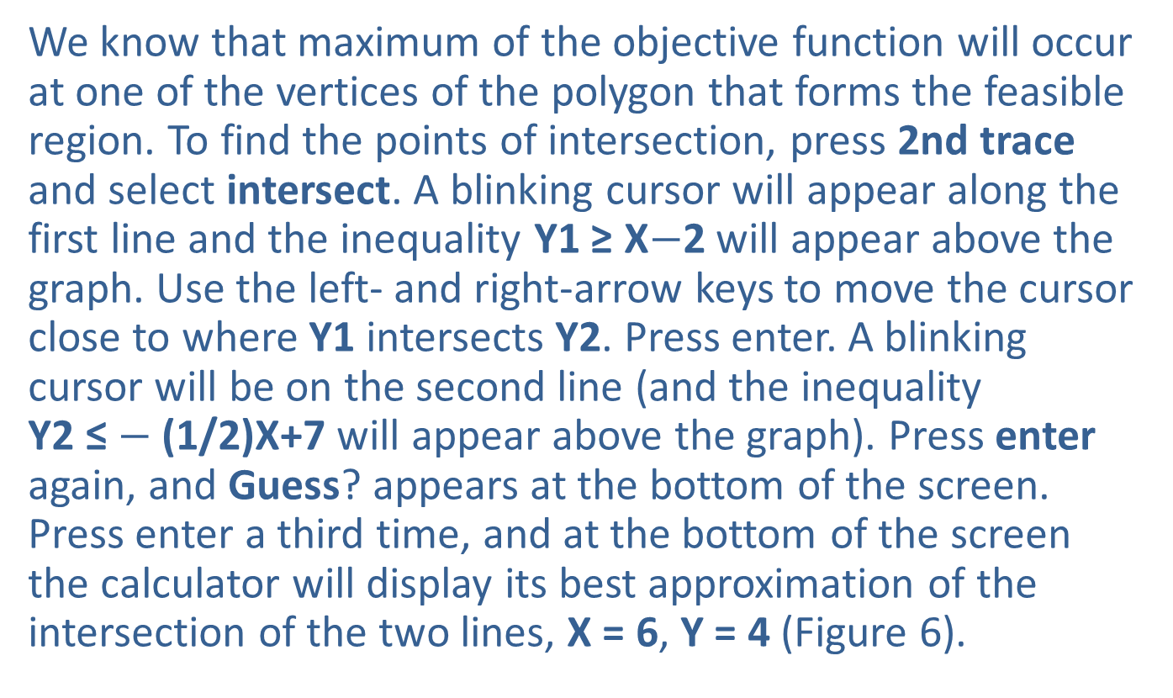
Example 3: Finding the Maximum Value of an Objective Function—Slide 12
We know that maximum of the objective function will occur at one of the vertices of the polygon that forms the feasible region. To find the points of intersection, press 2nd trace and select intersect. A blinking cursor will appear along the first line and the inequality Y1 ≥ X$−$2 will appear above the graph. Use the left- and right-arrow keys to move the cursor close to where Y1 intersects Y2. Press enter. A blinking cursor will be on the second line (and the inequality
Y2 ≤ $−$(1/2)X+7 will appear above the graph). Press enter again, and Guess? appears at the bottom of the screen. Press enter a third time, and at the bottom of the screen the calculator will display its best approximation of the intersection of the two lines, X = 6, Y = 4 (Figure 6).

Slide 25
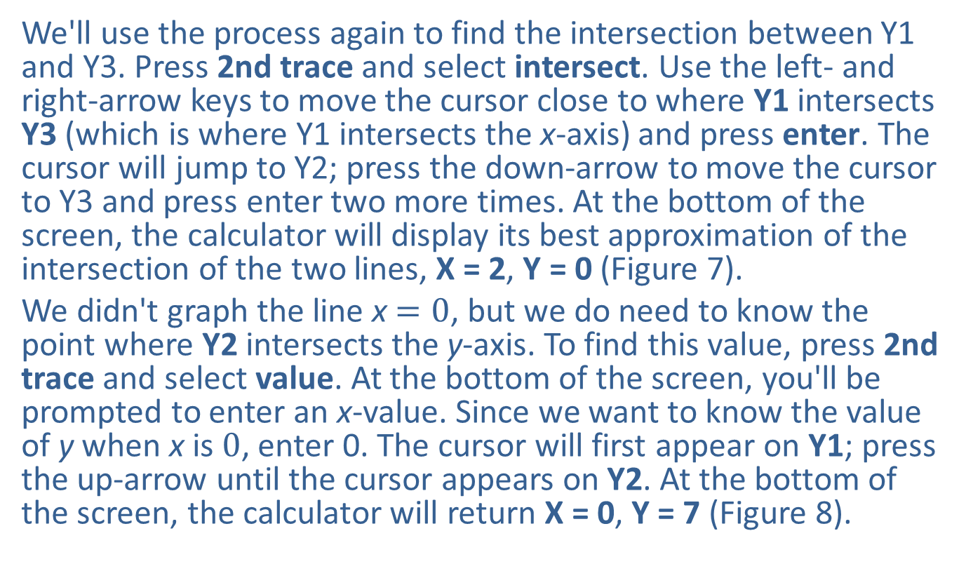
Example 3: Finding the Maximum Value of an Objective Function—Slide 13
We'll use the process again to find the intersection between Y1 and Y3. Press 2nd trace and select intersect. Use the left- and right-arrow keys to move the cursor close to where Y1 intersects Y3 (which is where Y1 intersects the x-axis) and press enter. The cursor will jump to Y2; press the down-arrow to move the cursor to Y3 and press enter two more times. At the bottom of the screen, the calculator will display its best approximation of the intersection of the two lines, X = 2, Y = 0 (Figure 7).
We didn't graph the line x $=0$, but we do need to know the point where Y2 intersects the y-axis. To find this value, press 2nd trace and select value. At the bottom of the screen, you'll be prompted to enter an x-value. Since we want to know the value of y when x is 0, enter 0. The cursor will first appear on Y1; press the up-arrow until the cursor appears on Y2. At the bottom of the screen, the calculator will return X = 0, Y = 7 (Figure 8).

Slide 26
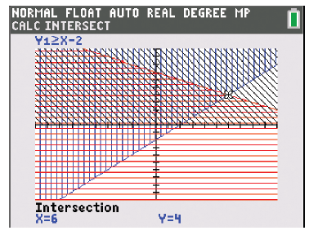
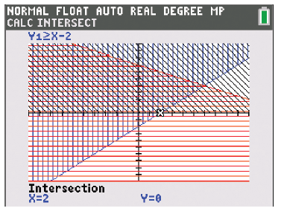
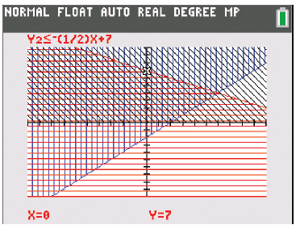
Example 3: Finding the Maximum Value of an Objective Function—Slide 14
Figure 6
Figure 7
Figure 8

Slide 27

Example 3: Finding the Maximum Value of an Objective Function—Slide 15
Therefore, the vertices of the polygon—which is the feasible region—are
​
We now substitute these points into the objective function z = 3x + 4y to find the maximum.
The third substitution shows the maximum of z is 34 and occurs at the point $\left(6\text{, }4\right)$.

Slide 28
Skill Check 2
Determine the three vertices of the polygon formed by the following constraints.
a.​ x – 2y ≤ 100
c. ​x ≥ 0
d.​ y ≥ 0

Slide 29
Example 4: Modeling with Linear Programming—Slide 1
An entrepreneur is opening an online business selling original handcrafted items. To start, they will focus on two types of art: original paintings framed in reclaimed wood and a set of wooden placemats and coasters. Each framed piece is priced so that the profit is $105. For the artwork, it takes 4 hours to cut and sand the wood for one frame, 2.5 hours to assemble the artwork on the frame, and 1.5 hours to put the finishing touches on it. Each set of placemats and coasters is priced for a profit of $57. However, the placemat and coaster sets are slightly faster to make than the artwork. Each set requires 2 hours to cut the wood, 1 hour to assemble, and 2 hours for finishing touches. With friends who have committed to help get the business off the ground, the entrepreneur has manpower equivalent to 165 hours a week to devote to making the pieces: 70 hours for cutting the wood, 40 hours for assembly work, and 55 hours for finishing touches. How many of each piece should be made in order to maximize the monthly profit?

Slide 30
Example 4: Modeling with Linear Programming—Slide 2
Solution
To maximize monthly profit, the objective function will be based on the profit z from each item. If we let x be the number of framed artwork pieces and y be the number of placemat and coaster sets, the objective function to maximize the amount of profit is as follows.
Objective Function for Maximum Profit
z = 105x + 57y
The constraints are then formed using the information provided.

Slide 31
Example 4: Modeling with Linear Programming—Slide 3
Notice that since only a positive number of items can be made, two more constraints are needed.
Other constraints for profit: x ≥ 0 and y ≥ 0
In Table 4, we have put each constraint into slope-intercept form and identified the necessary information needed for graphing each by hand.

Slide 32
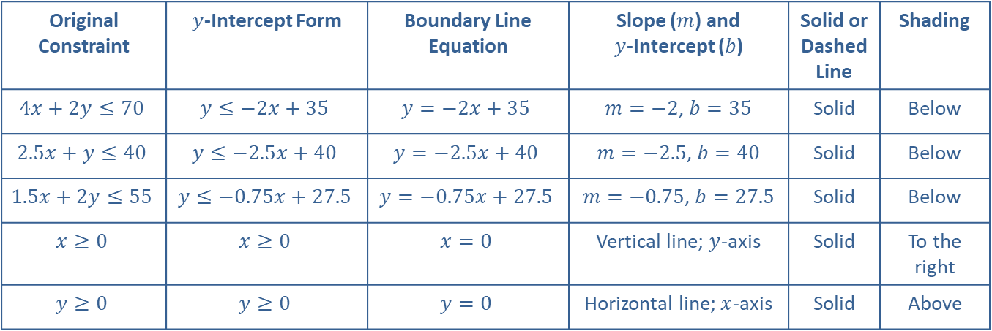
Example 4: Modeling with Linear Programming—Slide 4
Table 4
Original Constraint | $y$-Intercept Form | Boundary Line Equation | Slope ($m$) and $y$-Intercept ($b$) | Solid or Dashed Line | Shading
$$4x+2y≤70$$ | $$y≤−2x+35$$ | $$y=−2x+35$$ | $m=−2$, $b=35$ | Solid | Below
$$2.5x+y≤40$$ | $$y≤−2.5x+40$$ | $$y=−2.5x+40$$ | $m=−2.5$, $b=40$ | Solid | Below
$$1.5x+2y≤55$$ | $$y≤−0.75x+27.5$$ | $$y=−0.75x+27.5$$ | $m=−0.75$, $b=27.5$ | Solid | Below
$$x≥0$$ | $$x≥0$$ | $$x=0$$ | Vertical line; $y$-axis | Solid | To the right
$$y≥0$$ | $$y≥0$$ | $$y=0$$ | Horizontal line; $x$-axis | Solid | Above

Slide 33
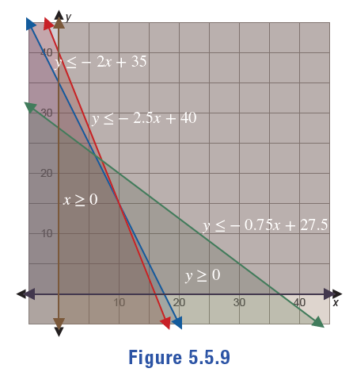
Example 4: Modeling with Linear Programming—Slide 5
Figure 9 shows each constraint inequality with its appropriate shading, whether done by hand or with technology.
Figure 9

Slide 34
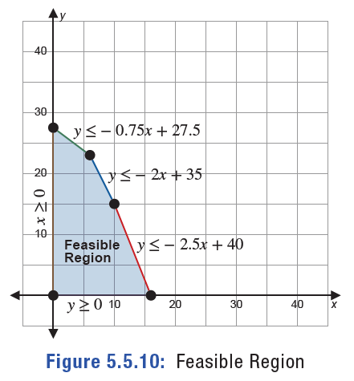
Example 4: Modeling with Linear Programming—Slide 6
Figure 10 shows only the intersection of all of the shaded areas, or the feasible region. We can now see the vertices that need to be found in order to identify a maximum profit.
Figure 10: Feasible Region

Slide 35
Example 4: Modeling with Linear Programming—Slide 7
Once again, we need to solve the systems of equations for each pair of lines in order to find the vertices of the polygon. Notice that the lines y = −2.5x + 40 and y = − 0.75x + 27.5 don't intersect at one of our corners, so we do not need to find their intersection. In fact, not all of the intersections of the constraint lines are the corners of the area we are interested in. It's important to notice which lines form the vertices of the feasible region; the feasible region is the intersection of all of the overlapping shaded regions.

Slide 36
Example 4: Modeling with Linear Programming—Slide 8
System 1

Slide 37
Example 4: Modeling with Linear Programming—Slide 9
System 2

Slide 38
Example 4: Modeling with Linear Programming—Slide 10
System 3
System 4

Slide 39

Example 4: Modeling with Linear Programming—Slide 11
Once again, the origin is one of the corners because of the two constraints x $≥0$ and y $≥0$.
So the vertices of the polygon for the feasible region are
We now substitute these points into the objective function for profit to find any maximum that may occur.

Slide 40
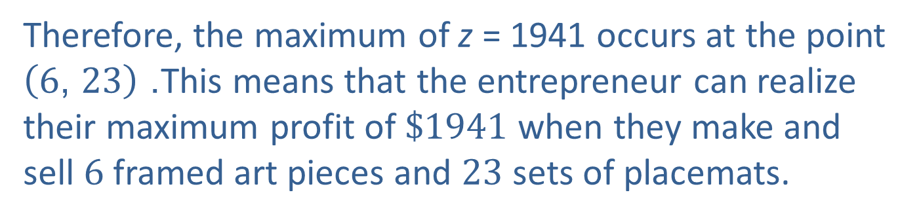
Example 4: Modeling with Linear Programming—Slide 12
Therefore, the maximum of z = 1941 occurs at the point $\left(6\text{, }23\right)$. This means that the entrepreneur can realize their maximum profit of $\$1941$ when they make and sell 6 framed art pieces and 23 sets of placemats.

