Slide 1
Section 5.6
Modeling with Quadratics

Slide 2
Fun Fact—Slide 1
The term sabermetrics (sometimes written SABRmetrics) is derived from the acronym SABR, which stands for the Society for American Baseball Research. SABR, held its first meeting in 1971 with 16 baseball enthusiasts. 40 years later, with more than 6,000 members, SABR has earned the reputation as the "Conscience of Baseball."

Slide 3
Definition: Quadratic Equation
A quadratic equation in x is written in standard form as
where a, b, and c are numbers and a ≠ 0.

Slide 4
Definition: f(x) Quadratic Formula
Solutions to a quadratic equation written in standard form,
where a is nonzero, can be found
using the quadratic formula.

Slide 5
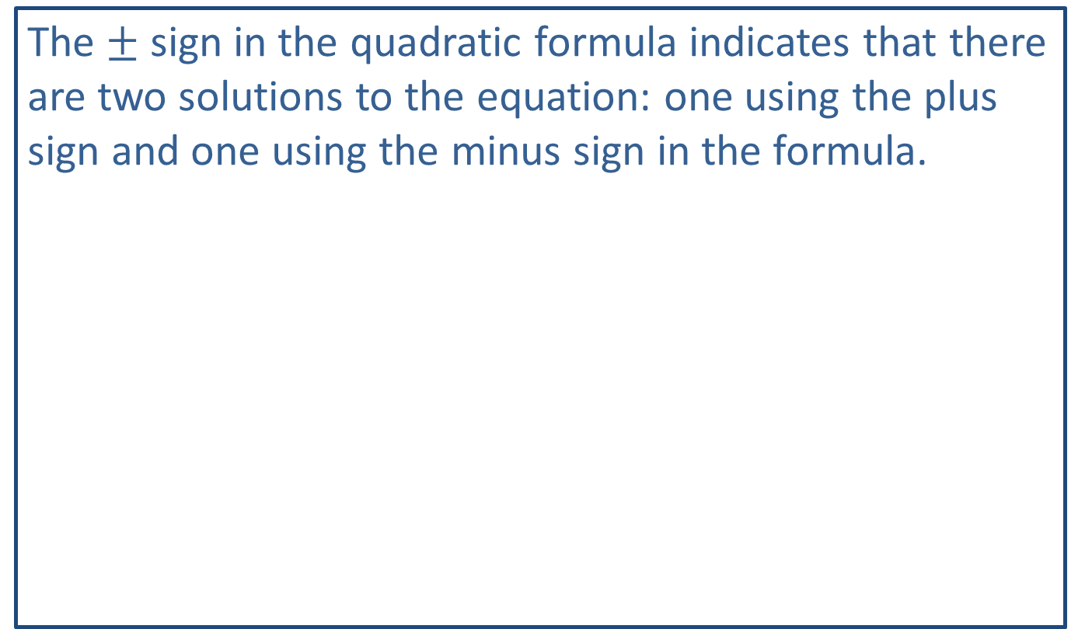
Helpful Hint—Slide 1
The $±$ sign in the quadratic formula indicates that there are two solutions to the equation: one using the plus sign and one using the minus sign in the formula.
and

Slide 6
Example 1: Solving a Quadratic Equation—Slide 1
Use the quadratic formula to solve the equation
Solution
To use the quadratic formula, the equation must be in
the form
Since we are given the
equation in standard form, we can identify a, b, and c.

Slide 7
Example 1: Solving a Quadratic Equation—Slide 2
Now, substitute these values into the quadratic formula.

Slide 8
Example 1: Solving a Quadratic Equation—Slide 3
We need to determine if either (or both) of the solutions we found to the linear equations satisfies the original quadratic equation. Check each by substituting back into the original equation.
Check:
Thus, we have verified that both of these numbers are solutions to the quadratic equation.

Slide 9
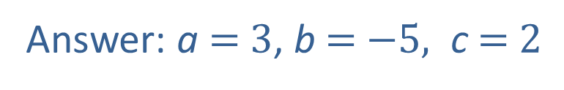
Skill Check 1
Identify a, b, and c in the quadratic equation
Answer: a $=$ $3$, b $=$ $−5,$ c $=$ $2$

Slide 10
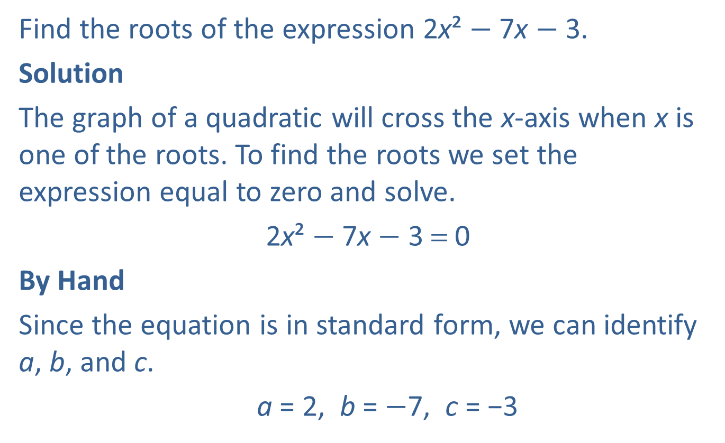
Example 2: Solving a Quadratic Equation—Slide 1
Find the roots of the expression 2x² $−$ 7x $−$ 3.
Solution
The graph of a quadratic will cross the x-axis when x is one of the roots. To find the roots we set the expression equal to zero and solve.
2x² $−$ 7x $−$ 3 = 0
By Hand
Since the equation is in standard form, we can identify a, b, and c.
a = 2, b = $−$7, c = −3

Slide 11
Example 2: Solving a Quadratic Equation—Slide 2
Substitute these values into the quadratic formula and simplify.

Slide 12
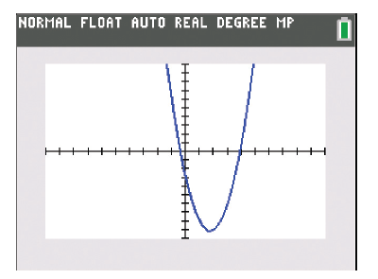

Example 2: Solving a Quadratic Equation—Slide 3
TI-83/84 Plus
To find the roots by graphing on a TI-83/84 Plus, press y= and clear any equations currently in the calculator. Type 2x² $−$ 7x $−$ 3 for Y1 and press graph.
Figure 4

Slide 13
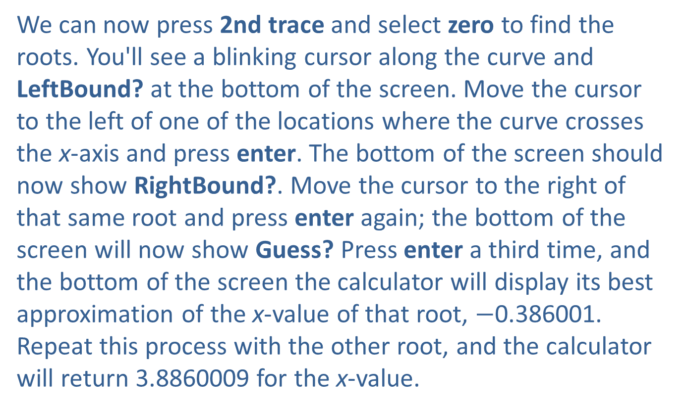
Example 2: Solving a Quadratic Equation—Slide 4
We can now press 2nd trace and select zero to find the roots. You'll see a blinking cursor along the curve and LeftBound? at the bottom of the screen. Move the cursor to the left of one of the locations where the curve crosses the x-axis and press enter. The bottom of the screen should now show RightBound?. Move the cursor to the right of that same root and press enter again; the bottom of the screen will now show Guess? Press enter a third time, and the bottom of the screen the calculator will display its best approximation of the x-value of that root, $−$0.386001. Repeat this process with the other root, and the calculator will return 3.8860009 for the x-value.

Slide 14
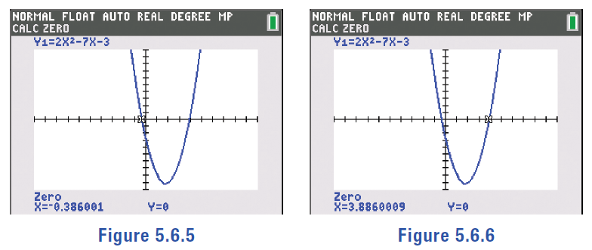
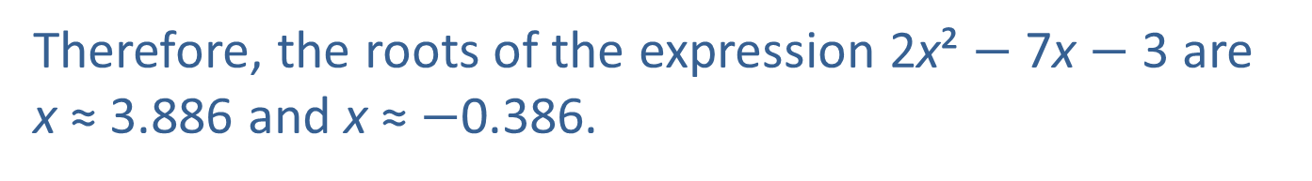
Example 2: Solving a Quadratic Equation—Slide 5
Figure 5
Figure 6
Therefore, the roots of the expression 2x² $−$7x $−$3 are x ≈ 3.886 and x ≈ $−$0.386.

Slide 15

Skill Check 2
Find the roots of the equation.
4x² $−$12x = 27
Answer:

Slide 16
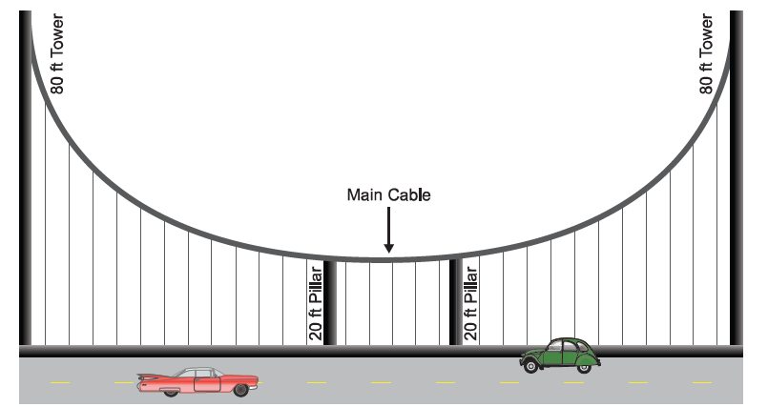
Example 3: Modeling with a Parabola—Slide 1
An architect firm has been hired to design a new suspension bridge to be included in a town's overall plan to revive the downtown area. The outermost support towers extend 80 feet above the deck (or road) of the bridge. Two inner decorative pillars are 20 feet tall and reach to the main cable. A simplified rendering of the bridge is shown in Figure 7.
Figure 7: Suspension Bridge with Two Decorative Pillars

Slide 17
Example 3: Modeling with a Parabola—Slide 2
The shape of the main cable can be modeled by the quadratic equation
where x is
the horizontal distance from the leftmost tower and y is the vertical height from the deck to the cable. If the leftmost tower is placed at 0 on the x-axis, how far away from the leftmost tower do each of the two 20-foot pillars need to be? Round your answer to the nearest tenth of a foot.

Slide 18

Example 3: Modeling with a Parabola—Slide 3
Solution
We are told that the shape of the main cable can be
modeled by the quadratic
Every point on this quadratic has an x-value that is the horizontal distance from the leftmost tower and a y-value that is the height of the main cable above the deck. We are told that the height of each decorative pillar is 20 feet; in other words, y $=20$.
By Hand
In order to use the quadratic formula, we need to substitute this into the equation and rearrange it into standard form.

Slide 19
Example 3: Modeling with a Parabola—Slide 4

Slide 20
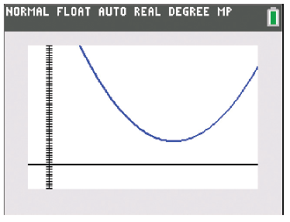
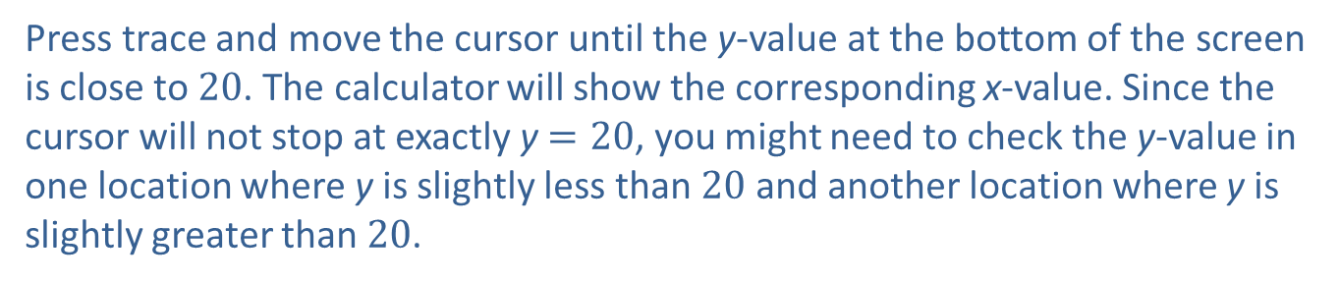
Example 3: Modeling with a Parabola—Slide 5
TI-83/84 Plus
Press y= and clear any equations currently in the calculator. Type
for Y1. Now press graph.
Figure 9
Press trace and move the cursor until the y-value at the bottom of the screen is close to 20. The calculator will show the corresponding x-value. Since the cursor will not stop at exactly y $=20$, you might need to check the y-value in one location where y is slightly less than 20 and another location where y is slightly greater than 20.

Slide 21
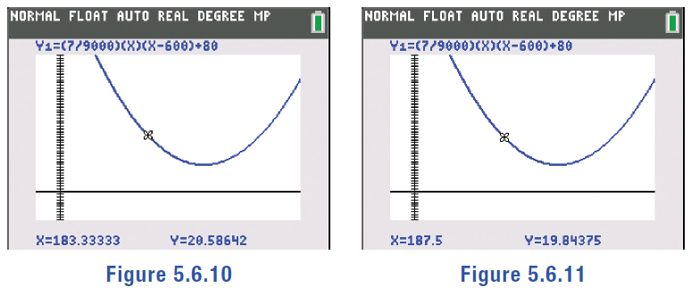
Example 3: Modeling with a Parabola—Slide 6
Figure 10
Figure 11
The corresponding x-value is somewhere between 183.33333 and 187.5. Since we don’t know the exact x-value, we can average 183.33333 and 187.5, which gives us 186.6.
Repeat this process for the other location on the graph where y is 20.

Slide 22
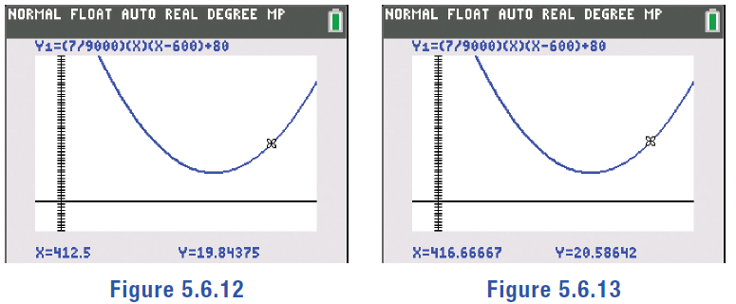
Example 3: Modeling with a Parabola—Slide 7
Figure 12
Figure 13
The corresponding x-value is somewhere between 412.5 and 416.66667. We again average these numbers and get 413.4.
Thus, the decorative pillars should be placed at approximately 186.6 feet and 413.4 feet from the leftmost tower.

Slide 23
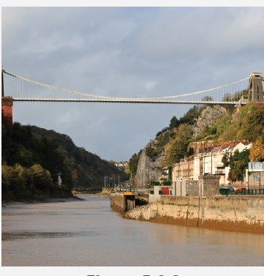
Fun Fact—Slide 2
The Clifton Suspension Bridge in Bristol, UK, is similar to the bridge modeled in Example 3. The bridge has a length of 1352 feet and is 331 feet tall.
Figure 8: Photo by Gothick, Creative Commons Attribution – Share Alike 3.0 Unported license

Slide 24
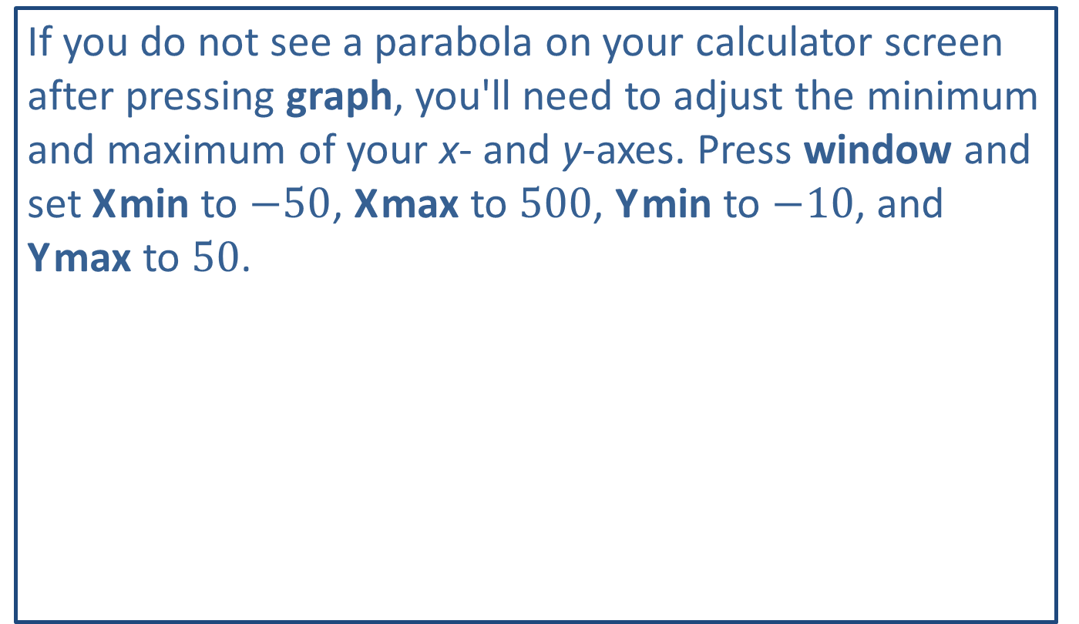
Tech Tip
If you do not see a parabola on your calculator screen after pressing graph, you'll need to adjust the minimum and maximum of your x- and y-axes. Press window and set X min to $−50$, X max to 500, Y min to $−10$, and Y max to 50.

Slide 25
Definition: Parabola and Vertex—Slide 1
Parabola
The graph of a quadradic equation is called a parabola. It is a symmetrical U-shaped curve around a vertical or horizontal line.
Vertex
The vertex of a parabola is the extreme point representing the quadratic equation’s minimum or
maximum value. It occurs at the point
given that

Slide 26
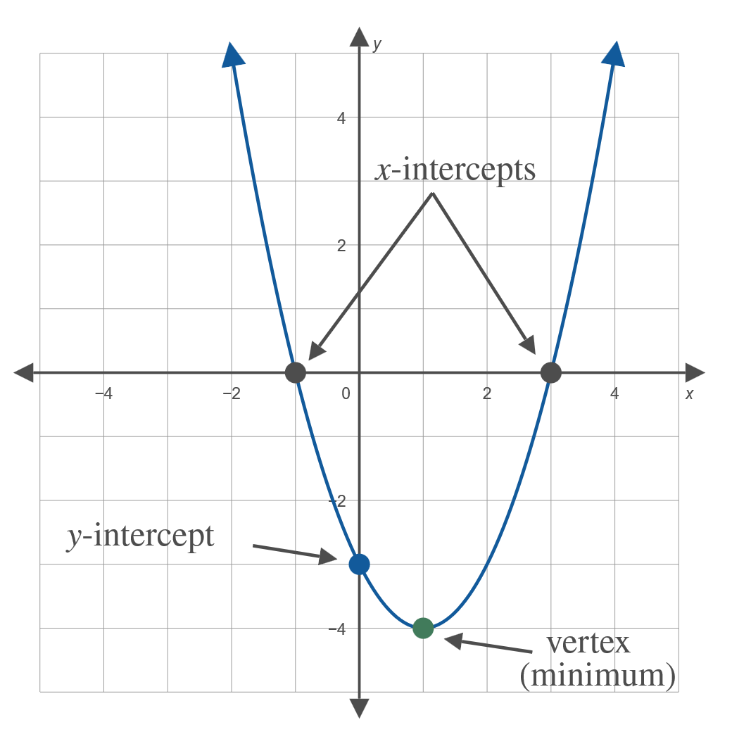
Definition: Parabola and Vertex—Slide 2
Figure 14

Slide 27
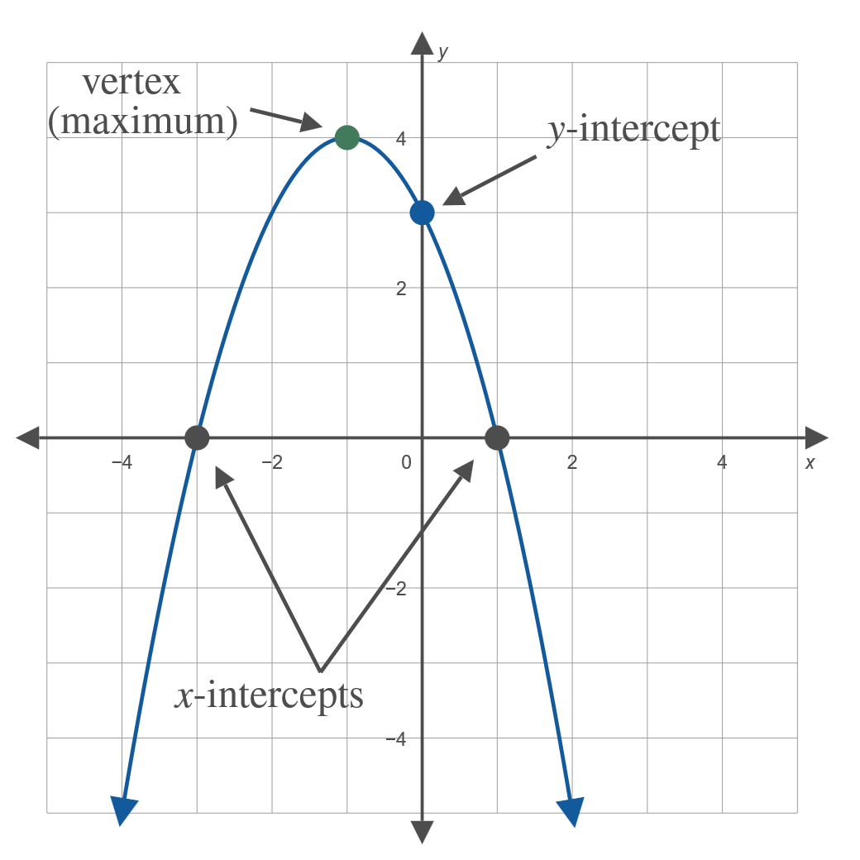
Definition: Parabola and Vertex—Slide 3
Figure 15

Slide 28
Example 4: Modeling with a Parabola—Slide 1
As part of new landscaping for an art museum, an outdoor water fountain is being designed. The water jets will create a parabolic stream of water modeled by the equation
where y is the height of the jet of water and x is the horizontal distance of the jet of water from the water nozzle, both in meters.

Slide 29
Example 4: Modeling with a Parabola—Slide 2
a.​ The design includes lights placed so that the water stream ends on them. Determine how far from the nozzle each light needs to be placed so that the jet of water lands on it.
b.​ What is the maximum height the jet of water will reach?
c. ​If the designer would like to have varying heights for the jets of water but have the streams land at the same distance, can the same equation be used? Explain.
d.​ How would you change the equation to produce a water jet that goes half as high but still lands in the same spot?

Slide 30
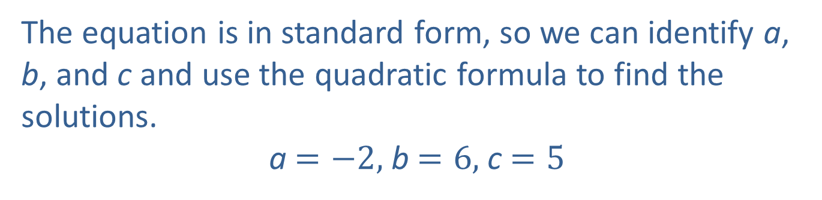
Example 4: Modeling with a Parabola—Slide 3
Solution
a.​ The lights will need to be placed where the water hits the ground, which is where y = 0. This point is the x-intercept of the parabola. To find this distance of the nozzle to the light, we need to solve the equation
​​
​The equation is in standard form, so we can identify a, b, and c and use the quadratic formula to find the solutions.
a $=−2,$ b $=6,$ c $=5$

Slide 31
Example 4: Modeling with a Parabola—Slide 4
​Substitute these values into the quadratic formula and simplify.
Because we are interested in distance, we need the positive value of x. So the lights should be placed 3.68 meters from the nozzle.

Slide 32
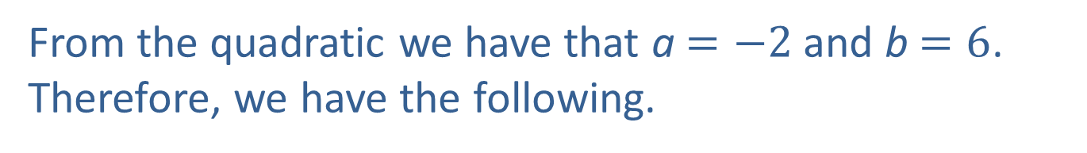
Example 4: Modeling with a Parabola—Slide 5
b.​ The water will reach its highest point at the vertex of the parabola.
By Hand
To find this height (that is, the y-coordinate of the vertex), we first find the x-coordinate using ​
From the quadratic we have that a $=−2$ and b $=6$. Therefore, we have the following.

Slide 33
Example 4: Modeling with a Parabola—Slide 6
Now that we have the x-coordinate, substitute this value back into the equation to find the maximum height of the water; that is, the y-coordinate.
​
Thus, the vertex occurs at the point $\left(1.5\text{, }9.5\right)$.

Slide 34
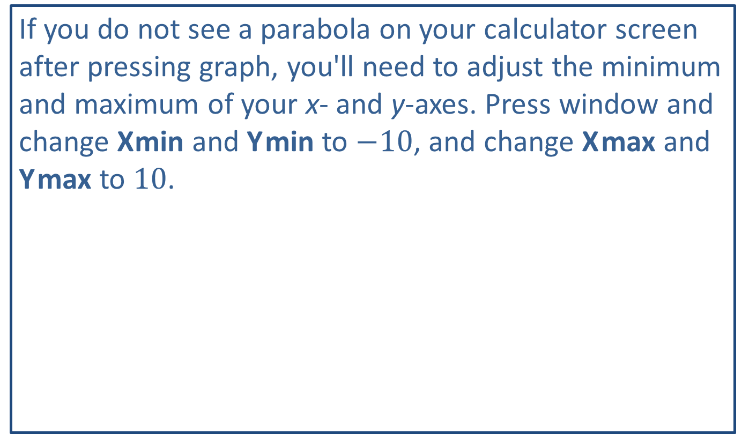
Tech Tips
If you do not see a parabola on your calculator screen after pressing graph, you'll need to adjust the minimum and maximum of your x- and y-axes. Press window and change X min and Y min to $−10$, and change X max and Y max to 10.

Slide 35
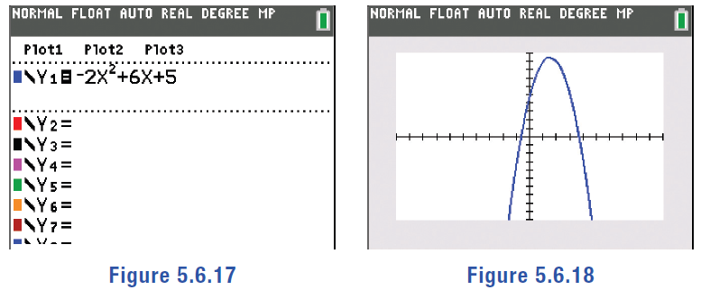
Example 4: Modeling with a Parabola—Slide 7
TI-83/84 Plus
To find the vertex, first graph the parabola by pressing y=. Type the right-hand side of the equation
for Y1, using X,T,θ,n for the variable, x, and press graph.
Figure 17
Figure 18

Slide 36
Example 4: Modeling with a Parabola—Slide 8
Press 2nd trace and select maximum. A blinking cursor will appear on the curve. Use the right- and left-arrow keys to move the cursor somewhere to the left of the maximum and press enter, then move the cursor to the right side of the maximum and press enter. The word Guess? will appear at the bottom of the screen. Press enter again, and the calculator will return both coordinates of the maximum: x = 1.4999985 and y = 9.5.

Slide 37
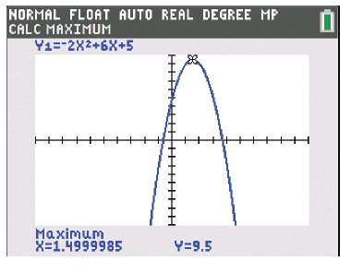
Example 4: Modeling with a Parabola—Slide 9
Figure 19
This means that the water reaches its maximum height of 9.5 meters when it is 1.5 meters away from the nozzle.

Slide 38
Example 4: Modeling with a Parabola—Slide 10
c.​ No; the same equation cannot be used for different heights. However, the equation can be used as a basis for new equations that will have different maximums and the same starting and ending points for the jets. Because we know that the arc of the fountain must begin and end at the same point no matter the height that it reaches, the equation must be a quadratic equation that has the same solutions as the original equation. The only such equations are multiples of the original equation. In other words, if the vertex needs to be three times as high, we can multiply the entire original equation by 3 to construct the new equation.

Slide 39
Example 4: Modeling with a Parabola—Slide 11
d.​ To produce a water jet that reaches half as high, multiply the entire original equation by
to construct the new equation. The new equation
would be

Slide 40
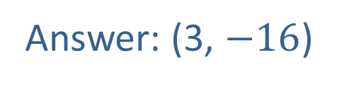
Skill Check 3
Determine the coordinates of the vertex of the equation
Answer: (3, $−16$)

Slide 41
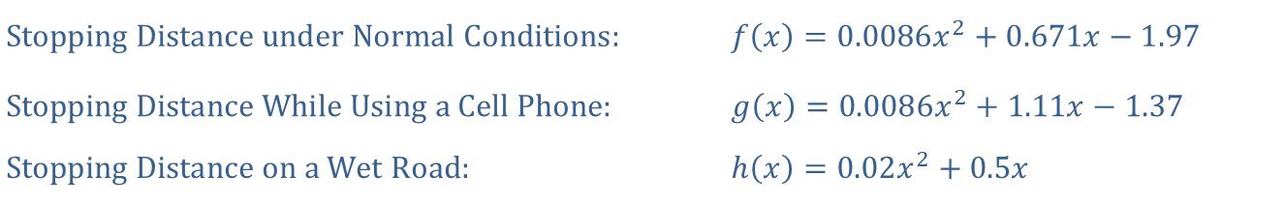
Example 5: Modeling with Quadratic Functions—Slide 1
According to the National Highway Traffic Safety Administration, the stopping distances of a vehicle under various conditions are modeled with the following quadratic functions, where x is the speed of the car in miles per hour, and the value of the function is the distance, in feet, required to stop under those conditions.
Each of the curves are depicted in Figure 20. Note, that although these formulas are defined for any value of x, for this application, we are only interested in the positive values shown in the graph. In the next section, we will further explore why this is the case.
​
​$\text{Stopping} \text{Distance} \text{under} \text{Normal} \text{Conditions}\text{:}$ | ​$f\left(x\right)=0.0086x^{2}+0.671x−1.97$
​$\text{Stopping} \text{Distance} \text{While} \text{Using} \text{a} \text{Cell} \text{Phone}\text{:}$ | ​$g\left(x\right)=0.0086x^{2}+1.11x−1.37$
​$\text{Stopping} \text{Distance} \text{on} \text{a} \text{Wet} \text{Road}\text{:}$ | ​$h\left(x\right)=0.02x^{2}+0.5x$

Slide 42
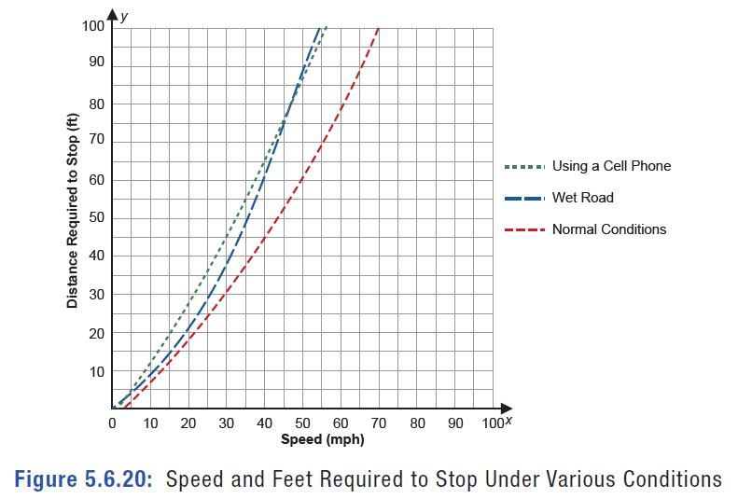
Example 5: Modeling with Quadratic Functions—Slide 2
Figure 20: Speed and Feet Required to Stop Under Various Conditions

Slide 43
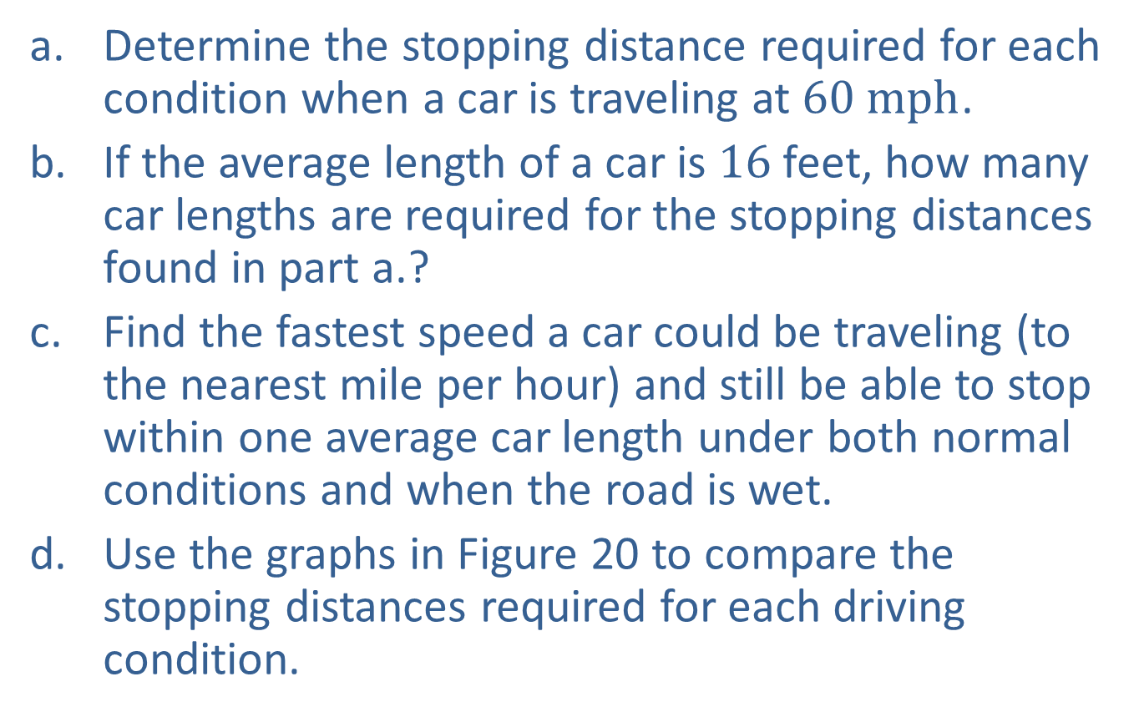
Example 5: Modeling with Quadratic Functions—Slide 3
a. ​Determine the stopping distance required for each condition when a car is traveling at $60 mph$.
b. ​If the average length of a car is 16 feet, how many car lengths are required for the stopping distances found in part a.?
c. ​Find the fastest speed a car could be traveling (to the nearest mile per hour) and still be able to stop within one average car length under both normal conditions and when the road is wet.
d.​ Use the graphs in Figure 20 to compare the stopping distances required for each driving condition.

Slide 44

Example 5: Modeling with Quadratic Functions—Slide 4
Solution
a.​ In order to determine the stopping distance for a car traveling at $60 mph$ in each of the conditions, we need to evaluate each function at x $=60$.
​Under Normal Conditions
.
.​
While Using a Cell Phone

Slide 45
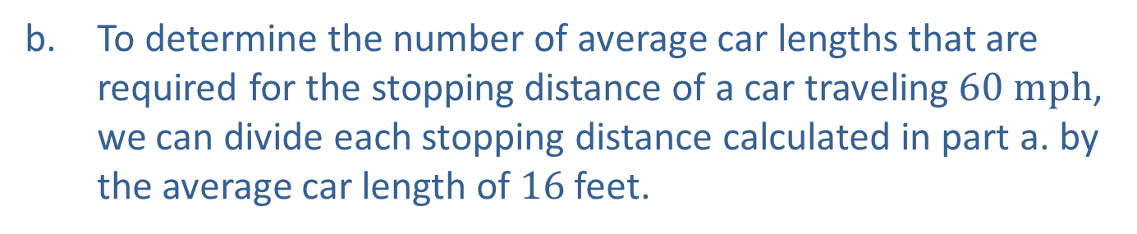
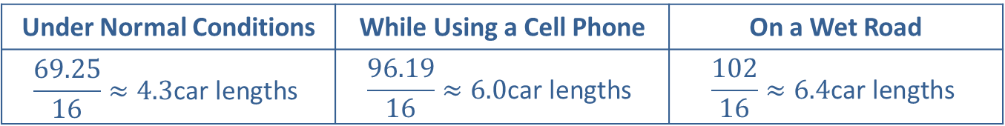
Example 5: Modeling with Quadratic Functions—Slide 5
​On a Wet Road
b.​ To determine the number of average car lengths that are required for the stopping distance of a car traveling $60 mph$, we can divide each stopping distance calculated in part a. by the average car length of 16 feet.
Under Normal Conditions | While Using a Cell Phone | On a Wet Road
$$\frac{69.25}{16}≈4.3\text{car} \text{lengths}$$ | $$\frac{96.19}{16}≈6.0\text{car} \text{lengths}$$ | $$\frac{102}{16}≈6.4\text{car} \text{lengths}$$

Slide 46
Example 5: Modeling with Quadratic Functions—Slide 6
c. We are interested in the maximum speed that a car could be traveling and still only need 16 feet of stopping distance under both normal conditions and when the road is wet. Thus, we need to set each of the two respective functions equal to 16 and solve for x using the quadratic formula.
​Under Normal Conditions
​

Slide 47

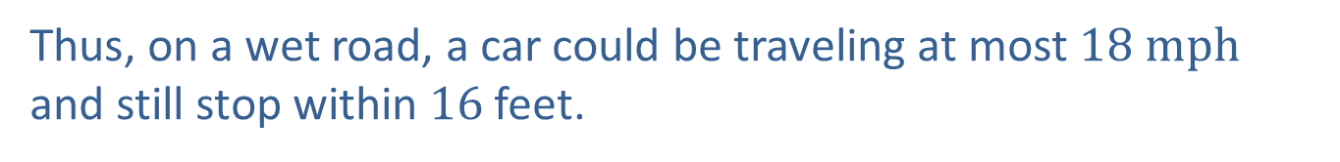
Example 5: Modeling with Quadratic Functions—Slide 7
​Since the car can only travel at a positive speed, we discard the negative value of x. Thus, under normal conditions, a car could be traveling at most $21 mph$ and still stop within 16 feet.
​On a Wet Road
​
Thus, on a wet road, a car could be traveling at most $18 mph$ and still stop within 16 feet.

Slide 48
Example 5: Modeling with Quadratic Functions—Slide 8
d. Using the graphs in Figure 20, we can see that the distance required to stop while talking on a cell phone versus normal driving conditions is greater at all speeds, thus making it not safe to talk on a cell phone while driving. The stopping distances for driving on a wet road is similar to that of talking on a cell phone.

Slide 49
Helpful Hint—Slide 2
We use subscripts of 0 on variables to denote the beginning, or initial, values. For instance, the initial height of a falling object is denoted as y₀ and the initial velocity is denoted as v₀.

Slide 50
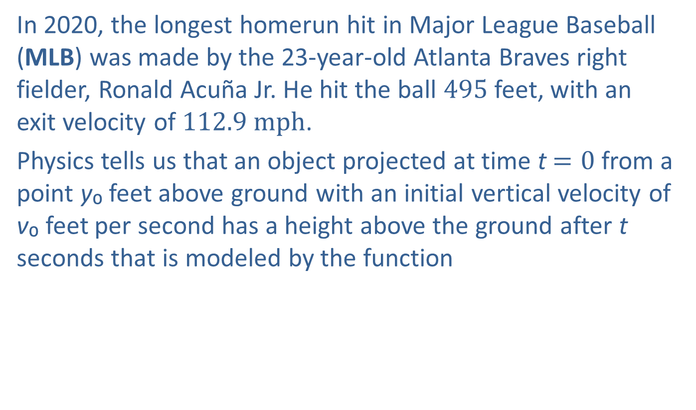
Example 6: Using Multiple Functions—Slide 1
In 2020, the longest homerun hit in Major League Baseball (MLB) was made by the 23-year-old Atlanta Braves right fielder, Ronald Acuña Jr. He hit the ball 495 feet, with an exit velocity of $112.9 mph$.
Physics tells us that an object projected at time t$=0$ from a point y₀ feet above ground with an initial vertical velocity of v₀ feet per second has a height above the ground after t seconds that is modeled by the function
At that same time t,
the distance the object has traveled is modeled by the
function
where v₁ is the initial horizontal velocity.

Slide 51
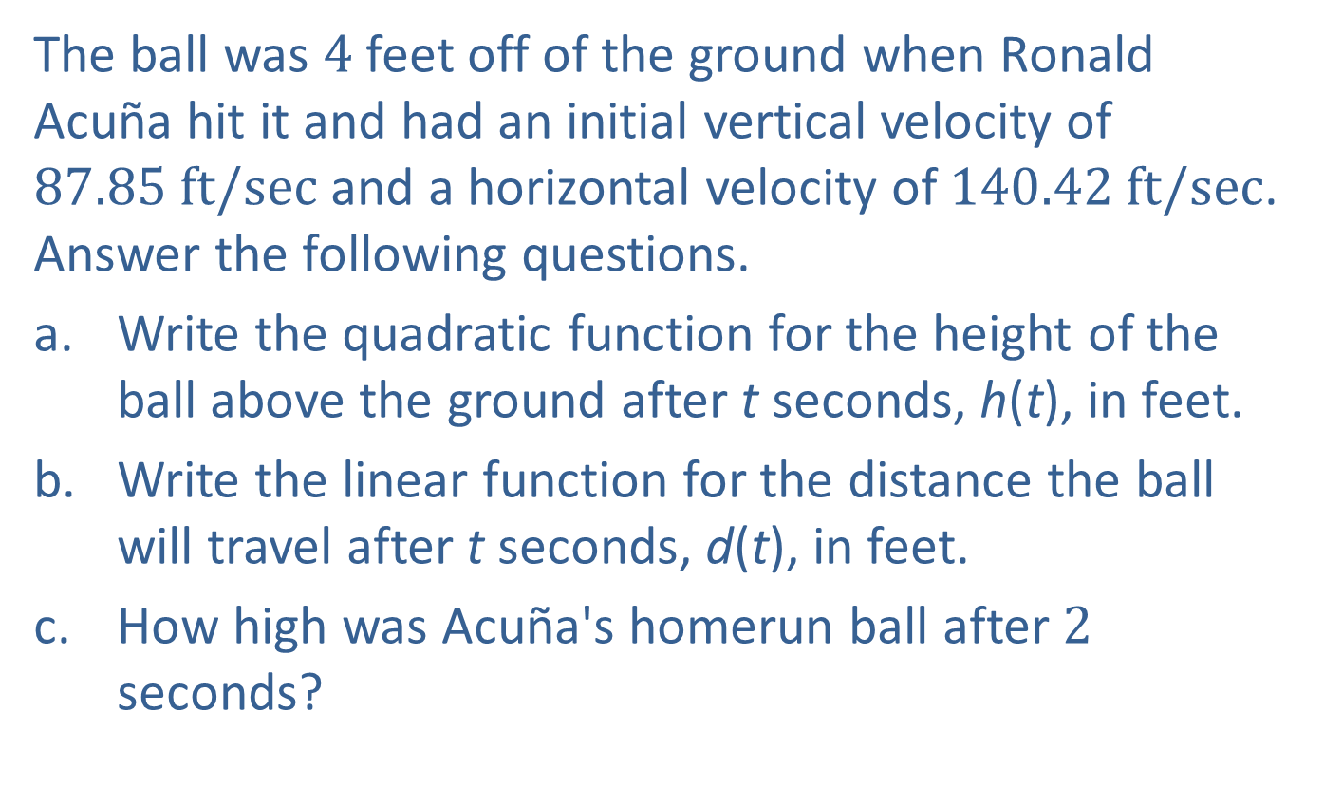
Example 6: Using Multiple Functions—Slide 2
The ball was 4 feet off of the ground when Ronald Acuña hit it and had an initial vertical velocity of $87.85 ft/sec$ and a horizontal velocity of $140.42 ft/sec$. Answer the following questions.
a. ​Write the quadratic function for the height of the ball above the ground after t seconds, h(t), in feet.
b.​ Write the linear function for the distance the ball will travel after t seconds, d(t), in feet.
c.​ How high was Acuña's homerun ball after 2 seconds?

Slide 52
Example 6: Using Multiple Functions—Slide 3
d.​ During what time interval was the homerun ball more than 100 feet above the ground?
e.​ How long was the ball in flight before it became a homerun because it passed over the outfield fence at a distance of approximately 395 feet?
f​. The outfield fence at Truist park where Acuña hit the homeroom is 8 feet 8 inches tall. How high above the fence was the ball when it went over the fence?

Slide 53
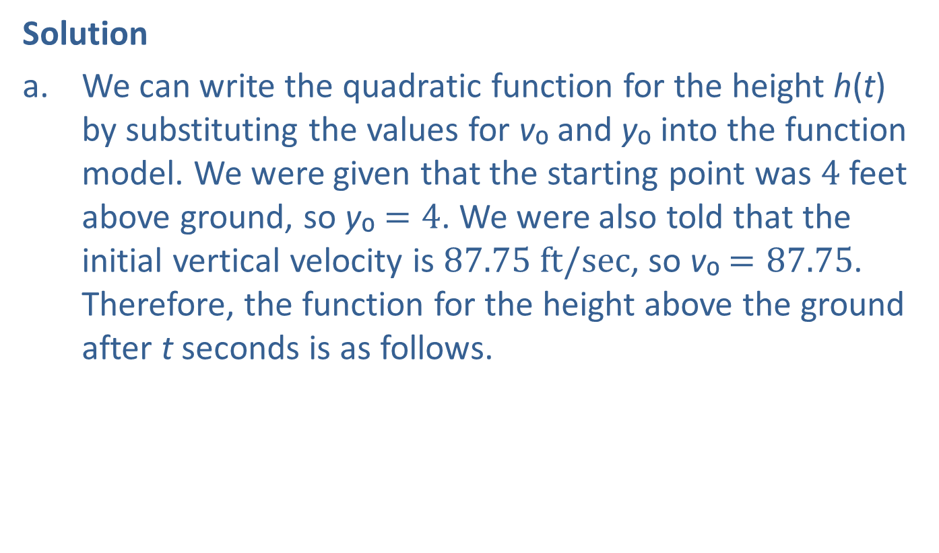
Example 6: Using Multiple Functions—Slide 4
Solution
a. We can write the quadratic function for the height h(t) by substituting the values for v₀ and y₀ into the function model. We were given that the starting point was 4 feet above ground, so y₀ $=4$. We were also told that the initial vertical velocity is $87.75 ft/sec$, so v₀ $=87.75$. Therefore, the function for the height above the ground after t seconds is as follows.
​
​
In this function, time t is the independent variable and the height of the projectile h(t) is the dependent variable.

Slide 54
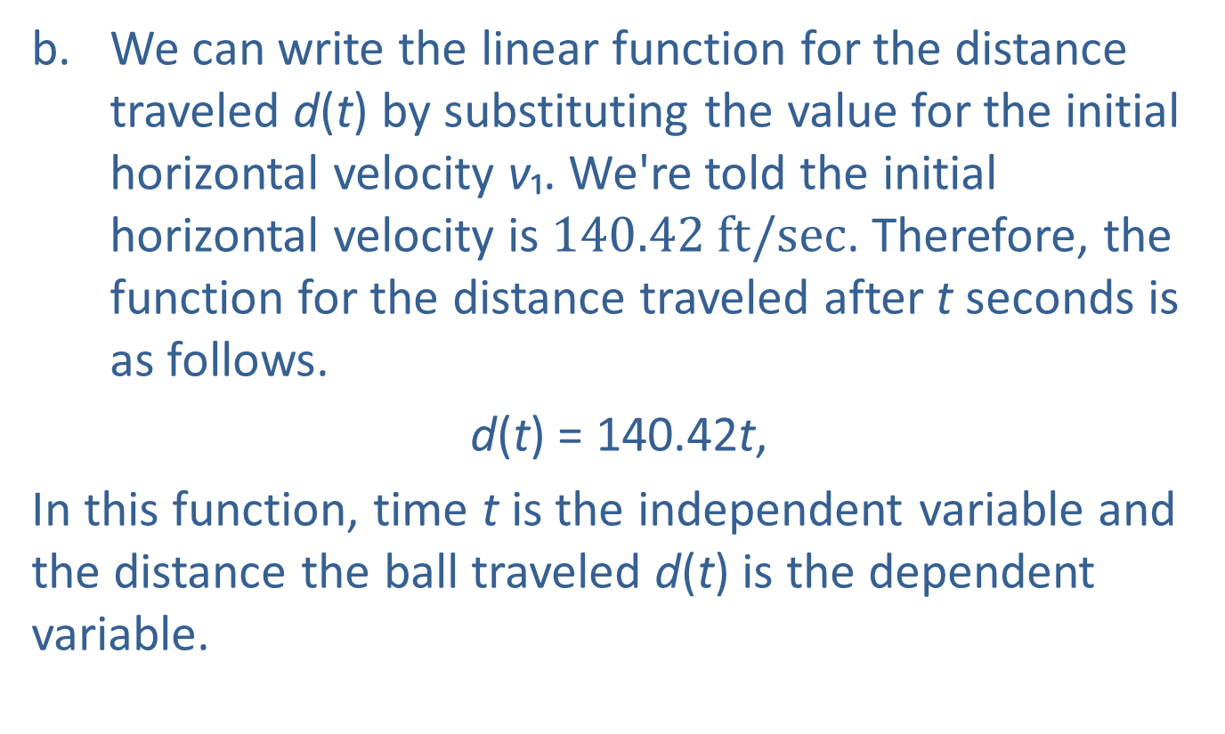
Example 6: Using Multiple Functions—Slide 5
b. We can write the linear function for the distance traveled d(t) by substituting the value for the initial horizontal velocity v₁. We're told the initial horizontal velocity is $140.42 ft/sec$. Therefore, the function for the distance traveled after t seconds is as follows.
​d(t) = 140.42t,
​In this function, time t is the independent variable and the distance the ball traveled d(t) is the dependent variable.

Slide 55
Example 6: Using Multiple Functions—Slide 6
c.​ We can use the function we found in part a. to determine how high the ball will be after a time of 2 seconds. In other words, we need to find h(2). Using the formula, we have the following.
​
Thus, after 2 seconds the ball was 115.5 feet in the air.
d.​ The height of the ball is the dependent variable h(t), and we are asked to find the values of t that make the function more than 100. In other words, we need to find the values of t such that h(t) > 100. Algebraically, we have the following.

Slide 56
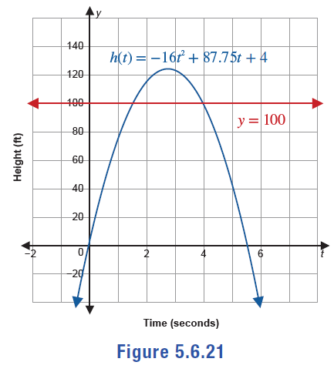

Example 6: Using Multiple Functions —Slide 7
​Figure 21 is graph of the function along with a line indicating the cutoff height of $100 ft$.
​
Figure 21

Slide 57
Example 6: Using Multiple Functions—Slide 8
​By Hand
As you can see in Figure 21, the height of the curve is more than 100 feet between the two points of intersection involving the function and the line. Therefore, we need to find the two intersection points that occur when the function is equal to 100. We can do this by changing the inequality sign to an equal sign, and then solving for t by using the quadratic formula.

Slide 58
Example 6: Using Multiple Functions—Slide 9
So we have a = −16, b = 87.75, and c = −96. Substitute these values into the quadratic formula and simplify.
​

Slide 59
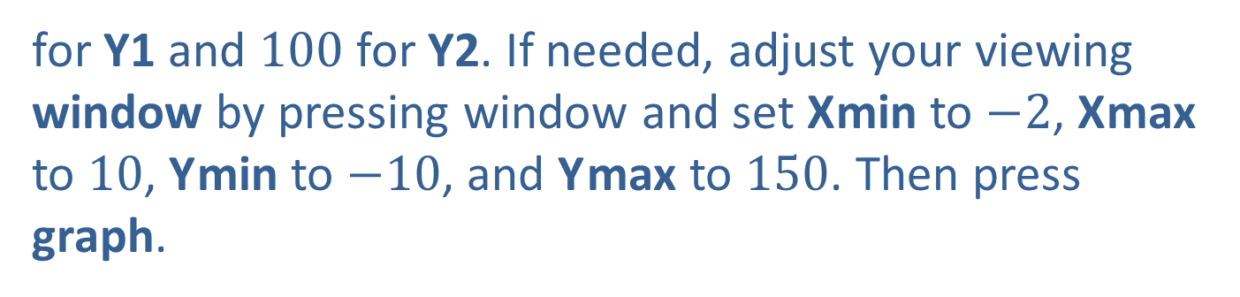
Example 6: Using Multiple Functions—Slide 10
TI-83/84 Plus
Using a graphing utility, we can graph both h(t) and the horizontal line y = 100. (When graphing h(t), we will use X,T,θ,n for the variable t, but it will appear as x in the calculator.) Press y= and enter
for Y1 and 100 for Y2. If needed, adjust your viewing window by pressing window and set X min to $−2$, X max to 10, Y min to $−10$, and Y max to 150. Then press graph.

Slide 60
Example 6: Using Multiple Functions—Slide 11
Notice that the two places where the function and the horizontal line intersect are the endpoints of the interval when the height is above 100. To find the two points of intersection, press 2nd trace and select intersect. Move the cursor close to one of the points of intersection and press enter three times; at the bottom of the screen the calculator will display its best approximation of the intersection: x ≈ 1.5094701 (Figure 22). Repeat this process for the other point of intersection. The calculator returns a value of x ≈ 3.9749049 (Figure 23).

Slide 61
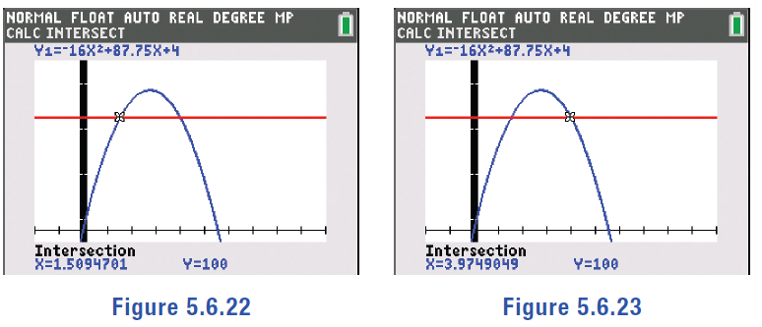
Example 6: Using Multiple Functions—Slide 12
Figure 22
Figure 23
Therefore, the ball is above 100 feet when 1.51 < t < 3.97.

Slide 62
Example 6: Using Multiple Functions—Slide 13
e.​ The ball became a homerun when it went over the fence, which was 395 feet away. Thus, we need to set our distance function equal to 395 and solve for t.
​Substituting in the distance function we have the following.
​
​
Therefore, we know that the ball was in the air for 2.81 seconds before going over the fence to score the homerun.

Slide 63
Example 6: Using Multiple Functions—Slide 14
f.​ To determine how high above the fence the ball was when it went over the fence, we first need to determine the height of the ball as it went over the fence. Then, we need to subtract the height of the fence from the height of the ball.
​From part e., we know that the ball went over the fence after 2.81 seconds. We can use that value for t in the height function to calculate how high the ball was when it went over the fence. Using the formula, we have the following.

Slide 64
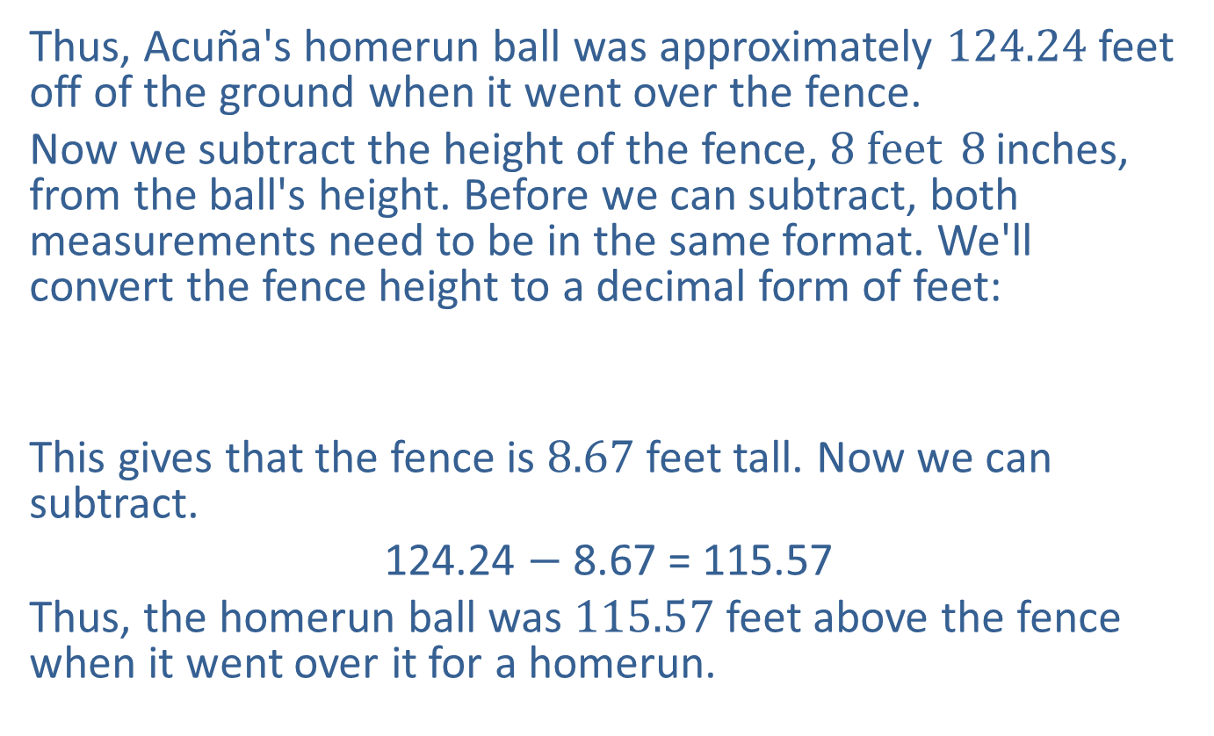
Example 6: Using Multiple Functions—Slide 15
​Thus, Acuña's homerun ball was approximately 124.24 feet off of the ground when it went over the fence.
​Now we subtract the height of the fence, ${8 feet}^{ }8^{ }$inches, from the ball's height. Before we can subtract, both measurements need to be in the same format. We'll convert the fence height to a decimal form of feet:
​This gives that the fence is 8.67 feet tall. Now we can subtract.
​124.24 $−$ 8.67 = 115.57
​Thus, the homerun ball was 115.57 feet above the fence when it went over it for a homerun.

Slide 65

Skill Check 4
Suppose a rocket is fired vertically upward from 1200 feet above the ground, with an initial velocity of
$620 ft/sec$. Write the quadratic model for its height h(t) in feet above the ground after t seconds and determine how long the projectile will be in flight.
Answer:
approximately 40.6 seconds

