Slide 1
Section 5.7
Exponential and Logarithmic Functions

Slide 2
Definition: Exponential Function
An exponential function is a function of the form
where b > 0, b ≠ 1, a is the initial value, and
x is a real number.

Slide 3
Helpful Hint—Slide 1
The base number b tells us how the quickly the function grows. If b is the number two, the function doubles with every unit increase. If b is the number three, the function triples with every unit increase.

Slide 4
Fun Fact—Slide 1
Albert Bartlett was a physics professor that became quite famous after delivering a lecture in 1969 titled Arithmetic, Population, and Energy: Sustainability 101. The lecture was a mathematical demonstration of the capacity of Earth's population based on the energy needs and available resources. He delivered the lecture over 1700 times over the next 36 years!

Slide 5
Example 1: Using an Exponential
Function—Slide 1
A certain type of bacteria reproduces in such a way that every minute, the number of bacteria doubles. At 8:00 a.m., or time t = 0, a single bacterium is placed in a jar. At 8:01 a.m., there are two bacteria in the jar, and at 8:02 a.m., there are four bacteria. Assume the bacteria continues to reproduce in this manner, with no loss in the number of bacteria, and that the jar is full of bacteria at 8:30 a.m. Table 1 displays the pattern of growth in the bacteria. Note that time t = 0 represents the starting time of 8:00 a.m.

Slide 6
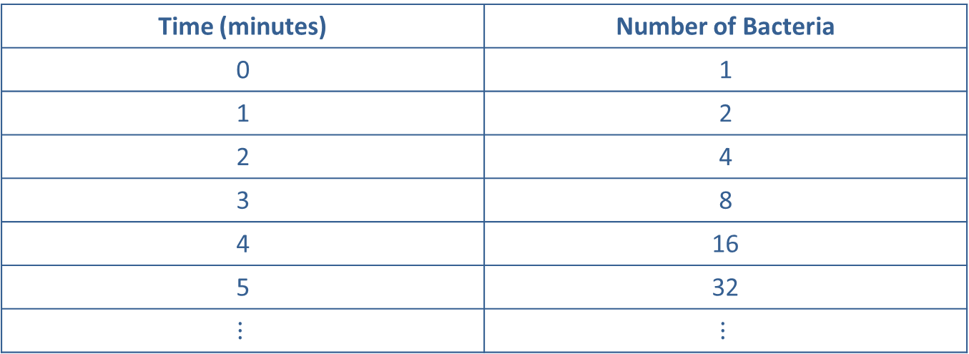
Example 1: Using an Exponential
Function—Slide 2
Table 1: Bacteria Growth
Time (minutes) | Number of Bacteria
0 | 1
1 | 2
2 | 4
3 | 8
4 | 16
5 | 32
$$⋮$$ | $$⋮$$
a. At what time will the jar be half full of bacteria?
b.​ Using what you already know, develop a function to model this data.

Slide 7
Example 1: Using an Exponential
Function—Slide 3
Solution
a.​ At first glance, you might conclude that the jar will be half full halfway through the time period; that is, at 8:15 a.m. This would be incorrect because this situation cannot be represented by a linear function—the increase between each y-value is not consistent. Since the number of bacteria doubles every minute, the jar will be half full one minute prior to the end time. In other words, at 8:29 a.m. the jar is half full, and when the number of bacteria doubles at 8:30 a.m., the jar is full. We can work backward and know that at 8:28 a.m., the jar is a quarter full.

Slide 8

Example 1: Using an Exponential
Function—Slide 4
b.​ To help us determine what type of equation will model the data, we need to look at the output values in the table (1, 2, 4, 8, 16, 32, $…$). Notice that the quantity of bacteria doubles during each unit of time increase. This indicates that an exponential function of the form
​​
will model this behavior. Since it doubles
each time, the base b of the function is 2. From the definition, we also know that a will be the initial value. So in this case a = 1. Using the variable t, for time, the exponential function that models this bacteria growth is

Slide 9
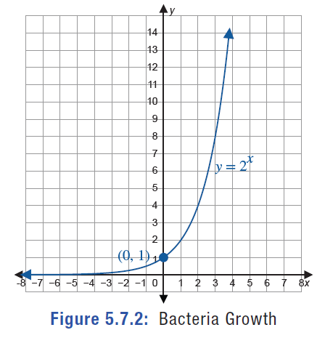
Example 1: Using an Exponential
Function—Slide 5
Figure 2 is a graph of the bacteria function.
Figure 2: Bacteria Growth

Slide 10
Skill Check 1
Use Example 1 to answer the following questions
​At what time will the jar of bacteria be
full?
b. ​How full is the jar at 8:26 a.m.?
Answer:
a.​ 8:27 a.m.

Slide 11
Definition: Expanded Form of an Exponential Function
The expanded form of an exponential function is a function of the form
where a is the
initial value, r is the rate of change, and x is any real number.

Slide 12
Helpful Hint—Slide 2
When using a function to estimate the amount of living things (such as bacteria, animals, and people), if the function results in a fractional number, you should round up to the next whole number.

Slide 13
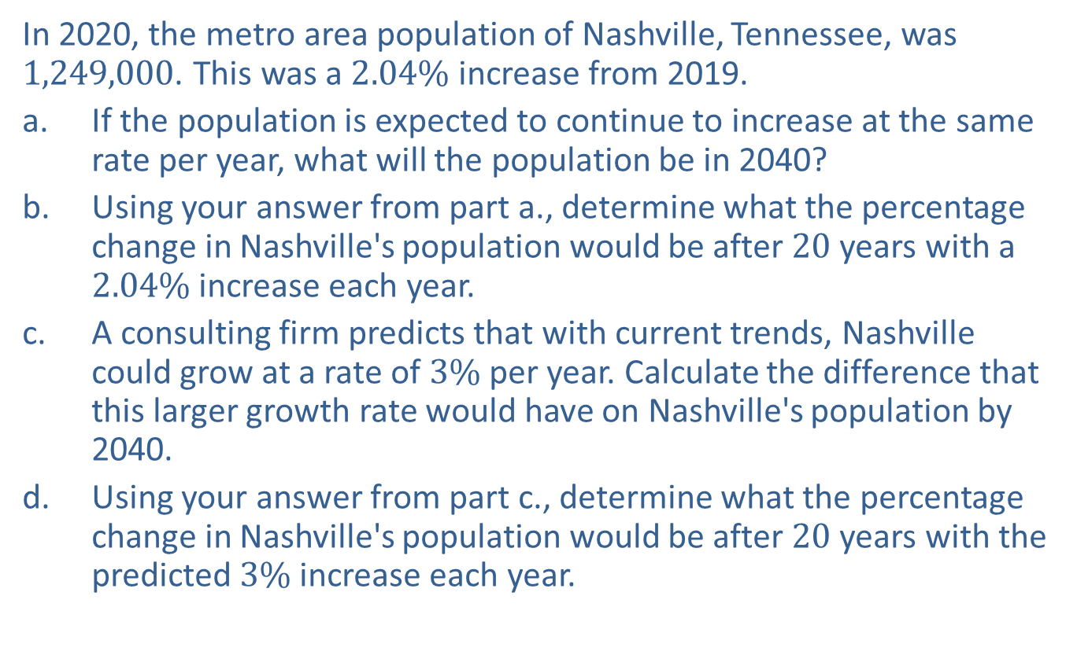
Example 2: Predicting Population Growth—Slide 1
In 2020, the metro area population of Nashville, Tennessee, was 1,249,000. This was a $2.04\%$ increase from 2019.
a. ​If the population is expected to continue to increase at the same rate per year, what will the population be in 2040?
b. ​Using your answer from part a., determine what the percentage change in Nashville's population would be after 20 years with a $2.04\%$ increase each year.
c.​ A consulting firm predicts that with current trends, Nashville could grow at a rate of $3\%$ per year. Calculate the difference that this larger growth rate would have on Nashville's population by 2040.
d.​ Using your answer from part c., determine what the percentage change in Nashville's population would be after 20 years with the predicted $3\%$ increase each year.

Slide 14
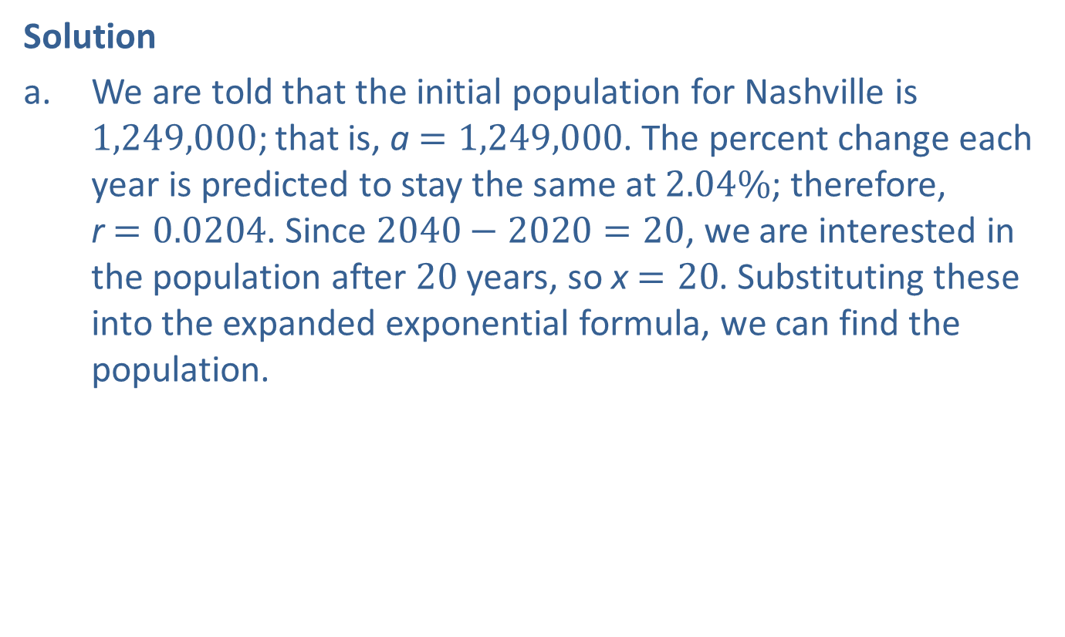

Example 2: Predicting Population Growth—Slide 2
Solution
a.​ We are told that the initial population for Nashville is 1,249,000; that is, a $=1,249,000$. The percent change each year is predicted to stay the same at $2.04\%$; therefore, r $=0.0204$. Since $2040−2020=20$, we are interested in the population after 20 years, so x $=20$. Substituting these into the expanded exponential formula, we can find the population.
​
This means that the population would be approximately 1,870,560 people after 20 years assuming a growth rate of $2.04\%$.

Slide 15

Example 2: Predicting Population Growth—Slide 3
b.​ Recall from an earlier section that percentage change is given by the formula
​
This gives us the following.
This means that after 20 years, Nashville's population will have grown by nearly $50\%$.

Slide 16

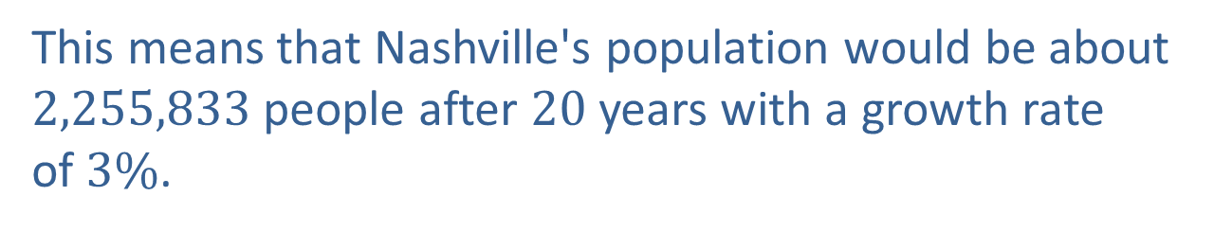
Example 2: Predicting Population Growth—Slide 4
c.​ We will use the same process as we did in part a., but the growth rate is now $3\%$ instead of $2.04\%$. The values for the initial population and the number of years remain the same; that is, a $=1,249,000$ and
x $=20$.
​
This means that Nashville's population would be about
2,255,833 people after 20 years with a growth rate
of $3\%$.

Slide 17

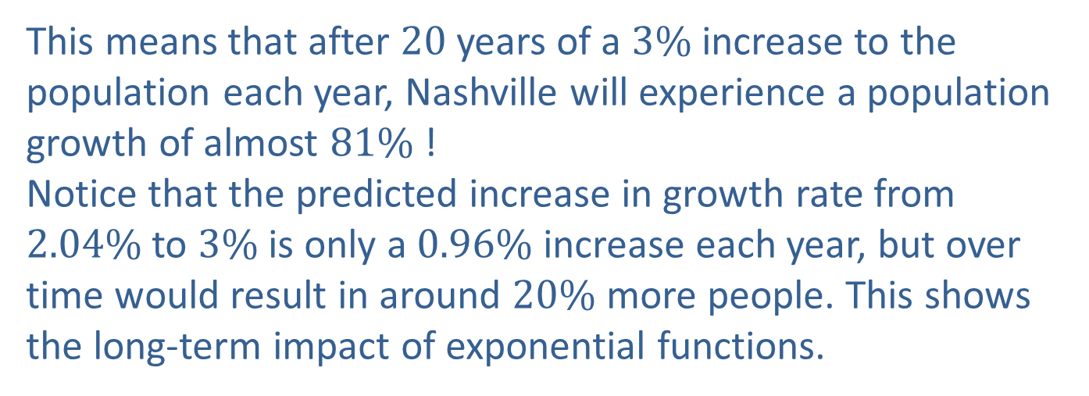
Example 2: Predicting Population Growth—Slide 5
d.​ The percentage change in the population with a $3\%$ growth each year would be
​
​
This means that after 20 years of a $3\%$ increase to the population each year, Nashville will experience a population growth of almost $81\%$ !
​Notice that the predicted increase in growth rate from $2.04\%$ to $3\%$ is only a $0.96\%$ increase each year, but over time would result in around $20\%$ more people. This shows the long-term impact of exponential functions.

Slide 18
Definition: Frequency and Pitch
Frequency
The frequency of a sound is the number of energy wave cycles completed in one second. Frequency is measured in hertz, Hz.
Pitch
Pitch is the tonal quality of sound that describes how low or high an instrument (or voice) sounds to our ears.

Slide 19
Fun Fact—Slide 2
The strings on a guitar are tuned to increase in pitch from one side to the other. However, strings on a ukulele are not in order of pitch.

Slide 20
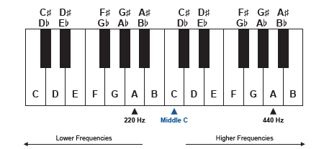
Helpful Hint—Slide 3
As Figure 4 indicates, a label is made for the note called middle C. This note gets its name from being the 4th C of eight Cs on the piano; that is, it is the C located in the middle of the piano.
Figure 4

Slide 21
Definition: Steps and Octaves
Half Step
A half step is the distance between one note and the next nearest note on a piano.
Whole Step
A whole step is defined as the interval between two half steps on a piano.
Octave
An octave is the interval of notes between 12 half steps on a piano.

Slide 22
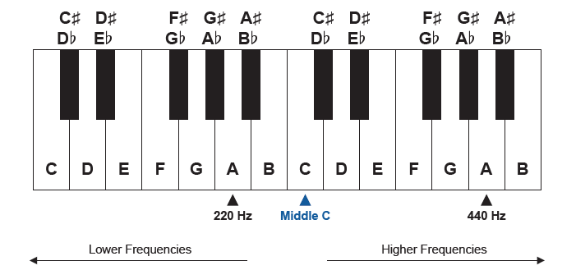
Skill Check 2
Starting at F in Figure 4, name the notes that are one half step up on a keyboard and one half step down on a keyboard.
Answer: One half step up is F♯ and one half step down is E.
Figure 4

Slide 23
Helpful Hint—Slide 4
If you don't have access to a piano, you can use the virtual piano on the website http://www.virtualpiano.net/.

Slide 24
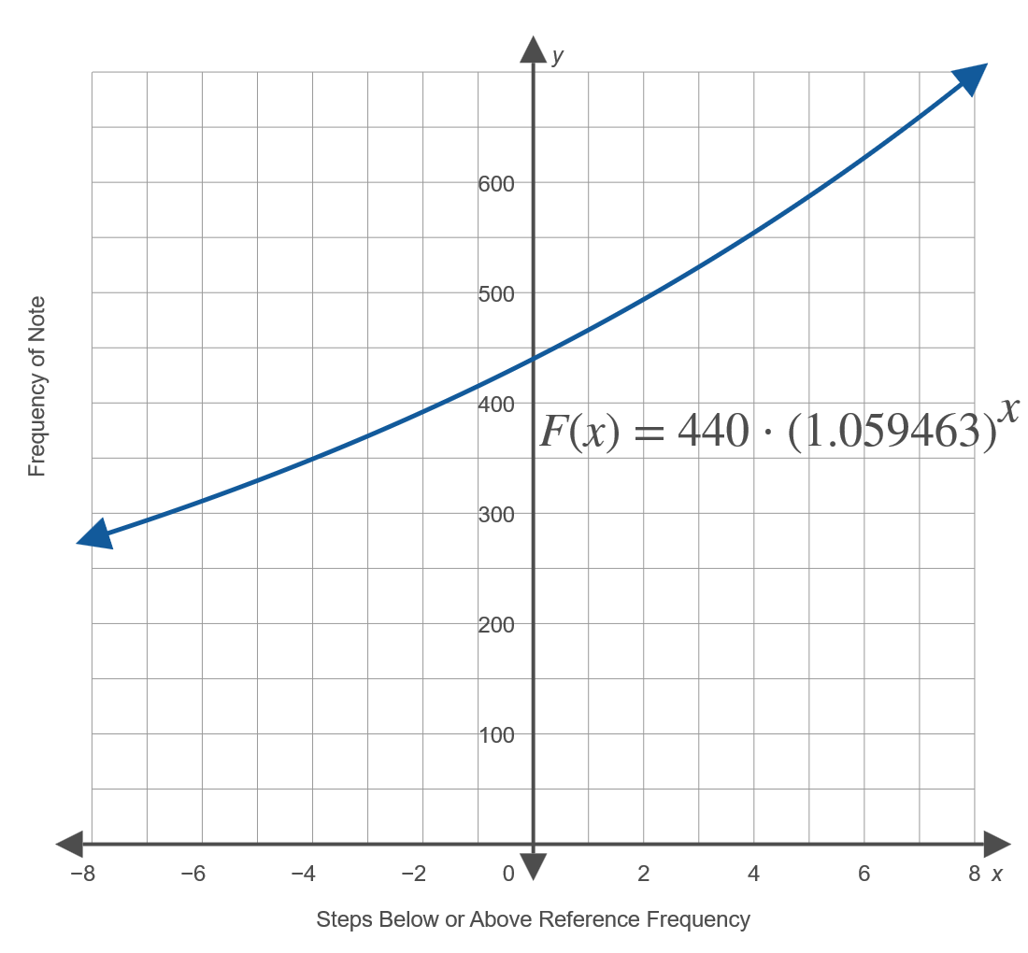
Definition: Frequency of Musical Notes
The frequency of a music note in relation to a specific note is modeled by the following function.
Here, F₀ is the reference frequency and x is the number of half steps up from F₀.
Figure 5: Frequency of Notes in Reference to A above Middle C

Slide 25
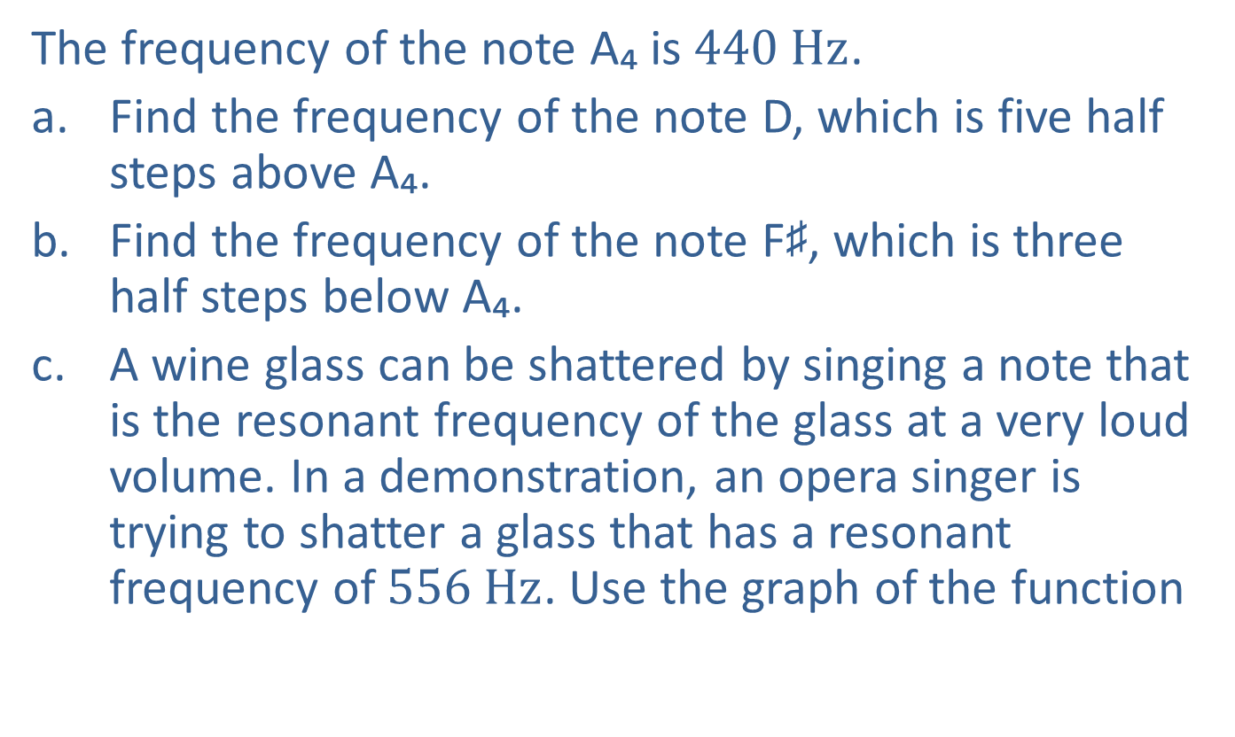
Example 3: Finding the Frequency of Musical Notes—Slide 1
The frequency of the note A₄ is $440 Hz$.
a.​ Find the frequency of the note D, which is five half steps above A₄.
b.​ Find the frequency of the note F♯, which is three half steps below A₄.
c.​ A wine glass can be shattered by singing a note that is the resonant frequency of the glass at a very loud volume. In a demonstration, an opera singer is trying to shatter a glass that has a resonant frequency of $556 Hz$. Use the graph of the function
to estimate how many half
steps above A₄ the note is.

Slide 26
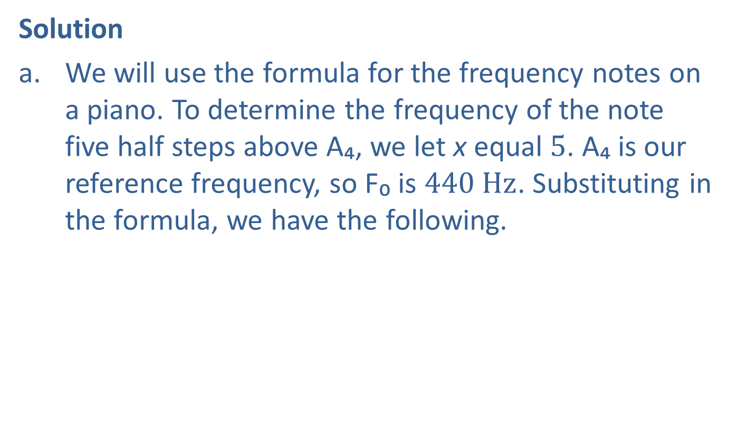

Example 3: Finding the Frequency of Musical Notes—Slide 2
Solution
a.​ We will use the formula for the frequency notes on a piano. To determine the frequency of the note five half steps above A₄, we let x equal 5. A₄ is our reference frequency, so F₀ is $440 Hz$. Substituting in the formula, we have the following.
​
Therefore, the note D above A₄ has a frequency of approximately $588 Hz$.

Slide 27


Example 3: Finding the Frequency of Musical Notes—Slide 3
b.​ We can use the same formula as we did in part a., where F₀ remains the same. This time the note we are interested in is 3 half steps below A₄, so x will equal $−3$.
​
Therefore, the note F♯ below A₄ has a frequency of approximately $370 Hz$.

Slide 28
Example 3: Finding the Frequency of Musical Notes—Slide 4
c. ​Instead of attempting to solve the function for x, we will use a graphing calculator to estimate how many half steps above A₄ the glass-shattering note is.
​Graph the equation
by pressing y=
and typing in the right-hand side of the equation. We know
from part a. that the frequency of a note five half steps
above A₄ is 587.56. This means that the y-value on our graph will be 587.56 when x is 5. This tells us that in order to see what we're graphing; we need the y-axis to go to a number larger than the default 10. Press window and change Ymax to 1000. Press graph.

Slide 29
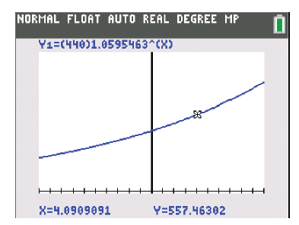

Example 3: Finding the Frequency of Musical Notes—Slide 5
​To find the number of half-steps above A₄ that a note must be to have a frequency of $556 Hz$, we need to find what the value of x is when y is 556. Press trace and move the cursor until the y-value at the bottom of the screen is close to 556. The x and y-values are shown at the bottom of the calculator screen. At y = 557.46302 we see that
x = 4.0909091.
​
Figure 6:
So for a note to be capable of shattering the wine glass, it would need to be approximately 4 half steps above A₄.

Slide 30
Helpful Hint—Slide 5
Net income is the amount of revenue a business has left after subtracting all expenses, taxes, and costs.

Slide 31
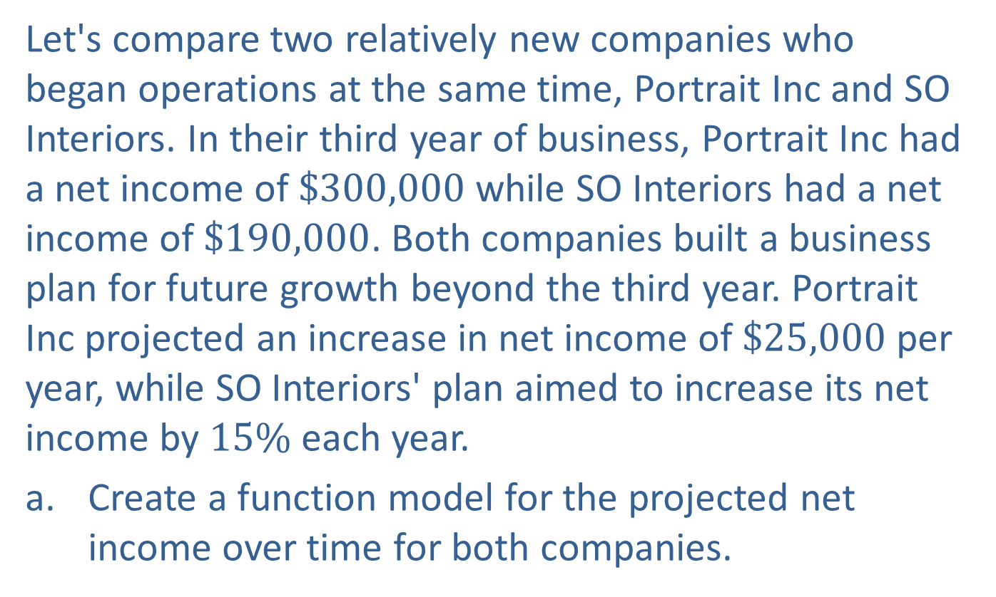
Example 4: Comparing Linear and Exponential Models—Slide 1
Let's compare two relatively new companies who began operations at the same time, Portrait Inc and SO Interiors. In their third year of business, Portrait Inc had a net income of $\$300,000$ while SO Interiors had a net income of $\$190,000$. Both companies built a business plan for future growth beyond the third year. Portrait Inc projected an increase in net income of $\$25,000$ per year, while SO Interiors' plan aimed to increase its net income by $15\%$ each year.
a.​ Create a function model for the projected net income over time for both companies.

Slide 32
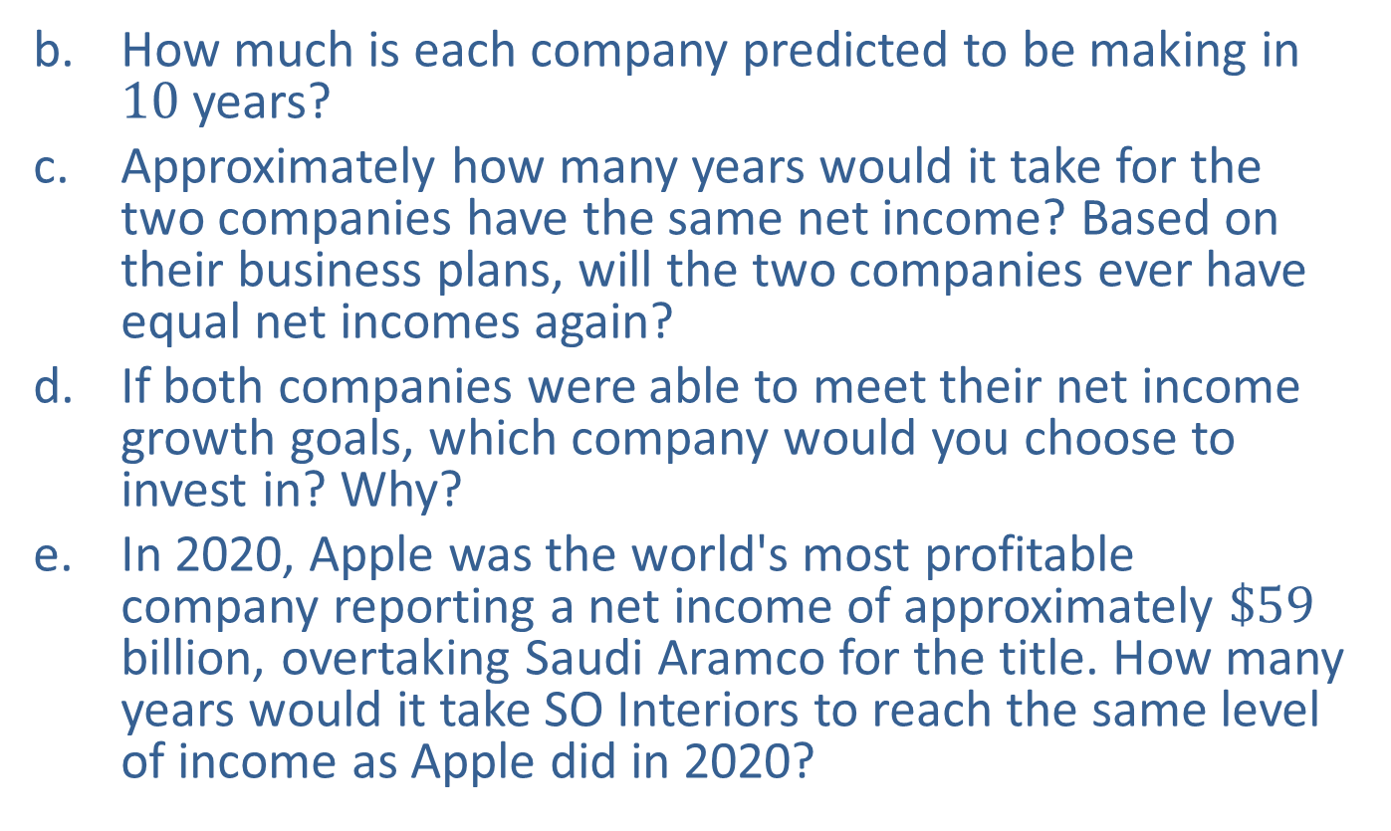
Example 4: Comparing Linear and Exponential Models—Slide 2
b.​ How much is each company predicted to be making in 10 years?
c.​ Approximately how many years would it take for the two companies have the same net income? Based on their business plans, will the two companies ever have equal net incomes again?
d.​ If both companies were able to meet their net income growth goals, which company would you choose to invest in? Why?
e.​ In 2020, Apple was the world's most profitable company reporting a net income of approximately $\$59$ billion, overtaking Saudi Aramco for the title. How many years would it take SO Interiors to reach the same level of income as Apple did in 2020?

Slide 33
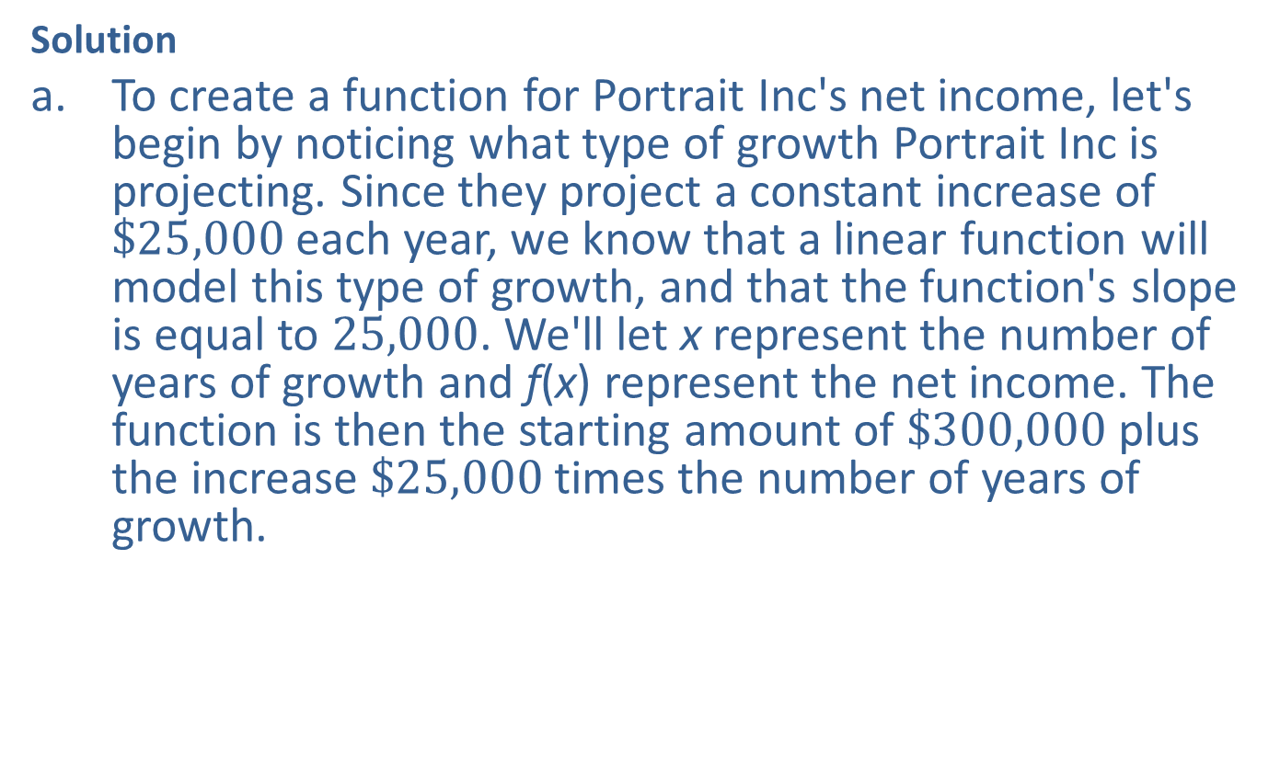
Example 4: Comparing Linear and Exponential Models—Slide 3
Solution
a.​ To create a function for Portrait Inc's net income, let's begin by noticing what type of growth Portrait Inc is projecting. Since they project a constant increase of $\$25,000$ each year, we know that a linear function will model this type of growth, and that the function's slope is equal to 25,000. We'll let x represent the number of years of growth and f(x) represent the net income. The function is then the starting amount of $\$300,000$ plus the increase $\$25,000$ times the number of years of growth.
​

Slide 34
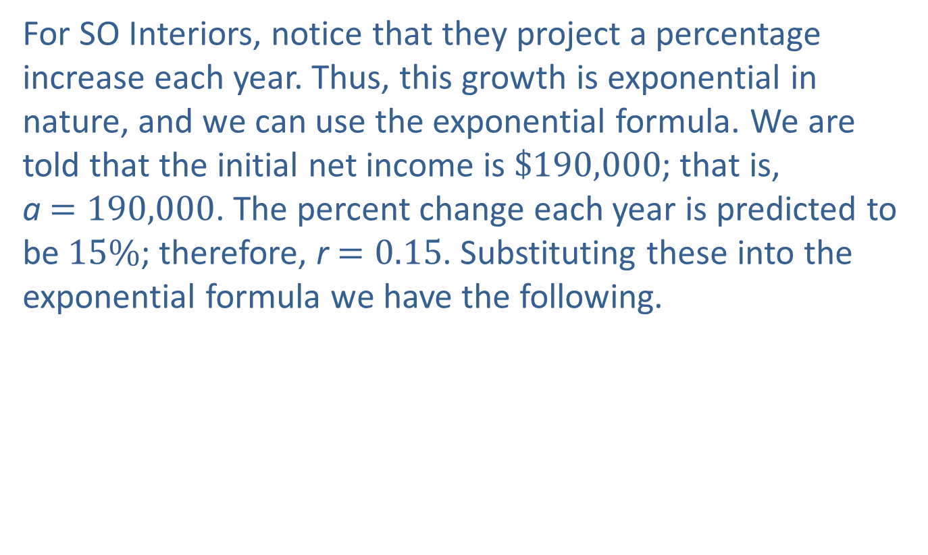
Example 4: Comparing Linear and Exponential Models—Slide 4
​For SO Interiors, notice that they project a percentage increase each year. Thus, this growth is exponential in nature, and we can use the exponential formula. We are told that the initial net income is $\$190,000$; that is,
a $=190,000$. The percent change each year is predicted to be $15\%$; therefore, r $=0.15$. Substituting these into the exponential formula we have the following.

Slide 35
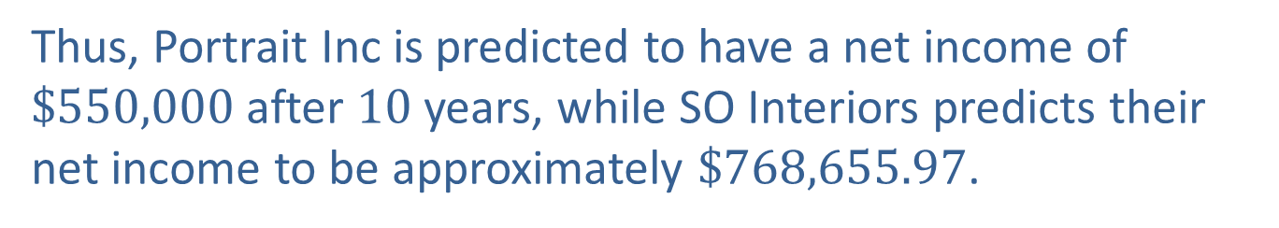
Example 4: Comparing Linear and Exponential Models—Slide 5
b.​ We can use the functions from part a. to determine the amount of net income each company is predicting after 10 years.
​
Portrait Inc
SO Interiors
Thus, Portrait Inc is predicted to have a net income of
$\$550,000$ after 10 years, while SO Interiors predicts their net income to be approximately $\$768,655.97$.

Slide 36
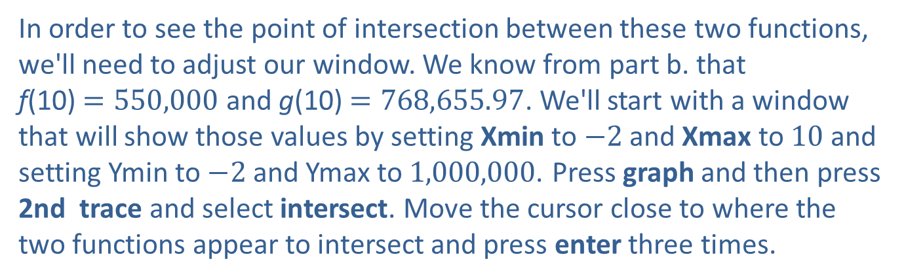
Example 4: Comparing Linear and Exponential Models—Slide 6
c. ​In order to determine when the two companies have the same net income, we can graph the functions on the same graph and determine where they intersect. We will use a TI-83/84 Plus calculator to graph the functions.
​Press y= and clear any equations currently in the calculator. Input the equation
for Y1 and
for Y2.
In order to see the point of intersection between these two functions, we'll need to adjust our window. We know from part b. that
f(10) $=550,000$ and g(10) $=768,655.97$. We'll start with a window that will show those values by setting Xmin to $−2$ and Xmax to 10 and setting Ymin to $−2$ and Ymax to 1,000,000. Press graph and then press 2nd trace and select intersect. Move the cursor close to where the two functions appear to intersect and press enter three times.

Slide 37
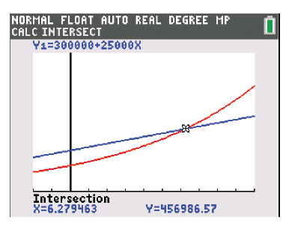
Example 4: Comparing Linear and Exponential Models—Slide 7
​At the bottom of the screen, the calculator gives the point of intersection as x = 6.279463, y = 456,986.57.
​
​
Figure 7
Thus, the two companies are projected to have the same net income at approximately 6.3 years.

Slide 38
Example 4: Comparing Linear and Exponential Models—Slide 8
​Since Portrait Inc's projected net income is increasing linearly, and SO Interiors project net income is increasing exponentially, the net incomes will never be equal again. SO Interiors will continue to grow at a faster rate and Portrait Inc will not catch up if it only has linear growth.
d. ​If you are able to invest money for more than 6.3 years, then SO Interiors is the better long-term investment because their income will continue to grow at a faster rate. However, you might choose Portrait Inc if you prefer a quick return of your investment.

Slide 39

Example 4: Comparing Linear and Exponential Models—Slide 9
e. ​We are told the future value we want to reach is 59,000,000,000, so g(x)$=59,000,000,000$. We are asked to find the time x if the rate stays at $15\%$. Substituting this into in our function for SO Interiors gives the following.
​
​ ​
Because the variable x is in the exponent, we need
to use logarithms to solve the equation.

Slide 40

Example 4: Comparing Linear and Exponential Models—Slide 10
So if they were able to keep increasing their net income at $15\%$ each year, it would take SO interiors approximately
years to reach 59 billion in net income.

Slide 41
Helpful Hint—Slide 6
When a variable is in the exponent of an equation, we can use common logs to solve.

Slide 42
Fun Fact—Slide 3
The word logarithm implies exponent or power. It originates from the Greek words logos (reckoning) and arithmos (number).

Slide 43

Definition: Logarithm
If
then the logarithm with base b of a is x.
Symbolically, we can express this exponential as an equivalent logarithm
where b $>0$, b $≠1$, and a $>0$.

Slide 44
Example 5: Evaluating Logarithms—Slide 1
Astronomers refer to the magnitude of a star or planet by how bright an object appears in the night sky. The brightest stars are called first magnitude, slightly fainter stars are second magnitude, and so on until the faintest stars the naked eye can see are listed as sixth magnitude. This system means that the brighter a star is, the lower the value of its magnitude. Apparent magnitude uses one object as a reference, or baseline, and measures other objects against it. The formula for comparing the magnitude of two objects,
is given by

Slide 45
Example 5: Evaluating Logarithms—Slide 2
where m₁ and m _{ref} are the magnitudes for a star m₁ and a reference star m _{ref}. The luminosities of the stars, which is the amounts of energy they emit from their surfaces, are l₁ and l _{ref}.
The luminosity of the sun is approximately 400,000 times more than that of the full moon. That means
Find the difference between the
apparent magnitudes of the sun and the full moon,

Slide 46
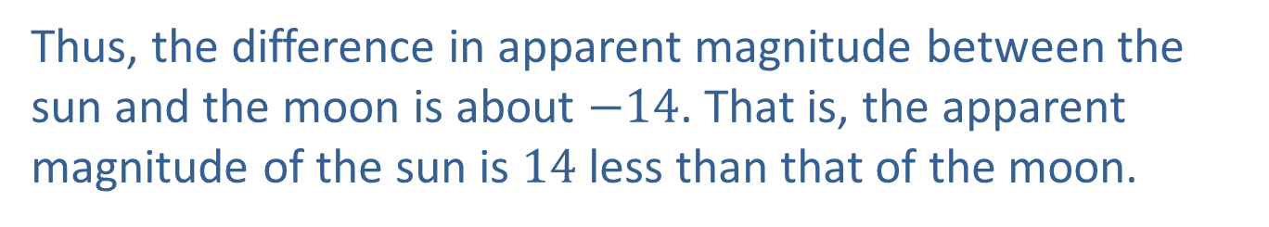
Example 5: Evaluating Logarithms—Slide 3
Solution
To find the difference between the apparent magnitudes of the sun and moon, we substitute the given value of
into the formula.
Thus, the difference in apparent magnitude between the sun and the moon is about $−14$. That is, the apparent magnitude of the sun is 14 less than that of the moon.

Slide 47
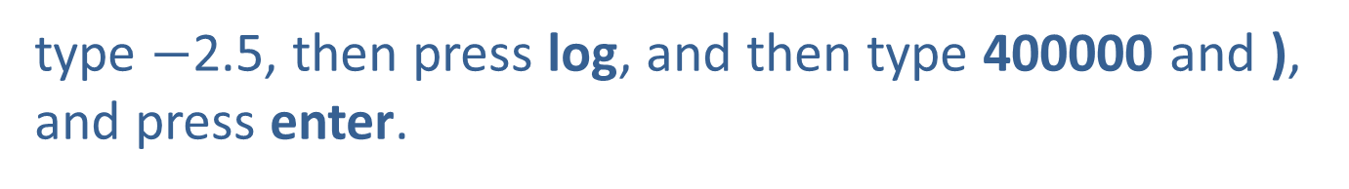
Tech Tip
The log button on a calculator is a logarithm base 10, so to calculate
type $−$2.5, then press log, and then type 400000 and ), and press enter.

Slide 48
Skill Check 3
Find f(23), if
Answer: f(23) ≈ 2.262

Slide 49
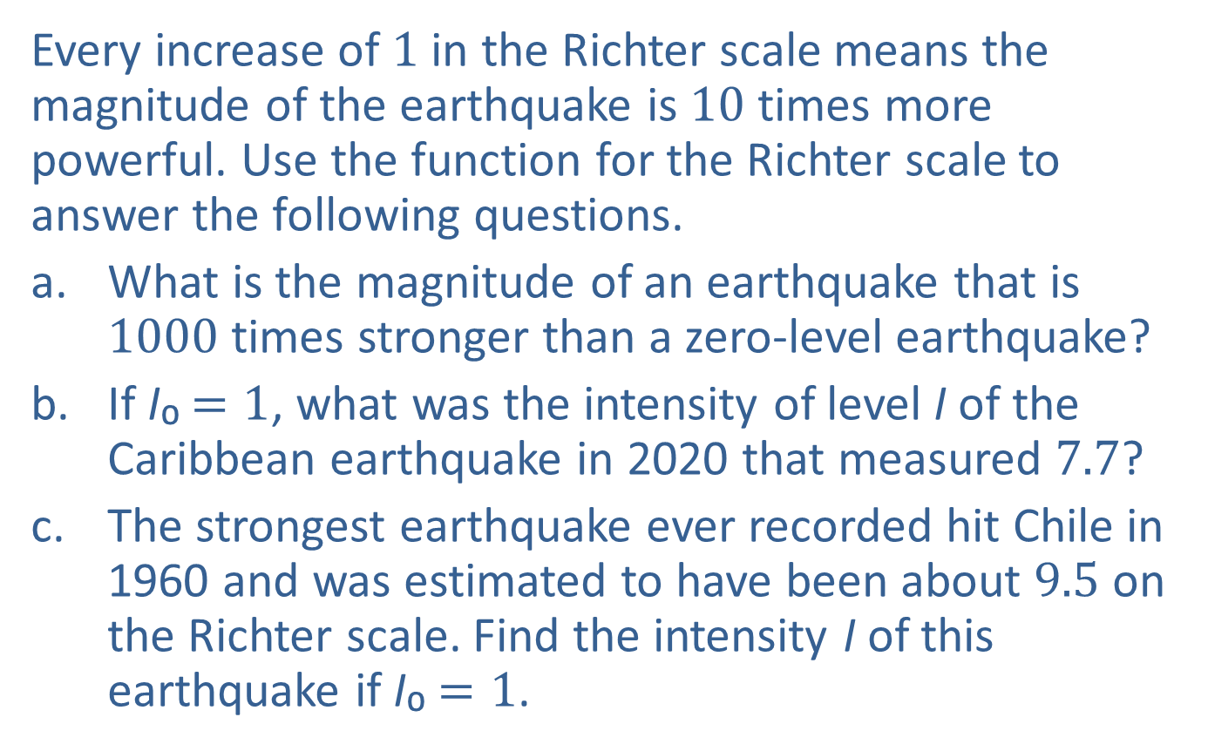
Example 6: Using Logarithmic Functions—Slide 1
Every increase of 1 in the Richter scale means the magnitude of the earthquake is 10 times more powerful. Use the function for the Richter scale to answer the following questions.
a. ​What is the magnitude of an earthquake that is 1000 times stronger than a zero-level earthquake?
b. ​If I₀ $=1$, what was the intensity of level I of the Caribbean earthquake in 2020 that measured 7.7?
c.​ The strongest earthquake ever recorded hit Chile in 1960 and was estimated to have been about 9.5 on the Richter scale. Find the intensity I of this earthquake if I₀ $=1$.

Slide 50
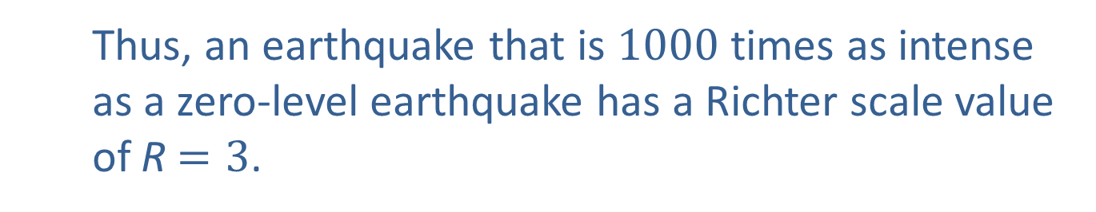
Example 6: Using Logarithmic Functions—Slide 2
Solution
a.​ Since
​
an intensity of 1000 times that of
a zero-level earthquake would mean the following.
​ Thus, an earthquake that is 1000 times as intense
as a zero-level earthquake has a Richter scale value
of R $=3$.

Slide 51

Example 6: Using Logarithmic Functions—Slide 3
b.​ We are told that I₀ $=1$and the Caribbean earthquake in 2020 measured 7.7; that is, R $=7.7$. We can substitute these values into the function and solve to find out the intensity level.
​

Slide 52

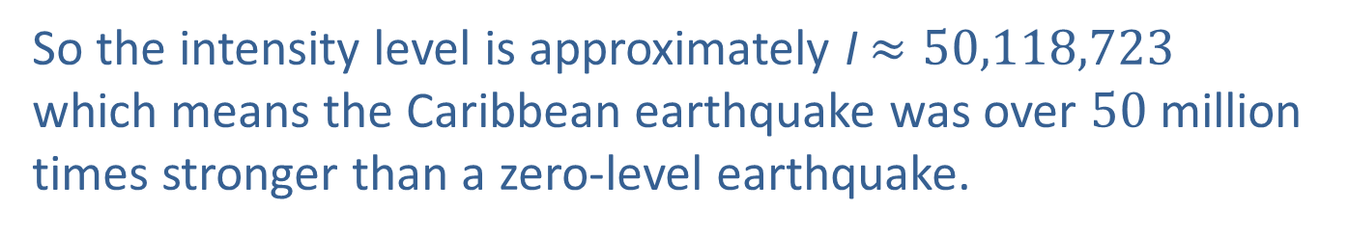
Example 6: Using Logarithmic Functions—Slide 4
​Just as logarithms helped us solve equations involving exponents, exponents can help us solve logarithmic equations. We can use the definition of a logarithm to determine what I is now. Recall that
​
From this, we know that x $=7.7$, a $=$I, and b$=10$. Substituting these into the equation, we have the following.
So the intensity level is approximately I $≈50,118,723$ which means the Caribbean earthquake was over 50 million times stronger than a zero-level earthquake.

Slide 53

Example 6: Using Logarithmic Functions—Slide 5
c.​ We can substitute the values for the scale number, R $=9.5$ and I₀ $=1$, into the function to obtain the following.
5
​
​
Once again, we know that x $=9.5$, a $=I$, and b $=10$.
This means that the Chilean earthquake was over 3.16 billion times stronger than a zero-level earthquake.

Slide 54
Skill Check 4
Determine how much stronger the Chilean earthquake was than the Caribbean earthquake.
Answer: About 63 times stronger

Slide 55
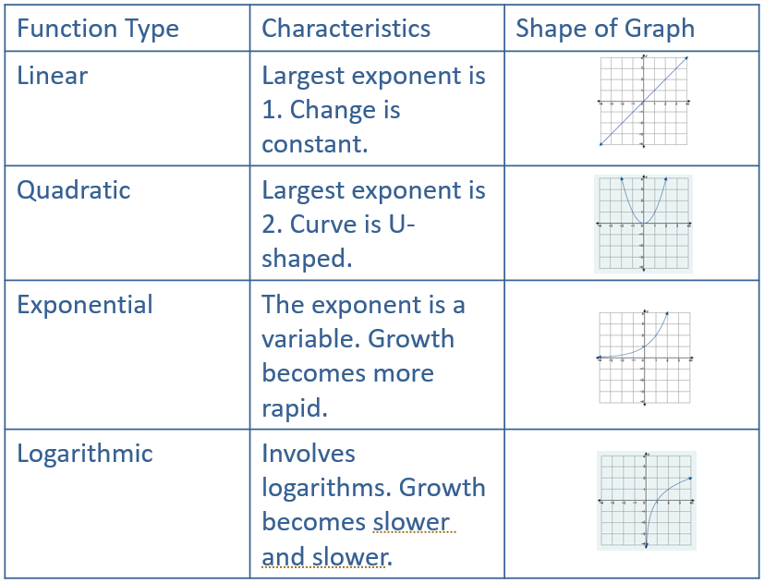
Table 3: Function Characteristics and Graph Shapes

