Slide 1
Chapter 5
Review

Slide 2
Definition: Dependent Variable
The value of the dependent variable changes with respect to the value of the independent variable.

Slide 3
Definition: Independent Variable
The value of an independent variable does not rely on the values of the other variables in an expression or function, and its value determines the values of the other variables.

Slide 4
Definition: Possible Solutions to Linear Equations
One solution —there exists only one number that makes the equation true.
Infinitely many solutions —any number makes the equation true.
No solution —no number exists that makes the equation true.

Slide 5
Definition: Function
A function is a set of ordered pairs in the form (x, y) in which each value of the dependent variable is associated to a unique independent variable.

Slide 6
Definition: Domain
The domain of a function is the set of all input values (independent variable) that result in a real number value for the output values (dependent variable).

Slide 7
Definition: Range
The range of a function is the set of all possible output values (dependent variable) that correspond to the domain values.

Slide 8
Procedure: Steps for Solving Linear Equations in One Variable
Step 1: Clear the equation of fractions and decimals by multiplying both sides of the equation by the least common denominator (LCD).
Step 2: Simplify the expressions on both sides by clearing the equation of parentheses. Repeat Step 1 if fractions or decimals remain; otherwise, move to Step 3.
Step 3: Simplify the expressions on both sides by combining like terms.
Step 4: Isolate the variable on one side of the equation.
Step 5: Make the variable coefficient equal to 1.

Slide 9
Definition: Parallel and Perpendicular Lines—Slide 1
Consider two lines y = m₁x + b₁ and y = m₂x + b₂.
If the two lines have the same slope (that is, m₁ = m₂), then they are parallel lines, which means they never intersect.
If the two lines have slopes that are negative reciprocals of each other (that is,
then they are perpendicular lines,
which means they intersect at right angles.

Slide 10
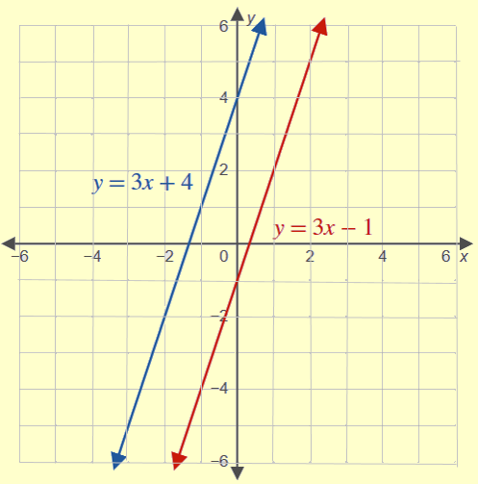
Definition: Parallel and Perpendicular Lines—Slide 2
Figure 21: Parallel Lines

Slide 11
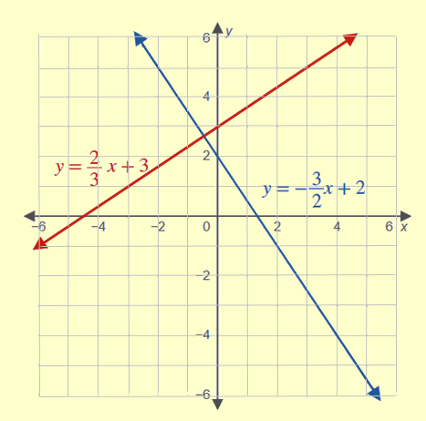
Definition: Parallel and Perpendicular Lines—Slide 3
Figure 22: Perpendicular Lines

Slide 12
Definition: Horizontal and Vertical Lines—Slide 1
The graph of a horizontal line y = b will pass through the point (0, b).
The graph of a horizontal line x = a will pass through the point (a, 0).

Slide 13
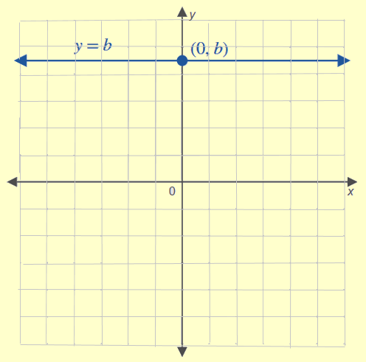
Definition: Horizontal and Vertical Lines—Slide 2
Figure 26: Horizontal Line

Slide 14
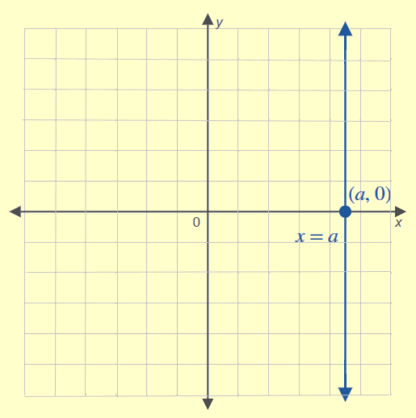
Definition: Horizontal and Vertical Lines—Slide 3
Figure 27: Vertical Line

Slide 15
Definition: Slope Formula
The slope of a line passing through the points
is given by the following.

Slide 16
Definition: Formulas for the Equation of a Line
The point-slope form of the equation for a line, where m is the slope of the line and (x₁, y₁) is a point on the line, is
The slope-intercept form of the equation for a line, where m is the slope and b is the y-intercept, is
y = mx + b.

Slide 17
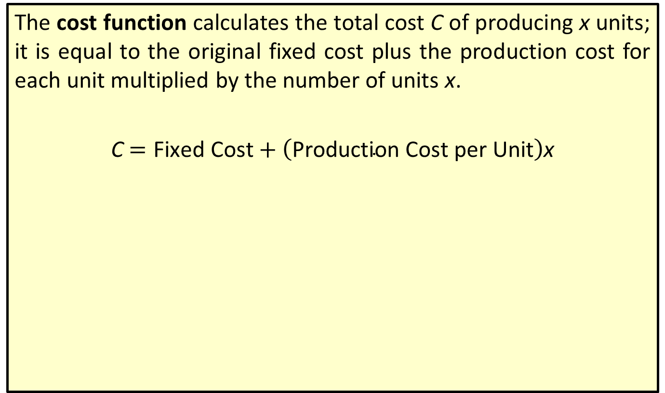

Definition: Cost Function ($C$)
The cost function calculates the total cost C of producing x units; it is equal to the original fixed cost plus the production cost for each unit multiplied by the number of units x.
C $=\text{Fixed} \text{Cost}+\left(\text{Production} \text{Cost} \text{per} \text{Unit}\right)$x

Slide 18

Definition: Revenue Function ($R$)
The revenue function calculates the revenue received R; it is equal to the price per unit multiplied by the number of units sold x.
R = (Price per Unit)x

Slide 19
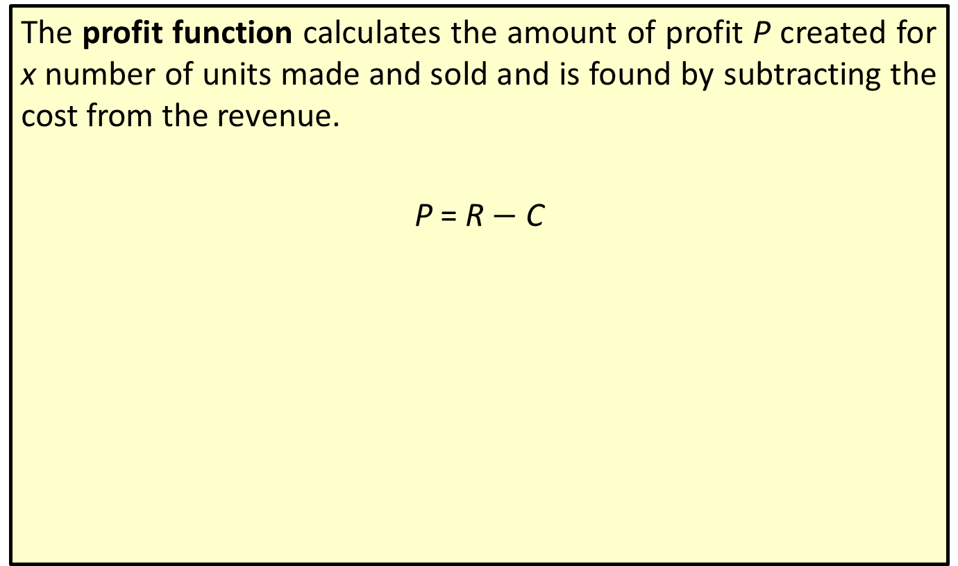

Definition: Profit Function ($P$)
The profit function calculates the amount of profit P created for x number of units made and sold and is found by subtracting the cost from the revenue.
P = R $−$ C

Slide 20
Definition: Break-Even Point
The quantity of units to be produced and sold so that the cost of production equals the revenues for a product is called the break-even point.

Slide 21
Procedure: Solving a System of Linear Equations by Substitution
1. ​Solve one of the equations for one of the variables.
2.​ Substitute the expression found in Step 1 into the other equation and solve for the remaining variable.
3.​ Re-substitute the value found in Step 2 into the original equation from Step 1 to find the corresponding coordinate.

Slide 22
Definition: Inequality Symbol
An inequality symbol is a relation used between two expressions that are not strictly equal.
< less than,
≤ less than or equal to,
> greater than,
≥ greater than or equal to.

Slide 23
Definition: Linear Inequality
A linear inequality in the variable x can be written in one of the following forms
where a, b, and c are numbers and a ≠ 0.

Slide 24
Definition: Boundary Line
A boundary line is a line that separates those points that satisfy an inequality from those that do not. It is a representation of the equation created when the inequality sign is replaced with an equal sign.

Slide 25
Procedure: Steps to Graphing Linear Inequalities
1.​ Graph the boundary line.
​The line will be solid if the inequality is ≥ or ≤,
​The line will dashed if the inequality is > or <.
2.​ Determine which side of the line to shade by using a test point.
3.​ Shade the half-plane that contains the solution set.

Slide 26
Procedure: Steps to Graphing Systems of Linear Inequalities
1.​ Graph the boundary line for each inequality.
​The line will be solid if the inequality is ≥ or ≤,
​The line will be dashed if the inequality is > or <.
2. ​Determine which side of the line to shade for each inequality by using a test point.
3.​ Lightly shade the half-plane that contains the solution set for each individual inequality.
4.​ The solution region for the system of inequalities is the intersection of the shaded half-planes from Step 3.

Slide 27
Definition: Linear Programming
The mathematical process of linear programming is a method to optimize a particular quantity in a mathematical model constrained by linear inequalities.

Slide 28
Definition: Objective Function
An objective function, or optimization function, is a function that expresses the quantity that is to be optimized.

Slide 29
Definition: Constraints
Constraints in linear programming are the linear inequalities that express the limitation of each variable or combination of variables.

Slide 30
Definition: Feasible Region
The feasible region is the set of all possible points that satisfy the constraints of an optimization problem.

Slide 31
Procedure: Steps for Solving an Optimization or Linear Programming Problem
1.​ Define the objective function.
2. ​Define the constraints using linear inequalities.
3. ​Graph the constraint inequalities.
4.​ Identify the vertices of the feasible region; that is, the polygon formed by intersection of the lines.
5. ​Identify any maximum or minimum values of the objective function by finding the values of the objective function at each of the vertices.

Slide 32
Theorem: Fundamental Theorem of Linear Programming
The maximal and minimal values of a linear function over a convex polygonal region are found at the corners of the region.

Slide 33
Definition: Quadratic Equation
A quadratic equation in x is written in standard form as
where a, b, and c are numbers and a ≠ 0.

Slide 34
Definition: Parabola
The graph of a quadradic equation is called a parabola. It is a symmetrical U-shaped curve around a vertical or horizontal line.

Slide 35
Definition: Vertex—Slide 1
The vertex of a parabola is the extreme point representing the quadratic equation’s minimum or maximum value. It occurs at
the point
given that

Slide 36
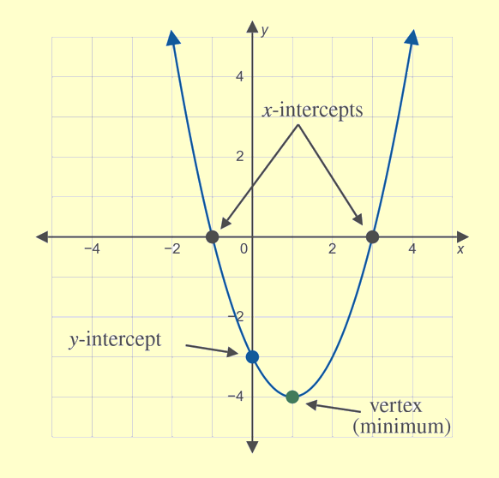
Definition: Vertex—Slide 2
Figure 14: Vertical Line

Slide 37
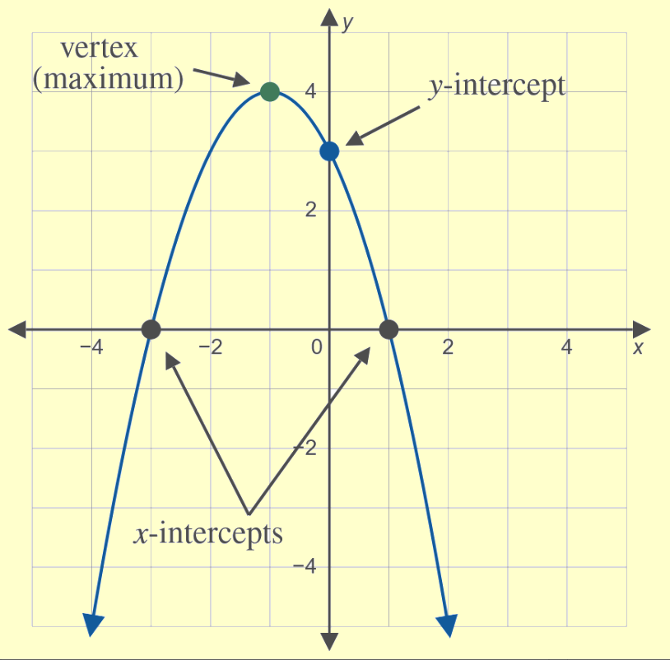
Definition: Vertex—Slide 3
Figure 15

Slide 38
Definition: Quadratic Formula
A quadratic equation written in standard form,
where a is nonzero, can be found using the quadratic formula.

Slide 39
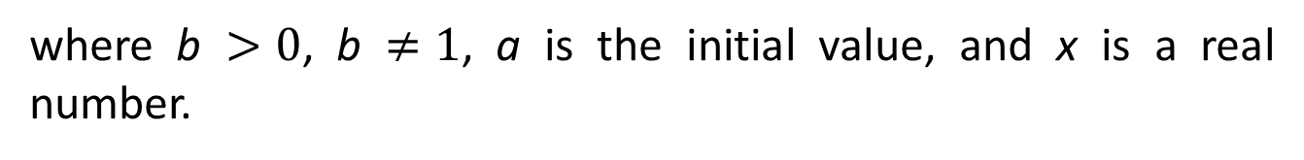
Definition: Exponential Function
An exponential function is a function of the form
where b $>0$, b $≠1$, a is the initial value, and x is a real number.

Slide 40
Definition: Expanded Form of an Exponential Function
The expanded form of an exponential function is a function of the form
where a is the initial value, r is the
rate of change, and x is any real number.

Slide 41
Definition: Frequency
The frequency of a sound is the number of energy wave cycles completed in one second. Frequency is measured in hertz, Hz.

Slide 42
Definition: Pitch
Pitch is the tonal quality of sound that describes how low or high an instrument (or voice) sounds to our ears.

Slide 43
Definition: Half Step
A half step is the distance between one note and the next nearest note on a piano.

Slide 44
Definition: Whole Step
A whole step is defined as the interval between two half steps on a piano.

Slide 45
Definition: Octave
An octave is the interval of notes between 12 half steps on a piano.

Slide 46
Definition: Frequency of Musical Notes—Slide 1
The frequency of a music note in relation to a specific note is modeled by the following function.
Here, F₀ is the reference frequency and x is the number of half steps up from F₀.

Slide 47
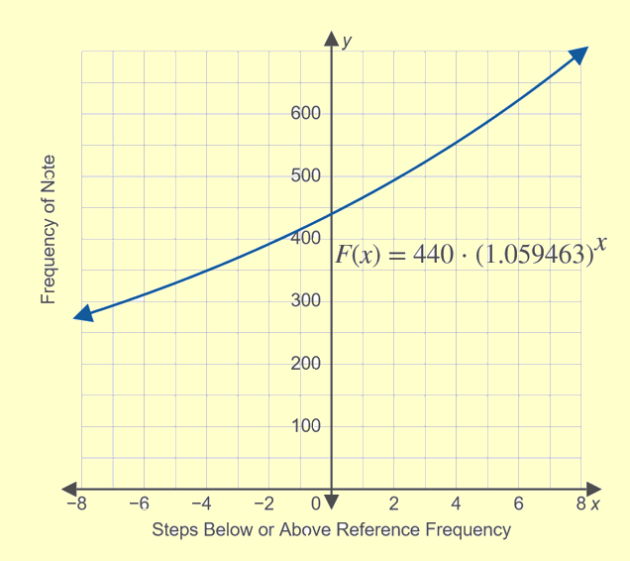
Definition: Frequency of Musical Notes—Slide 2
Figure 5: Frequency of Notes in Reference to A above Middle C

Slide 48
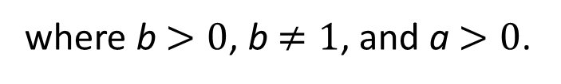
Definition: Logarithm
then the logarithm with base b of a is x. Symbolically,
If
we can express this exponential as an equivalent logarithm
where b $>0$, b $≠1$, and a $>0$.

