Slide 1
Section 6.2
Saving and Investing

Slide 2
Fun Fact 1
Born and raised near Atlanta, Georgia, Bill Copeland (1946–2010) was an American poet, writer and historian whose works focused on the Holocaust, World War II, and Native Americans.

Slide 3
Helpful Hint 1
The terms present value, used here, and principal, used earlier, both refer to an initial amount of money and are often used interchangeably.

Slide 4
Definition: Present Value with Compound Interest
The amount of principal needed now in order to reach a future value amount is called the present value (PV). The present value with compound interest is calculated with the following formula.
Here A is the future value, r is the APR written as a decimal, n is the number of compound intervals per year, and t is time in years.

Slide 5
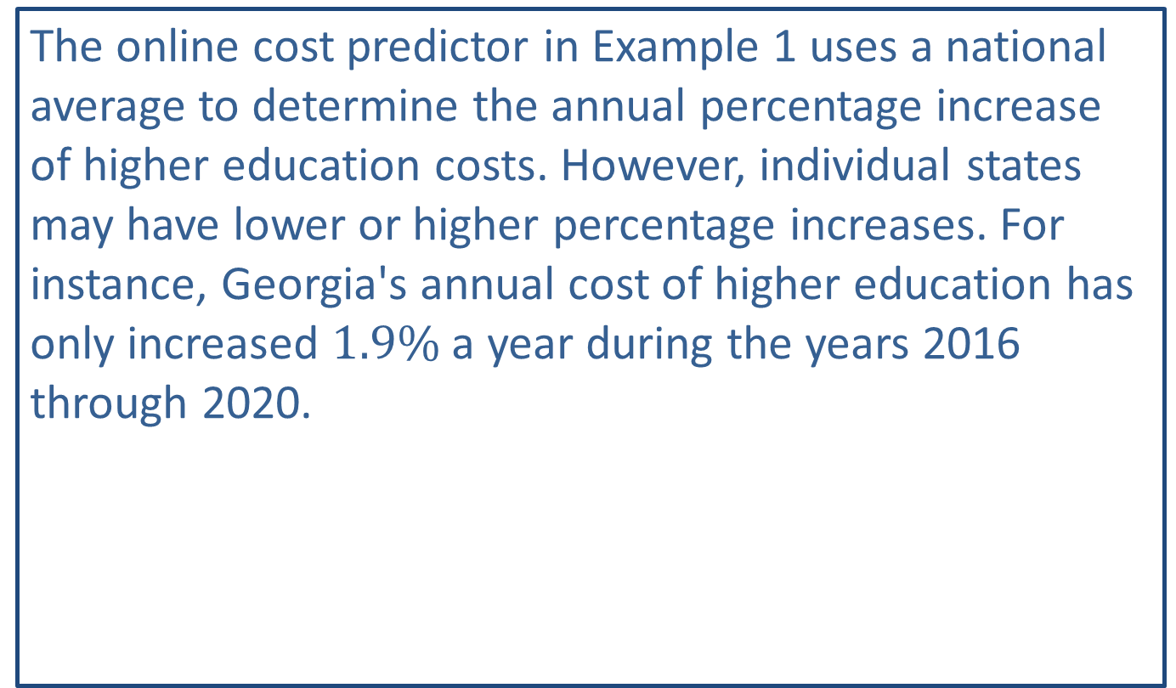
Fun Fact 2
The online cost predictor in Example 1 uses a national average to determine the annual percentage increase of higher education costs. However, individual states may have lower or higher percentage increases. For instance, Georgia's annual cost of higher education has only increased $1.9\%$ a year during the years 2016 through 2020.

Slide 6
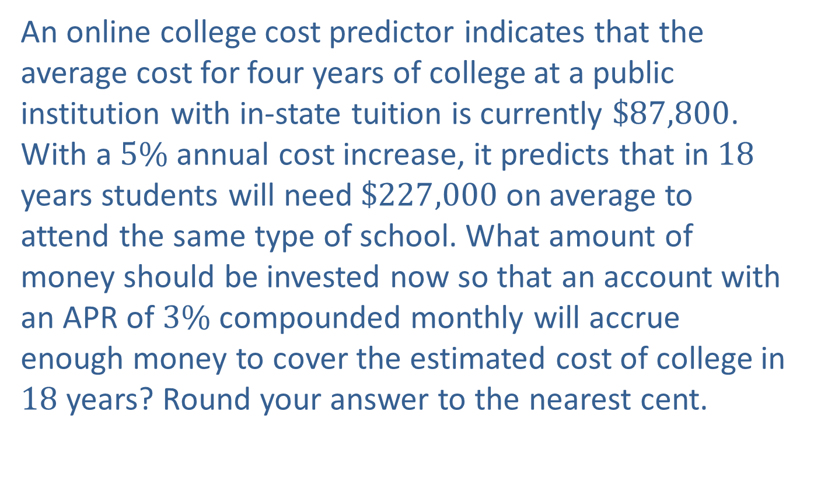
Example 1: Calculating Present Value—Slide 1
An online college cost predictor indicates that the average cost for four years of college at a public institution with in-state tuition is currently $\$87,800$. With a $5\%$ annual cost increase, it predicts that in 18 years students will need $\$227,000$ on average to attend the same type of school. What amount of money should be invested now so that an account with an APR of $3\%$ compounded monthly will accrue enough money to cover the estimated cost of college in 18 years? Round your answer to the nearest cent.

Slide 7
Example 1: Calculating Present Value—Slide 2
Solution
Begin by identifying the information needed to find present value: future value, interest rate, number of compounding periods, and the number of years to invest. Notice that there are two percentages given. We will need to use the APR in the formula, not the annual cost increase.

Slide 8
Example 1: Calculating Present Value—Slide 3
By Hand
From the information given we know the following quantities.
A = $227,000, r = 3% = 0.03, n = 12, t = 18
Substituting these values into the present value formula, we have the following equation.

Slide 9
Example 1: Calculating Present Value—Slide 4
TI-83/84 Plus
As in the previous lesson, we can press apps , then select Finance... and use the TVM Solver.
​In this case, the interest is compounded monthly for 18 years, so N = 12 ⋅ 18 = 216.
​For I%, enter 3. Remember that when using the TVM Solver, we use the percentage form of the rate, not the decimal form.
​The present value is what we need to solve for, so we will come back to the PV entry after filling out the other values.

Slide 10
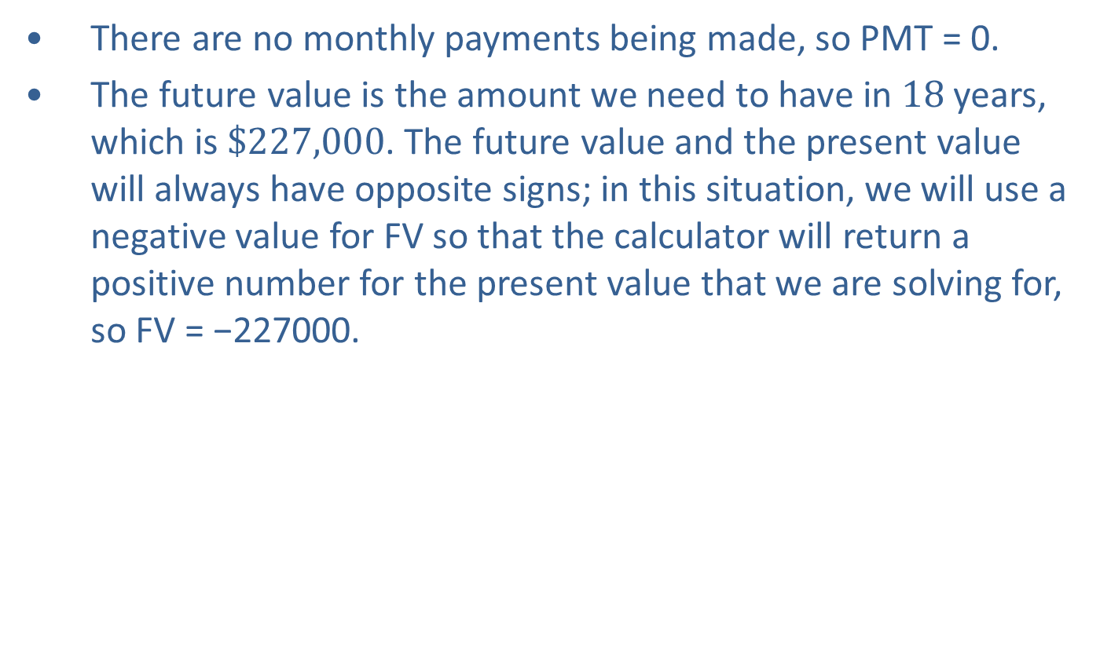
Example 1: Calculating Present Value—Slide 5
​There are no monthly payments being made, so PMT = 0.
​The future value is the amount we need to have in 18 years, which is $\$227,000$. The future value and the present value will always have opposite signs; in this situation, we will use a negative value for FV so that the calculator will return a positive number for the present value that we are solving for, so FV = −227000.

Slide 11
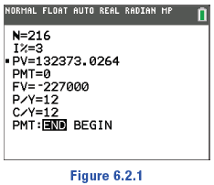
Example 1: Calculating Present Value—Slide 6
​Because the interest is being compounded monthly, P/Y = C/Y = 12
We’ll assume that payments are made at the end of each period, so be sure that END is highlighted in the final row.
Once these values are filled out, return your cursor to the PV entry and press clear . To solve for this value, press alpha enter . The calculator returns 132373.0264.
Figure 1

Slide 12
Example 1: Calculating Present Value—Slide 7
Microsoft Excel
Excel has a built-in financial function PV(rate, nper, pmt, [fv], [type]) that can be used to calculate the present value needed to reach a certain value in the future. The specific arguments for this function are similar to the arguments for the future value function that we used in the previous lesson:
rate is the interest rate per period. This is the interest rate divided by the number of compounding periods per year.
nper is the total number of compounding periods. This is the number of periods per year multiplied by the length of the loan in years.

Slide 13
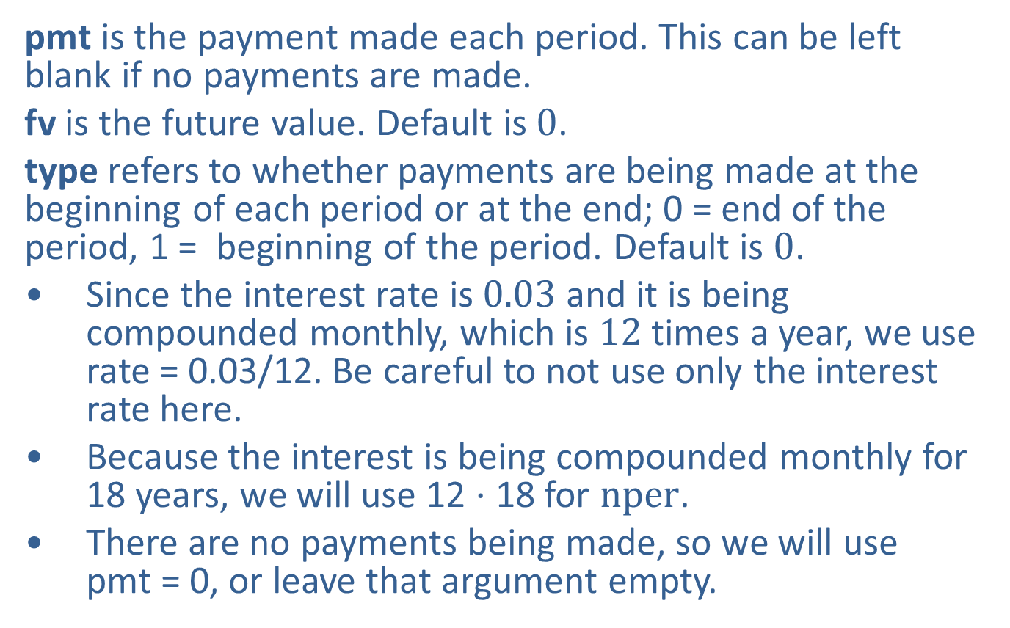
Example 1: Calculating Present Value—Slide 8
pmt is the payment made each period. This can be left blank if no payments are made.
fv is the future value. Default is 0.
type refers to whether payments are being made at the beginning of each period or at the end; 0 = end of the period, 1 = beginning of the period. Default is 0.
​Since the interest rate is 0.03 and it is being compounded monthly, which is 12 times a year, we use rate = 0.03/12. Be careful to not use only the interest rate here.
​Because the interest is being compounded monthly for 18 years, we will use 12 ⋅ 18 for $nper$.
There are no payments being made, so we will use pmt = 0, or leave that argument empty.

Slide 14
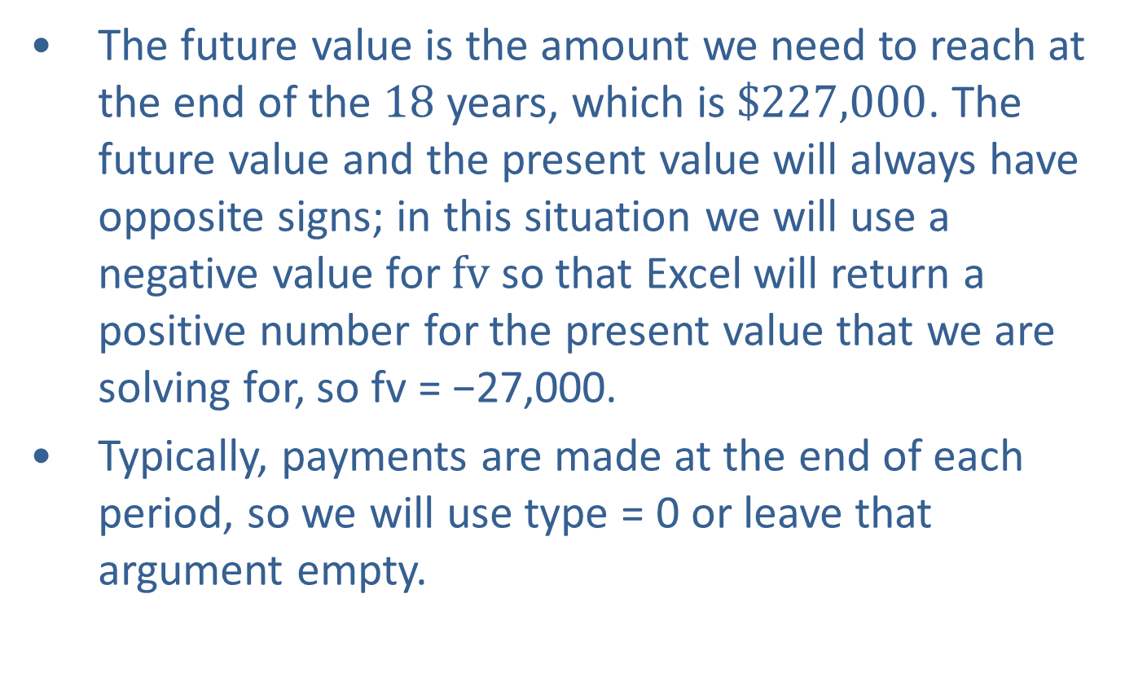
Example 1: Calculating Present Value—Slide 9
​​The future value is the amount we need to reach at the end of the 18 years, which is $\$227,000$. The future value and the present value will always have opposite signs; in this situation we will use a negative value for $fv$ so that Excel will return a positive number for the present value that we are solving for, so fv = −27,000.
​Typically, payments are made at the end of each period, so we will use type = 0 or leave that argument empty.

Slide 15
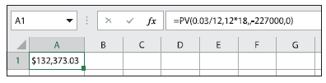

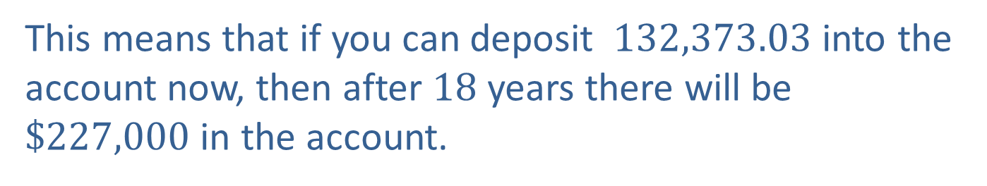
Example 1: Calculating Present Value—Slide 10
In an empty cell, type "=PV(0.03/12,12*18,,-227000,0)", and press Enter. The present value is given as $\$132,373.03$.
Figure 2
This means that if you can deposit $132,373.03$ into the account now, then after 18 years there will be $\$227,000$ in the account.

Slide 16

Skill Check 1
How much should you deposit now in an account with an APR of $7\%$ compounded monthly if you wish for the account to have a balance of $\$200,000$ in 25 years?
Answer: $\$$34,931.95

Slide 17
Definition: Annuity
An annuity is a sequence of regular payments made into an account, or taken out of an account, over time.

Slide 18
Definition: Annuity Payment Amount
The annuity payment amount (PMT), or regular payment amount, needed to be deposited at the end of each compounding period in order to reach a future goal with an annuity savings account is calculated with the following formula.
Here, FV is the future value desired, r is the APR written as a decimal, n is the number of compounding intervals per year, and t is time in years.

Slide 19
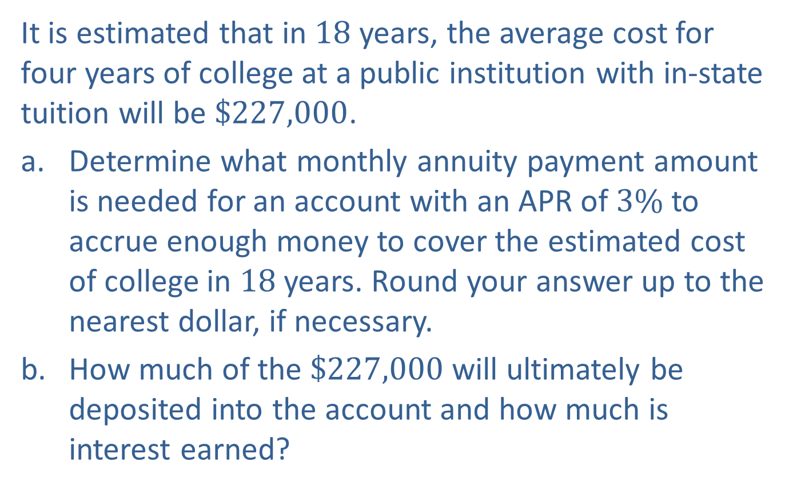
Example 2: Determining Annuity Payments in Order to Meet a Goal—Slide 1
It is estimated that in 18 years, the average cost for four years of college at a public institution with in-state tuition will be $\$227,000$.
​Determine what monthly annuity payment amount is needed for an account with an APR of $3\%$ to accrue enough money to cover the estimated cost of college in 18 years. Round your answer up to the nearest dollar, if necessary.
​How much of the $\$227,000$ will ultimately be deposited into the account and how much is interest earned?

Slide 20
Example 2: Determining Annuity Payments in Order to Meet a Goal—Slide 2
Solution
a. ​The formula to determine the annuity payment amount requires knowing not only the goal amount and date, but also the annual percentage rate along with the number of compounding intervals per year.
​By Hand
We are told that FV = $227,000, r = 0.03, n = 12, and t = 18. Substituting these values into the annuity payment formula, we have the following equation.

Slide 21
Example 2: Determining Annuity Payments in Order to Meet a Goal—Slide 3
TI-83/84 Plus
We can again use the TVM Solver, but this time we'll be solving for the PMT. The account in this example has the same terms as the account in Example 1, so many of the values will be the same. Instead of trying to find the necessary present value, however, we are starting with a present value of 0 and finding the monthly payment amount needed to meet the goal.
​Again, the interest is compounded monthly for 18 years, so N = 12 ⋅ 18 = 216.
​The interest rate is still 3%, so I% = 3.
​In this scenario, we are not starting with any money in the account, so PV = 0.
​The monthly payment amount is what we need to solve for, so we will come back to the PMT entry after filling out the other values.

Slide 22
Example 2: Determining Annuity Payments in Order to Meet a Goal—Slide 4
​The future value is the amount we need to have in 18 years, which is again $227,000. Since the future value and the PMT amount will always have opposite signs, we will use a negative value for FV so that the calculator will return a positive value for the regular payment amount. This means FV = −227000.
​Because the interest is being compounded monthly, P/Y = C/Y = 12.
​We'll assume that payments are made at the end of each period, so be sure that END is highlighted in the final row.

Slide 23
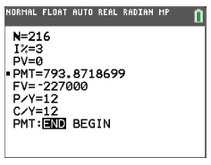
Example 2: Determining Annuity Payments in Order to Meet a Goal—Slide 5
Once these values have been filled out, return your cursor to the PMT entry and press clear. To solve for this value, press alpha enter. The calculator returns 793.8718699.
Figure 3

Slide 24
Example 2: Determining Annuity Payments in Order to Meet a Goal—Slide 6
​Microsoft Excel
Excel has a built-in financial function PMT(rate, nper, pv, [fv], [type]) that can be used to calculate the amount that each monthly payment should be in order to reach a future goal. The specific arguments for this function are similar to the arguments for the future value and present value functions.
rate is the interest rate per period. This is the interest rate divided by the number of compounding periods per year.
nper is the total number of compounding periods. This is the number of periods per year multiplied by the length of the loan in years.
pv is the present value, or principal amount. Default is 0.
fv is the future value. Default is 0.
type refers to whether payments are being made at the beginning of each period or at the end; 0 = end of the period, 1 = beginning of the period. Default is 0.

Slide 25
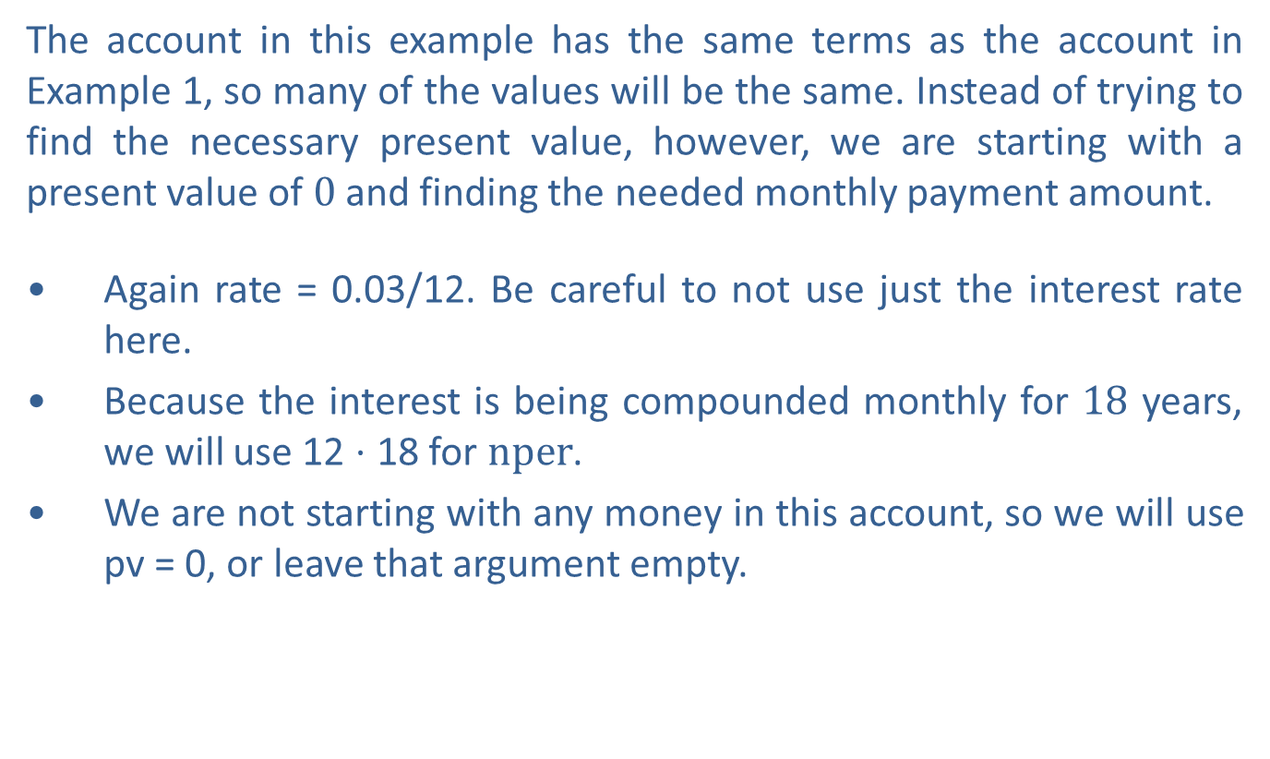
Example 2: Determining Annuity Payments in Order to Meet a Goal—Slide 7
The account in this example has the same terms as the account in Example 1, so many of the values will be the same. Instead of trying to find the necessary present value, however, we are starting with a present value of 0 and finding the needed monthly payment amount.
​Again rate = 0.03/12. Be careful to not use just the interest rate here.
​Because the interest is being compounded monthly for 18 years, we will use 12 ⋅ 18 for $nper$.
​We are not starting with any money in this account, so we will use pv = 0, or leave that argument empty.

Slide 26
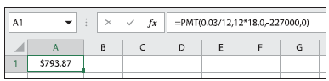
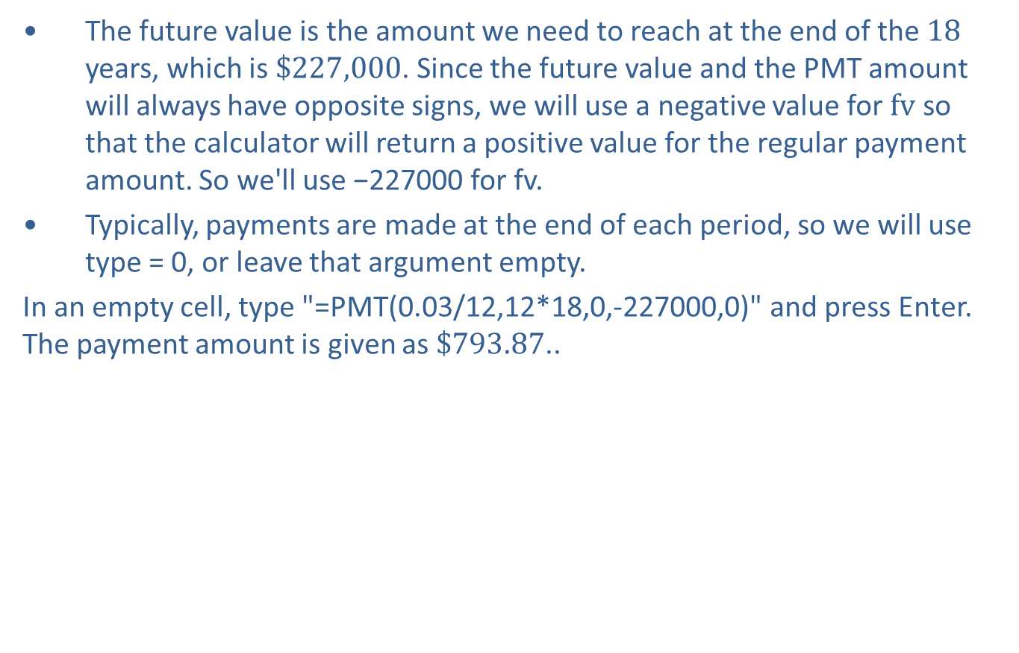
Example 2: Determining Annuity Payments in Order to Meet a Goal—Slide 8
​The future value is the amount we need to reach at the end of the 18 years, which is $\$227,000$. Since the future value and the PMT amount will always have opposite signs, we will use a negative value for $fv$ so that the calculator will return a positive value for the regular payment amount. So we'll use −227000 for fv.
​Typically, payments are made at the end of each period, so we will use type = 0, or leave that argument empty.
In an empty cell, type "=PMT(0.03/12,12*18,0,-227000,0)" and press Enter. The payment amount is given as $\$793.87$..
​
Figure 4
Therefore, a monthly deposit of $794 over the next 18 years is needed in order to meet the goal of saving $227,000.

Slide 27

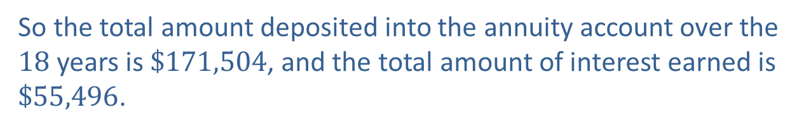
Example 2: Determining Annuity Payments in Order to Meet a Goal—Slide 9
b. We know that 18 years of monthly payments of $\$794$ are required to meet the goal. We can calculate the overall contribution that is deposited by multiplying the monthly payment amount by the number of payments a year and then by the number of years.
The interest earned is then the difference between the goal and the contributed amount. Subtracting, we have the following equation.
So the total amount deposited into the annuity account over the 18 years is $\$171,504$, and the total amount of interest earned is $\$55,496$.

Slide 28

Definition: Future Value of an Annuity
The future value ($FV$) of an annuity account is calculated with the following formula.
Here, PMT is the payment amount deposited at the end of each compounding interval, r is the APR written as a decimal, n is the number of compounding intervals per year, and t is time in years.

Slide 29
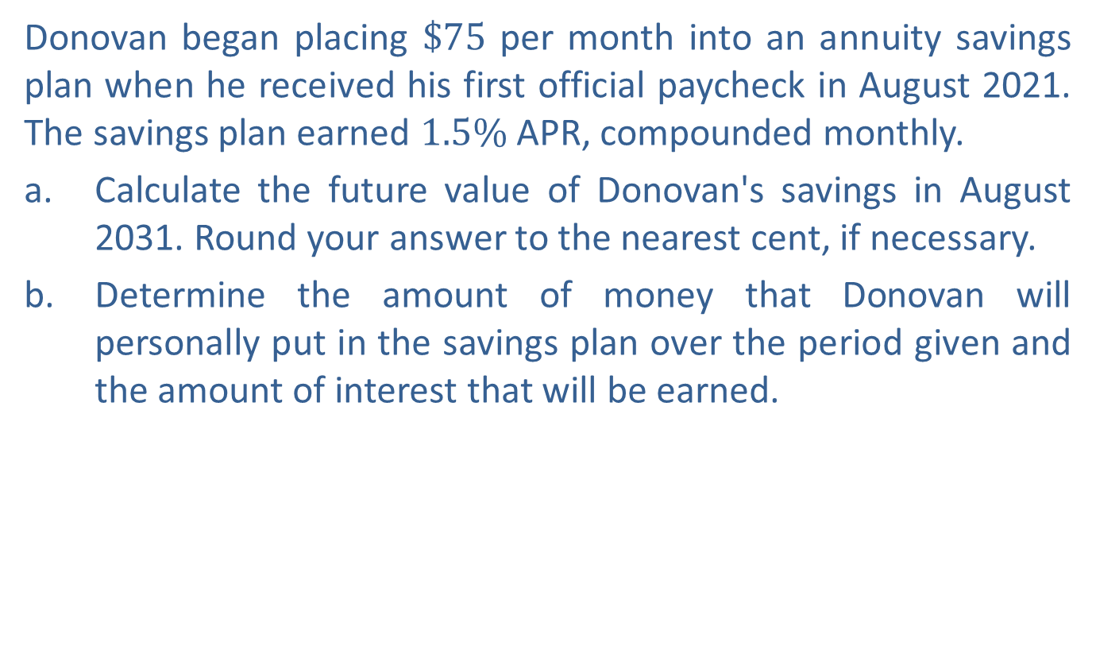
Example 3: Calculating Future Value of an Annuity—Slide 1
Donovan began placing $\$75$ per month into an annuity savings plan when he received his first official paycheck in August 2021. The savings plan earned $1.5\%$ APR, compounded monthly.
a. Calculate the future value of Donovan's savings in August 2031. Round your answer to the nearest cent, if necessary.
b. ​Determine the amount of money that Donovan will personally put in the savings plan over the period given and the amount of interest that will be earned.

Slide 30
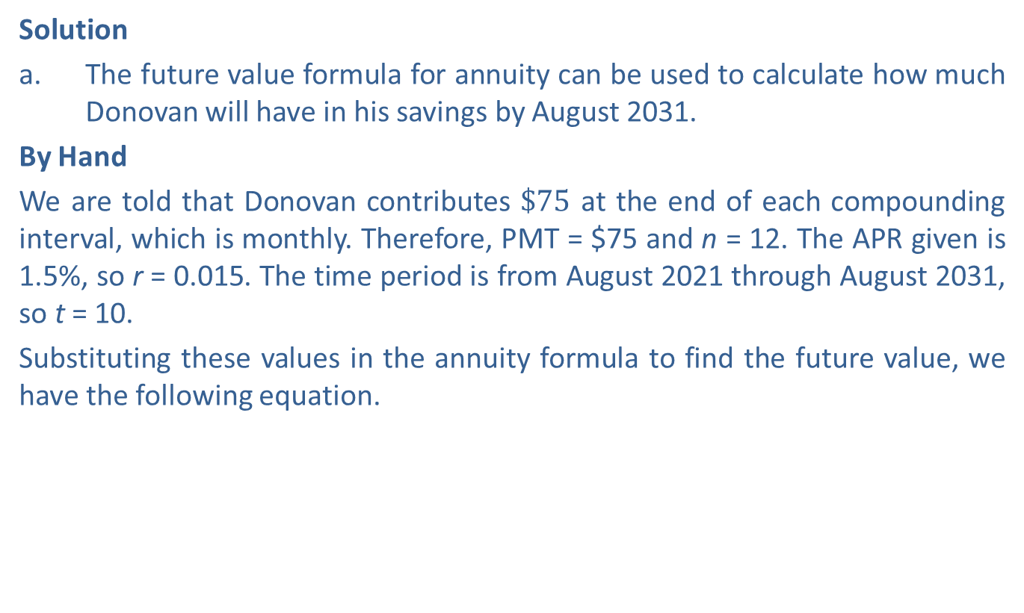
Example 3: Calculating Future Value of an Annuity—Slide 2
Solution
a. The future value formula for annuity can be used to calculate how much Donovan will have in his savings by August 2031.
​By Hand
We are told that Donovan contributes $\$75$ at the end of each compounding interval, which is monthly. Therefore, PMT = $75 and n = 12. The APR given is 1.5%, so r = 0.015. The time period is from August 2021 through August 2031, so t = 10.
Substituting these values in the annuity formula to find the future value, we have the following equation.

Slide 31
Example 3: Calculating Future Value of an Annuity—Slide 3
TI-83/84 Plus
We can again use the TVM Solver to solve for the future value, except this time PMT will not be 0.
​The interest is compounded monthly for 10 years, so N = 12 ⋅ 10 = 120.
​The interest rate is 1.5%, so I% = 1.5.

Slide 32
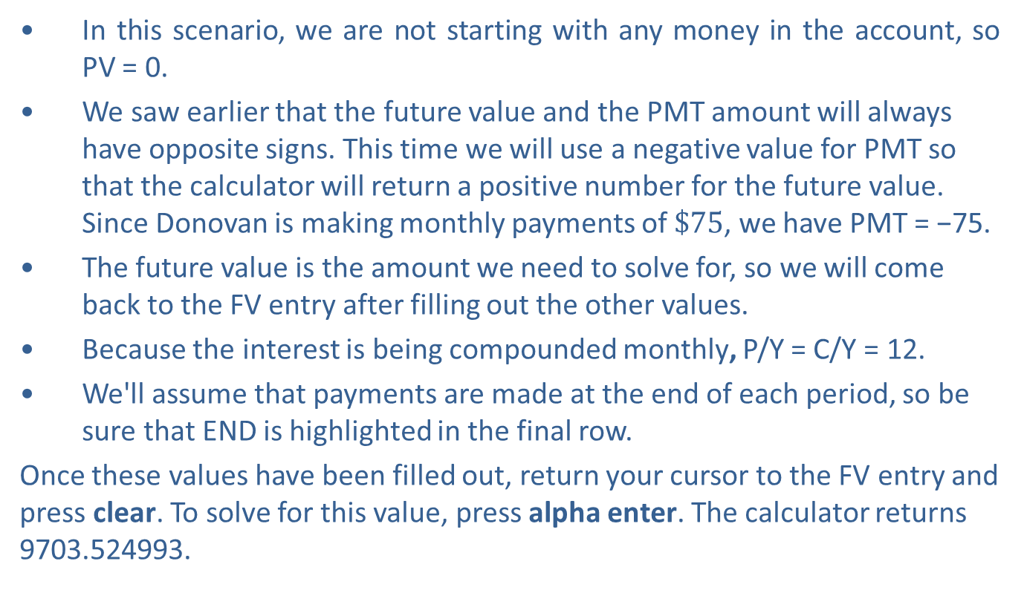
Example 3: Calculating Future Value of an Annuity—Slide 4
​In this scenario, we are not starting with any money in the account, so PV = 0.
​We saw earlier that the future value and the PMT amount will always have opposite signs. This time we will use a negative value for PMT so that the calculator will return a positive number for the future value. Since Donovan is making monthly payments of $\$75$, we have PMT = −75.
The future value is the amount we need to solve for, so we will come back to the FV entry after filling out the other values.
​Because the interest is being compounded monthly, P/Y = C/Y = 12.
​We'll assume that payments are made at the end of each period, so be sure that END is highlighted in the final row.
Once these values have been filled out, return your cursor to the FV entry and press clear. To solve for this value, press alpha enter. The calculator returns 9703.524993.

Slide 33
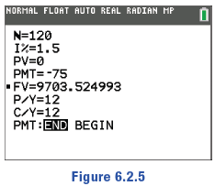
Example 3: Calculating Future Value of an Annuity—Slide 5
Figure 5
Microsoft Excel
We can use the built-in financial function FV(rate, nper, pmt, [pv], [type]), which we used in the previous section.
​Since the interest rate is 0.015 and it is being compounded monthly, we use rate = 0.015/12.
​Because the interest is being compounded monthly for 10 years, we will use 12 ⋅ 10 for nper.

Slide 34
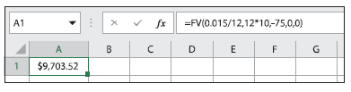
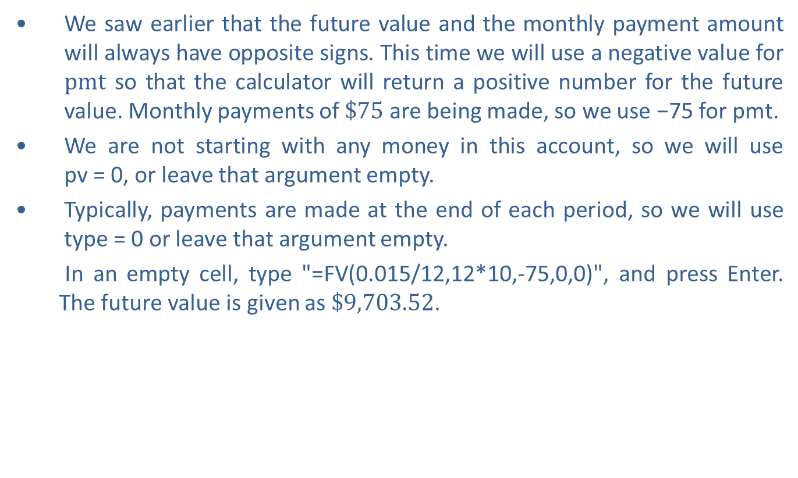
Example 3: Calculating Future Value of an Annuity—Slide 6
​We saw earlier that the future value and the monthly payment amount will always have opposite signs. This time we will use a negative value for $pmt$ so that the calculator will return a positive number for the future value. Monthly payments of $\$75$ are being made, so we use −75 for pmt.
​We are not starting with any money in this account, so we will use pv = 0, or leave that argument empty.
​Typically, payments are made at the end of each period, so we will use type = 0 or leave that argument empty.
In an empty cell, type "=FV(0.015/12,12*10,-75,0,0)", and press Enter. The future value is given as $\$9,703.52$.
Figure 6

Slide 35

Example 3: Calculating Future Value of an Annuity—Slide 7
Therefore, after 10 years, Donovan's savings account will contain approximately $\$9703.52$.
b. ​To find the amount of money that Donovan will personally add to the savings plan, we need to multiply the monthly payment amount by the number of payments each year and then by the number of years he plans to continue his payments. This gives us the following calculation.
So over 10 years Donovan will contribute $9000 to his savings plan. Since we know that the account will contain $9703.52, the interest earned in the account is $9703.52 − $9000 = $703.52.

Slide 36

Skill Check 2
Use the annuity formula to calculate the future value after six months of monthly $\$50$ payments for an annuity savings plan that compounds monthly with an APR of $0.8\%$.
Answer : $300.50

Slide 37
Helpful Hint 2
Similar to 401(k), educators and nonprofit workers are offered 403(b) and government employees are offered 457(b) plans.

Slide 38
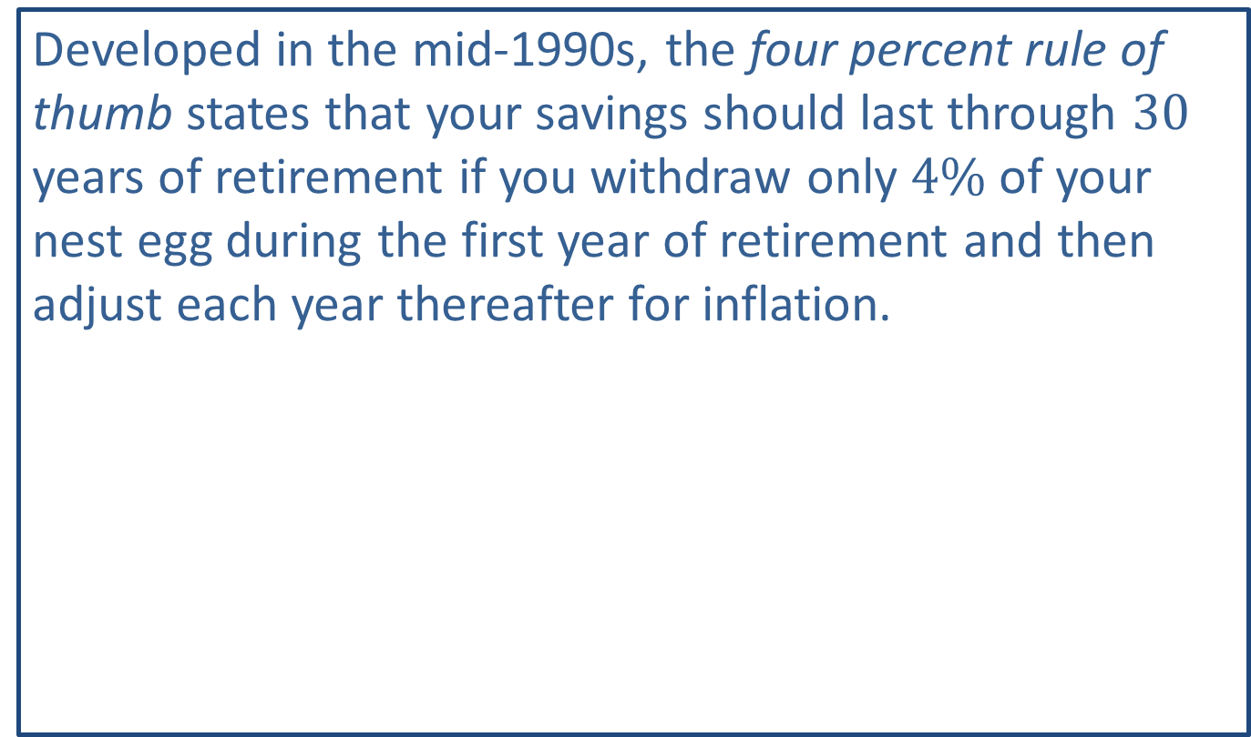
Fun Fact 3
Developed in the mid-1990s, the four percent rule of thumb states that your savings should last through 30 years of retirement if you withdraw only $4\%$ of your nest egg during the first year of retirement and then adjust each year thereafter for inflation.

Slide 39
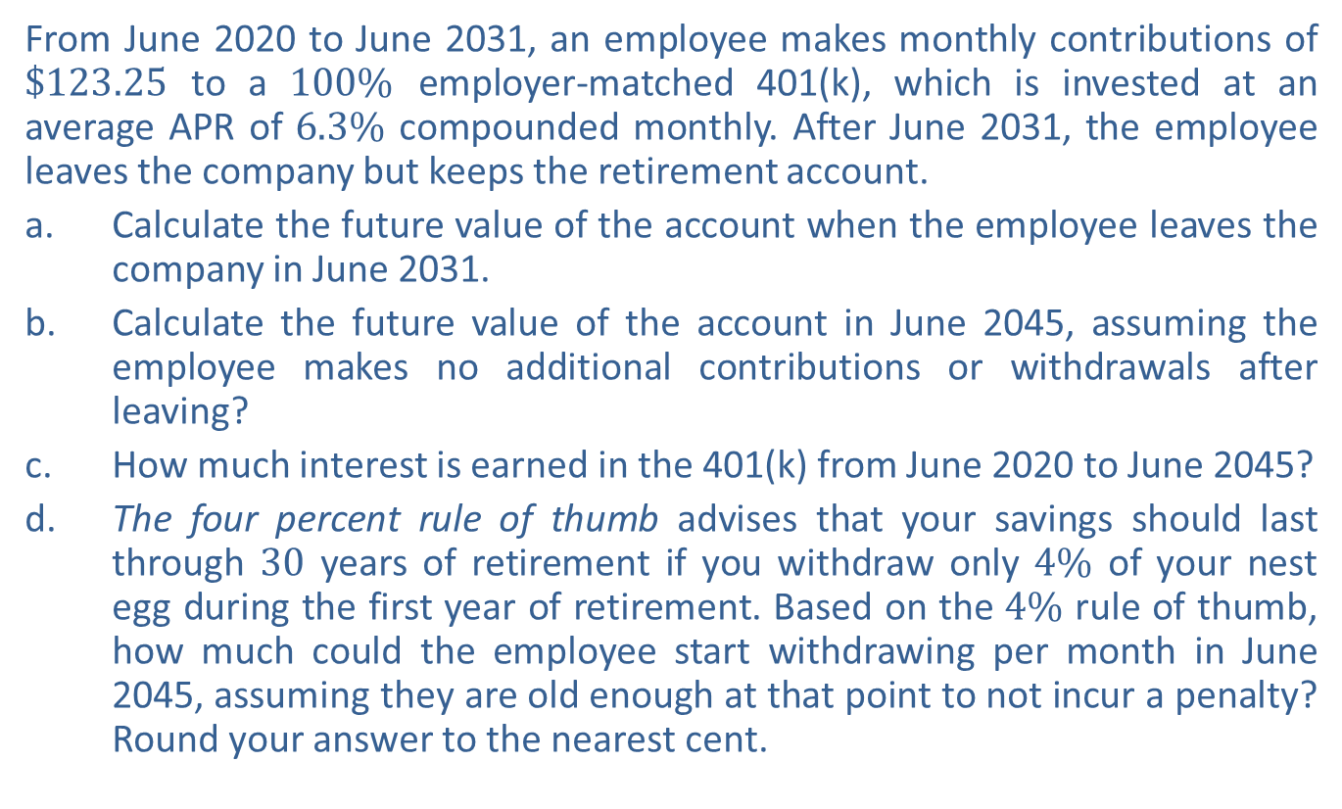
Example 4: Calculating Future Value of a Retirement Account—Slide 1
From June 2020 to June 2031, an employee makes monthly contributions of $\$123.25$ to a $100\%$ employer-matched 401(k), which is invested at an average APR of $6.3\%$ compounded monthly. After June 2031, the employee leaves the company but keeps the retirement account.
a. ​Calculate the future value of the account when the employee leaves the company in June 2031.
b. ​Calculate the future value of the account in June 2045, assuming the employee makes no additional contributions or withdrawals after leaving?
c. How much interest is earned in the 401(k) from June 2020 to June 2045?
d. The four percent rule of thumb advises that your savings should last through 30 years of retirement if you withdraw only $4\%$ of your nest egg during the first year of retirement. Based on the $4\%$ rule of thumb, how much could the employee start withdrawing per month in June 2045, assuming they are old enough at that point to not incur a penalty? Round your answer to the nearest cent.

Slide 40
Example 4: Calculating Future Value of a Retirement Account—Slide 2
Solution
a. ​The future value formula for an annuity can be used to calculate how much the employee will have in the 401(k) by June 2031.
By Hand
We are told that the employee contributes $123.25 each month. But since this amount is matched by the employer, the actual PMT is $123.25 ⋅ 2 = $246.50. The number of compounding intervals per year is 12. The APR given is 6.3%, so r = 0.063. The time period is from June 2020 through June 2031, so t = 11 years.
Substituting these values in the annuity formula to find the future value, we have the following equation.

Slide 41
Example 4: Calculating Future Value of a Retirement Account—Slide 3

Slide 42
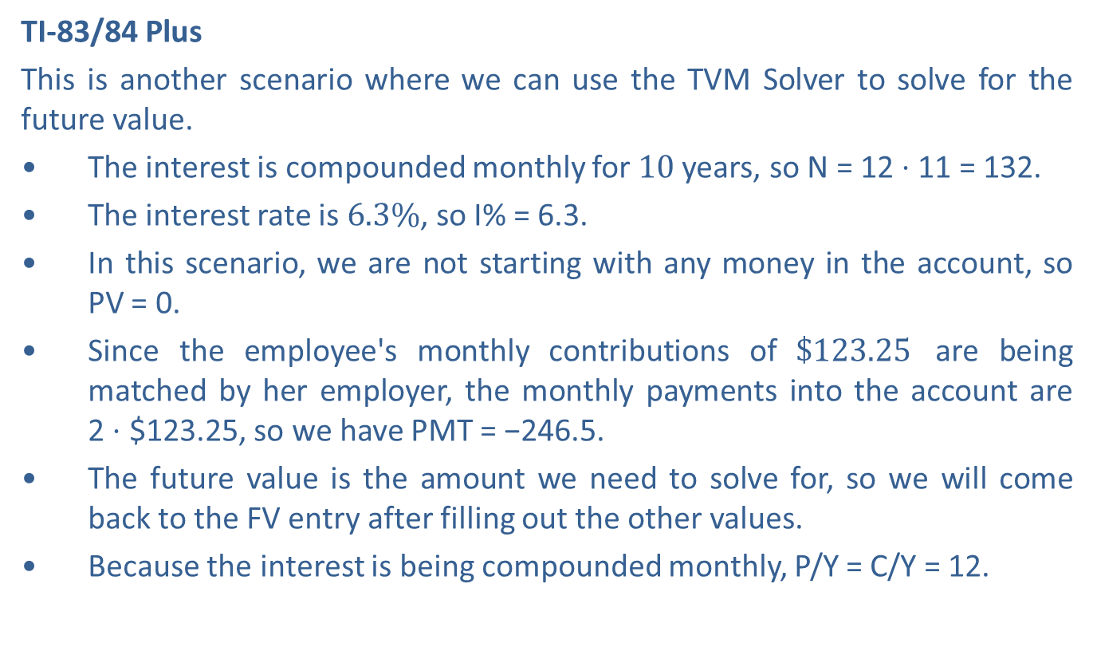
Example 4: Calculating Future Value of a Retirement Account—Slide 4
TI-83/84 Plus
This is another scenario where we can use the TVM Solver to solve for the future value.
​The interest is compounded monthly for 10 years, so N = 12 ⋅ 11 = 132.
​The interest rate is $6.3\%$, so I% = 6.3.
​In this scenario, we are not starting with any money in the account, so PV = 0.
​Since the employee's monthly contributions of $\$123.25$ are being matched by her employer, the monthly payments into the account are 2 ⋅ $123.25, so we have PMT = −246.5.
​The future value is the amount we need to solve for, so we will come back to the FV entry after filling out the other values.
​Because the interest is being compounded monthly, P/Y = C/Y = 12.

Slide 43
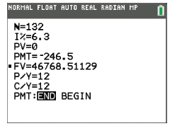
Example 4: Calculating Future Value of a Retirement Account—Slide 5
​We'll assume that payments are made at the end of each period, so be sure that END is highlighted in the final row.
Once these values have been filled out, return your cursor to the FV entry and press clear . Press alpha enter to solve for this value. The
calculator returns 46768.51129.
​
Figure 7

Slide 44
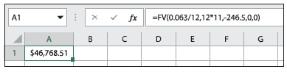

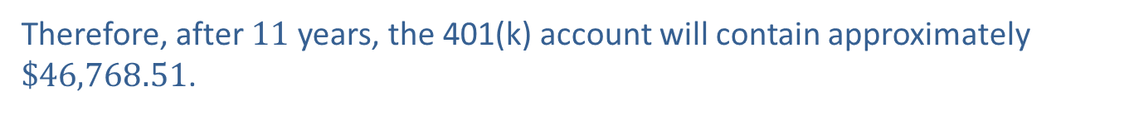
Example 4: Calculating Future Value of a Retirement Account—Slide 6
​Microsoft Excel
We can again use the built-in financial function FV(rate, nper, pmt, [pv], [type]) with rate = 0.063/12, nper = 12 ⋅ 1, and pmt = −246.5
In an empty cell, type "=FV(0.063/12,12*11,-246.50,0,0)" and press Enter. The future value is given as $\$46,768.51$.
Figure 8
Therefore, after 11 years, the 401(k) account will contain approximately $\$46,768.51$.

Slide 45
Example 4: Calculating Future Value of a Retirement Account—Slide 7
b. From 2031 to 2045, the account will still accrue interest, but monthly payments will no longer be added to the account. So now we need to use the future value formula for compound interest with a principal of $46,768.51. There are 14 years between 2031 and 2045 where interest continues being compounded monthly at a rate of 6.3%.
​By Hand

Slide 46
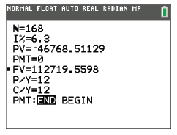
Example 4: Calculating Future Value of a Retirement Account—Slide 8
TI-83/84 Plus
We'll use the TVM Solver again to solve for the future value over the next time period. The terms of the 401(k) have not changed, so I% and P/Y = C/Y are unchanged. However, since this time period has the interest compounding monthly for 14 years, we will change N to 12 ⋅ 14 = 168. The future value we found in part a. is now the present value, so PV = −46768.51129. (Although this is value represents money, we will not round here so that the final answer is more precise.) During this time period, no monthly payments are being made, so PMT = 0. Once all of these values have been filled out, return the cursor to the FV entry and press clear . Solve for this value by pressing alpha enter. The calculator returns 112719.5598.
​
Figure 9

Slide 47
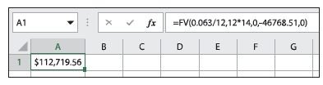

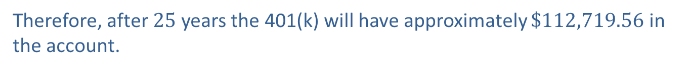
Example 4: Calculating Future Value of a Retirement Account—Slide 9
​Microsoft Excel
We can again use the built-in financial function, FV(rate, nper, pmt, [pv], [type]), with rate = 0.063/12, nper = 12 ⋅ 14, pmt = 0, and pv = −46768.51.
In an empty cell, type "=FV(0.063/12,12*14,0,-46768.51,0)" and press Enter. The future value is given as $\$112,719.56$.
Figure 10
Therefore, after 25 years the 401(k) will have approximately $\$112,719.56$ in the account.

Slide 48
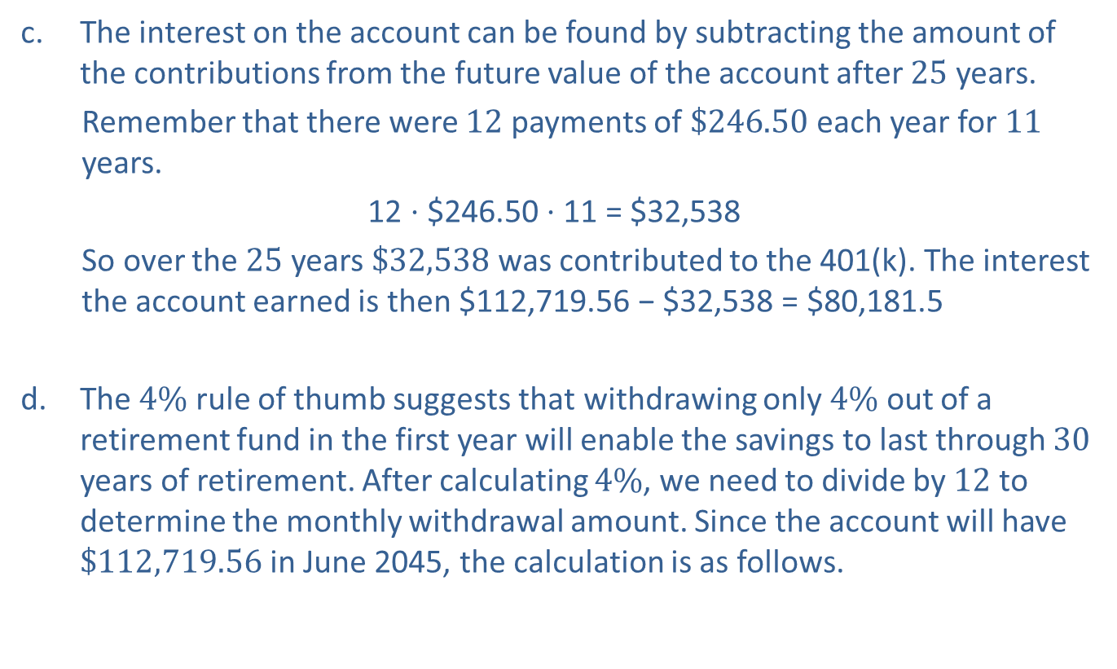
Example 4: Calculating Future Value of a Retirement Account—Slide 10
c. The interest on the account can be found by subtracting the amount of the contributions from the future value of the account after 25 years.
Remember that there were 12 payments of $\$246.50$ each year for 11 years.
12 ⋅ $246.50 ⋅ 11 = $32,538 ​
​So over the 25 years $\$32,538$ was contributed to the 401(k). The interest the account earned is then $112,719.56 − $32,538 = $80,181.5
d. The $4\%$ rule of thumb suggests that withdrawing only $4\%$ out of a retirement fund in the first year will enable the savings to last through 30 years of retirement. After calculating $4\%$, we need to divide by 12 to determine the monthly withdrawal amount. Since the account will have $\$112,719.56$ in June 2045, the calculation is as follows.

Slide 49
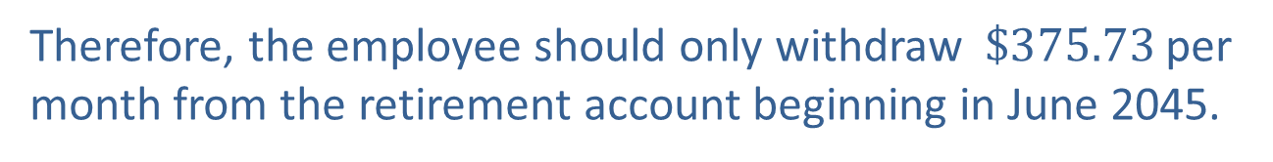
Example 4: Calculating Future Value of a Retirement Account—Slide 11
​Suggested Maximum Monthly Withdrawal:
Therefore, the employee should only withdraw $\$375.73$ per month from the retirement account beginning in June 2045.

Slide 50
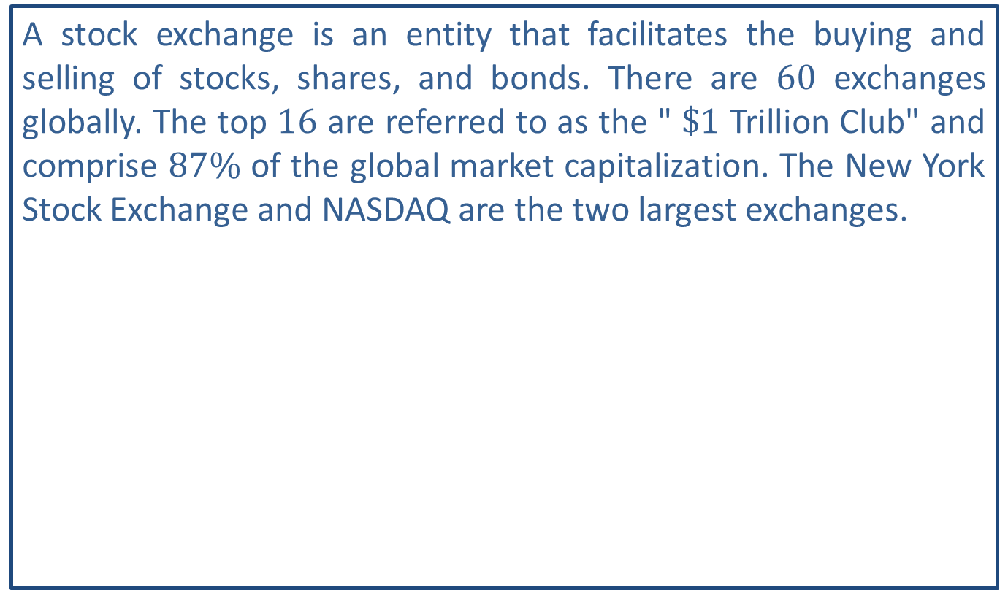
Helpful Hint 3
A stock exchange is an entity that facilitates the buying and selling of stocks, shares, and bonds. There are 60 exchanges globally. The top 16 are referred to as the " $\$1$ Trillion Club" and comprise $87\%$ of the global market capitalization. The New York Stock Exchange and NASDAQ are the two largest exchanges.

Slide 51
Fun Fact 4
Warren Buffett, considered one of the most successful investors in the world and consistently one of the wealthiest, once advised that "it's far better to buy a wonderful company at a fair price than a fair company at a wonderful price."

Slide 52
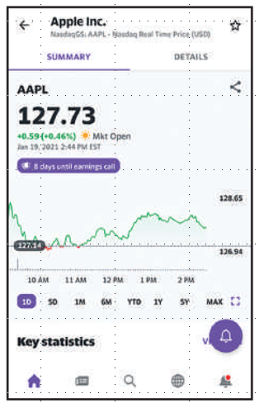
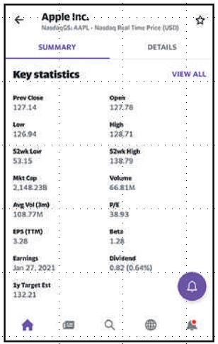
Example 5: Reading a Stock Chart—Slide 1
Use the Apple stock listing from the Yahoo Finance app to answer each question.
Figure 13
Figure 14

Slide 53
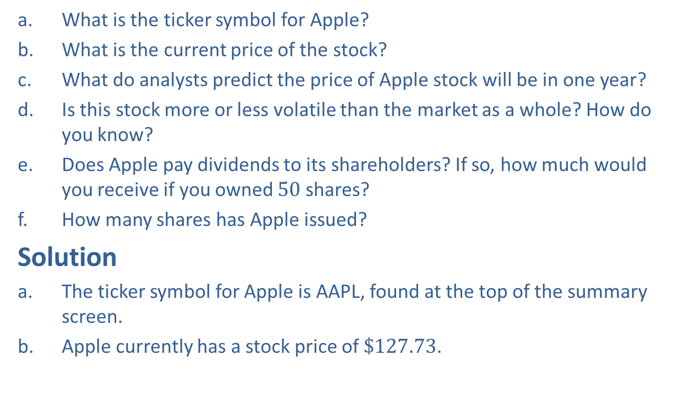
Example 5: Reading a Stock Chart—Slide 2
a. What is the ticker symbol for Apple?
b. What is the current price of the stock?
c. ​What do analysts predict the price of Apple stock will be in one year?
d. Is this stock more or less volatile than the market as a whole? How do you know?
e. ​Does Apple pay dividends to its shareholders? If so, how much would you receive if you owned 50 shares?
f. How many shares has Apple issued?
Solution
a. The ticker symbol for Apple is AAPL, found at the top of the summary screen.
b. Apple currently has a stock price of $\$127.73$.

Slide 54
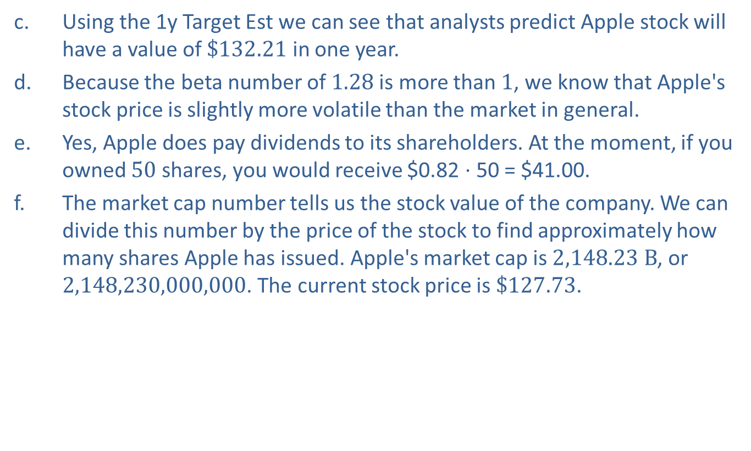
Example 5: Reading a Stock Chart—Slide 3
c. ​Using the 1y Target Est we can see that analysts predict Apple stock will have a value of $\$132.21$ in one year.
d. ​Because the beta number of 1.28 is more than 1, we know that Apple's stock price is slightly more volatile than the market in general.
e. Yes, Apple does pay dividends to its shareholders. At the moment, if you owned 50 shares, you would receive $0.82 ⋅ 50 = $41.00.
f. The market cap number tells us the stock value of the company. We can divide this number by the price of the stock to find approximately how many shares Apple has issued. Apple's market cap is $2,148.23 B$, or 2,148,230,000,000. The current stock price is $\$127.73$.
Therefore, Apple has issued approximately 16.8 billion shares.

Slide 55
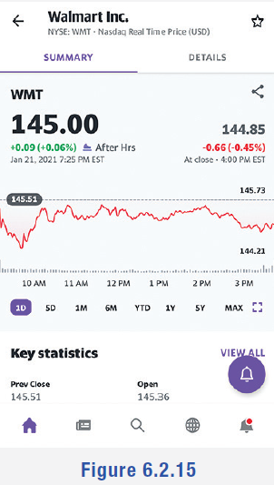
Skill Check 3
Use the stock listing to answer the following questions.
a. What company is being listed?
b. What is the current stock price?
c. ​Is tomorrow's opening price likely to be the same, lower, or higher than today's closing price? What did you base your opinion on?
Answer:
a. Walmart, Inc.
b. $145
c. Lower, because the after-hours price is showing a small loss.
Figure 15

Slide 56
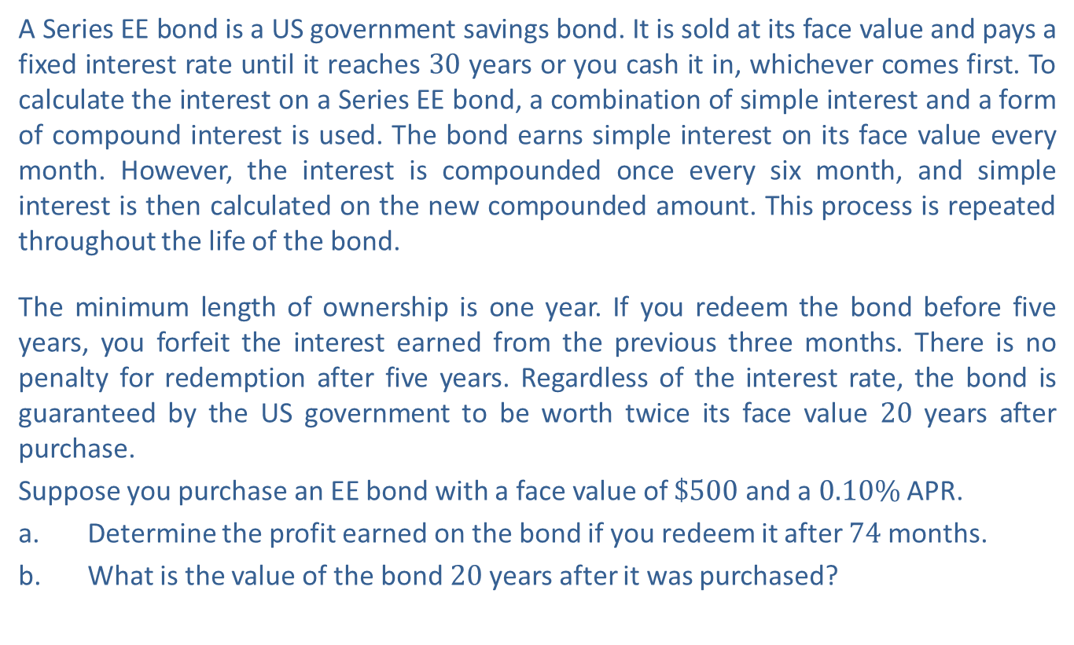
Example 6: Calculating Interest on US Treasury Bonds—Slide 1
A Series EE bond is a US government savings bond. It is sold at its face value and pays a fixed interest rate until it reaches 30 years or you cash it in, whichever comes first. To calculate the interest on a Series EE bond, a combination of simple interest and a form of compound interest is used. The bond earns simple interest on its face value every month. However, the interest is compounded once every six month, and simple interest is then calculated on the new compounded amount. This process is repeated throughout the life of the bond.
The minimum length of ownership is one year. If you redeem the bond before five years, you forfeit the interest earned from the previous three months. There is no penalty for redemption after five years. Regardless of the interest rate, the bond is guaranteed by the US government to be worth twice its face value 20 years after purchase.
Suppose you purchase an EE bond with a face value of $\$500$ and a $0.10\%$ APR.
a. Determine the profit earned on the bond if you redeem it after 74 months.
b. ​What is the value of the bond 20 years after it was purchased?

Slide 57
Example 6: Calculating Interest on US Treasury Bonds—Slide 2
Solution
​The profit earned on the bond is the value of the bond at 74 months minus the original cost of the bond. Note that 74 months is equal to 6 years and 2 months. Since the bond earns interest monthly but the earned interest only compounds every 6 months, we can use the future value for compound interest formula, with n = 2, to calculate the value of the bond after 6 years. Then, we can use the simple interest formula to calculate the interest earned over the final 2 months.
To find the value after 6 years, we know that P = $500, r = 0.001, n = 2, and t = 6. Substitute these values into the formula and simplify.

Slide 58

Example 6: Calculating Interest on US Treasury Bonds—Slide 3
​So after 6 years, the value of the bond is $\$503.01$. Over the first 6 years of the bond, $503.01 − $500 = $3.01 interest was earned.
​To find the interest earned over the final two months of the bond, we use the
simple interest formula I = Prt with P = $503.01, r = 0.001, and

Slide 59
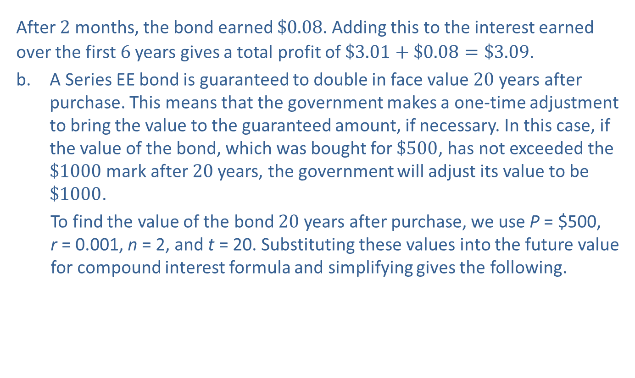
Example 6: Calculating Interest on US Treasury Bonds—Slide 4
​After 2 months, the bond earned $\$0.08$. Adding this to the interest earned over the first 6 years gives a total profit of $\$3.01+\$0.08=\$3.09$.
b. A Series EE bond is guaranteed to double in face value 20 years after purchase. This means that the government makes a one-time adjustment to bring the value to the guaranteed amount, if necessary. In this case, if the value of the bond, which was bought for $\$500$, has not exceeded the $\$1000$ mark after 20 years, the government will adjust its value to be $\$1000$.
To find the value of the bond 20 years after purchase, we use P = $500, r = 0.001, n = 2, and t = 20. Substituting these values into the future value for compound interest formula and simplifying gives the following.

Slide 60
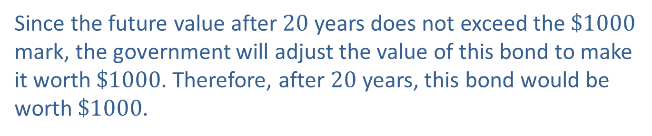
Example 6: Calculating Interest on US Treasury Bonds—Slide 5
​Since the future value after 20 years does not exceed the $\$1000$ mark, the government will adjust the value of this bond to make it worth $\$1000$. Therefore, after 20 years, this bond would be worth $\$1000$.

Slide 61
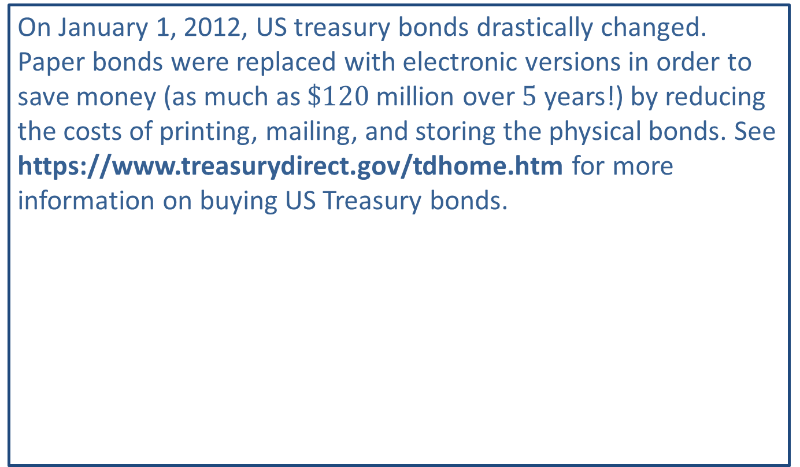
Fun Fact 5
On January 1, 2012, US treasury bonds drastically changed. Paper bonds were replaced with electronic versions in order to save money (as much as $\$120$ million over 5 years!) by reducing the costs of printing, mailing, and storing the physical bonds. See https://www.treasurydirect.gov/tdhome.htm for more information on buying US Treasury bonds.

Slide 62

Helpful Hint 4
Tips for Building a Nest Egg
1. Build a budget.
2. Set up a retirement account.
3. Invest $15\%$ of your income.
4. Pay off a mortgage early.
5. Add to the nest egg every year and don't take money out.
Start today!

