Slide 1
Section 6.3
Borrowing Money

Slide 2

Fun Fact 1
In March 2020, at the outset of the Coronavirus pandemic, the CARES Act offered $\$2$ trillion in government funding to individuals, small businesses, and medical providers, among others, as emergency relief during the global economic disruption.

Slide 3
Helpful Hint 1
Collateral is something used as security for the repayment of a loan. It is forfeited if the loan is not paid back.

Slide 4
Definition: Fixed Installment Loan and Down Payment
Fixed Installment Loan
A fixed installment loan is a loan with a fixed interest rate and loan period. Repayments are made in equal installments throughout the life of the loan.
Down Payment
A down payment is a cash payment made up front towards the total purchase price of the goods or service.

Slide 5
Definition: Regular Payment for Fixed Installment Loans
The amount of a regular payment (PMT) on a fixed installment loan is calculated with the following formula.
Here, P is the principal amount of money borrowed, r is the APR in decimal form, n is the number of payments per year, and t is time in years.

Slide 6
Helpful Hint 2
Notice that the formula contains a negative exponent in the denominator. Be careful not to drop the negative sign during calculations.

Slide 7
Fun Fact 2
The US Department of Education pays the interest on a Direct Subsidized Loan while you are in school at least half-time. However, you are responsible for paying the interest on a Direct Unsubsidized Loan during all periods.

Slide 8
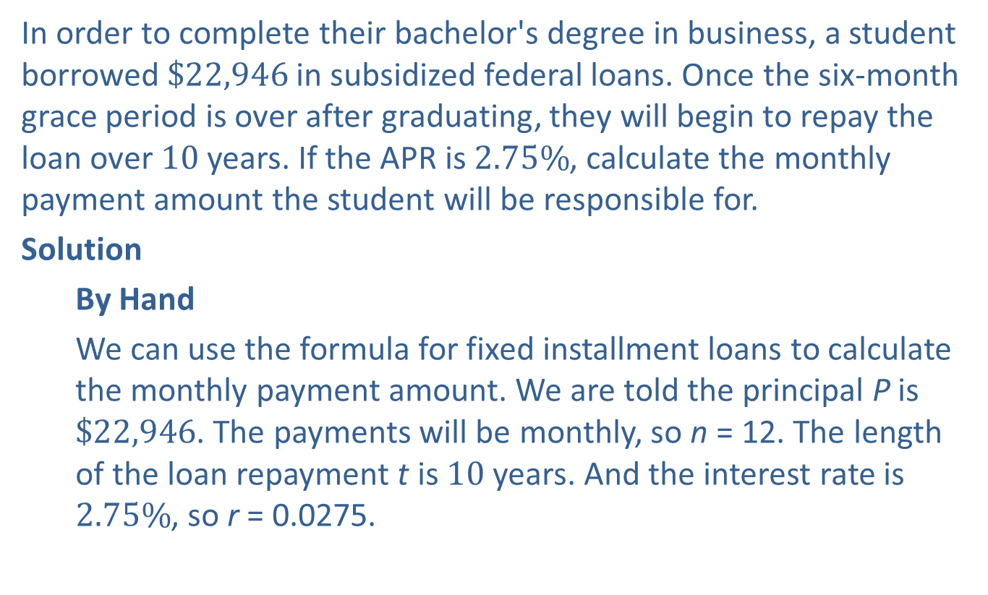
Example 1: Determining the Monthly Payment on a Fixed Installment Loan—Slide 1
In order to complete their bachelor's degree in business, a student borrowed $\$22,946$ in subsidized federal loans. Once the six-month grace period is over after graduating, they will begin to repay the loan over 10 years. If the APR is $2.75\%$, calculate the monthly payment amount the student will be responsible for.
Solution
By Hand
We can use the formula for fixed installment loans to calculate the monthly payment amount. We are told the principal P is $\$22,946$. The payments will be monthly, so n = 12. The length of the loan repayment t is 10 years. And the interest rate is $2.75\%$, so r = 0.0275.

Slide 9
Example 1: Determining the Monthly Payment on a Fixed Installment Loan—Slide 2
Substituting into the formula, we have the following equation.

Slide 10
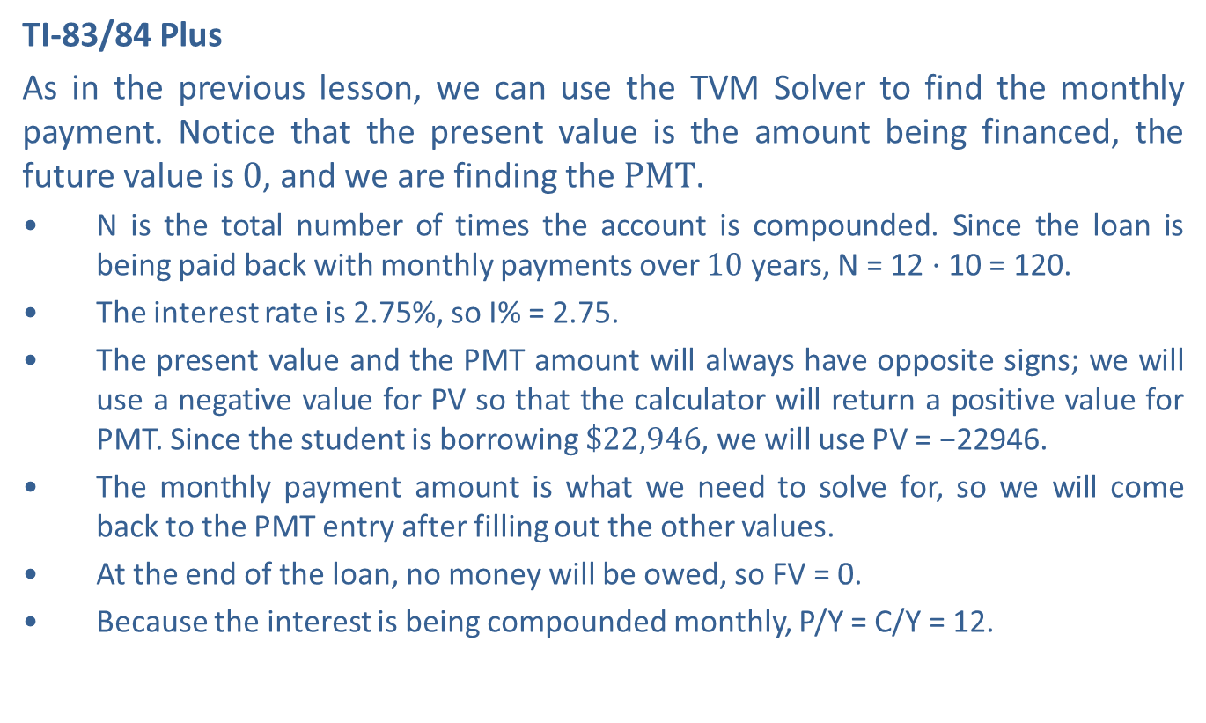
Example 1: Determining the Monthly Payment on a Fixed Installment Loan—Slide 3
TI-83/84 Plus
As in the previous lesson, we can use the TVM Solver to find the monthly payment. Notice that the present value is the amount being financed, the future value is 0, and we are finding the $PMT$.
​N is the total number of times the account is compounded. Since the loan is being paid back with monthly payments over 10 years, N = 12 ⋅ 10 = 120.
​The interest rate is 2.75%, so I% = 2.75.
​The present value and the PMT amount will always have opposite signs; we will use a negative value for PV so that the calculator will return a positive value for PMT. Since the student is borrowing $\$22,946$, we will use PV = −22946.
​The monthly payment amount is what we need to solve for, so we will come back to the PMT entry after filling out the other values.
​At the end of the loan, no money will be owed, so FV = 0.
​Because the interest is being compounded monthly, P/Y = C/Y = 12.

Slide 11
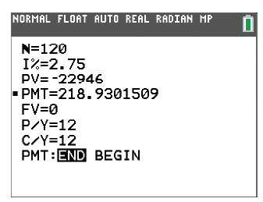
Example 1: Determining the Monthly Payment on a Fixed Installment Loan—Slide 4
​We'll assume that payments are made at the end of each period, so be sure that END is highlighted in the final row.
Figure 1
Once these values have been filled out, return your cursor to the PMT entry and press clear. To solve for this value, press alpha enter. The calculator returns 218.9101509.

Slide 12
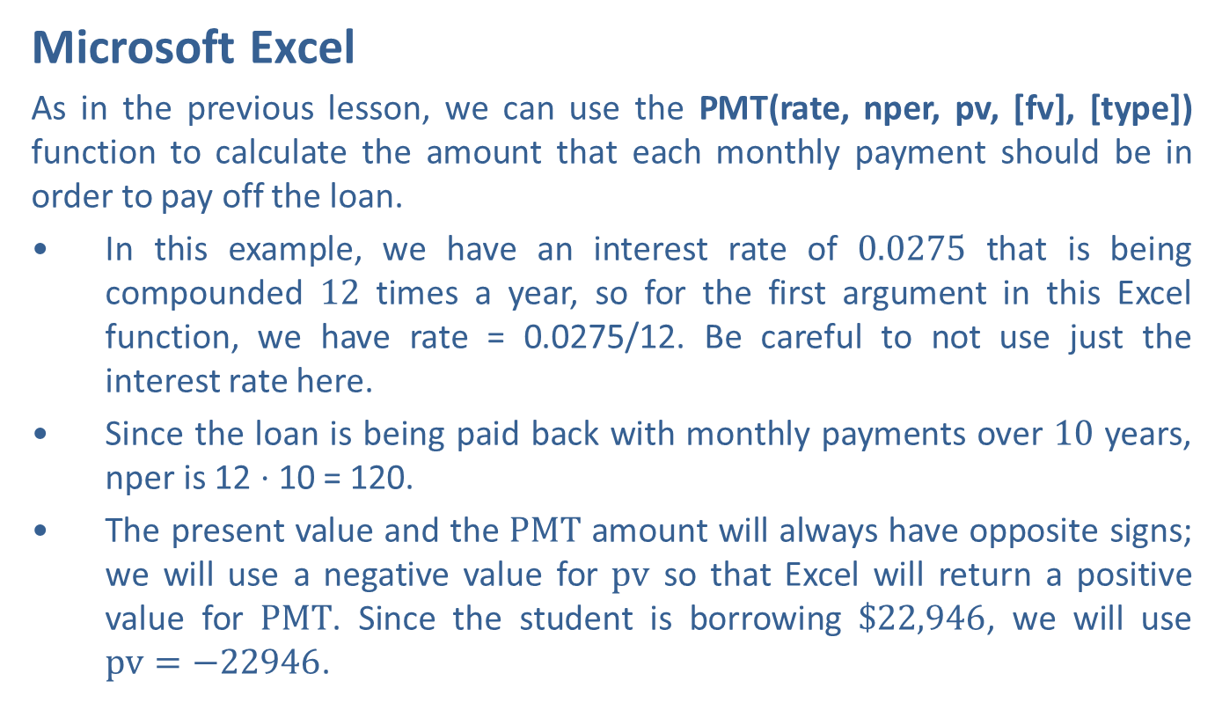
Example 1: Determining the Monthly Payment on a Fixed Installment Loan—Slide 5
Microsoft Excel
As in the previous lesson, we can use the PMT(rate, nper, pv, [fv], [type]) function to calculate the amount that each monthly payment should be in order to pay off the loan.
​In this example, we have an interest rate of 0.0275 that is being compounded 12 times a year, so for the first argument in this Excel function, we have rate = 0.0275/12. Be careful to not use just the interest rate here.
​Since the loan is being paid back with monthly payments over 10 years, nper is 12 ⋅ 10 = 120.
The present value and the $PMT$ amount will always have opposite signs; we will use a negative value for $pv$ so that Excel will return a positive value for $PMT$. Since the student is borrowing $\$22,946$, we will use $pv=−22946$.

Slide 13
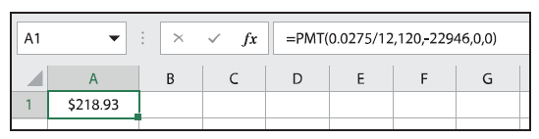

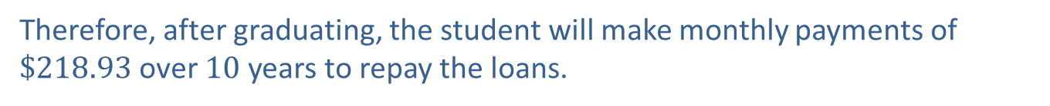
Example 1: Determining the Monthly Payment on a Fixed Installment Loan—Slide 6
​We will use $FV=0$, or leave that argument empty, because nothing will be owed by the end of the loan.
​Typically, payments are made at the end of each period, so we will use type $=0$, or leave that argument empty.
In an empty cell, type "=PMT(0.0275/12,120,-22946,0,0)" and press Enter. The payment amount is given as $\$218.93$.
Figure 2
Therefore, after graduating, the student will make monthly payments of $\$218.93$ over 10 years to repay the loans.

Slide 14
Fun Fact 3
Most auto loans are advertised with the number of months (typically 60 or 72) unlike other loans such as mortgages that are described in terms of years.

Slide 15
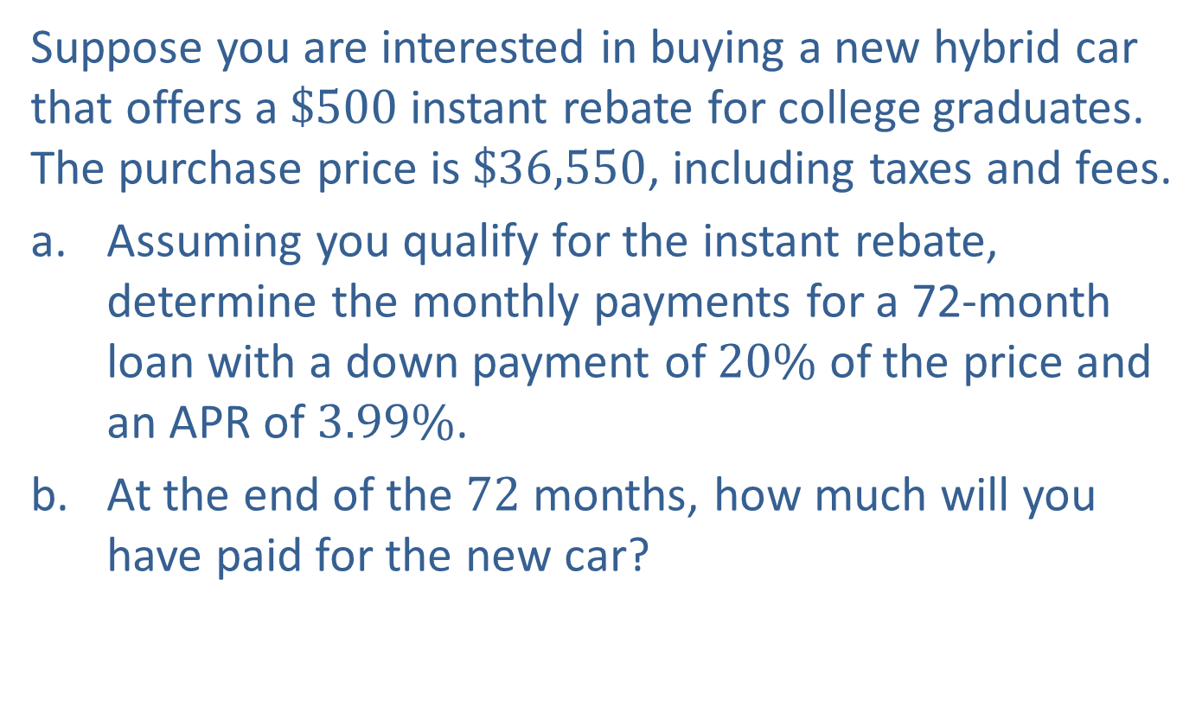
Example 2: Using an Installment Loan to Purchase a New Car—Slide 1
Suppose you are interested in buying a new hybrid car that offers a $\$500$ instant rebate for college graduates. The purchase price is $\$36,550$, including taxes and fees.
a. Assuming you qualify for the instant rebate, determine the monthly payments for a 72-month loan with a down payment of $20\%$ of the price and an APR of $3.99\%$.
b. ​At the end of the 72 months, how much will you have paid for the new car?

Slide 16
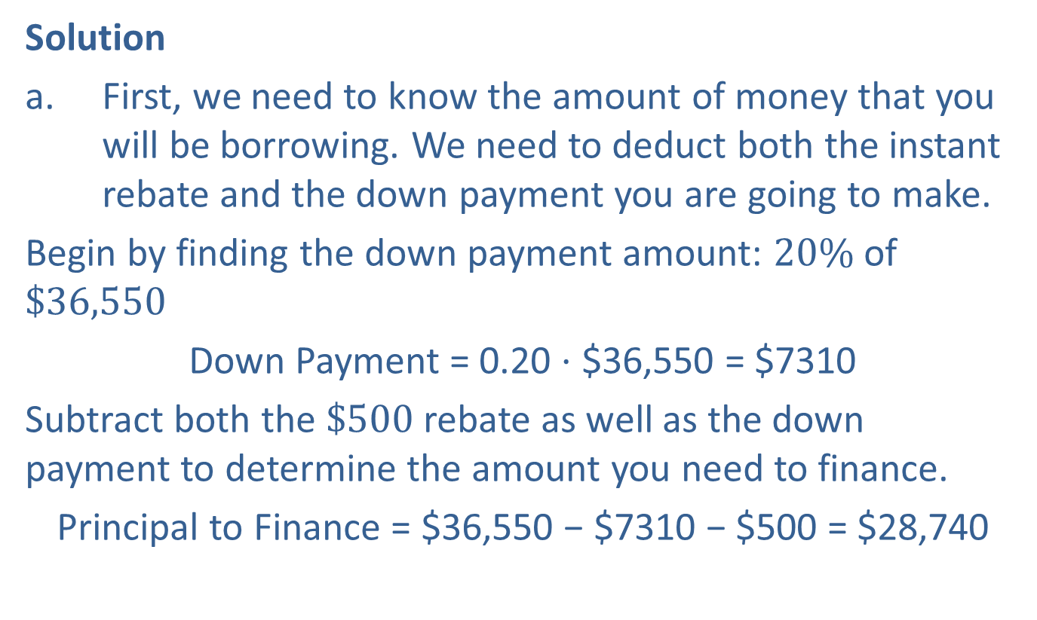
Example 2: Using an Installment Loan to Purchase a New Car—Slide 2
Solution
a. First, we need to know the amount of money that you will be borrowing. We need to deduct both the instant rebate and the down payment you are going to make.
​Begin by finding the down payment amount: $20\%$ of $\$36,550$
Down Payment = 0.20 ⋅ $36,550 = $7310​
​Subtract both the $\$500$ rebate as well as the down payment to determine the amount you need to finance.
Principal to Finance = $36,550 − $7310 − $500 = $28,740

Slide 17
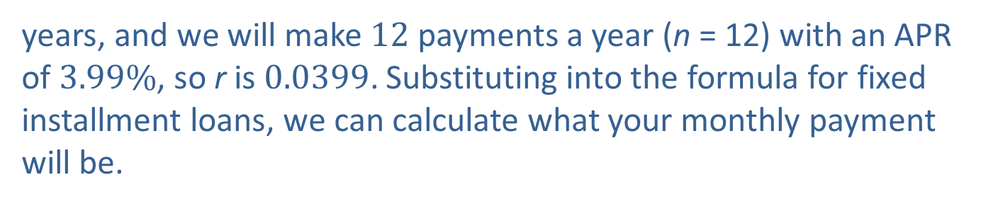
Example 2: Using an Installment Loan to Purchase a New Car—Slide 3
​By Hand
Now we have P = $28,740. A 72-month loan means that
years, and we will make 12 payments a year (n = 12) with an APR of $3.99\%$, so r is 0.0399. Substituting into the formula for fixed installment loans, we can calculate what your monthly payment will be.

Slide 18
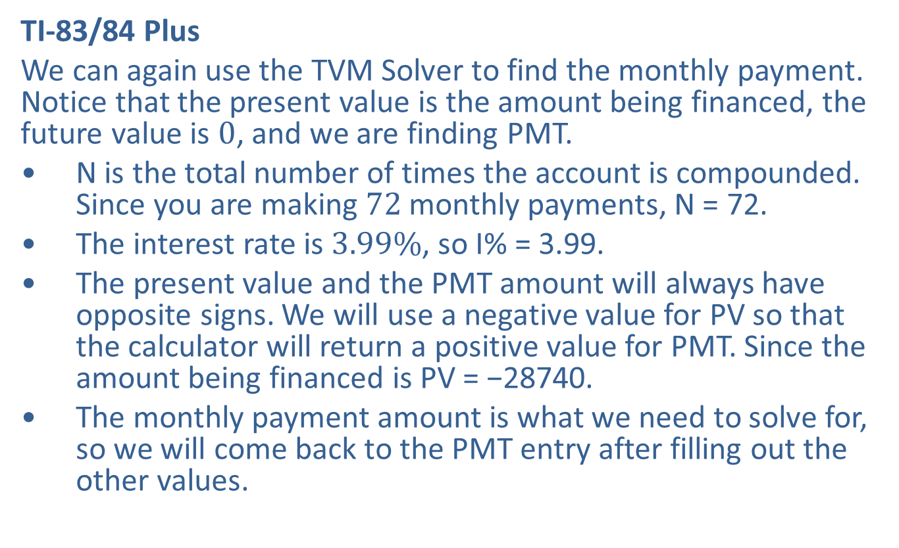
Example 2: Using an Installment Loan to Purchase a New Car—Slide 4
TI-83/84 Plus
We can again use the TVM Solver to find the monthly payment. Notice that the present value is the amount being financed, the future value is 0, and we are finding PMT.
​N is the total number of times the account is compounded. Since you are making 72 monthly payments, N = 72.
​The interest rate is $3.99\%$, so I% = 3.99.
​The present value and the PMT amount will always have opposite signs. We will use a negative value for PV so that the calculator will return a positive value for PMT. Since the amount being financed is PV = −28740.
​The monthly payment amount is what we need to solve for, so we will come back to the PMT entry after filling out the other values.

Slide 19
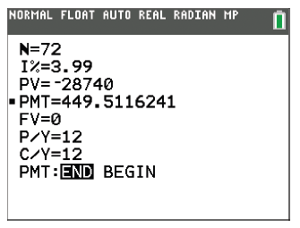
Example 2: Using an Installment Loan to Purchase a New Car—Slide 5
At the end of the loan, no money will be owed, so FV = 0.
​Because the interest is being compounded monthly, P/Y = C/Y = 12.
​We'll assume that payments are made at the end of each period, so be sure that END is highlighted in the final row.
Once these values have been filled out, return your cursor to the PMT entry and press clear. To solve for this value, press alpha enter. The calculator returns 449.5116241.
​
Figure 3

Slide 20
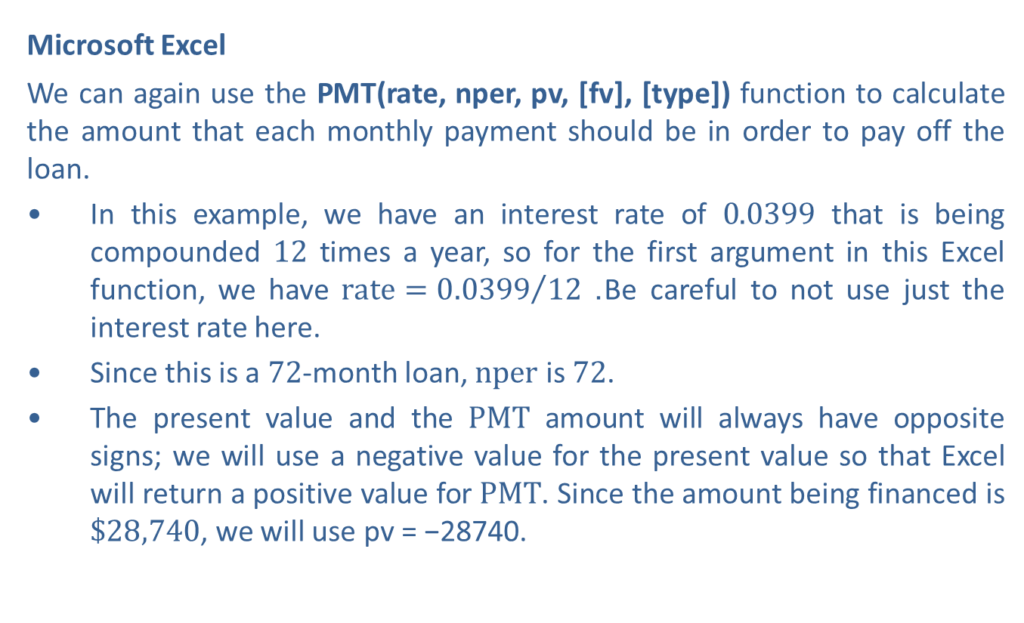
Example 2: Using an Installment Loan to Purchase a New Car—Slide 6
​Microsoft Excel
We can again use the PMT(rate, nper, pv, [fv], [type]) function to calculate the amount that each monthly payment should be in order to pay off the loan.
​In this example, we have an interest rate of 0.0399 that is being compounded 12 times a year, so for the first argument in this Excel function, we have $rate={0.0399}/{12}$. Be careful to not use just the interest rate here.
​Since this is a 72-month loan, $nper$ is 72.
​The present value and the $PMT$ amount will always have opposite signs; we will use a negative value for the present value so that Excel will return a positive value for $PMT$. Since the amount being financed is $\$28,740$, we will use pv = −28740.

Slide 21
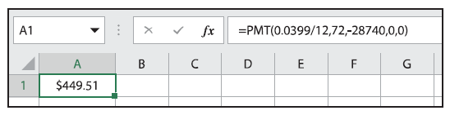

Example 2: Using an Installment Loan to Purchase a New Car—Slide 7
We will use $fv=0$, or leave that argument empty, because nothing will be owed by the end of the loan.
Typically, payments are made at the end of each period, so we will use type $=0$, or leave that argument empty.
In an empty cell, type "=PMT(0.0399/12,72,-28740,0,0)" and press Enter. The payment amount is given as $\$499.51$.
Figure 4
Therefore, the monthly car payment will be $\$499.51$.

Slide 22

Example 2: Using an Installment Loan to Purchase a New Car—Slide 8
b. At the end of the 72 months, you will have made 72 payments of $\$499.51$ plus the down payment of $\$7310$. Therefore, the total cost of the car is found as follows.
​Total Cost of the Car to the Buyer, Including Interest
$72⋅\$449.51+\$7310=\$39,674.72$

Slide 23
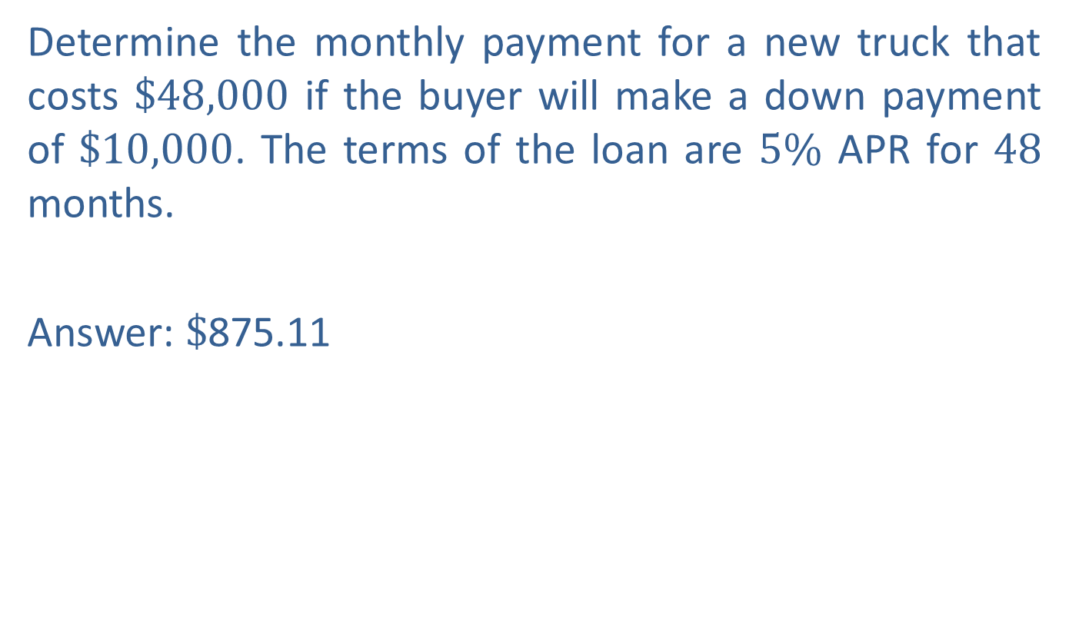
Skill Check 1
Determine the monthly payment for a new truck that costs $\$48,000$ if the buyer will make a down payment of $\$10,000$. The terms of the loan are $5\%$ APR for 48 months.
Answer: $\$$875.11

Slide 24
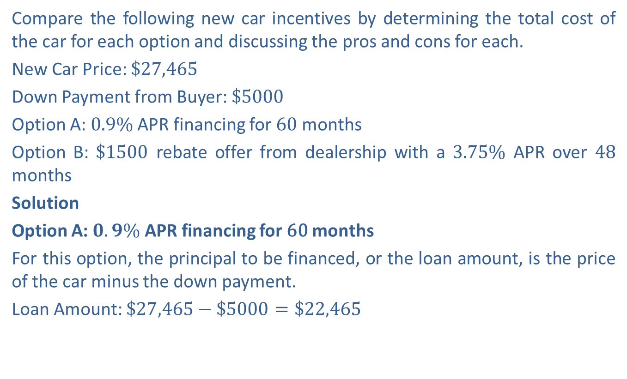
Example 3: Comparing Installment Loan Options—Slide 1
Compare the following new car incentives by determining the total cost of the car for each option and discussing the pros and cons for each.
New Car Price: $\$27,465$
Down Payment from Buyer: $\$5000$
Option A: $0.9\%$ APR financing for 60 months
Option B: $\$1500$ rebate offer from dealership with a $3.75\%$ APR over 48 months
Solution
Option A: $0.9\%$ APR financing for 60 months
For this option, the principal to be financed, or the loan amount, is the price of the car minus the down payment.
Loan Amount: $\$27,465−\$5000=\$22,465$

Slide 25
Example 3: Comparing Installment Loan Options—Slide 2
By Hand
In addition to knowing the loan amount, we are told that payments are monthly, so n = 12. Also, r = 0.009 and
The monthly payment is calculated as follows.

Slide 26
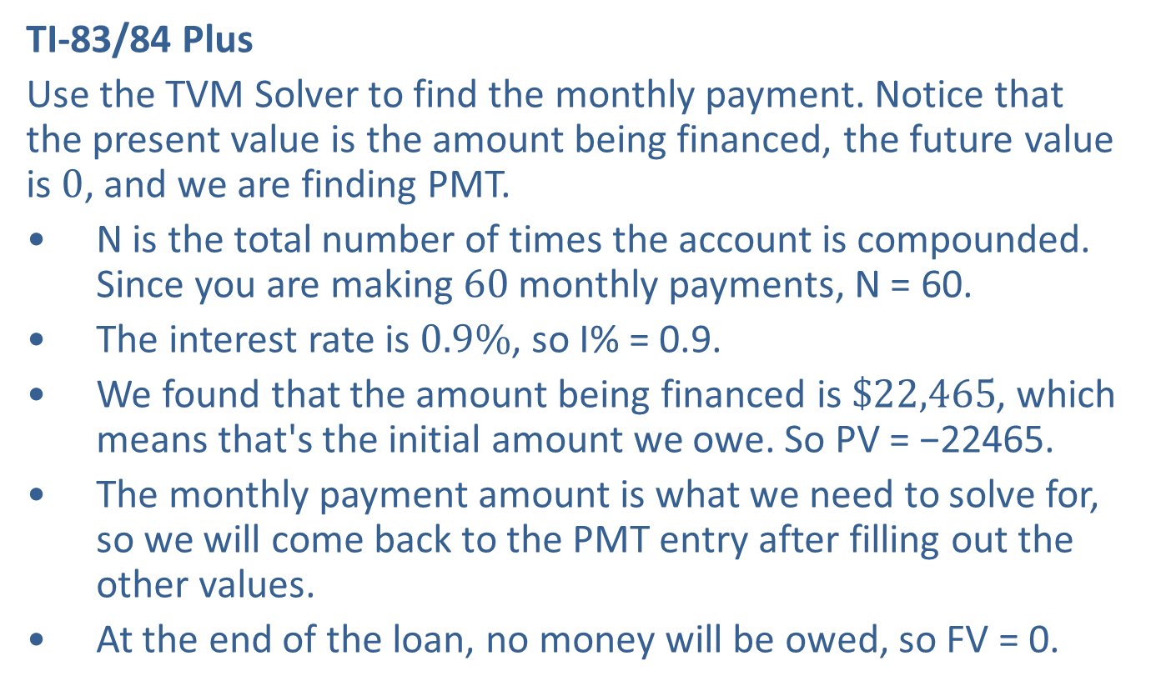
Example 3: Comparing Installment Loan Options—Slide 3
TI-83/84 Plus
Use the TVM Solver to find the monthly payment. Notice that the present value is the amount being financed, the future value is 0, and we are finding PMT.
​N is the total number of times the account is compounded. Since you are making 60 monthly payments, N = 60.
​The interest rate is $0.9\%$, so I% = 0.9.
​We found that the amount being financed is $\$22,465$, which means that's the initial amount we owe. So PV = −22465.
​The monthly payment amount is what we need to solve for, so we will come back to the PMT entry after filling out the other values.
​At the end of the loan, no money will be owed, so FV = 0.

Slide 27
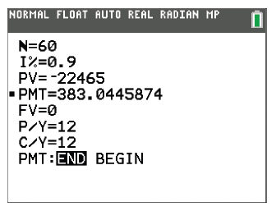
Example 3: Comparing Installment Loan Options—Slide 4
​Because the interest is being compounded monthly, P/Y = C/Y = 12.
​We'll assume that payments are made at the end of each period, so be sure that END is highlighted in the final row.
Once these values are filled out, return your cursor to the PMT entry and press clear . To solve for this value, press alpha enter . The calculator returns 383.0445874.
Figure 5

Slide 28
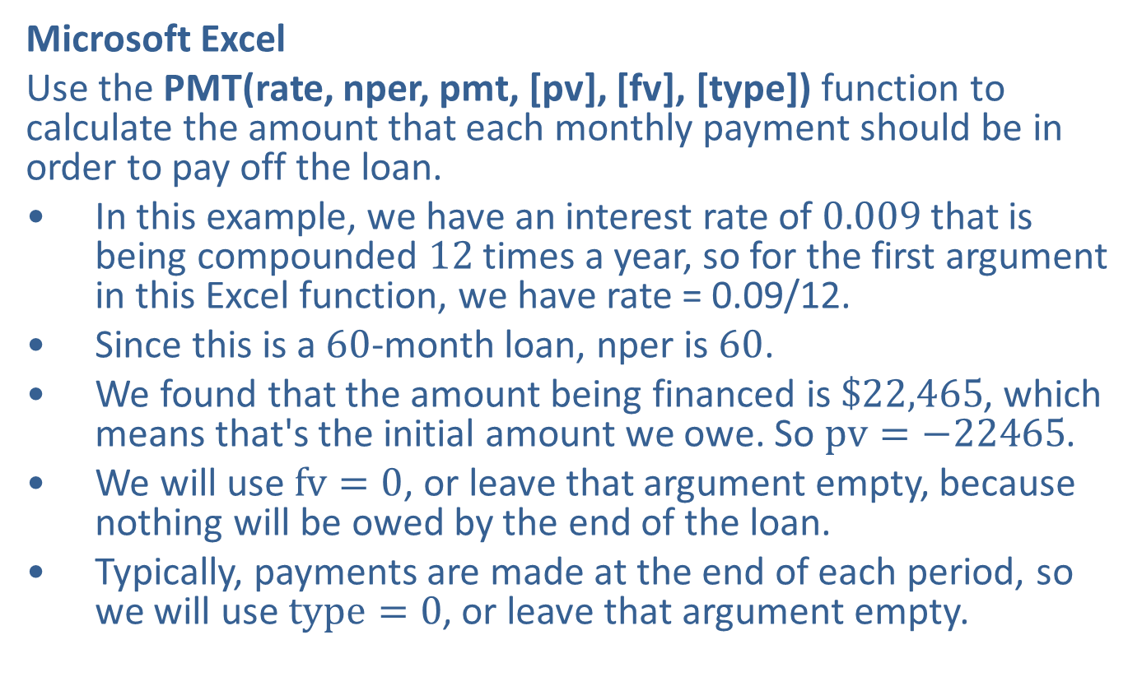
Example 3: Comparing Installment Loan Options—Slide 5
Microsoft Excel
Use the PMT(rate, nper, pmt, [pv], [fv], [type]) function to calculate the amount that each monthly payment should be in order to pay off the loan.
​In this example, we have an interest rate of 0.009 that is being compounded 12 times a year, so for the first argument in this Excel function, we have rate = 0.09/12.
​Since this is a 60-month loan, nper is 60.
​We found that the amount being financed is $\$22,465$, which means that's the initial amount we owe. So $pv=−22465$.
​We will use $fv=0$, or leave that argument empty, because nothing will be owed by the end of the loan.
​Typically, payments are made at the end of each period, so we will use $type=0$, or leave that argument empty.

Slide 29
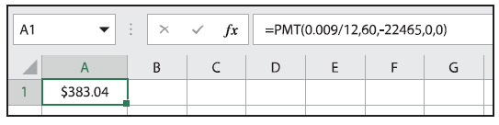

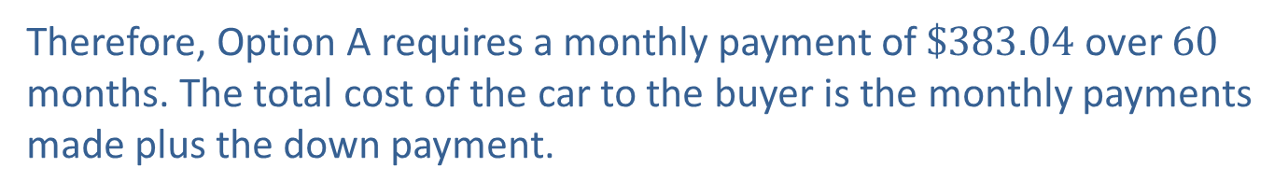
Example 3: Comparing Installment Loan Options—Slide 6
In an empty cell, type "=PMT(0.009/12,60,-22465,0,0)" and press Enter. The payment amount is given as $\$383.04$.
Figure 6
Therefore, Option A requires a monthly payment of $\$383.04$ over 60 months. The total cost of the car to the buyer is the monthly payments made plus the down payment.
Total Cost of the Car to the Buyer, Including Interest
$383.04 ⋅ 60 + $5000 = $27,982.40

Slide 30
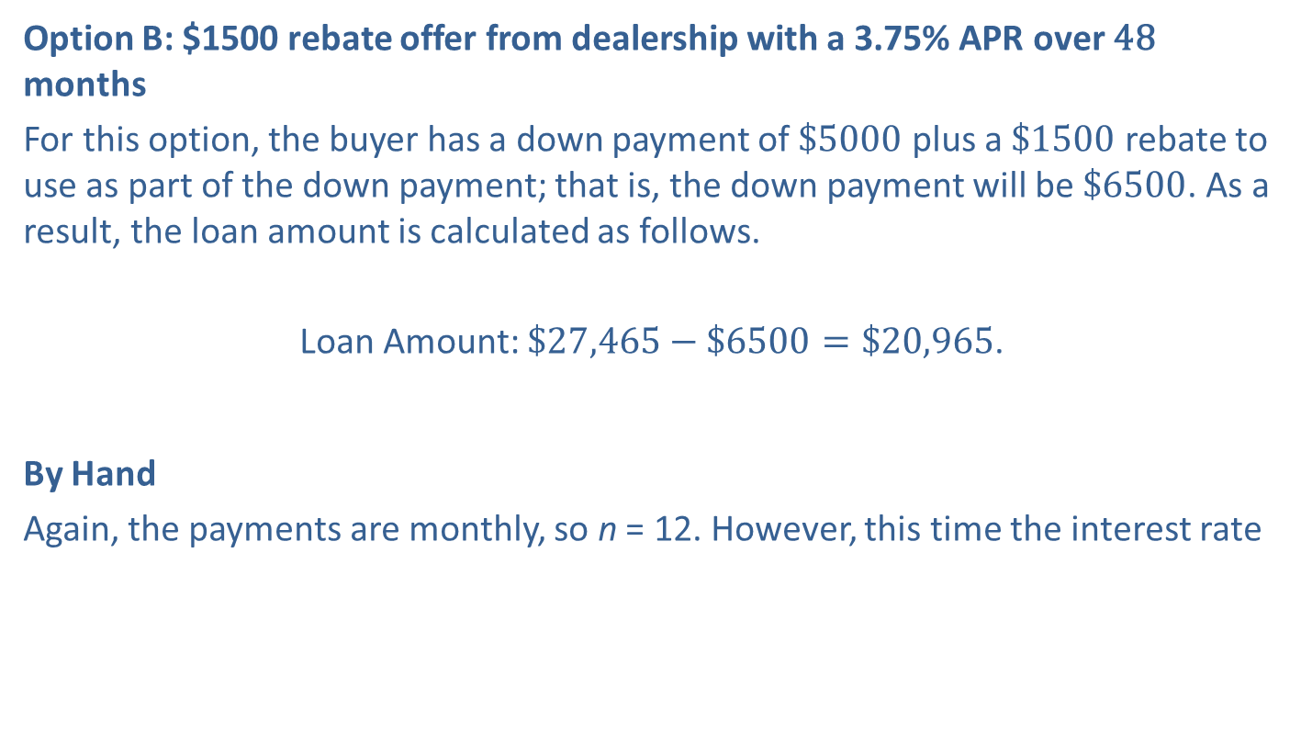
Example 3: Comparing Installment Loan Options—Slide 7
Option B: $1500 rebate offer from dealership with a 3.75% APR over 48 months
For this option, the buyer has a down payment of $\$5000$ plus a $\$1500$ rebate to use as part of the down payment; that is, the down payment will be $\$6500$. As a result, the loan amount is calculated as follows.
Loan Amount: $\$27,465−\$6500=\$20,965$.
By Hand
Again, the payments are monthly, so n = 12. However, this time the interest rate
is 3.75% over 48 months; so r = 0.0375 and
The payment for
each month is calculated as follows.

Slide 31
Example 3: Comparing Installment Loan Options—Slide 8

Slide 32
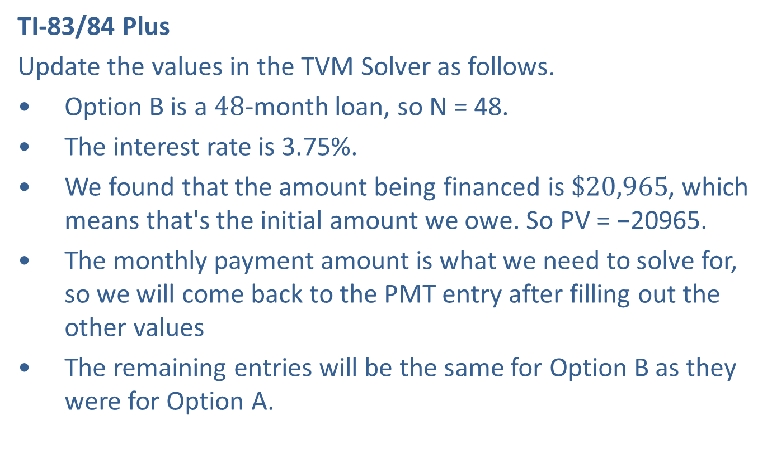
Example 3: Comparing Installment Loan Options—Slide 9
TI-83/84 Plus
Update the values in the TVM Solver as follows.
​Option B is a 48-month loan, so N = 48.
​The interest rate is 3.75%.
​We found that the amount being financed is $\$20,965$, which means that's the initial amount we owe. So PV = −20965.
​The monthly payment amount is what we need to solve for, so we will come back to the PMT entry after filling out the other values
​The remaining entries will be the same for Option B as they were for Option A.

Slide 33
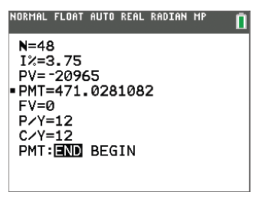
Example 3: Comparing Installment Loan Options—Slide 10
Once these values are filled out, return your cursor to the PMT entry and press clear. To solve for this value, press alpha enter. The calculator returns 471.0281082.
Figure 7

Slide 34
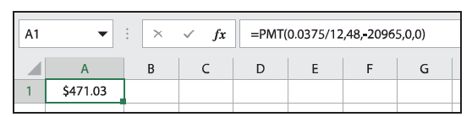

Example 3: Comparing Installment Loan Options—Slide 11
Microsoft Excel
Use the PMT function to calculate the amount that each monthly payment should be in order to pay off the loan. For Option B, rate will be 0.0375/12, nper will be 48, and pv will be $−20965$.
In an empty cell, type "=PMT(0.0375/12,48,-20965,0,0)" and press Enter. The payment amount is given as $\$471.03$.
Figure 8

Slide 35
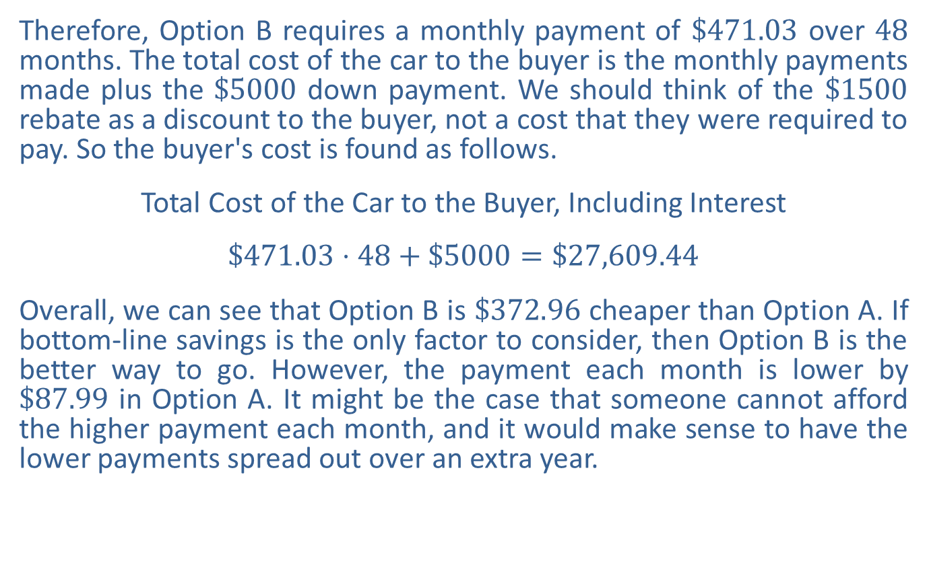
Example 3: Comparing Installment Loan Options —Slide 12
Therefore, Option B requires a monthly payment of $\$471.03$ over 48 months. The total cost of the car to the buyer is the monthly payments made plus the $\$5000$ down payment. We should think of the $\$1500$ rebate as a discount to the buyer, not a cost that they were required to pay. So the buyer's cost is found as follows.
Total Cost of the Car to the Buyer, Including Interest
$$\$471.03⋅48+\$5000=\$27,609.44$$
Overall, we can see that Option B is $\$372.96$ cheaper than Option A. If bottom-line savings is the only factor to consider, then Option B is the better way to go. However, the payment each month is lower by $\$87.99$ in Option A. It might be the case that someone cannot afford the higher payment each month, and it would make sense to have the lower payments spread out over an extra year.

Slide 36
Helpful Hint 3
The closing of a mortgage is the last step in the process of buying real estate. It is when the buyer, lender, and any other parties associated sign the necessary documents. After signing, the buyer becomes responsible for the mortgage loan.

Slide 37
Definition: Mortgage, Fixed-Rate Mortgage, Adjustable-Rate Mortgage, and Mortgage Point
Mortgage
An installment loan used for the purposes of buying a house or other real estate where the property is used as collateral is called a mortgage.
Fixed-Rate Mortgage
In a fixed-rate mortgage, the interest rate remains constant throughout the life of the loan.
Adjustable-Rate Mortgage
In an adjustable-rate mortgage (ARM) the interest rate is fixed for a period of time at the beginning of the loan period, and then is allowed to fluctuate over time.
Mortgage Point
A mortgage point is interest prepaid by the buyer to the lender and is equal to 1% of the loan amount.

Slide 38
Fun Fact 4
Conversationally, when we refer to a person's monthly "mortgage payment," what we actually mean is the amount of out-of-pocket money that a homeowner has to pay each month. This amount typically includes not only the mortgage loan payment, but also a prorated share of the homeowner's insurance and property taxes that are held in an account by the lender to be paid yearly.

Slide 39
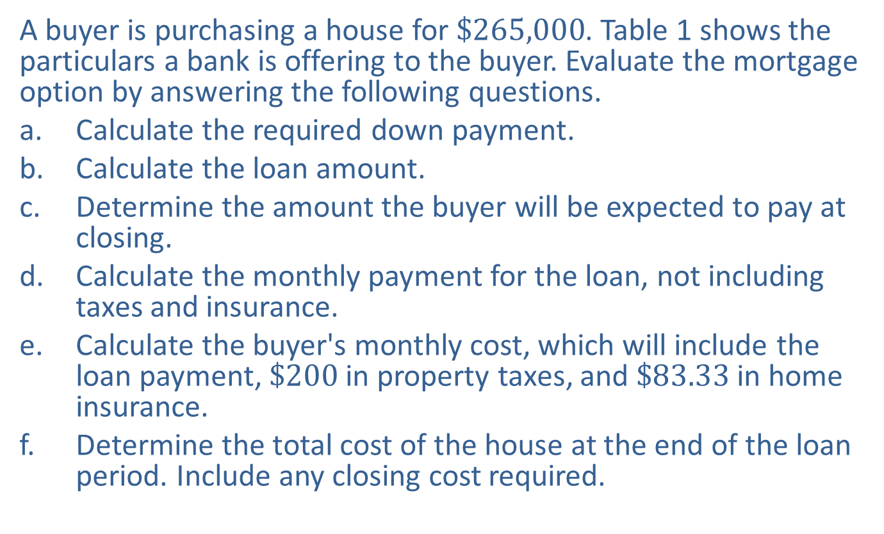
Example 4: Calculating Mortgage Payments and Fees—Slide 1
A buyer is purchasing a house for $\$265,000$. Table 1 shows the particulars a bank is offering to the buyer. Evaluate the mortgage option by answering the following questions.
a. Calculate the required down payment.
b. ​Calculate the loan amount.
c. Determine the amount the buyer will be expected to pay at closing.
d. Calculate the monthly payment for the loan, not including taxes and insurance.
e. Calculate the buyer's monthly cost, which will include the loan payment, $\$200$ in property taxes, and $\$83.33$ in home insurance.
f. Determine the total cost of the house at the end of the loan period. Include any closing cost required.

Slide 40
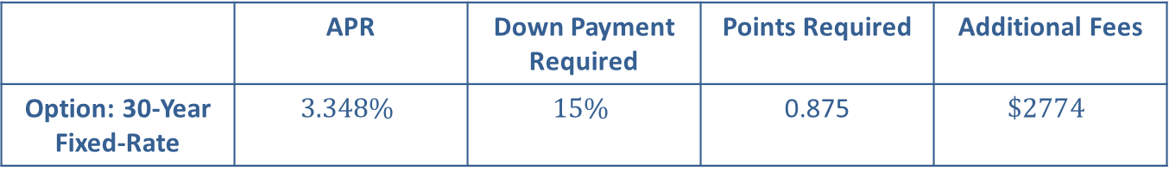
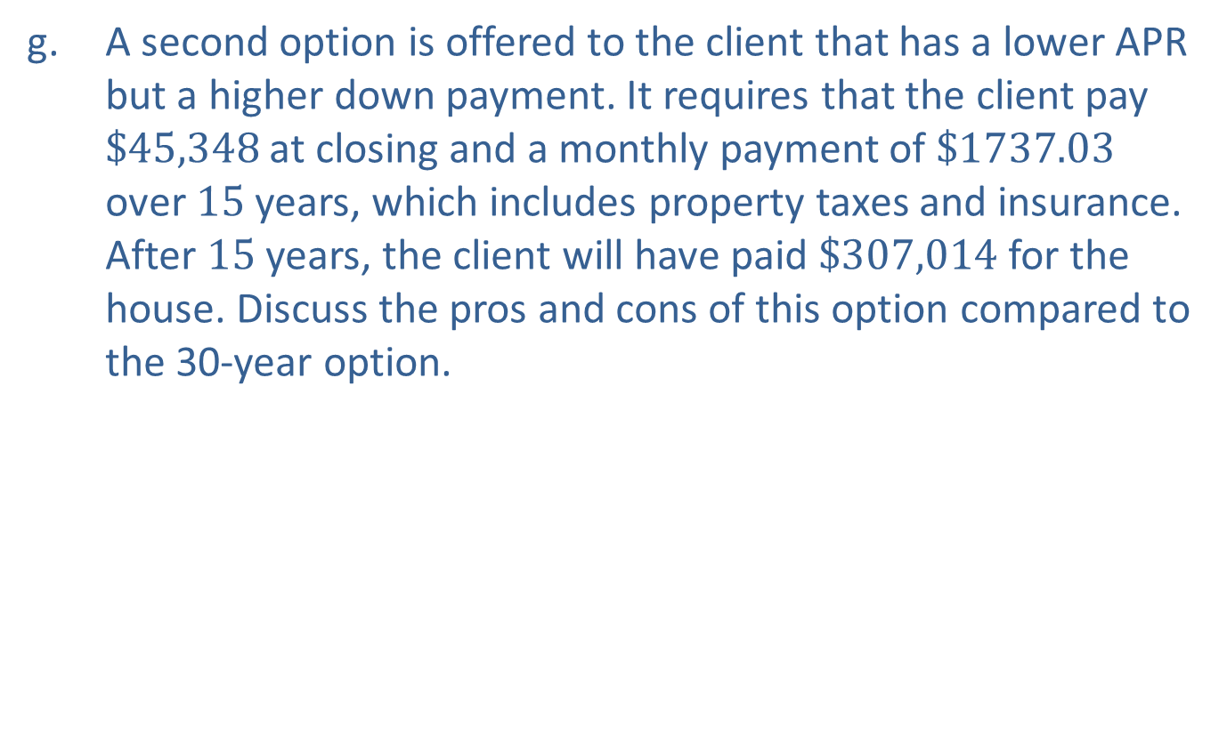
Example 4: Calculating Mortgage Payments and Fees—Slide 2
g. A second option is offered to the client that has a lower APR but a higher down payment. It requires that the client pay $\$45,348$ at closing and a monthly payment of $\$1737.03$ over 15 years, which includes property taxes and insurance. After 15 years, the client will have paid $\$307,014$ for the house. Discuss the pros and cons of this option compared to the 30-year option.
Table 1: Bank Mortgage Details
 | APR | Down Payment Required | Points Required | Additional Fees
Option: 30-Year Fixed-Rate | $$3.348\%$$ | $$15\%$$ | 0.875 | $$\$2774$$

Slide 41
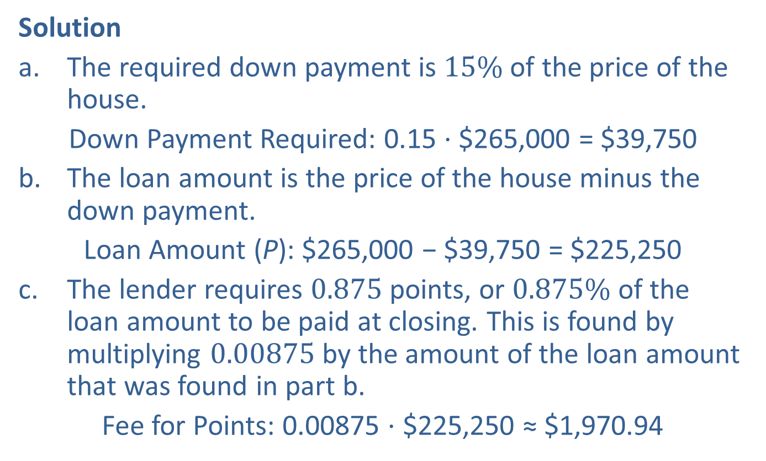
Example 4: Calculating Mortgage Payments and Fees—Slide 3
Solution
a. The required down payment is $15\%$ of the price of the house.
​Down Payment Required: 0.15 ⋅ $265,000 = $39,750
b. The loan amount is the price of the house minus the down payment.
​Loan Amount (P): $265,000 − $39,750 = $225,250
c. The lender requires 0.875 points, or $0.875\%$ of the loan amount to be paid at closing. This is found by multiplying 0.00875 by the amount of the loan amount that was found in part b.
​Fee for Points: 0.00875 ⋅ $225,250 ≈ $1,970.94

Slide 42
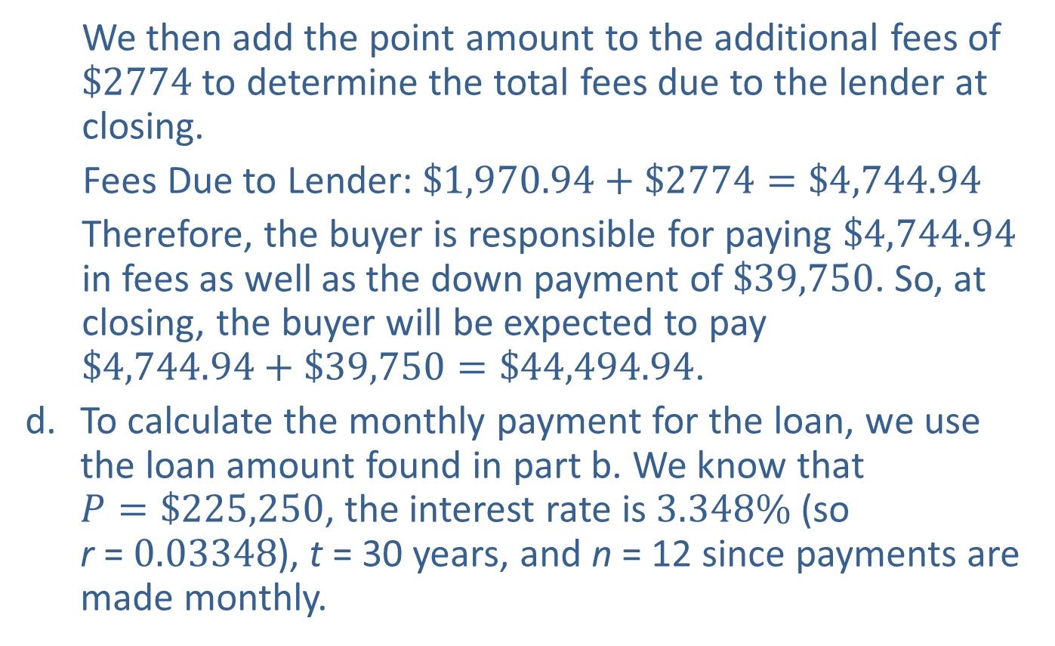
Example 4: Calculating Mortgage Payments and Fees—Slide 4
We then add the point amount to the additional fees of $\$2774$ to determine the total fees due to the lender at closing.
​Fees Due to Lender: $\$1,970.94+\$2774=\$4,744.94$
Therefore, the buyer is responsible for paying $\$4,744.94$ in fees as well as the down payment of $\$39,750$. So, at closing, the buyer will be expected to pay $\$4,744.94+\$39,750=\$44,494.94$.
d. To calculate the monthly payment for the loan, we use the loan amount found in part b. We know that $P=\$225,250$, the interest rate is $3.348\%$ (so r = $0.03348$), t = 30 years, and n = 12 since payments are made monthly.

Slide 43
Example 4: Calculating Mortgage Payments and Fees—Slide 5
​By Hand

Slide 44
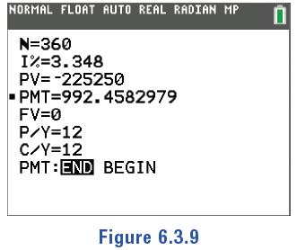
Example 4: Calculating Mortgage Payments and Fees—Slide 6
TI-83/84 Plus
Using the TVM Solver, N is the total number of times the interest is compounded. Since this is a 30-year mortgage with monthly payments, N = 12 ⋅ 30 = 360. PV is the amount being financed, which we will enter as −225250. Update the values in the TVM Solver as shown in Figure 9. Clear the entry for PMT and press alpha enter to solve for that value. The calculator returns 992.4582979.
Figure 9

Slide 45
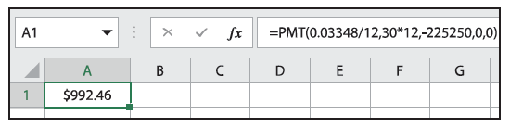
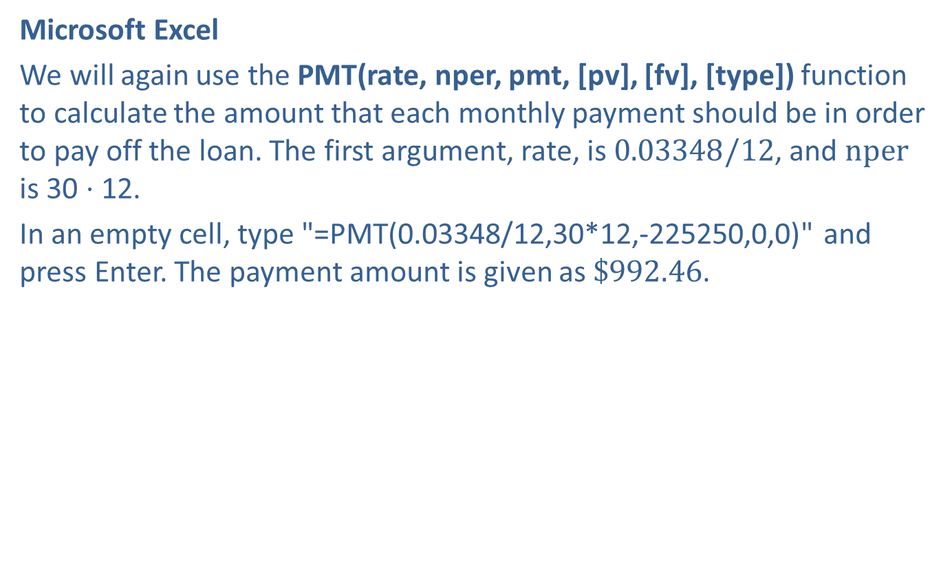

Example 4: Calculating Mortgage Payments and Fees—Slide 7
​Microsoft Excel
We will again use the PMT(rate, nper, pmt, [pv], [fv], [type]) function to calculate the amount that each monthly payment should be in order to pay off the loan. The first argument, rate, is $0.03348/12$, and $nper$ is 30 ⋅ 12.
In an empty cell, type "=PMT(0.03348/12,30*12,-225250,0,0)" and press Enter. The payment amount is given as $\$992.46$.
Figure 10
Therefore, the monthly loan payment will be $\$992.46$ over 30 years.

Slide 46
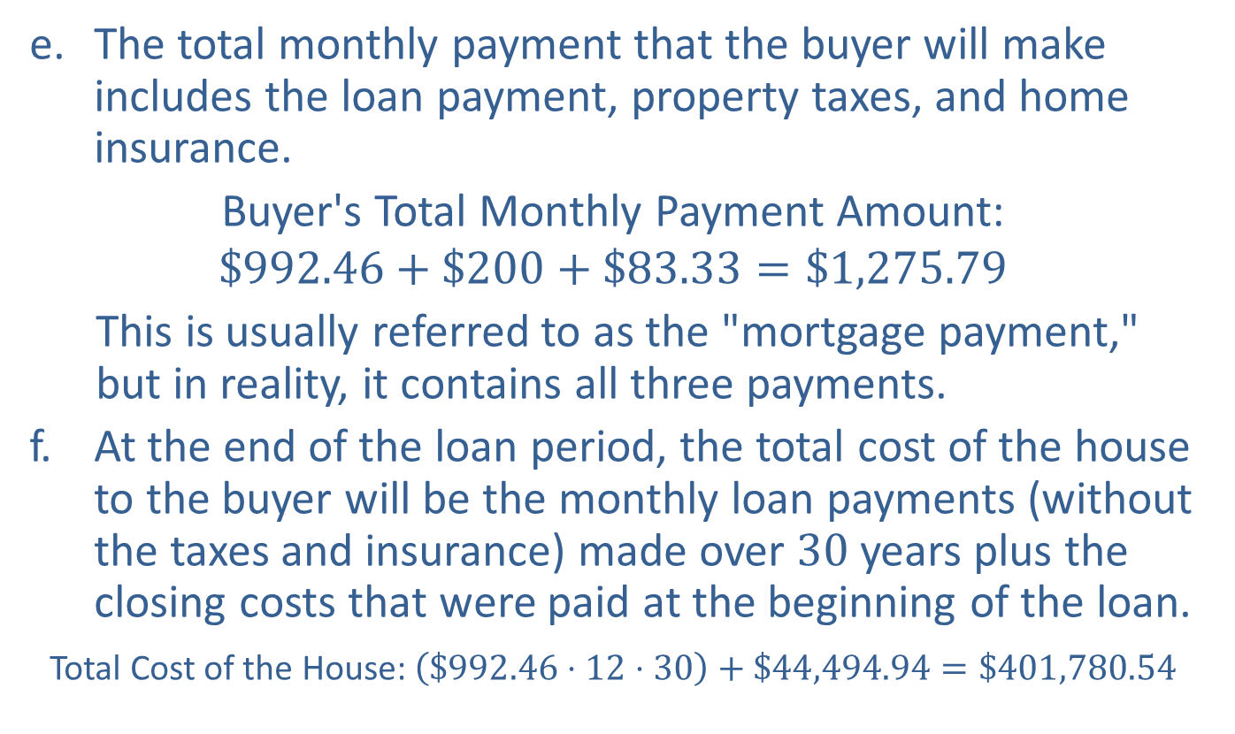
Example 4: Calculating Mortgage Payments and Fees—Slide 8
e. The total monthly payment that the buyer will make includes the loan payment, property taxes, and home insurance.
​Buyer's Total Monthly Payment Amount:
$$\$992.46+\$200+\$83.33=\$1,275.79$$
This is usually referred to as the "mortgage payment," but in reality, it contains all three payments.
f. ​At the end of the loan period, the total cost of the house to the buyer will be the monthly loan payments (without the taxes and insurance) made over 30 years plus the closing costs that were paid at the beginning of the loan.
​Total Cost of the House: $\left(\$992.46⋅12⋅30\right)+\$44,494.94=\$401,780.54$

Slide 47
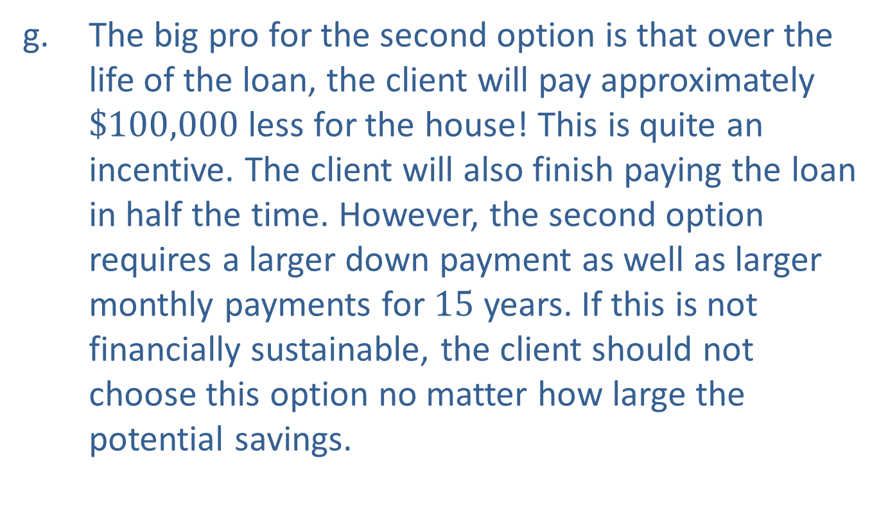
Example 4: Calculating Mortgage Payments and Fees—Slide 9
g. The big pro for the second option is that over the life of the loan, the client will pay approximately $\$100,000$ less for the house! This is quite an incentive. The client will also finish paying the loan in half the time. However, the second option requires a larger down payment as well as larger monthly payments for 15 years. If this is not financially sustainable, the client should not choose this option no matter how large the potential savings.

Slide 48

Skill Check 2
Calculate the amount to be paid for 0.75 points on a mortgage loan of $\$137,500$.
Answer: $\$$1,031.25

Slide 49
Fun Fact 5
To help homeowners offset the cost of buying a home, the IRS allows you to deduct the interest paid on your mortgage when you file your personal income taxes.

Slide 50
Helpful Hint 4
When the celebratory day comes to finally settle the debt on your mortgage, your payoff amount is likely to differ from the monthly payments you've been making. Along with the balance on the loan, it will include any interest you owe through the day you intend to pay off your loan, as well as any fees or additional charges from the lender. It's best to ask for a payoff amount one to two months before your last payment.

Slide 51
Tech tip
Websites and smartphone apps can quickly create amortization tables for you. These apps can also quickly help you see the effects of changing the mortgage

Slide 52
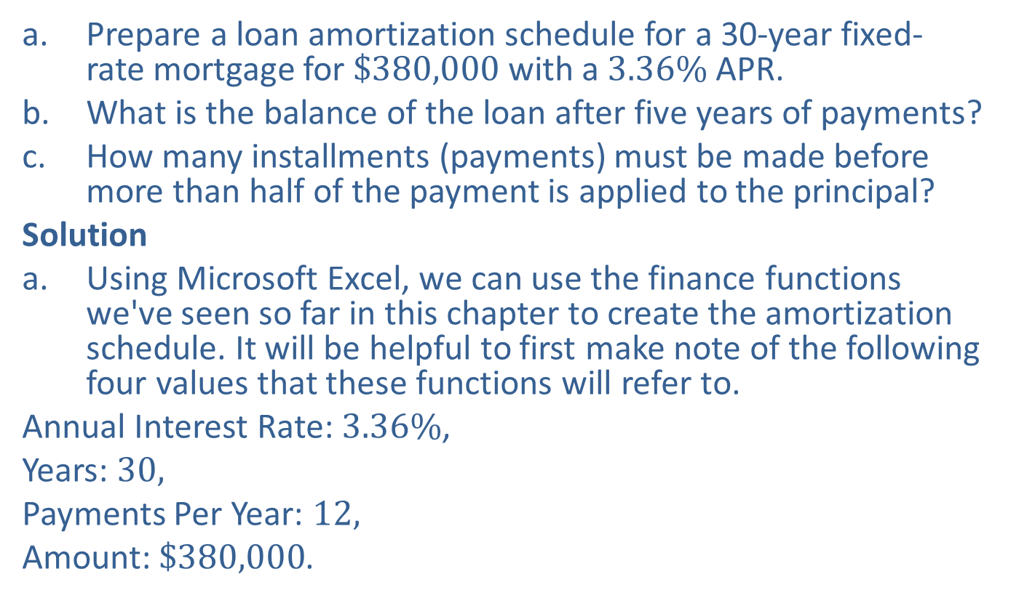
Example 5: Creating a Loan Amortization Schedule—Slide 1
a. Prepare a loan amortization schedule for a 30-year fixed-rate mortgage for $\$380,000$ with a $3.36\%$ APR.
b. ​What is the balance of the loan after five years of payments?
c. How many installments (payments) must be made before more than half of the payment is applied to the principal?
Solution
a. Using Microsoft Excel, we can use the finance functions we've seen so far in this chapter to create the amortization schedule. It will be helpful to first make note of the following four values that these functions will refer to.
​Annual Interest Rate: $3.36\%$,
​Years: 30,
​Payments Per Year: 12,
​Amount: $\$380,000$.

Slide 53
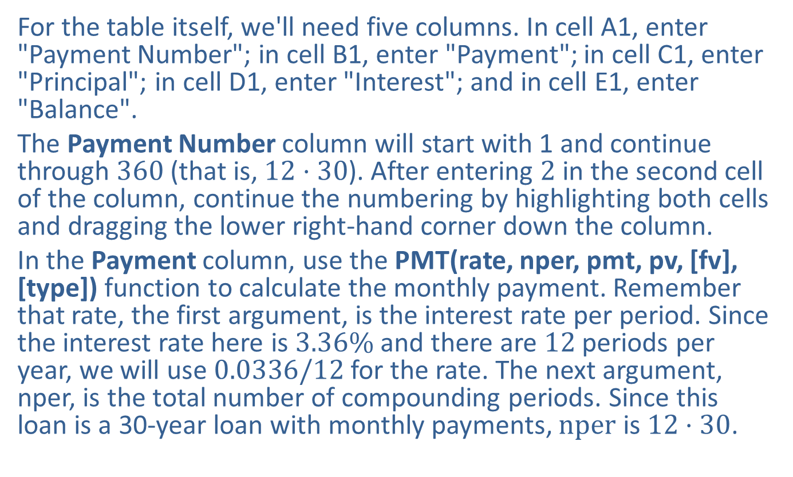
Example 5: Creating a Loan Amortization Schedule—Slide 2
​For the table itself, we'll need five columns. In cell A1, enter "Payment Number"; in cell B1, enter "Payment"; in cell C1, enter "Principal"; in cell D1, enter "Interest"; and in cell E1, enter "Balance".
​The Payment Number column will start with 1 and continue through 360 (that is, $12⋅30$). After entering 2 in the second cell of the column, continue the numbering by highlighting both cells and dragging the lower right-hand corner down the column.
​In the Payment column, use the PMT(rate, nper, pmt, pv, [fv], [type]) function to calculate the monthly payment. Remember that rate, the first argument, is the interest rate per period. Since the interest rate here is $3.36\%$ and there are 12 periods per year, we will use $0.0336/12$ for the rate. The next argument, nper, is the total number of compounding periods. Since this loan is a 30-year loan with monthly payments, $nper$ is $12⋅30$.

Slide 54
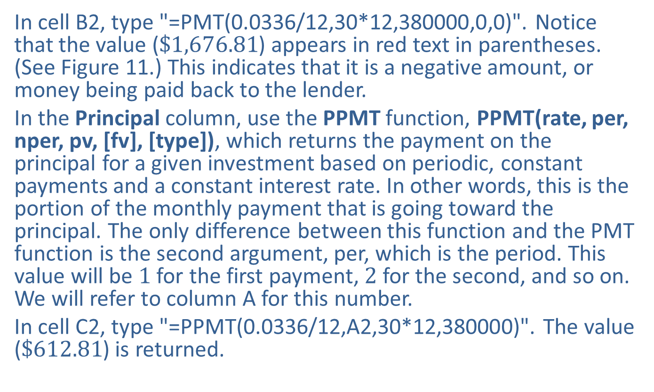
Example 5: Creating a Loan Amortization Schedule—Slide 3
​In cell B2, type "=PMT(0.0336/12,30*12,380000,0,0)". Notice that the value ($\$1,676.81$) appears in red text in parentheses. (See Figure 11.) This indicates that it is a negative amount, or money being paid back to the lender.
​In the Principal column, use the PPMT function, PPMT(rate, per, nper, pv, [fv], [type]), which returns the payment on the principal for a given investment based on periodic, constant payments and a constant interest rate. In other words, this is the portion of the monthly payment that is going toward the principal. The only difference between this function and the PMT function is the second argument, per, which is the period. This value will be 1 for the first payment, 2 for the second, and so on. We will refer to column A for this number.
​In cell C2, type "=PPMT(0.0336/12,A2,30*12,380000)". The value ($\$612.81$) is returned.

Slide 55
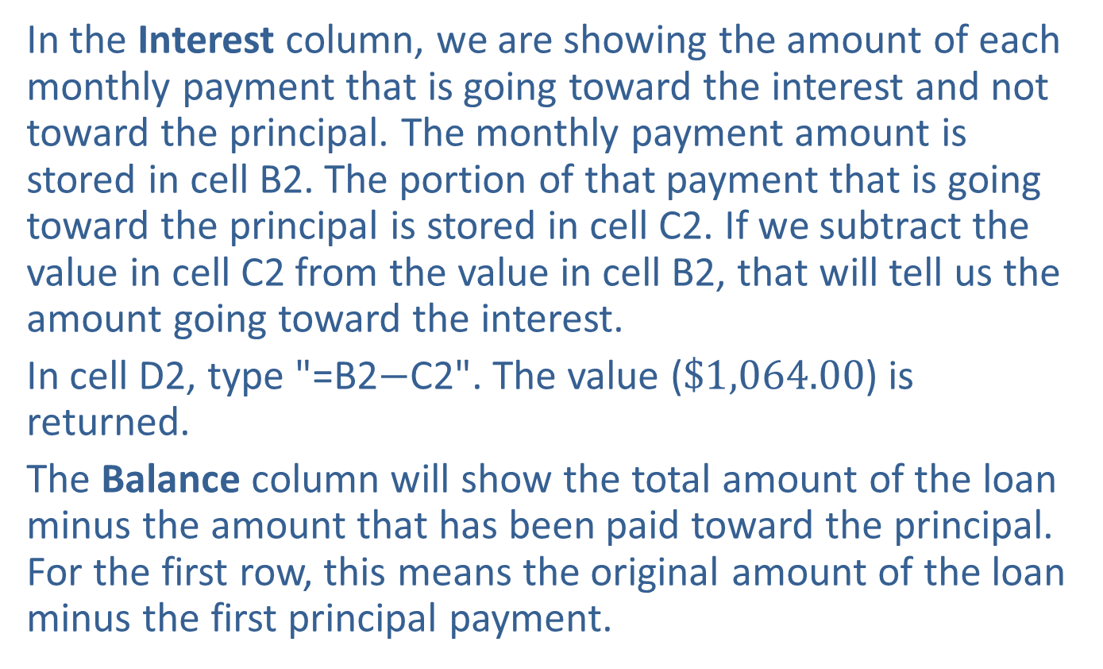
Example 5: Creating a Loan Amortization Schedule—Slide 4
​​In the Interest column, we are showing the amount of each monthly payment that is going toward the interest and not toward the principal. The monthly payment amount is stored in cell B2. The portion of that payment that is going toward the principal is stored in cell C2. If we subtract the value in cell C2 from the value in cell B2, that will tell us the amount going toward the interest.
​In cell D2, type "=B2$−$C2". The value ($\$1,064.00$) is returned.
​The Balance column will show the total amount of the loan minus the amount that has been paid toward the principal. For the first row, this means the original amount of the loan minus the first principal payment.

Slide 56
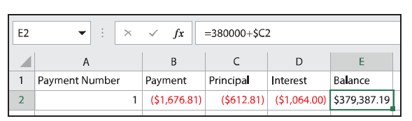

Example 5: Creating a Loan Amortization Schedule—Slide 5
​​​In cell E2, type "=380000+C2". (Recall that the value in the Principal column is negative, which is why we are adding instead of subtracting.) The value $\$379,387.19$ is returned.
Figure 11
We cannot copy these cells for the entire table quite yet. For the second row, select cells B2 through E2 and drag the selection down one row. The Payment stays the same, but the amounts in the Principal and Interest columns are updated. We need to adjust the balance column for the second payment since we no longer want to subtract from the original loan amount; instead, we want to subtract from the previous balance in cell E2.

Slide 57
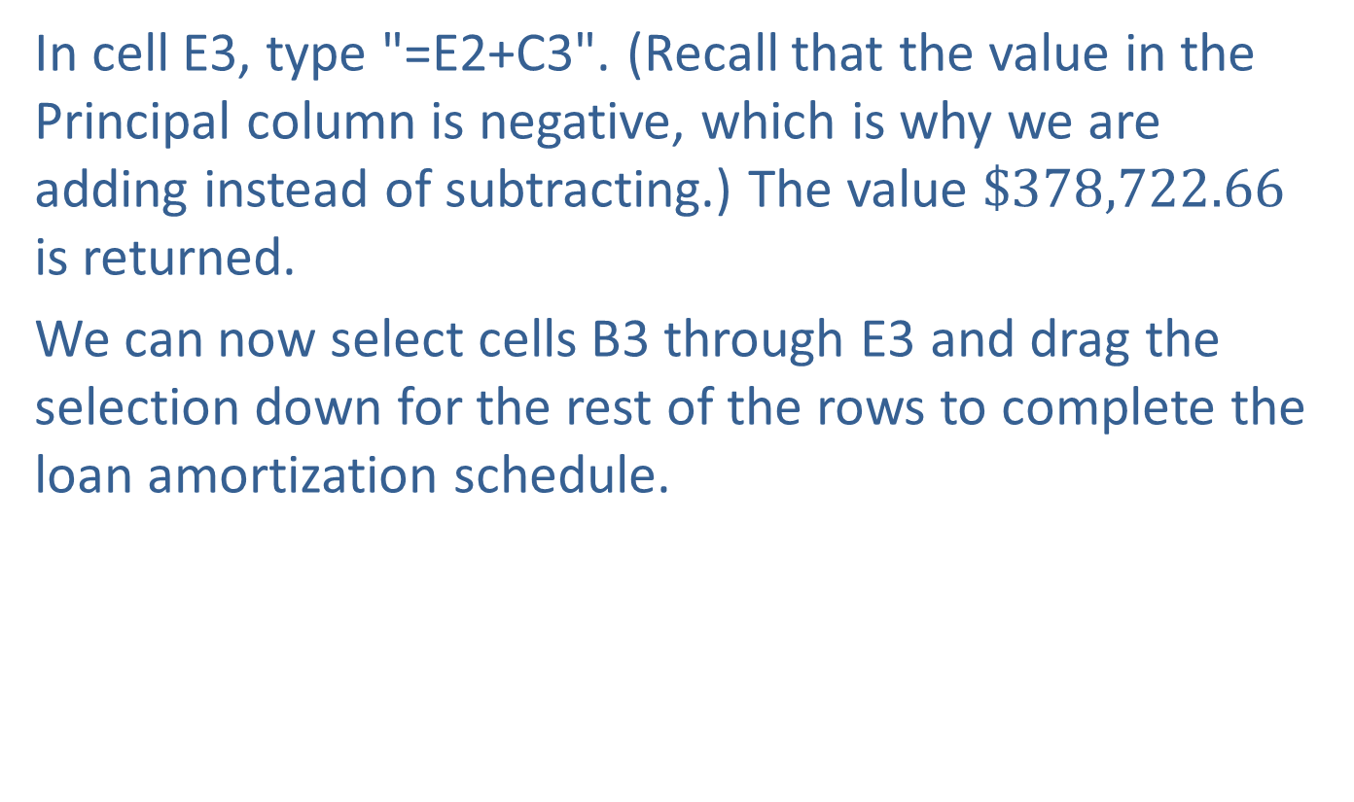
Example 5: Creating a Loan Amortization Schedule—Slide 6
​In cell E3, type "=E2+C3". (Recall that the value in the Principal column is negative, which is why we are adding instead of subtracting.) The value $\$378,722.66$ is returned.
​We can now select cells B3 through E3 and drag the selection down for the rest of the rows to complete the loan amortization schedule.
​

Slide 58
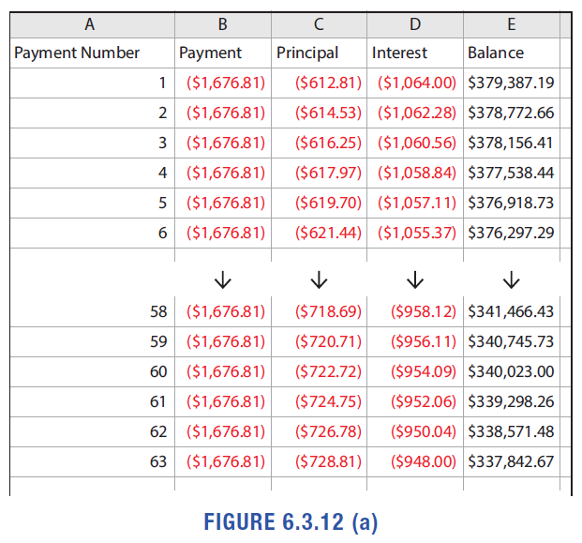
Example 5: Creating a Loan Amortization Schedule—Slide 7
Figure 12 a

Slide 59
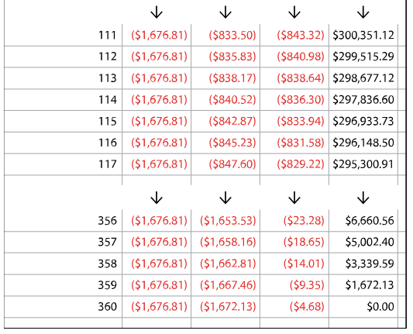
Example 5: Creating a Loan Amortization Schedule—Slide 8
Figure 12 b

Slide 60

Example 5: Creating a Loan Amortization Schedule—Slide 9
​To make sure that the loan amortization schedule table is correct, you can find the sum of the column containing the principal amounts paid each time. This should add to the original loan amount. To determine how much interest was paid over the life of the loan, you can add the interest column.
b. There will be $5⋅12=60$ payments in five years. The table tells us that after the 60th payment is made, a balance of $\$340,023.00$ remains.
c. More than half the payment will be applied to the principal after the 113th payment. The 114th payment shows a flip in the columns so that the principal payment is greater than the interest payment.

Slide 61


Skill Check 3—Slide 1
Based on the loan amortization schedule shown, what is the balance of the $\$114,000$ loan after 2 years of payments?

Slide 62

Skill Check 3—Slide 2

Slide 63

Skill Check 3—Slide 3
Figure 13

Slide 64

Skill Check 3
Based on the loan amortization schedule shown, what is the balance of the $\$114,000$ loan after 2 years of payments?
Answer: $109,405.33

Slide 65
Fun Fact 6
Usually a derogatory term, Investopedia defines a deadbeat as a slang term in the credit world for a credit card user who pays off his or her balance in full and on time every month, thus avoiding the need to pay off the interest that would have accrued on their accounts.

Slide 66
Definition: Open-Ended Loans
Open-Ended Loans (Revolving Credit)
An open-ended loan, or revolving credit, is a preapproved loan amount that may be used by the borrower repeatedly. Interest is applied to any unpaid balance at the end of the payment period.
Credit Limit
The maximum amount of an open-ended loan is called your credit limit.
Grace Period
A grace period is a period of time in which no interest accrues on a debt.

Slide 67
Helpful Hint 5
Debit cards (or check cards) are not credit cards for borrowing money, they are simply an electronic means by which consumers can access the money already in their bank accounts.

Slide 68


Example 6: Comparing Payoff Times for Credit Cards—Slide 1
The graphs in Figure 6.3.15 show the payment timeline for a credit card with a balance of $\$1000$ and a $14\%$ fixed interest rate where no new purchases are made. Graph A shows the timeline with the $4\%$ minimum payment made each month. Graph B shows the payment timeline with consistent payments of $\$40$ per month.
Figure 15

Slide 69


Example 6: Comparing Payoff Times for Credit Cards—Slide 2
a. ​Use the graphs to determine approximately how many payments are needed to pay off the $\$1000$ debt in each scenario.
b. ​How much longer does it take to pay off the debt in Graph A than in Graph B?
Solution
a. In Graph A, the balance is paid off after 248 monthly payments. In Graph B, the balance is paid off in approximately 30 monthly payments.
b. ​Making minimum payments, it takes 248 months or
Using payments of $\$40$ a month, it takes
balance. Therefore, it takes approximately 20.7 $−$ 2.5 = 18.2 years
longer to pay off the $1000 debt making only minimum payments.

Slide 70
Helpful Hint 6
Schumer boxes are the easy-to-read tables used by credit card issuers to clearly disclose important rate, fee, and term information. They are named after the New York Senator (then Congressman) Charles Schumer who is responsible for the legislation which requires easily readable font instead of "mice type" legal print.

Slide 71
Definition: Number of Fixed Payments Required to Pay Off Credit Card Debt
The number of fixed payments R required to pay off credit card debt is calculated with the formula.
where A is the loan amount, r is the APR in decimal form, n is the number of payments per year, and the payment amount is PMT.

Slide 72
Helpful Hint 7
The payment amount must be more than the amount of interested add on each period. Otherwise, the balance will never decrease. The formula will return an error if the payment is less than the interest to be added.

Slide 73

Example 7: Paying Off Credit Card Debt with a Fixed Payment—Slide 1
Assume you want to buy a new computer that costs $\$2200$ using a credit card that has an APR of $19.99\%$.
a. Determine how long it will take you to pay off the new computer if you make regular monthly payments of $\$40$.
b. Determine how long it will take you to pay off the computer if you make regular monthly payments of $\$80$.
c. How much is saved by making monthly payments at the higher amount?

Slide 74

Example 7: Paying Off Credit Card Debt with a Fixed Payment—Slide 2
Solution
a. We can determine how many $\$40$ payments are needed to pay off the computer by using the fixed payments formula for R.
By Hand
The formula we are using requires that we know the APR, the loan amount, payment amount, and the number of payments. From the information given, these are as follows.
r = 0.1999 A = $2200 PMT = $40 n = 12

Slide 75
Example 7: Paying Off Credit Card Debt with a Fixed Payment—Slide 3
Substituting these values into the formula for the number of fixed payments, we have the following equation.

Slide 76

Example 7: Paying Off Credit Card Debt with a Fixed Payment—Slide 4
TI-83/84 Plus
We can use the TVM Solver again, but this time we'll be solving for N.
We've said that N is the total number of times interest is compounded, or the total number of payments. Finding the total number of payments will tell us how long it will take to pay off the computer.
​Since this is the value we are solving for, we will come back to the N entry after filling out the other values.
​The interest rate is 19.99%, so I% = 19.99.
​We are starting with a balance of $\$2200$, so PV = −2200. (Notice that this value is negative because it is the amount you owe.)
​We are making monthly payments of $\$40$, so PMT = 40.
​At the end of the loan, no money will be owed, so FV = 0.

Slide 77

Example 7: Paying Off Credit Card Debt with a Fixed Payment—Slide 5
​Because the interest is being compounded monthly, P/Y = C/Y = 12.
​We'll assume that payments are made at the end of each period, so be sure that END is highlighted in the final row.
Clear the entry for N and press alpha enter to solve for the number of payments. The calculator returns 150.0760203.
​
Figure 17

Slide 78

Example 7: Paying Off Credit Card Debt with a Fixed Payment—Slide 6
​Microsoft Excel
Excel has a built-in financial function NPER(rate, pmt, pv, [fv], [type]) that can be used to calculate the number of payments necessary to pay off a loan. The specific arguments for this function are similar to the arguments for other financial functions we've discussed in this chapter.
rate rate is the interest rate per period. This is the interest rate divided by the number of compounding periods per year. For this example, $rate={0.1999}/{12}$.
pmt is the amount of each monthly payment. For this example, $=40$.
pv is the present value, or principal amount. Default is 0. For this example, pv = −2200, because that’s the initial balance that is owed.

Slide 79


Example 7: Paying Off Credit Card Debt with a Fixed Payment—Slide 7
fv is the future value. For this example, $fv=0$, because when the credit card is paid off, nothing will be owed.
type refers to whether payments are being made at the beginning of each period or at the end; $0=$ end of the period, $1=$ beginning of the period. Default is 0.
In an empty cell, type "=NPER(0.1999/12,40,-2200,0,0)" and press Enter. The number of payments is given as 150.076.
Figure 18
Therefore, it will take approximately 150 monthly payments, or
years, to pay off the debt.​​

Slide 80

Example 7: Paying Off Credit Card Debt with a Fixed Payment—Slide 8
b. For this second option, the only value that changes is the fixed payment amount, $PMT=\$80$.
By Hand
Substituting into the formula for the number of fixed payments, we have the following.

Slide 81



Example 7: Paying Off Credit Card Debt with a Fixed Payment—Slide 9
TI-83/84 Plus
In the TVM Solver, change the PMT value to 80 and clear the entry for $N$ and press alpha enter to solve for the new number of payments. The calculator returns 37.084776.
Figure 19
Microsoft Excel
We can again use the NPER(rate, pmt, pv, [fv], [type]) formula. The only difference this time will be that we need to use $pmt=80$ instead of 40.

Slide 82

Example 7: Paying Off Credit Card Debt with a Fixed Payment—Slide 10
In an empty cell, type "=NPER(0.1999/12,80, −2200,0,0)" and press Enter. The number of payments is given as 37.08478.
Figure 19
Therefore, it will take approximately 37 monthly payments, or just over three years, to pay off the debt.

Slide 83

Example 7: Paying Off Credit Card Debt with a Fixed Payment—Slide 11
c. In part a., we've seen that we could pay off the debt with 150 monthly payments of $\$40$. That would be $150⋅\$40=\$6000$.
In part b., we saw that you need to make 37 monthly payments of $\$80$ to pay off the computer. The second option would be $37⋅\$80=\$2960$.
By the time we've paid off the computer using the second option, we would save $\$6000−\$2960=\$3040$. By doubling the minimum payment from $\$40$ a month to $\$80$ a month, you can save $\$3040$ and be finished with payments in just over 3 years. This is a much wiser financial decision for purchasing the computer with a credit card.

Slide 84


Example 8: Calculating Interest Rate on a Payday Loan—Slide 1
Assume you wish to borrow $\$300$ for two weeks in the form of a payday loan and the amount of interest you must pay is $\$25$ per $\$100$ borrowed. What is the APR on the payday loan?
Solution
If the interest is $\$25$ per $\$100$, that is a rate of $\$25$ for a two-week period. We can expand that for a year by determining how many two-week periods there are in a year.
Now multiply the two-week rate by 26 to see the yearly rate (APR).
APR: $25\%⋅26=650\%$

Slide 85

Example 8: Calculating Interest Rate on a Payday Loan—Slide 2
Thus, the APR for the payday loan is $650\%$!
One might reasonably argue that this APR rate is never actually paid because the loan is for such a short period of time. However, payday loans often become a brutal cycle that is hard to break. The loan along with the interest needs to be paid in two weeks. If a borrower is not able to pay it, they are forced to borrow again and start the cycle over. These high-interest, short-term loans should be procured with caution.

Slide 86
Helpful Hint 8
The government-approved website https://www.annualcreditreport.com allows you to get a free copy of your credit report every 12 months from each credit of the three reporting companies. You can request all three at once, or as they suggest, spread them out over the course of the year, once every four months, so that you can monitor your credit score.

Slide 87

Example 9: Comparing Effects of Credit Scores on a Loan—Slide 1
Table 3 displays the interest rates that will be applied to a $\$25,000$ monthly installment loan paid off in 3 years based on a borrower's credit score.
a. Determine the overall costs for a borrower who has a credit score of 660.
b. Determine the overall costs for a borrower who has a credit score of 720.
c. ​Compare the difference in costs found in parts a. and b.

Slide 88

Example 9: Comparing Effects of Credit Scores on a Loan—Slide 2
Table 3: Interest Rate Tiers
Credit Score | APR
720–850 | $$7.13\%$$
690–719 | $$8.03\%$$
660–689 | $$9.79\%$$
620–659 | $$11.75\%$$
590–619 | $$15.17\%$$
500–589 | $$16.00\%$$

Slide 89

Example 9: Comparing Effects of Credit Scores on a Loan—Slide 3
Solution
Begin by determining the monthly payments for each credit score using the payment formula and the appropriate APR. Then multiply the payment amount by 36 months to calculate the total cost of the loan for each level of score. For both scores, the only difference is the interest rate. The other variables needed for the formula remain the same: the P = $25,000, the time t = 3, and the payments are monthly so n = 12.
a. The table shows that a credit score of 660 would secure an annual interest rate of $9.79\%$.
​

Slide 90
Example 9: Comparing Effects of Credit Scores on a Loan—Slide 4
​By Hand
Substituting the values in the formula we have the following.

Slide 91


Example 9: Comparing Effects of Credit Scores on a Loan—Slide 5
Figure 22
TI-83/84 Plus
We can use the TVM Solver again to solve for PMT.
​This loan will be paid off with three years of monthly payments, so N = 12 ⋅ 3 = 36.
​The interest rate is $9.79\%$, so I% = 19.99.
​We are starting with a balance of $\$25,000$, so PV = −25000.

Slide 92
Example 9: Comparing Effects of Credit Scores on a Loan—Slide 6
​The monthly payment amount is what we are solving for, so we will come back to the PMT entry after filling out the other values.
​At the end of the loan, no money will be owed, so FV = 0.
​Because the interest is being compounded monthly, P/Y = C/Y = 12.
​We'll assume that payments are made at the end of each period, so be sure that END is highlighted in the final row.
Clear the entry for PMT and press alpha enter to solve for the number of payments. The calculator returns 804.217082.

Slide 93


Example 9: Comparing Effects of Credit Scores on a Loan—Slide 7
​Microsoft Excel
We will use the PMT(rate, nper, pv, [fv], [type]) function with $rate={0.0979}/{12}$, $nper=12⋅3$, and $pv=−25000$.
In an empty cell, input "=PMT(0.0979/12,12*3,−25000,0,0)" and press Enter. The payment amount is given as $\$804.22$.
Figure 23
So after 3 years the total cost of the loan would be as follows.
$804.22 ⋅ 36 = $28,951.92

Slide 94

Example 9: Comparing Effects of Credit Scores on a Loan—Slide 8
b. The table shows that a credit score of 720 would secure an interest rate of $7.13\%$.
By Hand
Substituting the values in the formula we have the following equation.

Slide 95

Example 9: Comparing Effects of Credit Scores on a Loan—Slide 9
TI-83/84 Plus
In the TVM Solver, change I% to the new rate of 7.13. All other values should stay the same. Clear the value for PMT. Press alpha enter to solve for PMT. The calculator returns 773.4142407.
Figure 24

Slide 96


Example 9: Comparing Effects of Credit Scores on a Loan—Slide 10
​Microsoft Excel
We will again use the PMT(rate, nper, pv, [fv], [type]) function again to calculate the monthly payment with the new credit score.
In an empty cell, type "=PMT(0.0713/12,12*3,-25000,0,0)" and press Enter. The payment amount is given as $\$773.41$.
​
Figure 25

Slide 97

Example 9: Comparing Effects of Credit Scores on a Loan—Slide 11
So after 3 years the total cost of the loan would be as follows.
​$\$773.41⋅36=\$27,842.76$
c. The difference between the overall cost of the loan for the two credit scores is found by subtracting the results found in parts a. and b.
​Difference between Loan Costs over 3 Years:
$$\$28,951.92−\$27,842.76=\$1,109.16$$
This means that the better credit score would save the borrower $\$1,109.16$ over the 3-year loan period.

