Slide 1
Section 6.4
Federal Revenue

Slide 2
Fun Fact 1
Ratified in 1913, the 16th Amendment to the US Constitution established Congress's power to collect income taxes annually in order to fund public services and pay governmental obligations.

Slide 3
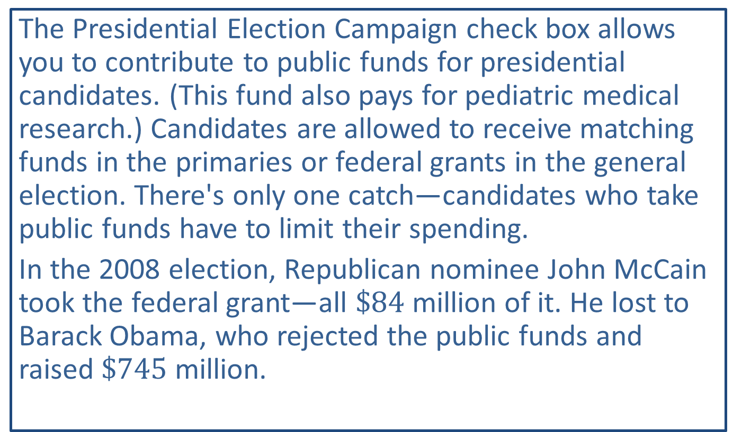
Fun Fact 2
The Presidential Election Campaign check box allows you to contribute to public funds for presidential candidates. (This fund also pays for pediatric medical research.) Candidates are allowed to receive matching funds in the primaries or federal grants in the general election. There's only one catch—candidates who take public funds have to limit their spending.
In the 2008 election, Republican nominee John McCain took the federal grant—all $\$84$ million of it. He lost to Barack Obama, who rejected the public funds and raised $\$745$ million.

Slide 4
Helpful Hint 1
Your marital status on December 31 is your status for the whole year.

Slide 5
Definition: Gross Income and Adjusted Gross Income
Gross Income
Gross income is the sum of all forms of earnings, including wages, tips, benefits, investment income, alimony, etc.
Adjusted Gross Income
Adjusted gross income (AGI) is defined as gross income minus any adjustments you are allowed such as education expenses, health savings account contributions, paid alimony, or self-employment expenses.

Slide 6
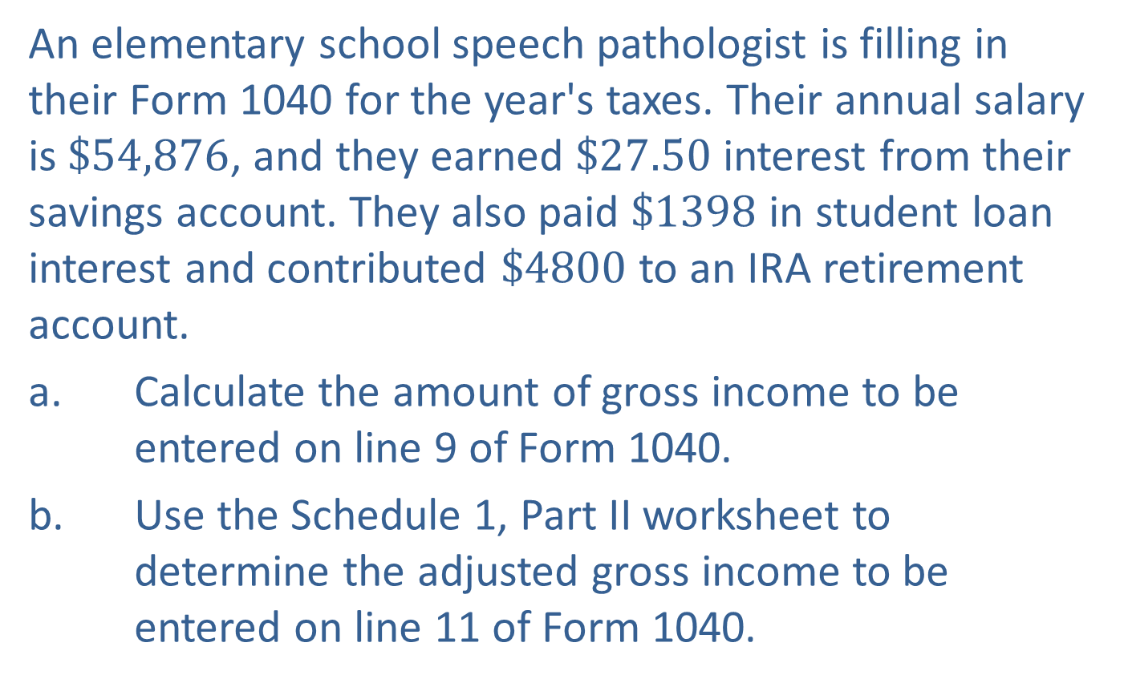
Example 1: Determining Gross Income and Adjusted Gross Income—Slide 1
An elementary school speech pathologist is filling in their Form 1040 for the year's taxes. Their annual salary is $\$54,876$, and they earned $\$27.50$ interest from their savings account. They also paid $\$1398$ in student loan interest and contributed $\$4800$ to an IRA retirement account.
a. Calculate the amount of gross income to be entered on line 9 of Form 1040.
b. Use the Schedule 1, Part II worksheet to determine the adjusted gross income to be entered on line 11 of Form 1040.

Slide 7
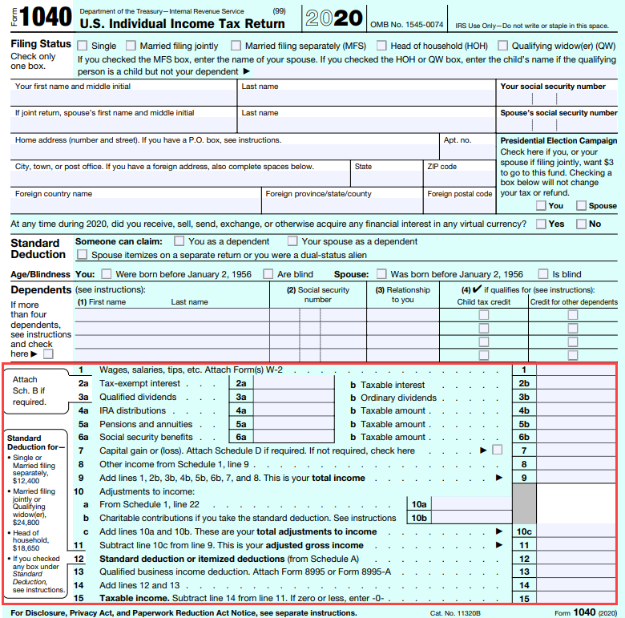
Example 1: Determining Gross Income and Adjusted Gross Income—Slide 2
FIGURE 3: Page 1 of Form 1040

Slide 8
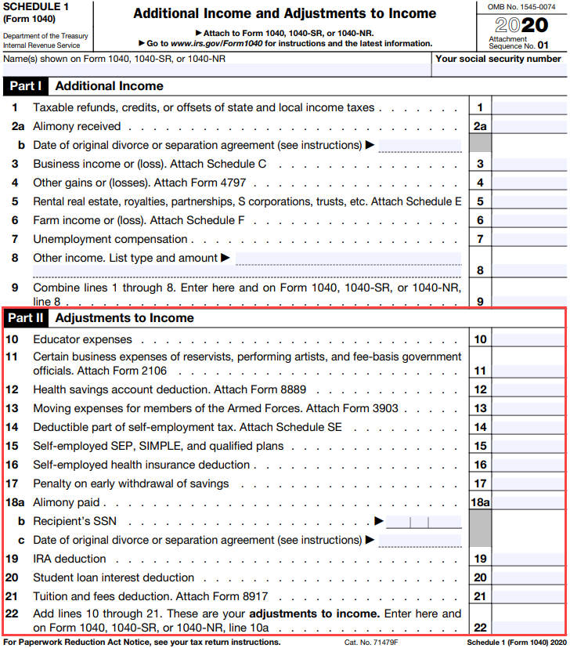
Example 1: Determining Gross Income and Adjusted Gross Income—Slide 3
FIGURE 4: Schedule 1 Form

Slide 9
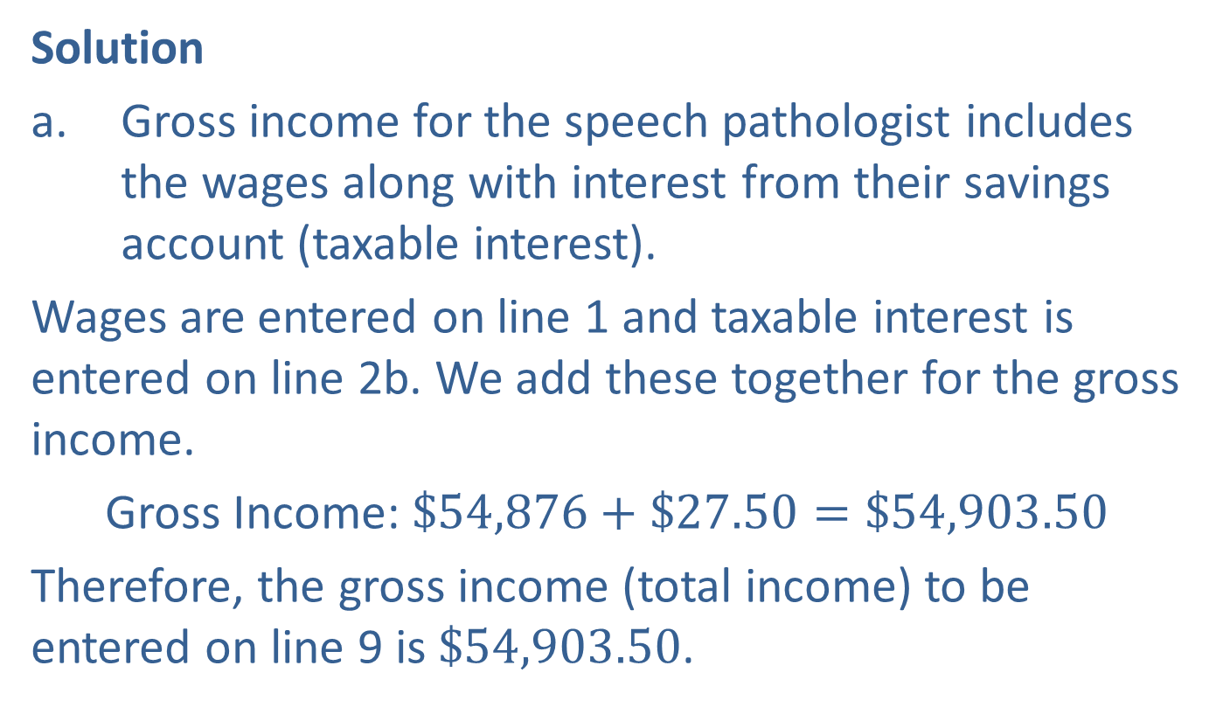
Example 1: Determining Gross Income and Adjusted Gross Income—Slide 4
Solution
a. Gross income for the speech pathologist includes the wages along with interest from their savings account (taxable interest).
​Wages are entered on line 1 and taxable interest is entered on line 2b. We add these together for the gross income.
​Gross Income: $\$54,876+\$27.50=\$54,903.50$
​Therefore, the gross income (total income) to be entered on line 9 is $\$54,903.50$.

Slide 10
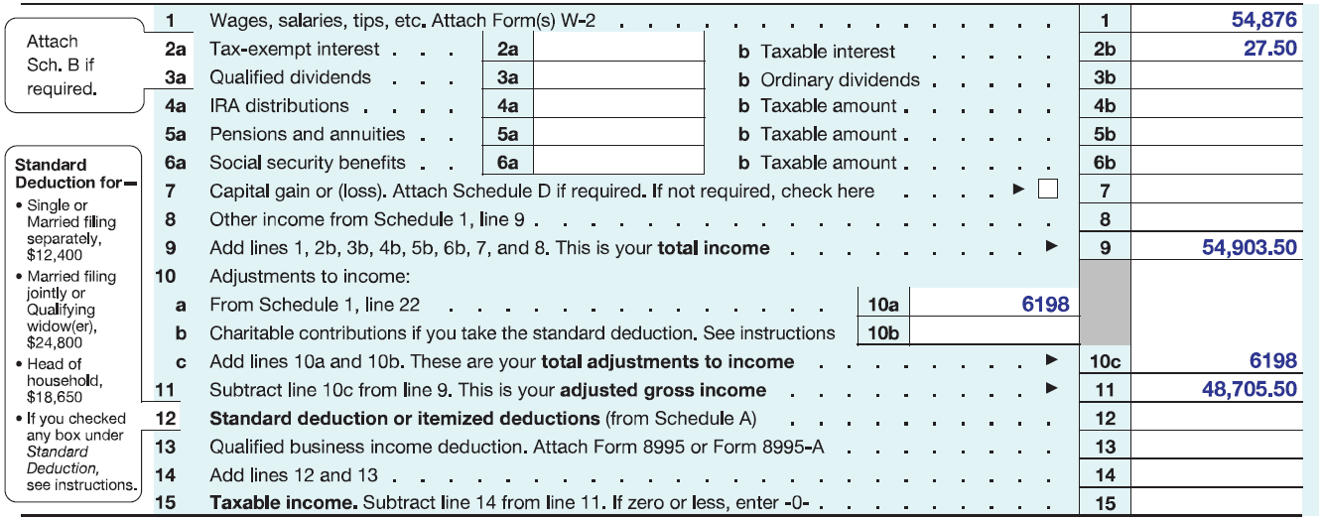
Example 1: Determining Gross Income and Adjusted Gross Income—Slide 5
FIGURE 5

Slide 11
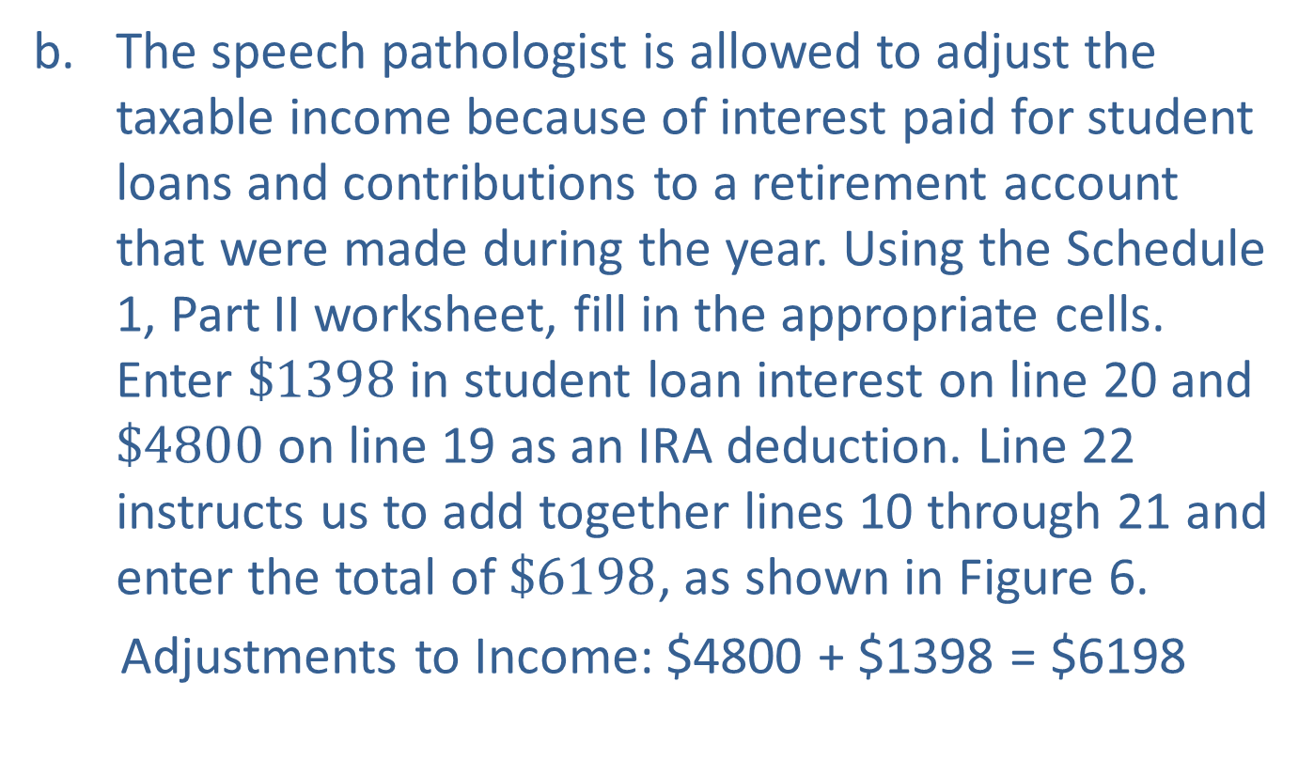
Example 1: Determining Gross Income and Adjusted Gross Income—Slide 6
b. ​The speech pathologist is allowed to adjust the taxable income because of interest paid for student loans and contributions to a retirement account that were made during the year. Using the Schedule 1, Part II worksheet, fill in the appropriate cells. Enter $\$1398$ in student loan interest on line 20 and $\$4800$ on line 19 as an IRA deduction. Line 22 instructs us to add together lines 10 through 21 and enter the total of $\$6198$, as shown in Figure 6.
​Adjustments to Income: $4800 + $1398 = $6198

Slide 12
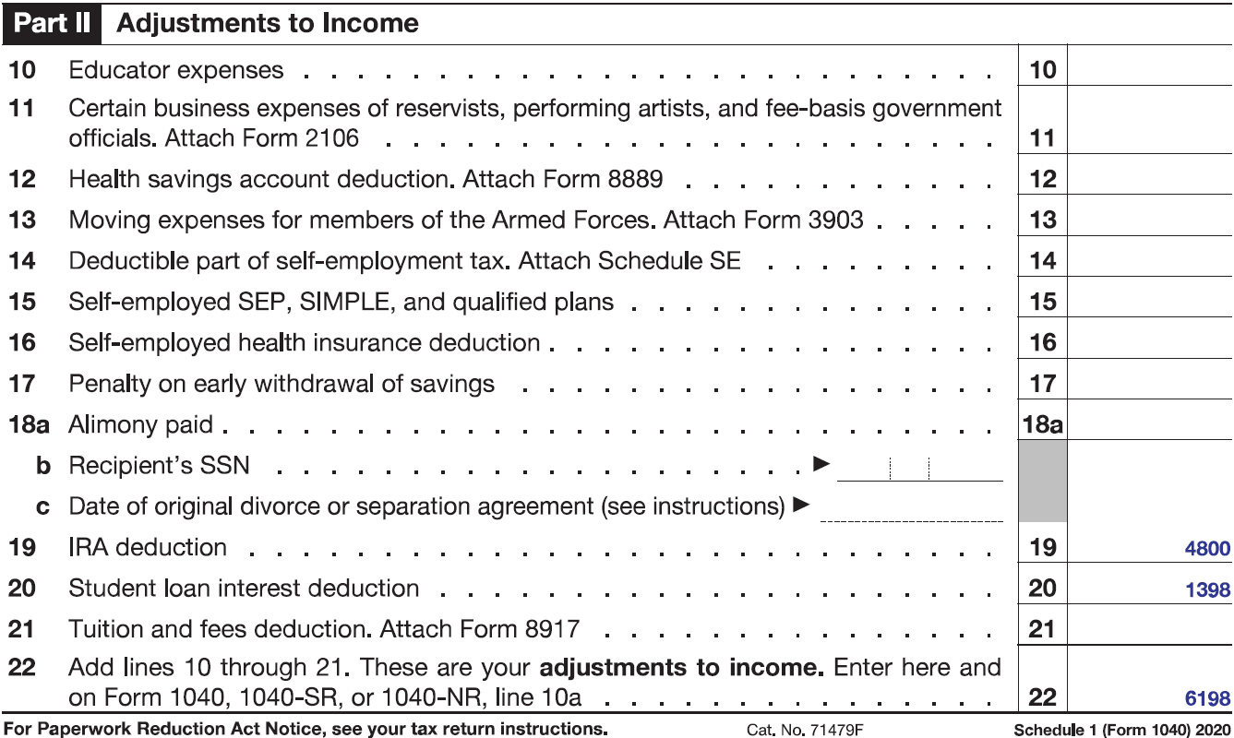
Example 1: Determining Gross Income and Adjusted Gross Income—Slide 7
FIGURE 6

Slide 13
Example 1: Determining Gross Income and Adjusted Gross Income—Slide 8
​The adjustments to income total (line 22 of the worksheet) is then entered on line 10a of Form 1040 as shown in Figure 7. If you are filling in the forms online, some programs will automatically do the addition for you and even transfer the amount from line 22 of the Schedule 1 worksheet to the correct place on Form 1040.
​Notice that line 10b on Form 1040 allows for charitable contributions to be counted separately if you choose to take the standard deduction. We will look at this more in the next example. Since the speech pathologist has no charitable contributions to add, we write 6198 on line 10c.
To find the adjusted gross income, we subtract line 10c from line 9 and enter this value on line 11, as instructed.

Slide 14
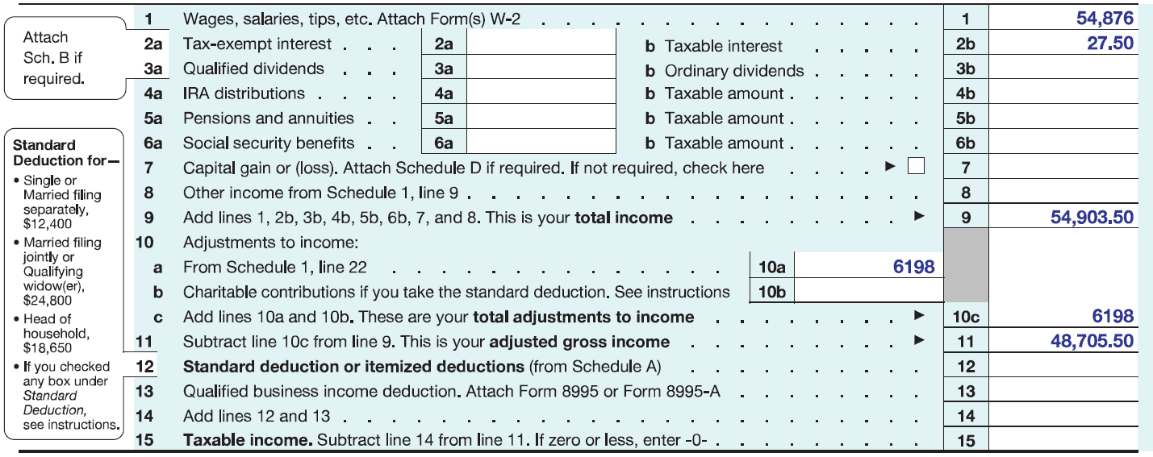

Example 1: Determining Gross Income and Adjusted Gross Income—Slide 9
​Adjusted Gross Income: $\$54,903.50−\$6198=\$48,705.50$
​So the adjusted gross income is $\$48,705.50$.
FIGURE 7

Slide 15
Helpful Hint 2
When entering a line amount, you can round to the nearest whole dollar on your tax return if you choose. However, if you round in one place on the form, you must round everywhere.

Slide 16
Helpful Hint 3
Many states also charge state income tax and use your federal adjusted gross income as a basis for your total tax bill.

Slide 17
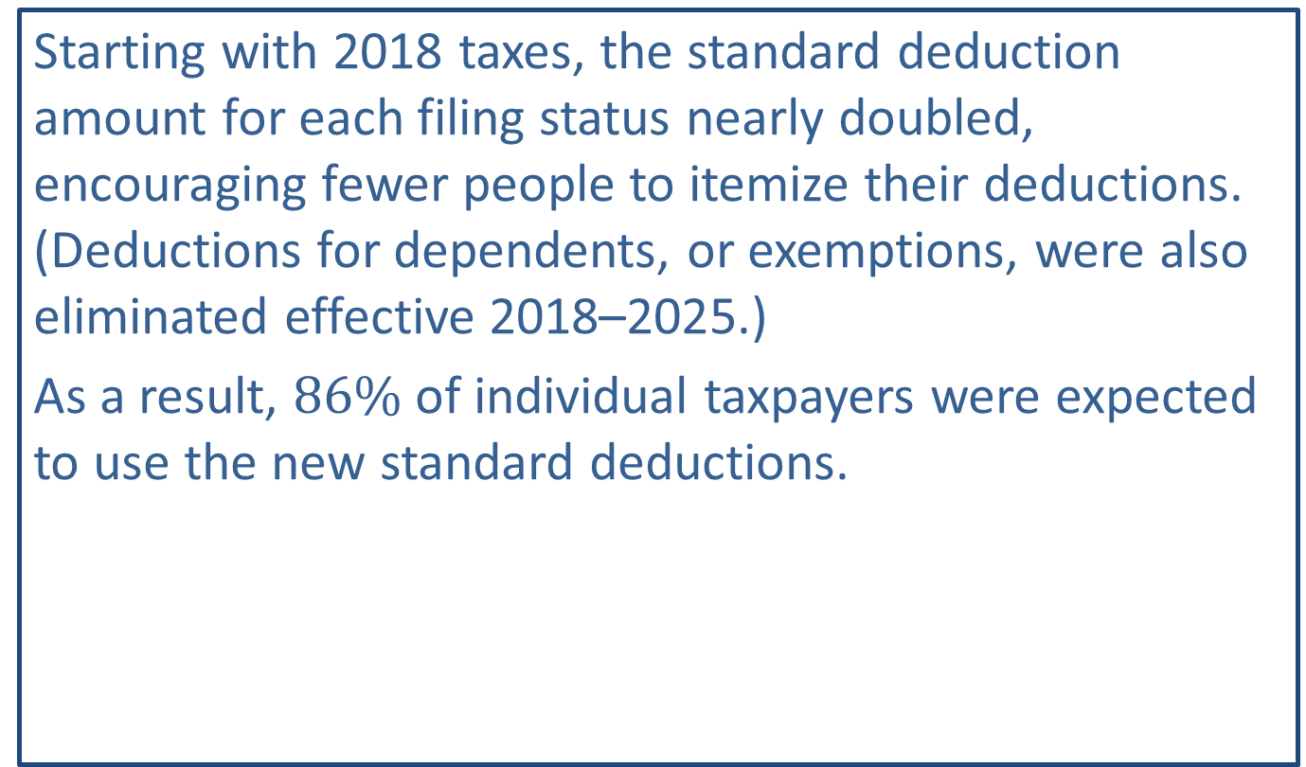
Fun Fact 3
Starting with 2018 taxes, the standard deduction amount for each filing status nearly doubled, encouraging fewer people to itemize their deductions. (Deductions for dependents, or exemptions, were also eliminated effective 2018–2025.)
As a result, $86\%$ of individual taxpayers were expected to use the new standard deductions.

Slide 18
Definition: Deduction and Taxable Income
Deduction
A tax deduction is comprised of expenses incurred by an individual or organization that can be subtracted from their gross income in order to reduce the amount of income that is able to be taxed.
Taxable Income
Taxable income is the amount of income subject to taxes by the government.

Slide 19
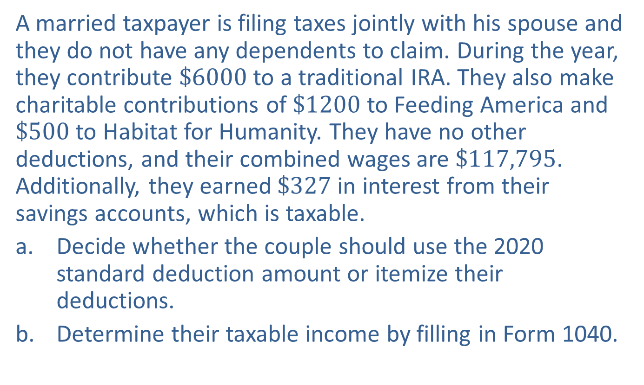
Example 2: Determining Taxable Income—Slide 1
A married taxpayer is filing taxes jointly with his spouse and they do not have any dependents to claim. During the year, they contribute $\$6000$ to a traditional IRA. They also make charitable contributions of $\$1200$ to Feeding America and $\$500$ to Habitat for Humanity. They have no other deductions, and their combined wages are $\$117,795$. Additionally, they earned $\$327$ in interest from their savings accounts, which is taxable.
a. Decide whether the couple should use the 2020 standard deduction amount or itemize their deductions.
b. Determine their taxable income by filling in Form 1040.

Slide 20
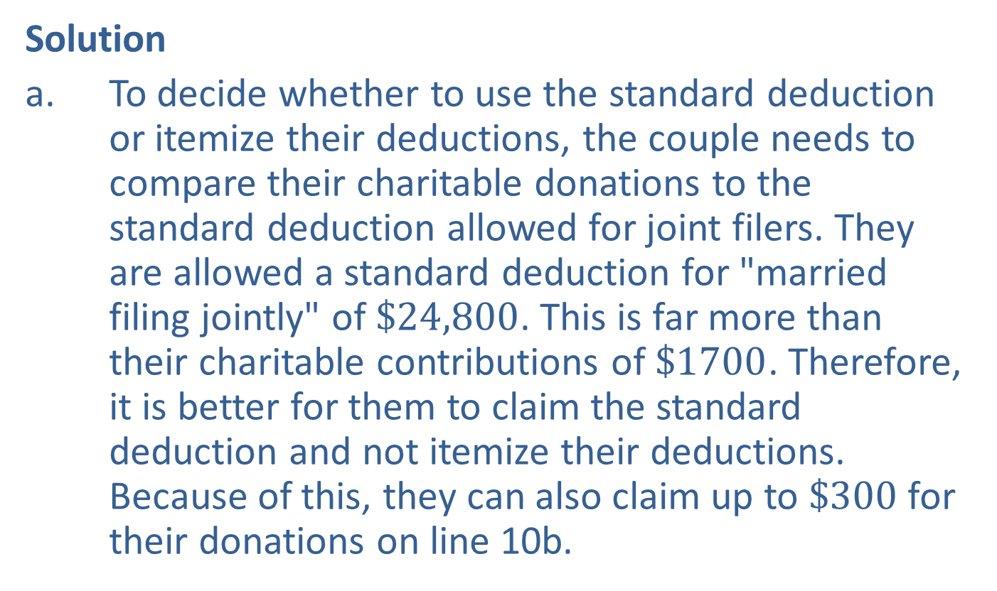
Example 2: Determining Taxable Income—Slide 2
Solution
a. To decide whether to use the standard deduction or itemize their deductions, the couple needs to compare their charitable donations to the standard deduction allowed for joint filers. They are allowed a standard deduction for "married filing jointly" of $\$24,800$. This is far more than their charitable contributions of $\$1700$. Therefore, it is better for them to claim the standard deduction and not itemize their deductions. Because of this, they can also claim up to $\$300$ for their donations on line 10b.

Slide 21
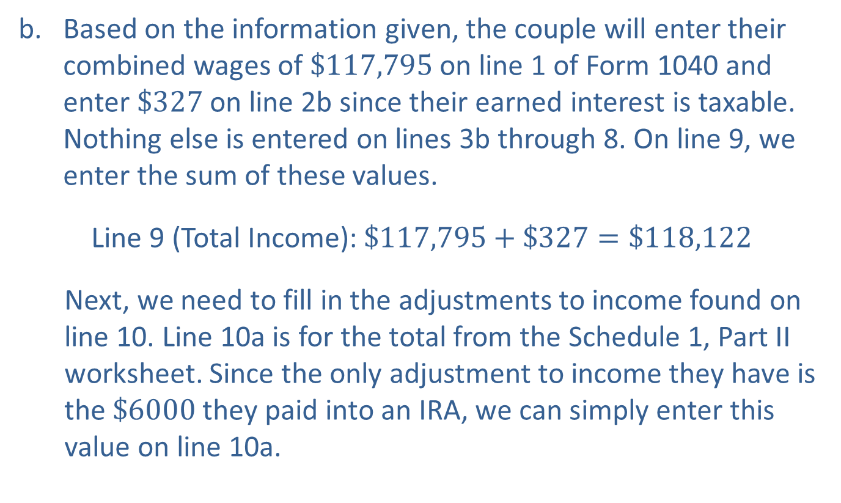
Example 2: Determining Taxable Income—Slide 3
b. Based on the information given, the couple will enter their combined wages of $\$117,795$ on line 1 of Form 1040 and enter $\$327$ on line 2b since their earned interest is taxable. Nothing else is entered on lines 3b through 8. On line 9, we enter the sum of these values.
​Line 9 (Total Income): $\$117,795+\$327=\$118,122$
Next, we need to fill in the adjustments to income found on line 10. Line 10a is for the total from the Schedule 1, Part II worksheet. Since the only adjustment to income they have is the $\$6000$ they paid into an IRA, we can simply enter this value on line 10a.

Slide 22
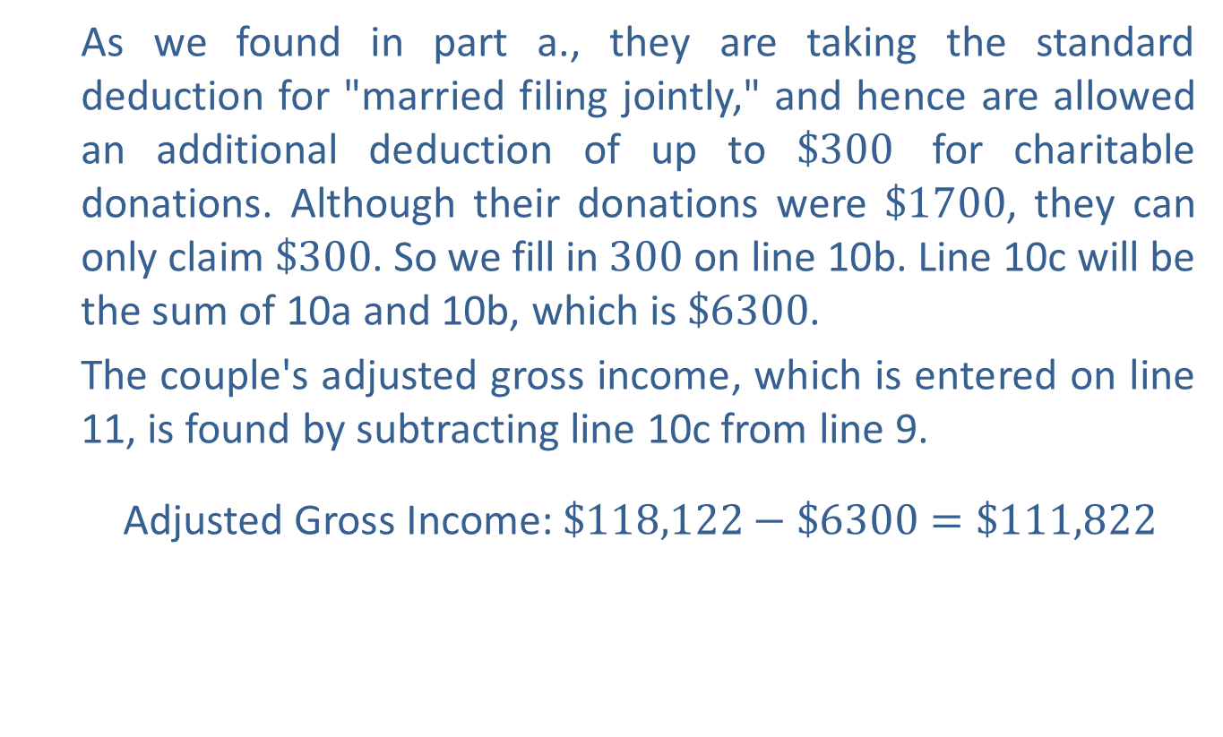
Example 2: Determining Taxable Income—Slide 4
As we found in part a., they are taking the standard deduction for "married filing jointly," and hence are allowed an additional deduction of up to $\$300$ for charitable donations. Although their donations were $\$1700$, they can only claim $\$300$. So we fill in 300 on line 10b. Line 10c will be the sum of 10a and 10b, which is $\$6300$.
The couple's adjusted gross income, which is entered on line 11, is found by subtracting line 10c from line 9.
​ Adjusted Gross Income: $\$118,122−\$6300=\$111,822$

Slide 23
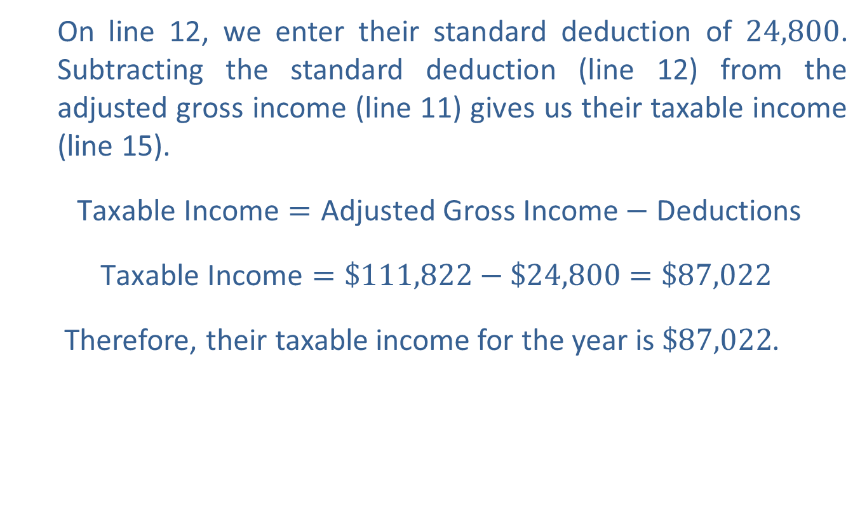
Example 2: Determining Taxable Income—Slide 5
On line 12, we enter their standard deduction of 24,800. Subtracting the standard deduction (line 12) from the adjusted gross income (line 11) gives us their taxable income (line 15).
​$\text{Taxable} \text{Income}=\text{Adjusted} \text{Gross} \text{Income}−\text{Deductions}$
​$\text{Taxable} \text{Income}=\$111,822−\$24,800=\$87,022$
Therefore, their taxable income for the year is $\$87,022$.

Slide 24
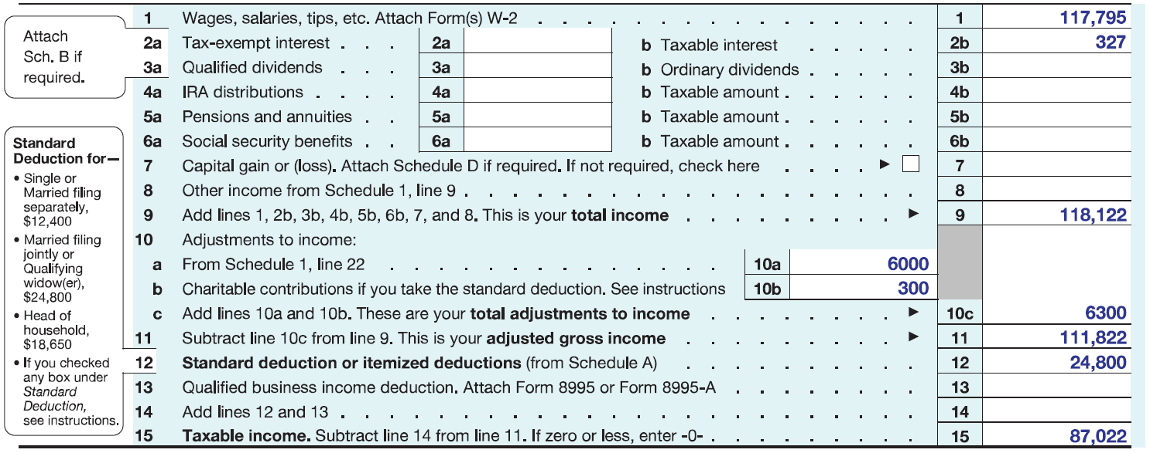
Example 2: Determining Taxable Income—Slide 6
FIGURE 8

Slide 25

Skill Check 1
Determine the standard deduction for a married taxpayer filing separately based on the 2020 Form 1040.
Answer: $\$$12,400

Slide 26
Helpful Hint 4
You can find up-to-date tax brackets by performing an internet search for "federal income tax brackets." Sometimes including the current year can help narrow down the results.

Slide 27

Example 3: Calculating Federal Income Tax Using the IRS Tax Worksheet—Slide 1
Use the partial 2020 IRS tax worksheet shown to calculate the amount of federal income tax charged to a taxpayer who is married filing jointly with a taxable income of $\$177,839$.

Slide 28
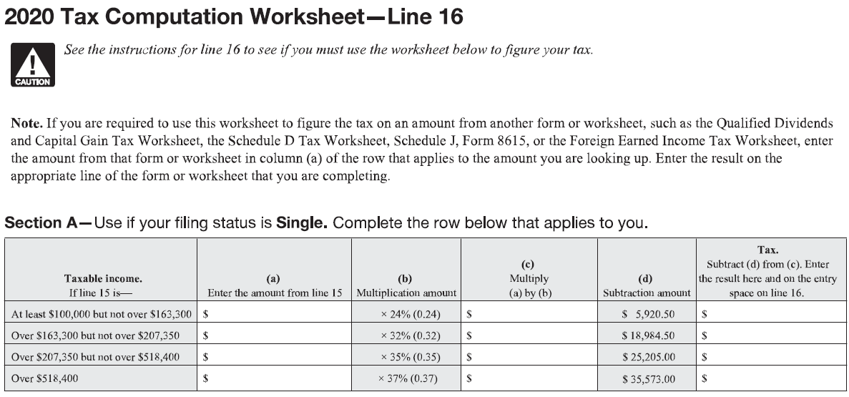
Example 3: Calculating Federal Income Tax Using the IRS Tax Worksheet—Slide 2

Slide 29
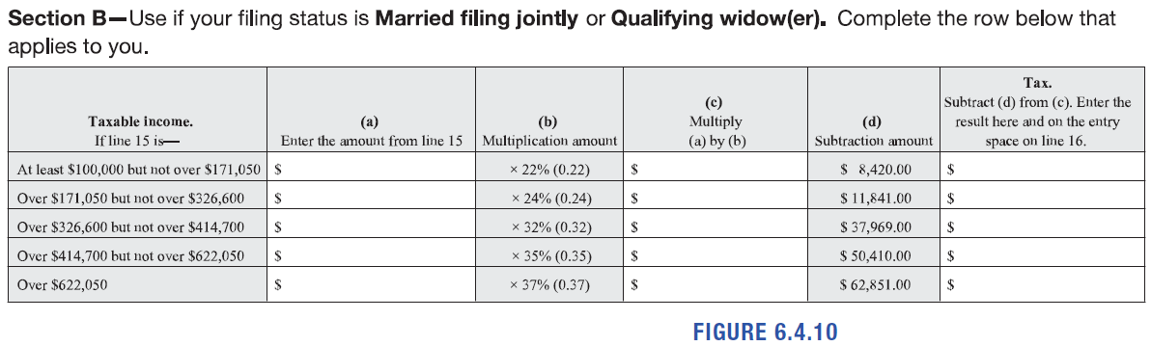
Example 3: Calculating Federal Income Tax Using the IRS Tax Worksheet—Slide 3
Figure 10

Slide 30
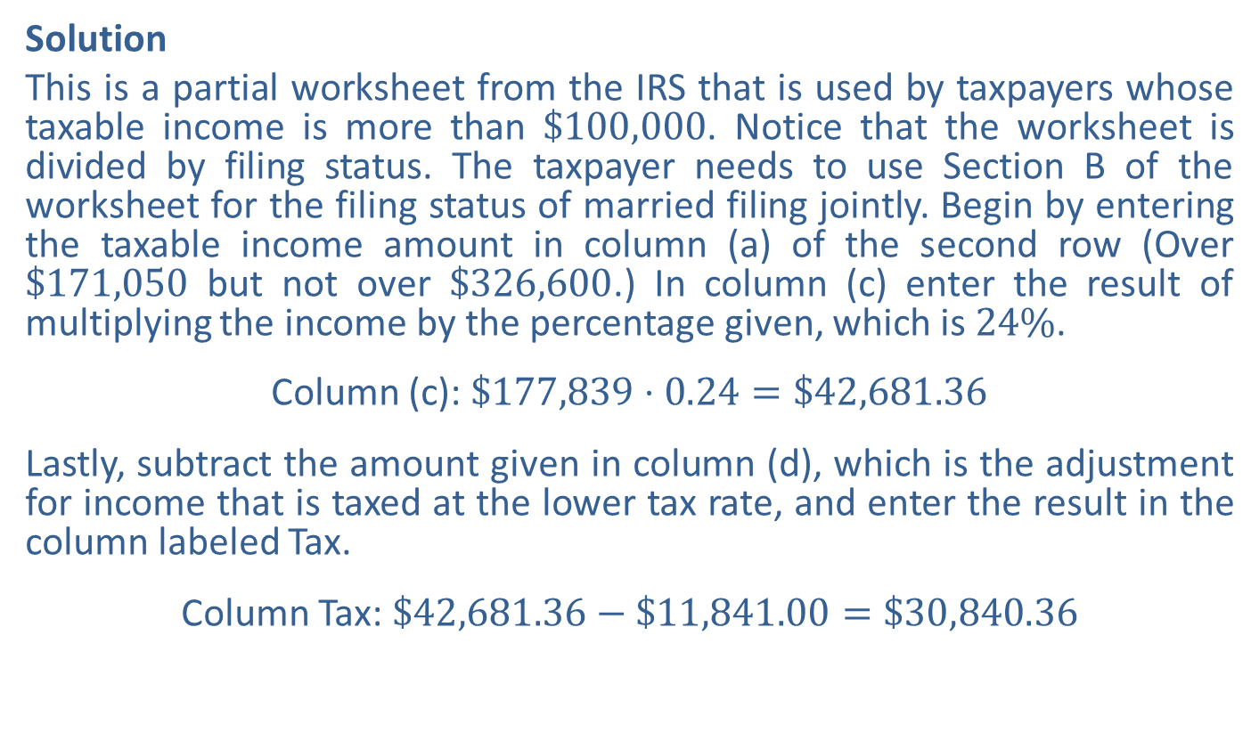
Example 3: Calculating Federal Income Tax Using the IRS Tax Worksheet—Slide 4
Solution
This is a partial worksheet from the IRS that is used by taxpayers whose taxable income is more than $\$100,000$. Notice that the worksheet is divided by filing status. The taxpayer needs to use Section B of the worksheet for the filing status of married filing jointly. Begin by entering the taxable income amount in column (a) of the second row (Over $\$171,050$ but not over $\$326,600$.) In column (c) enter the result of multiplying the income by the percentage given, which is $24\%$.
Column (c): $\$177,839⋅0.24=\$42,681.36$
Lastly, subtract the amount given in column (d), which is the adjustment for income that is taxed at the lower tax rate, and enter the result in the column labeled Tax.
Column Tax: $\$42,681.36−\$11,841.00=\$30,840.36$

Slide 31
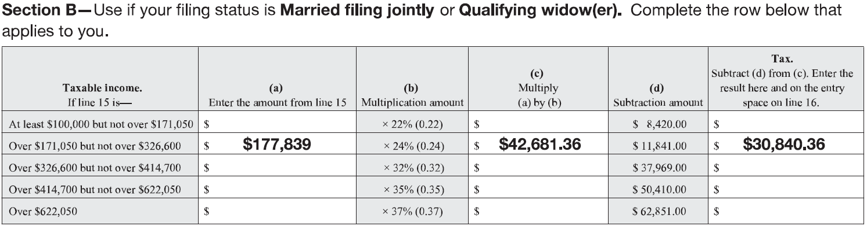

Example 3: Calculating Federal Income Tax Using the IRS Tax Worksheet—Slide 5
Figure 11
Thus, the amount of federal income tax that should be entered on line 16 of Form 1040 is $\$30,840.36$.

Slide 32
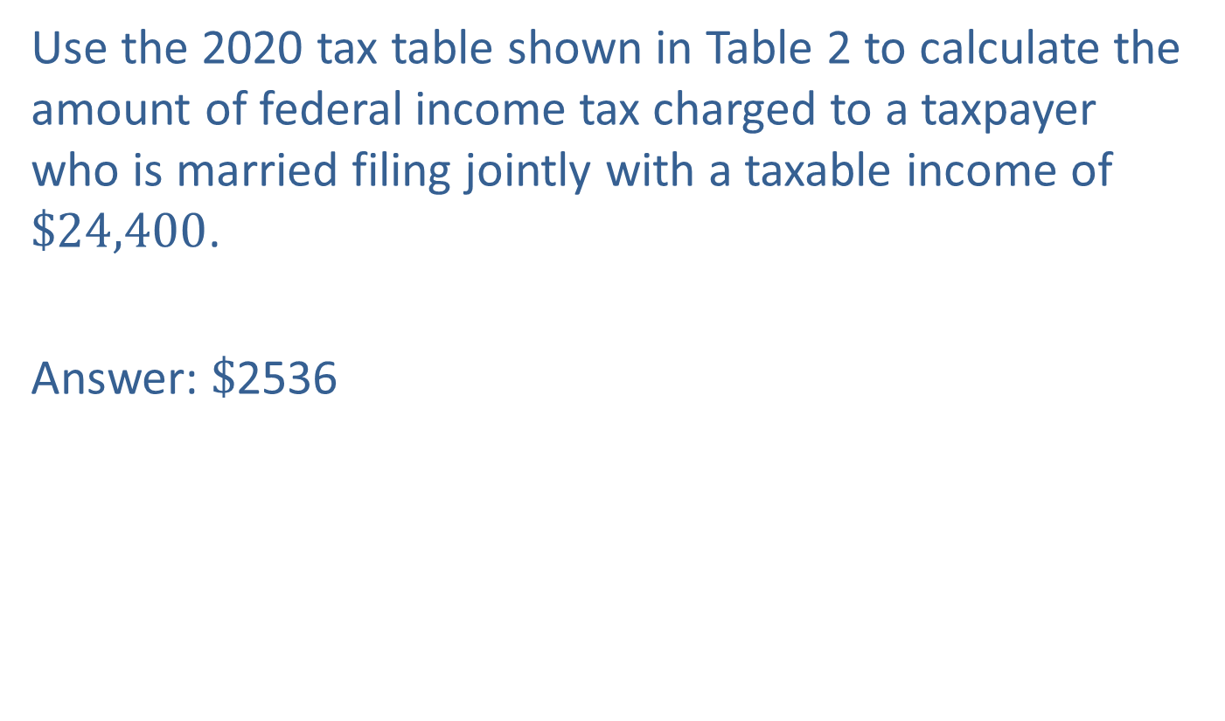
Skill Check 2
Use the 2020 tax table shown in Table 2 to calculate the amount of federal income tax charged to a taxpayer who is married filing jointly with a taxable income of $\$24,400$.
Answer: $\$$2536

Slide 33
Fun Fact 4
The April 15th deadline began in 1955. Besides moving for holidays and weekends, the deadline has only been extended nationally once. In 2020, due the economic effects of the coronavirus pandemic, the filing deadline was extended to July 15th.

Slide 34
Example 4: Determining the Bottom Line—Slide 1
Based on the following Form 1040, did the taxpayer receive a federal tax refund or owe an additional amount to the IRS in 2020?

Slide 35
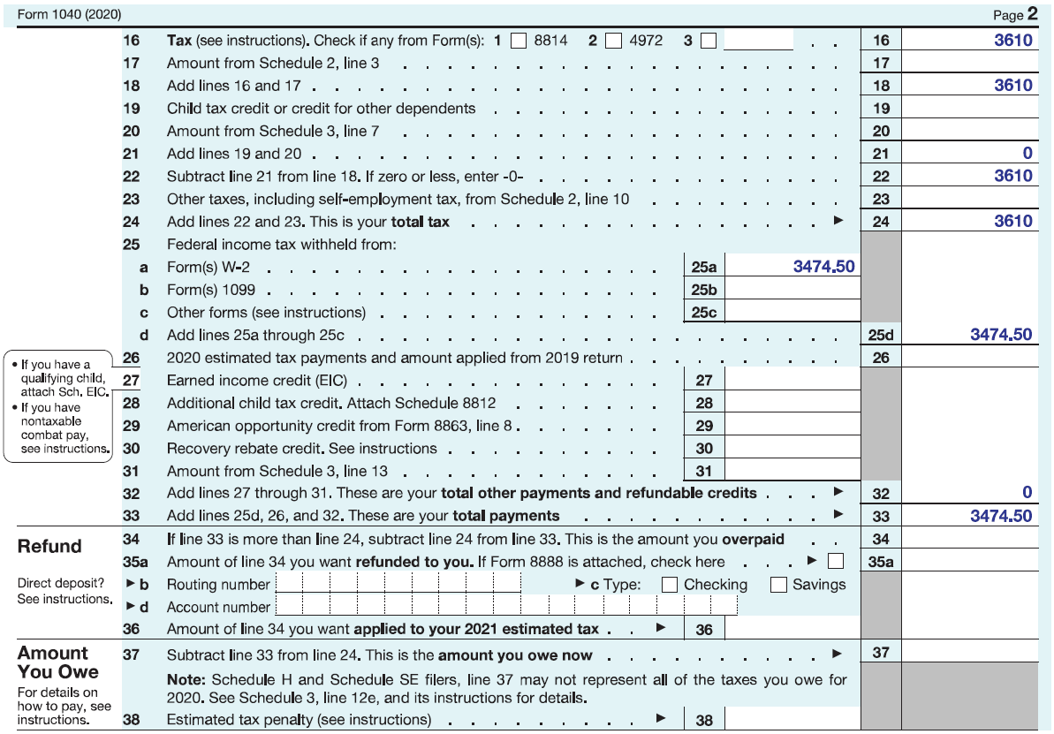
Example 4: Determining the Bottom Line—Slide 2
Figure 13

Slide 36
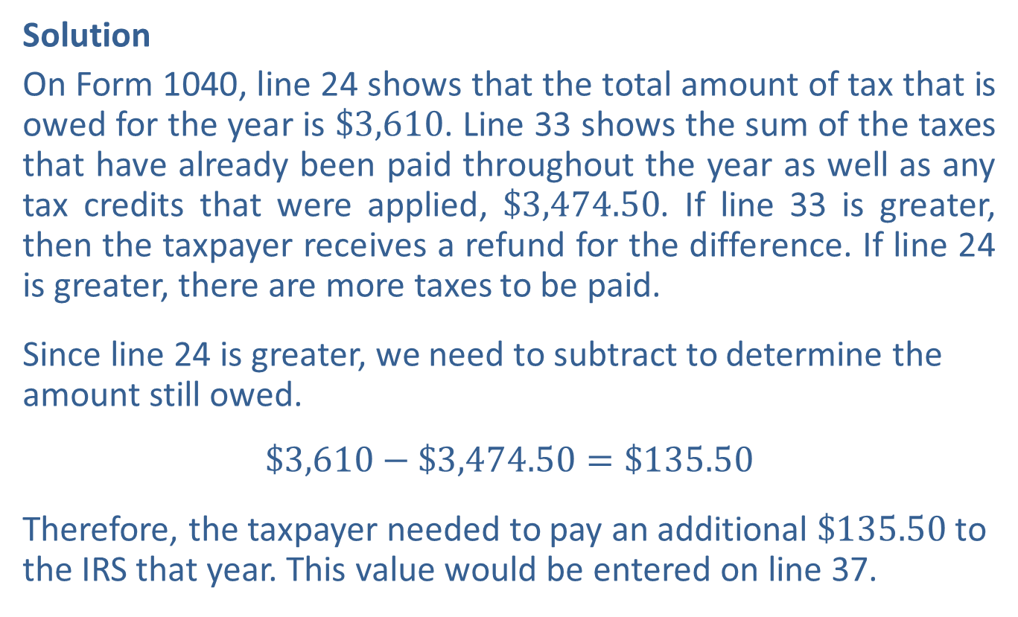
Example 4: Determining the Bottom Line—Slide 3
Solution
On Form 1040, line 24 shows that the total amount of tax that is owed for the year is $\$3,610$. Line 33 shows the sum of the taxes that have already been paid throughout the year as well as any tax credits that were applied, $\$3,474.50$. If line 33 is greater, then the taxpayer receives a refund for the difference. If line 24 is greater, there are more taxes to be paid.
Since line 24 is greater, we need to subtract to determine the amount still owed.
$$\$3,610−\$3,474.50=\$135.50$$
Therefore, the taxpayer needed to pay an additional $\$135.50$ to the IRS that year. This value would be entered on line 37.

Slide 37
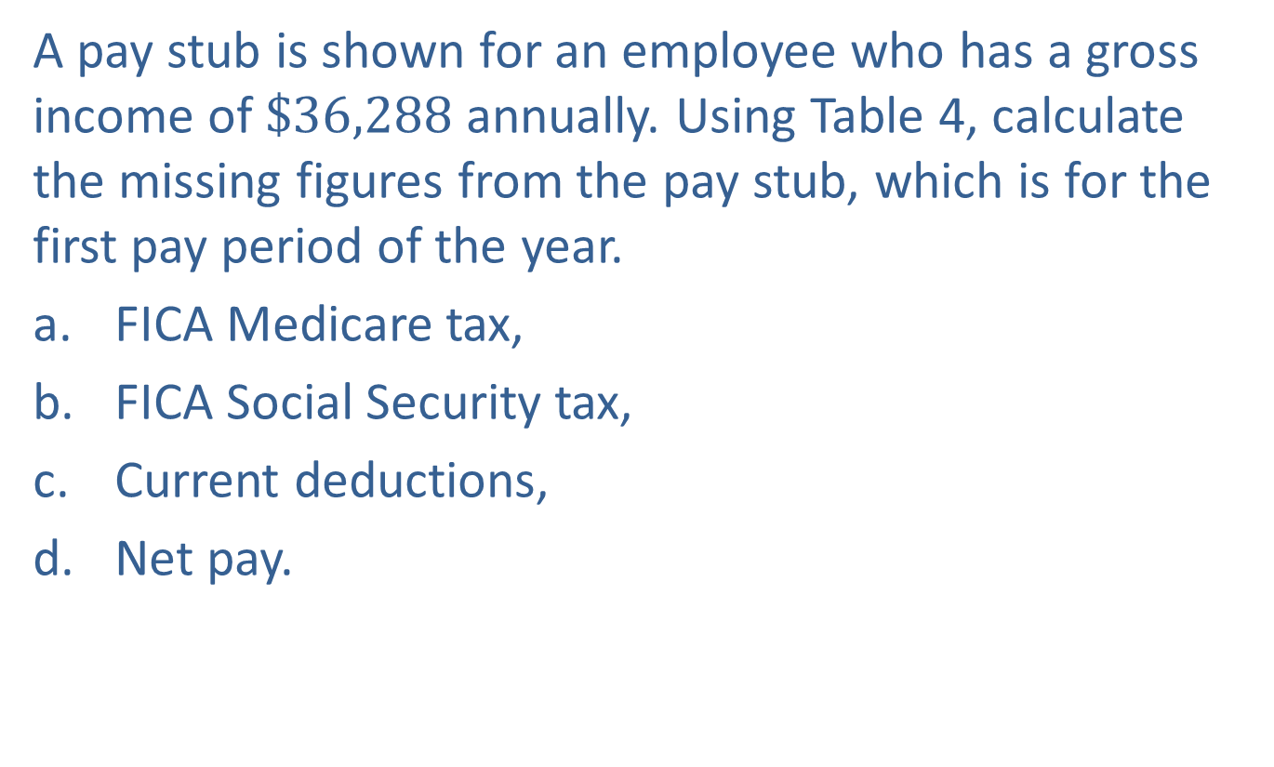
Example 5: Calculating FICA Taxes—Slide 1
A pay stub is shown for an employee who has a gross income of $\$36,288$ annually. Using Table 4, calculate the missing figures from the pay stub, which is for the first pay period of the year.
a. ​FICA Medicare tax,
b. FICA Social Security tax,
c. Current deductions,
d. Net pay.

Slide 38
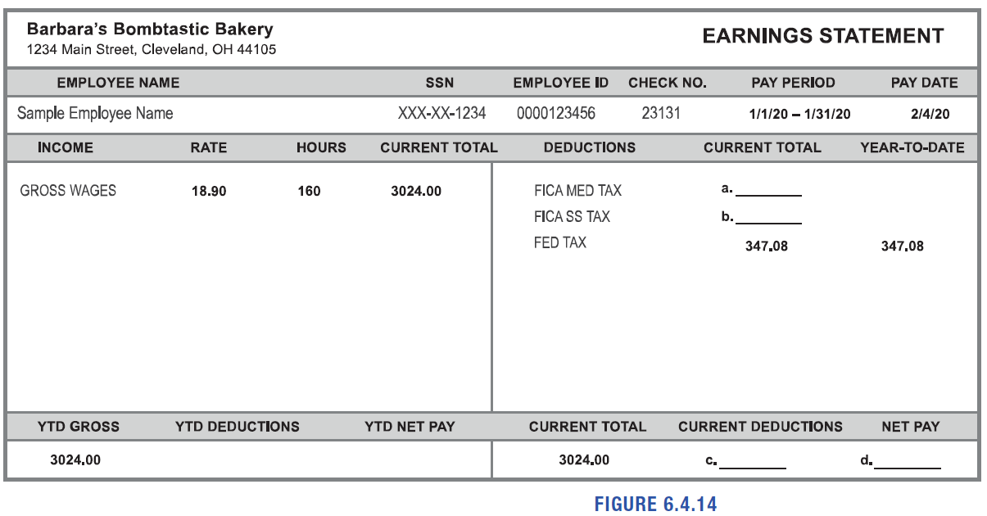
Example 5: Calculating FICA Taxes—Slide 2
Figure 14

Slide 39
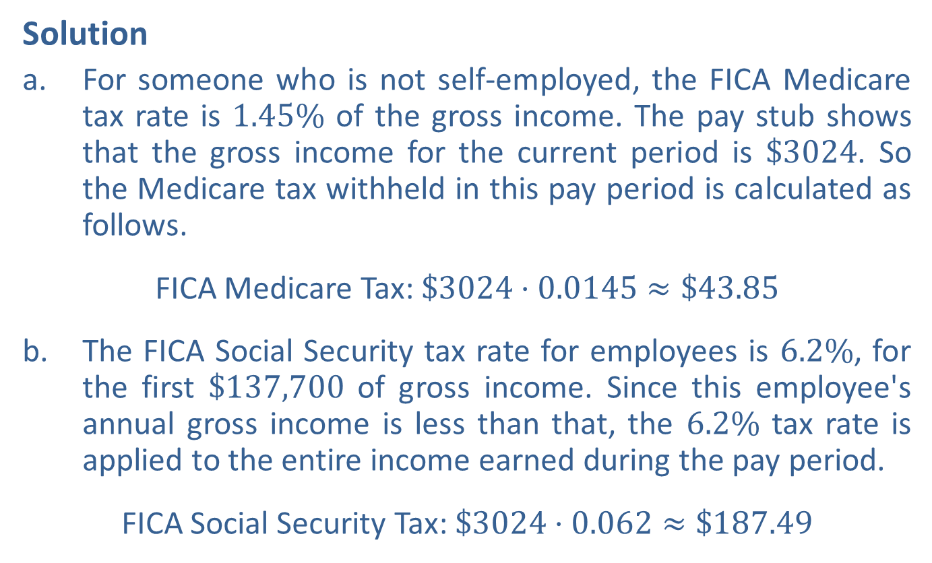
Example 5: Calculating FICA Taxes—Slide 3
Solution
a. ​For someone who is not self-employed, the FICA Medicare tax rate is $1.45\%$ of the gross income. The pay stub shows that the gross income for the current period is $\$3024$. So the Medicare tax withheld in this pay period is calculated as follows.
​FICA Medicare Tax: $\$3024⋅0.0145≈\$43.85$
b. ​The FICA Social Security tax rate for employees is $6.2\%$, for the first $\$137,700$ of gross income. Since this employee's annual gross income is less than that, the $6.2\%$ tax rate is applied to the entire income earned during the pay period.
​FICA Social Security Tax: $\$3024⋅0.062≈\$187.49$

Slide 40
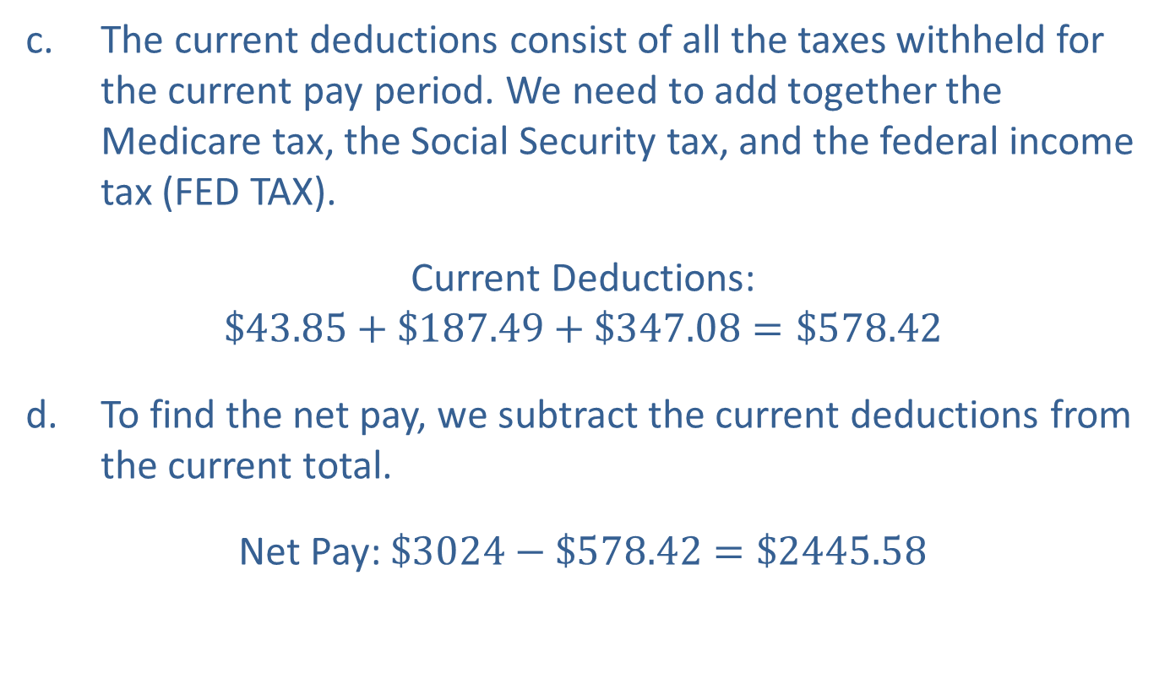
Example 5: Calculating FICA Taxes—Slide 4
c. ​The current deductions consist of all the taxes withheld for the current pay period. We need to add together the Medicare tax, the Social Security tax, and the federal income tax (FED TAX).
​Current Deductions:
$$\$43.85+\$187.49+\$347.08=\$578.42$$
d. ​To find the net pay, we subtract the current deductions from the current total.
​Net Pay: $\$3024−\$578.42=\$2445.58$

Slide 41

Skill Check 3
Use Table 4 to calculate the FICA taxes that a self-employed person owed in 2020 if their gross income was $\$94,538$.
Answer: $\$$14,464.31

