Slide 1
Section 6.5
Budgeting

Slide 2
Definition: Budget
A budget is a financial plan for your income over a defined period of time.

Slide 3
Helpful Hint
Thinking of a budget as a spending plan takes away the negative connotation of the word "budget." You can spend guilt-free knowing your needs are taken care of and you won't run out of money before the month is gone!

Slide 4
Procedure: Steps to Creating a Budget
1. ​Calculate monthly income.
2. ​Calculate monthly expenses.
3. Subtract expenses from income.
4. Allocate any remaining funds or make adjustments.

Slide 5
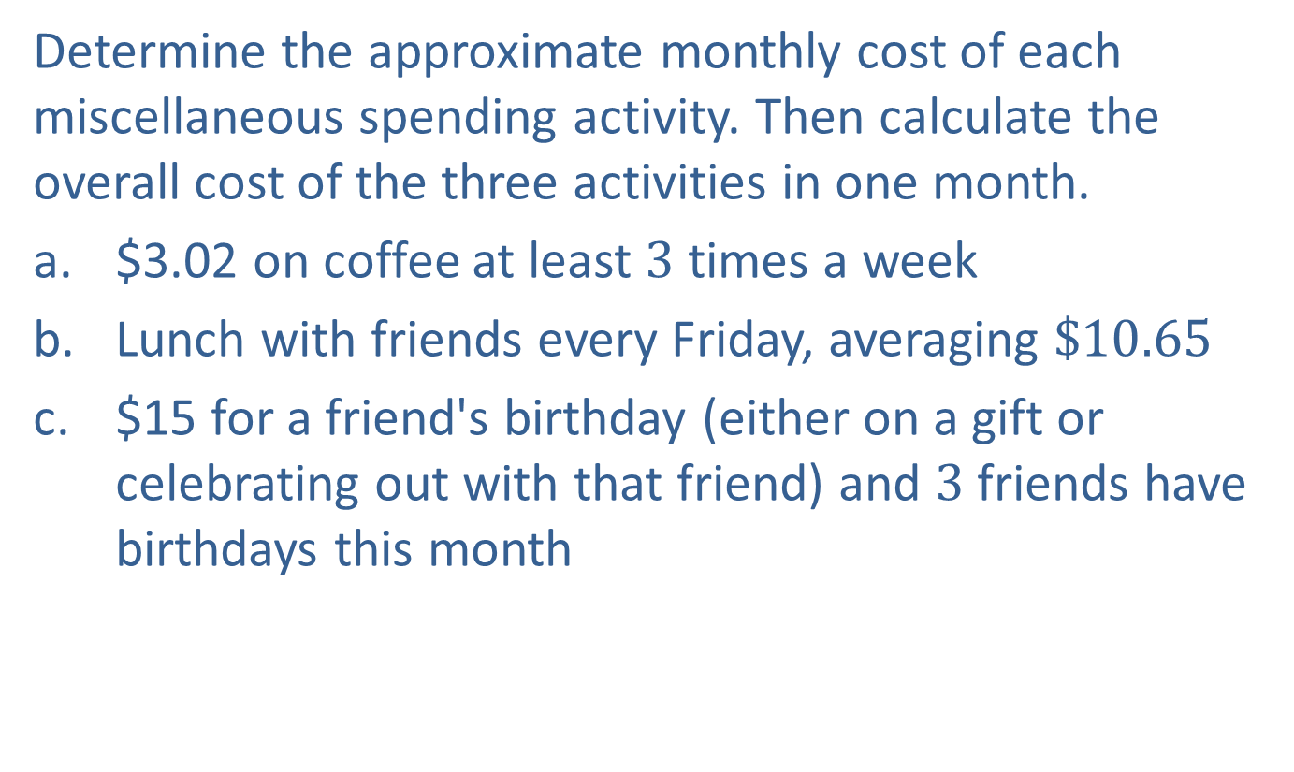
Example 1: Calculating Miscellaneous Spending—Slide 1
Determine the approximate monthly cost of each miscellaneous spending activity. Then calculate the overall cost of the three activities in one month.
a. $3.02 on coffee at least 3 times a week
b. Lunch with friends every Friday, averaging $\$10.65$
c. $15 for a friend's birthday (either on a gift or celebrating out with that friend) and 3 friends have birthdays this month

Slide 6
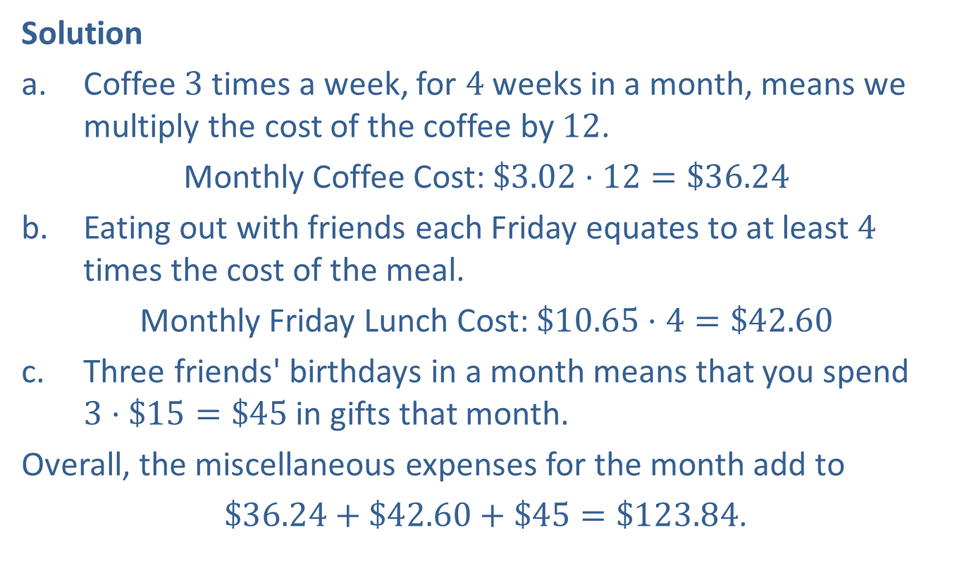
Example 1: Calculating Miscellaneous Spending—Slide 2
Solution
a. ​Coffee 3 times a week, for 4 weeks in a month, means we multiply the cost of the coffee by 12.
​Monthly Coffee Cost: $\$3.02⋅12=\$36.24$
b. ​Eating out with friends each Friday equates to at least 4 times the cost of the meal.
​Monthly Friday Lunch Cost: $\$10.65⋅4=\$42.60$
c. ​Three friends' birthdays in a month means that you spend $3⋅\$15=\$45$ in gifts that month.
Overall, the miscellaneous expenses for the month add to
$\$36.24+\$42.60+\$45=\$123.84$.

Slide 7
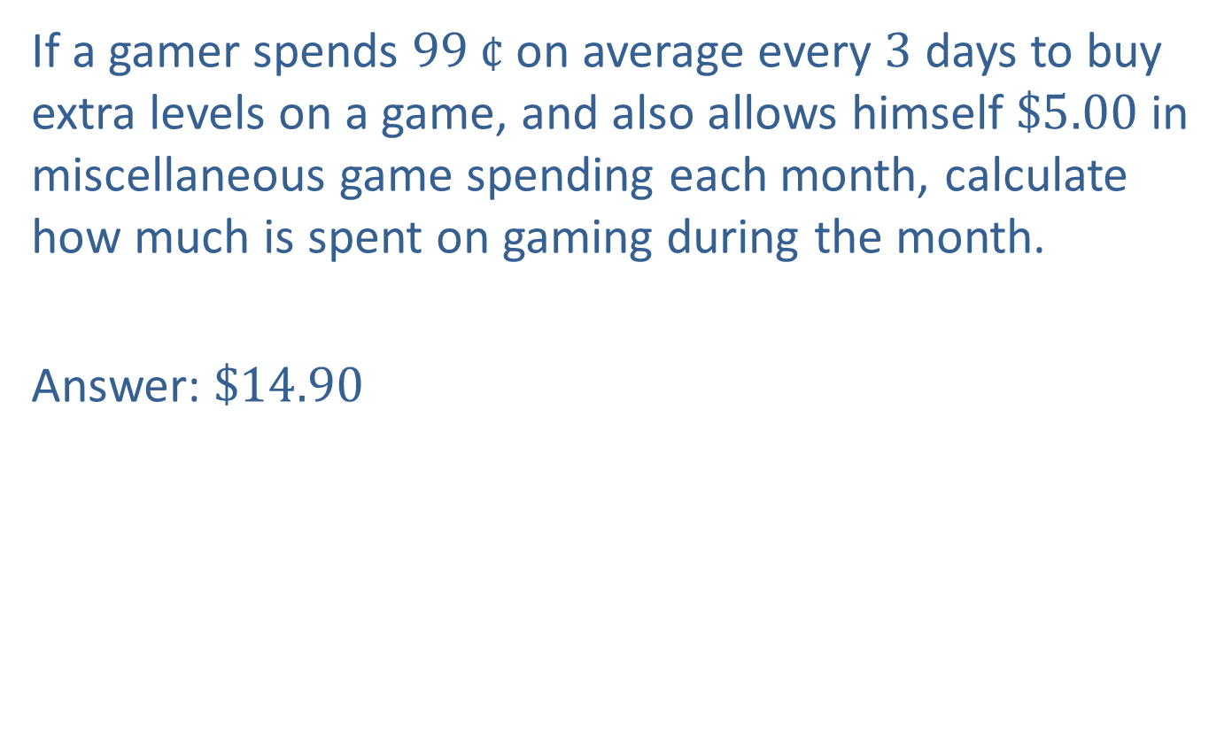
Skill Check 1
If a gamer spends $99 ¢$ on average every 3 days to buy extra levels on a game, and also allows himself $\$5.00$ in miscellaneous game spending each month, calculate how much is spent on gaming during the month.
Answer: $\$14.90$

Slide 8
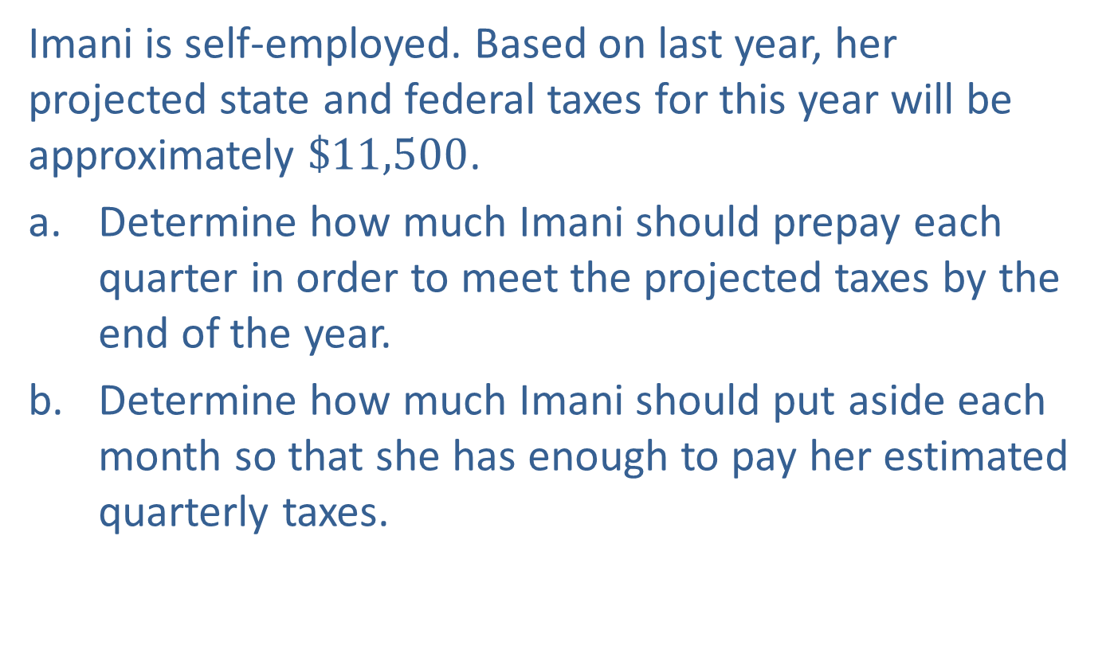
Example 2: Prorating Expenses—Slide 1
Imani is self-employed. Based on last year, her projected state and federal taxes for this year will be approximately $\$11,500$.
a. Determine how much Imani should prepay each quarter in order to meet the projected taxes by the end of the year.
b. Determine how much Imani should put aside each month so that she has enough to pay her estimated quarterly taxes.

Slide 9
Example 2: Prorating Expenses—Slide 2
Solution
a. If Imani is paying her projected taxes quarterly, then the annual estimate should be divided by 4 to find the quarterly amount.
Thus, Imani will need to pay $2875 each quarter in taxes.
b. Although Imani will only pay her taxes quarterly, setting aside funds each month is a smart move. There are two ways to determine the monthly portion: 1. divide the year's approximation by 12 months, or 2. divide the quarterly approximation by 3 months. Both calculations are shown.

Slide 10
Example 2: Prorating Expenses—Slide 3
​Monthly Amount Set Aside For Taxes
Yearly Amount Divided
by 12 Months:
Quarterly Amount Divided
by 3 Months:
Both methods show that Imani needs to allocate $958.33 each month for her state and federal taxes.

Slide 11
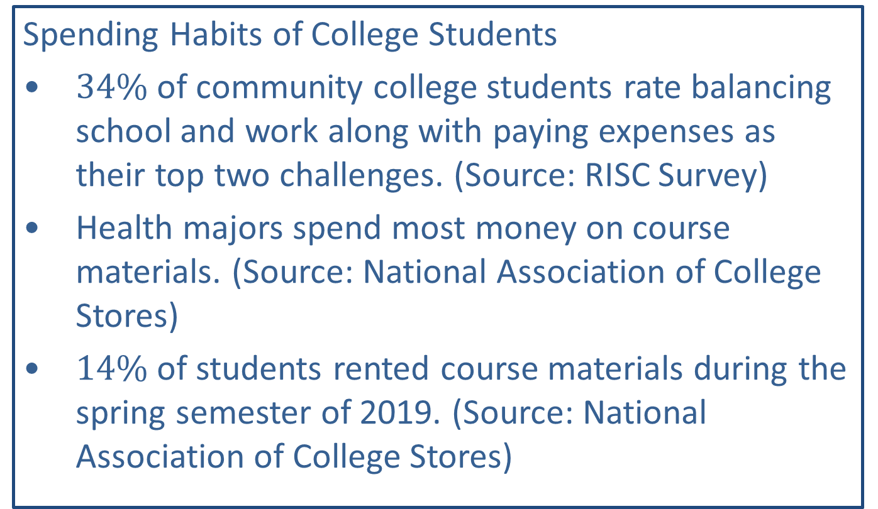
Fun Fact 1
Spending Habits of College Students
​$34\%$ of community college students rate balancing school and work along with paying expenses as their top two challenges. (Source: RISC Survey)
​Health majors spend most money on course materials. (Source: National Association of College Stores)
​$14\%$ of students rented course materials during the spring semester of 2019. (Source: National Association of College Stores)

Slide 12
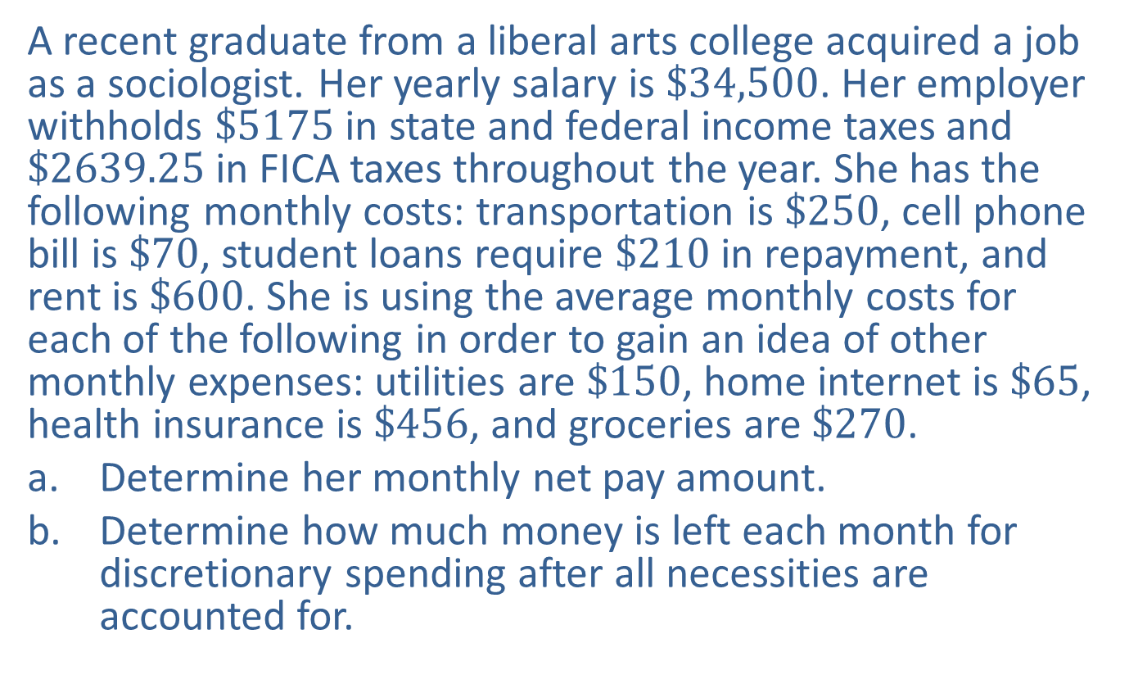
Example 3: Determining Total Monthly Expenses—Slide 1
A recent graduate from a liberal arts college acquired a job as a sociologist. Her yearly salary is $\$34,500$. Her employer withholds $\$5175$ in state and federal income taxes and $\$2639.25$ in FICA taxes throughout the year. She has the following monthly costs: transportation is $\$250$, cell phone bill is $\$70$, student loans require $\$210$ in repayment, and rent is $\$600$. She is using the average monthly costs for each of the following in order to gain an idea of other monthly expenses: utilities are $\$150$, home internet is $\$65$, health insurance is $\$456$, and groceries are $\$270$.
a. Determine her monthly net pay amount.
b. Determine how much money is left each month for discretionary spending after all necessities are accounted for.

Slide 13

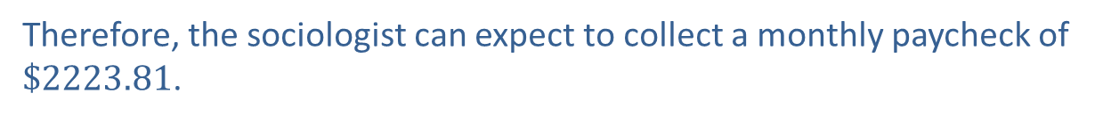
Example 3: Determining Total Monthly Expenses—Slide 2
Solution
a. The monthly net pay amount is the annual salary minus withholdings for all required taxes, divided over 12 months of the year. In this case, we need to subtract $\$5175$ and $\$2639.25$ from the yearly salary before dividing by 12.
Therefore, the sociologist can expect to collect a monthly paycheck of $\$2223.81$.

Slide 14
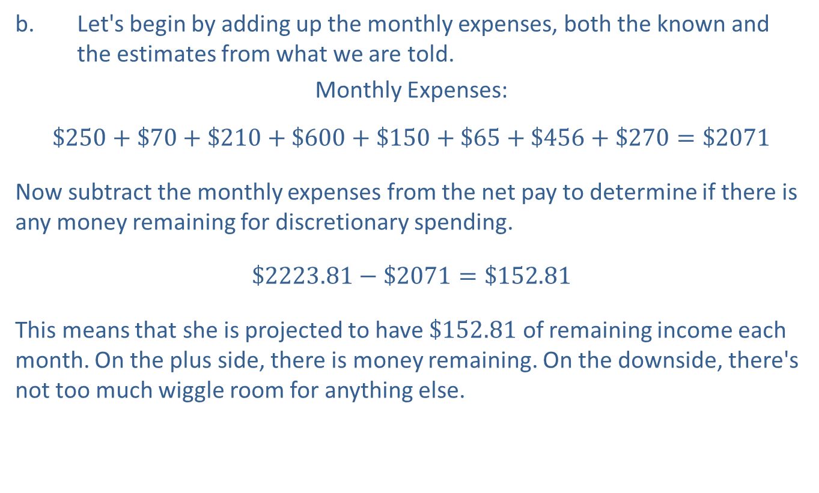
Example 3: Determining Total Monthly Expenses—Slide 3
b. ​Let's begin by adding up the monthly expenses, both the known and the estimates from what we are told.
​Monthly Expenses:
$$\$250+\$70+\$210+\$600+\$150+\$65+\$456+\$270=\$2071$$
​Now subtract the monthly expenses from the net pay to determine if there is any money remaining for discretionary spending.
​$\$2223.81−\$2071=\$152.81$
​This means that she is projected to have $\$152.81$ of remaining income each month. On the plus side, there is money remaining. On the downside, there's not too much wiggle room for anything else.

Slide 15
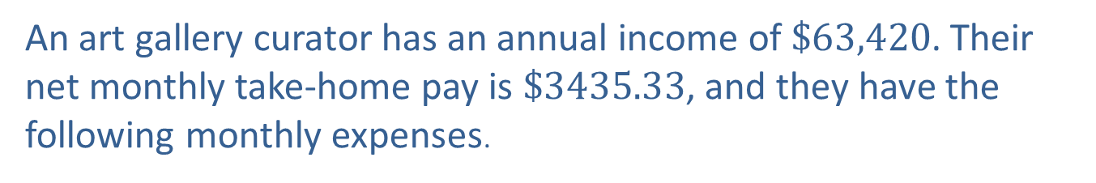
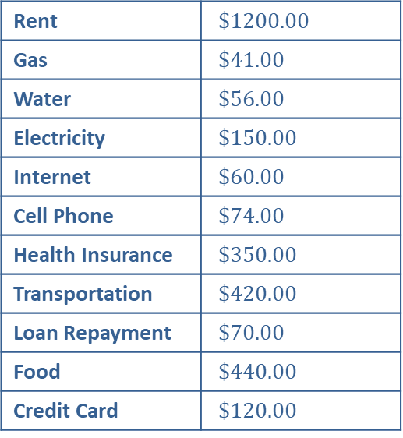
Example 4: Creating a Budget with a Spreadsheet—Slide 4
An art gallery curator has an annual income of $\$63,420$. Their net monthly take-home pay is $\$3435.33$, and they have the following monthly expenses.
Table 1: Monthly Expenses
Rent | $\$1200.00$
Gas | $\$41.00$
Water | $\$56.00$
Electricity | $\$150.00$
Internet | $\$60.00$
Cell Phone | $\$74.00$
Health Insurance | $\$350.00$
Transportation | $\$420.00$
Loan Repayment | $\$70.00$
Food | $\$440.00$
Credit Card | $\$120.00$

Slide 16
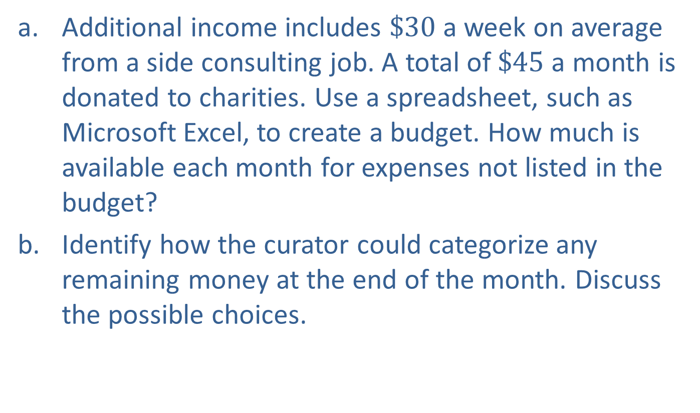
Example 4: Creating a Budget with a Spreadsheet—Slide 5
a. Additional income includes $\$30$ a week on average from a side consulting job. A total of $\$45$ a month is donated to charities. Use a spreadsheet, such as Microsoft Excel, to create a budget. How much is available each month for expenses not listed in the budget?
b. Identify how the curator could categorize any remaining money at the end of the month. Discuss the possible choices.

Slide 17
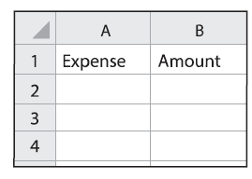
Example 4: Creating a Budget with a Spreadsheet—Slide 6
Solution
a. To prepare a budget for the curator, we need to add both the incomes and expenses separately. We'll start by creating a column for expenses and one for incomes. Let's start with expenses. In cell A1 of the spreadsheet, type "Expense", and in the adjacent cell, B2, type "Amount". The spreadsheet should look like Figure 2.​
Figure 2

Slide 18
Example 4: Creating a Budget with a Spreadsheet—Slide 7
​Under the column labeled "Expense" enter the name of each of the curator's expenses and under the column labeled "Amount" enter the amount associated with each expense. Don't forget to include the donations to charity as an expense. The updated spreadsheet should now appear as Figure 3.
​

Slide 19
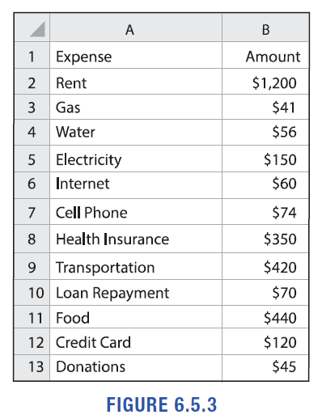
Example 4: Creating a Budget with a Spreadsheet—Slide 8
Figure 3

Slide 20
Example 4: Creating a Budget with a Spreadsheet—Slide 9
​To obtain the total amount of expenses, we need a place for the total on row 14. Enter "Expense Total" in A14. In B14, we'll put a formula that will add up all the expenses. Type "=sum(B2:B13)", which instructs Excel to add together the data from column B, row 2 through column B, row 13.
​

Slide 21
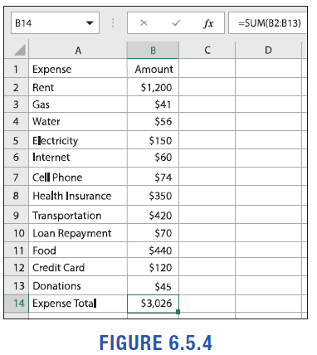
Example 4: Creating a Budget with a Spreadsheet—Slide 10
Figure 4
Figure 4 shows that the monthly expenses are $\$3026$.

Slide 22
Example 4: Creating a Budget with a Spreadsheet—Slide 11
​Next, we'll follow the same process for incomes. Create a set of columns for Income and Amount in columns D and E. (We've intentionally left column C blank for clarity.)
​Enter the income labels in column D and the amounts in column E. Note that when we enter the amount for the consulting income, we'll need to write a formula for the monthly income, since we're given the weekly amount. The formula will multiply the weekly amount by 4; that is, "=30*4". (Note that during some months, this will be paid 5 times.) Doing it this way means that if the amount received each week changes, you can simply replace the number 30 with the new weekly income, and the spreadsheet will adjust the monthly amount accordingly. To calculate the total income for the month, enter "=sum(E2:E3)" into cell E14. The budget spreadsheet now looks like Figure 5.

Slide 23
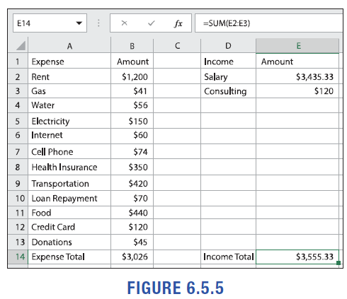
Example 4: Creating a Budget with a Spreadsheet—Slide 12
Figure 5

Slide 24
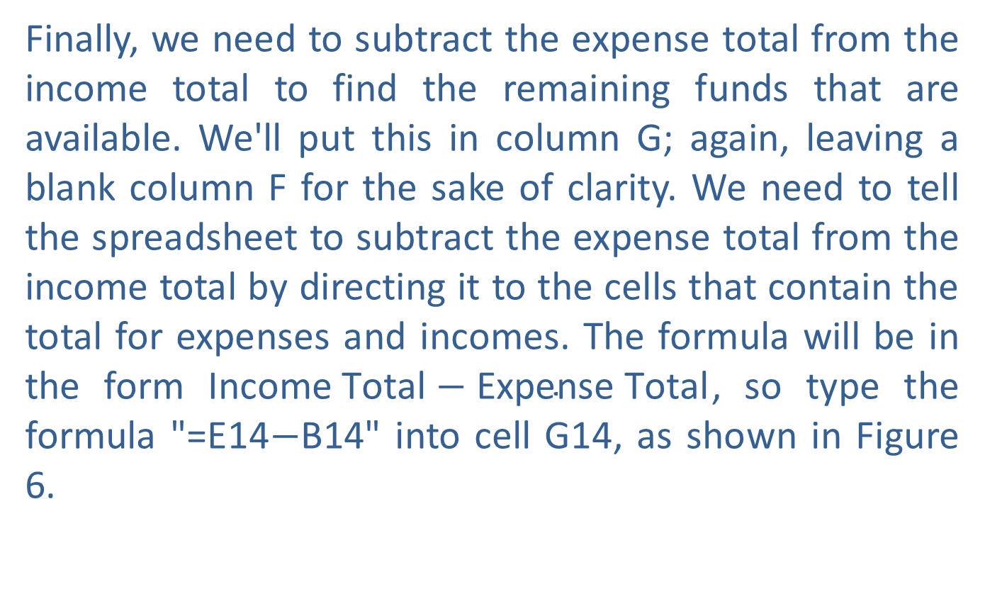
Example 4: Creating a Budget with a Spreadsheet—Slide 13
​Finally, we need to subtract the expense total from the income total to find the remaining funds that are available. We'll put this in column G; again, leaving a blank column F for the sake of clarity. We need to tell the spreadsheet to subtract the expense total from the income total by directing it to the cells that contain the total for expenses and incomes. The formula will be in the form $\text{Income} \text{Total}−\text{Expense} \text{Total}$, so type the formula "=E14$−$B14" into cell G14, as shown in Figure 6.
​

Slide 25
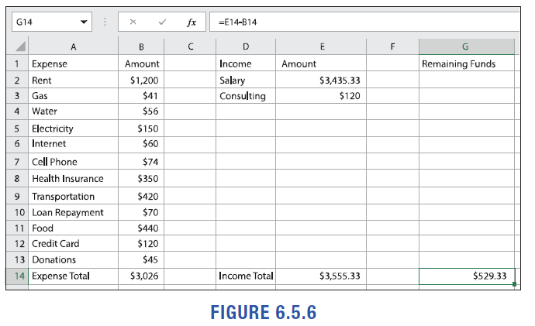
Example 4: Creating a Budget with a Spreadsheet—Slide 14
Figure 6

Slide 26
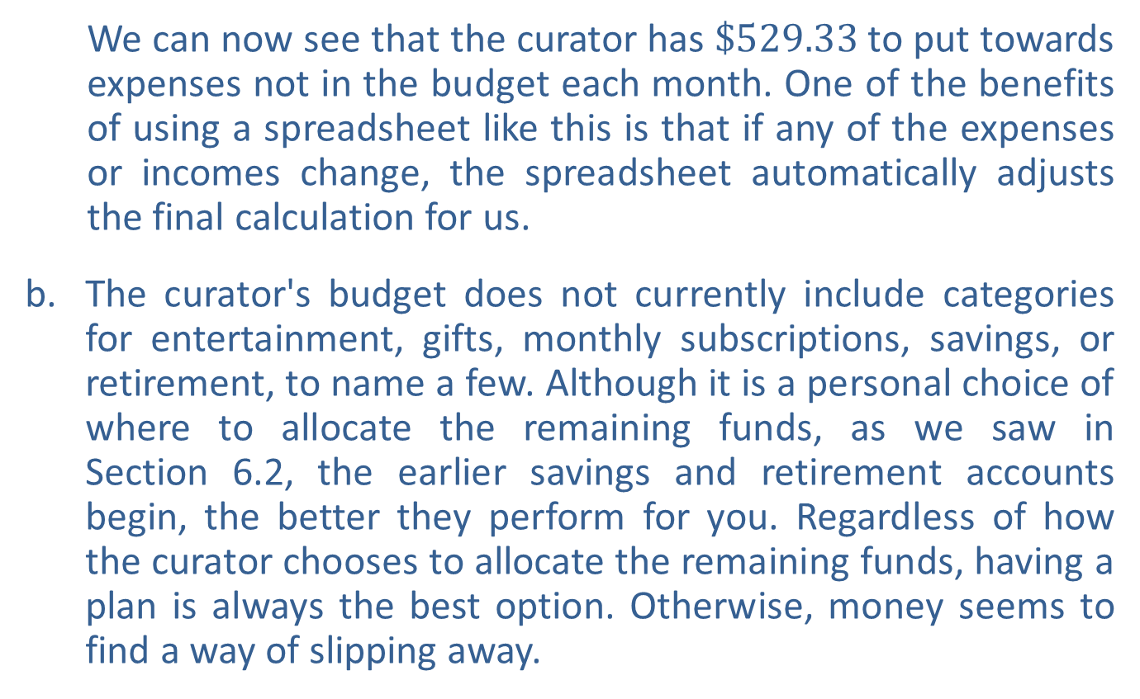
Example 4: Creating a Budget with a Spreadsheet—Slide 15
  We can now see that the curator has $\$529.33$ to put towards expenses not in the budget each month. One of the benefits of using a spreadsheet like this is that if any of the expenses or incomes change, the spreadsheet automatically adjusts the final calculation for us.
b. ​The curator's budget does not currently include categories for entertainment, gifts, monthly subscriptions, savings, or retirement, to name a few. Although it is a personal choice of where to allocate the remaining funds, as we saw in
Section 6.2, the earlier savings and retirement accounts begin, the better they perform for you. Regardless of how the curator chooses to allocate the remaining funds, having a plan is always the best option. Otherwise, money seems to find a way of slipping away.

Slide 27

Skill Check 2
Using the spreadsheet from Example 4, find the amount available for other expenses at the end of the month if the curator's utilities increase by $\$50$.
Answer: $\$$479.33

Slide 28
Fun Fact 2
Ways to Make Extra $$$
​Consulting/tutoring
​Driving for ride shares/delivery services
​Personal assistant/household helper
​Care giver
​Pet sitter
​Customer service rep from home
​Rent your extra space
​Sell your stuff
​Participate in research studies/focus groups

Slide 29
Example 5: Comparing Cell Phone Plans—Slide 1
Compare the following cell phone plans. Explain which plan you would choose if you are only interested in a single line?

Slide 30
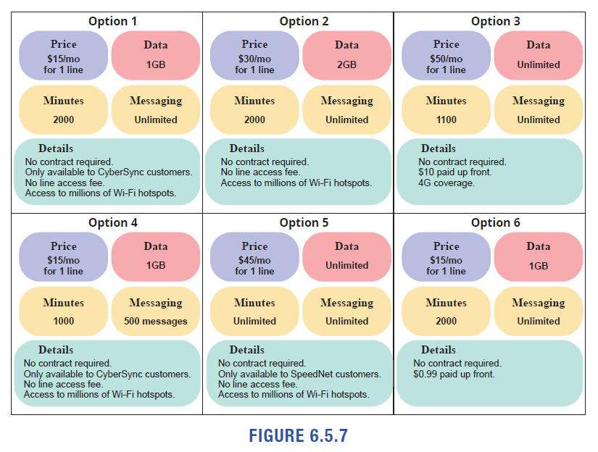
Example 5: Comparing Cell Phone Plans—Slide 2
Figure 7

Slide 31
Example 5: Comparing Cell Phone Plans—Slide 3
Solution
We are confronted with six options, but it is unlikely that we can easily rank these options best to worst. One option may be cheaper, but also has less data; another option may be more expensive but has unlimited calls; and still another option may look attractive but is only available to certain customers.
Consequently, when you begin to compare any set of options, one of the first things you should do is narrow down your choices by eliminating similar options. In a group of similar things, choose the best one and then discard the others. Continue this process until you have only a small number to choose from. Then you can make a decision based on personal needs or wants.

Slide 32
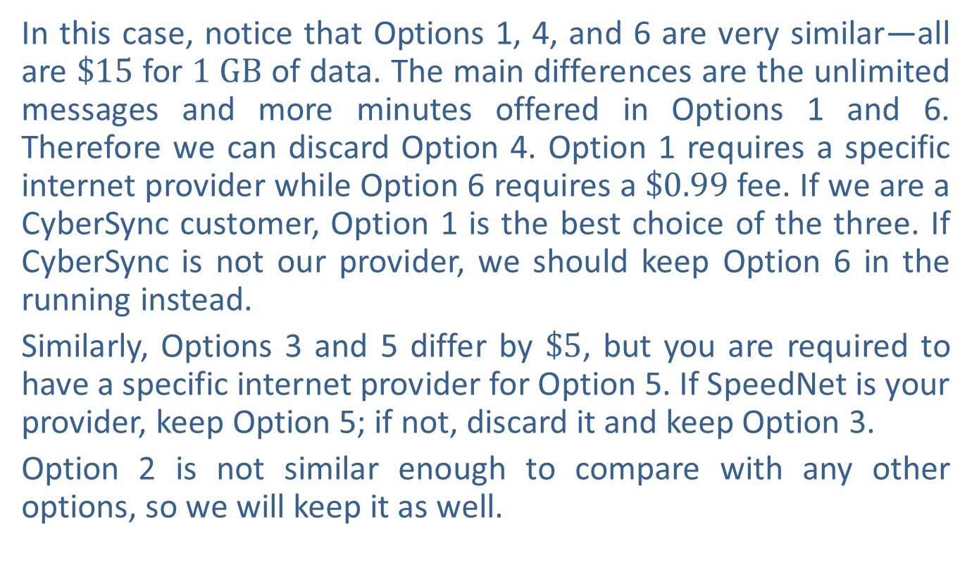
Example 5: Comparing Cell Phone Plans—Slide 4
In this case, notice that Options 1, 4, and 6 are very similar—all are $\$15$ for $1 GB$ of data. The main differences are the unlimited messages and more minutes offered in Options 1 and 6. Therefore we can discard Option 4. Option 1 requires a specific internet provider while Option 6 requires a $\$0.99$ fee. If we are a CyberSync customer, Option 1 is the best choice of the three. If CyberSync is not our provider, we should keep Option 6 in the running instead.
Similarly, Options 3 and 5 differ by $\$5$, but you are required to have a specific internet provider for Option 5. If SpeedNet is your provider, keep Option 5; if not, discard it and keep Option 3.
Option 2 is not similar enough to compare with any other options, so we will keep it as well.

Slide 33
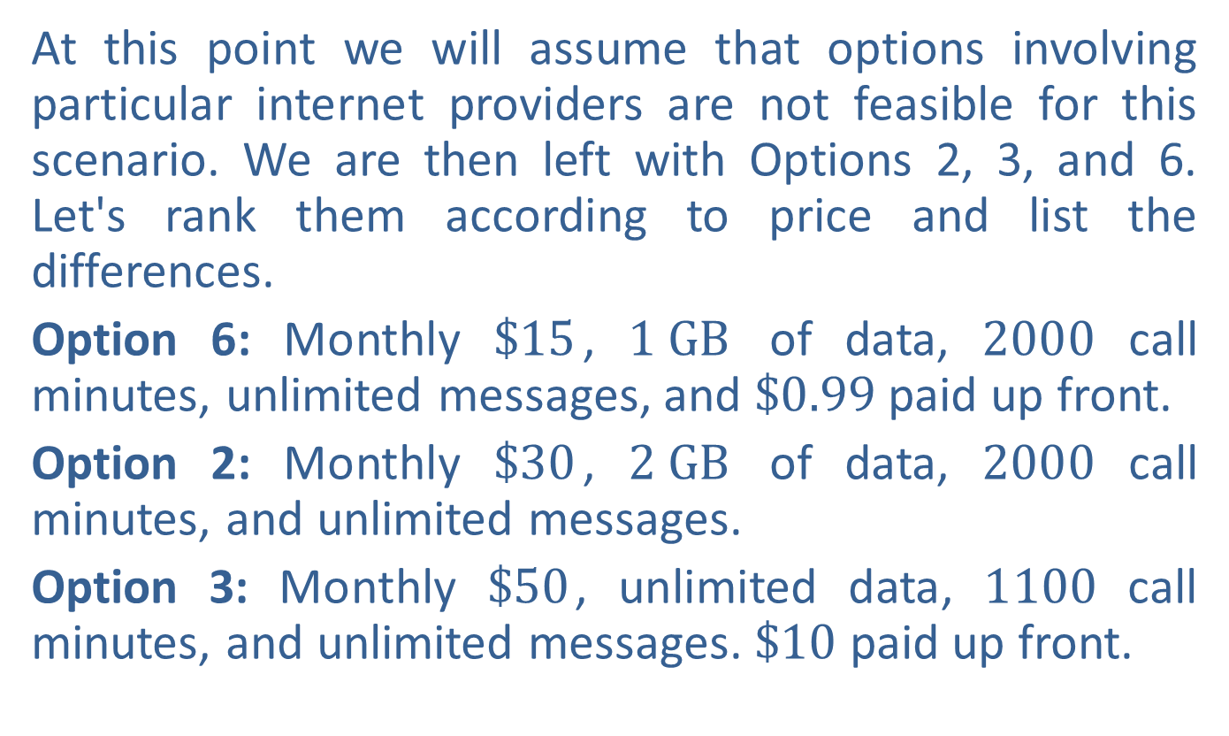
Example 5: Comparing Cell Phone Plans—Slide 5
At this point we will assume that options involving particular internet providers are not feasible for this scenario. We are then left with Options 2, 3, and 6. Let's rank them according to price and list the differences.
Option 6: Monthly $\$15$, $1 GB$ of data, 2000 call minutes, unlimited messages, and $\$0.99$ paid up front.
Option 2: Monthly $\$30$, $2 GB$ of data, 2000 call minutes, and unlimited messages.
Option 3: Monthly $\$50$, unlimited data, 1100 call minutes, and unlimited messages. $\$10$ paid up front.

Slide 34
Example 5: Comparing Cell Phone Plans—Slide 6
Now the choice between these three options needs to be based on what your budget can afford and what your priorities are for cell phone coverage. Do you need unlimited data or 2000 call minutes for work or school? Could you get away with less until your budget allows for the extra? It would be a good idea to inform this decision with any information you might have about your past data use and calling habits. That information is usually available from a cell phone carrier if you previously had one.

Slide 35
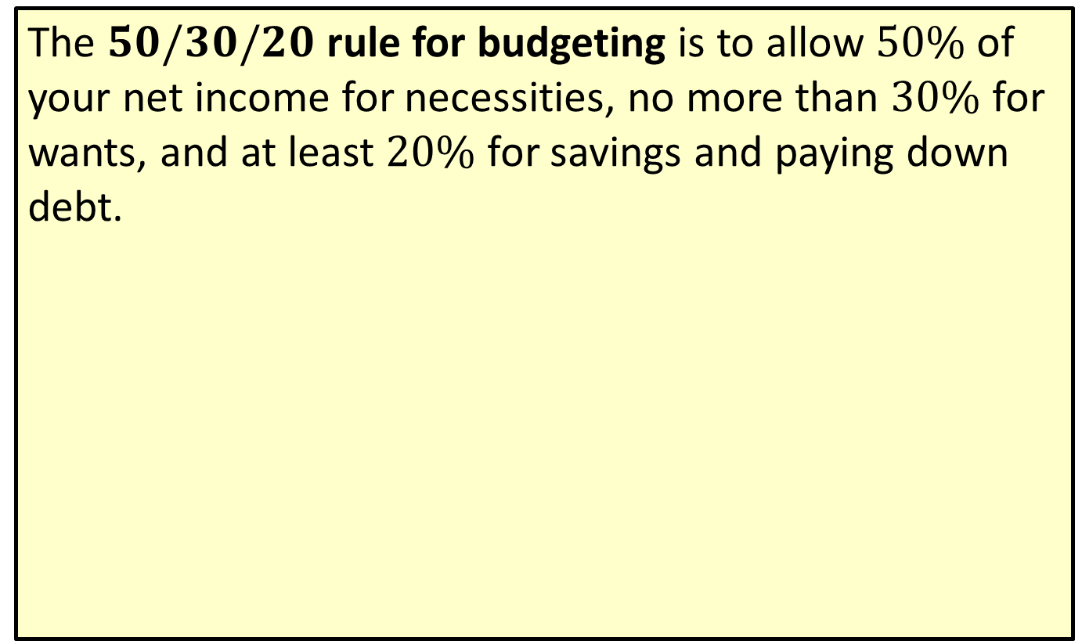
Definition: 50/30/20 Budgeting Rule
The $50/30/20$ rule for budgeting is to allow $50\%$ of your net income for necessities, no more than $30\%$ for wants, and at least $20\%$ for savings and paying down debt.

Slide 36
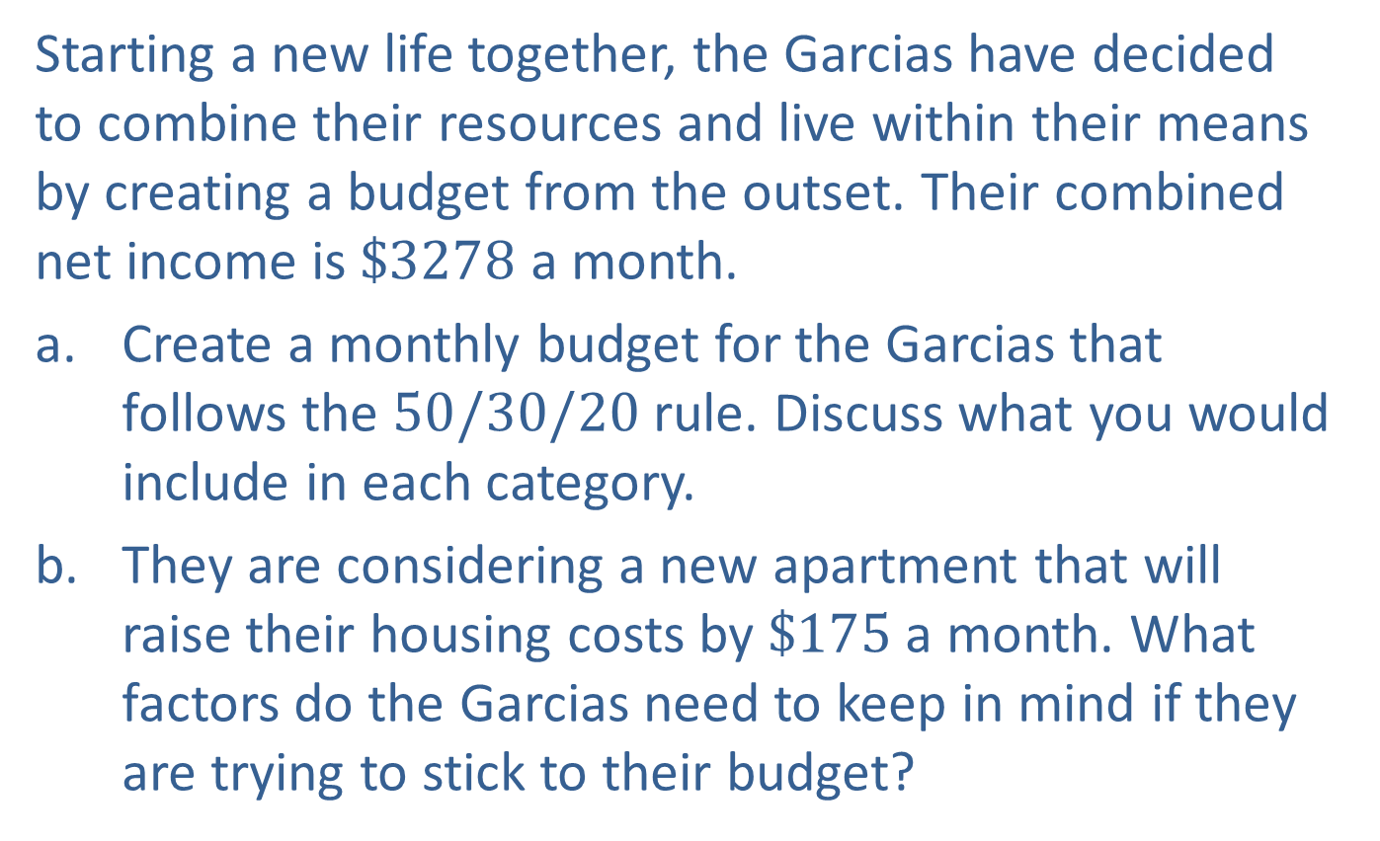
Example 6: Preparing a Budget—Slide 1
Starting a new life together, the Garcias have decided to combine their resources and live within their means by creating a budget from the outset. Their combined net income is $\$3278$ a month.
a. Create a monthly budget for the Garcias that follows the $50/30/20$ rule. Discuss what you would include in each category.
b. They are considering a new apartment that will raise their housing costs by $\$175$ a month. What factors do the Garcias need to keep in mind if they are trying to stick to their budget?

Slide 37
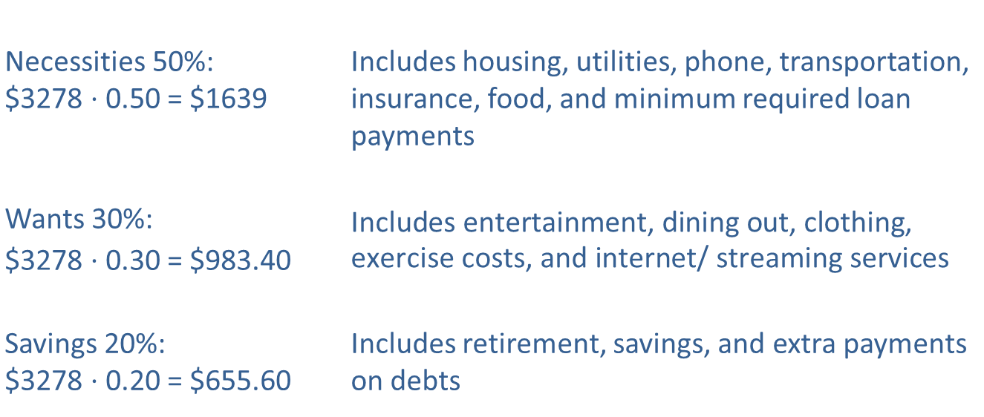

Example 6: Preparing a Budget—Slide 2
Solution
a. To follow the $50/30/20$ rule, the monthly income should be divided as follows:
​
Necessities 50%: $3278 ⋅ 0.50 = $1639 |  | Includes housing, utilities, phone, transportation, insurance, food, and minimum required loan payments
Wants 30%: $3278 ⋅ 0.30 = $983.40 |  | $$\text{Includes} \text{entertainment}\text{, }\text{dining} \text{out}\text{, }\text{clothing}\text{, }\text{exercise} \text{costs}\text{, }\text{and} \text{internet}\text{/ }\text{streaming} \text{services}$$
Savings 20%: $3278 ⋅ 0.20 = $655.60 |  | Includes retirement, savings, and extra payments on debts

Slide 38
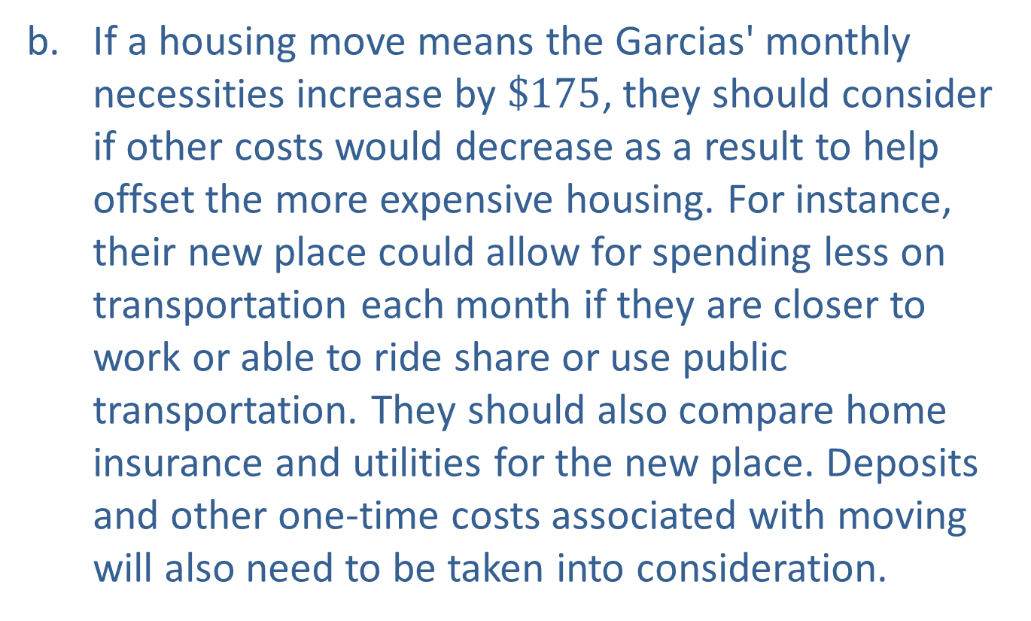
Example 6: Preparing a Budget—Slide 3
b. If a housing move means the Garcias' monthly necessities increase by $\$175$, they should consider if other costs would decrease as a result to help offset the more expensive housing. For instance, their new place could allow for spending less on transportation each month if they are closer to work or able to ride share or use public transportation. They should also compare home insurance and utilities for the new place. Deposits and other one-time costs associated with moving will also need to be taken into consideration.

Slide 39
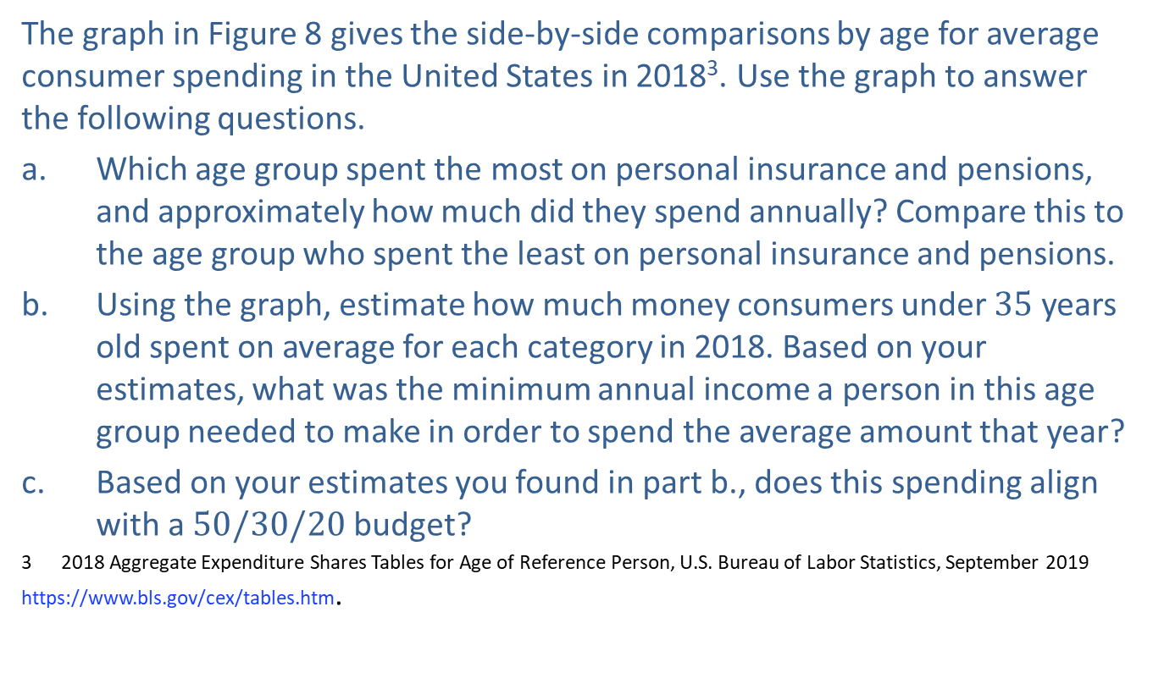
Example 7: Comparing Spending Habits—Slide 1
The graph in Figure 8 gives the side-by-side comparisons by age for average consumer spending in the United States in 2018³. Use the graph to answer the following questions.
a. Which age group spent the most on personal insurance and pensions, and approximately how much did they spend annually? Compare this to the age group who spent the least on personal insurance and pensions.
b. Using the graph, estimate how much money consumers under 35 years old spent on average for each category in 2018. Based on your estimates, what was the minimum annual income a person in this age group needed to make in order to spend the average amount that year?
c. Based on your estimates you found in part b., does this spending align with a $50/30/20$ budget?
3 2018 Aggregate Expenditure Shares Tables for Age of Reference Person, U.S. Bureau of Labor Statistics, September 2019 https://www.bls.gov/cex/tables.htm.

Slide 40
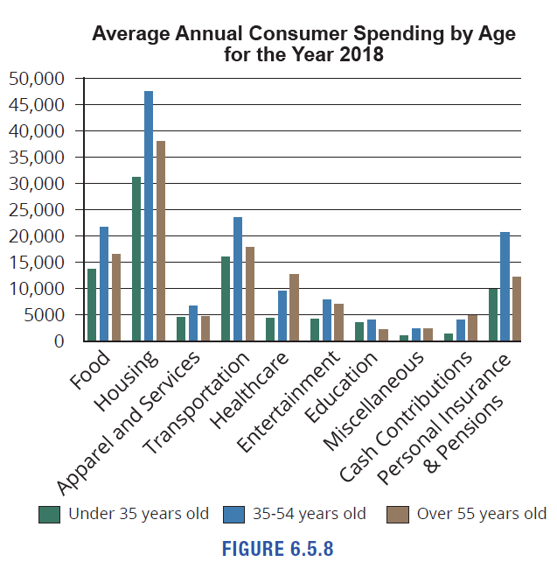
Example 7: Comparing Spending Habits—Slide 2
Figure 8

Slide 41
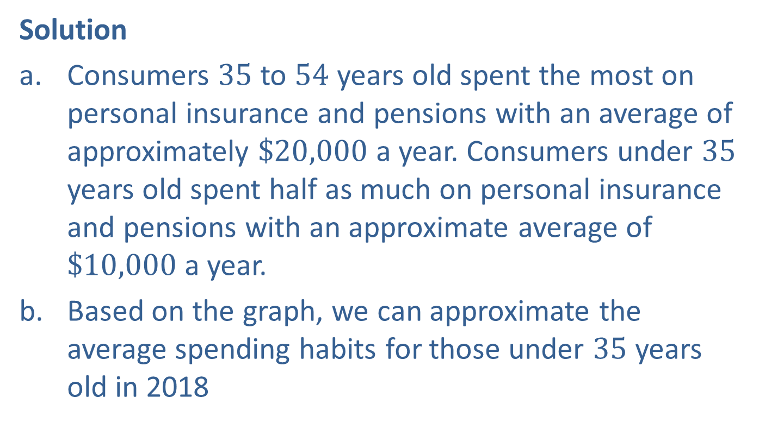
Example 7: Comparing Spending Habits—Slide 3
Solution
a. Consumers 35 to 54 years old spent the most on personal insurance and pensions with an average of approximately $\$20,000$ a year. Consumers under 35 years old spent half as much on personal insurance and pensions with an approximate average of $\$10,000$ a year.
b. Based on the graph, we can approximate the average spending habits for those under 35 years old in 2018

Slide 42
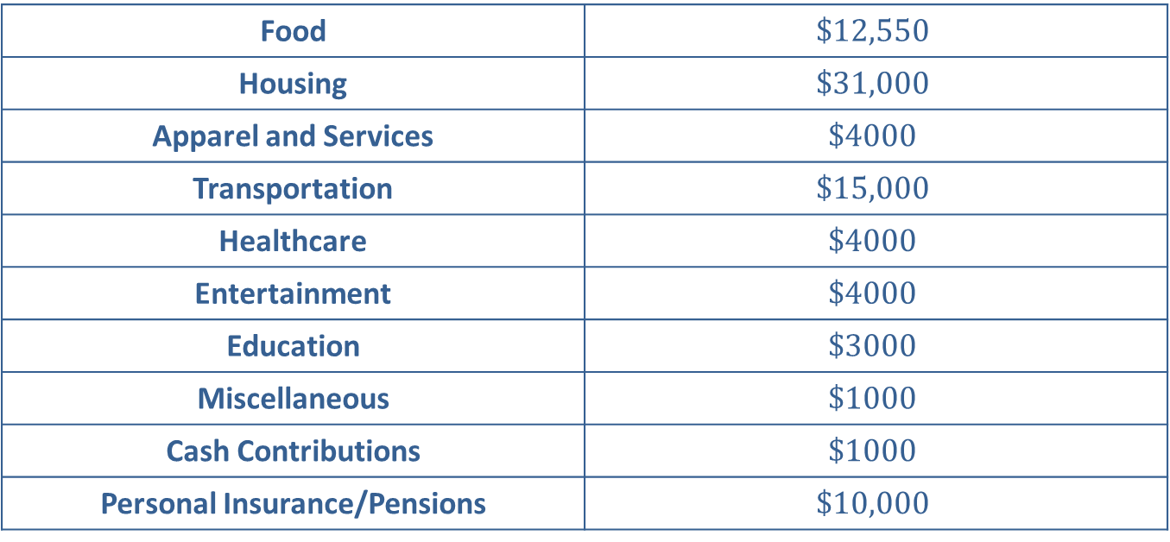
Example 7: Comparing Spending Habits—Slide 4
Table 2: Spending Habits for People Under 35 in 2018
Food | $$\$12,550$$
Housing | $$\$31,000$$
Apparel and Services | $$\$4000$$
Transportation | $$\$15,000$$
Healthcare | $$\$4000$$
Entertainment | $$\$4000$$
Education | $$\$3000$$
Miscellaneous | $$\$1000$$
Cash Contributions | $$\$1000$$
Personal Insurance/Pensions | $$\$10,000$$

Slide 43
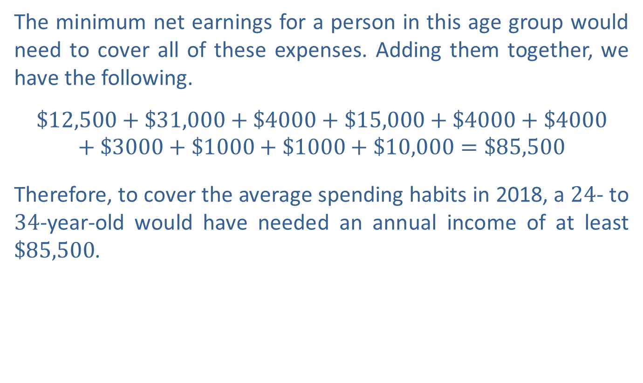
Example 7: Comparing Spending Habits—Slide 5
​The minimum net earnings for a person in this age group would need to cover all of these expenses. Adding them together, we have the following.
$$\$12,500+\$31,000+\$4000+\$15,000+\$4000+\$4000+\$3000+\$1000+\$1000+\$10,000=\$85,500$$
​Therefore, to cover the average spending habits in 2018, a 24- to 34-year-old would have needed an annual income of at least $\$85,500$.

Slide 44
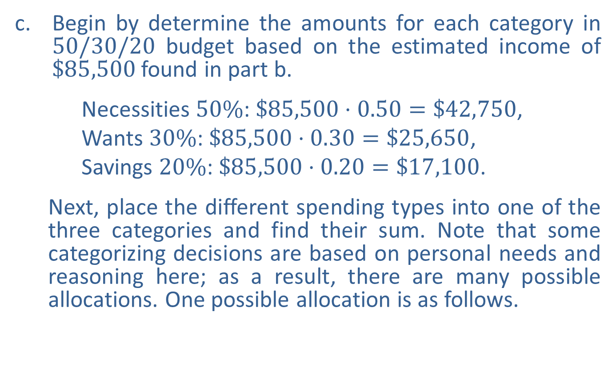
Example 7: Comparing Spending Habits—Slide 6
​Begin by determine the amounts for each category in $50/30/20$ budget based on the estimated income of $\$85,500$ found in part b.
​ Necessities $50\%$: $\$85,500⋅0.50=\$42,750$,
​ Wants $30\%$: $\$85,500⋅0.30=\$25,650$,
​ Savings $20\%$: $\$85,500⋅0.20=\$17,100$.
  Next, place the different spending types into one of the three categories and find their sum. Note that some categorizing decisions are based on personal needs and reasoning here; as a result, there are many possible allocations. One possible allocation is as follows.
​

Slide 45
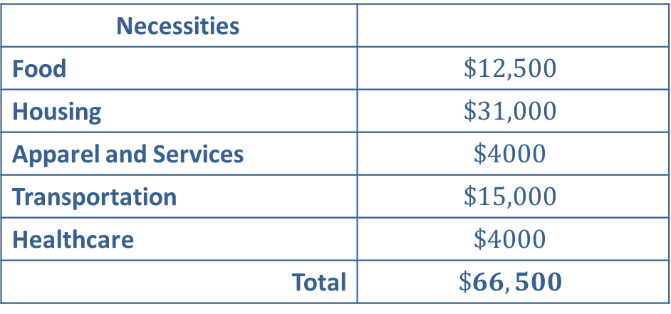
Example 7: Comparing Spending Habits—Slide 7
Table 3: 50/30/20 Budget for People Under 35 in 2018
Necessities
Food | $$\$12,500$$
Housing | $$\$31,000$$
Apparel and Services | $$\$4000$$
Transportation | $$\$15,000$$
Healthcare | $$\$4000$$
Total | $$\$66,500$$

Slide 46
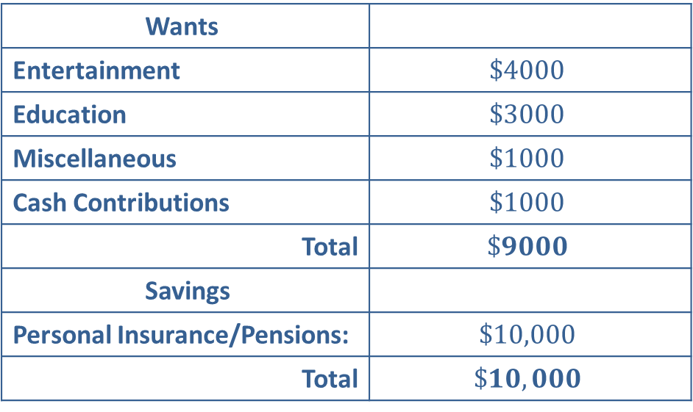
Example 7: Comparing Spending Habits—Slide 8
Table 3: 50/30/20 Budget for People Under 35 in 2018
Wants
Entertainment | $$\$4000$$
Education | $$\$3000$$
Miscellaneous | $$\$1000$$
Cash Contributions | $$\$1000$$
Total | $$\$9000$$
Savings
Personal Insurance/Pensions: | $$\$10,000$$
Total | $$\$10,000$$

Slide 47

Example 7: Comparing Spending Habit—Slide 9
​Based on the way we distributed the spending to the different categories, this does not follow a $50/30/20$ budget model. The necessities category is way over budget, while the other two are under budget.

