Slide 1
Chapter 6
Review

Slide 2
Definition: Interest and Principal
Interest
The amount charged by a lender for borrowing money is the interest.
Principal
The principal is the sum of money on which interest is charged.

Slide 3
Definition: Interest Rate and Annual Percentage Rate (APR)
Interest Rate
The interest rate is the percentage of the principal that is charged to the borrower.
Annual Percentage Rate (APR)
The annual percentage rate (APR) is the yearly interest rate that is charged for borrowing money, including fees. APR is normally given as a percentage per year.

Slide 4
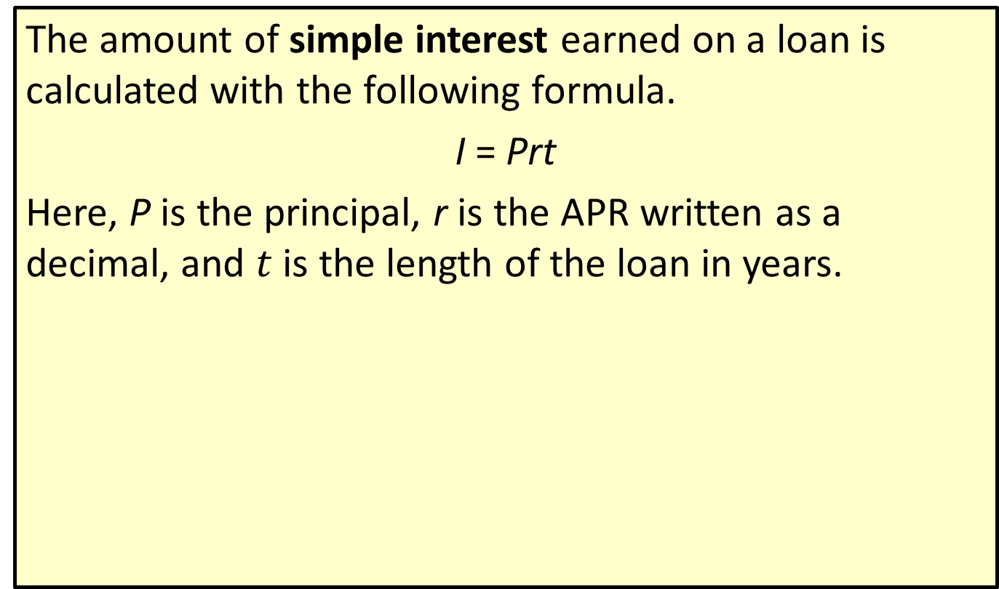
Definition: Simple Interest
The amount of simple interest earned on a loan is calculated with the following formula.
I = Prt
Here, P is the principal, r is the APR written as a decimal, and $t$ is the length of the loan in years.

Slide 5
Definition: Future Value for Simple Interest
The future value, A, of a loan is the amount to be repaid at the end of the loan period. It is the principal amount plus any interest accrued. Using simple interest, future value is calculated with the following formula.
A = P(1 + rt)
Here, P is the principal, r is the APR written as a decimal, and t is the length of the loan in years.

Slide 6
Definition: Future Value for Compound Interest
The future value, A, of a loan is the amount to be repaid at the end of the loan period. It is the principal amount plus any interest accrued. Using compound interest, future value is calculated with the following formula.
Here, P is the principal, r is the APR written as a decimal, t is the length of the loan in years, and n is the number of compounding intervals per year.

Slide 7
Definition: Future Value for Continuous Compound Interest
The future value, A, of a loan is the amount to be repaid at the end of the loan period. It is the principal amount plus any interest accrued. Using continuous compound interest, future value is calculated with the following formula.
Here, P is the principal, r is the APR written as a decimal, and t is the length of the loan in years.

Slide 8
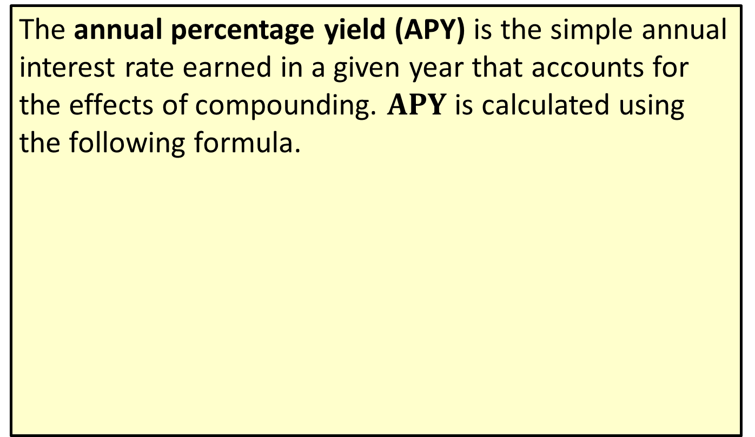
Definition: Annual Percentage Yield (APY)
The annual percentage yield (APY) is the simple annual interest rate earned in a given year that accounts for the effects of compounding. $APY$ is calculated using the following formula.
Here, r is the APR written as a decimal and n is the number of compounding intervals per year.

Slide 9
Definition: Annuity
An annuity is a sequence of regular payments made into an account, or taken out of an account, over time.

Slide 10
Definition: Present Value with Compound Interest
The amount of principal needed now in order to reach a future value amount is called the present value (PV). The present value with compound interest is calculated with the following formula.
Here A is the future value, r is the APR written as a decimal, n is the number of compound intervals per year, and t is time in years.

Slide 11
Definition: Annuity Payment Amount
The annuity payment amount (PMT), or regular payment amount, needed to be deposited at the end of each compounding period in order to reach a future goal with an annuity savings account is calculated with the following formula.
Here, FV is the future value desired, r is the APR written as a decimal, n is the number of compounding intervals per year, and t is time in years.

Slide 12

Definition: Future Value of an Annuity
The future value ($FV$) of an annuity account is calculated with the following formula.
Here, PMT is the payment amount deposited at the end of each compounding interval, r is the APR written as a decimal, n is the number of compounding intervals per year, and t is time in years.

Slide 13
Definition: Fixed Installment Loan
A fixed installment loan is a loan with a fixed interest rate and loan period. Repayments are made in equal installments throughout the life of the loan.

Slide 14
Definition: Down Payment
A down payment is a cash payment made up front towards the total purchase price of the goods or service.

Slide 15
Definition: Mortgage
An installment loan used for the purposes of buying a house or other real estate where the property is used as collateral is called a mortgage.

Slide 16
Definition: Fixed-Rate Mortgage
In a fixed-rate mortgage, the interest rate remains constant throughout the life of the loan.

Slide 17
Definition: Adjustable-Rate Mortgage
In an adjustable-rate mortgage (ARM), the interest rate is fixed for a period of time at the beginning of the loan period, and then is allowed to fluctuate over time.

Slide 18
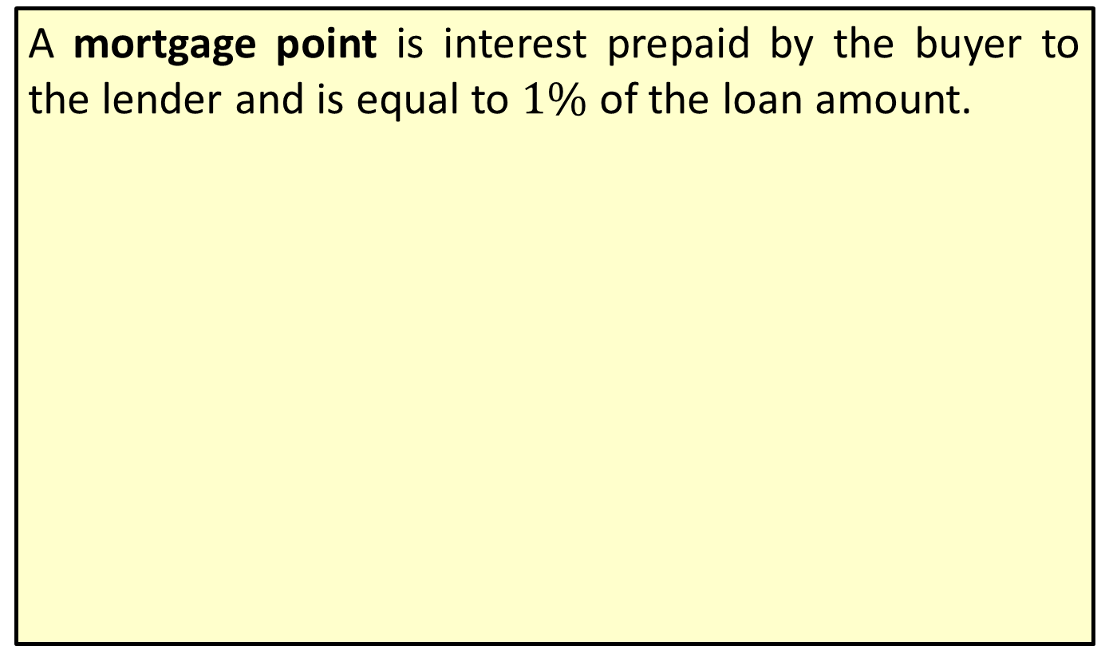
Definition: Mortgage Point
A mortgage point is interest prepaid by the buyer to the lender and is equal to $1\%$ of the loan amount.

Slide 19
Definition: Open-Ended Loans (Revolving Credit)
An open-ended loan, or revolving credit, is a preapproved loan amount that may be used by the borrower repeatedly. Interest is applied to any unpaid balance at the end of the payment period.

Slide 20
Definition: Credit Limit
The maximum amount of an open-ended loan is called your credit limit.

Slide 21
Definition: Grace Period
A grace period is a period of time in which no interest accrues on a debt.

Slide 22
Definition: Regular Payment for Fixed Installment Loans
The amount of a regular payment (PMT) on a fixed installment loan is calculated with the following formula.
Here, P is the principal amount of money borrowed, r is the APR in decimal form, n is the number of payments per year, and t is time in years.

Slide 23
Definition: Number of Fixed Payments Required to Pay Off Credit Card Debt
The number of fixed payments R required to pay off credit card debt is calculated with the formula.
where A is the loan amount, r is the APR in decimal form, n is the number of payments per year, and the payment amount is PMT.

Slide 24
Definition: Gross Income
Gross income is the sum of all forms of earnings, including wages, tips, benefits, investment income, alimony, etc.

Slide 25
Definition: Adjusted Gross Income
Adjusted gross income (AGI) is defined as gross income minus any adjustments you are allowed such as education expenses, health savings account contributions, paid alimony, or self-employment expenses.

Slide 26
Definition: Deduction
A tax deduction is comprised of expenses incurred by an individual or organization that can be subtracted from their gross income in order to reduce the amount of income that is able to be taxed.

Slide 27
Definition: Taxable Income
Taxable income is the amount of income subject to taxes by the government.

Slide 28
Definition: Budget
A budget is a financial plan for your income over a defined period of time.

Slide 29
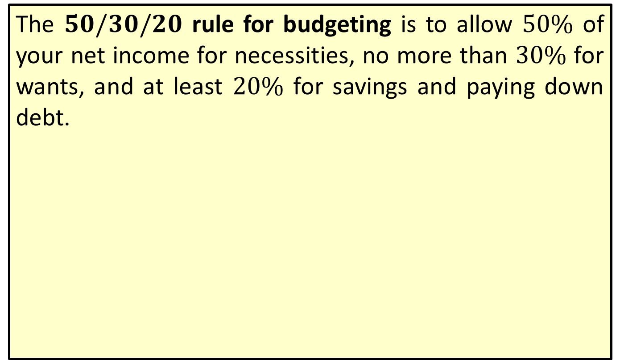
Definition: 50/30/20 Budgeting Rule
The $50/30/20$ rule for budgeting is to allow $50\%$ of your net income for necessities, no more than $30\%$ for wants, and at least $20\%$ for savings and paying down debt.

Slide 30
Procedure: Steps to Creating a Budget
1. ​Calculate monthly income.
2. ​Calculate monthly expenses.
3. Subtract expenses from income.
4. Allocate any remaining funds or make adjustments.

