Slide 1
Section 7.1
Numeral Systems Based on Position

Slide 2
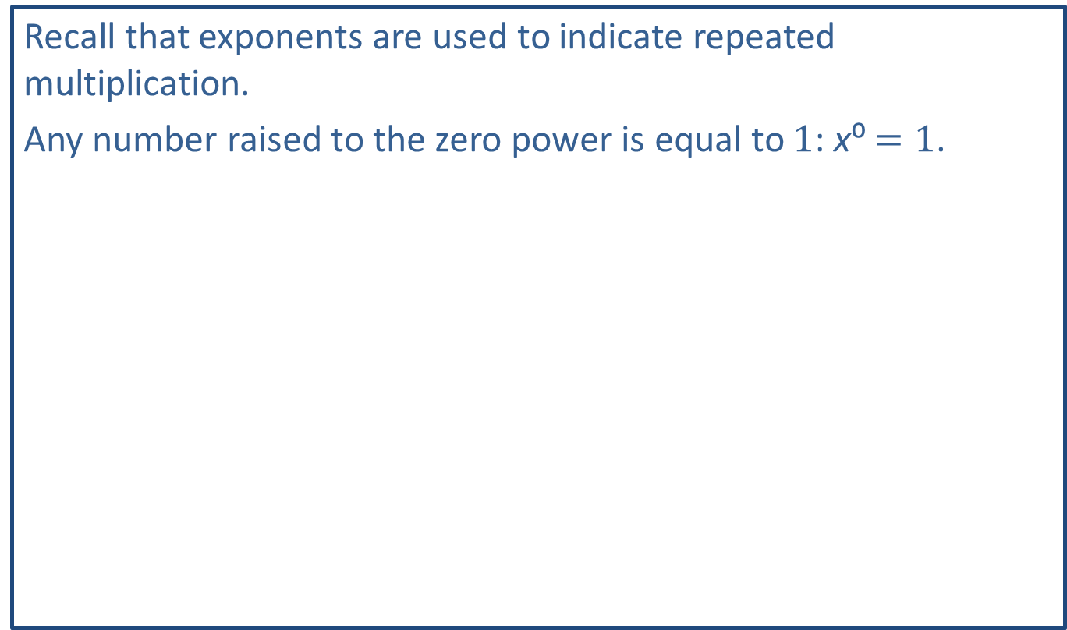
Think Back—Slide 1
Recall that exponents are used to indicate repeated multiplication.
Any number raised to the zero power is equal to 1: x⁰ $=1$.

Slide 3
Think Back—Slide 2
Expanded form, or expanded notation, is a way to write out numbers so that one can see the math involved for each digit.

Slide 4
Example 1: Converting between Hindu-Arabic Numerals and Expanded Form—Slide 1
a.​ Write the numeral 10,325 in expanded form.
b.​ Express the following expanded form as a Hindu-Arabic numeral.
​
​
Solution
Notice that digit for the place value of 10³ is a 0, so we do not need to include it in the expanded form, but it is not wrong if you do include it.

Slide 5
Helpful Hint
The use of multiplication and then addition, as we saw in Example 1, shows that the Hindu-Arabic numeral system is both multiplicative and additive.

Slide 6
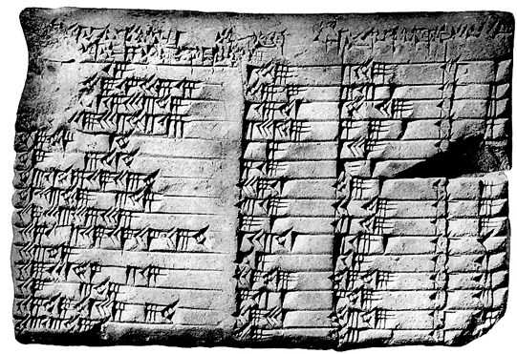
Fun Fact—Slide 1
The Plimpton 322 is a Babylonian clay tablet circa 1800 BC, which is held in the Columbia University Libraries.
Figure 4: Plimpton 322

Slide 7


Example 2: Converting Numbers from the Babylonian Numeral System to the Hindu-Arabic Numeral System—Slide 1
Write each Babylonian numeral as a Hindu-Arabic numeral.
a.​
b.
c.

Slide 8


Example 2: Converting Numbers from the Babylonian Numeral System to the Hindu-Arabic Numeral System—Slide 2
Solution
a.​ The first number does not contain any large spaces between the symbols, so we know that it is a number between 1 and 59. We know the
symbol
represents 10 and the
symbol represents 1.
There are three 10s and eight 1s, so this Babylonian numeral can be written as the Hindu-Arabic numeral 38.
b. Because the second numeral contains spaces between the groupings, we will need to multiply by the corresponding place value.

Slide 9

Example 2: Converting Numbers from the Babylonian Numeral System to the Hindu-Arabic Numeral System—Slide 3
The Babylonian numeral can be written as the Hindu-Arabic numeral 201. Notice that although our system has a 0 as a place holder for the 10 s place, the Babylonian numeral system does not contain a symbol for 0.

Slide 10

Example 2: Converting Numbers from the Babylonian Numeral System to the Hindu-Arabic Numeral System—Slide 4
c.​ Again, we have spaces between the symbol groupings so we will have to perform multiplication and addition to convert to a Hindu-Arabic numeral.
​
Our calculations show that the Babylonian numeral can be written as the Hindu-Arabic numeral 7322.

Slide 11
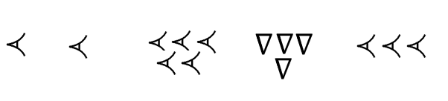
Skill Check 1
Write the Babylonian numeral as a Hindu-Arabic numeral.
Answer: 2,199,270

Slide 12
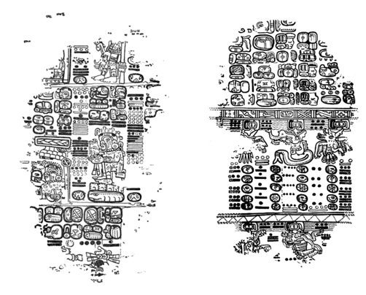
Fun Fact—Slide 2
The Paris Codex, shown here, displays a use of the Mayan numeration system. This codex was discovered and forgotten several times. The most recent rediscovery was in 1859 by León de Rosny at the Bibliothèque Nationale in Paris.
Figure 5: A portion of the Paris Codex
Source: "The Paris Codex," Northwestern University Web Archive, accessed June 2021, http://digital.library.northwestern.edu/codex/background.html

Slide 13
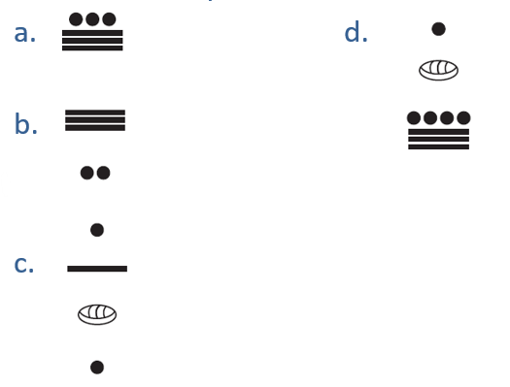
Example 3: Converting Numbers from the Mayan System to the Hindu-Arabic Numeral System—Slide 1
Write each Mayan numeral as a Hindu-Arabic numeral.

Slide 14
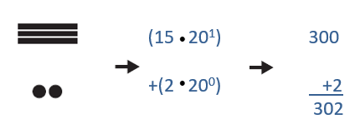
Example 3: Converting Numbers from the Mayan System to the Hindu-Arabic Numeral System—Slide 2
Solution
a.​ The first number does not contain any large vertical spaces between the symbols, so we know that it is a number between 0 and 19. We know the
symbol represents 1, and the
symbol represents 5. Since there
are three 5s and three 1s, the Mayan numeral can be written as the Hindu
Arabic numeral 18.
b. Because the second numeral contains a vertical space between the groupings, we will need to multiply each group by the corresponding place value. Remember that the highest power of 20 is at the top and then it decreases from there.
The Mayan numeral can be written as the Hindu-Arabic numeral 302.

Slide 15
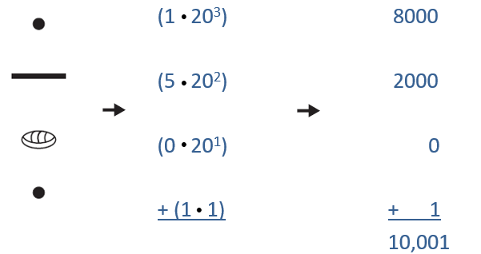

Example 3: Converting Numbers from the Mayan System to the Hindu-Arabic Numeral System—Slide 3
c.​ We have vertical spacing again, so we will need multiplication and addition for the calculation. The top symbol here is for the number 1 and is in the ${20}^{3}$s place, 5 is in the ${20}^{2}$s place, 0 is in the ${20}^{1}$s place, and 1 is in the 1s place.
Our calculations show that the Mayan numeral can be written as the Hindu-Arabic numeral 10,001.

Slide 16
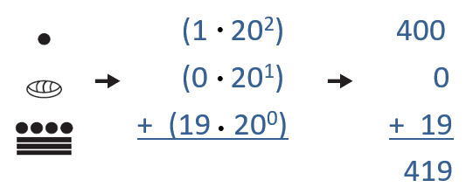

Example 3: Converting Numbers from the Mayan System to the Hindu-Arabic Numeral System—Slide 4
d.​ Here the top symbol is in the ${20}^{2}$s place, the symbol for zero is in the ${20}^{1}$s place, and the last symbol is in the 1s place.
The Mayan numeral can be written as the Hindu-Arabic numeral 419. Notice that a zero character written in the Mayan numeral does not necessarily mean there will be a zero in the Hindu-Arabic numeral.

Slide 17
Fun Fact—Slide 3
The Mayan calendar, the Haab', consists of 19 months. Eighteen of the months have 20 days and the final month has only 5 days, making a total of 365 calendar days. The final month was used for celebrations that closed one cycle and opened a new one.

Slide 18

Skill Check 2
Write the Mayan numeral as a Hindu-Arabic numeral.
Answer: 1312

Slide 19

Example 4: Converting Numbers from the Hindu-Arabic Numeral System to the Babylonian and Mayan Systems—Slide 1
Express each Hindu-Arabic numeral in both the Babylonian and Mayan systems.
a.​ 8
b.​ 157
Solution
a.​ Express 8 as a Babylonian numeral and a Mayan numeral.
​Babylonian
Recall that there are only two symbols in the Babylonian system:
represents 1, and
represents 10. Since 8 is less than 10, we
only need to use the symbol for 1 to write the number.

Slide 20

Example 4: Converting Numbers from the Hindu-Arabic Numeral System to the Babylonian and Mayan Systems—Slide 2
​Mayan
To symbolize the number 8 in the Mayan system, we need to use the character for 1 (which is
).
) three times
stacked on top of the character for 5 (which is
b. Express 157 as a Babylonian numeral and a Mayan numeral.

Slide 21

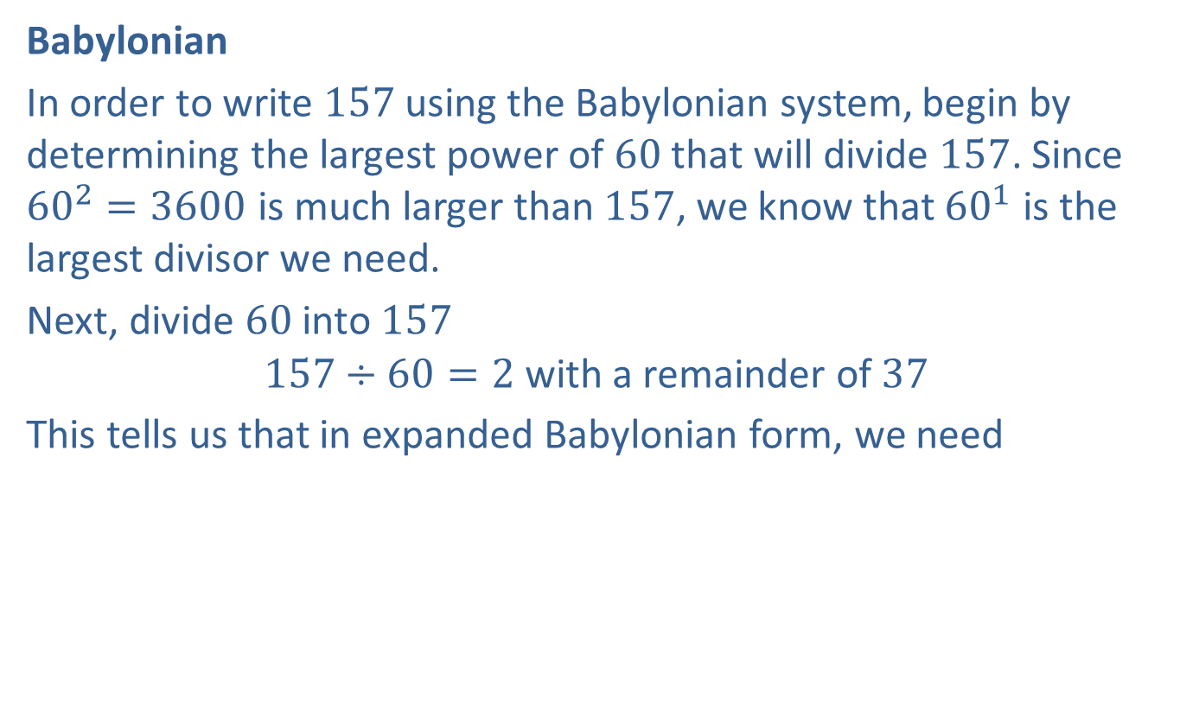
Example 4: Converting Numbers from the Hindu-Arabic Numeral System to the Babylonian and Mayan Systems—Slide 3
​Babylonian
In order to write 157 using the Babylonian system, begin by determining the largest power of 60 that will divide 157. Since ${60}^{2}=3600$ is much larger than 157, we know that ${60}^{1}$ is the largest divisor we need.
Next, divide 60 into 157
$$157÷60=2 \text{with} \text{a} \text{remainder} \text{of} 37$$
This tells us that in expanded Babylonian form, we need
with a large gap in between each set of characters.

Slide 22

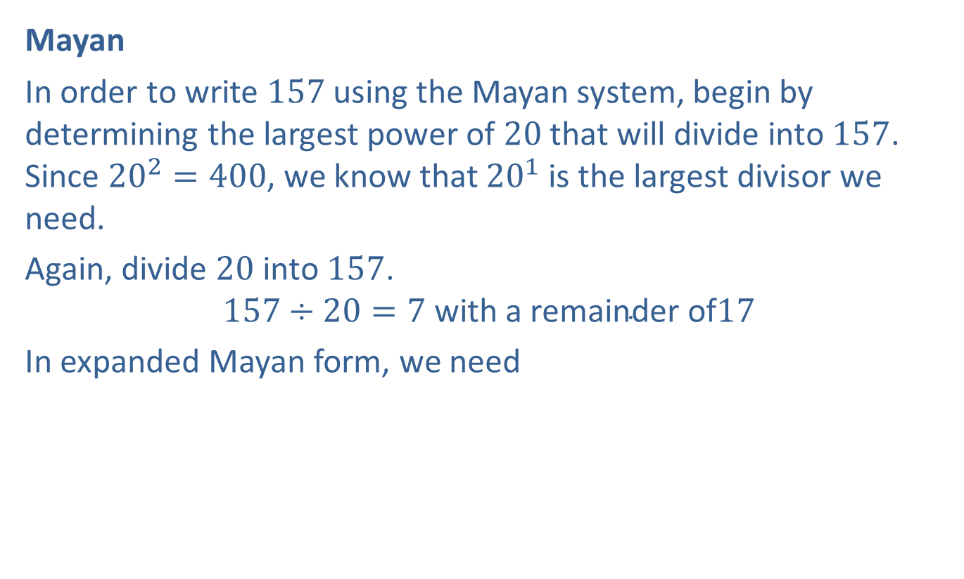
Example 4: Converting Numbers from the Hindu-Arabic Numeral System to the Babylonian and Mayan Systems—Slide 4
​Mayan
In order to write 157 using the Mayan system, begin by determining the largest power of 20 that will divide into 157. Since ${20}^{2}=400$, we know that ${20}^{1}$ is the largest divisor we need.
Again, divide 20 into 157.
$$157÷20=7 \text{with} \text{a} \text{remainder} \text{of}17$$
In expanded Mayan form, we need
stacked one on top of the other.

