Slide 1
Section 7.2
Early Numeral Systems

Slide 2

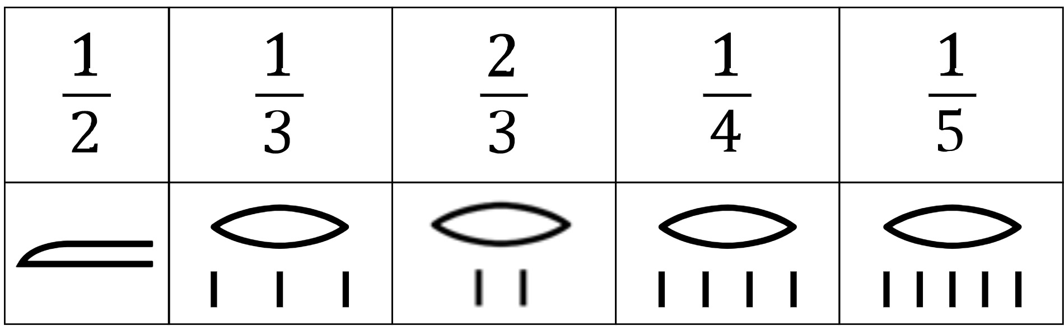
Fun Fact—Slide 1
Fractions, with the exception of
,
were represented
as unit fractions with the form
where the 1 in the
numerator was represented by the symbol
which means "[one] among." Some of the common fractions used are shown here.

Slide 3
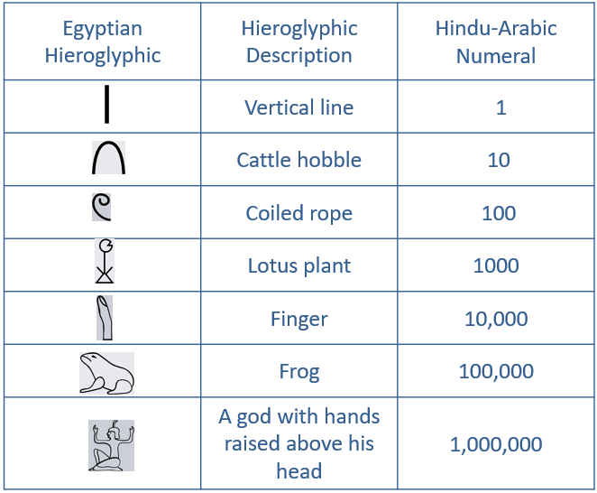
Table 1: Hieroglyphics for Egyptian Numerals

Slide 4

Example 1: Converting between the Egyptian Numeral System and the Hindu-Arabic Numeral System—Slide 1
a.​ Write the following Egyptian numeral as a Hindu-Arabic numeral.
​
b.​ Write the following Hindu-Arabic numeral using Egyptian hieroglyphics.
​1,325,000

Slide 5
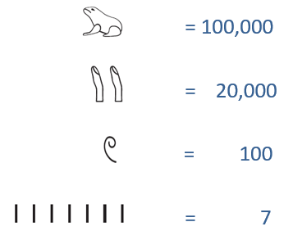
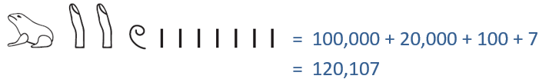
Example 1: Converting between the Egyptian Numeral System and the Hindu-Arabic Numeral System—Slide 2
Solution
a. ​Using Table 1, we can find the value of each hieroglyphic and then add them together.
So we have the following.

Slide 6
Example 1: Converting between the Egyptian Numeral System and the Hindu-Arabic Numeral System—Slide 3
b.​ To begin, we need to write the numeral in expanded form so we can easily see how many symbols of each to write.
​
​
  Expanded form conveys how many of each hieroglyphic is needed. Using Table 1, we can identify the appropriate symbol for each number.

Slide 7
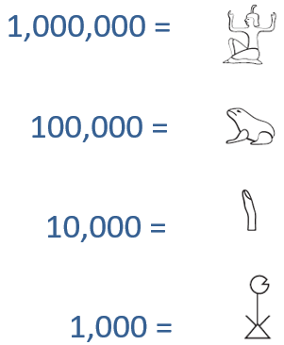

Example 1: Converting between the Egyptian Numeral System and the Hindu-Arabic Numeral System—Slide 4
So the Egyptian hieroglyphic for 1,325,000 is written as follows.

Slide 8

Skill Check 1
Write the Hindu-Arabic numeral 2461 using Egyptian hieroglyphics.
Answer:

Slide 9
Fun Fact—Slide 2
The three Phoenician letters (vau, koph, and sampi) used by the Greeks to supplement their alphabet were symbols from the earliest written alphabet of the Phoenicia, which had become obsolete by the time the Ionic Greek numeral system was used.

Slide 10
Fun Fact—Slide 3
Maybe you noticed there was not a symbol to represent 0 in the Egyptian numeral system; the same is true of the Greek numeral system.

Slide 11
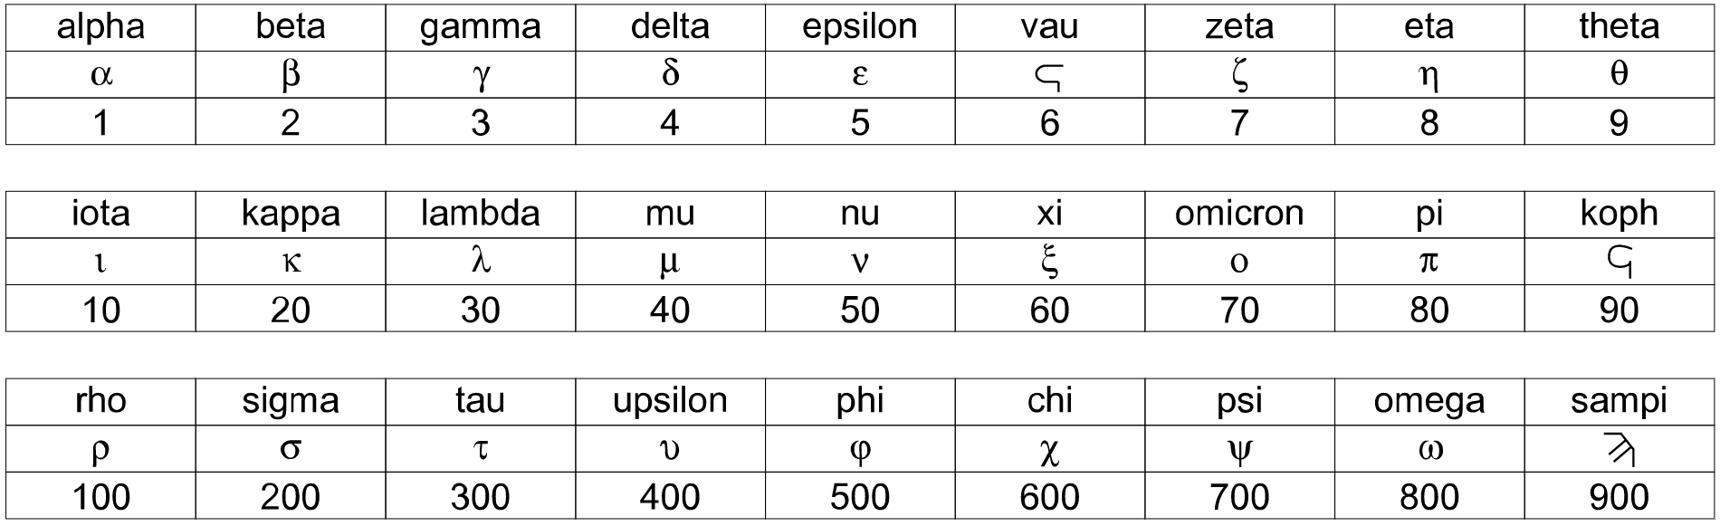
Table 2: Ionic Greek Numerals

Slide 12
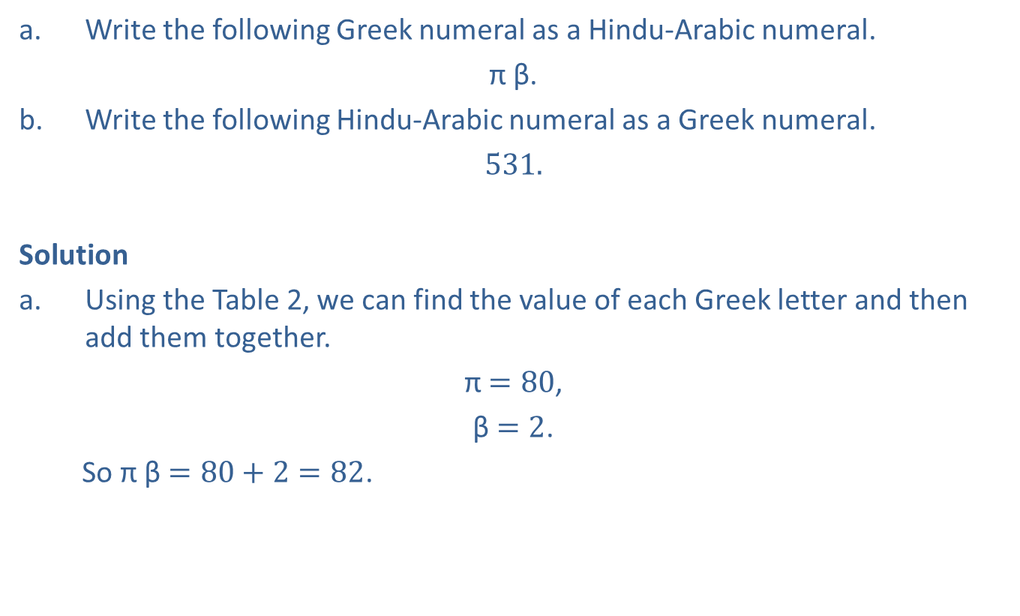
Example 2: Converting between the Ionic Greek Numeral System and the Hindu-Arabic Numeral System—Slide 1
a.​ Write the following Greek numeral as a Hindu-Arabic numeral.
π β.
b.​ Write the following Hindu-Arabic numeral as a Greek numeral.
​531.
Solution
a.​ Using the Table 2, we can find the value of each Greek letter and then add them together.
π $=80$,
β $=2$.
  So π β $=80+2=82$.

Slide 13


Example 2: Converting between the Ionic Greek Numeral System and the Hindu-Arabic Numeral System—Slide 2
b.​ To begin with, we need to write the numeral in expanded form so that we can easily see which symbols will be needed.
​$531=500+30+1$.
  Using Table 2, we can find the appropriate Greek letter for
each value.
​
​ So $531=$ φ λ α.

Slide 14
Skill Check 2
Write the Hindu-Arabic numeral 402 as a Greek numeral.
Answer: νβ

Slide 15
Addition and Subtraction Rules for Roman Numerals—Slide 1
1.​ A letter may be repeated up to 3 times to indicate multiple values. For example,
​
​
​
2.​​ If a smaller value is placed on the right of a character, that smaller value is added to the larger one. For example,
3. If a smaller value is placed on the left of a character, that smaller value is subtracted from the larger one. For example,

Slide 16
Addition and Subtraction Rules for Roman Numerals—Slide 2
4. A bar is placed above a symbol, or group of symbols, to indicate that the numeral is to be multiplied by 1000. For example,

Slide 17
Table 4: Roman Numerals Up to 1000
Value | Roman Numeral | Value | Roman Numeral | Value | Roman Numeral
One | I | Eleven | XI | Thirty | XXX
Two | II | Twelve | XII | Forty | XL
Three | III | Thirteen | XIII | Fifty | L
Four | IV | Fourteen | XIV | Sixty | LX
Five | V | Fifteen | XV | Seventy | LXX
Six | VI | Sixteen | XVI | Eighty | LXXX
Seven | VII | Seventeen | XVII | Ninety | XC
Eight | VIII | Eighteen | XVIII | One hundred | C
Nine | IX | Nineteen | XIX | Five hundred | D
Ten | X | Twenty | XX | One thousand | M

Slide 18
Example 3: Converting between the Hindu-Arabic Numeral System and the Roman Numeral System—Slide 1
Complete Table 4 by writing the following Hindu-Arabic numerals as Roman numerals.
a.​ Eight
b. ​Fourteen
c.​ Nineteen
d. ​Forty

Slide 19
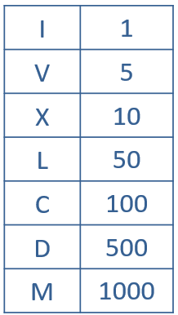
Example 3: Converting between the Hindu-Arabic Numeral System and the Roman Numeral System—Slide 2
Solution
To write each of the numbers as Roman numerals, we need to break down each number into quantities represented by the Roman numeral system; that is, 1, 5, 10, etc. (It's a similar concept to making change for someone with a limited pile of coins.)

Slide 20
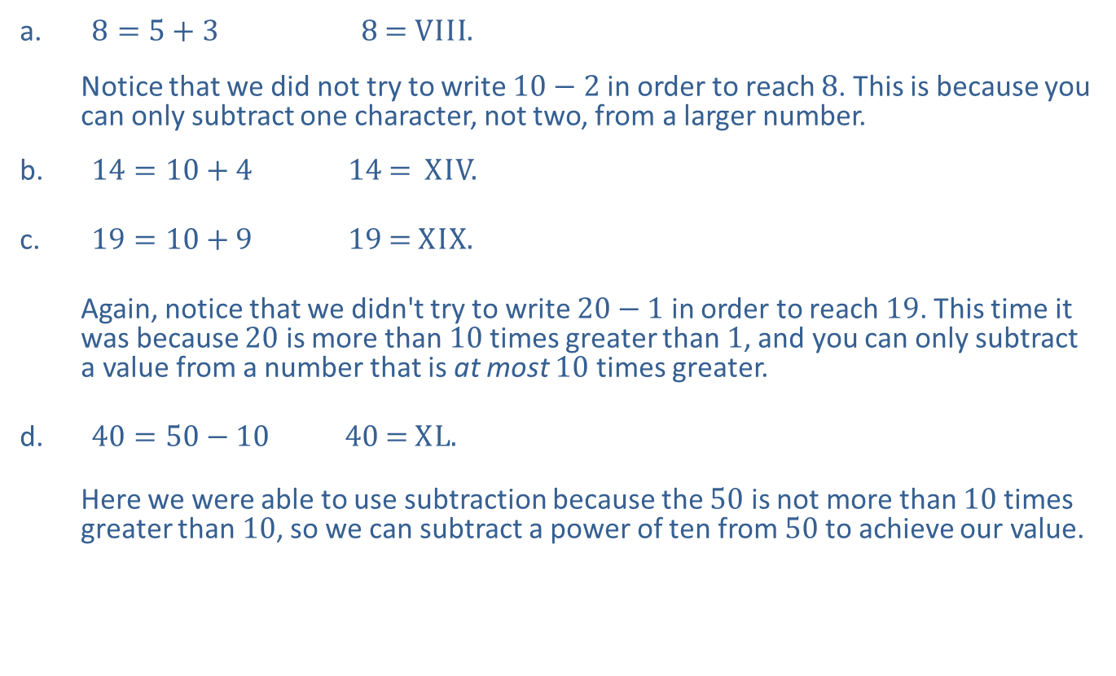
Example 3: Converting between the Hindu-Arabic Numeral System and the Roman Numeral System—Slide 3
a. $8=5+3$ 8 = V I I I.
  Notice that we did not try to write $10−2$ in order to reach 8. This is because you can only subtract one character, not two, from a larger number.
b. $14=10+4$ 14 = X I V.
c. $19=10+9$ 19 = X I X.
  Again, notice that we didn't try to write $20−1$ in order to reach 19. This time it was because 20 is more than 10 times greater than 1, and you can only subtract a value from a number that is at most 10 times greater.
d. $40=50−10$ 40 = X L.
  Here we were able to use subtraction because the 50 is not more than 10 times greater than 10, so we can subtract a power of ten from 50 to achieve our value.

Slide 21
Skill Check 3
Write the Hindu-Arabic numeral 24 as a Roman numeral.
Answer: X X I V

Slide 22
Example 4: Converting between the Hindu-Arabic Numeral System and the Roman Numeral System—Slide 1
Write the following Roman numerals as Hindu-Arabic numerals.
a.​ M D C L X
b.​ M C M X L I I
Solution
In each case, we need to focus on the values of each of the letters so that we can determine where the letters should be grouped for subtraction. Remember that smaller numbers to the left indicate subtraction.
  Since there are no smaller values to the left of any number, we can simply add the values together.
M D C L X = 1000 + 500 + 100 + 50 + 10 = 1660

Slide 23
Example 4: Converting between the Hindu-Arabic Numeral System and the Roman Numeral System—Slide 2
  Notice that this time, C (100) is to the left of the larger value M (1000), and X (10) is to the left of the larger value L (50). So we need to group these pairs together for subtraction.

Slide 24
Fun Fact—Slide 4
The Suàn shù shù, or the Book on Numbers and Computation, circa 200 BC, is one of the earliest examples of Chinese mathematics. Consisting of 200 strips of bamboo, it contains 69 mathematical problems with their solutions and methods.

Slide 25
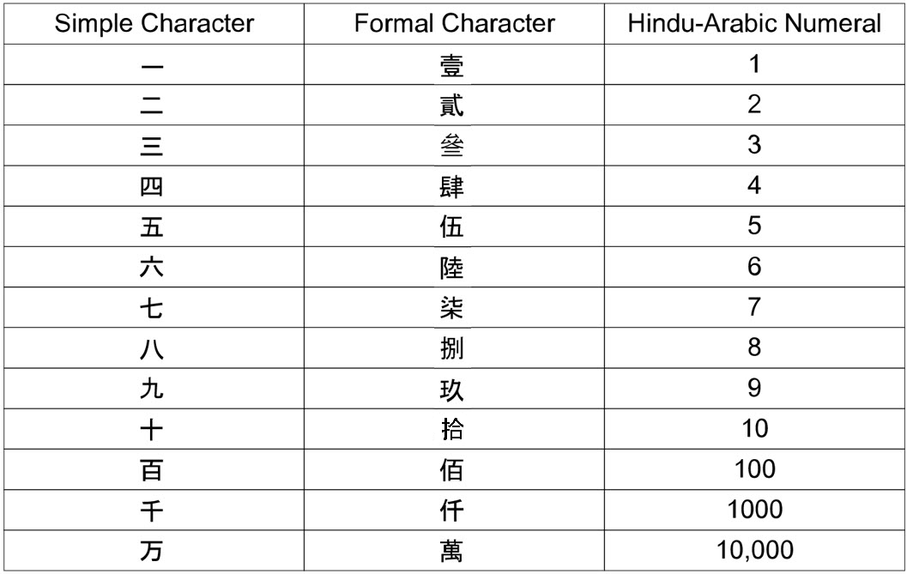
Table 5: Chinese Numerals

Slide 26






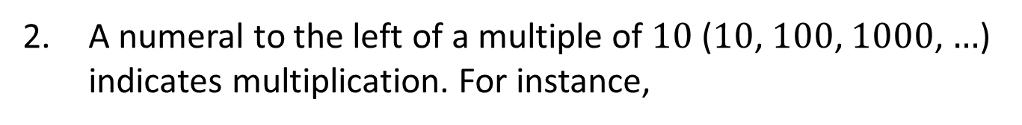
Definition: Addition and Multiplication Rules for the Chinese Numeral System
1.​ A numeral to the right of a multiple of 10 (10, 100, 1000, $…$) indicates addition. For instance,
​
2.​ A numeral to the left of a multiple of 10 (10, 100, 1000, $…$) indicates multiplication. For instance,
3.​ A position holder,
is used for when a zero occurs in the
middle of a numeral. Only one is needed to show any
number of consecutive zeros. For instance,

Slide 27

Example 5: Converting between the Hindu-Arabic Numeral System and the Chinese Numeral System—Slide 1
a. Write the following Chinese numeral as a Hindu-Arabic numeral.
b. Write the following Hindu-Arabic numeral as a Chinese numeral.
​407
Solution
​We can use Table 5 to determine the value for each symbol
9 10 8

Slide 28

Example 5: Converting between the Hindu-Arabic Numeral System and the Chinese Numeral System —Slide 2
  Because the 9 symbol is to the left of the 10, we will multiply the two together and then add 8, which is to the right of the 10.
b.​ Writing 407 in expanded form we have
  This means that we need the character for 4 to be on the left of the symbol for 100 and the character for 7 to be on the right. However, because there is a 0 in the middle of our numeral, we also need the place holder. The symbols needed are as follows.

Slide 29
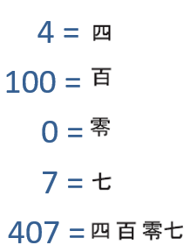
Example 5: Converting between the Hindu-Arabic Numeral System and the Chinese Numeral System —Slide 3

Slide 30

Skill Check 4
Write the following Chinese numeral as a Hindu-Arabic numeral.
Answer : 35

