Slide 1
Section 7.3
Working with Base Number Systems

Slide 2
Think Back—Slide 1
Any number raised to the zero power is equal to 1.
x⁰ = 1

Slide 3
Think Back—Slide 2
You are already accustomed to interpreting numbers written in different ways. For example, scientific notation is a compact way to write very large and very small numbers with ease; i.e.,

Slide 4
Example 1: Converting from Other Bases to Base 10—Slide 1
a. Convert the number
to base 10.
b.​ Convert the number
to base 10.
Solution
In order to convert to base 10, we need to write the number in expanded form using the appropriate powers.

Slide 5
Skill Check 1
Convert the number
to base 10.
Answer: 108

Slide 6
Table 1: Characters Used for Base 16 (the Hexadecimal System)
Base 10 Digit | 1 | 2 | 3 | 4 | 5 | 6 | 7 | 8 | 9 | 10 | 11 | 12 | 13 | 14 | 15
Hexadecimal (Base 16 Digit) | 1 | 2 | 3 | 4 | 5 | 6 | 7 | 8 | 9 | A | B | C | D | E | F

Slide 7
Example 2: Converting from the Hexadecimal System to Base 10—Slide 1
Convert the number
to base 10.
Solution
We need to write the number in expanded form, using the appropriate Hindu-Arabic numbers in Table 1 and multiplying by the appropriate powers of 16.
Therefore,
is equivalent to 2863 in base 10.

Slide 8
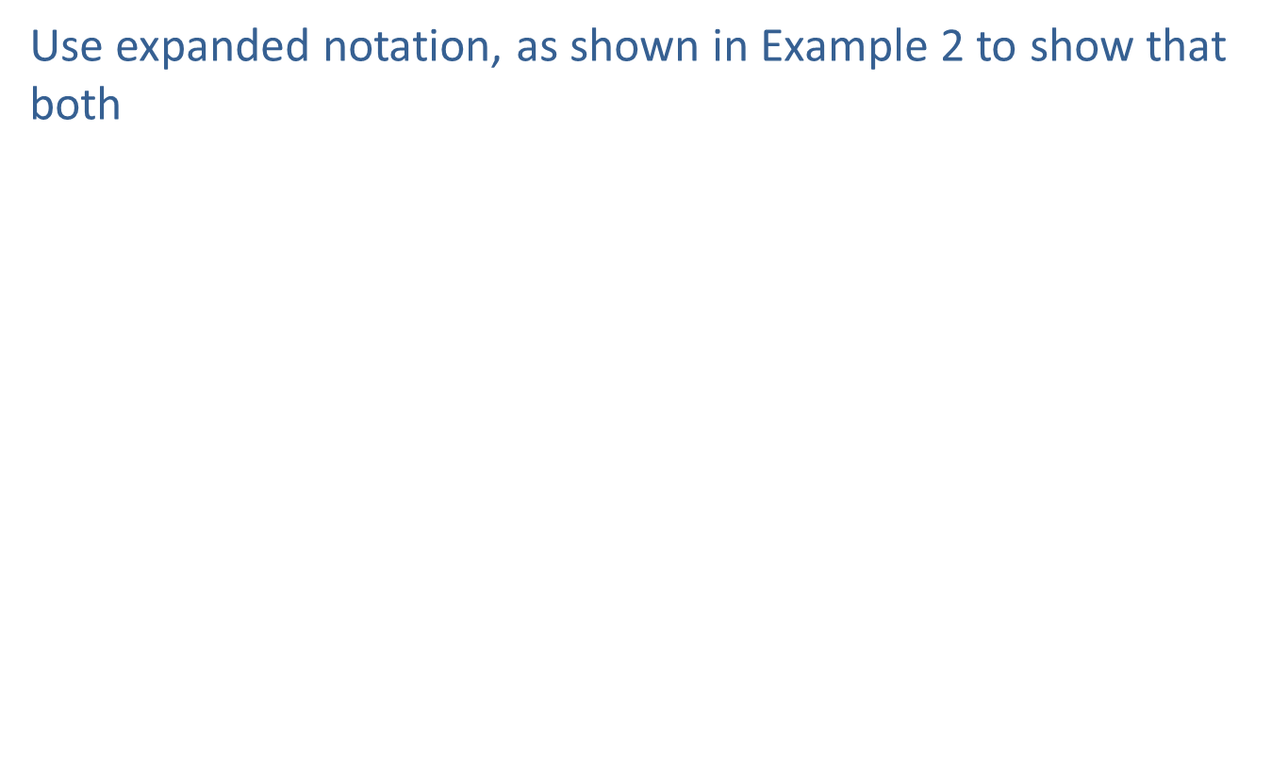
Skill Check 2
Use expanded notation, as shown in Example 2 to show that both
1111001000110000002
Answer:

Slide 9
Example 3: Converting from Base 10 to Other Bases—Slide 1
Convert the given base 10 number to the indicated base.
a.​ 102 to base 2
b.​ 138 to base 16
Solution
When converting from base 10 to any other base, it's helpful to begin by examining the powers of the desired base.
a. Converting the base 10 number 102 to base 2 signifies that powers of 2 are desired for each place value. We’ve listed the powers of two for you, until they exceed 102.

Slide 10

Example 3: Converting from Base 10 to Other Bases—Slide 2
Notice that the eighth position of the base 2 system, which is 2⁷ (and equal to 128), is already larger than our numeral 102. Therefore, we need to start the division process with the next smallest number, 2⁶, or 64. Using division, we can find out how many multiples of 2⁶ we will need.

Slide 11
Example 3: Converting from Base 10 to Other Bases—Slide 3
The quotient tells us that we will need to use one multiple of 2⁶. We then repeat the process by dividing the remainder of 38 by the next smaller power 2⁵, or 32. This will show us how many multiples of 2⁵ we will need.

Slide 12
Example 3: Converting from Base 10 to Other Bases—Slide 4
​We now know that we will also need to use one multiple of 2⁵. Notice that since the remainder here is 6, we can skip dividing by 16 and 8 and move right on to finding how many multiples of 2², or 4, are needed.
​
Thus, we need one multiple of 2². And finally, we divide the last remainder by 2¹.

Slide 13
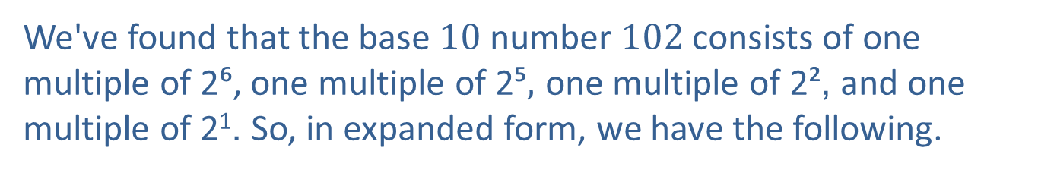
Example 3: Converting from Base 10 to Other Bases—Slide 5
We've found that the base 10 number 102 consists of one multiple of 2⁶, one multiple of 2⁵$,$ one multiple of 2², and one multiple of 2¹. So, in expanded form, we have the following.
When writing the number down in base 2, we need to remember to put 0s in the positions for the multiples of 2 that are not needed.
​Thus, the base 10 number 102 written in base 2 is

Slide 14
Example 3: Converting from Base 10 to Other Bases—Slide 6
b.​ Converting the base 10 number 138 to base 16 signifies that multiples of 16 are desired for each place value. Again, we list the multiples of 16 until they exceed 138.
​
Notice that the powers of 16 grow very rapidly. This time we begin the division with 16¹ since 16² = 256 is too large.

Slide 15
Example 3: Converting from Base 10 to Other Bases—Slide 7
​​This division tells us that we need eight multiples of 16 ² in our answer. Since our remainder of 10 is less than 16, no further division is required. In expanded form we have
​
​
Using Table 1, the character for 10 in base 16 is A.
​Therefore, the base 10 number 138 written in base 16 is

Slide 16
Example 4: Converting between Base 2 and Base 16—Slide 1
Convert the given number to the indicated base.
Solution
a.​ Recall that in Example 2, we converted
One option for converting from base 16 to base 2 is to first convert base 16 to base 10 and then convert base 10 to base 2. That option works, although it requires a significant number of steps. Alternatively, there's a shortcut option for converting directly between base 16 and base 2.
​Let's expand Table 1 to include the first sixteen base 2 equivalents.

Slide 17
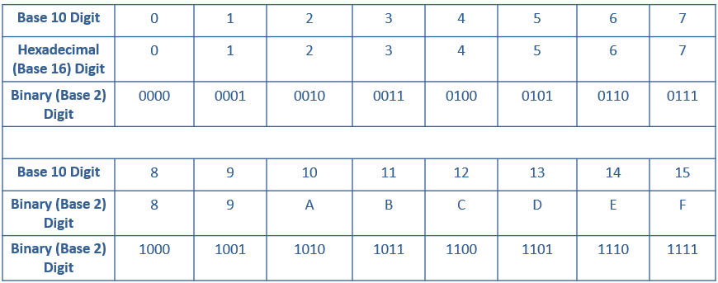
Example 4: Converting between Base 2 and
Base 16—Slide 2
Table 2: Characters Used for Base 16 (the Hexadecimal System)

Slide 18

Example 4: Converting between Base 2 and
Base 16—Slide 3
  We can use this conversion table for values represented in the table. Our given number was
  Start by finding B in the hexadecimal row and then locate its equivalent in binary, which is 1011. Doing the same for 2 and F gives us 0010 and 1111, respectively. Thus, we can join them in a string to give the following equivalent in base 2.
  This gives us that
b.​ When converting from base 2 to base 16 using the shortcut method, we work from right to left, splitting the given number into groups of four. This works because the first sixteen binary numbers can each be represented using four characters.
  Working from right to left, find the first block of four in our given number.

Slide 19

Example 4: Converting between Base 2 and
Base 16—Slide 4
​We then locate 1001 on the conversion table above and find that its base 16 equivalent is 9. Remember that this will be the rightmost digit in our base 16 number.
​Continue working from right to left in blocks of four.
​
​
This gives us that
is equivalent to

Slide 20
Example 5: Adding Two Numbers of Like
Base—Slide 1
Solution
a.​ Remember that when working in base 5, the only digits used are 0, 1, 2, 3, and 4. So if we ever perform an operation and obtain a number bigger than 5, we will need to convert that number back to base 5.
  Let's begin by lining up the digits of our numbers in
  columns for addition.

Slide 21
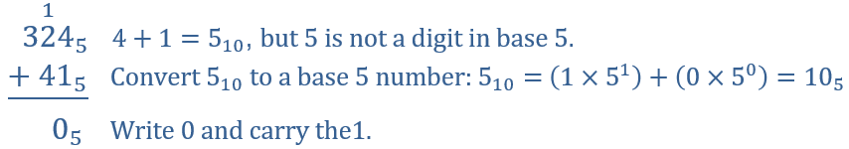
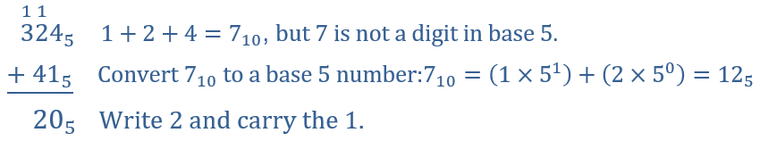
Example 5: Adding Two Numbers of Like
Base—Slide 2
​Just as with addition in base 10, add the numbers in the right-hand column first and work your way left, carrying over numbers into the next column, as needed.
​
​

Slide 22
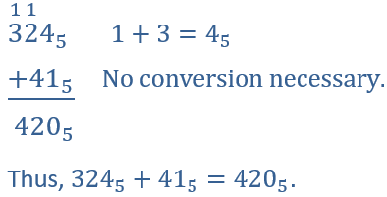
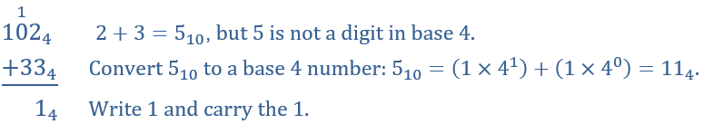
Example 5: Adding Two Numbers of Like
Base—Slide 3
b. When working in base 4, the only digits used are 0, 1, 2, and 3. So any number bigger than or equal to 4 will need to be converted back to base 4.

Slide 23
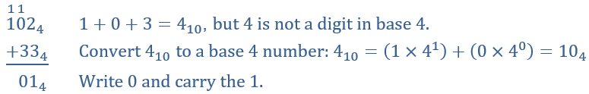
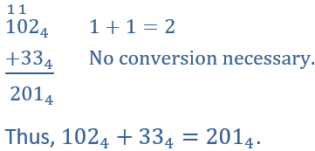
Example 5: Adding Two Numbers of Like
Base—Slide 4

Slide 24
Skill Check 3

Slide 25
Example 6: Subtracting Two Numbers of Like Base—Slide 1
Solution
a.​ Begin by lining up the digits appropriately for subtraction and subtract in columns from right to left, borrowing from the column to the left when needed. What we have to remember is that when borrowing for subtraction in any base, we borrow one multiple of the base. For instance, we are already accustomed to borrowing 10¹ when we subtract in base 10. Likewise, in base 9 we will borrow 9¹ if necessary. And in base 6, we will borrow 6¹.

Slide 26
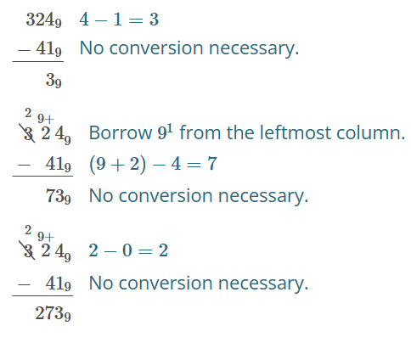
Example 6: Subtracting Two Numbers of Like Base—Slide 2

Slide 27
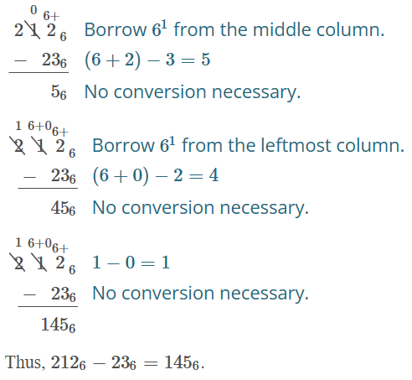
Example 6: Subtracting Two Numbers of Like Base—Slide 3

Slide 28
Skill Check 4

Slide 29
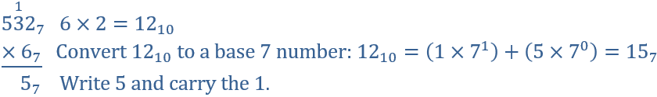
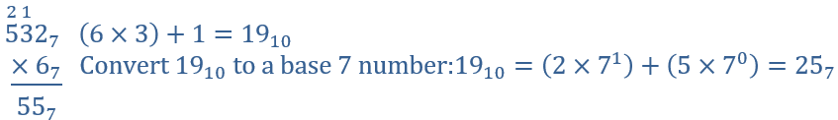
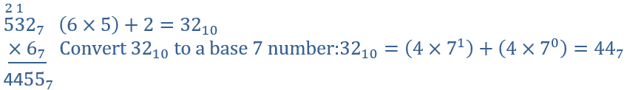
Example 7: Multiplying Two Numbers of Like Base—Slide 1
Solution
a.​ Begin by aligning the numbers for long-hand multiplication.

Slide 30
Example 7: Multiplying Two Numbers of Like Base—Slide 2
​b. Begin by aligning the numbers for long-hand multiplication.
​
We multiply here just like long-hand multiplication in base 10 that we are used to. Beginning with the number on the far right-hand side, multiply each digit in the bottom row by each digit in the top row.

Slide 31
Example 7: Multiplying Two Numbers of Like Base—Slide 3
​​
​
Repeat the process for the digit 2 in 21 base 3$,$ inserting a place holder 0, just as we would in base 10.

Slide 32
Example 7: Multiplying Two Numbers of Like Base—Slide 4

Slide 33
Example 7: Multiplying Two Numbers of Like Base—Slide 5
​​Now we can add the two products together to find the answer, converting any values back into base 3, if necessary.
​

Slide 34
Skill Check 5

