Slide 1
Section 7.4
The Metric System

Slide 2
Helpful Hint 1
Mass and weight are often referred to interchangeably in our everyday speech. However, scientifically, they are not the same. Weight is actually defined as mass with the effects of gravity pulling on it and it is measured in newtons. If your bathroom scale says you "weigh" 120 pounds, that is really your mass; you actually weigh 533.8 newtons.

Slide 3
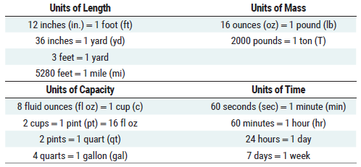
Table 1: Measurements Used in the US Customary System

Slide 4
Definition: Conversion Factor
A conversion factor is a fraction equal to 1 that contains different units in the numerator and denominator.

Slide 5
Helpful Hint 2
Conversion factors are sometimes called unit fractions since the numerator and denominator are equivalent values.

Slide 6
Think Back 1
Recall that fractions are of the form

Slide 7
Example 1: Using Conversion Factors to Convert between US Units of Measure—Slide 1
Convert each measurement to the desired unit of measure using conversion factors.
a.​ If an extra-large bag of Halloween candy weighs 76.2 ounces, how many pounds of candy are in the bag? Round your answer to the nearest tenth of a pound.
b.​ A recipe calls for
cup of milk. How many fluid
ounces would you need?

Slide 8
Example 1: Using Conversion Factors to Convert between US Units of Measure—Slide 2
Solution
a.​ Begin by choosing a unit fraction that has the desired units in the numerator and the original units in the denominator. For this conversion, we'll need pounds (lb) in the numerator and ounces (oz) in the denominator.
Using Table 1, the conversion factor is
Convert the value by multiplying the original measurement by the conversion factor.
Therefore, there are approximately 4.8 pounds of candy in the bag.

Slide 9
Example 1: Using Conversion Factors to Convert between US Units of Measure—Slide 3
b.​ We first need to choose an appropriate conversion factor. For this conversion, we'll need fluid ounces in the numerator and cups in the denominator. Using Table 1, we can write the conversion factor as follows.
​
​
Multiply the original measurement by the conversion factor.
Therefore, approximately 2.7 fluid ounces of milk are needed for the recipe.

Slide 10
Skill Check 1
Convert 30 inches to feet.
Answer: 2.5 feet

Slide 11
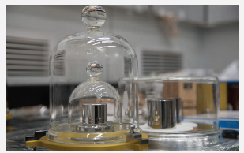
Fun Fact 1
In November 2018, at the 26th meeting of the General Conference on Weights and Measures in Vienna, the new official definition of the kilogram was unanimously approved. As of May 2019, the new definition for the kilogram will be expressed in terms of Planck's constant and the speed of light. The previous standard was based on a cylinder made from a platinum alloy, copies of which were held in environmentally monitored safes around the world.
Figure 1
Photo credit: National Institute of Standards and Technology

Slide 12
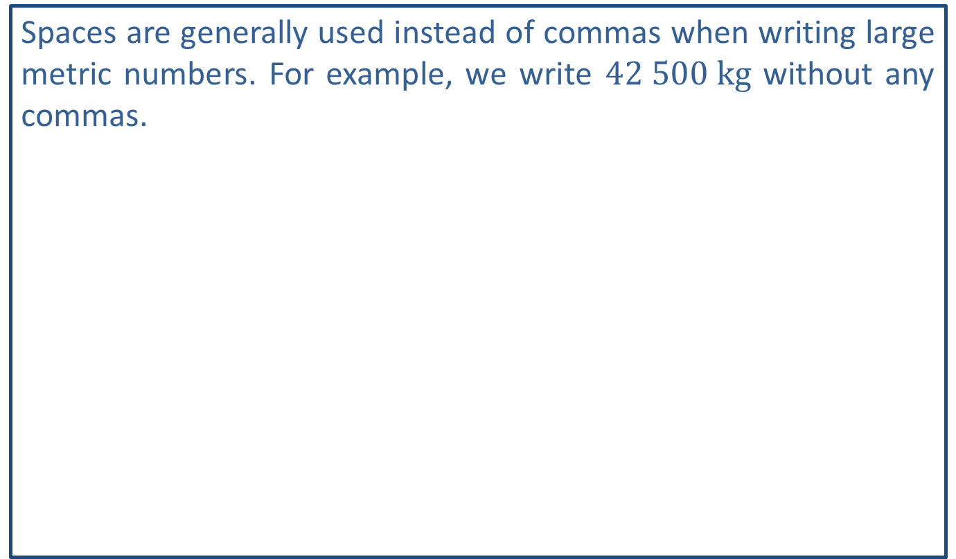
Helpful Hint 3
Spaces are generally used instead of commas when writing large metric numbers. For example, we write $42 500 kg$ without any commas.

Slide 13
Helpful Hint 4
You cannot convert between base units in the metric system. For example, you cannot convert between kilometers and milligrams. That's like trying to convert miles to ounces.

Slide 14
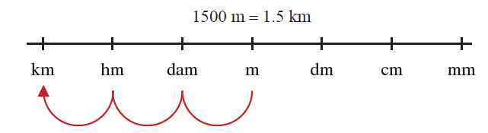
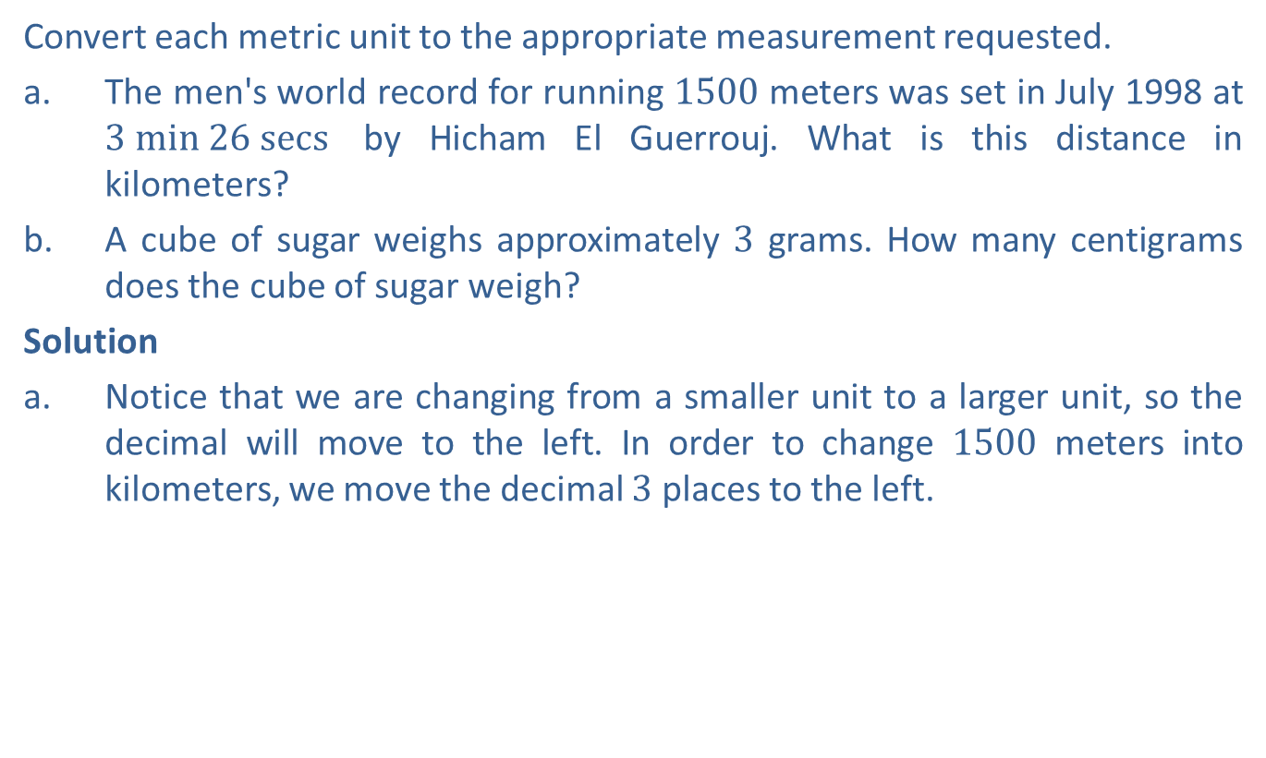
Example 2: Converting within the Metric System in One Dimension—Slide 1
Convert each metric unit to the appropriate measurement requested.
a.​ The men's world record for running 1500 meters was set in July 1998 at $3 min 26 secs$ by Hicham El Guerrouj. What is this distance in kilometers?
b.​ A cube of sugar weighs approximately 3 grams. How many centigrams does the cube of sugar weigh?
Solution
a.​ Notice that we are changing from a smaller unit to a larger unit, so the decimal will move to the left. In order to change 1500 meters into kilometers, we move the decimal 3 places to the left.
Figure 3

Slide 15
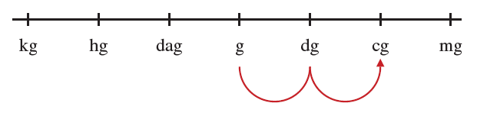

Example 2: Converting within the Metric System in One Dimension—Slide 2
b.​ Notice that we are changing from a larger unit to a smaller one, so the decimal will move to the right. In order to change 3 grams into centigrams, we move the decimal 2 places to the right.
​$3 g=300 cg$
​
Figure 4

Slide 16

Skill Check 2
Convert $1500 \text{milliliters}$ to liters.
Answer: 1.5 liters

Slide 17
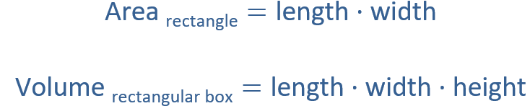
Think Back 2

Slide 18
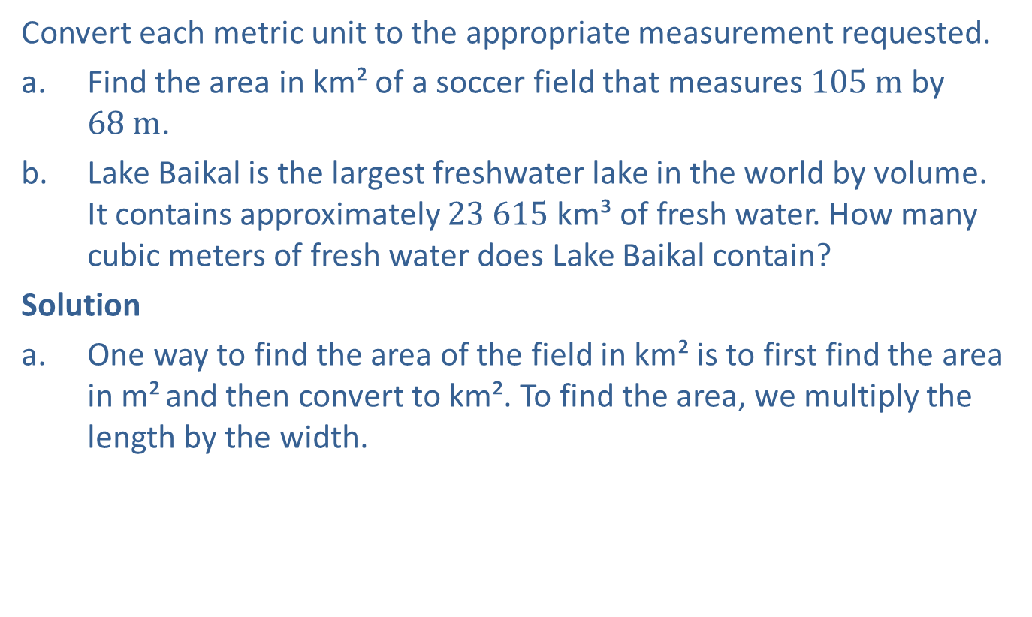
Example 3: Converting within the Metric System in Two or Three Dimensions—Slide 1
Convert each metric unit to the appropriate measurement requested.
a.​ Find the area in km² of a soccer field that measures $105 m$ by $68 m$.
b.​ Lake Baikal is the largest freshwater lake in the world by volume. It contains approximately $23 615 \text{km}$³ of fresh water. How many cubic meters of fresh water does Lake Baikal contain?
Solution
a. One way to find the area of the field in km² is to first find the area in m² and then convert to km². To find the area, we multiply the length by the width.

Slide 19
Example 3: Converting within the Metric System in Two or Three Dimensions—Slide 2
​Converting m² to km² requires a conversion factor
comparing kilometers to meters:
​
​
Remember that
we need to cancel out meters, so that is the unit to put in the denominator here. Because our unit is m², we need to use two of the conversion factors.
Figure 8 shows that the decimal shifts two places for each prefix
along the conversion line, or
places to the left when
converting m² to km².

Slide 20
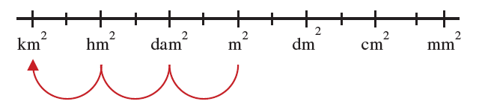
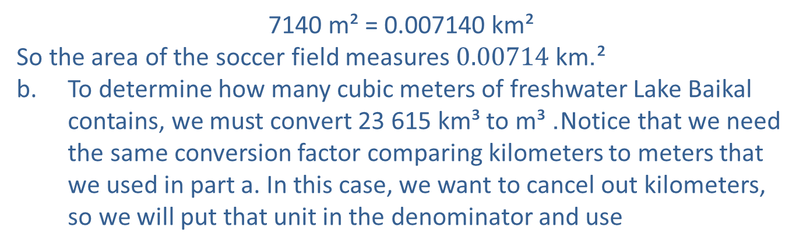
Example 3: Converting within the Metric System in Two or Three Dimensions—Slide 3
Figure 8
7140 m² = 0.007140 km²
​So the area of the soccer field measures $0.00714 \text{km}$².
b. To determine how many cubic meters of freshwater Lake Baikal contains, we must convert 23 615 km³ to m³. Notice that we need the same conversion factor comparing kilometers to meters that we used in part a. In this case, we want to cancel out kilometers, so we will put that unit in the denominator and use
as our factor. We will also need to use the conversion
factor three times since our units are cubed.

Slide 21
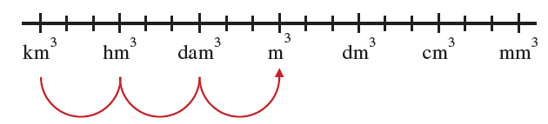
Example 3: Converting within the Metric System in Two or Three Dimensions—Slide 4
Figure 9 shows that the decimal shifts 3 places for each prefix along the
conversion line, or
places to the right when converting kilometers
cubed to meters cubed.
Figure 9
23 615 km³ = 23 615 000 000 000 km³
​So Lake Baikal contains approximately 23 615 000 000 000 cubic meters (m³) of fresh water.

Slide 22
Skill Check 3
Convert 220 cm² to m².
Answer: 0.022 m²

Slide 23
Fun Fact 2
The term acre derives from the Middle English term aker and was commonly thought of as the amount of land that could be plowed in one day with oxen pulling a wooden plow.

Slide 24
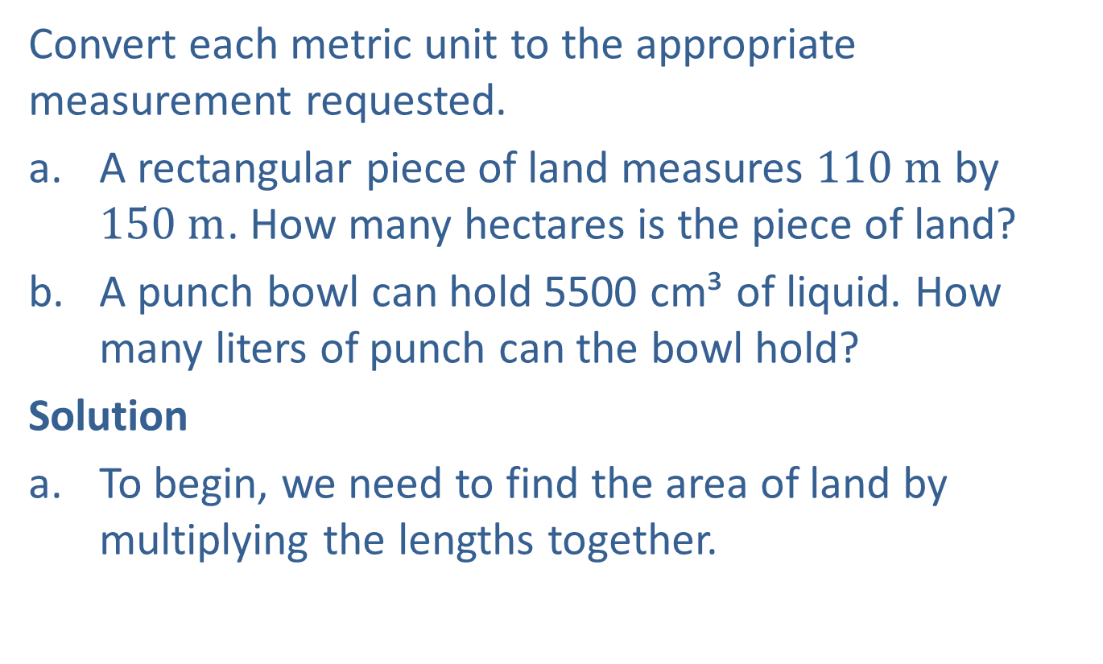
Example 4: Converting Area and Volume within the Metric System—Slide 1
Convert each metric unit to the appropriate measurement requested.
​a. A rectangular piece of land measures $110 m$ by $150 m$. How many hectares is the piece of land?
​b. A punch bowl can hold 5500 cm³ of liquid. How many liters of punch can the bowl hold?
Solution
a. To begin, we need to find the area of land by multiplying the lengths together.
​

Slide 25
Example 4: Converting Area and Volume within the Metric System—Slide 2
​We can now use the conversion factor
​
​
to convert
square meters into hectares.
Therefore, the land is 1.65 hectares.
b.​ We need to use the conversion factor
to convert
cubic centimeters into liters.
So, the bowl can hold 5.5 liters of punch.

