Slide 1
Section 7.5
Converting between the US Customary System and the Metric System

Slide 2
Fun Fact 1
A large amount of physics is finding laws that connect the seven dimensions together to describe our world. For instance, Einstein's equation E = mc², describes energy in terms of mass, length, and time.

Slide 3
Definition: Dimensional Analysis
Dimensional Analysis is a process by which the relationship between different physical quantities of the same dimension can be compared by converting between units of measurement using the rules of algebra.

Slide 4
Think Back
A conversion factor is a fraction that is equal to 1 that contains different units in the numerator and denominator.

Slide 5
Helpful Hint 1
Table 1 is not an exhaustive list of equivalences between the metric system and the US customary system. Other equivalences can be referenced online and in previous sections.

Slide 6
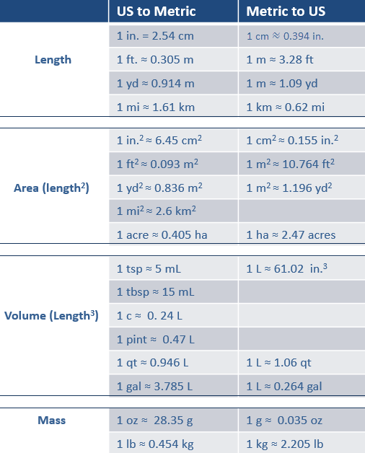
Table 1: Commonly Used Equivalences

Slide 7
Example 1: Applying Dimensional Analysis with One Measurement—Slide 1
Convert each measurement using the appropriate conversion factor. Round to the nearest hundredth.
a.​ 137 pounds to kilograms
b.​ 420 kilometers to miles
c.​ 2.8 cubic feet to cubic meters

Slide 8
Example 1: Applying Dimensional Analysis with One Measurement—Slide 2
Solution
a.​ To convert pounds to kilograms, the conversion factor should contain pounds in the denominator and kilograms in the numerator. Table 1 gives two equivalences that we could use for a conversion
factor:
​
Both are appropriate to
use but may produce slightly different answers due
to rounding. We will use

Slide 9
Example 1: Applying Dimensional Analysis with One Measurement—Slide 3
​Notice that since the equivalence we are using is an approximation, our conversion is also an approximation. Hence, our calculations begin with ≈ instead of =.
​
Therefore, 137 pounds is approximately equal to 62.2 kilograms.
b. To change from kilometers to miles we can use the
conversion factor
Therefore, 420 kilometers is approximately equal to 260.4 miles.

Slide 10
Example 1: Applying Dimensional Analysis with One Measurement—Slide 4
c. There is not a conversion for cubic feet to cubic meters in Table 1. However, we can still use the conversion for feet to meters
​
Notice that we
need to account for the multiple dimensions but are still only changing one unit of measure.
Therefore, 2.8 cubic feet is approximately equal to 0.08 cubic meters.

Slide 11
Skill Check 1
Convert 4.3 meters to yards. Round to the nearest hundredth.
Answer: 4.70 yards

Slide 12
Example 2: Converting between Systems When Conversion Factors Are Unknown—Slide 1
Convert 3 cups to milliliters.
Solution
Although Table 1 does not have an equivalence for cups to millimeters, it does have a conversion for cups to liters. From there, we can use a conversion from liters to milliliters. So we will need to use two conversion factors:
So 3 cups is approximately equal to 720 milliliters.

Slide 13
Skill Check 2
Convert 1.5 meters to inches. Round to the nearest hundredth.
Answer: 59.06 inches

Slide 14
Helpful Hint 2
Conversion factors are most often approximations. Therefore, it's not uncommon for ending decimals to differ slightly when the sources of the conversion factors you choose vary.

Slide 15
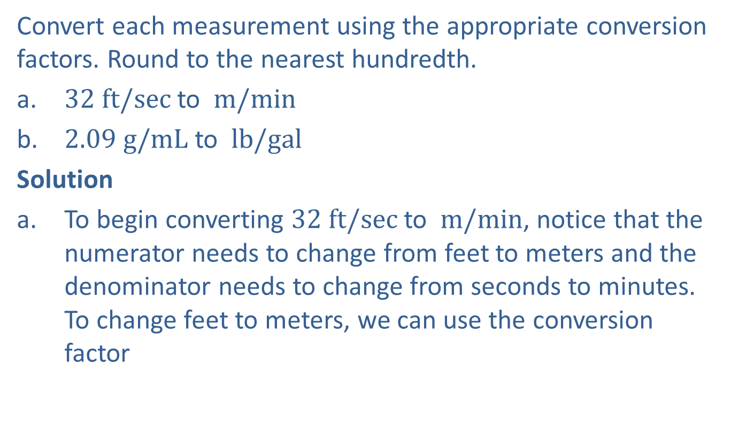
Example 3: Applying Dimensional Analysis with More than One Measurement—Slide 1
Convert each measurement using the appropriate conversion factors. Round to the nearest hundredth.
a.​ $32 ft/sec$ to $m/min$
b.​ $2.09 g/mL$ to $lb/gal$
Solution
a.​ To begin converting $32 ft/sec$ to $m/min$, notice that the numerator needs to change from feet to meters and the denominator needs to change from seconds to minutes. To change feet to meters, we can use the conversion factor
). Remember that the
measurement you would like to end up with needs to
be in the numerator.)

Slide 16
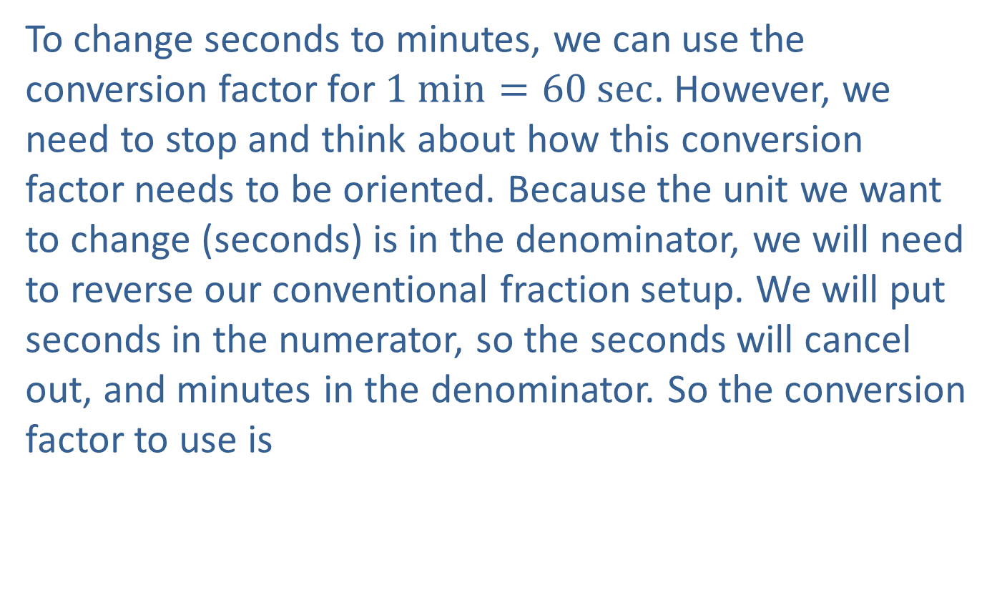
Example 3: Applying Dimensional Analysis with More than One Measurement—Slide 2
​To change seconds to minutes, we can use the conversion factor for $1 min=60 sec$. However, we need to stop and think about how this conversion factor needs to be oriented. Because the unit we want to change (seconds) is in the denominator, we will need to reverse our conventional fraction setup. We will put seconds in the numerator, so the seconds will cancel out, and minutes in the denominator. So the conversion factor to use is
​

Slide 17
Example 3: Applying Dimensional Analysis with More than One Measurement—Slide 3
​​Now we can multiply with both conversion factors.
​
So $32 ft/sec$ is approximately $585.37 m/min$.

Slide 18
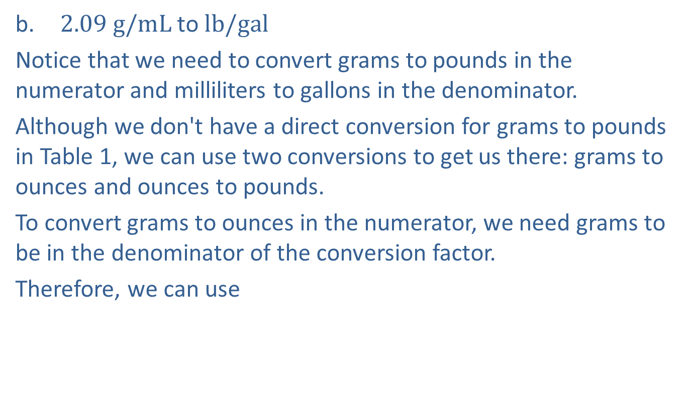
Example 3: Applying Dimensional Analysis with More than One Measurement—Slide 4
b. ​$2.09 g/mL$ to$lb/gal$
​Notice that we need to convert grams to pounds in the numerator and milliliters to gallons in the denominator.
​Although we don't have a direct conversion for grams to pounds in Table 1, we can use two conversions to get us there: grams to ounces and ounces to pounds.
​To convert grams to ounces in the numerator, we need grams to be in the denominator of the conversion factor.
Therefore, we can use
for grams to ounces. Then, to
change ounces to pounds, we need ounces in the denominator
of the fraction:
These two fractions will take care of the
numerator. Now we need to consider the denominator.

Slide 19
Example 3: Applying Dimensional Analysis with More than One Measurement—Slide 5
​​Again, we don't have a direct conversion for milliliters to gallons, but we can use milliliters to liters and liters to gallons. Since milliliters is in the denominator to begin with, the conversion factor will need to have milliliters in the numerator:
​
Once we have that
first conversion factor, we then know to put liters in the numerator and gallons in the denominator for the
other fraction:
So the conversion requires that we multiply our original measurement by the 4 conversion factors, as shown.

Slide 20
Example 3: Applying Dimensional Analysis with More than One Measurement—Slide 6
​
Therefore, $2.09 g/mL$ is approximately $17.32 lb/gal$.

Slide 21

Skill Check 3
Convert $3.42 g/cm$ to $lb/in.$ Round to the nearest hundredth.
Answer: 0.02 lb/in.

Slide 22
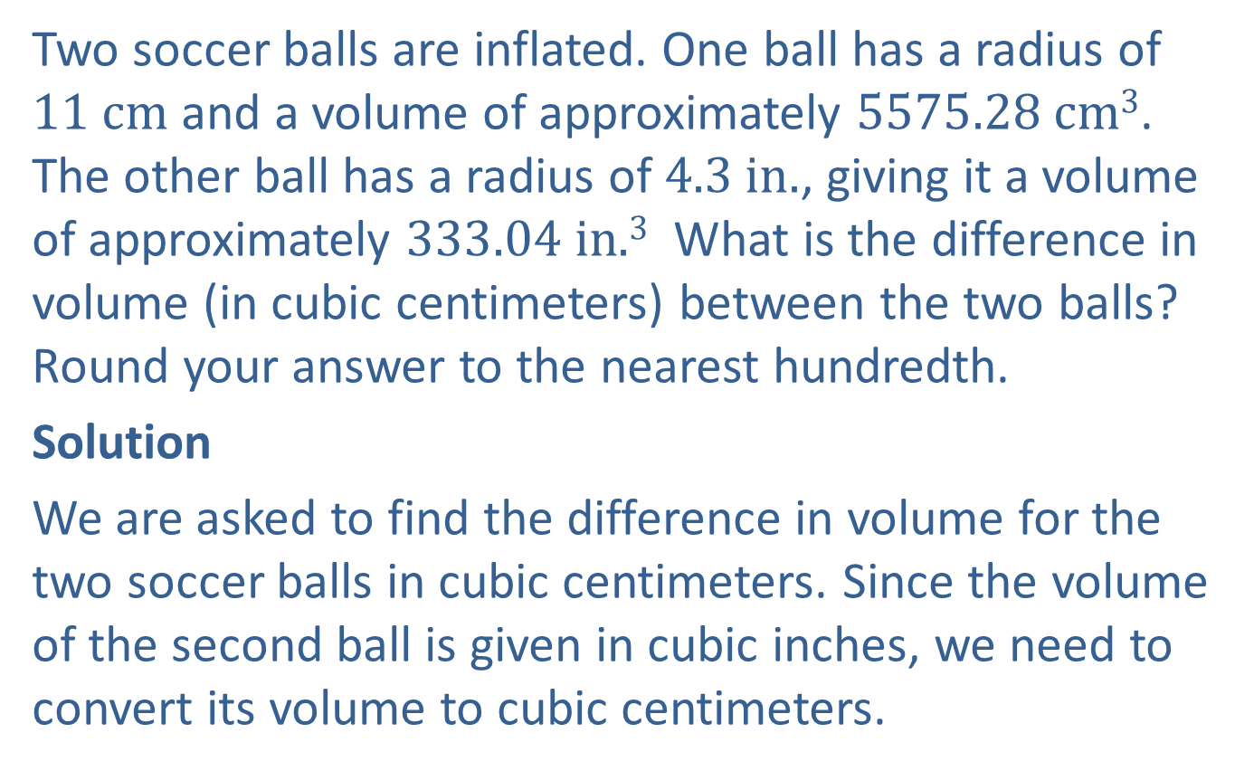
Example 4: Applying Dimensional Analysis—Slide 1
Two soccer balls are inflated. One ball has a radius of $11 cm$ and a volume of approximately $5575.28 cm3$. The other ball has a radius of $4.3 in.$, giving it a volume of approximately $333.04 in{\text{.}3}^{ }$ What is the difference in volume (in cubic centimeters) between the two balls? Round your answer to the nearest hundredth.
Solution
We are asked to find the difference in volume for the two soccer balls in cubic centimeters. Since the volume of the second ball is given in cubic inches, we need to convert its volume to cubic centimeters.

Slide 23

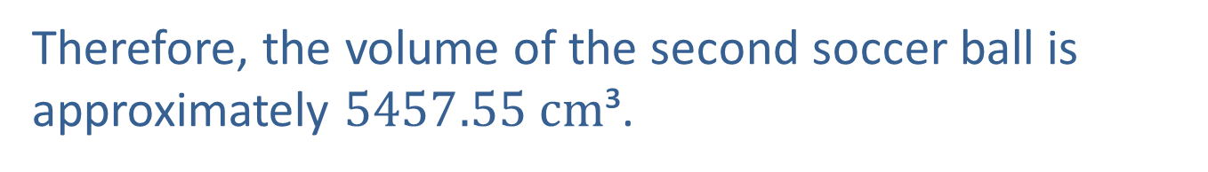
Example 4: Applying Dimensional Analysis—Slide 2
The conversion factor we need to use involves $1 in.=2.54 cm$ and places the inches in the denominator so that the inches will cancel out:
Since we are
changing cubic inches, we will need to use the conversion factor 3 times.
Therefore, the volume of the second soccer ball is approximately $5457.55 cm$³.

Slide 24

Example 4: Applying Dimensional Analysis—Slide 3
We can now find the difference in volume between the two soccer balls.
5575.28 cm³ $−$ 5457.55 cm³ = 117.73 cm³
The first soccer ball has a volume that is 117.73 cm³ more than the volume of the second ball.

Slide 25
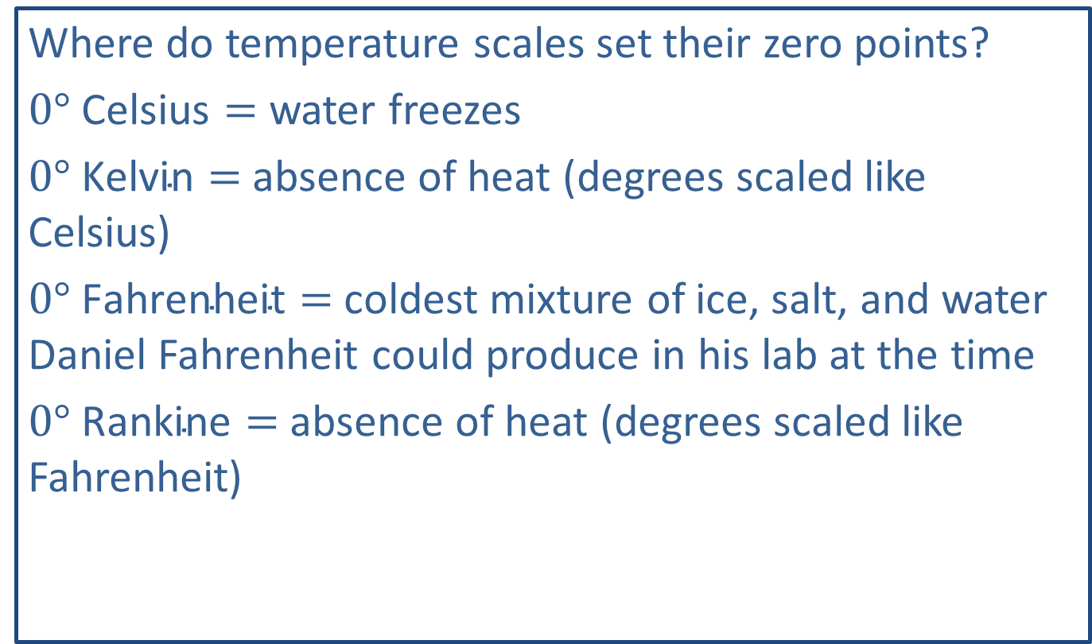
Fun Fact 2
Where do temperature scales set their zero points?
$0° \text{Celsius}=$ water freezes
$0° \text{Kelvin}=$ absence of heat (degrees scaled like Celsius)
$0° \text{Fahrenheit}=$ coldest mixture of ice, salt, and water Daniel Fahrenheit could produce in his lab at the time
$0° \text{Rankine}=$ absence of heat (degrees scaled like Fahrenheit)

Slide 26
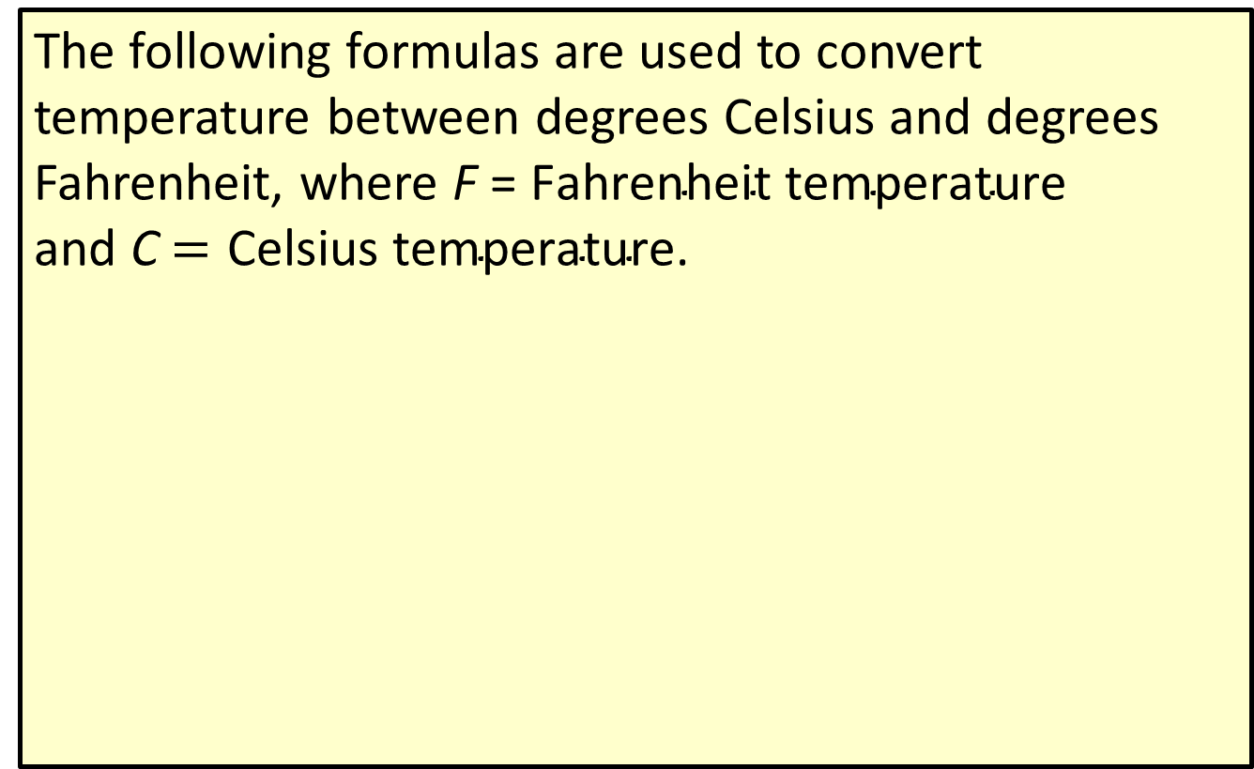
Definition: Temperature Formulas
The following formulas are used to convert temperature between degrees Celsius and degrees Fahrenheit, where F = $\text{Fahrenheit} \text{temperature}$ and C $=\text{Celsius} \text{temperature}$.

Slide 27
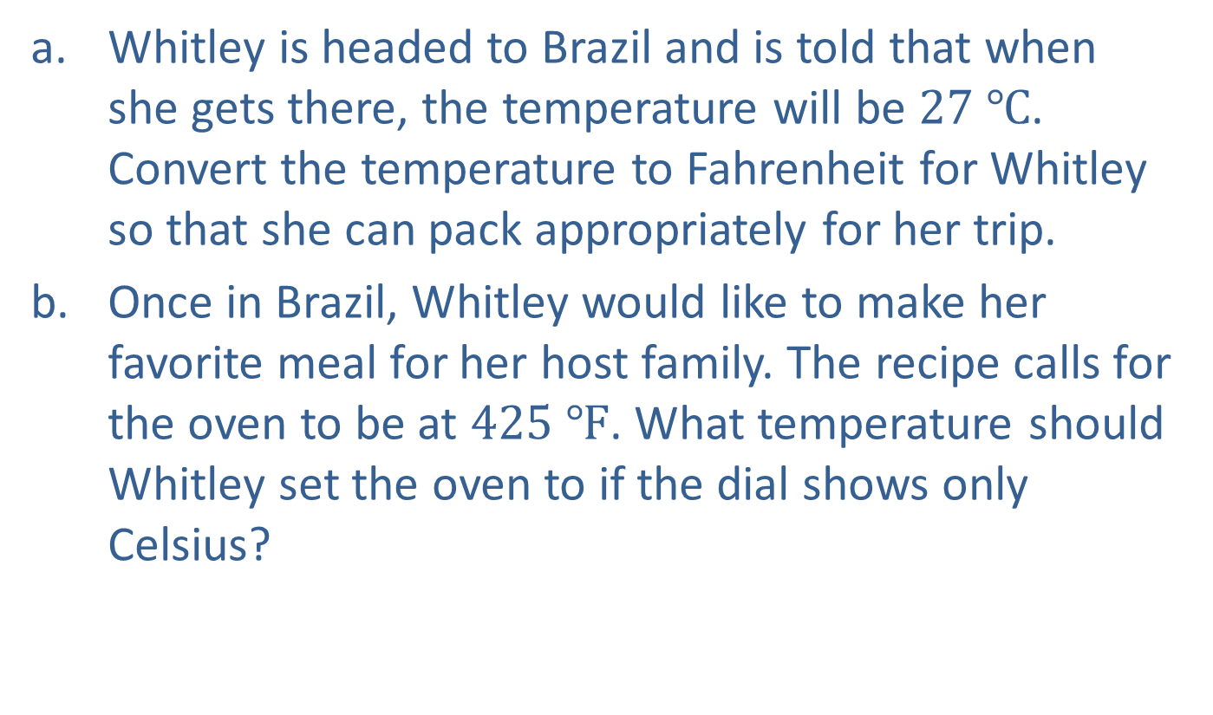
Example 5: Converting Temperature between Celsius and Fahrenheit—Slide 1
a.​ Whitley is headed to Brazil and is told that when she gets there, the temperature will be $27 ℃$. Convert the temperature to Fahrenheit for Whitley so that she can pack appropriately for her trip.
b.​ Once in Brazil, Whitley would like to make her favorite meal for her host family. The recipe calls for the oven to be at $425 ℉$. What temperature should Whitley set the oven to if the dial shows only Celsius?

Slide 28
Example 5: Converting Temperature between Celsius and Fahrenheit—Slide 2
Solution
a.​ Whitley must use the formula for converting degrees Celsius to Fahrenheit:
​​
So Whitley knows it will be warm when she arrives in Brazil.

Slide 29
Example 5: Converting Temperature between Celsius and Fahrenheit—Slide 3
​​To convert to Celsius, Whitley must use the formula
​
​Therefore, Whitley needs to set the oven to approximately $218 ℃$.

Slide 30

Skill Check 4
Convert $68 ℉$ to $℃$.
Answer: 20 $℃$

