Slide 1
Chapter 7
Review

Slide 2
Definition: Babylonian Numeral System—Slide 1
The Babylonian Numeration System for the numbers 1 through 60 is as follows. The Babylonian's system was additive and horizontal.

Slide 3
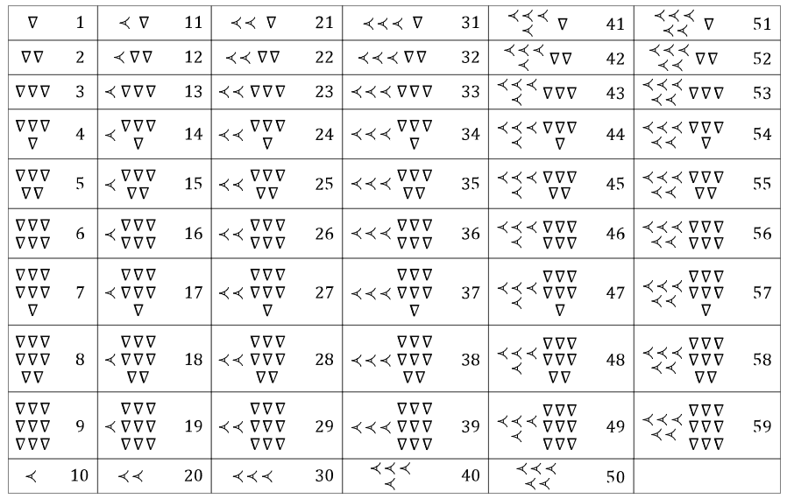
Definition: Babylonian Numeral System—Slide 2

Slide 4
Definition: Mayan Numeral System—Slide 1
The Mayan Numeration System for the numbers 1 through 19 is as follows. The Mayan's system was additive and vertical.

Slide 5
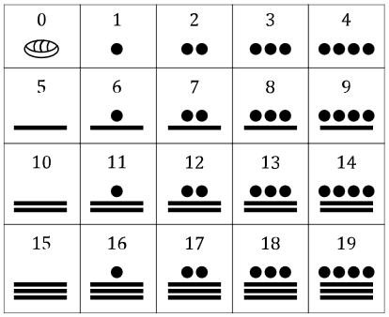
Definition: Mayan Numeral System—Slide 2

Slide 6
Definition: Egyptian Numeral System—Slide 1
The Egyptian hieroglyphics that represent the digits and powers of 10 are given in Table 1. The Egyptian numeral system uses duplicate characters to represent multiples of numbers. The position of the characters does not play a role in the value of the characters.

Slide 7
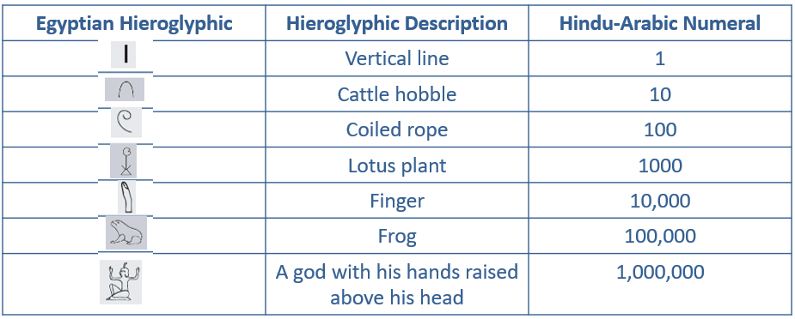
Definition: Egyptian Numeral System—Slide 2
Table 1: Hieroglyphics for Egyptian Numerals

Slide 8
Definition: Ionic Greek Numeral System—Slide 1
Table 2 shows the symbols used for numbers from 1 to 900 in the Ionic Greek Numeral System.
​Putting a comma before any of the first nine symbols multiplies the value by 1000.
​An Ionic Greek numeral written above M means that value is multiplied by 10,000.
​Characters written next to one another in the Ionic Greek system are added together.

Slide 9
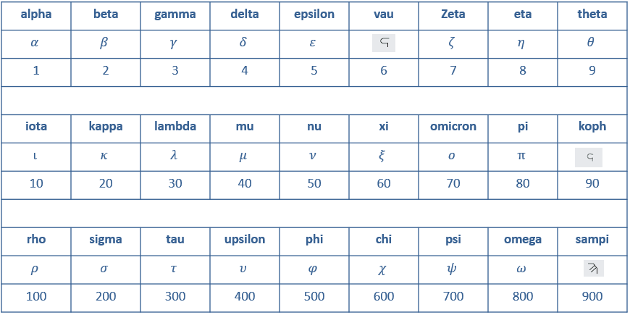
Definition: Ionic Greek Numeral System—Slide 2
Table 2: Ionic Greek Numerals

Slide 10
Definition: Roman Numeral System—Slide 1
Table 4 shows the Roman numerals along with their values in Hindu-Arabic numerals.

Slide 11
Definition: Roman Numeral System—Slide 2
Table 4: Roman Numerals Up to 1000
Value | Roman numeral | Value | Roman numeral | Value | Roman numeral
One | I | Eleven | XI | Thirty | XXX
Two | II | Twelve | XII | Forty | XL
Three | III | Thirteen | XIII | Fifty | L
Four | IV | Fourteen | XIV | Sixty | LX
Five | V | Fifteen | XV | Seventy | LXX
Six | VI | Sixteen | XVI | Eighty | LXXX
Seven | VII | Seventeen | XVII | Ninety | XC
Eight | VIII | Eighteen | XVIII | One hundred | C
Nine | IX | Nineteen | XIX | Five hundred | D
Ten | X | Twenty | XX | One thousand | M

Slide 12
Definition: Chinese Numeral System—Slide 1
Table 5 shows the characters for numbers 1 through 10,000 in the Chinese numeral system.

Slide 13
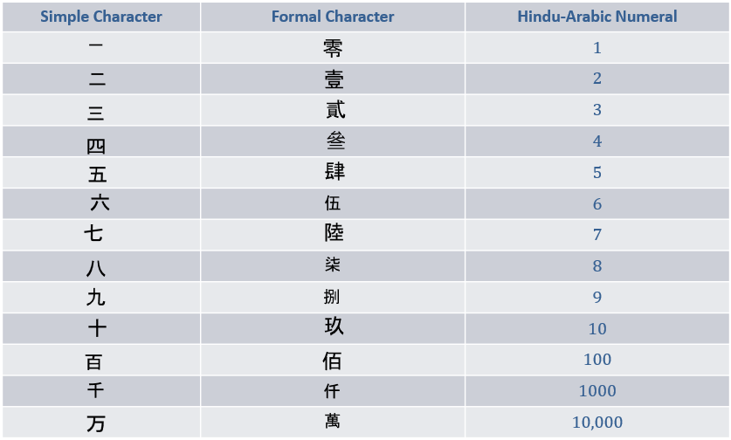
Definition: Chinese Numeral System—Slide 2
Table 5: Chinese Numerals

Slide 14
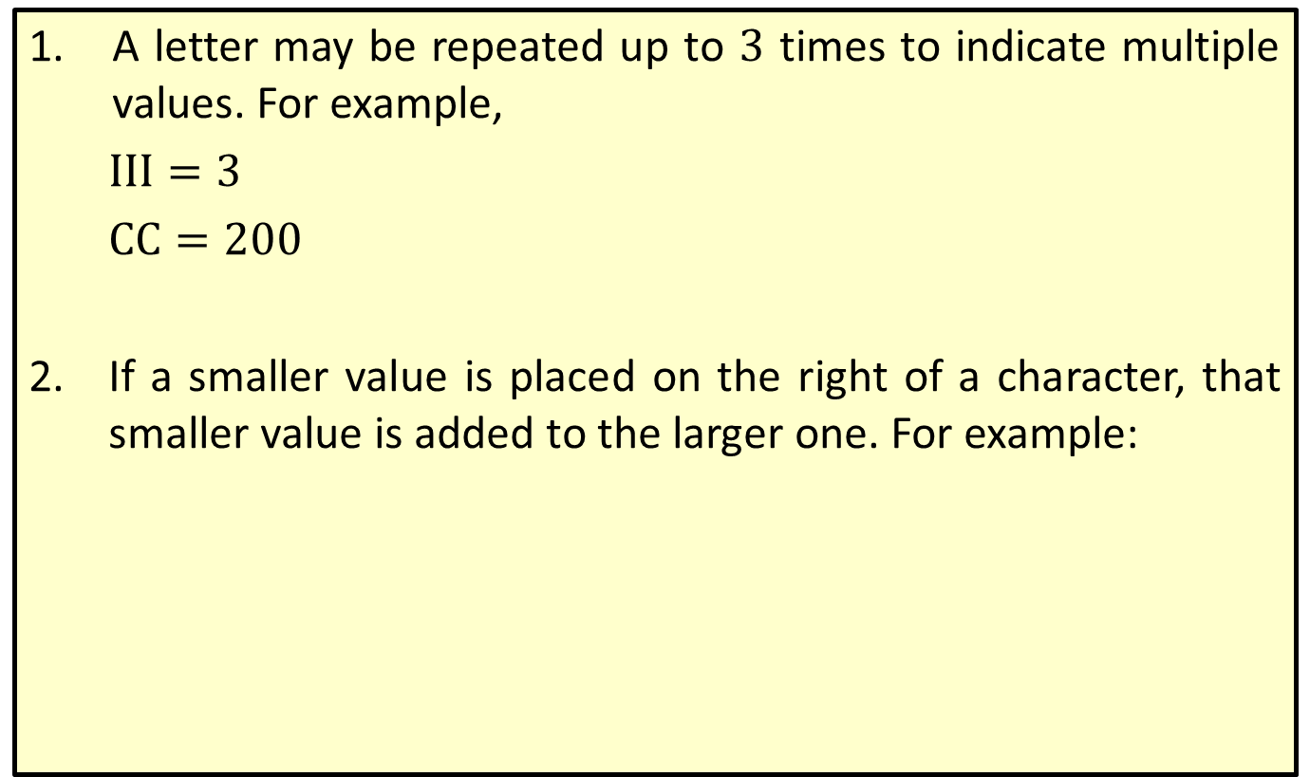
Properties: Addition and Subtraction Rules for Roman Numerals—Slide 1
1.​ A letter may be repeated up to 3 times to indicate multiple values. For example,
​$III=3$
​$CC=200$
2.​ If a smaller value is placed on the right of a character, that smaller value is added to the larger one. For example:
​

Slide 15
Properties: Addition and Subtraction Rules for Roman Numerals—Slide 2
3.​ If a smaller value is placed on the left of a character, that smaller value is subtracted from the larger one. For example,
​
​
​
4.​ A bar is placed above a symbol, or group of symbols, to indicate that the numeral is to be multiplied by 1000. For example,

Slide 16



Definition: Addition and Subtraction Rules for the Chinese Numeral System
1.​ A numeral to the right of a multiple of 10 (10, 100, 1000, . . .) indicates addition. For instance,
​
​
2.​ A numeral to the left of a multiple of 10 (10, 100, 1000, . . .) indicates multiplication. For instance,
3.​ A position holder,
is used for when a zero occurs in
the middle of a numeral. Only one is needed to show any number of consecutive zeros. For instance,

Slide 17
Definition: Hexadecimal System
The digits and letters used for the hexadecimal system are shown in Table 1.
Table 1: Characters Used for Base 16 (the Hexadecimal System)
Base 10 Digit | 0 | 1 | 2 | 3 | 4 | 5 | 6 | 7 | 8 | 9 | 10 | 11 | 12 | 13 | 14 | 15
Hexadecimal (Base 16) Digit | 0 | 1 | 2 | 3 | 4 | 5 | 6 | 7 | 8 | 9 | A | B | C | D | E | F

Slide 18
Definition: Conversion Factor
A conversion factor is a fraction equal to 1 that contains different units in the numerator and denominator.

Slide 19
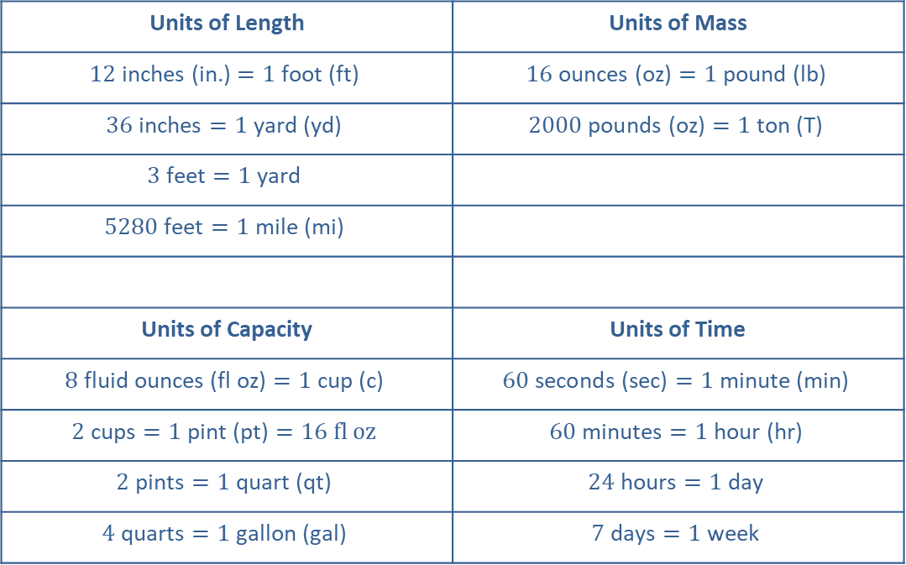
Definition: Conversion Tables—Slide 1
Table 1: Measurements Used in the US Customary System
Units of Length | Units of Mass
$$12 \text{inches}\text{ (}\text{in}\text{.)}=1 \text{foot}\text{ (}\text{ft}\text{)}$$ | $$16 \text{ounces}\text{ (}\text{oz}\text{)}=1 \text{pound}\text{ (}\text{lb}\text{)}$$
$$36 \text{inches}=1 \text{yard}\text{ (}\text{yd}\text{)}$$ | $$2000 \text{pounds}\text{ (}\text{oz}\text{)}=1 \text{ton}\text{ (}\text{T}\text{)}$$
$$3 \text{feet}=1 \text{yard}$$
$$5280 \text{feet}=1 \text{mile}\text{ (}\text{mi}\text{)}$$
Units of Capacity | Units of Time
$$8 \text{fluid} \text{ounces}\text{ (}\text{fl} \text{oz}\text{)}=1 \text{cup}\text{ (}\text{c}\text{)}$$ | $$60 \text{seconds}\text{ (}\text{sec}\text{)}=1 \text{minute}\text{ (}\text{min}\text{)}$$
$$2 \text{cups}=1 \text{pint}\text{ (}\text{pt}\text{)}=16 fl oz$$ | $$60 \text{minutes}=1 \text{hour}\text{ (}\text{hr}\text{)}$$
$$2 \text{pints}=1 \text{quart}\text{ (}\text{qt}\text{)}$$ | $$24 \text{hours}=1 \text{day}$$
$$4 \text{quarts}=1 \text{gallon}\text{ (}\text{gal}\text{)}$$ | $$7 \text{days}=1 \text{week}$$

Slide 20
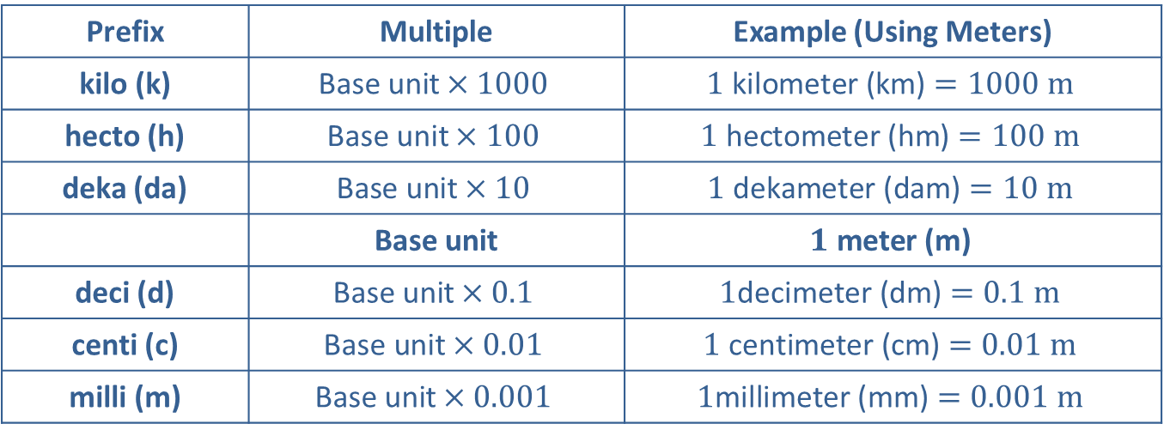
Definition: Conversion Tables—Slide 2
Table 2: Common Metric Prefixes for Any Base Unit
Prefix | Multiple | Example (Using Meters)
kilo (k) | $$\text{Base} \text{unit}×1000$$ | $$1 \text{kilometer}\text{ (}\text{km}\text{)}=1000 m$$
hecto (h) | $$\text{Base} \text{unit}×100$$ | $$1 \text{hectometer}\text{ (}\text{hm}\text{)}=100 m$$
deka (da) | $$\text{Base} \text{unit}×10$$ | $$1 \text{dekameter}\text{ (}\text{dam}\text{)}=10 m$$
 | Base unit | $$1 \text{meter}\text{ (}\text{m}\text{)}$$
deci (d) | $$\text{Base} \text{unit}×0.1$$ | $$1\text{decimeter}\text{ (}\text{dm}\text{)}=0.1 m$$
centi (c) | $$\text{Base} \text{unit}×0.01$$ | $$1 \text{centimeter}\text{ (}\text{cm}\text{)}=0.01 m$$
milli (m) | $$\text{Base} \text{unit}×0.001$$ | $$1\text{millimeter}\text{ (}\text{mm}\text{)}=0.001 m$$

Slide 21
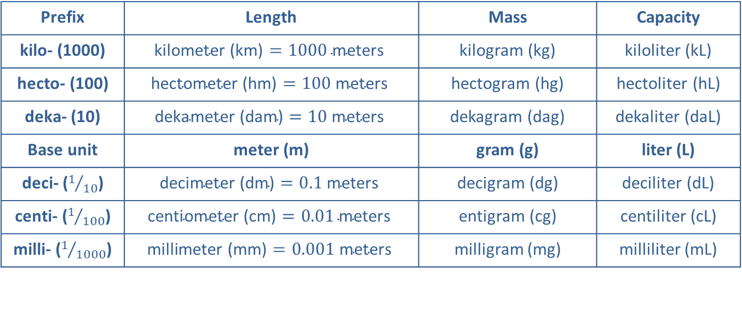
Definition: Conversion Tables—Slide 3
Table 3: Common Units in the Metric System
Prefix | Length | Mass | Capacity
kilo- (1000) | $$\text{kilometer}\text{ (}\text{km}\text{)}=1000 \text{meters}$$ | kilogram (kg) | kiloliter (kL)
hecto- (100) | $$\text{hectometer}\text{ (}\text{hm}\text{)}=100 \text{meters}$$ | hectogram (hg) | hectoliter (hL)
deka- (10) | $$\text{dekameter}\text{ (}\text{dam}\text{)}=10 \text{meters}$$ | dekagram (dag) | dekaliter (daL)
Base unit | meter (m) | gram (g) | liter (L)
deci- ($1/{10}$) | $$\text{decimeter}\text{ (}\text{dm}\text{)}=0.1 \text{meters}$$ | decigram (dg) | deciliter (dL)
centi- ($1/{100}$) | $$\text{centiometer}\text{ (}\text{cm}\text{)}=0.01 \text{meters}$$ | entigram (cg) | centiliter (cL)
milli- ($1/{1000}$) | $$\text{millimeter}\text{ (}\text{mm}\text{)}=0.001 \text{meters}$$ | milligram (mg) | milliliter (mL)

Slide 22
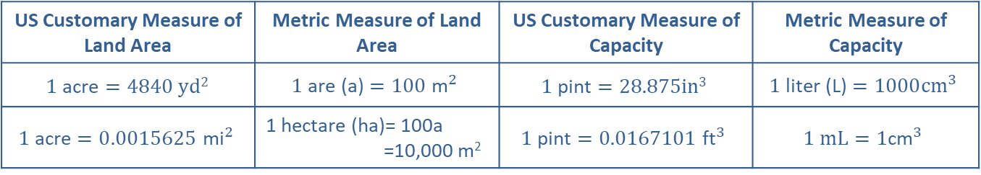
Definition: Conversion Tables—Slide 4
Table 4: Measures of Land Area and Capacity
US Customary Measure of Land Area | Metric Measure of Land Area | US Customary Measure of Capacity | Metric Measure of Capacity
$$1 \text{acre}=4840 yd2$$ | $$1 \text{are}\text{ (}\text{a}\text{)}=100{ \text{m}}^{2}$$ | $$1 \text{pint}=28.875in3$$ | $$1 \text{liter}\text{ (}\text{L}\text{)}=1000{cm}^{3}$$
$$1 \text{acre}=0.0015625{ \text{mi}}^{2}$$ | 1 hectare (ha)= 100a​ =10,000 m² | $$1 \text{pint}=0.0167101{ \text{ft}}^{3}$$ | $$1 mL=1{\text{cm}}^{3}$$

Slide 23
Definition: Dimensional Analysis
Dimensional Analysis is a process by which the relationship between different physical quantities of the same dimension can be compared by converting between units of measurement using the rules of algebra.

Slide 24
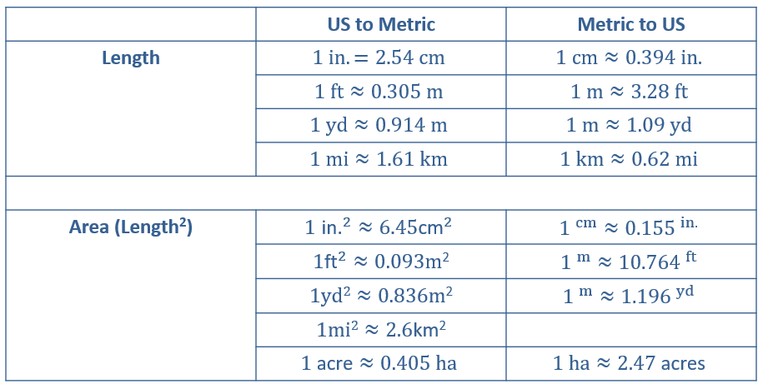
Definition: US and Metric Equivalences—Slide 1
Table 1: Commonly Used Equivalences

Slide 25
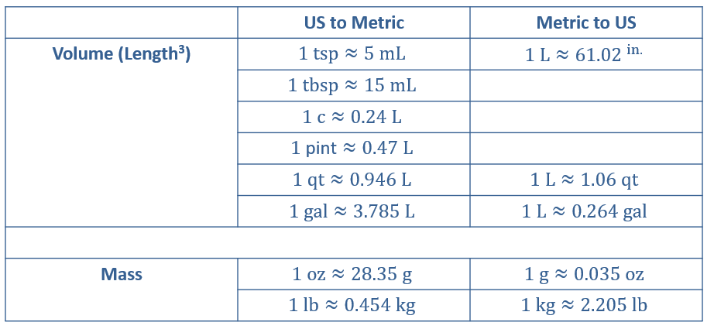
Definition: US and Metric Equivalences—Slide 2
Table 1: Commonly Used Equivalences

Slide 26
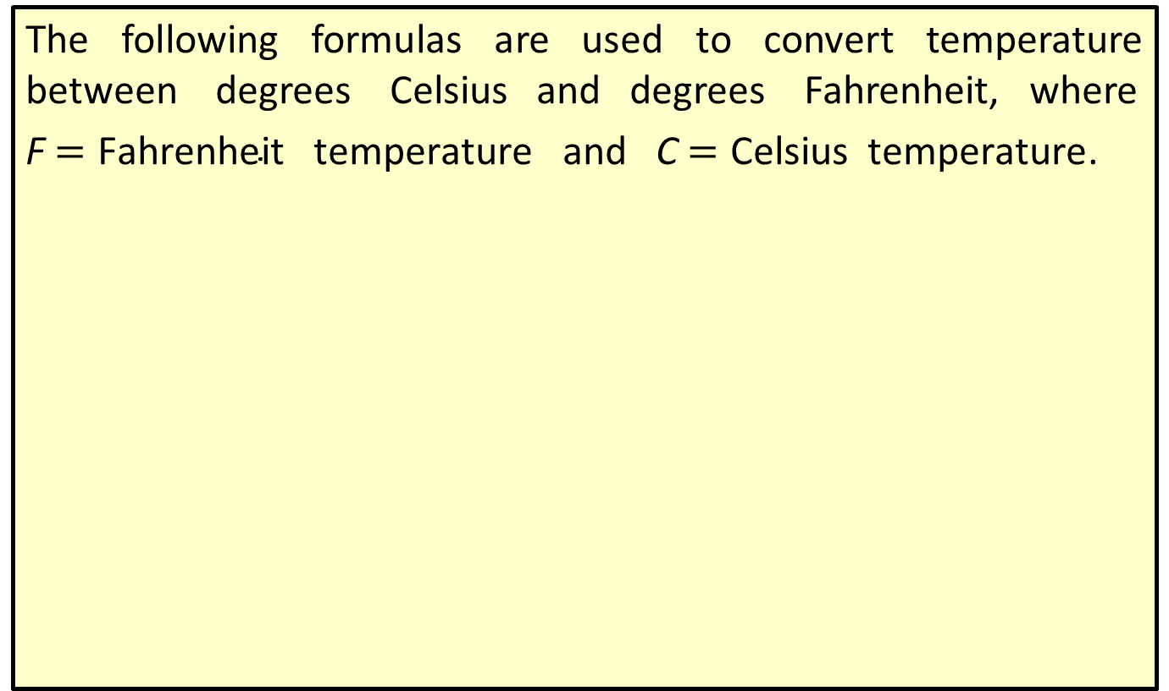
Formulas: Temperature Formulas
The following formulas are used to convert temperature between degrees Celsius and degrees Fahrenheit, where
F $=\text{Fahrenheit} \text{temperature}$ and C $=\text{Celsius} \text{temperature}$.

