Slide 1
Section 8.1
Prime Numbers

Slide 2
Think Back 1
The set of integers includes all whole numbers, their negatives, and 0.

Slide 3
Think Back 2
Remember that a divisor, or factor, of a number x is a number that divides x with a remainder of 0.

Slide 4
Definition: Prime and Composite Numbers
Prime numbers
A prime number is a positive integer that has precisely two divisors: 1 and itself.
Composite Numbers
A composite number is a positive integer that has more than two divisors. Note that the numbers 0 and 1 are neither prime nor composite.

Slide 5
Fun Fact 1
The only even prime number is 2.

Slide 6
Math Milestone 1
Eratosthenes (276‑194 B.C.) was a Greek librarian of Alexandria who is remembered as a scholar, poet, and inventor. He is known for his measurement of the circumference of the Earth as well as his estimates of the distances from the Earth to the sun and the moon. He is also credited with the discipline of geography as we know it, inventing the system of longitude and latitude.

Slide 7
Procedure: Sieve of Eratosthenes
Step 1: List all the positive integers between 2 and N.
Step 2: Highlight the smallest number (p) not crossed out or previously highlighted. This is a prime number.
Step 3: Cross out all multiples of p.
Step 4: Repeat steps 2 and 3 until all numbers are either highlighted or crossed out.

Slide 8
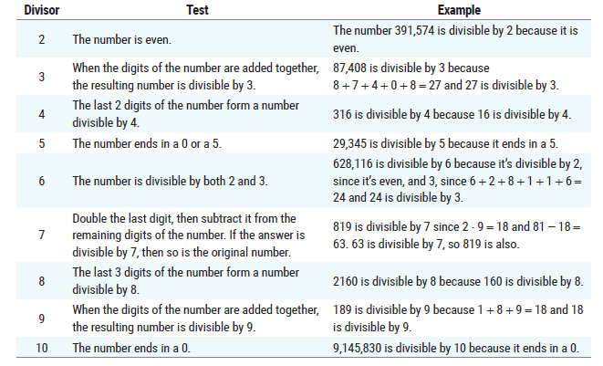
Table 1: Divisibility Rules

Slide 9
Example 1: Classifying a Number as Prime or Composite—Slide 1
Determine if the following numbers are prime or composite using the divisibility rules.
a. ​312
b. 101
c. 2,344,017
Solution
a. Since the number 312 is even, we know that it is divisible by 2. It is enough to stop here and know that the number is composite, but we'll continue on to determine if there are other small divisors of 312.
If we add the digits together, we get 3 + 1 + 2 = 6. Because 6 is divisible by 3, 312 is also divisible by 3.

Slide 10
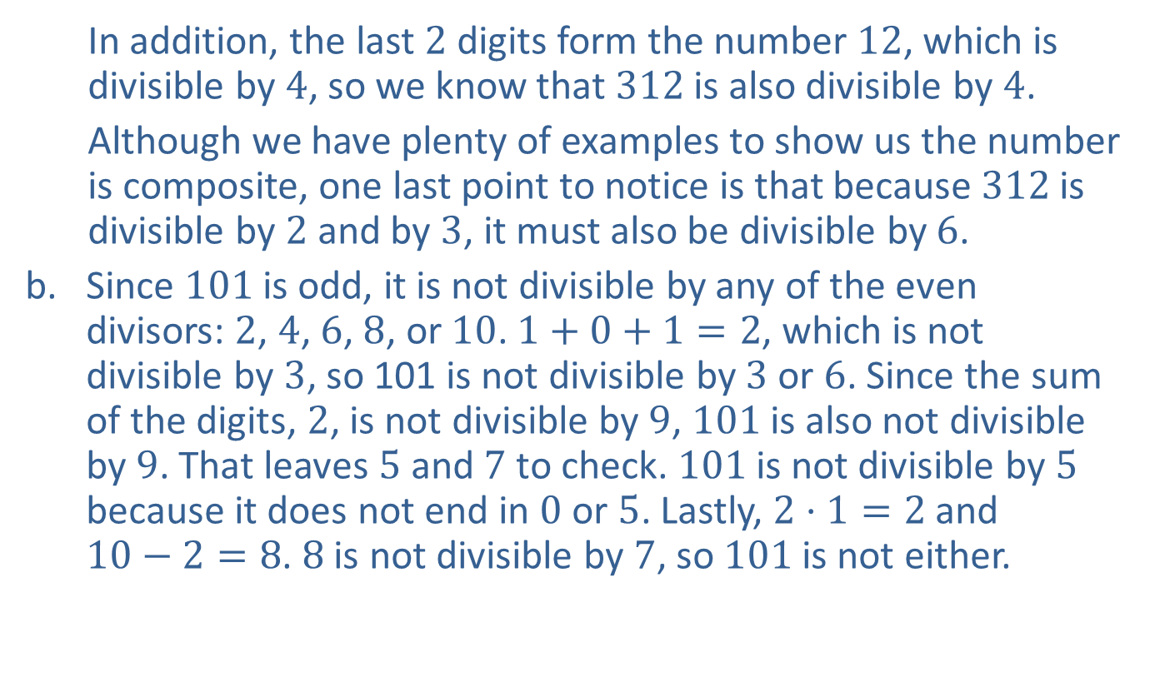
Example 1: Classifying a Number as Prime or Composite—Slide 2
In addition, the last 2 digits form the number 12, which is divisible by 4, so we know that 312 is also divisible by 4.
Although we have plenty of examples to show us the number is composite, one last point to notice is that because 312 is divisible by 2 and by 3, it must also be divisible by 6.
b. Since 101 is odd, it is not divisible by any of the even divisors: 2, 4, 6, 8, or 10. $1+0+1=2$, which is not divisible by 3, so 101 is not divisible by 3 or 6. Since the sum of the digits, 2, is not divisible by 9, 101 is also not divisible by 9. That leaves 5 and 7 to check. 101 is not divisible by 5 because it does not end in 0 or 5. Lastly, $2⋅1=2$ and $10−2=8$. 8 is not divisible by 7, so 101 is not either.

Slide 11
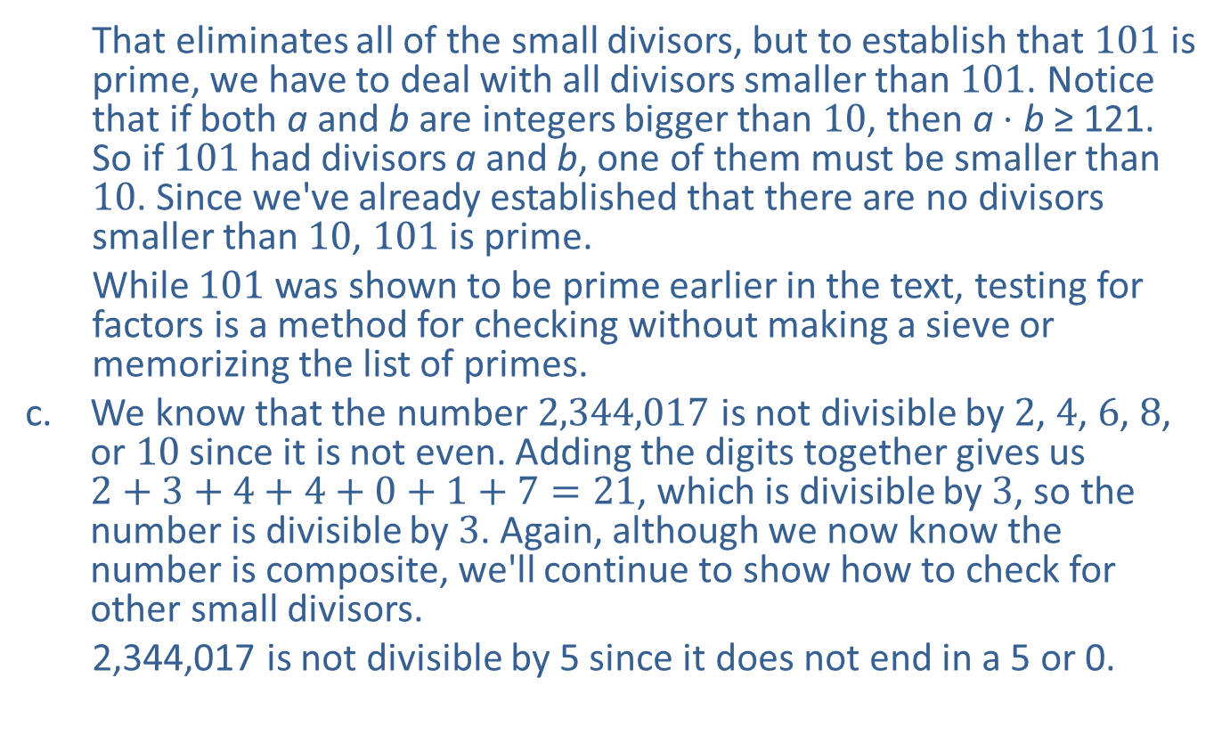
Example 1: Classifying a Number as Prime or Composite—Slide 3
That eliminates all of the small divisors, but to establish that 101 is prime, we have to deal with all divisors smaller than 101. Notice that if both a and b are integers bigger than 10, then a ⋅ b ≥ 121. So if 101 had divisors a and b, one of them must be smaller than 10. Since we've already established that there are no divisors smaller than 10, 101 is prime.
​While 101 was shown to be prime earlier in the text, testing for factors is a method for checking without making a sieve or memorizing the list of primes.
c. ​We know that the number 2,344,017 is not divisible by 2, 4, 6, 8, or 10 since it is not even. Adding the digits together gives us $2+3+4+4+0+1+7=21$, which is divisible by 3, so the number is divisible by 3. Again, although we now know the number is composite, we'll continue to show how to check for other small divisors.
2,344,017 is not divisible by 5 since it does not end in a 5 or 0.

Slide 12

Example 1: Classifying a Number as Prime or Composite—Slide 4
​Doubling the last digit we have 7 ⋅ 2 = 14. Then, $234,401−14=234,387$. This is still a large number, so we can apply the rule again to check if it's divisible by 7. Continue repeating this process until we are able to definitively say if a number is divisible by 7.
Since 12 is not divisible by 7, our original number is not divisible by 7. Although we used the divisibility rule for 7 here, it may have been quicker to use long division and see if the number has a remainder when divided by 7.

Slide 13
Example 1: Classifying a Number as Prime or Composite—Slide 5
The only other number left in our list to check is 9. Adding the digits together, as we did earlier, we have 21. Since 21 is not divisible by 9, the number 2,344,017 is not divisible by 9.
However, we know that 2,344,017 is composite because it is divisible by the number 3.

Slide 14
Skill Check 1
Determine if 3,743,216 is prime or composite.
Answer: It's even, so it's composite.

Slide 15
Theorem: Fundamental Theorem of Arithmetic
The fundamental theorem of arithmetic states that every positive integer greater than 1 is either a prime number or can be written as a unique product of prime numbers. This unique product of prime numbers is called its prime factorization.

Slide 16
Helpful Hint 1
A mathematical theorem is a statement or rule that can be, and has been, proven to be (logically) true.

Slide 17
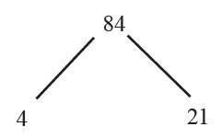
Example 2: Using a Factor Tree to Find a Prime Factorization—Slide 1
Use a factor tree to determine the prime factorization of the number 84.
Solution
Start by choosing any pair of factors you like, other than 1 and 84. We'll use the pair 4 and 21, as shown here.
Figure 4
Next, notice that both of the numbers 4 and 21 also have factors. Branching each off into its own factors, we have the following.

Slide 18
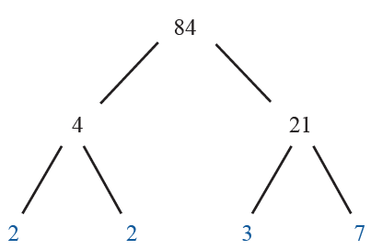
Example 2: Using a Factor Tree to Find a Prime Factorization—Slide 2
Figure 5
This time, as we look across the bottom row of factors, we can see that they are all prime. Thus, the prime factorization of 84 is 2 ⋅ 2 ⋅ 3 ⋅ 7.

Slide 19
Helpful Hint 2
Although factor trees for the same number may not have identical branches, the prime factorization on the bottom row of factors will always be the same.

Slide 20
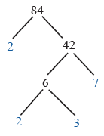
Skill Check 2
Use a factor tree to find the prime factorization of 84 by starting with the pair of factors 2 and 42.
Answer: The prime factorization of 84 is 2 ⋅ 2 ⋅ 3 ⋅ 7 .

Slide 21
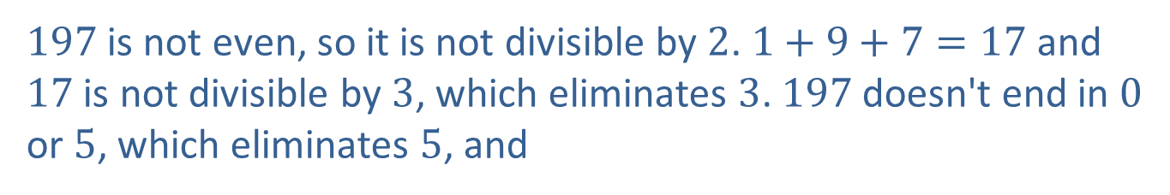
Example 3: Classifying a Number as Prime or Composite
Determine whether 197 is prime or composite.
Solution
If 197 is composite, it must have a prime divisor that is less than
The prime numbers less than 14 are 2, 3, 5, 7, 11, and 13.
197 is not even, so it is not divisible by 2. $1+9+7=17$ and 17 is not divisible by 3, which eliminates 3. 197 doesn't end in 0 or 5, which eliminates 5, and
and 5 is not divisible by 7, which eliminates 7. All that remains is to check 11 and 13.
Therefore, 197 is prime.

Slide 22
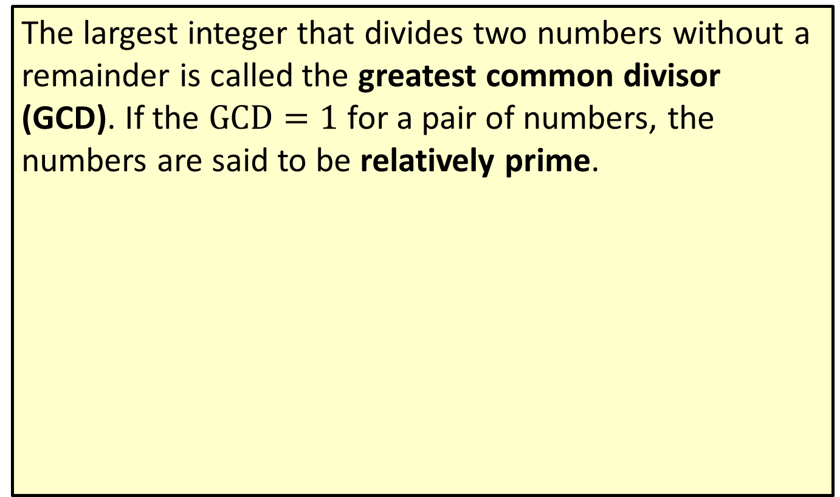
Definition: Greatest Common Divisor (GCD)
The largest integer that divides two numbers without a remainder is called the greatest common divisor (GCD). If the $GCD=1$ for a pair of numbers, the numbers are said to be relatively prime.

Slide 23
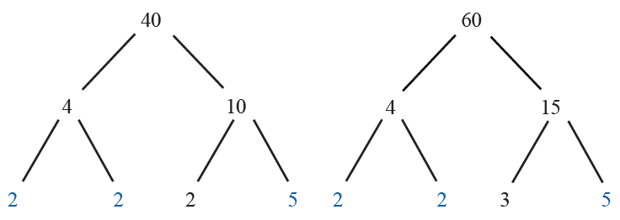
Example 4: Finding the GCD Using Factor Trees
Use factor trees to find the greatest common divisor of 40 and 60.
Solution
Begin by constructing the factor trees of 40 and 60 as shown.
Figure 8
Notice that both 40 and 60 have the factors 2 and 5 in common. In fact, both numbers have two 2s in common as well as one 5. So, the GCD of 40 and 60 is 2 ⋅ 2 ⋅ 5 = 20.

Slide 24
Example 5: Using the GCD—Slide 1
One way that the Manna Café Pantry serves the hungry of Clarksville, TN, is by distributing boxes of food each week to the local shelters. As part of the stipulation for receiving local governmental funds, all boxes must contain the same number of items from each of the following categories: pasta, canned vegetable, and canned meat. This week, the pantry has the following in supply: 360 pasta items, 540 canned vegetables, and 240 canned meats.
a. ​Using all of the food, what is the maximum number of food boxes that the Manna Café Pantry can distribute this week?
b. ​How many of each item will be in each box?

Slide 25
Example 5: Using the GCD—Slide 2
Solution
a. ​In order to distribute all of the food items evenly among the food boxes, the number of boxes must be a divisor of 360, 540, and 240. To find the maximum number of food boxes that can be made from all of the pantry supplies, we need to find the GCD of the three numbers. First, find the prime factorization of each number. We'll do this by constructing factor trees of each number.

Slide 26
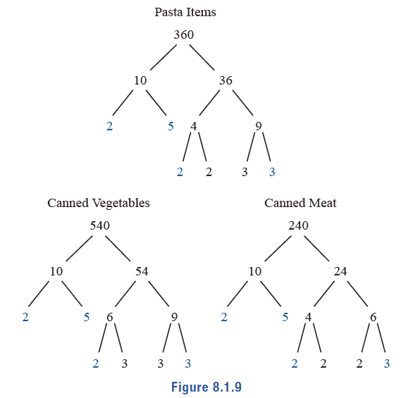
Example 5: Using the GCD—Slide 3
Figure 9
The GCD of 360, 540, and 240 is 2 ⋅ 2 ⋅ 3 ⋅ 5 = 60. Therefore, the pantry can give out 60 food boxes to the local shelters this week.

Slide 27
Example 5: Using the GCD—Slide 5
b. In order to find how many of each item will be in the boxes, we can use the prime factorizations that we found in part a. For each food category, if we remove the GCD from the prime factorization, the remaining factors will tell us how many of each item needs to go in a box. Each prime factorization with the GCD marked out is as follows.
Therefore, we can see that there will be 2 ⋅ 3 = 6 pasta items, 3 ⋅ 3 = 9 canned vegetables, and 2 ⋅ 2 = 4 canned meats in each box.

Slide 28
Procedure: Steps for Using Euclid's Algorithm
1. ​Divide the larger of the given numbers by the smaller (the divisor) and note the remainder.
2. Divide the original divisor (the smaller of the given numbers) by the remainder found in Step 1.
3. Continue dividing the previous divisor by the previous remainder until the remainder is 0.
4. The last nonzero remainder is the GCD of the given numbers.

Slide 29
Math Milestone 2
Euclid, known as the father of Geometry, wrote a book on Geometry in 300 BC called Elements. As a Greek mathematician, he also wrote works on number theory, such as Rigor and Perspective. Although we know much about his scholarly life, little is known about his personal life—not even the exact dates, times, or places of his birth or death.

Slide 30
Example 6: Finding the GCD Using Euclid's Algorithm
Use Euclid’s Algorithm to find the greatest common divisor of 88 and 300.
Solution
Begin with the two numbers 88 and 300. Divide the larger number by the smaller number and note the remainder.
Our next division will use the remainder that we just found, 36, and the original divisor, 88. Again, divide the larger number by the smaller and note the remainder. Continue this division process until we get a remainder of zero.
Since 4 is the last nonzero remainder, it is the GCD of 88 and 300.

Slide 31
Example 7: Using Euclid's Algorithm—Slide 1
Two college classes, one with 88 students and one with 17, need to be split into smaller groups of equal sizes. Use Euclid’s Algorithm to determine what size the smaller groups could be, if it is possible.
Solution
Begin by dividing the larger number by the smaller number and note the remainder.

Slide 32
Example 7: Using Euclid's Algorithm—Slide 2
Our next division will use the remainder we just found and the divisor. Repeat this process until the remainder is zero.
The last nonzero remainder is 1, so the GCD of 88 and 17 is 1, which means that these numbers are relatively prime. Therefore, the two classes of 88 and 17 cannot be divided into smaller groups of equal sizes other than having 105 groups with 1 person each.

Slide 33
Fun Fact 2
John D. Cook's blog in February 2010 challenged readers to find elegant ways to summarize Euclid’s proof, but there was a catch—they had to be "tweet‑able" (that is, 140 characters or less). Several people joined in the fun to write such "tweets." Did Euclid ever imagine such things?
Source: The Endeavour, "Euclid's proof that there are infinitely many primes," by John D. Cook. http://www.johndcook.com/

