Slide 1
Section 8.2
Modular Arithmetic

Slide 2
Definition: Modular Arithmetic
In modular arithmetic, a number n is congruent to the remainder r when it is divided by a fixed number m. We write n ≡ r(mod m). Note that m is referred to as the modulus.

Slide 3
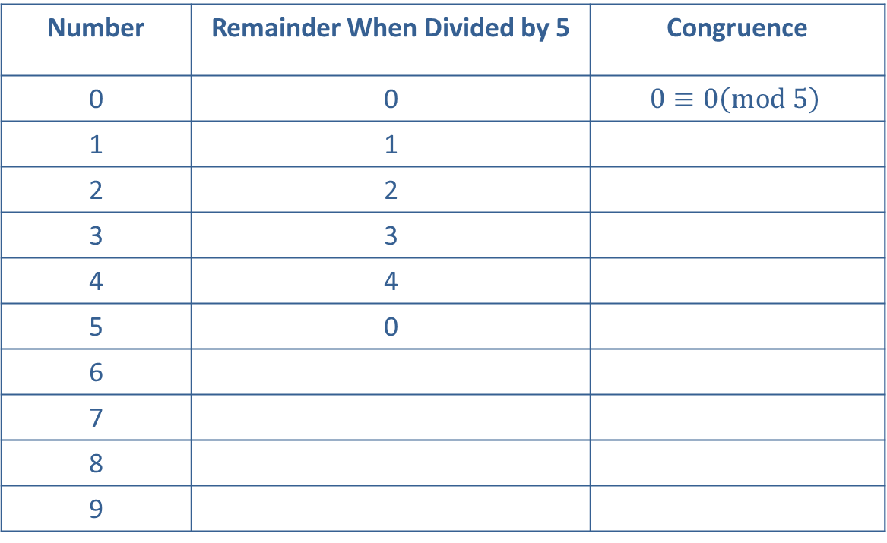
Example 1: Completing a Modular Congruence Table—Slide 1
Complete the following table for modulo 5.
Table 3: Modulo 5
Number | Remainder When Divided by 5 | Congruence
0 | 0 | $$0≡0\left(mod 5\right)$$
1 | 1
2 | 2
3 | 3
4 | 4
5 | 0
6
7
8
9

Slide 4
Example 1: Completing a Modular Congruence Table—Slide 2
Solution
The cycle of remainders for modulo 5 will consist of 0, 1, 2, 3, and 4. Because the cycle returns to 0 after reaching 4, we can complete the second column with the cycle. The last column of Table 4 is the notation that represents these remainders. Notice that until you reach the value of m, the remainder is the number itself.

Slide 5
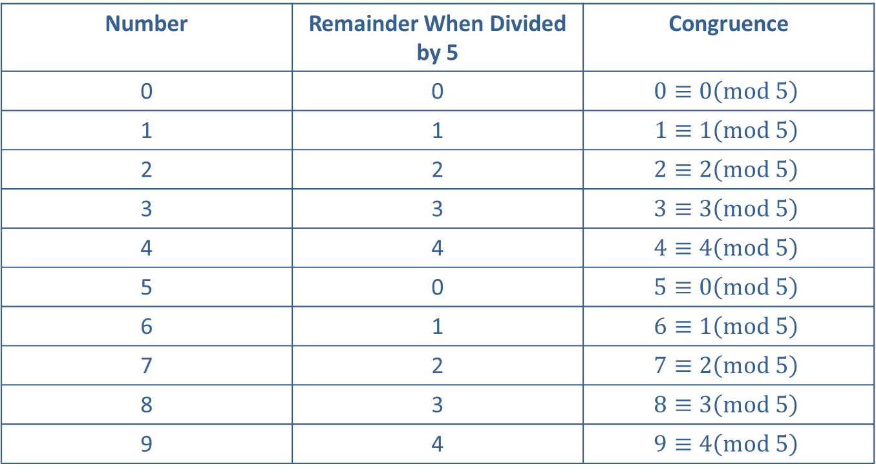
Example 1: Completing a Modular Congruence Table—Slide 3
Table 4: Modulo 5
Number | Remainder When Divided by 5 | Congruence
0 | 0 | $$0≡0\left(mod 5\right)$$
1 | 1 | $$1≡1\left(mod 5\right)$$
2 | 2 | $$2≡2\left(mod 5\right)$$
3 | 3 | $$3≡3\left(mod 5\right)$$
4 | 4 | $$4≡4\left(mod 5\right)$$
5 | 0 | $$5≡0\left(mod 5\right)$$
6 | 1 | $$6≡1\left(mod 5\right)$$
7 | 2 | $$7≡2\left(mod 5\right)$$
8 | 3 | $$8≡3\left(mod 5\right)$$
9 | 4 | $$9≡4\left(mod 5\right)$$

Slide 6
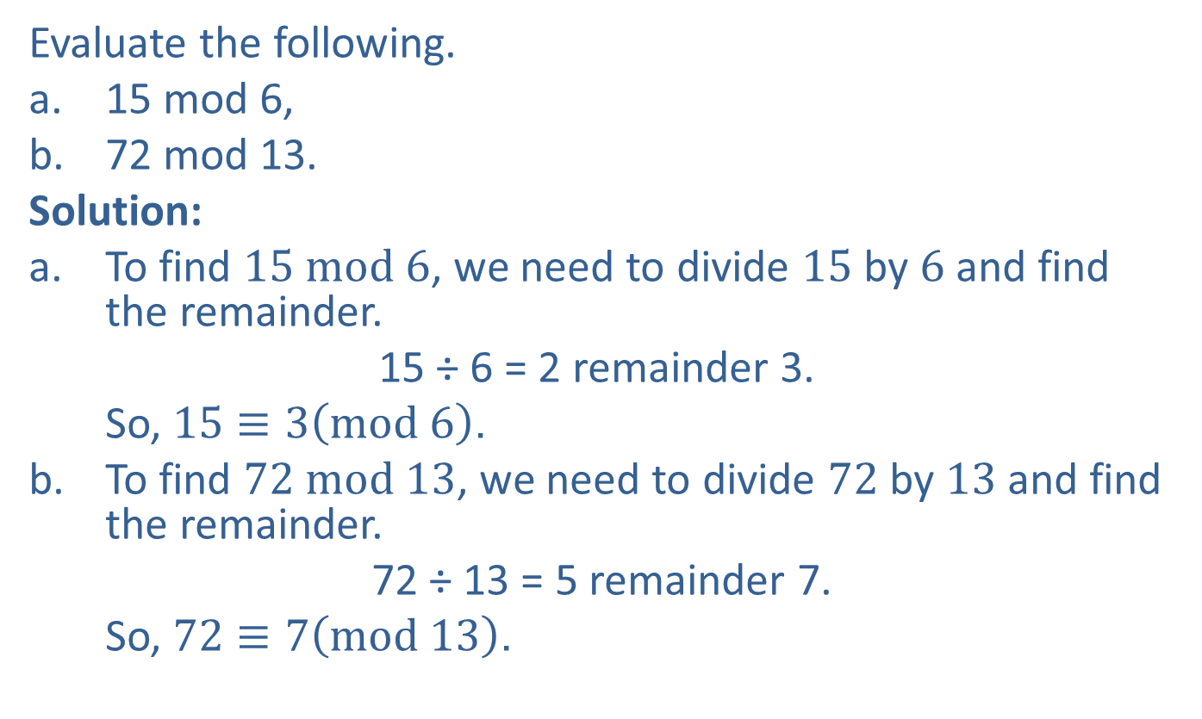
Example 2: Finding Modular Congruence
Evaluate the following.
a. ​15 mod 6,
b. 72 mod 13.
Solution:
a. To find $15 mod 6$, we need to divide 15 by 6 and find the remainder.
​15 ÷ 6 = 2 remainder 3.
  So, $15≡3\left(mod 6\right)$.
b. To find $72 mod 13$, we need to divide 72 by 13 and find the remainder.
​ 72 ÷ 13 = 5 remainder 7.
  So, $72≡7\left(mod 13\right)$.

Slide 7
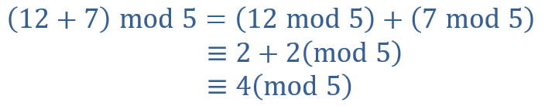
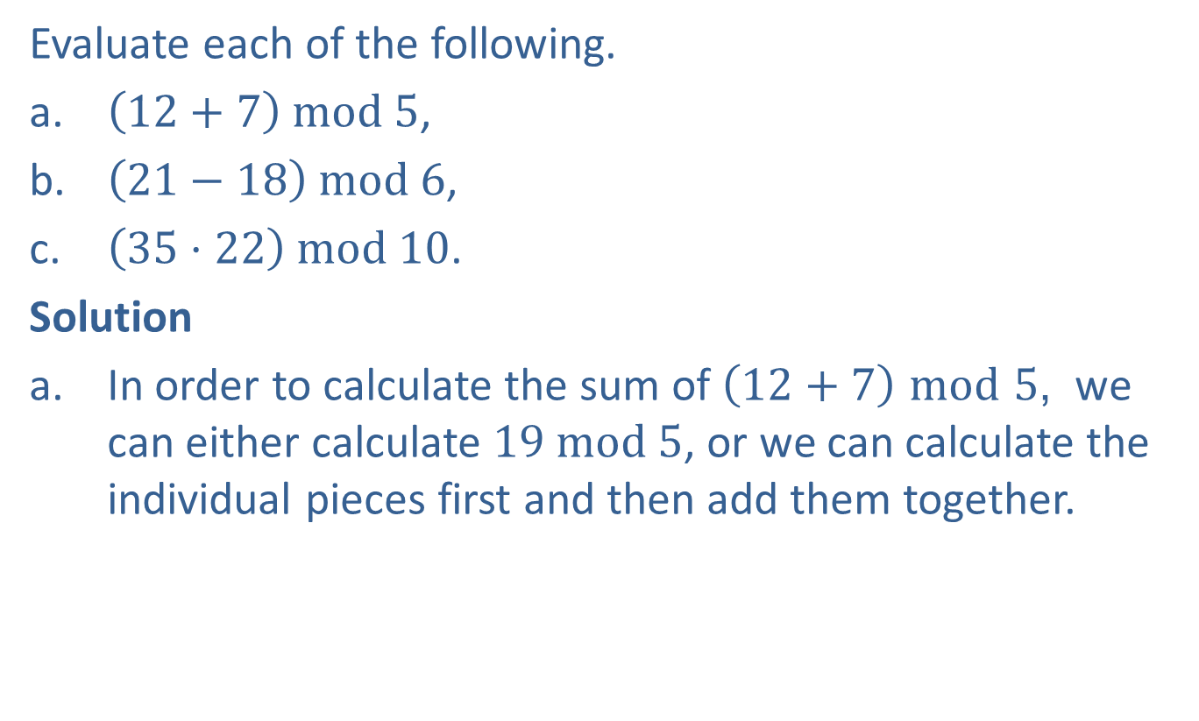
Example 3: Evaluating Modular
Operations—Slide 1
Evaluate each of the following.
a. $\left(12+7\right) mod 5$,
b. $\left(21−18\right) mod 6$,
c. $\left(35⋅22\right) mod 10$.
Solution
a. ​In order to calculate the sum of $\left(12+7\right) mod 5$, we can either calculate $19 mod 5$, or we can calculate the individual pieces first and then add them together.

Slide 8
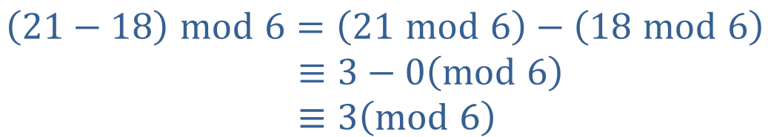
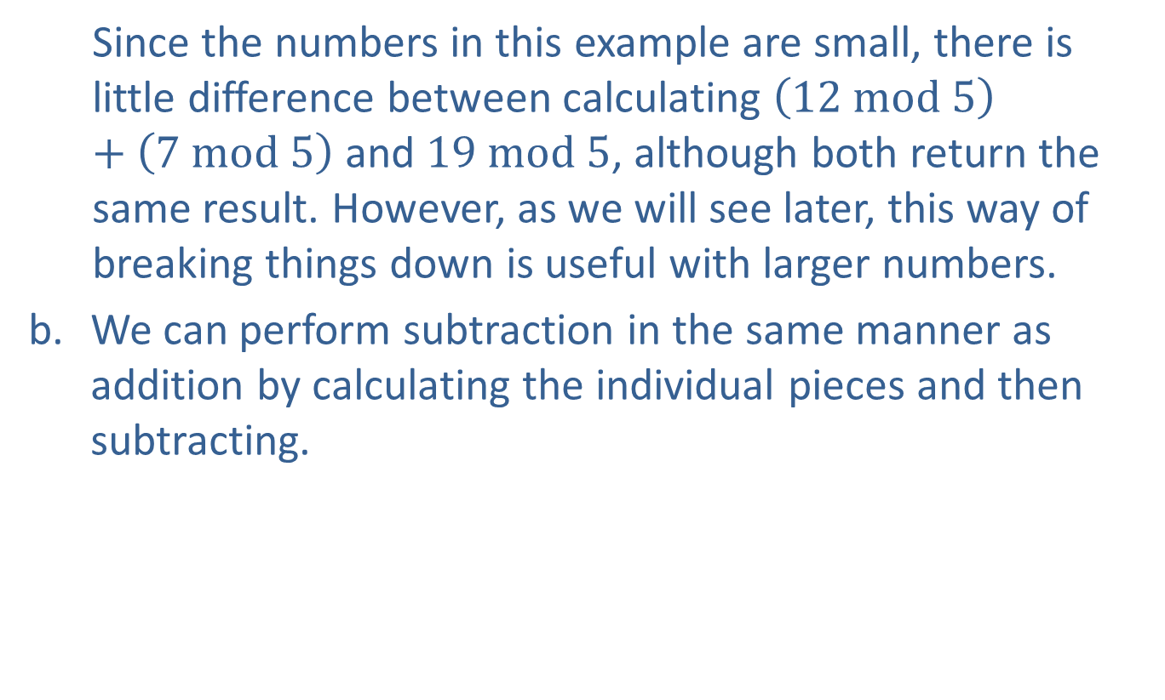
Example 3: Evaluating Modular
Operations—Slide 2
  Since the numbers in this example are small, there is little difference between calculating $\left(12 mod 5\right)+\left(7 mod 5\right)$ and $19 mod 5$, although both return the same result. However, as we will see later, this way of breaking things down is useful with larger numbers.
b. We can perform subtraction in the same manner as addition by calculating the individual pieces and then subtracting.

Slide 9
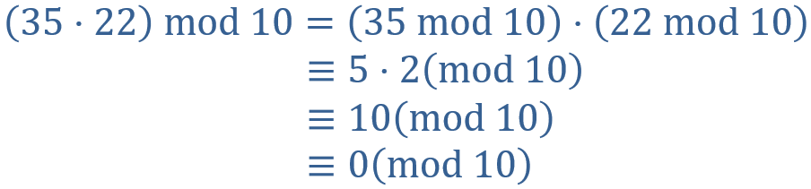
Example 3: Evaluating Modular
Operations—Slide 3
c. Multiplication is consistent with both addition and subtraction, in that you can find the modular congruences and then multiply.

Slide 10
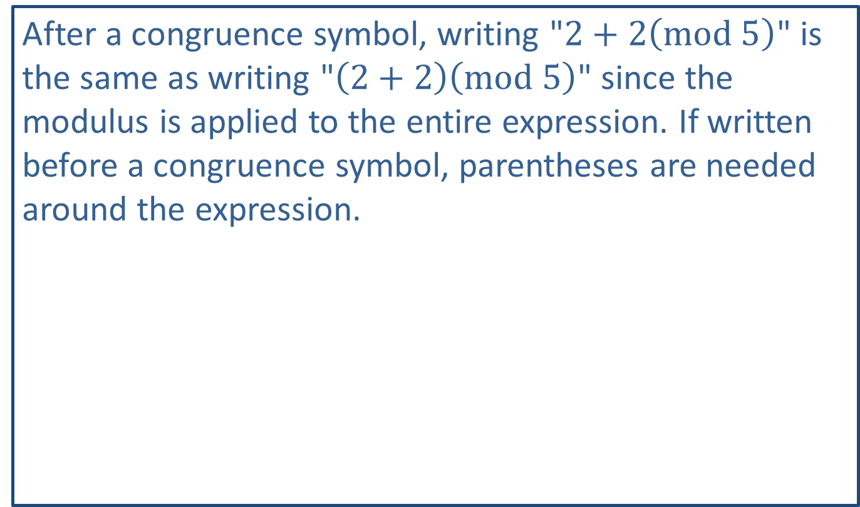
Helpful Hint 1
After a congruence symbol, writing "$2+2\left(mod 5\right)$" is the same as writing "$\left(2+2\right)\left(mod 5\right)$" since the modulus is applied to the entire expression. If written before a congruence symbol, parentheses are needed around the expression.

Slide 11
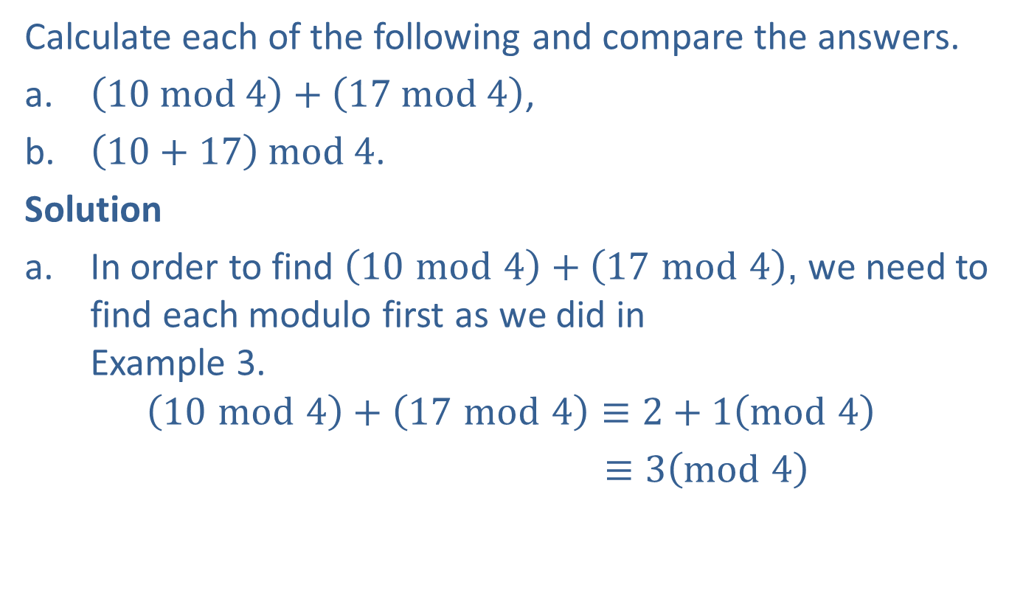
Example 4: Evaluating Modular Addition—Slide 1
Calculate each of the following and compare the answers.
a. $\left(10 mod 4\right)+\left(17 mod 4\right)$,
b. $\left(10+17\right) mod 4$.
Solution
a. In order to find $\left(10 mod 4\right)+\left(17 mod 4\right)$, we need to find each modulo first as we did in
Example 3.
$$\left(10 mod 4\right)+\left(17 mod 4\right)≡2+1\left(mod 4\right)$$
$≡3\left(mod 4\right)$

Slide 12
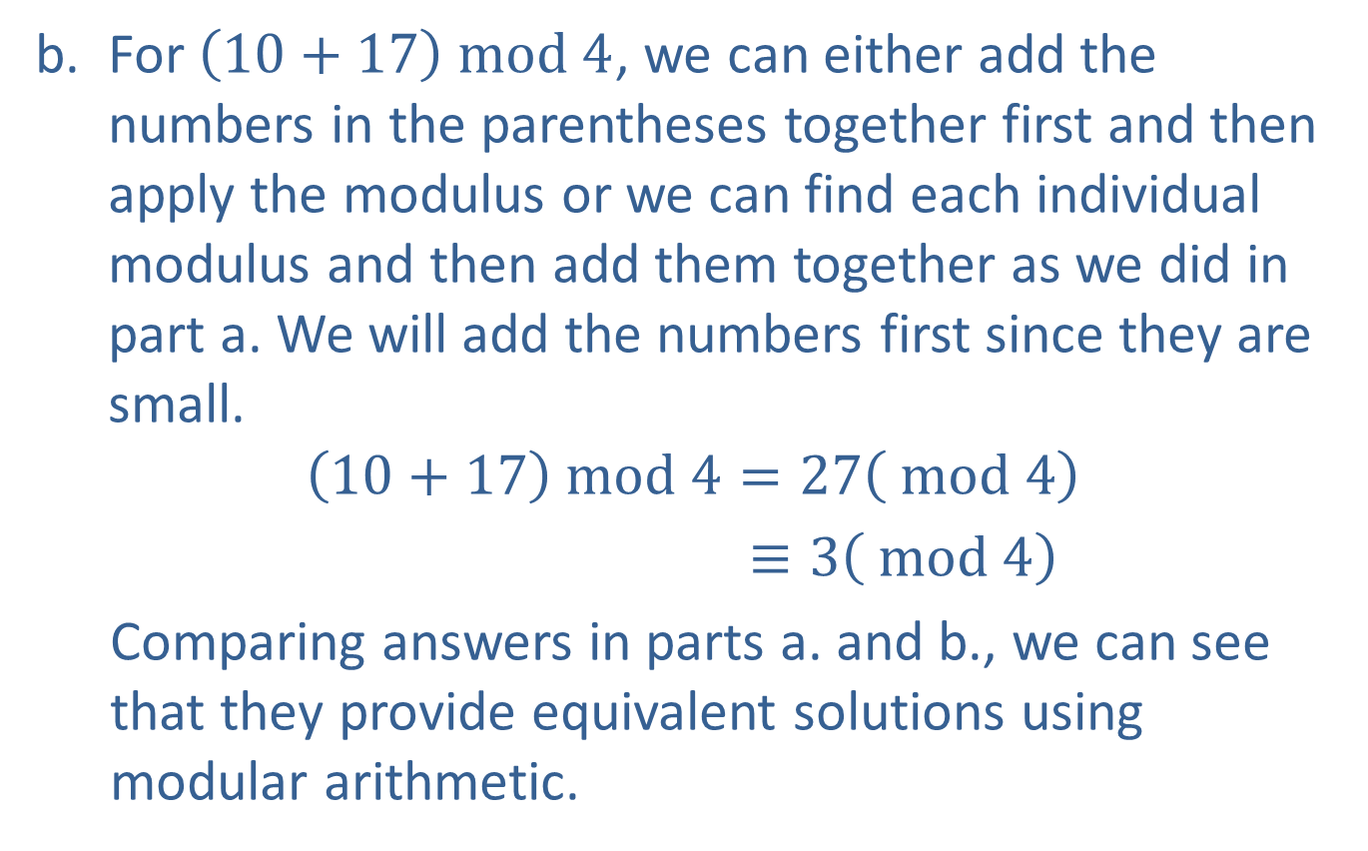
Example 4: Evaluating Modular Addition—Slide 2
b. ​For $\left(10+17\right) mod 4$, we can either add the numbers in the parentheses together first and then apply the modulus or we can find each individual modulus and then add them together as we did in part a. We will add the numbers first since they are small.
$$\left(10+17\right) mod 4=27\left( mod 4\right)$$
$≡3\left( mod 4\right)$
  Comparing answers in parts a. and b., we can see that they provide equivalent solutions using modular arithmetic.

Slide 13
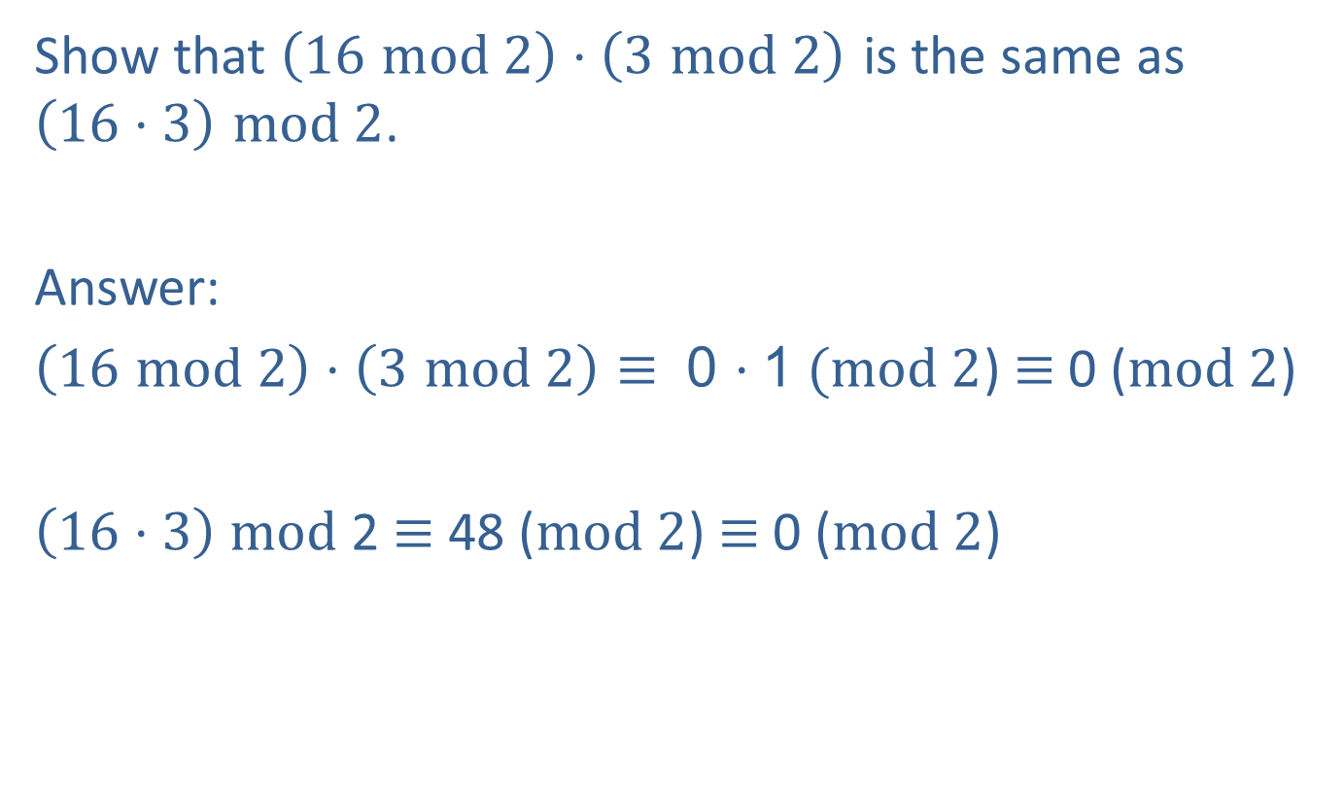
Skill Check 1
Show that $\left(16 mod 2\right)⋅\left(3 mod 2\right)$ is the same as
$\left(16⋅3\right) mod 2$.
Answer:
$\left(16 mod 2\right)⋅\left(3 mod 2\right)$ $≡$ 0 $⋅$1 $(mod 2$) $≡$ 0 ($mod 2$)
$\left(16⋅3\right)$ $mod$2 $≡$ 48 ($mod 2$) $≡$ 0 ($mod 2$)

Slide 14
Helpful Hint 2
The top number on this bar code is the 10-digit ISBN for the book. The bottom number is the 13-digit ISBN, which is the new standard as of 2007.

Slide 15
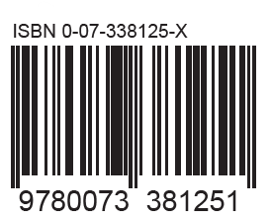
Example 5: Verifying the Validity of a 10-Digit ISBN—Slide 1
Verify the validity of the ISBN shown here by performing the process described for finding the check-sum digit.
Figure 3

Slide 16
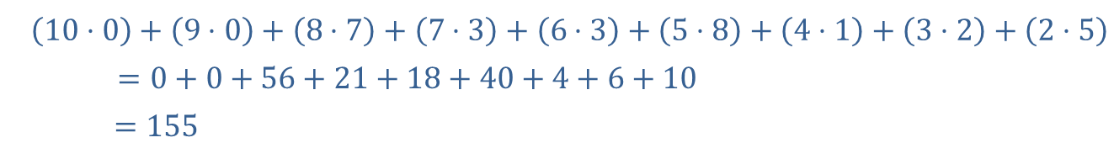

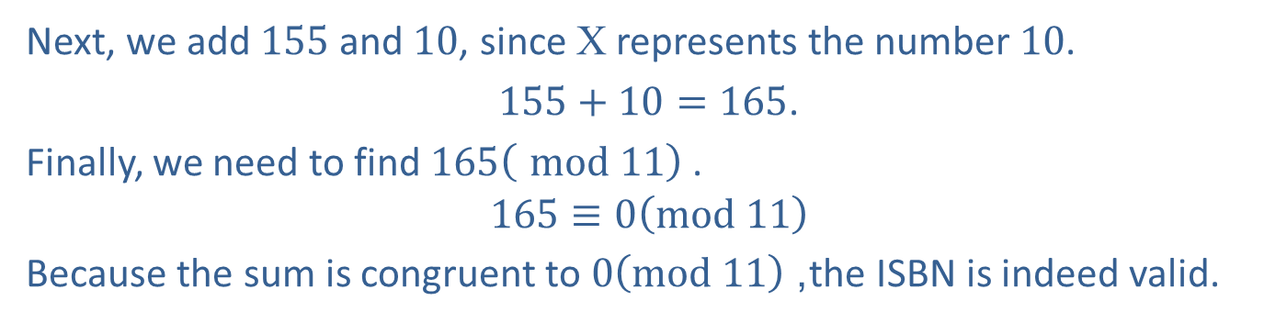
Example 5: Verifying the Validity of a 10-Digit ISBN—Slide 2
Solution
To verify the ISBN, we need to find the various multiples of the first 9 digits in the number, and add them together with the check-sum digit. Remember, the sum should be congruent to $0 \text{mod} 11$.
First, we'll find the multiples of the first 9 digits.
​
​$\left(10⋅0\right)+\left(9⋅0\right)+\left(8⋅7\right)+\left(7⋅3\right)+\left(6⋅3\right)+\left(5⋅8\right)+\left(4⋅1\right)+\left(3⋅2\right)+\left(2⋅5\right)$
$$=0+0+56+21+18+40+4+6+10$$
​ $=155$
Next, we add 155 and 10, since X represents the number 10.
$155+10=165$.
Finally, we need to find $165\left( mod 11\right)$ .
$$165≡0\left(mod 11\right)$$
Because the sum is congruent to $0\left(mod 11\right)$, the ISBN is indeed valid.

Slide 17
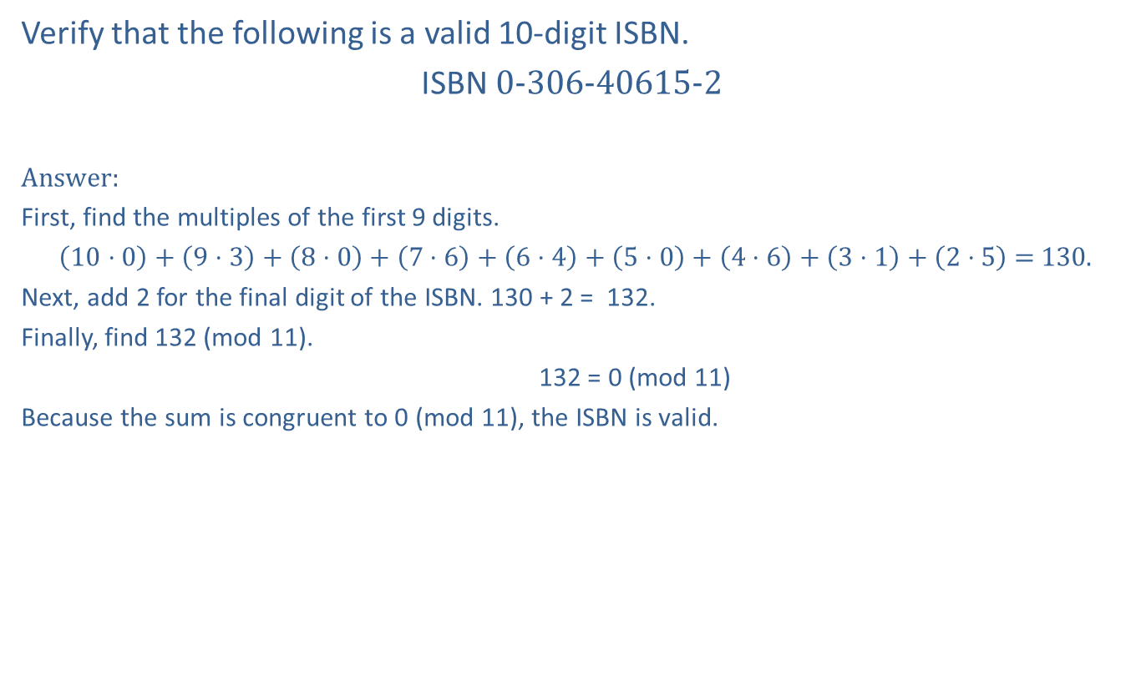
Skill Check 2
Verify that the following is a valid 10-digit ISBN.
ISBN 0-306-40615-2
Answer:
First, find the multiples of the first 9 digits.
$\left(10⋅0\right)+\left(9⋅3\right)+\left(8⋅0\right)+\left(7⋅6\right)+\left(6⋅4\right)+\left(5⋅0\right)+\left(4⋅6\right)+\left(3⋅1\right)+\left(2⋅5\right)$ = 130.
Next, add 2 for the final digit of the ISBN. 130 + 2 = 132.
Finally, find 132 (mod 11).
132 = 0 (mod 11)
Because the sum is congruent to 0 (mod 11), the ISBN is valid.

Slide 18
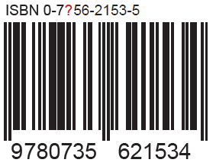
Example 6: Finding a Missing Digit of a 10-Digit ISBN—Slide 1
What should the third digit of the ISBN number be for the following barcode? Notice that the check-sum number is 5.
Figure 4

Slide 19

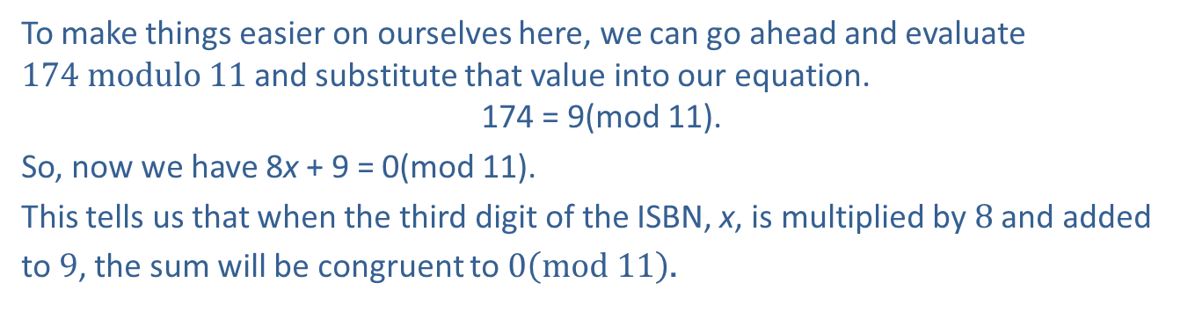
Example 6: Finding a Missing Digit of a 10-Digit ISBN—Slide 2
Solution
The ISBN we were given is $07\text{?}5621535$.
We can set up the equation for the multiplication as follows, using x to represent the missing digit.
$\left(10⋅0\right)+\left(9⋅7\right)+\left(8⋅\text{x}\right)+\left(7⋅5\right)+\left(6⋅6\right)+\left(5⋅2\right)+\left(4⋅1\right)+\left(3⋅5\right)+\left(2⋅3\right)+5≡0\left( mod 11\right)$.
Simplifying, we have
To make things easier on ourselves here, we can go ahead and evaluate $174 modulo 11$ and substitute that value into our equation.
174 = 9(mod 11).
So, now we have 8x + 9 = 0(mod 11).
This tells us that when the third digit of the ISBN, x, is multiplied by 8 and added to 9, the sum will be congruent to $0\left(mod 11\right)$.

Slide 20
Example 6: Finding a Missing Digit of a 10-Digit ISBN—Slide 3
Now, we need to use a bit of trial and error to find the missing digit. We know that the digit must be a number between 0 and 10, inclusive. So we can begin trying numbers, starting with 0. Substituting x = 0 in our equation gives the following.

Slide 21

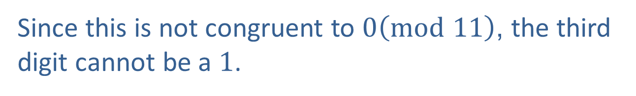
Example 6: Finding a Missing Digit of a 10-Digit ISBN—Slide 4
Since this is not congruent to $0\left(mod 11\right)$ the third digit cannot be a 0.
Next, suppose the third digit was a 1. Let's substitute
x = 1 in our equation.
Since this is not congruent to $0\left(mod 11\right)$, the third digit cannot be a 1.

Slide 22
Example 6: Finding a Missing Digit of a 10-Digit ISBN—Slide 5
Now, let x = 2.

Slide 23
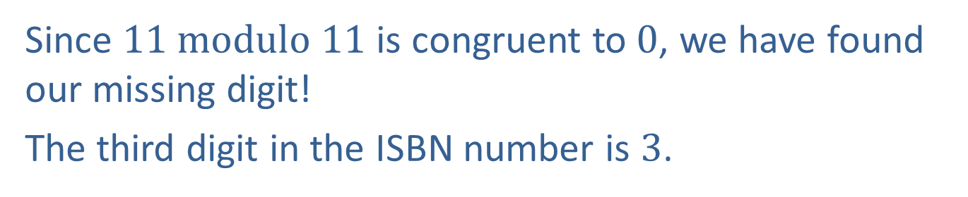
Example 6: Finding a Missing Digit of a 10-Digit ISBN—Slide 6
Again, we do not have a value equivalent to 0(mod 11), so we still have not found our number. Let x = 3.
Since $11 modulo 11$ is congruent to 0, we have found our missing digit!
The third digit in the ISBN number is 3.

