Slide 1
Section 8.3
Fermat's Little Theorem and Prime Testing

Slide 2
Theorem: Fermat's Little Theorem
Let p be any prime number and x be any positive integer. Then,

Slide 3
Math Milestones
Although he is considered to be one of the world's greatest mathematicians, Pierre de Fermat considered math to be only a hobby. Fluent in Latin, Occitan, Classical Greek, Italian, Spanish, as well as French, he spent his professional career as a lawyer at the Parlement of Toulouse, France.

Slide 4
Example 1: Verifying Fermat's Little Theorem—Slide 1
Verify that
when p = 7 and x = 4.
Solution
We'll stop at this point and introduce a useful short cut. You might not be able to calculate 4 ⁷ in your head, but the beauty of modular arithmetic is that you don't have to. Remember that we want our equation to work in modulo 7. So changing any number to its equivalent modulo 7 throughout the calculation is helpful in that it makes the numbers we are manipulating smaller. Notice that 4 ⋅ 4 = 16 ≡ 2(mod 7). By replacing each pair of 4s that are multiplied together with a 2, we can make life easier.

Slide 5
Example 1: Verifying Fermat's Little Theorem—Slide 2
Therefore, we've shown that

Slide 6
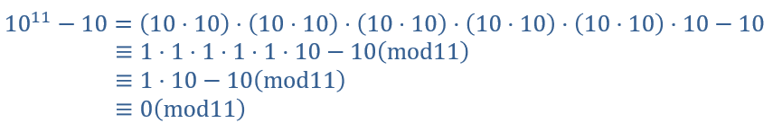
Skill Check 1
Verify that
when p = 11 and x = 10.
Answer

Slide 7
Theorem: Contrapositive of Fermat's Little Theorem
Let x and n be positive integers. If
not a prime number.

Slide 8

Example 2: Prime Testing—Slide 1
Use the contrapositive of Fermat's Little Theorem to verify that the number n = 8 is not prime by using the number 2 for x.
Solution
Substituting in n = 8 and x = 2 into the contrapositive, we have the following. Note that 2³ is congruent to $0\left(mod 8\right)$.

Slide 9
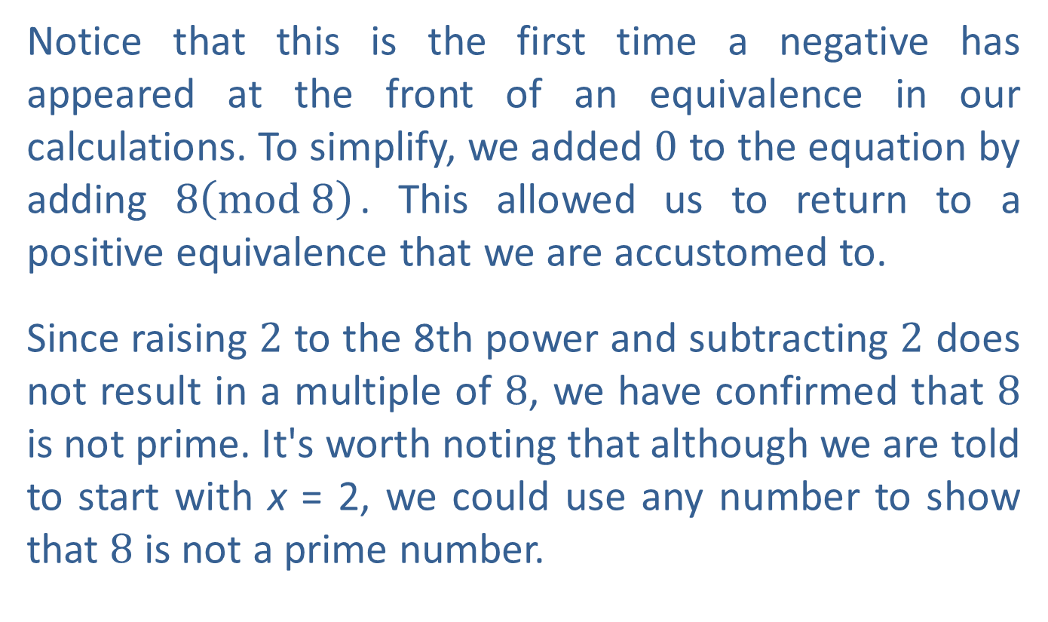
Example 2: Prime Testing—Slide 2
Notice that this is the first time a negative has appeared at the front of an equivalence in our calculations. To simplify, we added 0 to the equation by adding $8\left(mod 8\right)$. This allowed us to return to a positive equivalence that we are accustomed to.
Since raising 2 to the 8th power and subtracting 2 does not result in a multiple of 8, we have confirmed that 8 is not prime. It's worth noting that although we are told to start with x = 2, we could use any number to show that 8 is not a prime number.

Slide 10
Helpful Hint 1
To calculate negative equivalences, you can add any multiple of the modular base. In other words, −2 mod 8 is congruent to (−2 + 8)(mod 8), or 6(mod 8).

Slide 11
Skill Check 2
Simplify each of the following.
Answer :

Slide 12
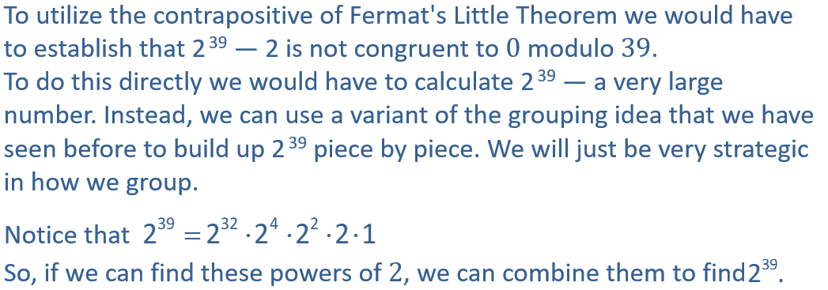
Example 3: Prime Testing Using Modular Arithmetic—Slide 1
Verify that 39 is not prime using the contrapositive of Fermat's Little Theorem and x = 2.
Solution
We want to show that 39 is not prime using the number 2.

Slide 13
Example 3: Prime Testing Using Modular Arithmetic—Slide 2
The following steps show the most efficient way to find these powers.
In standard arithmetic, 2⁸ = 256, and we would need to continue on with our calculations of
However, in arithmetic modulo 39, 2⁸ ≡ 22 (mod 39).
This smaller number of 22 will be much easier to work with. This pattern of reducing our calculations modulo 39 keeps the numbers manageable. Notice how the pattern continues in the next steps.

Slide 14
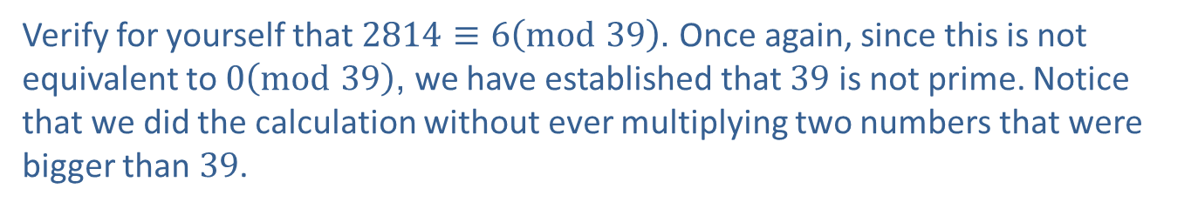
Example 3: Prime Testing Using Modular Arithmetic—Slide 3
From these powers of 2, we have all we need to calculate
Verify for yourself that $2814≡6\left(mod 39\right)$. Once again, since this is not equivalent to $0\left(mod 39\right)$, we have established that 39 is not prime. Notice that we did the calculation without ever multiplying two numbers that were bigger than 39.

Slide 15
Helpful Hint 2
Notice that each line uses the result of the previous line after the first congruence symbol. For instance, the third line uses 4 in place of 2². When an equal sign appears in the string of calculations, standard arithmetic was performed.

Slide 16
Fun Fact
To print out a number with one billion digits would require 300,000 pages of paper using a 12‑point font size!

