Slide 1
Chapter 8
Review

Slide 2
Definition: Prime and Composite Numbers
Prime numbers
A prime number is a positive integer that has precisely two divisors: 1 and itself.
Composite Numbers
A composite number is a positive integer that has more than two divisors. Note that the numbers 0 and 1 are neither prime nor composite.

Slide 3
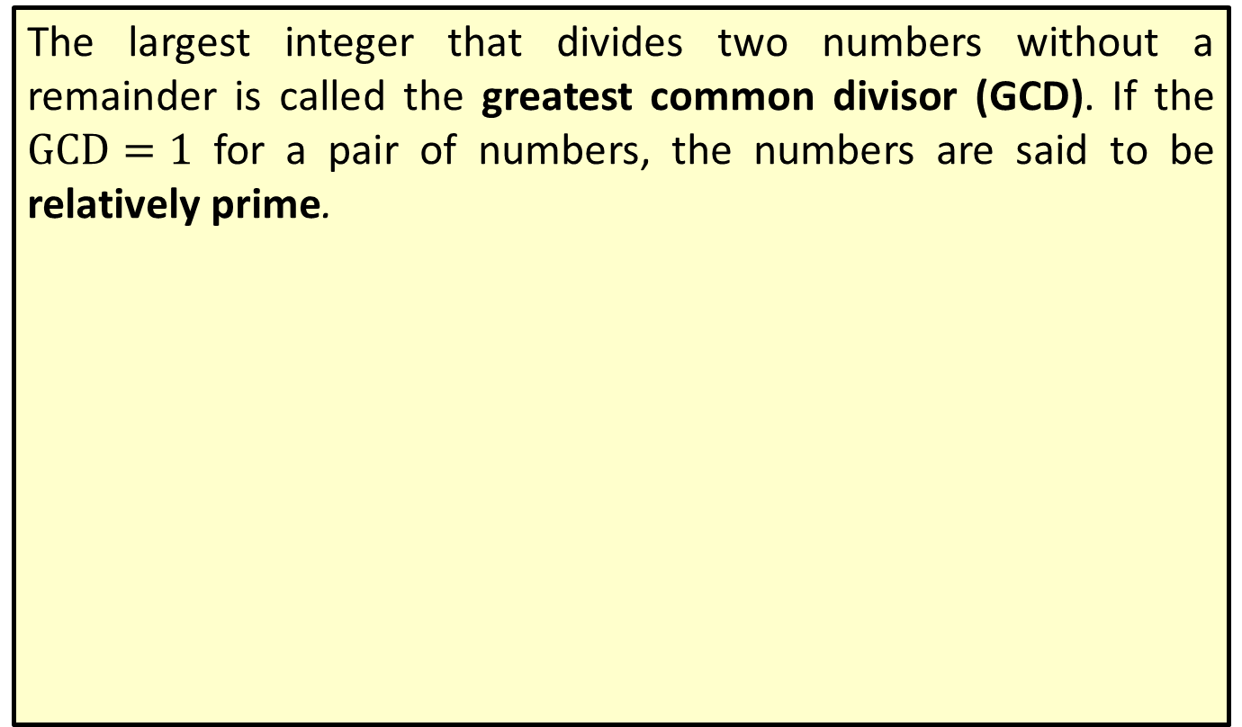
Definition: Greatest Common Divisor (GCD)
The largest integer that divides two numbers without a remainder is called the greatest common divisor (GCD). If the $GCD=1$ for a pair of numbers, the numbers are said to be relatively prime.

Slide 4
Procedure: Sieve of Eratosthenes
Step 1: List all the positive integers between 2 and N.
Step 2: Highlight the smallest number (p) not crossed out or previously highlighted. This is a prime number.
Step 3: Cross out all multiples of p.
Step 4: Repeat steps 2 and 3 until all numbers are either highlighted or crossed out.

Slide 5
Procedure: Steps for Using Euclid's Algorithm
​1. Divide the larger of the given numbers by the smaller (the divisor) and note the remainder.
​2. Divide the original divisor (the smaller of the given numbers) by the remainder found in Step 1.
​3. Continue dividing the previous divisor by the previous remainder until the remainder is 0.
​4. The last nonzero remainder is the GCD of the given numbers.

Slide 6
Theorem: Fundamental Theorem of Arithmetic
The fundamental theorem of arithmetic states that every positive integer greater than 1 is either a prime number or can be written as a unique product of prime numbers. This unique product of prime numbers is called its prime factorization.

Slide 7
Definition: Modular Arithmetic
In modular arithmetic, a number n is congruent to the remainder r when it is divided by a fixed number m. We write n ≡ r(mod m). Note that m is referred to as the modulus.

Slide 8
Theorem: Fermat's Little Theorem
Let p be any prime number and x be any positive integer. Then,

Slide 9
Theorem: Contrapositive of Fermat's Little Theorem
Let x and n be positive integers. If
not a prime number.

Slide 10
Theorem: Euler's Theorem
where p and q are prime numbers, n = pq, and x and a are any positive integers.

Slide 11
Theorem: (Modified) Euler's Theorem
where p and q are prime numbers, n = pq, and x and a are any positive integers.

