Slide 1
Section 9.1
Two-Dimensional Geometry

Slide 2
Fun Fact—Slide 1
The word geometry translates from Greek to mean earth measure.

Slide 3
Think Back—Slide 1
A polygon is a closed figure that is determined by three or more straight line segments.

Slide 4
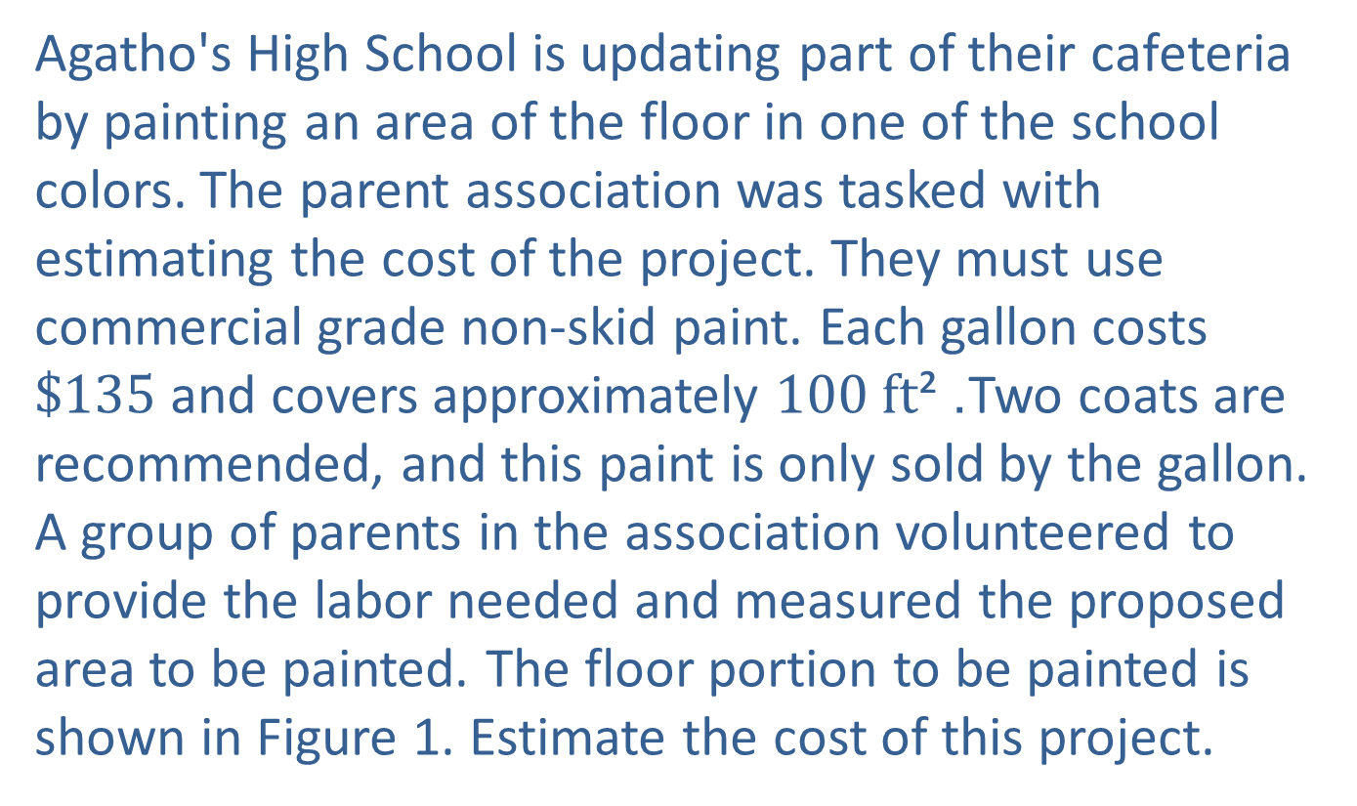
Example 1: Using Area of
Rectangles—Slide 1
Agatho's High School is updating part of their cafeteria by painting an area of the floor in one of the school colors. The parent association was tasked with estimating the cost of the project. They must use commercial grade non-skid paint. Each gallon costs $\$135$ and covers approximately $100 ft$. ²Two coats are recommended, and this paint is only sold by the gallon. A group of parents in the association volunteered to provide the labor needed and measured the proposed area to be painted. The floor portion to be painted is shown in Figure 1. Estimate the cost of this project.

Slide 5
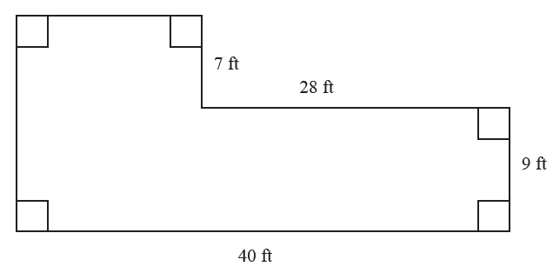
Example 1: Using Area of
Rectangles—Slide 2
Figure 1
Solution
In order to estimate the cost of the project, the parents must do the following.
1. ​Calculate the area of floor that needs to be painted.
2. ​Determine how many gallons of paint are needed.
3. ​Calculate the cost of the paint. 

Slide 6
Example 1: Using Area of
Rectangles—Slide 3
Step 1: Calculate the area of floor that needs to be painted.
Although the area of the floor to be painted is not a standard shape that we have a formula for, we can divide the figure into shapes whose areas we can calculate more easily. In this case, the shape can be divided into rectangles using the known dimensions. The dashed line in Figure 2 divides the area into two rectangles using the measurements provided in the Figure 1.

Slide 7
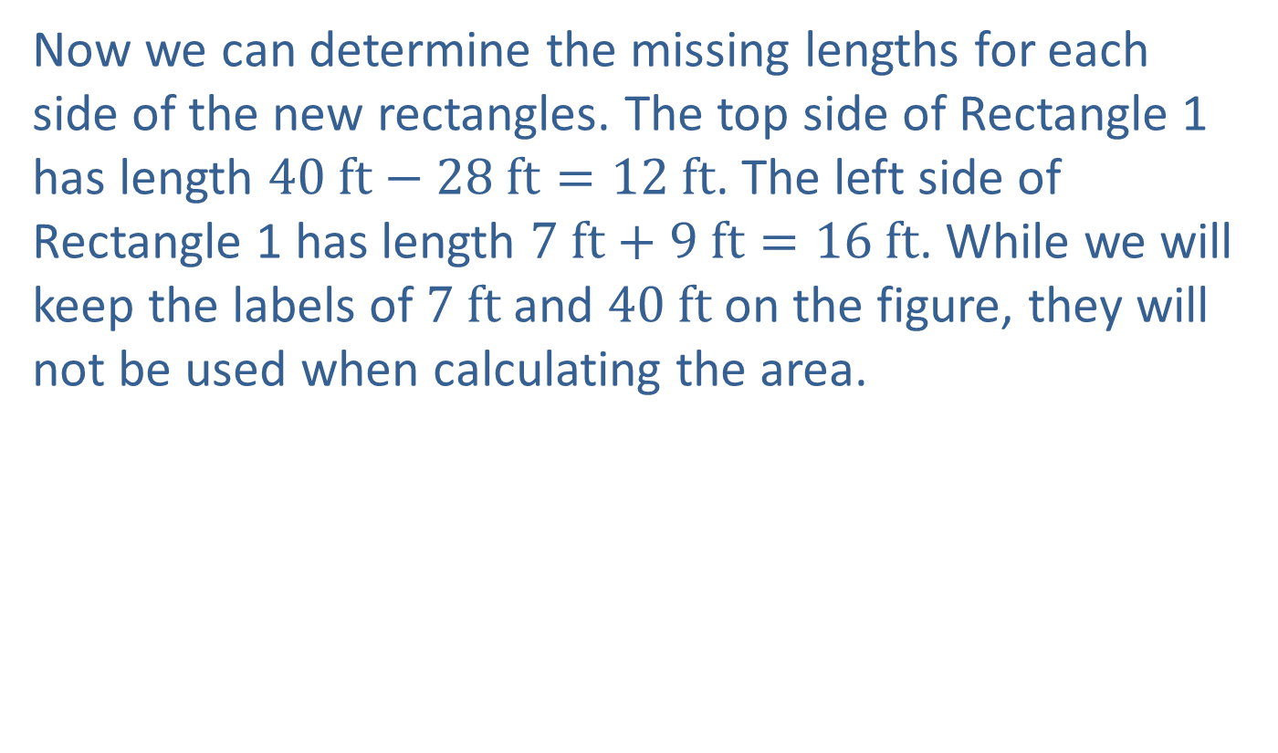
Example 1: Using Area of
Rectangles—Slide 4
Now we can determine the missing lengths for each side of the new rectangles. The top side of Rectangle 1 has length $40 ft−28 ft=12 ft$. The left side of Rectangle 1 has length $7 ft+9 ft=16 ft$. While we will keep the labels of $7 ft$ and $40 ft$ on the figure, they will not be used when calculating the area.

Slide 8
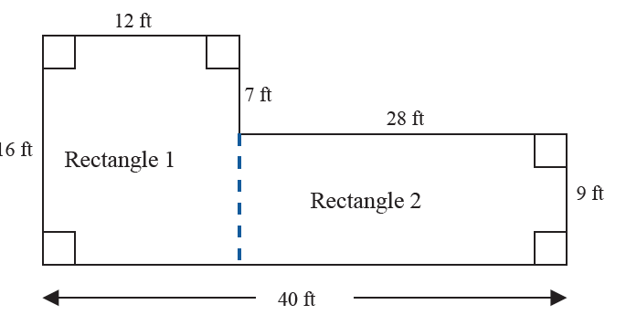
Example 1: Using Area of
Rectangles—Slide 5
Figure 2

Slide 9
Example 1: Using Area of
Rectangles—Slide 6
We know that the formula for the area of a rectangle is
Using this formula, the area for each rectangle is calculated as follows.
Adding the areas together, we have the total area of the floor to be painted.

Slide 10
Example 1: Using Area of
Rectangles—Slide 7
Total Area of Painted Floor:
It is worth noticing that this is not the only way that the cafeteria could be divided into rectangles. Skill Check 1 asks that you determine another way to divide the floor plan.

Slide 11

Example 1: Using Area of
Rectangles—Slide 8
Step 2: Determine how many gallons of paint are needed.
Since two coats of paint are recommended, we need to double the square footage to be painted, which gives us $888 ft$². Since each gallon of paint covers $100 ft$², we can determine the total number of gallons needed by multiplying this area by the
conversion factor
Since this paint is only sold by the gallon, the school will need to purchase 9 gallons of paint in order to ensure full coverage.

Slide 12
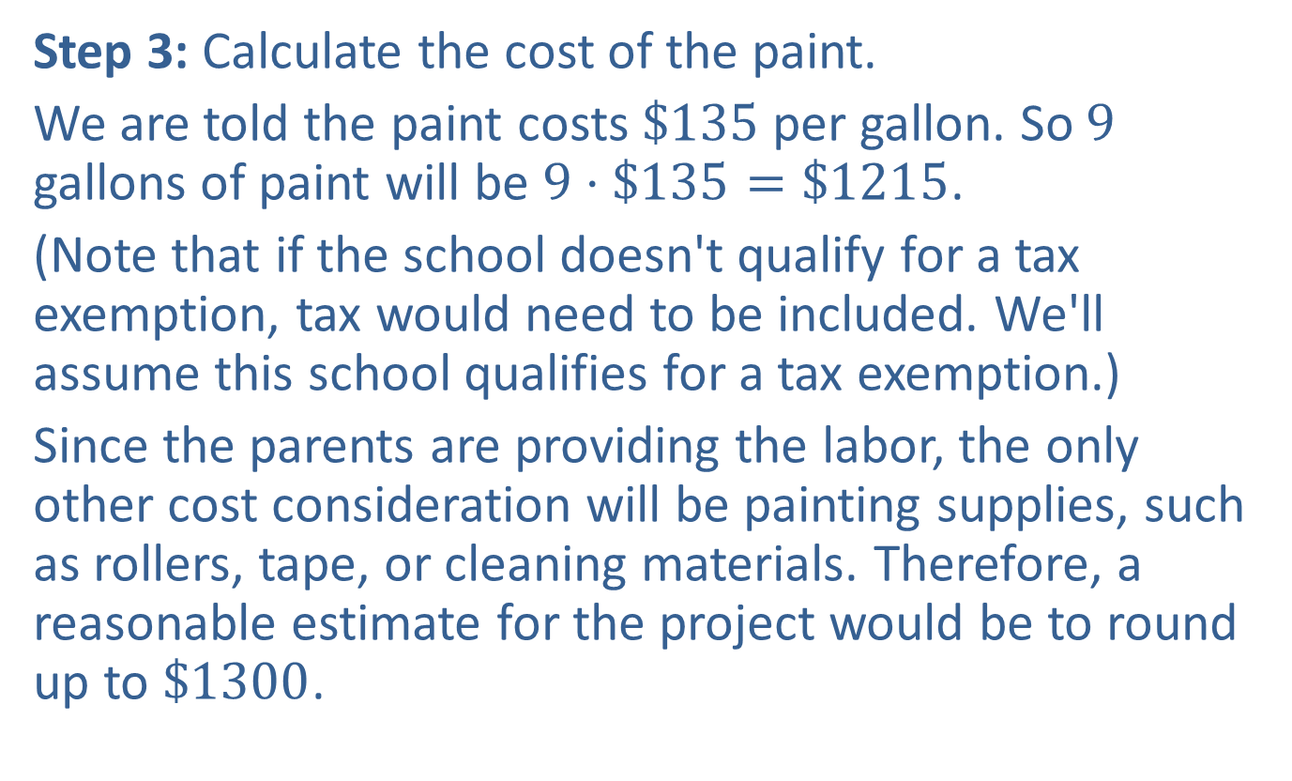
Example 1: Using Area of
Rectangles—Slide 9
Step 3: Calculate the cost of the paint.
We are told the paint costs $\$135$ per gallon. So 9 gallons of paint will be $9⋅\$135=\$1215$.
(Note that if the school doesn't qualify for a tax exemption, tax would need to be included. We'll assume this school qualifies for a tax exemption.)
Since the parents are providing the labor, the only other cost consideration will be painting supplies, such as rollers, tape, or cleaning materials. Therefore, a reasonable estimate for the project would be to round up to $\$1300$.

Slide 13
Think Back—Slide 2
The units we want to convert to should be put in the denominator of the conversion fraction.
For more practice with conversion factors, see
Section 4.4.

Slide 14

Skill Check 1
Divide the floor layout in Example 1 into a different pair of rectangles and give the dimensions of each.
Answer: $7$ $ft$ × $12$ $ft$ and $9$ $ft$ × $40$ $ft$

Slide 15
Example 2: Using Area of Circles and Rectangles—Slide 1
Water sprinkler heads should always be placed so that the sprays of water overlap one another. The distance one head throws should reach the head of the next sprinkler for full coverage; that is, head-to-head coverage. Unfortunately, in an effort to save water, the sprinklers at a local park were installed in a pattern in which the water sprays did not overlap. Figure 3 is a drawing of the sprinkler layout at the park. The park is 228 feet wide and 380 feet long, and each of the 15 installed sprinklers has a maximum radius of 38 feet. Determine the percentage of the park's grass that does not get watered with this sprinkler arrangement.

Slide 16
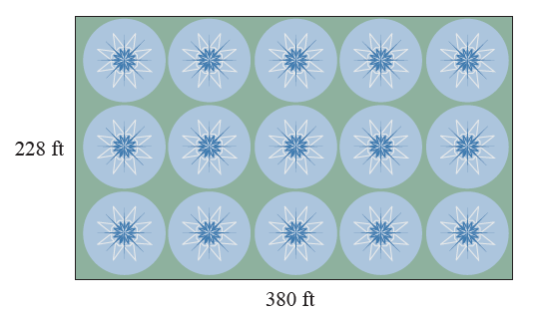
Example 2: Using Area of Circles and Rectangles—Slide 2
Figure 3

Slide 17
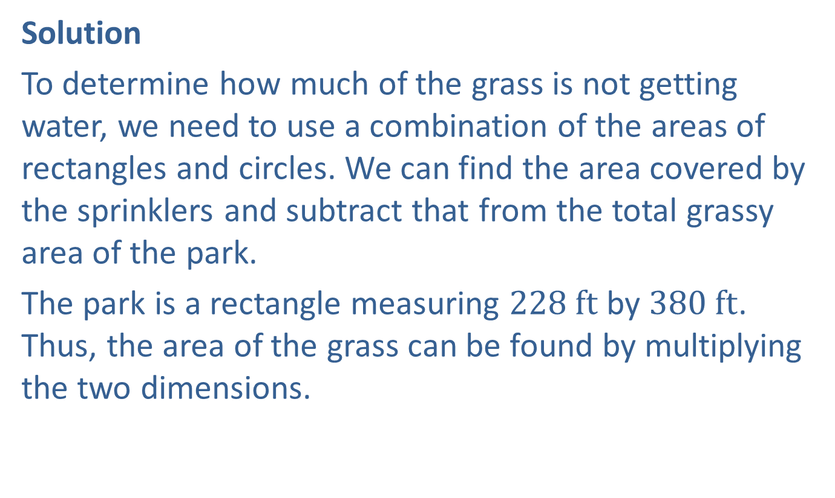
Example 2: Using Area of Circles and Rectangles—Slide 3
Solution
To determine how much of the grass is not getting water, we need to use a combination of the areas of rectangles and circles. We can find the area covered by the sprinklers and subtract that from the total grassy area of the park.
The park is a rectangle measuring $228 ft$ by $380 ft$. Thus, the area of the grass can be found by multiplying the two dimensions.

Slide 18
Example 2: Using Area of Circles and Rectangles—Slide 4
Each sprinkler creates a circular pattern with a radius of
38 feet. Using the area formula for a circle (A = πr ²), we can calculate the area watered by each sprinkler.

Slide 19
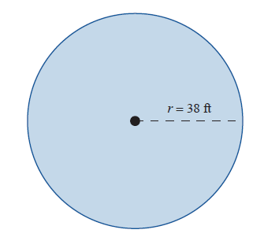
Example 2: Using Area of Circles and Rectangles—Slide 5
Figure 4

Slide 20
Example 2: Using Area of Circles and Rectangles—Slide 6
Since there are 15 sprinkler heads, multiplying the area by 15 gives us the total area of watered grass.
Subtracting the watered area from the total grassy area, we can find the area of grass that does not receive water.

Slide 21
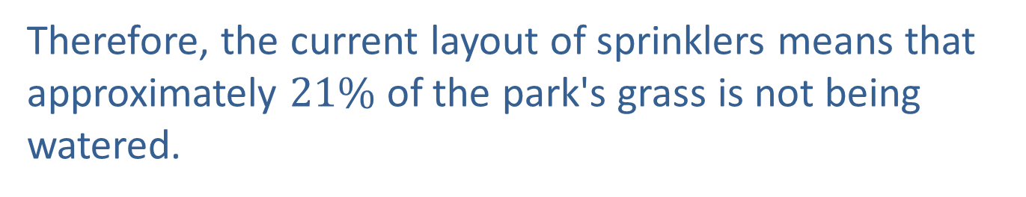
Example 2: Using Area of Circles and Rectangles—Slide 7
To determine the percentage of grass not watered, we divide the unwatered amount of grass by the total grass area.
Proportion of Unwatered Grass:
Therefore, the current layout of sprinklers means that approximately $21\%$ of the park's grass is not being watered.

Slide 22
Helpful Hint
When calculations involve several steps, avoid rounding at intermediate calculations. If necessary, round intermediate calculations to at least six decimal places to avoid additional rounding error in subsequent calculations.

Slide 23
Skill Check 2
Find the area and circumference of a circle with a diameter of 10 inches.
Answer: Area = 78.5 in. ²; Circumference = 31.4 in.

Slide 24
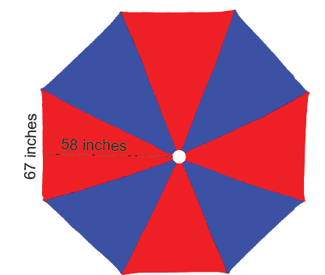
Example 3: Using Area of Triangles—Slide 1
Barbara has decided to personalize her patio umbrella with alternating colors. Her current umbrella has 8 triangular panels that measure 58 inches from the center to the outer edge, as shown in Figure 5. Each triangular panel has a base length of 67 inches.
Figure 5

Slide 25
Example 3: Using Area of Triangles—Slide 2
a. ​Determine the minimum amount of material (in square yards) that Barbara will need in each color for her new design.
b. ​Barbara wants to waterproof the umbrella once it is finished. The can of water repellant states that a 12-ounce can will cover approximately 60 square yards, or 540 square feet. How many cans does Barbara need to buy to waterproof her umbrella?
c. ​Determine how many yards of trim Barbara would need if she decided to edge the umbrella with it.

Slide 26

Example 3: Using Area of Triangles—Slide 3
Solution
a. ​The area of each triangular panel can be found by
using the formula
In this case, the base of each triangle is 67 inches and the height is 58 inches.
$$\text{Area} \text{of} \text{Triangular} \text{Panel}\text{:}$$

Slide 27

Example 3: Using Area of Triangles—Slide 4
  Therefore, each panel has an area of 1943 square inches. Since Barbara needs 4 panels of each color, we multiply the area by 4.
​Area for Four Panels: 1943 $in.$ ²$⋅4=7772$ $in. \text{²}$
​
This means that Barbara needs a minimum 7772 square inches of material in each color. To calculate what this amount is in yards, we need to use a conversion factor for inches and yards,

Slide 28
Example 3: Using Area of Triangles—Slide 5
  However, we need to square this conversion factor so that it contains the correct units. The conversion factor we need is
  Multiplying the area by the conversion factor
  gives us the following.
Area for Four Panels in Square Yards:
So Barbara needs approximately 6 square yards of each color.

Slide 29
Example 3: Using Area of Triangles—Slide 6
b. ​We are told that a 12-ounce can will cover approximately 60 square yards. Since Barbara will be using 6 square yards of each of the two colors, we know there will be 12 square yards of material total. She will only need one can to waterproof all 12 square yards of material.
c. The perimeter of the umbrella consists of the bases of each of the eight triangles. This means that the perimeter is 8 times the base length of 67 inches.
​Perimeter of the Umbrella:

Slide 30
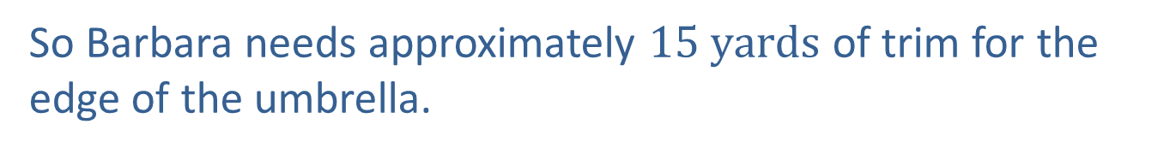
Example 3: Using Area of Triangles—Slide 7
To determine the yardage, we need to multiply by the
conversion factor for inches and yards,
​
Perimeter in Yards:
So Barbara needs approximately $15 yards$ of trim for the edge of the umbrella.

Slide 31
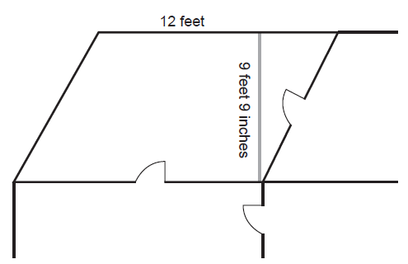

Example 4: Using Area of
Parallelograms—Slide 1
The Internal Revenue Service allows qualifying taxpayers to claim a home office deduction on their taxes for any area of their home that they use for business purposes. Taxpayers are allowed to claim $\$5$ per square foot for business use, with a maximum of 300 square feet. The Martins meet the requirements to deduct their home office space on their taxes. Calculate the amount they are allowed to deduct based on their home measurements.
Figure 6

Slide 32
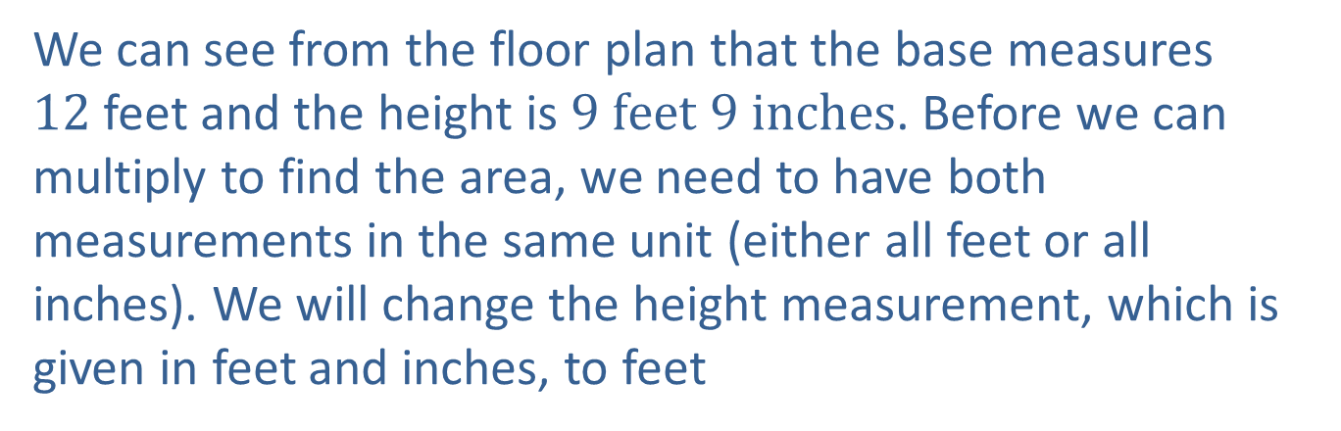
Example 4: Using Area of
Parallelograms—Slide 2
Solution
The home office area that the Martins are deducting is in the shape of a parallelogram. Recall that the area of a parallelogram is given by
We can see from the floor plan that the base measures
12 feet and the height is $9 feet 9 inches$. Before we can multiply to find the area, we need to have both measurements in the same unit (either all feet or all inches). We will change the height measurement, which is given in feet and inches, to feet

Slide 33
Example 4: Using Area of
Parallelograms—Slide 3
The conversion factor to change the inches into feet is
We convert 9 inches to feet by multiplying; that is, we get
Adding this to the 9 feet, we have that the height measurement is 9.75 feet.
Now we can use the area formula for a parallelogram A = bh to find the area of their home office.

Slide 34

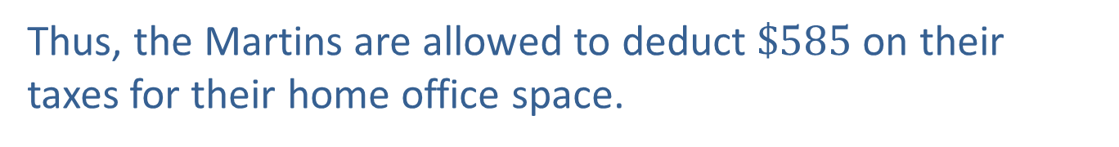
Example 4: Using Area of
Parallelograms—Slide 4
The Martins are allowed to deduct $\$5$ per square foot of
their home office, so we multiply the area by
Deduction Amount:
Thus, the Martins are allowed to deduct $\$585$ on their taxes for their home office space.

Slide 35
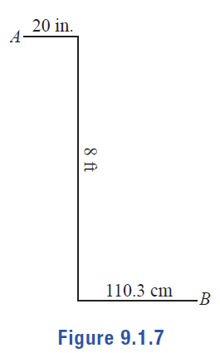
Example 5: Using Circumference—Slide 1
Members of a robotics club are tasked with moving their robot from point A to point B. The robot understands the following commands.
​Rotate wheels forward x number of rotations.
​Rotate wheels backward x number of rotations.
​Turn 90° left. Turn 90° right.
If the wheels of the robot are 2.5 inches in diameter, determine the sequence of commands that the robot should be given.
Figure 7

Slide 36
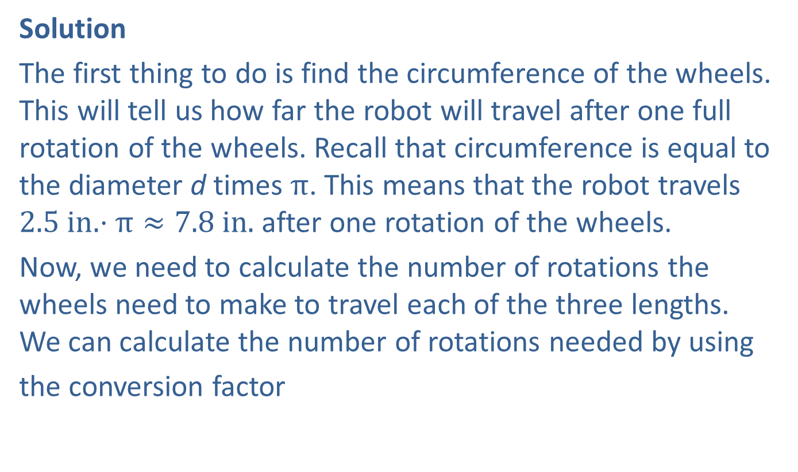
Example 5: Using Circumference—Slide 2
Solution
The first thing to do is find the circumference of the wheels. This will tell us how far the robot will travel after one full rotation of the wheels. Recall that circumference is equal to the diameter d times $π$. This means that the robot travels $2.5 in. ⋅π≈7.8 in.$ after one rotation of the wheels.
Now, we need to calculate the number of rotations the wheels need to make to travel each of the three lengths. We can calculate the number of rotations needed by using
the conversion factor

Slide 37
Example 5: Using Circumference—Slide 3
Notice that the second and third lengths will also need to be converted to inches for our calculations.
Wheel Rotations to Travel 20 Inches:
Wheel Rotations to Travel 8 Feet:
Wheel Rotations to Travel 110.3 Centimeters:

Slide 38
Example 5: Using Circumference—Slide 4
Thus, the commands for the robot should be as follows.
1. ​Rotate wheels forward 2.55 rotations.
2. ​Turn 90° right.
3. ​Rotate wheels forward 12.23 rotations.
4. ​Turn 90° left.
5. ​Rotate wheels forward 5.53 rotations.

Slide 39
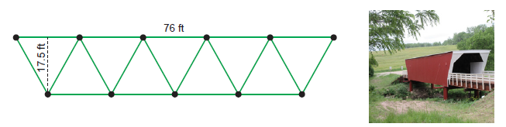
Example 6: Using Area of Trapezoids—Slide 1
A truss is a support framework that is used for structures like bridges and roofs. Typically, trusses are composed of triangles due to their stability. The Warren truss, popular in bridge construction, consists of equilateral triangles that form a trapezoid, as shown in Figure 8.
A covered bridge is to be built using two Warren trusses, one on each side, supporting the roof. Calculate the amount of cedar in square feet that will be needed to cover both sides of the bridge.
Figure 8

Slide 40
Example 6: Using Area of Trapezoids—Slide 2
Solution
The face of the Warren truss forms a trapezoid, the area of
which is found by the formula
From Figure 8, we can see that the bases measure 76 feet and 66 feet and the height is 17.5 feet.
Since the bridge has two Warren trusses, the area to be covered
in cedar is

Slide 41
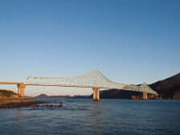
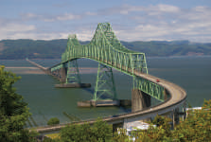
Fun Fact—Slide 2
In 1991, the Ikitsuki Bridge in Nagasaki became the world's longest continuous truss bridge, spanning 400 meters.
Figure 9
From 1966–1991, the title was held by the Astoria-Megler bridge in Oregon, measuring 376 meters.
Figure 10
Images Courtesy of Hiroshi Nakai and Ron Reiring, Creative Commons 2.0 Generic License (https://creativecommons.org/licenses/by/2.0/deed.en).

Slide 42
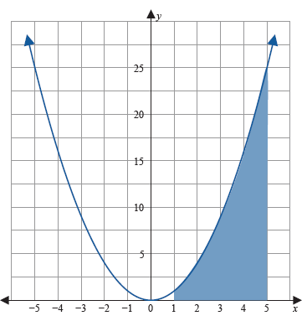

Example 7: Using Area of Trapezoids—Slide 1
The graph of the function y$=$ x² is shown in Figure 13, where x and y are both measured in inches. Approximate the shaded area under the curve between x $=1$ and x$=5$ by finding the areas of 4 trapezoids.
Figure 13

Slide 43

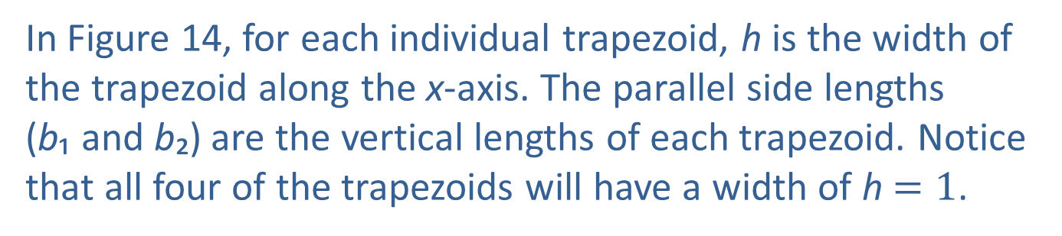
Example 7: Using Area of Trapezoids—Slide 2
Solution
Begin by dividing the area we are interested in, the area between x$=1$ and x $=5$, into four trapezoids, T ₁, T ₂, T ₃, and T ₄.
Recall that the formula for the area of a trapezoid is
In Figure 14, for each individual trapezoid, h is the width of the trapezoid along the x-axis. The parallel side lengths
(b₁ and b₂) are the vertical lengths of each trapezoid. Notice that all four of the trapezoids will have a width of h $=1$.

Slide 44
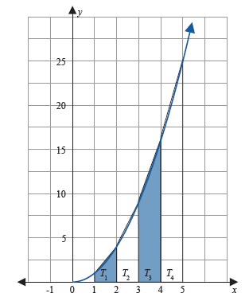
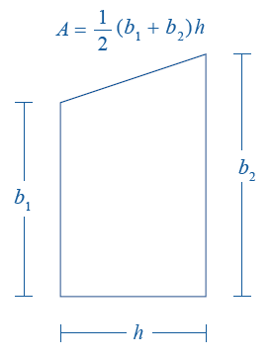
Example 7: Using Area of Trapezoids—Slide 3
Figure 14
Figure 15

Slide 45
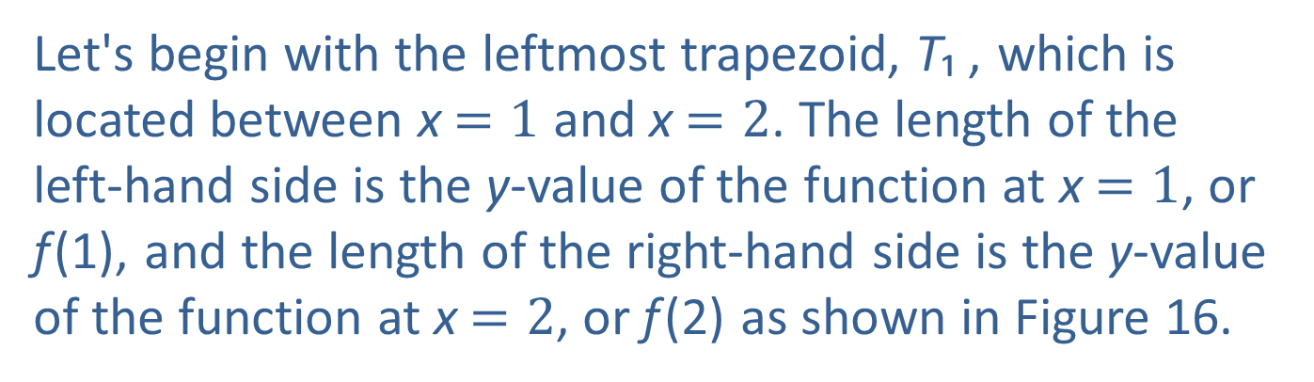
Example 7: Using Area of Trapezoids—Slide 4
Since the curve is the graph of
we can calculate the lengths of the sides of each trapezoid by evaluating the function
Let's begin with the leftmost trapezoid, T₁ , which is located between x$=1$ and x$=2$. The length of the left-hand side is the y-value of the function at x$=1$, or f (1), and the length of the right-hand side is the y-value of the function at x $=2$, or f (2) as shown in Figure 16.

Slide 46
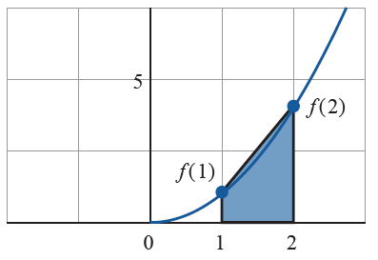
Example 7: Using Area of Trapezoids—Slide 5
Figure 16

Slide 47
Example 7: Using Area of Trapezoids—Slide 6
Evaluating each, we have the following for T₁.
Length of Left-Hand Side:
Length of Right-Hand Side:
Thus, the area of the first trapezoid, T₁, is
The areas of the other three trapezoids are found in the same manner. Each of the trapezoids has width 1, and the side lengths are found by evaluating the function at the endpoints along the x-axis.
The areas of the remaining trapezoids are shown in Table 2.

Slide 48
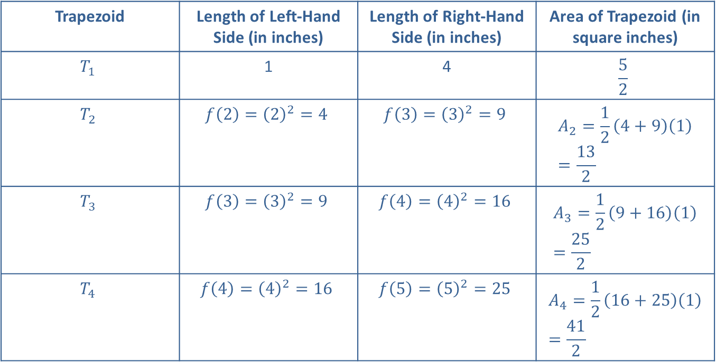
Example 7: Using Area of Trapezoids—Slide 7
Table 2
Trapezoid | Length of Left-Hand Side (in inches) | Length of Right-Hand Side (in inches) | Area of Trapezoid (in square inches)
$$T_{1}$$ | 1 | 4 | $$\frac{5}{2}$$
$$T_{2}$$ | $$f\left(2\right)={\left(2\right)}^{2}=4$$ | $$f\left(3\right)={\left(3\right)}^{2}=9$$ | $$A_{2}=\frac{1}{2}\left(4+9\right)\left(1\right)=\frac{13}{2}$$
$$T_{3}$$ | $$f\left(3\right)={\left(3\right)}^{2}=9$$ | $$f\left(4\right)={\left(4\right)}^{2}=16$$ | $$A_{3}=\frac{1}{2}\left(9+16\right)\left(1\right)=\frac{25}{2}$$
$$T_{4}$$ | $$f\left(4\right)={\left(4\right)}^{2}=16$$ | $$f\left(5\right)={\left(5\right)}^{2}=25$$ | $$A_{4}=\frac{1}{2}\left(16+25\right)\left(1\right)=\frac{41}{2}$$

Slide 49
Example 7: Using Area of Trapezoids—Slide 8
The Total Area of the Four Trapezoids:
Thus, the approximate area under the curve is 42 square inches.

