Slide 1
Section 9.2
Three-Dimensional Geometry

Slide 2

Fun Fact—Slide 1
A Klein bottle, first described by the German mathematician Felix Klein in 1882, is a unique structure in that it has no volume because it has no definable inside or outside.
Figure 1

Slide 3
Example 1: Determining which Measurement to Calculate—Slide 1
In each of the following scenarios, consider the space being described and determine whether you should calculate the volume or surface area to resolve the issue.
a. ​The amount of packing space in a moving truck
b. ​How much fabric is needed to re-cover a chair
c. ​The amount of wrapping paper needed for Christmas gifts
d. ​The amount of soil needed for a new planter

Slide 4
Example 1: Determining which Measurement to Calculate—Slide 2
Solution
a. ​The space inside a moving truck requires that you know the volume the truck can hold.
b. The fabric will cover the outside of the chair, so surface area needs to be calculated.
c. ​Wrapping paper will cover the outside area of packages, and hence surface area is needed.
d. The soil will fill in the inside of a planter, so volume needs to be calculated.

Slide 5
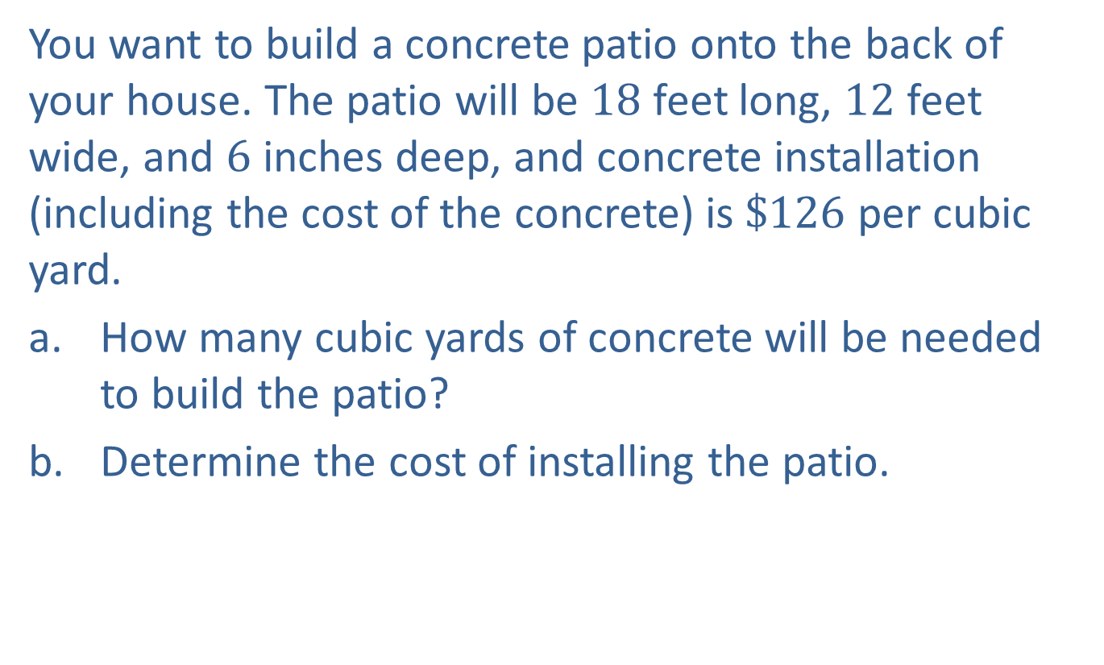
Example 2: Using the Volume of a Rectangular Solid—Slide 1
You want to build a concrete patio onto the back of your house. The patio will be 18 feet long, 12 feet wide, and 6 inches deep, and concrete installation (including the cost of the concrete) is $\$126$ per cubic yard.
a. ​How many cubic yards of concrete will be needed to build the patio?
b. ​Determine the cost of installing the patio.

Slide 6
Example 2: Using the Volume of a Rectangular Solid—Slide 2
Solution
a. ​A concrete patio is a rectangular solid and the volume is determined by the formula V = lwh.
  We know that the length l of the patio is 18 feet and the width w is 12 feet. However, the depth (which is the height) is given in inches. Because we should always work with dimensions that are in the same units, we need to first convert the depth to feet. A depth h of 6 inches is equivalent to 0.5 feet since there are 12 inches in a foot.

Slide 7
Example 2: Using the Volume of a Rectangular Solid—Slide 3
​The volume of the patio is calculated as follows.
​
In order to determine the number of cubic yards of concrete that are required to build the patio, we need to use a version of the conversion factor for feet and yards,

Slide 8
Example 2: Using the Volume of a Rectangular Solid—Slide 4
​Since volume is in cubic units, we need to cube the conversion factor so that it contains the correct units. Therefore, the conversion factor we need is ​
​
Multiplying the volume by the conversion factor gives us the following.
Volume in Cubic Feet:
Therefore, 4 cubic yards of concrete are required to build the patio.

Slide 9

Example 2: Using the Volume of a Rectangular Solid—Slide 5
b. We are told that the installation fee is $\$126$ per cubic
yard. So we can use the conversion factor
​
to determine the installation cost for the patio.
Installation Cost:
Therefore, the concrete patio will cost $\$504$ to install.

Slide 10
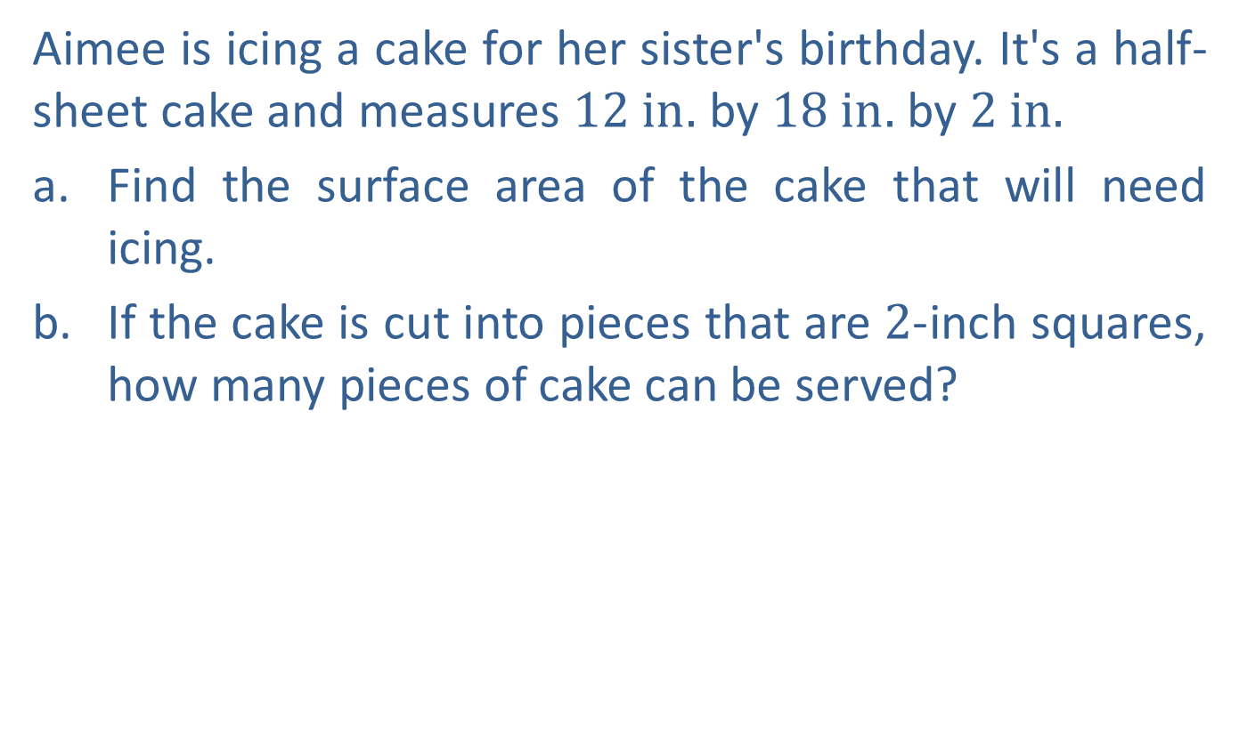
Example 3: Using the Surface Area of a Rectangular Solid—Slide 1
Aimee is icing a cake for her sister's birthday. It's a half-sheet cake and measures $12 in.$ by $18 in.$ by $2 in.$
​Find the surface area of the cake that will need icing.
​If the cake is cut into pieces that are 2-inch squares, how many pieces of cake can be served?

Slide 11
Example 3: Using the Surface Area of a Rectangular Solid—Slide 2
Solution
a. ​The cake is a rectangular solid with length
l = 18 in., width w = 12 in., and height h = 2in. Using our formula, we calculate the surface area as follows.

Slide 12
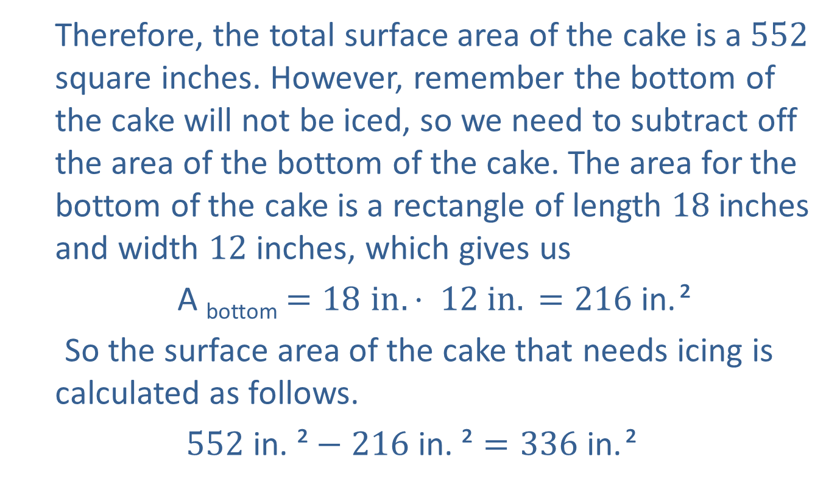
Example 3: Using the Surface Area of a Rectangular Solid—Slide 3
  Therefore, the total surface area of the cake is a 552 square inches. However, remember the bottom of the cake will not be iced, so we need to subtract off the area of the bottom of the cake. The area for the bottom of the cake is a rectangle of length 18 inches and width 12 inches, which gives us
  A _{bottom}$=18 in. \text{⋅} 12 in. =216 \text{in}\text{.}$ ²
  So the surface area of the cake that needs icing is calculated as follows.
​$552 \text{in}\text{. }\text{²}−216 \text{in}\text{. }\text{²}=336 \text{in}\text{.}$ ²

Slide 13
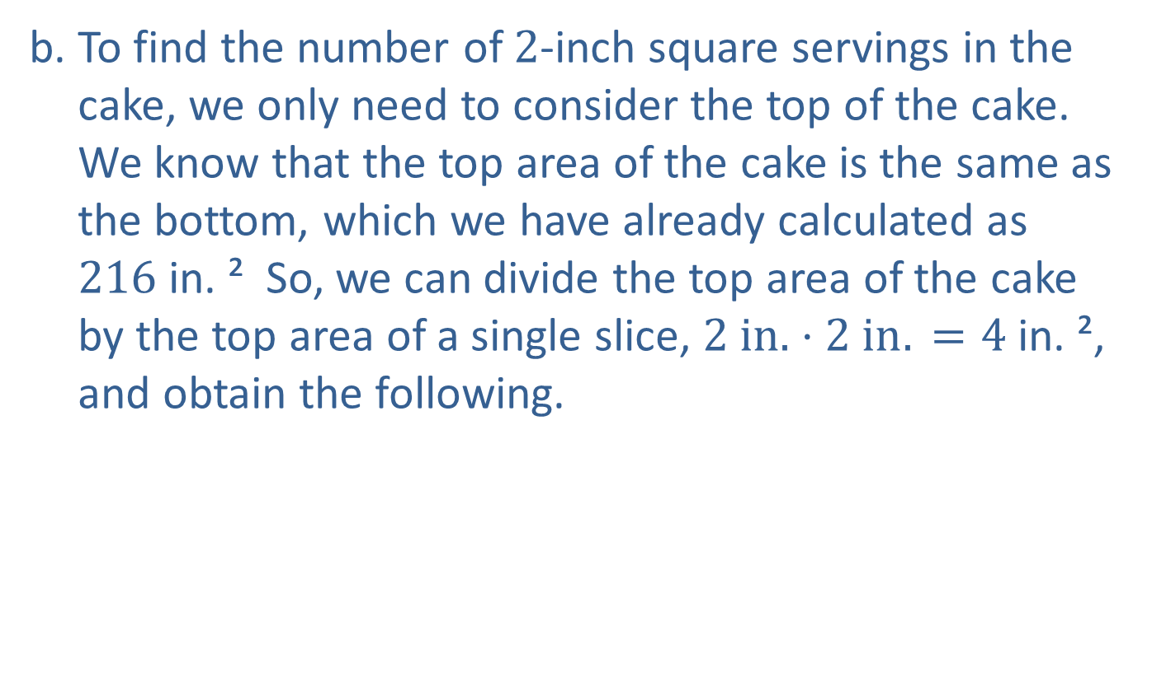
Example 3: Using the Surface Area of a Rectangular Solid—Slide 4
b. ​To find the number of 2-inch square servings in the cake, we only need to consider the top of the cake. We know that the top area of the cake is the same as the bottom, which we have already calculated as $216 \text{in}\text{.} \text{²}$ So, we can divide the top area of the cake by the top area of a single slice, $2 in. ⋅2 in. =4 \text{in}\text{.} \text{²}$, and obtain the following.
​

Slide 14
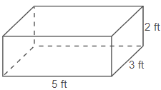
Skill Check 1
Find the volume and surface area for the given rectangular solid.
Figure 4
Answer : V $=30 ft³$; SA $=$ $62 ft²$

Slide 15
Example 4: Using the Surface Area of a
Sphere—Slide 1
Tyson's Athletic Gear Inc. manufactures 300 new baseballs a day. The cork center (or pill) is wrapped in rubber and then wool before having a cowhide cover applied. Each finished ball has a diameter of 2.9 inches and weighs between 5.0 and 5.25 ounces
a. Calculate the surface area of one baseball, rounded to two decimal places.
b. What is the minimum amount of cowhide needed (in square feet) to manufacture a week's worth of baseballs if the plant operates 5 days a week? Explain why this is a minimum amount.

Slide 16

Example 4: Using the Surface Area of a
Sphere—Slide 2
Solution
a. The formula to calculate the surface area of a sphere is
SA = 4πr². Since we were given the diameter, and we need the radius for the formula, we need to divide the diameter by two. Thus, the radius of each baseball is $2.9÷2=1.45 in.$ Using the formula, we can calculate the surface area of the baseball.
So the surface area of one baseball is approximately $26.42{\text{in}\text{.} \text{²}}^{ }$

Slide 17
Example 4: Using the Surface Area of a
Sphere—Slide 3
b. ​To find the minimum amount of cowhide needed to manufacture a week's worth of baseballs, we need to multiply the surface area we found in part a. by 300 (a day's worth of baseballs) and then by 5 since the plant is manufacturing baseballs 5 days a week.
​Minimum Cowhide Needed:
​
  We are asked to provide the area in square feet, so we need to change square inches to square feet using the conversion factor

Slide 18
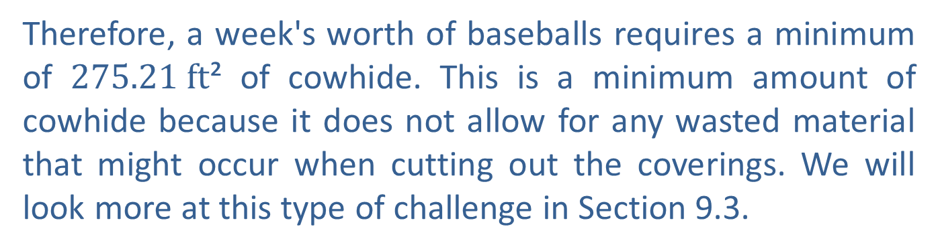
Example 4: Using the Surface Area of a
Sphere—Slide 4
  Therefore, a week's worth of baseballs requires a minimum of $275.21 ft$² of cowhide. This is a minimum amount of cowhide because it does not allow for any wasted material that might occur when cutting out the coverings. We will look more at this type of challenge in Section 9.3.

Slide 19
Think Back
The diameter of a circle is twice the length of the radius.

Slide 20
Example 5: Using the Volume of a
Sphere—Slide 1
Whitt is filling balloons with an air pump for his birthday party.
​a. After 2 pumps of air, a balloon has a radius of 2 inches. Find the volume of air contained in the balloon.
​b. Whitt wants to make the balloon bigger, so he puts in 2 more pumps of air and the volume of air doubles. What is the volume of air in the balloon now?
c. How big is the balloon's radius after the 4 pumps of air?
​d. By what percentage does the radius of the balloon increase when Whitt goes from 2 pumps of air to 4 pumps?

Slide 21

Example 5: Using the Volume of a
Sphere—Slide 2
Solution
a. ​We know that the volume of a sphere can be determined by
the formula
After 2 pumps of air, the balloon has a radius of 2 inches. Substituting in the known values and simplifying gives the following.
  The balloon has a volume of approximately $33.51 \text{in}\text{.} ³$ after two pumps of air.

Slide 22
Example 5: Using the Volume of a
Sphere—Slide 3
b. Since we are told that the volume of air doubles after two more pumps, the volume of air after 4 pumps is as follows.

Slide 23
Example 5: Using the Volume of a
Sphere—Slide 4
c. ​In part b., we found the volume of the balloon after the 4 pumps of air. We will use that information to find the new radius of the balloon by substituting the known values into the formula for the volume and solving for the radius, r.
  Thus, the radius of the balloon after four pumps is approximately 2.52 inches.

Slide 24
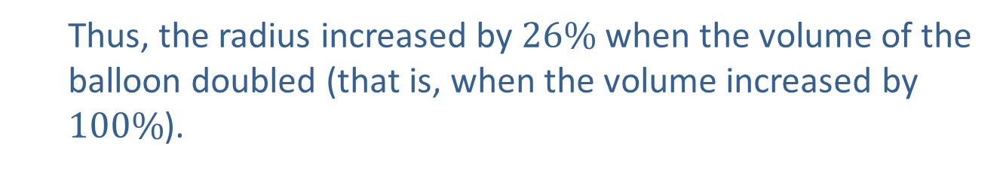
Example 5: Using the Volume of a
Sphere—Slide 5
d. ​Recall that percentage increase is found by dividing the absolute change in the measurements by the original amount, where absolute change is simply the difference between the two radii.
  Percent increase:
  Thus, the radius increased by $26\%$ when the volume of the balloon doubled (that is, when the volume increased by $100\%$).

Slide 25
Think Back—Slide 2

Slide 26
Example 6: Using the Volume of a Right Circular Cylinder—Slide 1
The sound a drum makes varies according to the diameter and height of the drum (assuming that the materials used to make the drum remain the same).
a. ​Find the volume of air, to the nearest tenth, in a snare drum that has a diameter of 14 inches and a height of 5 inches.
b. ​A tom-tom drum has a radius of 5 inches and a height of 8 inches. Find the volume of air, to the nearest tenth, in the tom-tom drum.
c. ​Vertical 5-inch brads (small nails) are placed around the edge of the snare drum. Calculate how many brads are on the drum if they are placed approximately 4 inches apart.

Slide 27
Example 6: Using the Volume of a Right Circular Cylinder—Slide 2
Solution
a. ​The drum forms a right cylinder, so we can use the formula for the volume of a right circular cylinder, V = πr²h. We are
given the diameter, d = 14in., so the radius is
The height of the drum, h, is 5 inches. Substituting these values into the formula, we have the following. 
  So the approximate volume of the snare drum is $769.7 \text{in}\text{.}$ ³

Slide 28

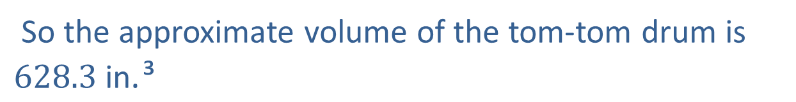
Example 6: Using the Volume of a Right Circular Cylinder—Slide 3
b. ​To find the volume of air in the tom-tom drum, we use the same formula, with r $=5 in.$ and h $=8 in.$
  So the approximate volume of the tom-tom drum is $628.3 \text{in}\text{.} \text{³}$

Slide 29
Example 6: Using the Volume of a Right Circular Cylinder—Slide 4
The brads are placed along the circumference of the drum. To determine how many there are, we need to calculate the drum's circumference using the formula C = πd.
​
  Since the brads are spaced 4 inches apart, we divide the circumference by four to determine the number of brads.
  We can conclude that 11 brads are used and placed approximately 4 inches apart.

Slide 30
Fun Fact—Slide 2
As a general rule, the smaller the diameter of the drum is, the higher its pitch is. A drum with a 15 " diameter will sound deep and fat, while a 10 " diameter will produce a thinner, sharper sound.

Slide 31
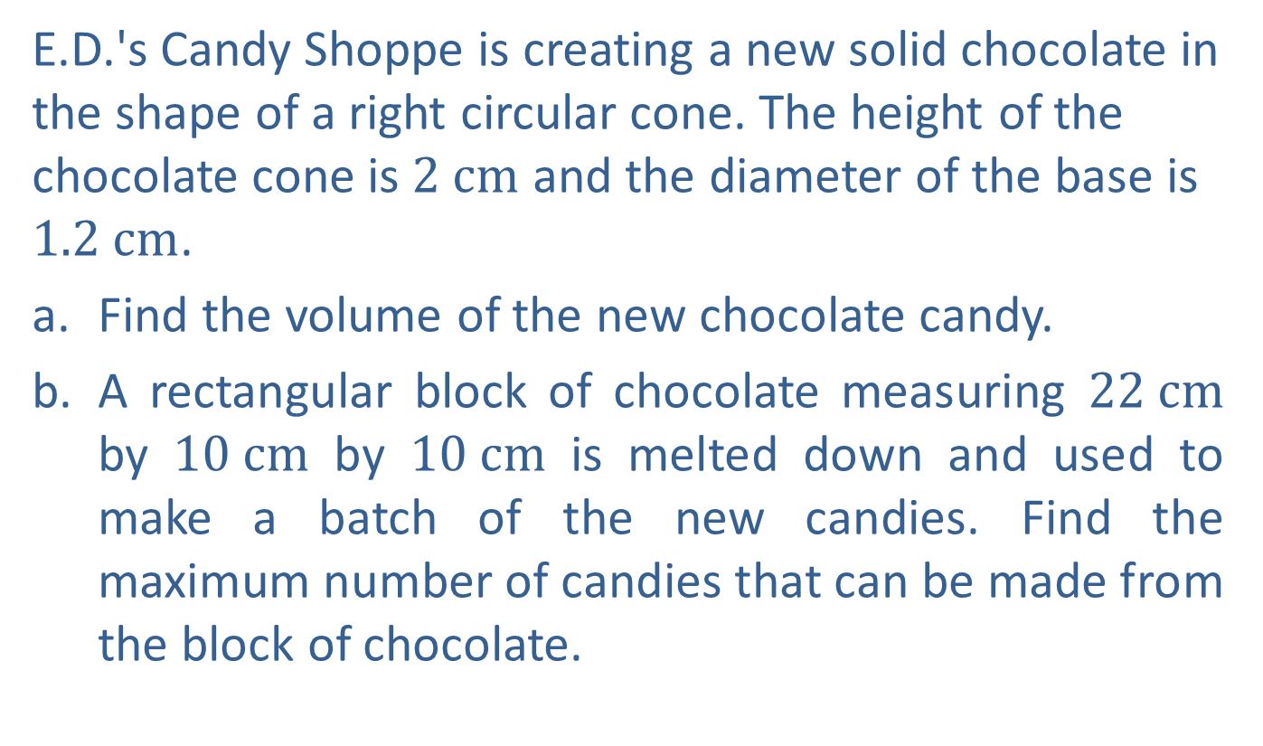
Example 7: Finding the Volume of a Right Circular Cone—Slide 1
E.D.'s Candy Shoppe is creating a new solid chocolate in the shape of a right circular cone. The height of the chocolate cone is $2 cm$ and the diameter of the base is $1.2 cm$.
​a. Find the volume of the new chocolate candy.
​b. A rectangular block of chocolate measuring $22 cm$ by $10 cm$ by $10 cm$ is melted down and used to make a batch of the new candies. Find the maximum number of candies that can be made from the block of chocolate.

Slide 32

Example 7: Finding the Volume of a Right Circular Cone—Slide 2
Solution
a. ​The formula for the volume of a right circular cone is
The radius of the base of the new chocolate is half of the
diameter we were given, or
The height is $2 cm$. Substituting these values into the formula, we have the following.
  Thus, the volume of the new chocolate is approximately $0.75cm$³.

Slide 33

Example 7: Finding the Volume of a Right Circular Cone—Slide 3
b. ​To find the maximum number of candies that can be made from a block of chocolate, we need to begin by finding the volume of the chocolate block. We know the volume of a rectangular solid is V = lwh and that the block has a length of $22 cm$, a width of $10 cm$, and a height of $10 cm$. Substituting these values into the formula, we have the following.
  Next, to find the number of candies that can be made from this block, divide the total volume we just found by the volume of chocolate of one of the new candies found in part a.

Slide 34
Example 7: Finding the Volume of a Right Circular Cone—Slide 4
  Number of Candies Made from One Block of Chocolate:
  We need to round this number down to the nearest whole number, since we are asked for the maximum number of chocolates that can be made from one block. So a maximum of 2933 candies can be made from the block of chocolate.

Slide 35

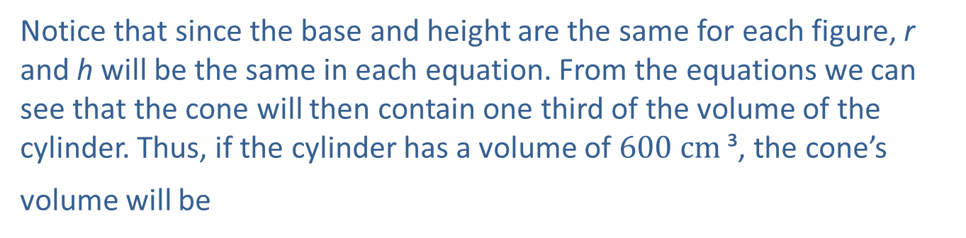
Example 8: Comparing Volumes
If the volume of a right circular cylinder is $600 cm$³, find the volume of a right circular cone with the same height and base.
Solution
Let's begin by considering the volume formulas for both the right circular cylinder and the right circular cone.
Notice that since the base and height are the same for each figure, r and h will be the same in each equation. From the equations we can see that the cone will then contain one third of the volume of the cylinder. Thus, if the cylinder has a volume of $600 {cm}^{ }$³, the cone’s
volume will be

Slide 36
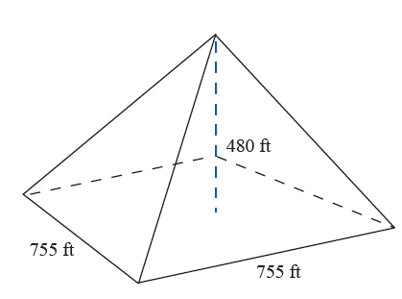

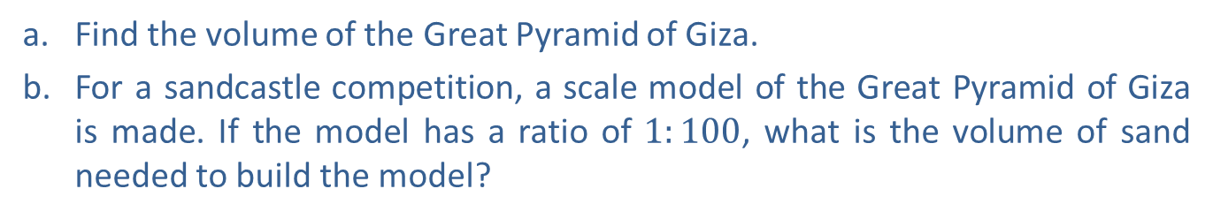
Example 9: Using the Volume of a Square Pyramid—Slide 1
The Great Pyramid of Giza was originally about $480 ft$ tall with a square base whose sides measured about $755 ft$ long.
Figure 11
a. Find the volume of the Great Pyramid of Giza.
b. ​For a sandcastle competition, a scale model of the Great Pyramid of Giza is made. If the model has a ratio of $1:100$, what is the volume of sand needed to build the model?

Slide 37
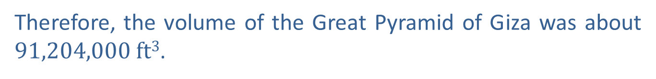
Example 9: Using the Volume of a Square Pyramid—Slide 2
Solution
a. ​The formula for the volume of a square pyramid is
The Great Pyramid of Giza has a height of 480 feet and each side of the base is 755 feet long. Substituting these values into the formula, we have the following.
  Therefore, the volume of the Great Pyramid of Giza was about $91,204,000 ft3$.

Slide 38
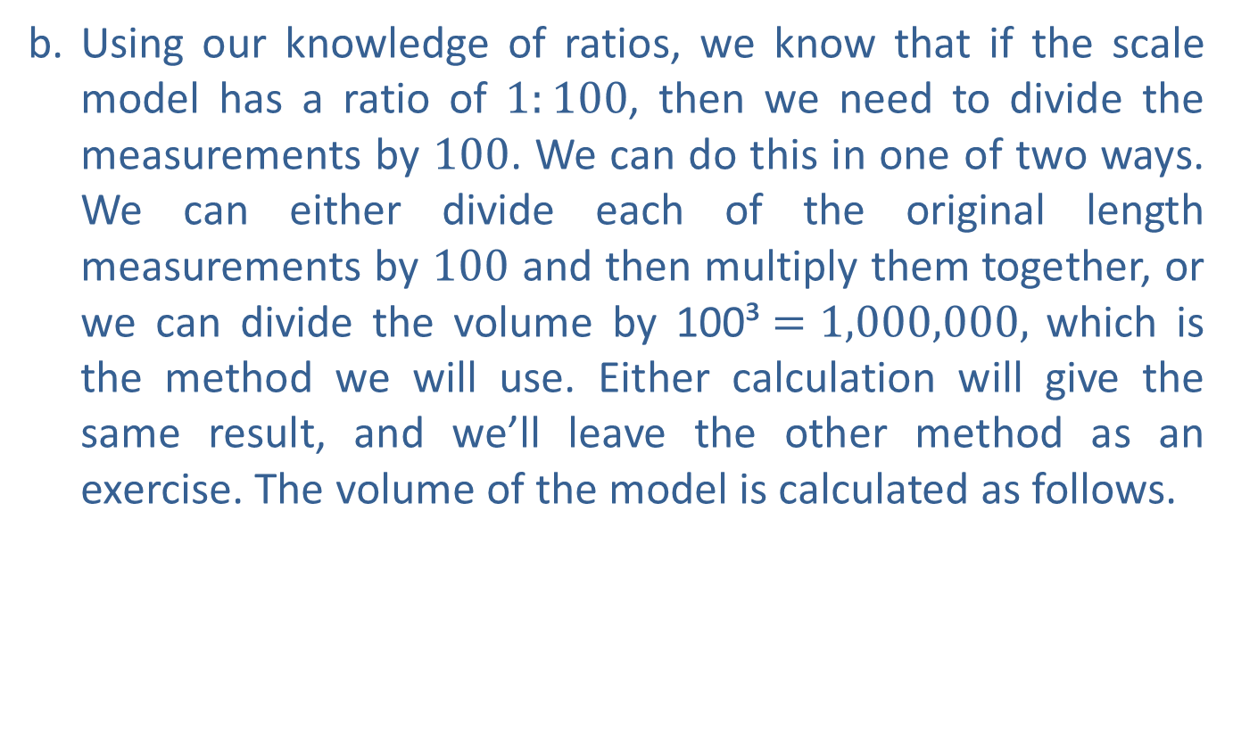
Example 9: Using the Volume of a Square Pyramid—Slide 3
b. Using our knowledge of ratios, we know that if the scale model has a ratio of $1:100$, then we need to divide the measurements by 100. We can do this in one of two ways. We can either divide each of the original length measurements by 100 and then multiply them together, or we can divide the volume by 100³$=1,000,000,$ which is the method we will use. Either calculation will give the same result, and we’ll leave the other method as an exercise. The volume of the model is calculated as follows.
​
Therefore, the model pyramid will require $91.204 ft$³ of sand.

Slide 39
Skill Check 2
Show that dividing each of the original measurements in Example 9 by 100 before using the formula produces the same volume found in part b.

Slide 40
Example 10: Comparing Volumes—Slide 1
Suppose you want to build a swimming pool in your backyard. The city in which you live has a restriction on the volume of water that the pool can hold. Pools may contain at most 4800 cubic feet of water. Your plans are to a build a pool that is 16 feet wide, 24 feet long, and has a depth that varies from 2 feet to 12 feet on a constant slope. Does the pool meet the restrictions required by the city?
Solution
To begin, let's use some of the problem-solving techniques from an earlier Chapter 1. By drawing a picture of the pool with views from both the top and side, we can better understand what is being asked. Figure 12 shows the top view of the swimming pool while Figure 13 shows the side view of the pool sloping from a depth of 2 feet to a depth of 12 feet.

Slide 41
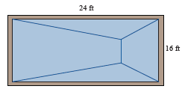
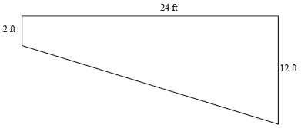
Example 10: Comparing Volumes—Slide 2
Figure 12: Top View of the Pool
Figure 13 Side View of the Pool
Notice from the side view that the pool is actually in the shape of a trapezoid. Although Table 1 does not list a formula for the volume of a solid in the shape of a trapezoid, we can find the volume by finding the area of the trapezoid and multiplying it by the width of the pool (16 feet).

Slide 42
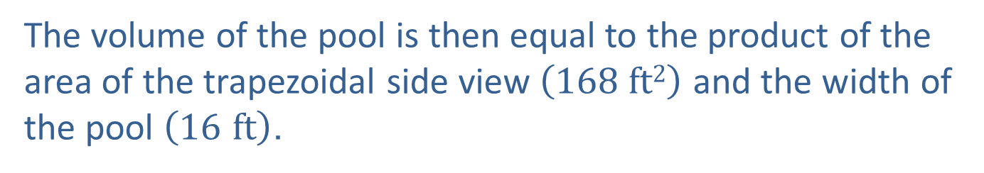
Example 10: Comparing Volumes—Slide 3
The formula for the area of a trapezoid is
where b₁ and b₂ are the lengths of the bases and h is the height. In this case, the lengths of the bases are 2 feet and 12 feet and the height is 24 feet. Substituting these values in the area formula, we have the following.
The volume of the pool is then equal to the product of the area of the trapezoidal side view $\left(168 ft2\right)$ and the width of the pool $\left(16 ft\right)$.

Slide 43

Example 10: Comparing Volumes—Slide 4
The volume of the pool is then equal to the product of the area of the trapezoidal side view (168 ft²) and the width of the pool $\left(16 ft\right)$.
Now we need to answer the initial question of whether a pool with these dimensions meets the restrictions set by the city. The answer is yes, the pool meets the restrictions because the volume of the pool (2688 ft³) is less than the maximum volume allowed by the city (4800 ft³) .

Slide 44
Example 11: Finding the Dimensions of a Right Circular Cylinder—Slide 1
A farmer wishes to build a grain silo in the shape of a right circular cylinder capable of storing 400,000 cubic feet of grain. City ordinances say the silo can be no taller than 100 feet. Determine a set of dimensions for a silo that satisfies the city's restrictions and meets the needs of the farmer.

Slide 45
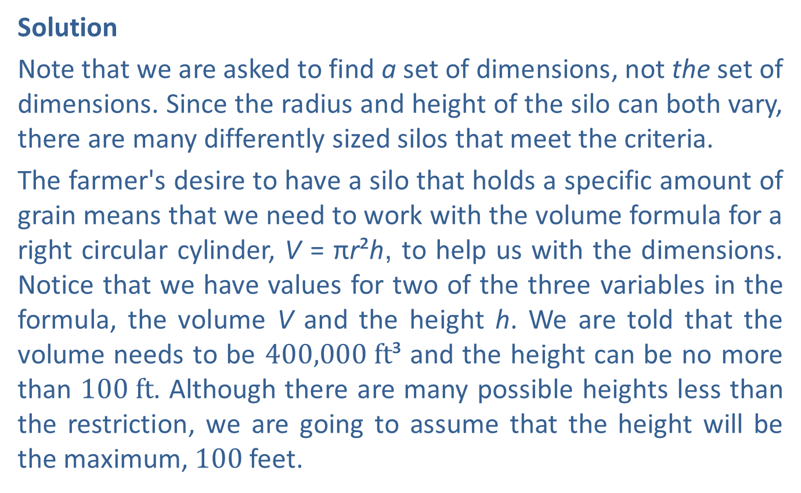
Example 11: Finding the Dimensions of a Right Circular Cylinder—Slide 2
Solution
Note that we are asked to find a set of dimensions, not the set of dimensions. Since the radius and height of the silo can both vary, there are many differently sized silos that meet the criteria.
The farmer's desire to have a silo that holds a specific amount of grain means that we need to work with the volume formula for a right circular cylinder, V = πr²h, to help us with the dimensions. Notice that we have values for two of the three variables in the formula, the volume V and the height h. We are told that the volume needs to be $400,000 ft$³ and the height can be no more than $100 ft$. Although there are many possible heights less than the restriction, we are going to assume that the height will be the maximum, 100 feet.

Slide 46
Example 11: Finding the Dimensions of a Right Circular Cylinder—Slide 3
Thus, we are left to find the radius of the base to determine the full dimensions of the silo. Using the formula for the volume of a cylinder, we can calculate the radius as follows.
Therefore, at 100 feet tall, in order for the silo to hold 400,000 cubic feet of grain, the radius should be approximately 35.68 feet.

Slide 47
Helpful Hint
Note that when we divide cubic feet by a foot, the result is in square feet.

Slide 48

Skill Check 3
Determine another set of dimensions for a silo with V = 400,000 ft³, as in Example 11, using a height of 85 feet.
Answer: r $≈38.70 ft$, h$=85 ft$

Slide 49
Example 12: Finding the Dimensions of a Conical Frustrum—Slide 1
The I Scream, U Scream Ice Cream shop is famous for their 0.5 L ice cream sundae. They had a special cup (instead of a cone) created just for them. The cup is in the shape of a conical frustum. (If we cut the top—or bottom depending on the orientation—off of a cone, we get a conical frustum, as shown in the figure, where the top radius is R₁, the bottom radius is R₂, and the height is h.)

Slide 50
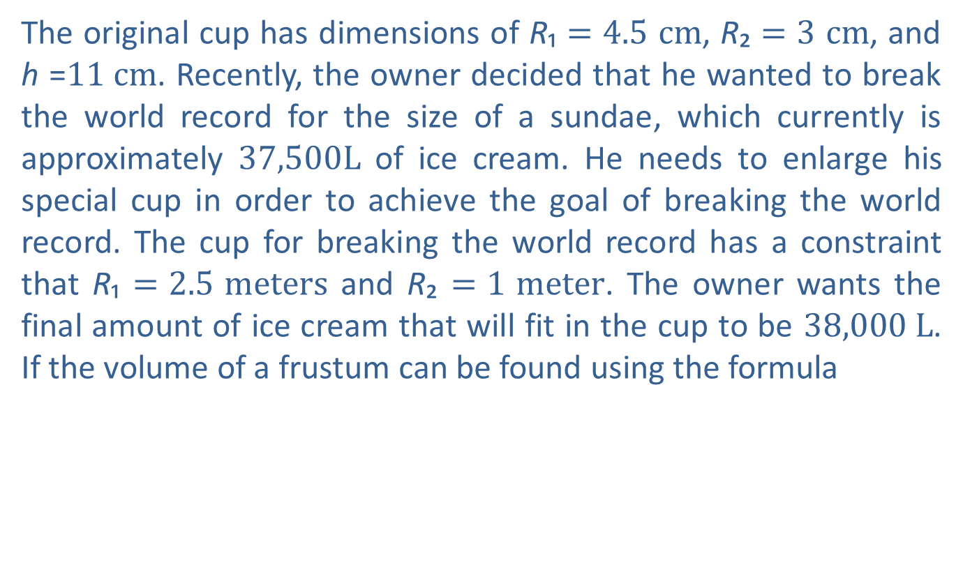
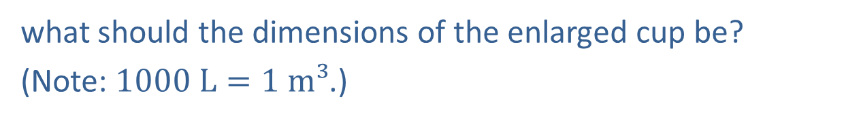
Example 12: Finding the Dimensions of a Conical Frustrum—Slide 2
The original cup has dimensions of R₁ $=4.5 cm$, R₂ $=3 cm$, and h =$11 cm$. Recently, the owner decided that he wanted to break the world record for the size of a sundae, which currently is approximately $37,500L$ of ice cream. He needs to enlarge his special cup in order to achieve the goal of breaking the world record. The cup for breaking the world record has a constraint that R₁ $=2.5 meters$ and R₂ $=1 meter$. The owner wants the final amount of ice cream that will fit in the cup to be $38,000 L$. If the volume of a frustum can be found using the formula
what should the dimensions of the enlarged cup be?
(Note: $1000 L=1 m³$.)

Slide 51

Example 12: Finding the Dimensions of a Conical Frustrum—Slide 3
Solution
Notice that with the constraints that were given (R₁ $= 2.5 m$,
R₂ $= 1 m$, and V $=38,000 L$), the only dimension that is unknown is the height (h) of the cup. We need to substitute these values into the formula for the volume and solve for h.​

Slide 52
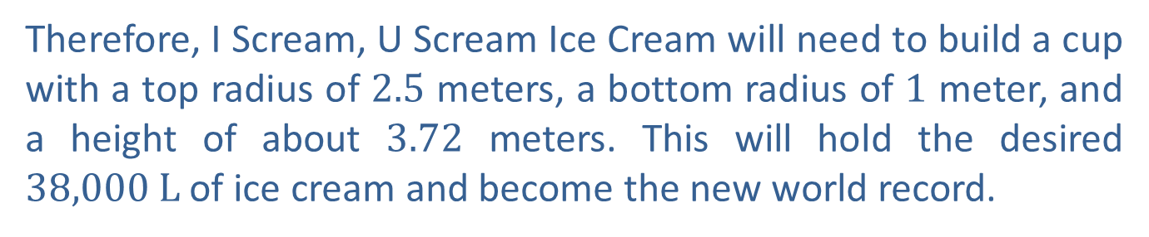
Example 12: Finding the Dimensions of a Conical Frustrum—Slide 4
We now need to use a conversion factor for liters and meters: 1000 L = 1 m³.
Placing liters in the denominator gives us the fraction
Therefore, I Scream, U Scream Ice Cream will need to build a cup with a top radius of 2.5 meters, a bottom radius of 1 meter, and a height of about 3.72 meters. This will hold the desired $38,000 L$ of ice cream and become the new world record.

Slide 53
Fun Fact—Slide 3
Just as with two dimensional surfaces, tessellating with geometric shapes is also used in three dimensions. By using a mesh of smaller shapes, computer animation and 3D printing is made possible.
In fact, in 2019, physicist and computer scientist Tony Derose won his second technical Oscar for his work in computer graphics. The academy of Motion Picture Arts and Sciences honored Derose and his fellow innovators at Pixar with their "pioneering advancement of the underlying science of subdivision surfaces as 3D geometric modeling primitives."

