Slide 1
Section 9.3
Angles and Trigonometry

Slide 2
Think Back—Slide 1
In geometry, the vertex is the common point where two or more lines, curves, or edges meet.

Slide 3
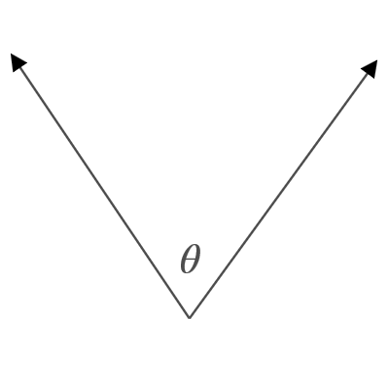

Properties: Labeling Angles—Slide 1
There are three common ways of labeling angles.
Figure 1: $∠\text{θ}$
Using a letter of the Greek alphabet such as θ or ψ.

Slide 4
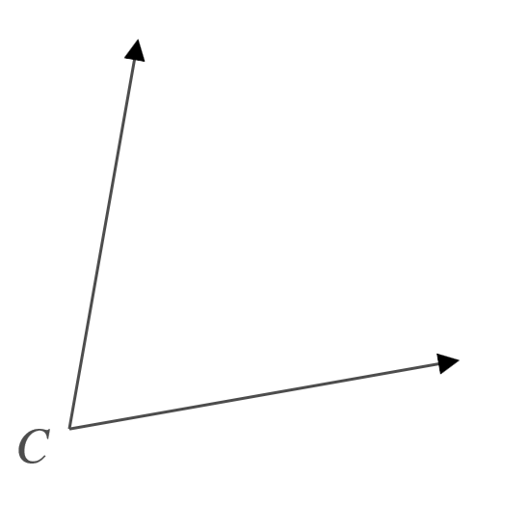
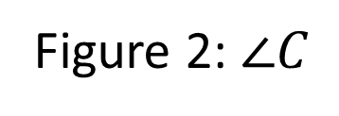
Properties: Labeling Angles—Slide 2
Figure 2: $∠C$
Using a single number or capital letter.

Slide 5
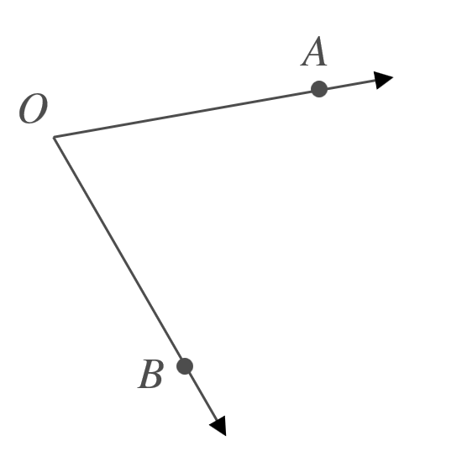

Properties: Labeling Angles—Slide 3
Figure 3: $∠$AOB
Using three capital letters with the vertex as the middle letter.

Slide 6
Think Back—Slide 2
A line may be denoted using any two of its points. For instance, the line passing through the points A and B is written as

Slide 7
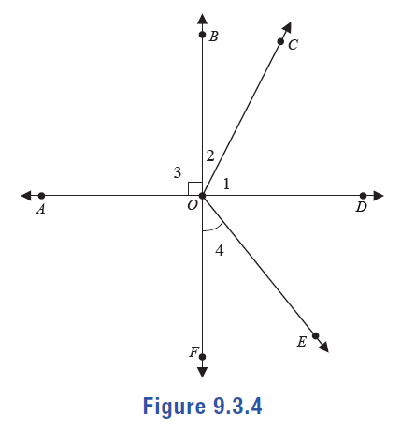
Example 1: Calculating Measurements of Angles—Slide 1
are straight lines.
In the figure shown,
Figure 4

Slide 8

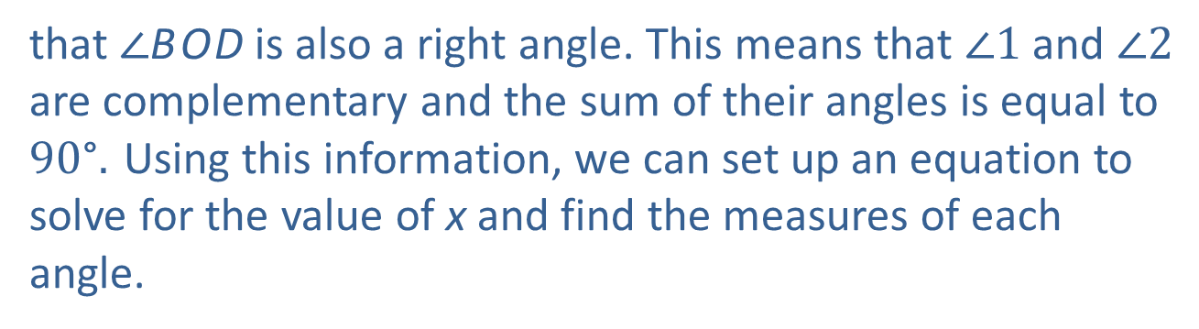

Example 1: Calculating Measurements of Angles—Slide 2
a. ​If m$⁡∠1$ is (26x $−$ 7)° and m$⁡∠2$ is (2x + 13) °find the measures of $∠1$ and $∠2$.
b. ​The measure of $∠$B O E is ${20\text{°}}^{ }$more than four times the measure of $∠4$. Find the measure of both angles.
c. Identify the two pairs of vertical angles.
Solution
a. ​Since
is a straight line and $∠3$ is a right angle we know
that $∠$B O D is also a right angle. This means that $∠1$ and $∠2$ are complementary and the sum of their angles is equal to ${90\text{°}.}^{ }$Using this information, we can set up an equation to solve for the value of x and find the measures of each angle.

Slide 9
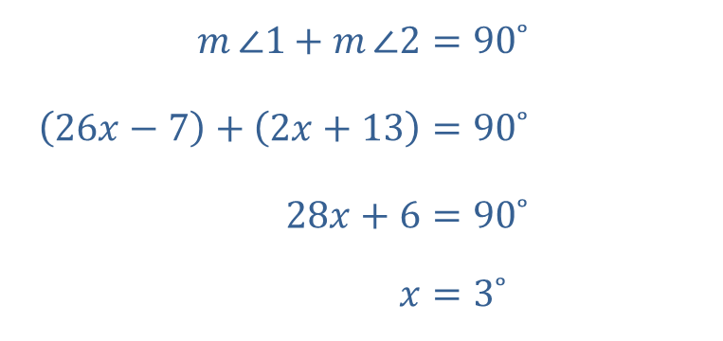
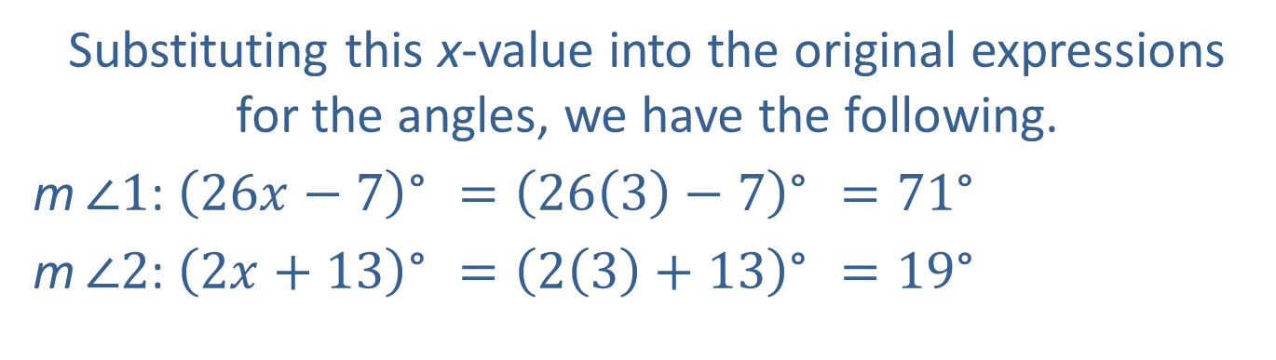
Example 1: Calculating Measurements of Angles—Slide 3
​$m{∠1}+m{∠2}$ | ​$={90˚}^{ }$
​$\left(26x−7\right)+\left(2x+13\right)$ | ​$={90˚}^{ }$
​$28x+6$ | ​$=90˚$
​$x$ | ​$={3˚}^{ }$
​​Substituting this x-value into the original expressions for the angles, we have the following.
m$⁡∠1$: ${\left(26x−7\right)\text{°}}^{ }={\left(26\left(3\right)−7\right)\text{°}}^{ }={71\text{°}}^{ }$
​m$⁡∠2$: ${\left(2x+13\right)\text{°}}^{ }={\left(2\left(3\right)+13\right)\text{°}}^{ }={19\text{°}}^{ }$

Slide 10
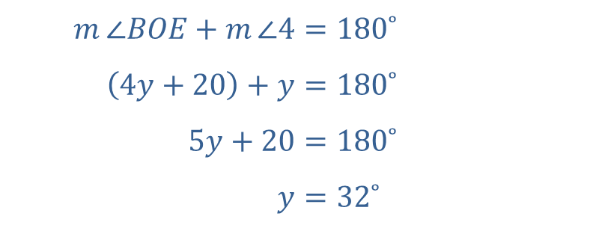

Example 1: Calculating Measurements of Angles—Slide 4
b. ​Begin by writing down $∠$B O E in algebraic terms relating to $∠4$. We will let m $∠4 =$y. We are told that if the m$⁡∠4$ is multiplied by four and added to 20, we have the measure of $∠$B O E. Thus, m$∠$B O E $=4\text{y}+20$.
We also know that since $∠$B O E and $∠4$ are supplementary angles, the sum of their angles is equal to ${180\text{°}.}^{ }$Using this information, we can set up an equation to determine the angle measures.
​$m{∠BOE}+m{∠4}$ | ​$={180˚}^{ }$
​$\left(4y+20\right)+y$ | ​$={180˚}^{ }$
​$5y+20$ | ​$={180˚}^{ }$
​$y$ | ​$={32˚}^{ }$
Thus, $∠4$ measures ${32\text{°}}^{ }$and $∠$B O E measures 4(32$\text{°}$) $+ {20\text{°}}^{ }$or ${148\text{°}.}^{ }$

Slide 11
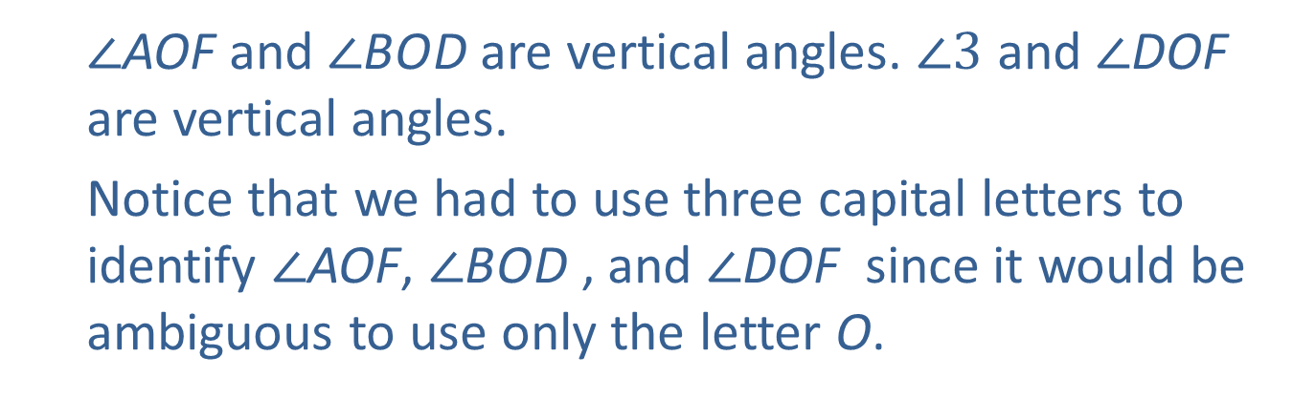
Example 1: Calculating Measurements of Angles—Slide 5
c. ​Vertical angles are the opposite angles formed when two lines intersect. The intersection of lines
form two sets of vertical angles.
$∠$AOF and $∠$B O D are vertical angles. $∠3$ and $∠$DOF are vertical angles.
Notice that we had to use three capital letters to identify $∠$AOF, $∠$B O D , and $∠$DOF since it would be ambiguous to use only the letter O.

Slide 12
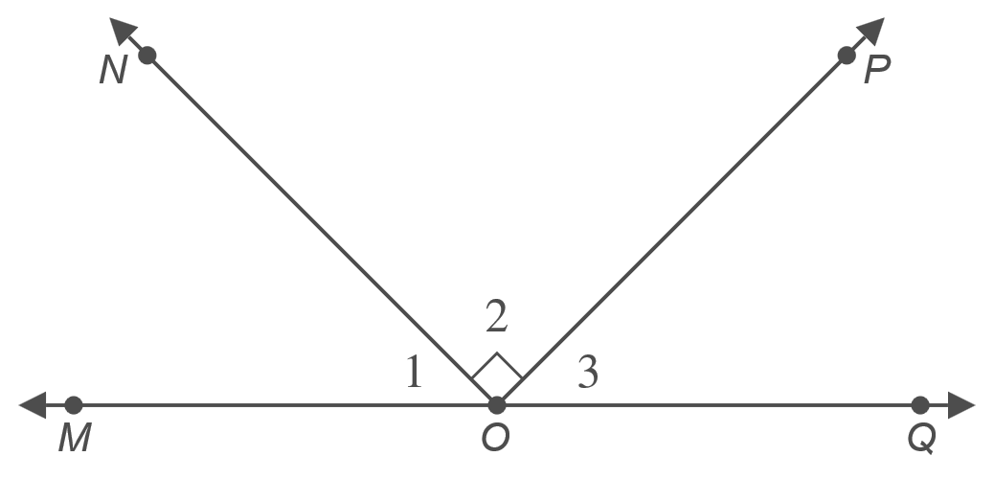
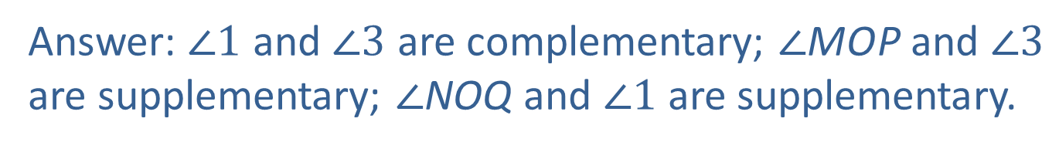
Skill Check 1
In the figure,
is a straight line. Identify all pairs of
complementary and supplementary angles.
Figure 5
Answer: $∠1$ and $∠3$ are complementary; $∠$M O P and $∠3$ are supplementary; $∠$NOQ and $∠1$ are supplementary.

Slide 13
Think Back—Slide 3
Two lines in the same plane are parallel if their slopes are equal, signifying that they never intersect one another.

Slide 14
Definition: Transversal and Congruent Angles
Transversal
A transversal is a line in a plane that intersects two or more lines in that same plane at different points.
Congruent Angles
Two angles of equal measure are said to be congruent to one another.

Slide 15
Math Milestone
The Greek astronomer and mathematician Eratosthenes calculated the earliest known circumference of the Earth. Although the method he used was lost, alternate interior angles are used to recreate our best guess at his accomplishment.

Slide 16
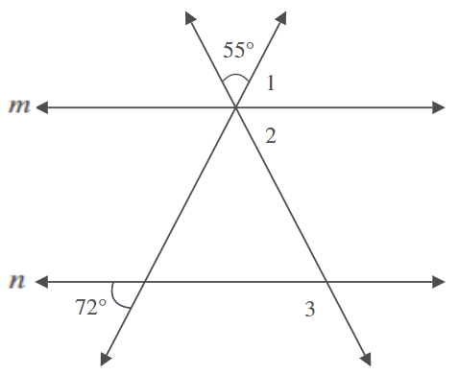
Example 2: Calculating Angles—Slide 1
In Figure 6, lines m and n are parallel. Find the measures of angles 1, 2, and 3.
Figure 6

Slide 17
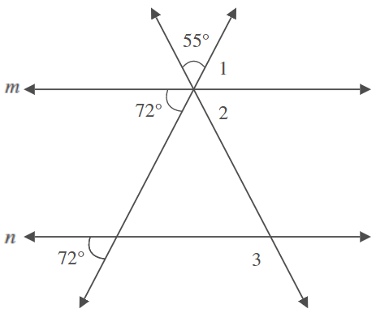

Example 2: Calculating Angles—Slide 2
Solution
In order to find the measure of $∠1$, we need to use some of the angles not yet labeled. Among the many different approaches, let's use the angle whose measurement is ${72°.}^{ }$The corresponding angle on line m will be congruent and also measure ${72°}^{ }$as shown in Figure 7.
Figure 7

Slide 18
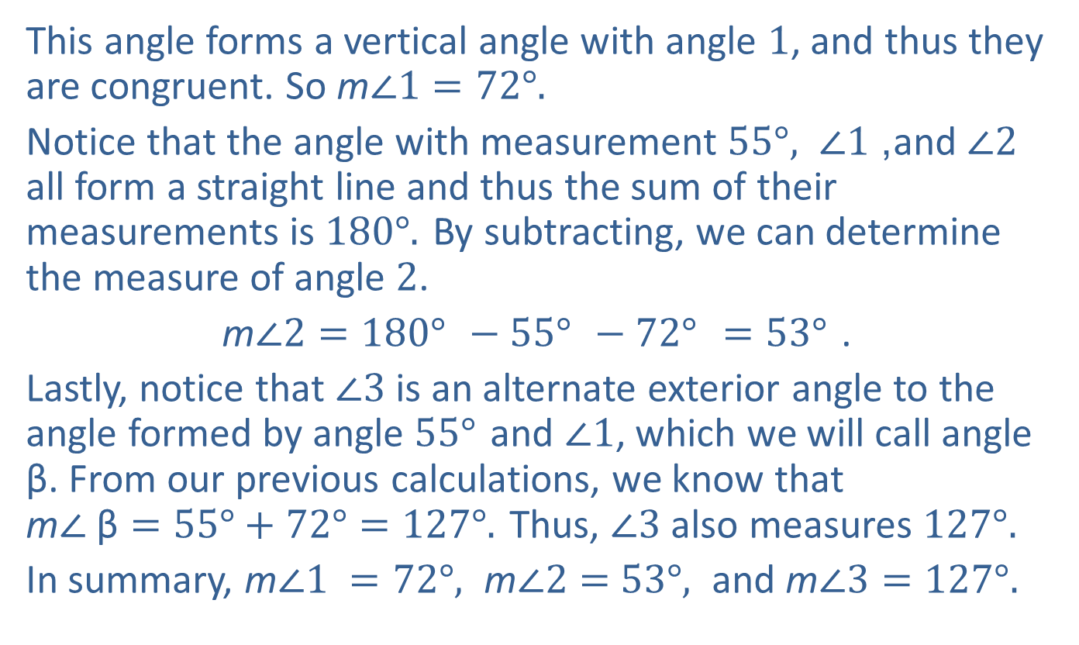
Example 2: Calculating Angles—Slide 3
This angle forms a vertical angle with angle 1, and thus they are congruent. So m$∠1={72°.}^{ }$
Notice that the angle with measurement ${55°,}^{ }∠1$, and $∠2$ all form a straight line and thus the sum of their measurements is ${180°.}^{ }$By subtracting, we can determine the measure of angle 2.
m$∠2={180°}^{ }−{55°}^{ }−{72°}^{ }={53°}^{ }$.
Lastly, notice that $∠3$ is an alternate exterior angle to the angle formed by angle ${55°}^{ }$and $∠1$, which we will call angle β. From our previous calculations, we know that m$∠ \text{β}=55°+72°={127°.}^{ }$Thus, $∠3$ also measures ${{127°.}^{ }}^{ }$
In summary, m$∠1 ={72°,}^{ }\text{m}∠2=$ $53°,$ and m$∠3={127°.}^{ }$

Slide 19
Fun Fact—Slide 1
Pappus of Alexandria, a fourth-century Greek mathematician noted that the bee is an expert mathematician when it comes to building their honeycombs.
"Though God has given to men the best and most perfect understanding of wisdom and mathematics, he has allotted a partial share to some of the unreasoning creatures as well…This instinct is specially marked among bees. They prepare for the reception of the honey the vessels called honeycombs, with cells all equal, similar and adjacent, and hexagonal in form."

Slide 20
Think Back—Slide 4
A regular polygon is a polygon where all sides have equal length and all angles are congruent.

Slide 21
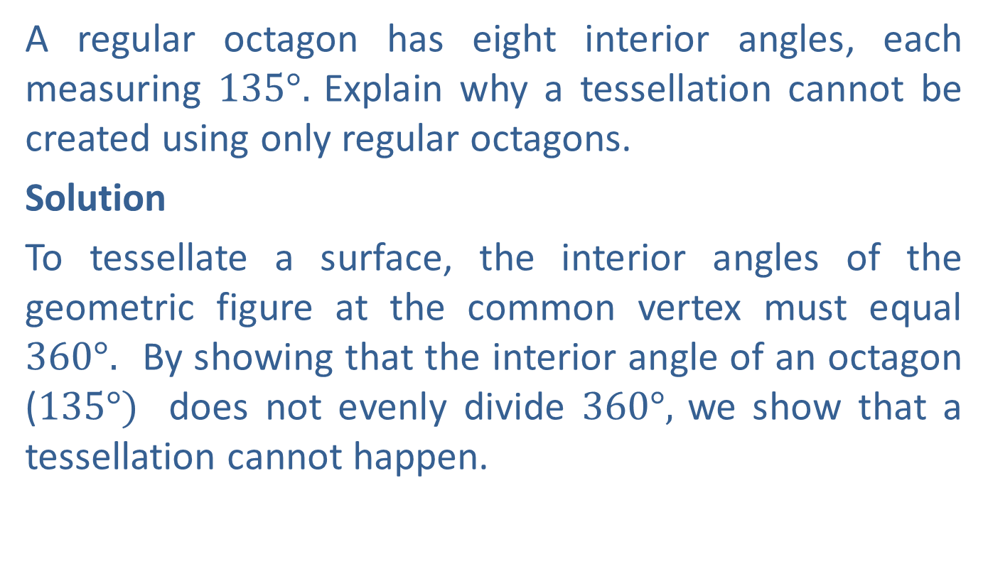
Example 3: Determining Whether Shapes Will Tessellate—Slide 1
A regular octagon has eight interior angles, each measuring ${135°.}^{ }$Explain why a tessellation cannot be created using only regular octagons.
Solution
To tessellate a surface, the interior angles of the geometric figure at the common vertex must equal ${360°.}^{ }$ By showing that the interior angle of an octagon (${135°)}^{ }$ does not evenly divide ${360°,}^{ }$we show that a tessellation cannot happen.

Slide 22
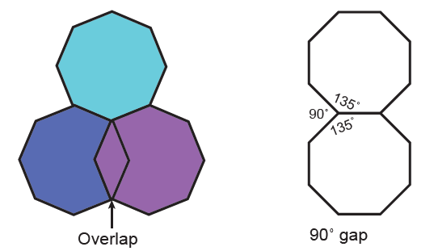
Example 3: Determining Whether Shapes Will Tessellate—Slide 2
From this we know that placing three octagons will create an overlap, while having only two octagons leaves a gap. Thus, regular octagons will not create a tessellation.
Figure 10

Slide 23
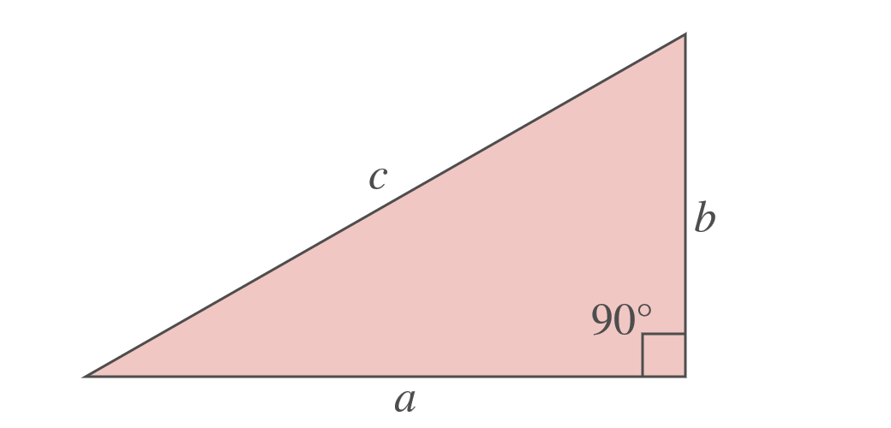
Theorem: Pythagorean Theorem
In a right triangle, the square length of the hypotenuse is equal to the sum of the squares of the lengths of the other two sides.
a² + b² = c²
Figure 12
Here, a and b are the are the legs and c is the hypotenuse.

Slide 24
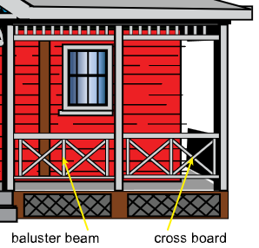
Example 4: Using the Pythagorean Theorem—Slide 1
A new front porch railing is being installed and will look as pictured in Figure 13. The vertical beams, or balusters, will be 20 inches apart and 18 inches high. Determine the length of the boards that will make the crosses between the balusters.
Figure 13

Slide 25
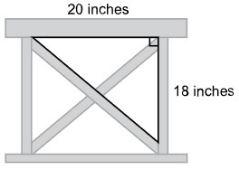
Example 4: Using the Pythagorean Theorem—Slide 2
Solution
Notice that the cross boards form right triangles with the baluster beams. Each triangle has legs that are 20 inches wide and 18 inches long, while the cross board is the hypotenuse.
Figure 14

Slide 26
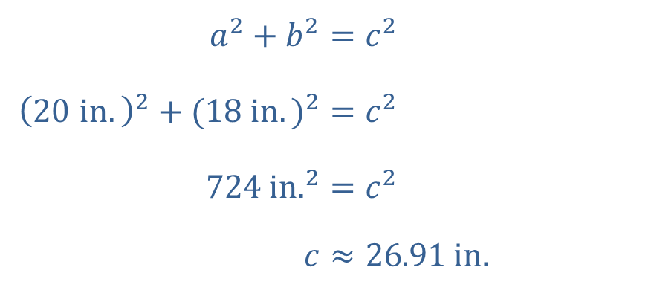
Example 4: Using the Pythagorean Theorem —Slide 3
We can use the Pythagorean Theorem to solve for the length of the cross board.
​$a^{2}+b^{2}$ | ​$=c^{2}$
​${\left(20 in.\right)}^{2}+{(18 in.)}^{2}$ | ​$=c^{2}$
​${724 in.}^{2}$ | ​$=c^{2}$
​$c$ | ​$≈26.91 in.$
Each cross board needs to be approximately 26.91 inches long.

Slide 27
Example 5: Using the Pythagorean Theorem—Slide 1
A carpenter builds custom bookcases in a workshop and then installs them in customers' homes. Once built, a bookcase is brought into the home and laid front side down before being stood upright. The carpenter must ensure that once the bookcase is ready to install, it does not hit the ceiling when it is set upright in the room.
a. ​If the bookcase is 12 inches deep and the ceiling is 10 feet high, what is the maximum height the carpenter can build the bookcase and not hit the ceiling when it is set upright?
b. Determine a general formula that the carpenter can use when building bookcases so that he can always know the maximum height of any bookcase given its depth and the ceiling height.

Slide 28
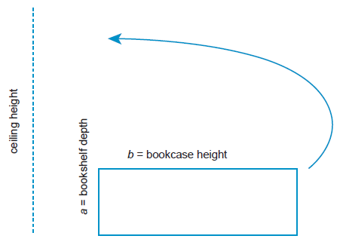
Example 5: Using the Pythagorean Theorem—Slide 2
Solution
a. ​Begin by sketching the situation.
​
Figure 15
​Notice that the longest part of the bookcase is not its height (b), but its diagonal across the side (c), as shown in Figure 16. The carpenter needs to make sure that the length of this diagonal is less than the height of the ceiling.

Slide 29
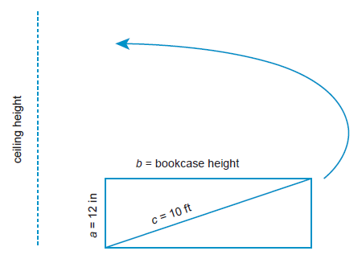
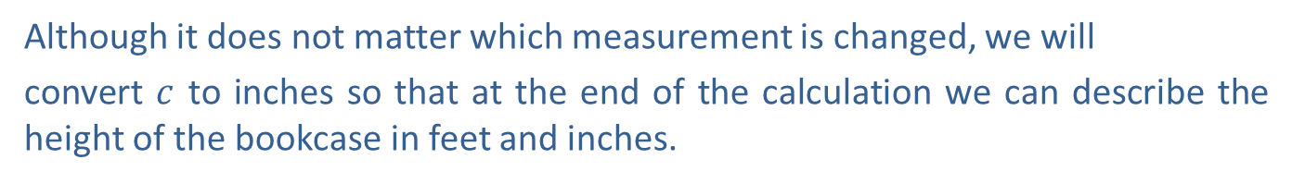
Example 5: Using the Pythagorean Theorem—Slide 3
Figure 16
Using the Pythagorean Theorem, we can determine the maximum bookcase height. Before substituting the values into the formula though, we need to
convert the measurements into the same units using the conversion factor
Although it does not matter which measurement is changed, we will
convert $c$ to inches so that at the end of the calculation we can describe the height of the bookcase in feet and inches.

Slide 30
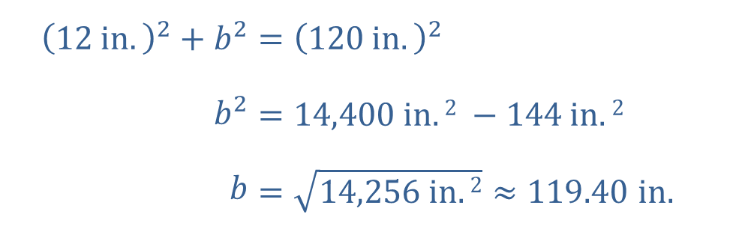
Example 5: Using the Pythagorean Theorem—Slide 4
​Now substitute into the formula and solve for b.
​${\left(12 in.\right)}^{2}+b^{2}$ | ​$={\left(120 in.\right)}^{2}$
​$b^{2}$ | ​$=14,400 in.2 −144 in.2$
​$b$ | ​$=\sqrt{14,256 in.2}≈119.40 in.$
So the bookcase must be less than 119.4 inches tall, which is approximately 9 feet 5 inches.

Slide 31
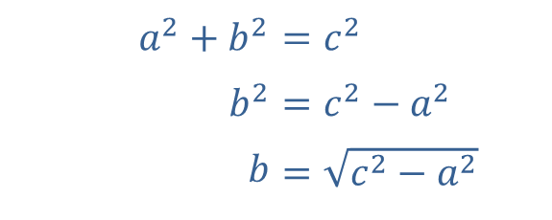

Example 5: Using the Pythagorean Theorem—Slide 5
b. We can rearrange the Pythagorean Theorem to solve for $b$ (the bookcase height) in terms of the ceiling height and the depth of the bookcase.
​​
​$a^{2}+b^{2}$ | ​$=c^{2}$
​$b^{2}$ | ​$=c^{2}−a^{2}$
​$b$ | ​$=\sqrt{c^{2}−a^{2}}$
Because the bookcase height must be less than the height of the ceiling, we need to use the less than inequality in the formula,
Therefore, we have the following general formula the carpenter can use to construct bookshelves that will not hit the ceiling when put upright.

Slide 32
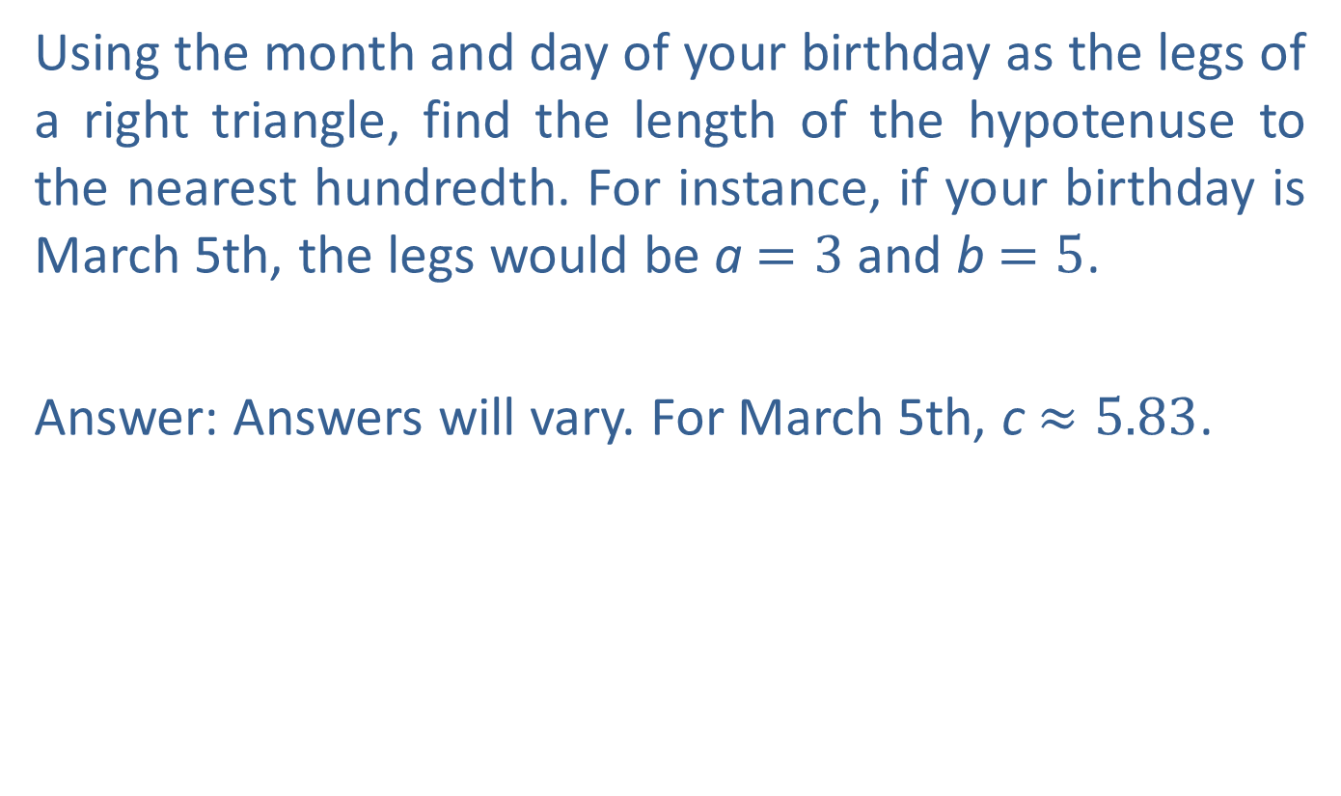
Skill Check 2
Using the month and day of your birthday as the legs of a right triangle, find the length of the hypotenuse to the nearest hundredth. For instance, if your birthday is March 5th, the legs would be a $=3$ and b$=5$.
Answer: Answers will vary. For March 5th, c$≈5.83$.

Slide 33
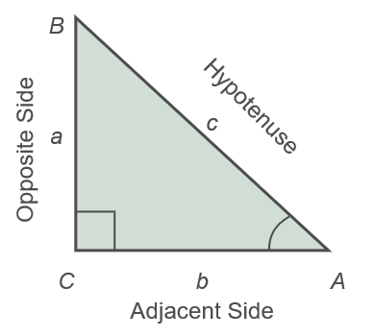
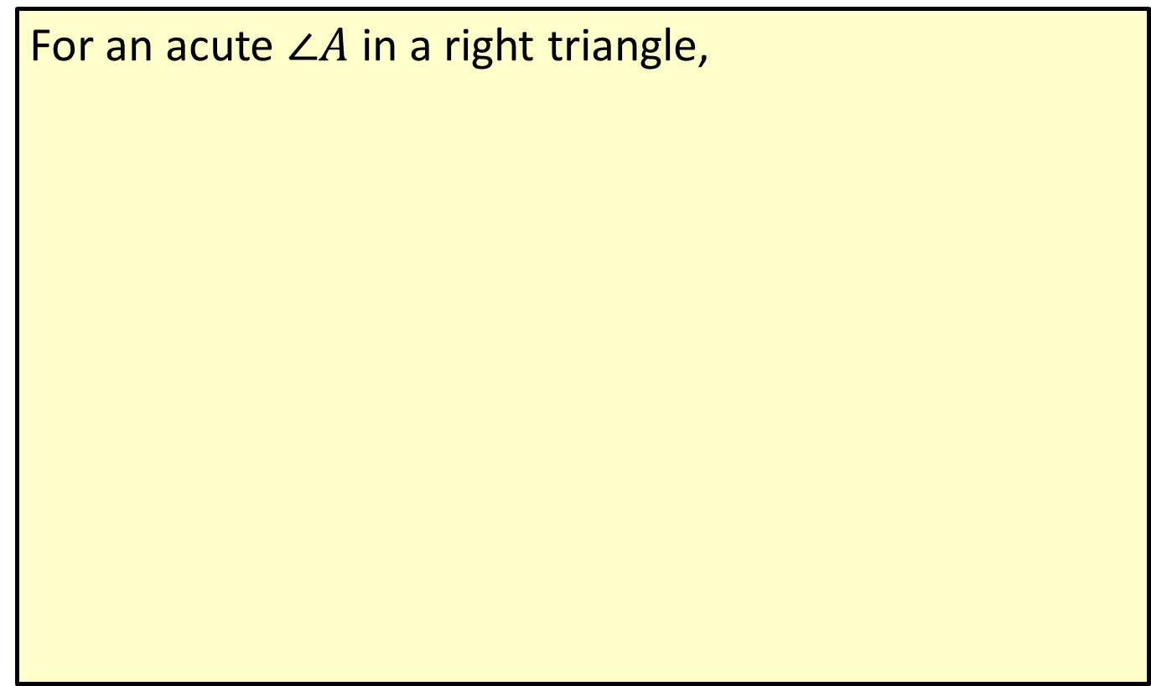
Definition: Sine, Cosine, and Tangent
For an acute $∠A$ in a right triangle,
Figure 18

Slide 34
Helpful Hint—Slide 1
The reciprocals of each trig function also have a formal name: Cosecant (csc), Secant (sec), and Cotangent (cot).

Slide 35
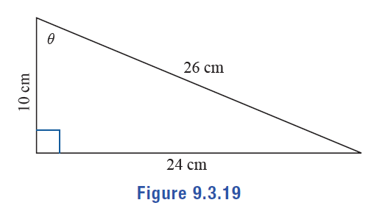

Example 6: Calculating Trigonometric Ratios
A right triangle with hypotenuse of length $26 cm$ and legs of lengths $10 cm$ and $24 cm$ is shown in Figure 19, with one of the acute angles labeled θ. Find the values of $sin⁡\text{θ}$, $cos⁡\text{θ}$, and $tan⁡\text{θ}$. Leave your answer as a reduced fraction.
Figure 19
Solution

Slide 36
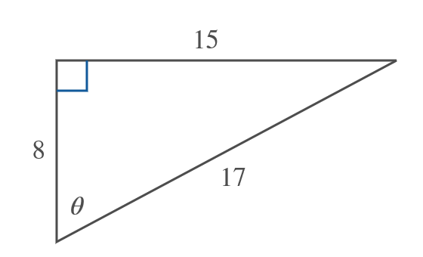
Skill Check 3
Find $sin⁡$θ, $cos⁡$θ, and $tan⁡$θ.
Figure 20

Slide 37
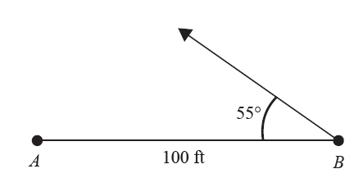
Example 7: Solving for Unknowns in a Right Triangle—Slide 1
A contractor is marking the property corners on a new construction site. She has marked the location of the first two corners, points A and B, which are 100 feet apart. The next corner will be 72 feet from point B at an angle of 55°. Using only a surveyor's rope and string, she needs to mark the 55° angle at point B. Determine how she can create this angle using a right triangle.
Figure 21

Slide 38
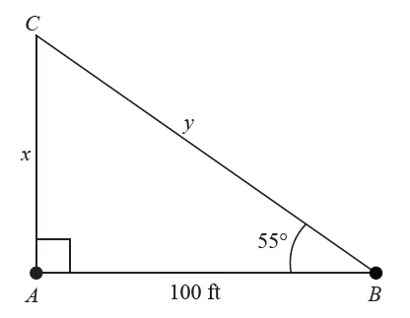

Example 7: Solving for Unknowns in a Right Triangle—Slide 2
Solution
Begin by forming a right triangle with the right angle at point $A$ as illustrated in Figure 22. Using the trigonometric ratios, we can find the lengths of the opposite side x and the hypotenuse y. The angle (${55˚\text{)}}^{ }$ and the adjacent side (100 feet) are known.
Figure 22

Slide 39
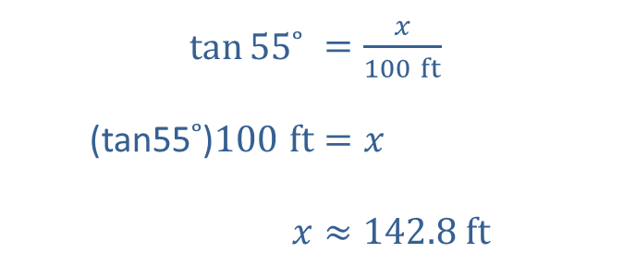
Example 7: Solving for Unknowns in a Right Triangle—Slide 3
Length of Side x:
The trigonometric function involving the opposite side and the
adjacent side is the tangent function,
​
So using the tangent function gives the following.
​$tan⁡{55˚}^{ }$ | ​$=\frac{x}{100 ft}$
​(tan55$˚\text{)}100 ft$ | ​$=x$
​$x$ | ​$≈142.8 ft$

Slide 40
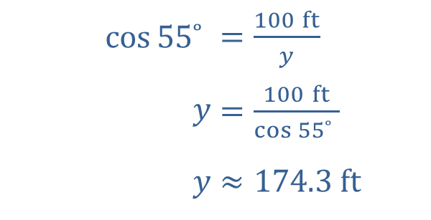
Example 7: Solving for Unknowns in a Right Triangle—Slide 4
Length of Side y:
The trigonometric function involving the hypotenuse and the adjacent side is
the cosine function,
So using the cosine function gives the following.
​$cos⁡{55˚}^{ }$ | ​$=\frac{100 ft}{y}$
​$y$ | ​$=\frac{100 ft}{\cos{{55˚}^{ }}}$
​$y$ | ​$≈174.3 ft$
Thus, to create a 55° angle, the contractor needs to make a right triangle with sides measuring 100 feet and 142.8 feet, and a hypotenuse measuring 174.3 feet. The contractor would then need to measure 72 feet along the hypotenuse to mark the next corner.

Slide 41
Tech Tip
To find the values of trigonometric function of angles measured in degrees, the calculator must be set in degree mode.

Slide 42
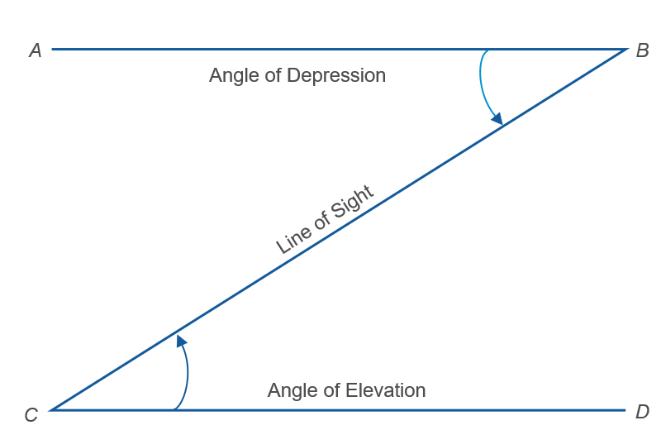
Helpful Hint—Slide 2
When two parallel lines are cut by a transversal, the angle of elevation and the angle of depression are equal to one another because they form alternate interior angles.
Figure 24

Slide 43
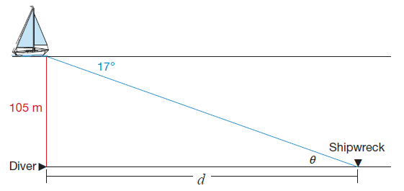
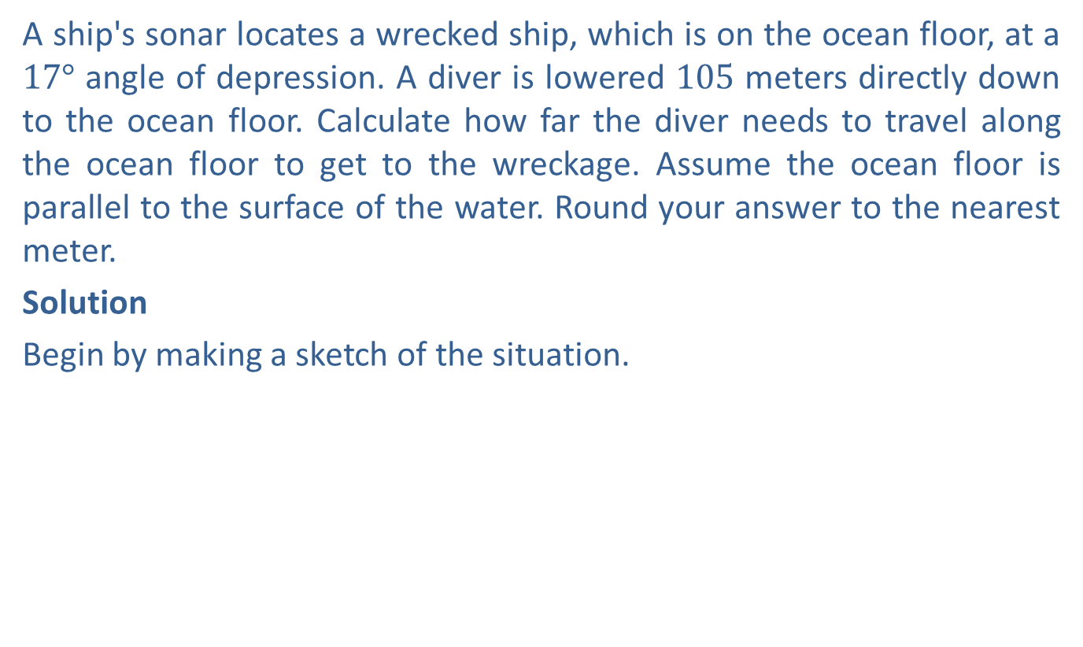
Example 8: Using Angles of Depression—Slide 1
A ship's sonar locates a wrecked ship, which is on the ocean floor, at a ${17°}^{ }$angle of depression. A diver is lowered 105 meters directly down to the ocean floor. Calculate how far the diver needs to travel along the ocean floor to get to the wreckage. Assume the ocean floor is parallel to the surface of the water. Round your answer to the nearest meter.
Solution
Begin by making a sketch of the situation.
Figure 25

Slide 44

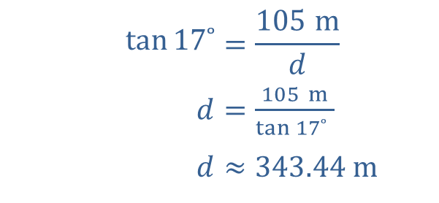
Example 8: Using Angles of Depression—Slide 2
Notice that the angle of depression from the ship to the shipwreck (${17°)}^{ }$ is equal to the angle of elevation from the shipwreck to the ship, θ$,$because they are alternate interior angles. From the sketch, we see that the length of the opposite side is 105 meters and the unknown length d is the adjacent side. Thus, we should use the
tangent function,
to find d.
​$tan⁡17˚$ | $$=\frac{105 m}{d}$$
​$d$ | ​$=\frac{105 m}{\tan{{17˚}^{ }}}$
​$d$ | ​$≈343.44 m$
Therefore, the diver needs to travel approximately 343 meters along the ocean floor to reach the wreckage.

Slide 45
Definition: Inverse Trigonometric Functions
The inverse trigonometric functions are used to find the angle from any trigonometric ratio. The common inverse trigonometric functions are

Slide 46
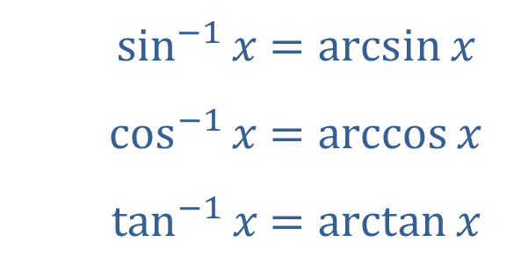
Helpful Hint—Slide 3
Inverse trig functions can also be labeled using "arc."
​$\sin^{−1}⁡x$ | ​$=\arcsin{x}$
​$\cos^{−1}⁡x$ | ​$=\arccos{x}$
​$\tan^{−1}⁡x$ | ​$=\arctan{x}$

Slide 47
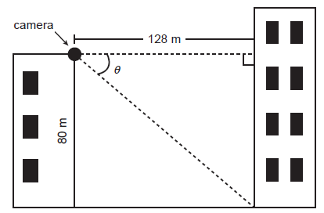
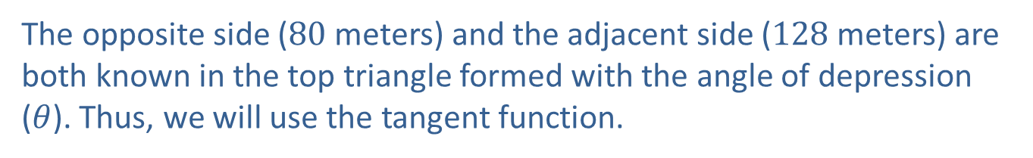
Example 9: Finding the Angle of Depression—Slide 1
A surveillance camera is being installed on the top corner of a building that is 80 meters tall in order to monitor the exit door at the base of a neighboring building. The base of the two buildings are 128 meters apart. Calculate the angle of depression needed for the eye of the camera so that it points directly at the exit door.
Solution
Begin by making a sketch of the situation.
Figure 26
The opposite side (80 meters) and the adjacent side (128 meters) are both known in the top triangle formed with the angle of depression ($θ$). Thus, we will use the tangent function.

Slide 48
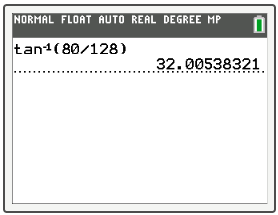
Example 9: Finding the Angle of Depression—Slide 2
To find the angle, we need to use the inverse tangent function.
Using a calculator to solve, press 2nd tan . On your screen, tan⁻¹ (will appear. Enter 80 / 128) and press enter . The calculator will return the value 32.00538321.
Figure 27
Thus, the angle of depression needed for the eye of the camera is approximately 32°.

Slide 49



Skill Check 4
Find m$⁡∠θ$.
Figure 28
Answer: Approximately ${25.5°}^{ }$

Slide 50

Definition: Law of Sines and Law of Cosines
For a triangle where a is the length of the side opposite angle A, b is the length of the side opposite angle B, and c is the length of the side opposite angle C, we have the following.
Figure 29
Law of Sines
Law of Cosines

Slide 51



Example 10: Choosing Between the Law of Sines and the Law of Cosines—Slide 1
Decide whether to use the Law of Sines or the Law of Cosines to solve for the unknown value $x$ in each scenario.

Slide 52

Example 10: Choosing Between the Law of Sines and the Law of Cosines—Slide 2
Solution
a. ​We are given the lengths of two sides and their included angle, and we wish to know the length of the third side. This is enough information to use the Law of Cosines to solve for x.
b. ​In order to use the Law of Sines, you need to know at least three of the
four parts in the proportional equation
In other words, you need one side and its opposite angle in the triangle, in addition to one of the corresponding parts for the unknown pair.
We know the measure of an angle (${50˚\text{)}}^{ }$and its opposite side (11), and we want to calculate the measure of angle x, which is opposite of the side with length 7. So we can use the Law of Sines to solve for x.

Slide 53

Skill Check 5
Determine whether to use the Law of Sines or the Law of Cosines to find the value of x in the triangle.
Figure 32
Answer: Law of Cosines

Slide 54

Example 11: Using the Law of Sines—Slide 1
In order to test a new security system, a drone is flown between two new radar stations that are located 50 miles apart. The angle of elevation of the drone measured by the first station is 36°. The angle of elevation of the drone measured by the second station is 17°. Calculate the altitude (perpendicular height) of the drone when it was detected.
Solution
Begin by making a sketch of the situation. A triangle is formed between the drone and the two stations.
Figure 33

Slide 55



Example 11: Using the Law of Sines—Slide 2
Because the triangle formed by the drone and the stations is not a right triangle, we cannot use the trigonometric functions to find the missing sides. However, we do know that the interior angles of a triangle sum to 180$˚.$ So the unknown interior angle is θ$=180°−36°−17°={127°}^{ }$
Figure 34
We now know an angle (m$∠$A$={127°\text{)}}^{ }$and the length of the side opposite it (a $=50$ miles). We also have the measure of the angle (m$∠$B$={17°\text{)}}^{ }$ opposite the unknown side b. This provides enough information to use the Law of Sines to find a missing side of the triangle.​

Slide 56



Example 11: Using the Law of Sines—Slide 3
​$\frac{\sin{{127˚}^{ }}}{50 mi}$ | ​$=\frac{\sin{{17˚}^{ }}}{b}$
​$b$ | ​$=\frac{\left(\sin{{17˚}^{ }}\right)\left(50 mi\right)}{\sin{{127˚}^{ }}}$
​$b$ | ​$≈18.304 mi$
​The unknown altitude h forms two smaller right triangles. In the smaller right triangle formed with station 1, we know the length of the hypotenuse (18.304 miles) and the measure of an angle (${36°\text{)}.}^{ }$The missing altitude is the side opposite the angle.
Figure 35

Slide 57

Example 11: Using the Law of Sines—Slide 4
With this information, we can use the sine function to find the altitude h.
​$sin⁡{36˚}^{ }$ | ​$=\frac{h}{18.304 mi}$
​$18.304 (\text{​}sin 36˚)$ | ​$=h$
​$10.759 mi$ | ​$≈h$
Thus, the altitude of the drone was approximately 10.759 miles when it was detected.

Slide 58
Helpful Hint—Slide 4
Sine, cosine, and tangent can only be used with right triangles.

Slide 59

Example 12: Using the Law of Cosines—Slide 1
Standing at the peak of Mount Rainier (located in the state of Washington) and looking south, a mountaineer can see two other volcanos: Mount St. Helens (also in Washington) and Mount Hood (in Oregon). From her current location, the mountaineer knows that Mount St. Helens is 50.25 miles away while Mount Hood is 109 miles away. If she approximates the angle that she sees between the two volcanos as $20°$, what is the approximate distance between Mount St. Helens and Mount Hood?

Slide 60


Example 12: Using the Law of Cosines—Slide 2
Standing at the peak of Mount Rainier (located in the state of Washington) and looking south, a mountaineer can see two other volcanos: Mount St. Helens (also in Washington) and Mount Hood (in Oregon). From her current location, the mountaineer knows that Mount St. Helens is 50.25 miles away while Mount Hood is 109 miles away. If she approximates the angle that she sees between the two volcanos as $20°$, what is the approximate distance between Mount St. Helens and Mount Hood?
Solution
Begin by labeling the known parts of the triangle formed by the three volcanos. We know the lengths of
Figure 36

Slide 61



Example 12: Using the Law of Cosines—Slide 3
two sides and the measure of the angle between those two sides. Therefore, we can use the Law of Cosines to find the missing side of the triangle. If we let a be the unknown side, then the measure of angle A is $20°$. Sides b and c are then 50.25 miles and 109 miles, respectively.
Thus, we have enough information to use the Law of Cosines.
​
​$a^{2}$ | ​$=b^{2}+c^{2}−2bc\cos{A}$
​$a^{2}$ | ​$={\left(50.25 mi\right)}^{2}+{\left(109 mi\right)}^{2}−2\left(50.25 mi\right)\left(109 mi\right)(cos$ 20˚)
​$a^{2}$ | ​$≈4112.20{ \text{mi}2}^{ }$
​$a$ | ​$≈64.13 mi$
Mount Hood and Mount St. Helens are approximately 64 miles apart.
Figure 37

Slide 62
Fun Fact—Slide 2
Mount Rainier stands 14,111 feet tall and last erupted in 1894.
Mount Hood stands 11,250 feet tall and last erupted in 1866.
Mount St. Helens stands 8,366 feet tall and last erupted in 2008.

