Slide 1
Section A.4
US and Metric Equivalents

Slide 2
Objectives
Convert between US and metric units of temperature.
Convert between US and metric units of length.
Convert between US and metric units of area.
Convert between US and metric units of capacity
(liquid volume).
Convert between US and metric units of weight
(mass).

Slide 3
Temperature
Definition
U.S. customary measure is in degrees Fahrenheit ( ).
Metric measure is in degrees Celsius (° ).
The two scales are shown here on thermometers. Approximate conversions can be found by reading along a ruler or the edge of a piece of paper held horizontally across the page.

Slide 4
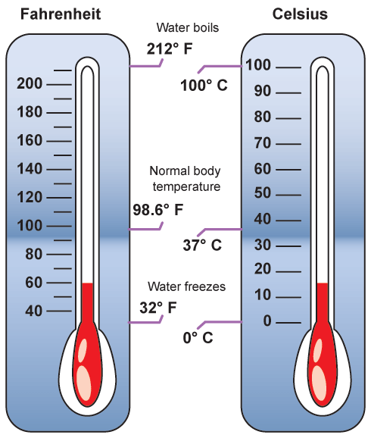
Temperature
Definition (cont.)

Slide 5
Example 1: Equivalent Measures of Temperature
Hold a straight edge horizontally across the two thermometers and you will read:

Slide 6
Temperature Formulas
Formula
F = Fahrenheit temperature and
C = Celsius temperature

Slide 7
Example 2: Converting Units of Temperature
Convert F = 86° to its equivalent measurement in degrees Celsius.
Solution

Slide 8
Example 3: Converting Units of Temperature
Convert C = 35° to its equivalent measurement in degrees Fahrenheit.
Solution

Slide 9
Length
Table 1: Length Equivalents
U.S. to Metric | Metric to U.S.
1 in. = 2.54 cm (exact) | 1 cm ≈ 0.394 in.
1 ft ≈ 0.305 m | 1 m ≈ 3.28 ft
1 yd ≈ 0.914 m | 1 m ≈ 1.09 yd
1 mi ≈ 1.61 km | 1 km ≈ 0.62 mi

Slide 10
Length
Notes
Most of the conversion units are not exact and slightly
different answers are possible, depending on the conversion units used. Generally, we will round conversions to the nearest hundredth.

Slide 11
Example 4: Converting Units of Length
6 in. = ______ cm
25 mi = ______ km
10 km = ______ mi
30 m = ______ ft
100 m = ______ yd
Solution
6 in.

Slide 12
Example 4: Converting Units of Length (cont.)
25 mi
10 km
30 m
100 m
With this information, do you think that a 100 m dash is longer (or shorter) than a 100 yd dash?

Slide 13
Area
Table 2: Area Equivalents
U.S. to Metric | Metric to U.S.
1 in.² ≈ 6.45 cm² | 1 cm² ≈ 0.155 in.²
1 ft² ≈ 0.093 m² | 1 m² ≈ 10.764 ft²
1 yd² ≈ 0.836 m² | 1 m² ≈ 1.196 yd²
1 acre ≈ 0.405 ha | 1 ha ≈ 2.47 acres

Slide 14
Example 5: Converting Units of Area
Convert each measurement, rounding to the nearest hundredth.
40 yd² = ______ m²
100 cm² = _____ in.²
6 acres = _____ ha
5 ha = _____ acres
Solution
40 yd²

Slide 15
Example 5: Converting Units of Area (cont.)
100 cm²
6 acres
5 ha

Slide 16
Volume
Table 3: Volume Equivalents
U.S. to Metric | Metric to U.S.
1 qt ≈ 0.946 L | 1 L ≈ 1.06 qt
1 gal ≈ 3.785 L | 1 L ≈ 0.264 gal

Slide 17
Example 6: Converting Units of Capacity (Liquid Volume)
Convert each measurement, rounding to the nearest hundredth.
20 gal = _____ L
42 L = _____ gal
6 qt = _____ L
Solution
20 gal

Slide 18
Example 6: Converting Units of Capacity (Liquid Volume) (cont.)
42 L
6 qt

Slide 19
Mass
Table 4: Mass Equivalents
U.S. to Metric | Metric to U.S.
1 oz ≈ 28.35 g | 1 g ≈ 0.035 oz
1 lb ≈ 0.454 kg | 1 kg ≈ 2.205 lb

Slide 20
Example 7: Converting Units of Weight (Mass)
5 lb = _____ kg
15 kg = _____ lb
35 oz = _____ g
Solution
5 lb
15 kg

Slide 21
Example 7: Converting Units of Weight (Mass) (cont.)
35 oz

