Slide 1
Section 11.1
Applications of Geometry to the Arts

Slide 2
Objectives
Understand the relationship between mathematics and art/architecture
Understand the use of geometry in art/architecture
Understand the use of the golden ratio, golden rectangles and triangles, and their use in art and architecture

Slide 3
Applications of Geometry to the Arts
To begin our discussion of mathematics in art, we first need to define exactly what art is in order to discuss the mathematics needed to produce art. Do you have a definition for art? As human beings, we are surrounded by art and we often take its influence on our lives for granted.

Slide 4
Art
Art
For the purposes of this book, art will be considered as any endeavor that requires creativity of the mind, whether it is a painting, a sculpture, architecture, a musical composition, etc.

Slide 5
Fibonacci Sequence
Fibonacci Sequence
The Fibonacci sequence is the sequence of numbers
1, 1, 2, 3, 5, 8, 13, 21, 34, 55, 89, 144, . . . that continues infinitely, where each successive number can be found by adding together the previous two numbers in the sequence.

Slide 6
Example 1: The Fibonacci Sequence
Fibonacci’s original version of the sequence goes something like the following.
Start with a pair of rabbits (one male and one female) born on January 1st. Assume that all months are of equal length and that: 1. rabbits begin to produce offspring two months after their own birth; 2. when the rabbits reach the age of two months, each pair produces a mixed pair (one male, one female), and then another mixed pair each month thereafter; and
3. no rabbit dies. How many pairs of rabbits will there be after one year?

Slide 7
Example 1: The Fibonacci Sequence (cont.)
Solution
Table 1: Fibonacci's Sequence: Original Version
Month | Pairs of Rabbits
1 | 1 = original pair
2 | 1 = original pair
3 | 2 = original pair + new pair of offspring = 1 + 1
4 | 3 = (original pair + offspring pair born in month 3) + new pair of offspring = 2 + 1
5 | 5 = (original pair + pair from month 3 + pair from month 4) + (new pair of offspring from original pair + new pair from offspring born in month 3)= 3 + 2
6 | 8 = 5 + 3

Slide 8
Example 1: The Fibonacci Sequence (cont.)
Table 1: Fibonacci's Sequence: Original Version (cont.)
Month | Pairs of Rabbits
7 | 13 = 8 + 5
8 | 21 = 13 + 8
9 | 34 = 21 + 13
10 | 55 = 34 + 21
11 | 89 = 55 + 34
12 | 144 = 89 + 55
So, we can see that at the end of the year, there will be 144 pairs of rabbits, all resulting from the one original pair born on January 1st of that year.

Slide 9
Example 2: More on the Fibonacci Sequence
What is the 25th Fibonacci number?
Solution
The most straightforward way to find the 25th number is to list the numbers in order. So, using the notation
F₁ = 1, F₂ = 1, F₃ = 1 + 1 = 2, . . . , where F₁ represents the first Fibonacci number, F₂ represents the second Fibonacci number, and so on, we find that the next
22 terms are as follows.

Slide 10
Example 2: More on the Fibonacci Sequence (cont.)
F₄ = 1 + 2 = 3
F₅ = 2 + 3 = 5
F₆ = 3 + 5 = 8
F₇ = 5 + 8 = 13
F₈ = 8 + 13 = 21
F₉ = 13 + 21 = 34
F₁₀ = 21 + 34 = 55
F₁₁ = 34 + 55 = 89
F₁₂ = 55 + 89 = 144

Slide 11
Example 2: More on the Fibonacci Sequence (cont.)
F₁₃ = 89 + 144 = 233
F₁₄ = 144 + 233 = 377
F₁₅ = 233 + 377 = 610
F₁₆ = 377 + 610 = 987
F₁₇ = 610 + 987 = 1597
F₁₈ = 987 + 1597 = 2584
F₁₉ = 1597 + 2584 = 4181
F₂₀ = 2584 + 4181 = 6765
F₂₁ = 4181 + 6765 = 10,946

Slide 12
Example 2: More on the Fibonacci Sequence (cont.)
F₂₂ = 6765 + 10,946 = 17,711
F₂₃ = 10,946 + 17,711 = 28,657
F₂₄ = 17,711 + 28,657 = 46,368
F₂₅ = 28,657 + 46,368 = 75,025
Therefore, the 25th Fibonacci number is 75,025.

Slide 13
Golden Ratio
The sequence of ratios of consecutive terms of the Fibonacci sequence, denoted as
approach the irrational number 1.618033988… as the ratio of larger numbers is considered. This number has been given the name 𝜙 (read “phi”). We call this ratio 𝜙 the golden ratio.

Slide 14
Phi (𝜙)
Phi (𝜙)
The number 𝜙 is defined by the following mathematical representation.
𝜙

Slide 15
Example 3: Approximating 𝜙 from the Fibonacci Sequence
Show that the ratio of the 22nd and 23rd Fibonacci numbers is approximately 𝜙.
Solution
The 22nd Fibonacci number is 17,711 and the 23rd Fibonacci number is 28,657. The ratio of the 23rd and 22nd Fibonacci numbers is So, the ratio of the 23rd and 22nd Fibonacci numbers is an approximation of 𝜙 accurate to the nearest thousandth.

Slide 16
Skill Check #1
Skill Check #1
Show that the ratio of the 25th and 24th Fibonacci numbers is approximately 𝜙.

Slide 17
Gnomonic Growth
Gnomonic Growth
Gnomonic growth is growth that occurs based on a previous amount of growth.

Slide 18
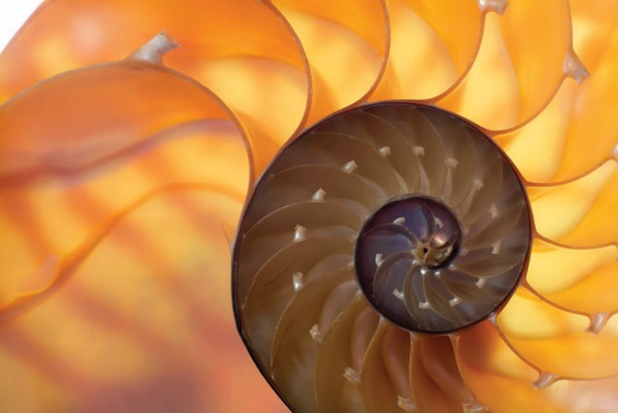
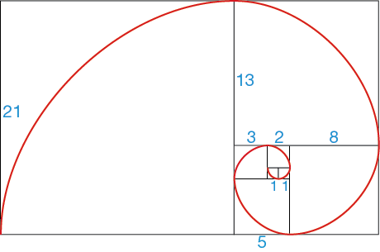
Golden Spiral
Think of the nautilus shell. This spiral grows in a special manner that can be modeled by the golden ratio. We call this spiral the golden spiral. Every quarter turn of the spiral gets wider by 𝜙. This means that shape of the spiral can be approximated using Fibonacci numbers.

Slide 19
Golden Rectangle
Golden Rectangle
A golden rectangle is a rectangle in which the ratio of the length to the width is the golden ratio.

Slide 20
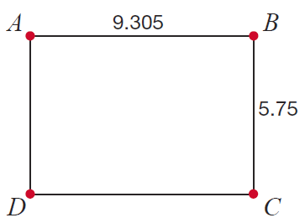
Example 4: Golden Rectangles
Verify that the rectangle in the given figure is a golden rectangle if AB = 9.305 and BC = 5.75.

Slide 21
Example 4: Golden Rectangles
Solution
We know that golden rectangles have the attribute that the ratio of the length and width is 𝜙. So, given length
AB = 9.305 and width BC = 5.75, we can see that
It is important to note that since 𝜙 is an irrational number, it is impossible to use numerical measurements to find an exact answer. Therefore, we must accept a level of accuracy that we feel comfortable with. We will consider rounding to the nearest thousandth as sufficient accuracy for our calculations.

Slide 22
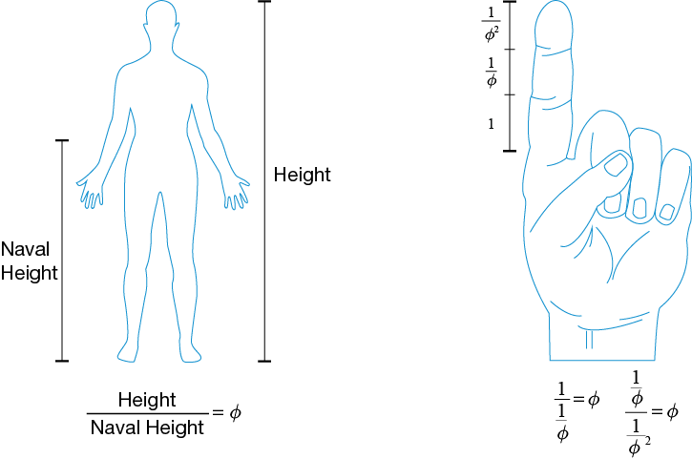
Golden Ratios in the Human Body
The golden ratio plays an important role in the human body, as rigorous mathematical analysis has shown that, on average, human beings and their skeletal structure have many golden relationships.

Slide 23
Skill Check #2
Skill Check #2
The ratio of the length of our arms, from the shoulder to the tips of our fingers, compared to the length from our elbow to the tips of our fingers is the golden ratio. Try it to see for yourself. It may be helpful, and more accurate, to accumulate multiple measurements from several individuals and find the average of the ratios.
Answer: Answers will vary.

Slide 24
Golden Triangle
Golden Triangle
A golden triangle is defined as an isosceles triangle whose length of a side compared to the length of the base is the golden ratio.

Slide 25
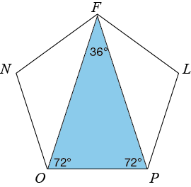
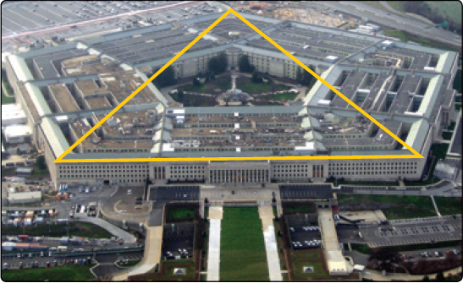
Golden Triangles in Art and Architecture
Golden triangles are a basis of other geometric figures, such as pentagons and hexagons, that are used frequently in art and architecture. For example, you can see a golden triangle in the US Pentagon building near Washington, D.C.
Photograph Courtesy of Patrick Neil

Slide 26
Example 5: Golden Rectangles in Modern Architecture
The United Nations headquarters is said to have been built using the golden ratio, where the width of the building compared to every 10 floors is the golden ratio. The height of the building is 516.75 feet and it contains 39 floors. That means that there are 13.25 feet per floor, or every 10 floors are approximately
132.5 feet. The width of the building is approximately 214.33 ft. Using the given information, show that this relationship indeed exists.

Slide 27
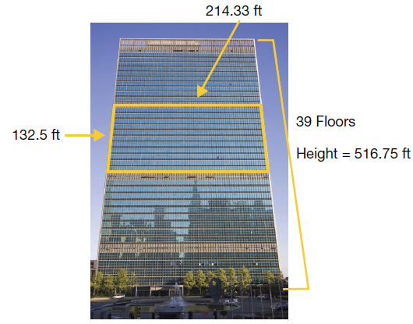
Example 5: Golden Rectangles in Modern Architecture (cont.)
Solution
We are given that the United Nations building is 214.33 feet wide and that every 10 floors measure approximately 132.5 feet, as indicated in the picture.

Slide 28
Example 5: Golden Rectangles in Modern Architecture (cont.)
Doing some arithmetic, we find that the ratio of the width to the height is
Therefore, the United Nations building does in fact display an approximate golden rectangle when the width of the building is compared to the height of 10 floors.

