Slide 1
Section 11.2
Tiling and Tessellations

Slide 2
Objectives
Understand triangular and square numbers
Understand the use of regular polygons in creating tilings and tessellations
Understand how rotations, translations, and reflections are used in art and architecture

Slide 3
Tiling and Tessellations
There are several numerical sequences and numbers patterns that are used in art and architecture, such as triangular and square numbers. Once we develop an understanding of these basic notions, we will transition into how number theory is used to create works of art within a given architecture.

Slide 4
Tessellation
Tessellation
A tessellation, or tiling, is the covering of a plane with a repeated geometric pattern with no gaps or overlaps.

Slide 5
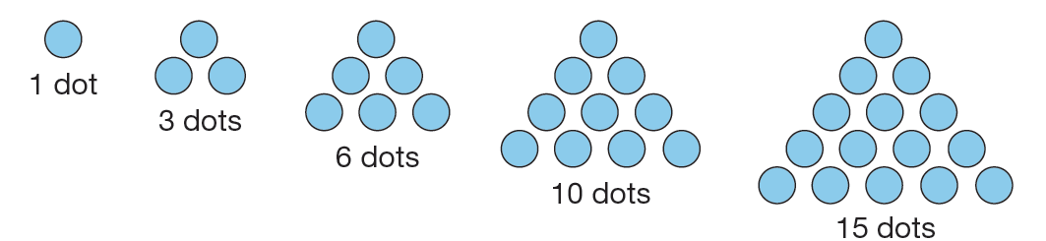
Triangular Numbers
Triangular numbers refer to numbers such as 1, 3, 6, 10, 15, …, where the number presents the number of objects that can be arranged in a triangular manner.

Slide 6
Triangular Numbers (cont.)
The pattern of triangular numbers is defined as the sum of the dots on successive rows that create equilateral triangles. They are represented as follows.
It should be noted that this pattern continues indefinitely as long as the number of objects continue to form a triangle.

Slide 7
Example 1: Finding Triangular Numbers
Find the 27th triangular number.
Solution
Recall from Chapter 1 that we discussed an example of how to find the sum of the first n integers and discussed how Carl Gauss found this solution by considering the pairs of sums. Recall that to find the sum of, for example, the first 10 integers
1 + 2 + 3 + 4 + 5 + 6 + 7 + 8 + 9 + 10,
we can use the “shortcut.”

Slide 8
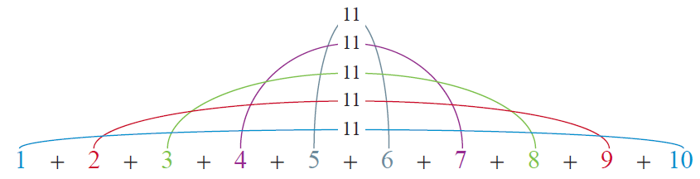
Example 1: Finding Triangular Numbers (cont.)
Instead of trying to add all 10 numbers, Gauss figured out that in any consecutive set of integers, it is possible to pair up the numbers to find the sums and, in affect, cut the work in half. For instance, 10 + 1 = 11,
9 + 2 = 11, 8 + 3 = 11, and so on.

Slide 9
Example 1: Finding Triangular Numbers (cont.)
In this case, there are 5 pairs of 11. This means the sum of the numbers from 1 to 10 would be 5 ∙ 11 = 55. We can rewrite this equation to get a general form of
Returning to our example, this means the 27th triangular number is then

Slide 10
Formula to Find the n^{th} Triangular Number
Formula to Find the n^{th} Triangular Number
To find the n^{th} triangular number t_{n}, use the following formula.

Slide 11
Formula to Find the n^{th} Triangular Number
Skill Check #1
Find the 12th triangular number.
Answer: 78

Slide 12
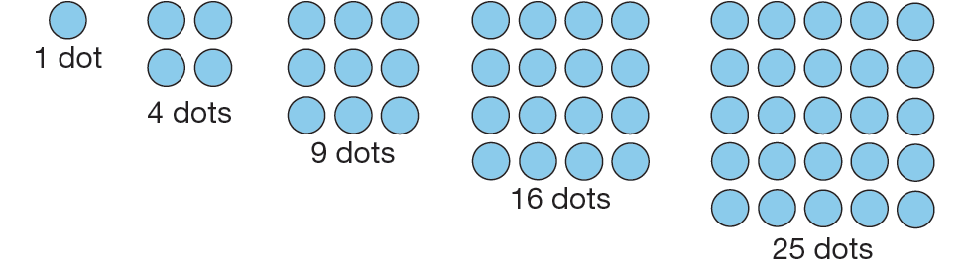
Square Numbers
Similar to triangular numbers, square numbers can be represented by a square.
The n^{th} square number is denoted by s_{n}.

Slide 13
Formula to Find the n^{th} Square Number
Formula to Find the n^{th} Square Number
To find the n^{th} square number s_{n}, use the following formula.

Slide 14
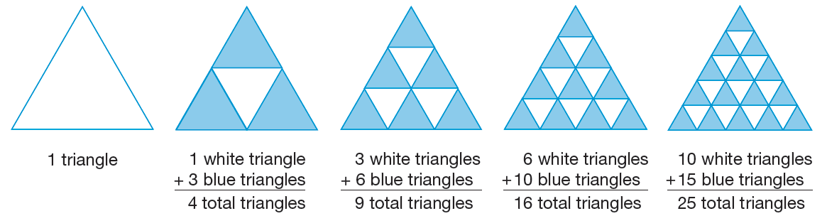
Square Numbers and Triangular Numbers
Consider the first two triangular numbers, t₁ = 2 and t₂ = 3. The sum of these two triangular numbers is 4, which is a perfect square, 2² = 4. This pattern actually continues for every pair of consecutive triangular numbers—their sum is a perfect square. Consider the following pattern.

Slide 15
Square Numbers and Triangular Numbers (cont.)
The pattern represented can be illustrated as the relationship between square and triangular numbers. Recall that a square number is represented by the sum of consecutive triangular numbers, so algebraically, we have the following.

Slide 16
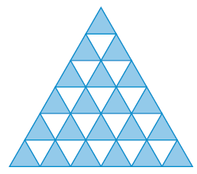
Example 2: Representing Square Numbers
How many total triangles are there in the following triangular number representation?
Solution
Since there are six blue triangles along the base, this triangle represents the 6th square number, and the total number of triangles present is 6² = 36 triangles.

Slide 17
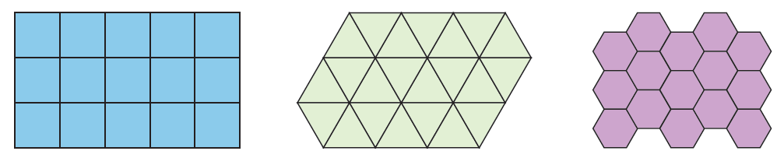
Tiling
A regular tiling, or tessellation, uses shapes that are regular polygons.
The process of tiling or tessellating a plane hinges on the key fact that the sum of the interior angles of the geometric figure at a common vertex must be 360°.

Slide 18
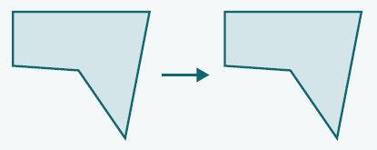
Translation
Translation
A translation is a motion where an object is moved, or “translated,” in a sliding manner vertically, horizontally, or diagonally. The shape and size of the object are not affected by the translation.

Slide 19
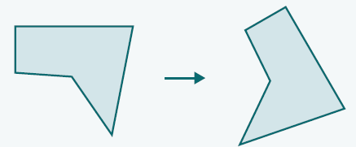
Rotation
Rotation
A rotation of an object occurs when the object is “turned” about a center point. The amount of rotation is determined by a particular angle. The shape and size of the object are not affected by the rotation.
Clockwise Rotation by 80°

Slide 20
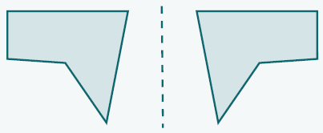
Reflection
Reflection
A reflection of an object occurs when a mirror image of the object is reflected about some line called a line of reflection. Once again, the shape and size of the object are not affected by the reflection.

Slide 21
Rigid Motions
Rigid Motions
Translations, rotations, and reflections can be further classified as rigid motions. This simply means that the motion itself does not distort the object’s size or shape.

Slide 22
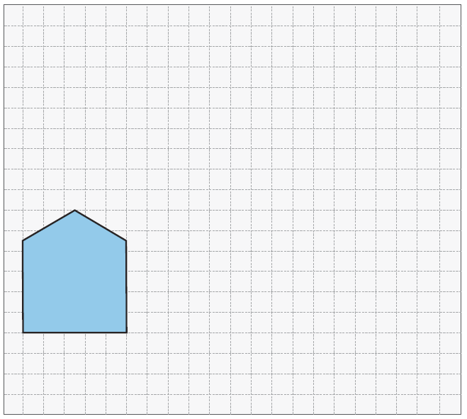
Example 3: Rigid Motions
In order to create a perspective drawing, Troy wishes to translate the following figure to create a 3-dimensional drawing. Translate the figure 10 units to the right and 2 units up.

Slide 23
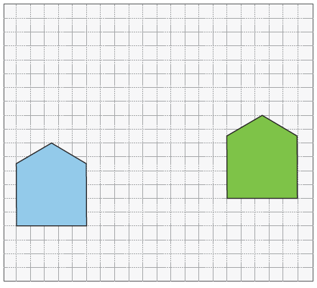
Example 3: Rigid Motions (cont.)
Solution
To complete the translation, we need to translate each point in the figure 10 units to the right and 2 units up. When done, the translation will be in the location of the green figure.

Slide 24
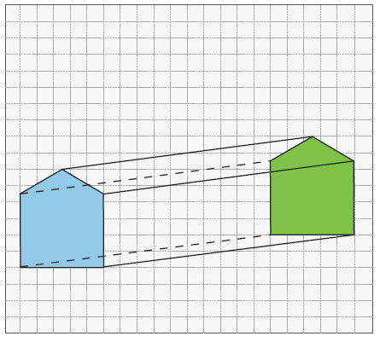
Example 3: Rigid Motions (cont.)
To finish the 3-dimensional figure, we only need to add line segments that connect the corresponding vertices of the figures, as follows.

Slide 25
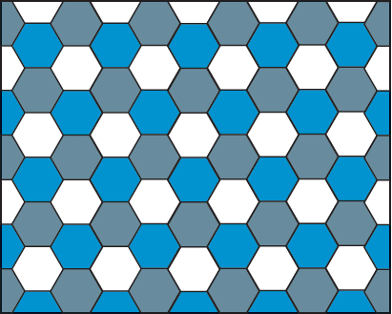
Regular Tilings
Regular Tilings
Regular tilings are tilings where the tiles are all the same and are made up of polygons such as equilateral triangles, squares, regular pentagons, regular hexagons, etc.

Slide 26
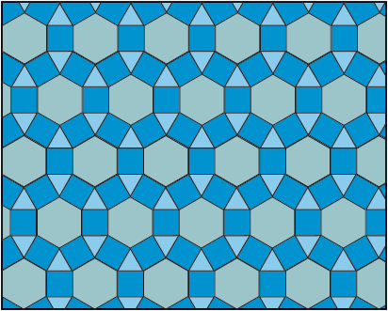
Archimedean Tilings
Archimedean Tilings
Archimedean tilings are regular tilings that are composed of multiple regular polygons, but not necessarily the same regular polygon, to form a planar surface.

Slide 27
Sum of Angles in an Archimedean Tiling
If an unknown number of polygons, say k polygons, with a number of sides equal to n₁, n₂, and so on, meeting at a singular vertex, the sum of the angles must satisfy the equation
and thus,
Finally,

Slide 28
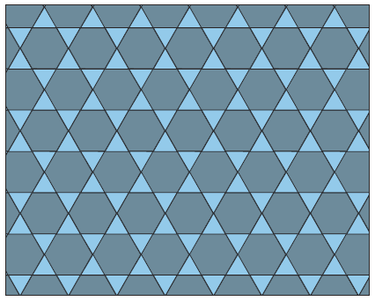
Example 4: Archimedean Tiling
Show that the given tiling is an Archimedean tiling.

Slide 29
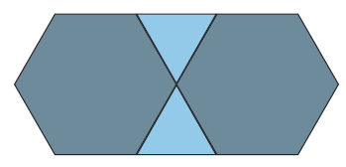
Example 4: Archimedean Tiling (cont.)
Solution
If we take a closer look at the intersection of polygons at any vertex, we can see that a given vertex consists of 4 polygons: 2 regular hexagons and 2 equilateral triangles.

Slide 30
Example 4: Archimedean Tiling (cont.)
So we have k = 4, n₁ = 3, n₂ = 3, n₃ = 6, and n₄ = 6. Now we need to make sure the formula is satisfied using these values.

Slide 31
Example 4: Archimedean Tiling (cont.)
Since the equation is true, it is confirmed that two equilateral triangles in combination with two regular hexagons, does in fact tessellate the plane.

Slide 32
Irregular Tilings
Irregular Tilings
Irregular, or nonregular, tilings are tilings in which there are no restrictions on the polygons used to tessellate, other than the requirement that the sum of the angles at meeting vertices must equal 360°. It should be noted that, since there are no restrictions on the polygons in terms of number of sides and interior angle measure, there are an infinite number of such tessellations.

Slide 33
Skill Check #2
Skill Check #2
Using a square piece of paper, create an irregular tessellation that involves translations. Repeat the process and complete a tessellation that involves rotations.
Answer: Answers will vary.

