Slide 1
Section 11.3
Mathematics and Music

Slide 2
Objectives
Understand how sound frequencies in music are used to tune a piano and their relationships in musical harmonies

Slide 3
Mathematics and Music
Now, we turn our attention to performance art, specifically that of music. For centuries, music has been a medium that has allowed man to express the breadth of the human experience. Musical sound can evoke a wide range of emotions, whether it is created vocally or with a stringed instrument such as a violin or harp, with drums, or any other instrument.

Slide 4
Frequency
Frequency
The frequency of a sound is the number of energy wave cycles completed in one second and is measured in hertz (Hz).

Slide 5
Pitch
Pitch
Pitch is the tonal quality that is defined by how low or high an instrument sounds to our ear.

Slide 6
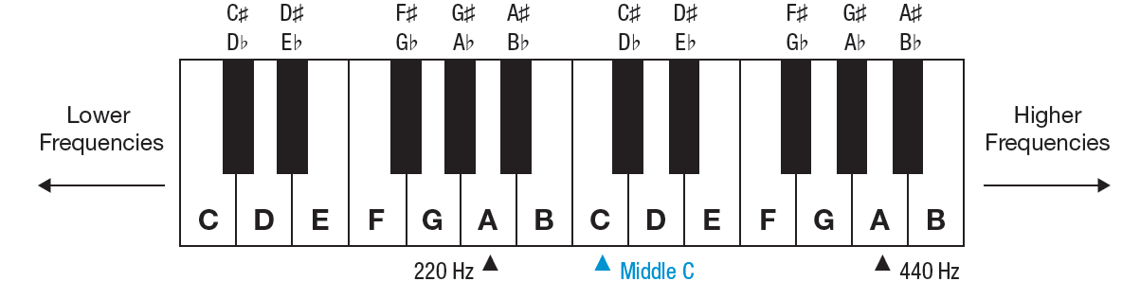
Piano Keyboard
A portion of a piano keyboard will give us a basis for how musical notes are represented. The white keys represent the notes A, B, C, D, E, F, and G. These notes are repeated over the entire keyboard. To the left of any key, the pitch of the notes gets lower. To the right of any key, the pitch of the notes gets higher.

Slide 7
Half Step
Half Step
A half step is the distance between one note and the next nearest note on a piano.

Slide 8
Whole Step
Whole Step
A whole step is defined as the interval between two half steps on a piano.

Slide 9
Octave
Octave
An octave is the interval of notes between 12 half steps on a piano.

Slide 10
Skill Check #1
Skill Check #1
Starting at F, name the notes which are one half step up the piano and one half step down the piano.
Answer:
One half step up is F♯ and one half step down is E.

Slide 11
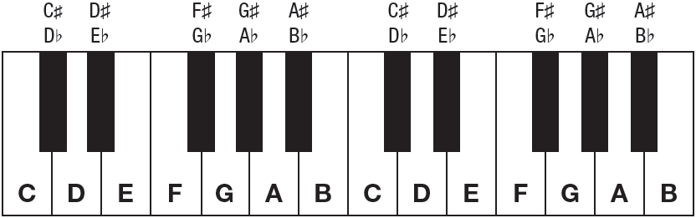
Example 1: Determining Half Steps, Whole Steps, and Octaves on a Keyboard
Use the keyboard to help determine each of the following.
a. What note is one half step up from G?
b. What note is one whole step down from G♭?
c. What note is one octave up from G?

Slide 12
Example 1: Determining Half Steps, Whole Steps, and Octaves on a Keyboard (cont.)
Solution
a. If we start at G, one half step up the keyboard is G♯, also known as A♭.

Slide 13
Example 1: Determining Half Steps, Whole Steps, and Octaves on a Keyboard (cont.)
b. Beginning with G♭, to find one whole step down, we need to count 2 half steps. So, a whole step down from G♭ is the note E.

Slide 14
Example 1: Determining Half Steps, Whole Steps, and Octaves on a Keyboard (cont.)
c. Beginning at G, we need to count up 12 half steps to the next octave. Counting this, we see that another G is located an octave up.

Slide 15
Frequency
In an octave, the frequency of the highest note always has twice the frequency of the lowest note. So, as you play Cs up the piano, the frequency of the note is doubling each time.

Slide 16
Example 2: Determining Frequencies of Octaves
What is the frequency of A₁ given that A₃ has a frequency of 220 Hz?
Solution
We know A₃ has a frequency of 220 Hz. We can use this information along with the fact that the frequency of a note is twice the frequency of the note an octave below it to find the frequency of A₂. Thus, A₂ has a frequency that is the frequency of A₃, or 110 Hz.

Slide 17
Example 2: Determining Frequencies of Octaves (cont.)
Then, to find the frequency of A₁ from the frequency of A₂, we need to find of 110 Hz, since A₁ is one octave below A₂. Therefore, we arrive at our solution for the frequency of A₁, which is of 110, or 55 Hz.

Slide 18
Frequency of Notes on a Piano
Frequency of Notes on a Piano
F = F₀ ⋅ 1.059463^{x}
where F₀ is the reference frequency and x is the number of half steps up from F₀.

Slide 19
Table 1: Frequency of Notes from A₃ to A₄
Note | Frequency | Note | Frequency
A₃ | 220 | E
A# |  | F
B |  | F#
C |  | G
C# |  | G#
D |  | A₄
D#

Slide 20
Example 3: Musical Notes as Exponential Functions
Using the values from Table 1, find the frequency of the note that is five half steps above A₄.
Solution
Since A₄ is our reference frequency and we know that the frequency of A₄ = 440 Hz, we can use our formula to determine the frequency of the note five half steps above A₄.

Slide 21
Example 3: Musical Notes as Exponential Functions (cont.)
So, the frequency of the note five half steps higher than A₄ is approximately 587 Hz. For reference, we call this note D₄. It should be noted that if the frequency of a note you wish to find is lower than the reference note, then the number of half steps x will be negative.

Slide 22
Skill Check #2
Skill Check #2
Find the frequency of the note that is 15 half steps below A₃.
Answer: 92.499 Hz

Slide 23
Chord
Chord
A chord is a set of two or more notes that produce one harmonious sound when played together.

Slide 24
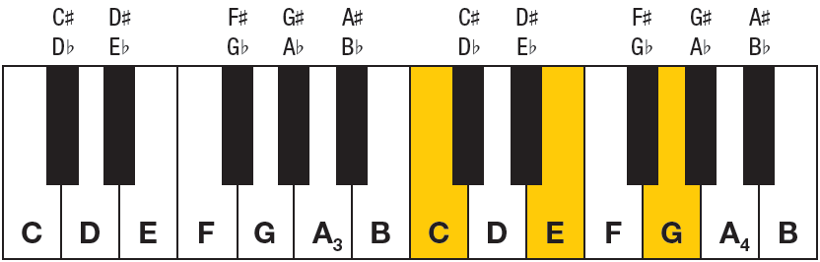
Major Chord
For a major chord, the notes are spaced such that there are four half steps between the 1st and 2nd notes and three half steps between the 2nd and 3rd notes.
The figure shows the C major chord, which consists of the notes C, E, and G.

Slide 25
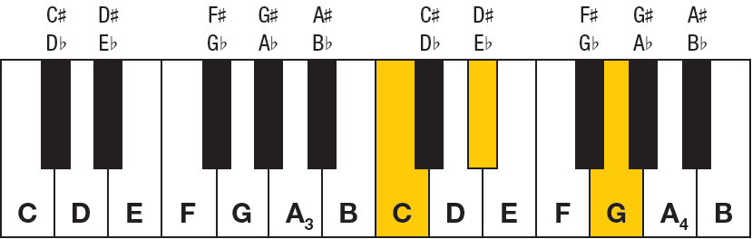
Minor Chord
For a minor chord, the notes are spaced such that there are three half steps between the 1st and 2nd notes and four half steps between the 2nd and 3rd notes.
The figure shows the C minor chord, which consists of the notes C, D#, and G.

Slide 26
Example 4: Finding Major and Minor Chords on a Piano
Use the keyboard shown in Figure 5 to find the following chords.
a. F ♯ major
b. A minor

Slide 27
Example 4: Finding Major and Minor Chords on a Piano (cont.)
Solution
To find F♯ major, we start with F♯ and count up four half steps to A♯, which gives us the middle note of the chord. Then, we count up another three half steps from there to reach the last note in the chord, C♯. Therefore, the chord F♯ major on a piano consists of the keys F♯, A♯, and C♯.

Slide 28
Example 4: Finding Major and Minor Chords on a Piano (cont.)
b. To find A minor on the keyboard, we start with the key A and count up three half steps to the middle note of the chord, which is C. Then, another four half steps give us the last note in the chord E. Thus, the chord A minor on a piano consists of the keys A, C, and E.

Slide 29
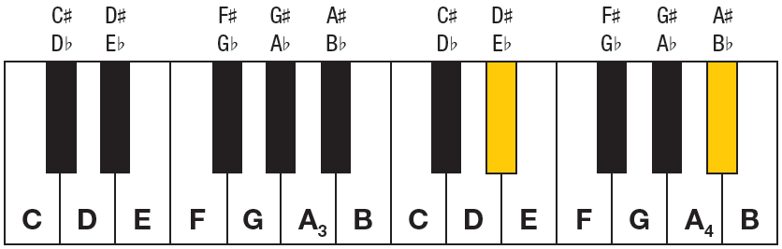
Perfect Fifth
A perfect fifth consists of the top and bottom notes in either a major or minor chord. In other words, starting with one note and counting up seven half steps (the length of a major or minor chord) competes a perfect fifth. The notes in a perfect fifth have the ratio 3 : 2.

Slide 30
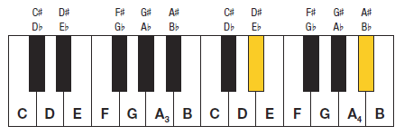
Example 5: Finding Frequency Ratios of Perfect Fifths
Show that the frequencies of the notes in the perfect fifth given in Figure 6 have a ratio of Use the approximate frequencies D♯ = 311.127 Hz and
A♯ = 466.164 Hz.

Slide 31
Example 5: Finding Frequency Ratios of Perfect Fifths (cont.)
Solution
To find the ratio of frequencies for A♯ and D♯, we need to divide the given values.
Because we started with approximate frequencies, the ratio is approximate as well. However, you can see that the notes in the perfect fifth do have a frequency ratio of

