Slide 1
Section 12.4
Additional Sports: Tennis, Golf, and Track & Field

Slide 2
Objectives
Demonstrate an understanding of the probability of winning a tennis match
Calculate reaction time to a tennis serve
Demonstrate an understanding of the dimensional analysis of track and field
Apply probability to putting on the PGA tour

Slide 3
Additional Sports: Tennis, Golf, and Track & Field
In the previous sections, we looked at statistics measuring player and team performance in team sports. Now we turn our attention to individual sports such as tennis, golf, and track & field with some unique mathematical applications.

Slide 4
Example 1: Probability of Winning in Tennis
If Susan is favored to win a tennis match and the probability that Susan wins a given point is P(Susan wins a point) = f, what is the probability that Susan wins four points in a row?
Solution
We are given that P(Susan wins a point) = f. We also know that the probability of winning a given point is an independent event. So, if we wish to determine the probability that Susan wins 4 points in a row, then P(Susan wins 4 points in a row) = f ⋅ f ⋅ f ⋅ f = f ⁴.

Slide 5
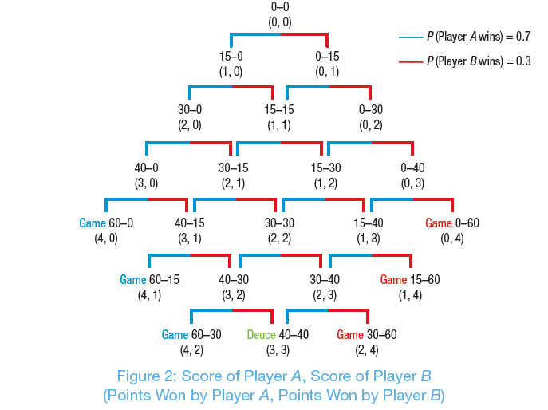
Figure 2: Score of Player A, Score of Player B

Slide 6
Probability of a Game Score in Tennis
Probability of a Game Score in Tennis
where n is the number of points Player A wins, m is the number of points Player B wins, P_{A} is the probability that Player A wins a point, and P_{B} is the probability that Player B wins a point.

Slide 7
Example 2: Probability of Winning a Point
Assume that two players, Jack and Glinda, are playing tennis. The probability that Glinda wins a given point is P (Glinda wins a point) = 0.6. What is the probability that after three points, the score will be 30-15, in favor of Jack?
Solution
The probability that Glinda wins any given point is P (Glinda wins a point) = 0.6, or P(G) = 0.6. This means P (Jack wins a point) = 0.4, or P(J) = 0.4.

Slide 8
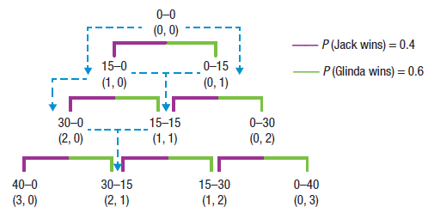
Example 2: Probability of Winning a Point (cont.)
Our goal is to determine the probability that the score will be 30-15, in favor of Jack, after three games. So, we are looking for P(JJG) or P (JGJ) or P (GJJ). The paths JJG, JGJ, and GJJ are shown in blue in the figure.

Slide 9
Example 2: Probability of Winning a Point (cont.)
The order of obtaining a score of 30-15, in favor of Jack, can happen in three different, independent ways. So we have
P(JJG) = (0.4)(0.4)(0.6) = 0.096,
P(JGJ) = (0.4)(0.6)(0.4) = 0.096, and
P(GJJ) = (0.6)(0.4)(0.4) = 0.096.
Therefore, the probability of Jack winning two points and Glinda winning one point is
0.096 + 0.096 + 0.096 = 0.288.

Slide 10
Example 2: Probability of Winning a Point (cont.)
Using the formula we developed, the solution can be calculated as follows.

Slide 11
Example 2: Probability of Winning a Point (cont.)
So, the probability that Jack wins two points and Glinda wins one is 0.288.

Slide 12
Skill Check #1
Skill Check #1
Using the probabilities from Example 2, determine the probability that Glinda wins a game of tennis against Jack where Jack wins two points and Glinda wins four points.
Answers:

Slide 13
Example 3: Miles per Hour to Feet per Second
If a car is traveling at 70 miles per hour, what is the car’s speed in feet per second?
Solution
We find the following based on our knowledge of proportions of time and distance.

Slide 14
Example 3: Miles per Hour to Feet per Second (cont.)
So, a car traveling at 70 mi/hr is traveling at 102.667 ft/sec.

Slide 15
Example 4: Reaction Time to a Tennis Serve
Venus Williams holds the record for the fastest women’s tennis serve at 129 miles per hour. Using the standard dimensions of a tennis court, how long does the player returning the serve have to react to the ball?
Solution
We must take into account the information we have regarding the velocity of the ball reaching the player. If we assume that the ball will reach the returning player at 75% of its initial velocity, then the ball has an average velocity of 0.75 ∙ 129 = 96.75 mi/hr.

Slide 16
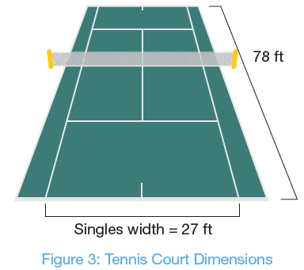
Example 4: Reaction Time to a Tennis Serve (cont.)
From Figure 3, we can see that the length of the court is 78 feet.

Slide 17
Example 4: Reaction Time to a Tennis Serve (cont.)
Converting 96.75 mi/hr to ft/sec, we get

Slide 18
Example 4: Reaction Time to a Tennis Serve (cont.)
Therefore, the average velocity of the serve would be 141.9 ft/sec. In terms of reaction time, since the serve only travels 78 feet, we can determine that the reaction time would be
The player moving to where the ball is located and returning the 129 mi/hr serve would have a little more than of a second to return the ball!

Slide 19
Skill Check #2
Skill Check #2
Andy Roddick once served a tennis ball 155 miles per hour. Using the same method as Example 4, determine the reaction time for the player returning the serve.
Answers: 0.457 seconds

Slide 20
Example 5: How Fast Is Usain Bolt?
Usain Bolt is the 2008, 2009, 2010, 2011, 2012, and 2013 world champion in the 100-meter dash and also holds the world record with a time of 9.58 seconds. Determine how fast Bolt runs in
a. meters per second.
b. kilometers per hour.
c. feet per second
d. miles per hour.

Slide 21
Example 5: How Fast Is Usain Bolt? (cont.)
Solution
Using the given conversions and knowledge of dimensional analysis, we can find each of these measurements. We know that Bolt runs 100 meters in 9.58 seconds, so we can calculate the following.

Slide 22
Example 5: How Fast Is Usain Bolt? (cont.)

Slide 23
Example 5: How Fast Is Usain Bolt? (cont.)

Slide 24
Example 5: How Fast Is Usain Bolt? (cont.)

Slide 25
Skill Check #3
Skill Check #3
Florence Griffith Joyner (December 21, 1959–September 21, 1998), nicknamed Flo Jo, holds the women’s world record in the 100-meter dash with a time of 10.40 seconds. Determine how fast Joyner ran in
a. meters per second. b. kilometers per hour.
c. feet per second. d. miles per hour.

Slide 26
Skill Check #3 (cont.)
Answers:
a. 9.615 m/s;
b. 34.614 km/hr;
c. 31.545 ft/sec;
d. 21.508 mi/hr

Slide 27
Example 6: Chances of Making a Putt
Using the function for a 2011 PGA player making a putt, f(x) = 113.374(0.902111)^{x}, determine the percent chance of a player making a 19.5-foot putt during the 2011 PGA season.
Solution
We are given the function for percentage of putts made as f(x) = 113.374(0.902111)^{x}. If the distance is 19.5 feet, then the chance of making the putt is as follows.
f(19) = 113.374(0.902111)^{19.5} ≈ 15.21%

Slide 28
Example 6: Chances of Making a Putt (cont.)
So, statistically speaking, a 2011 PGA player had approximately a 15.21% chance of actually making a 19.5-foot putt.

