Slide 1
Section 13.1
Introduction to Graph Theory

Slide 2
Objectives
Identify parts of a graph
Determine if graphs are connected or disconnected
Determine the chromatic number of a graph

Slide 3
Introduction to Graph Theory
In the world of mathematics, the field of graph theory is a relative newcomer. However, as one of the fastest-growing and most applicable branches of mathematics, graph theory permeates throughout academic disciplines such as computer science, linguistics, biology, chemistry, physics, cartography, and operations research.

Slide 4
Graph
Graph
A graph consists of a set of vertices and a set of edges that join pairs of vertices together. Graphs are generally represented with a capital letter, such as G.

Slide 5
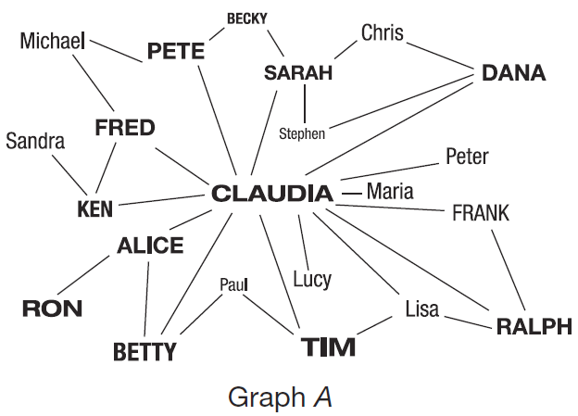
Example 1: Identifying Parts of a Graph
In graph A, identify the vertices and edges.

Slide 6
Example 1: Identifying Parts of a Graph (cont.)
Solution
In graph A, the vertices are represented by the names and the edges are the lines joining the names to one another.

Slide 7
Loop
Loop
A loop is an edge that has the same vertex for both of its ends.

Slide 8
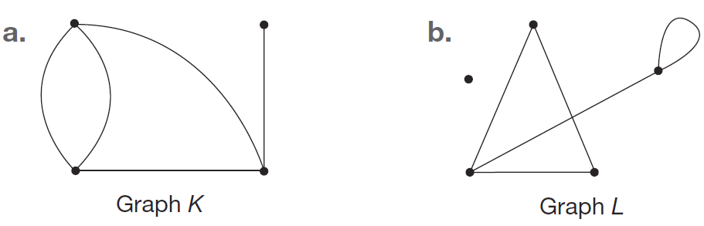
Example 2: Identifying Parts of a Graph
For the given graphs, label each vertex and edge. Identify any loops.

Slide 9
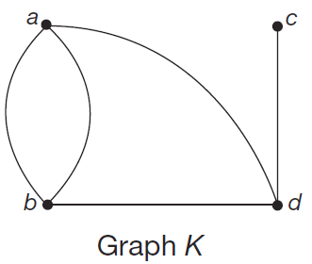
Example 2: Identifying Parts of a Graph (cont.)
Solution
a. First, label the four vertices in graph K with lowercase letters. We’ll use a, b, c, and d. Note that the assignment of the letters is not critical; they can be in any order.

Slide 10
Example 2: Identifying Parts of a Graph (cont.)
Second, since the graph has two edges between the vertices a and b, it is not sufficient to use the ends as labels. Instead, use distinct identifiers in order to distinguish between the edges. We will use f₁, f₂, f₃, f₄, and f₅.
Although graph K might appear to have a loop on the left-hand side of it, there is not an edge that begins and ends at the same vertex.

Slide 11
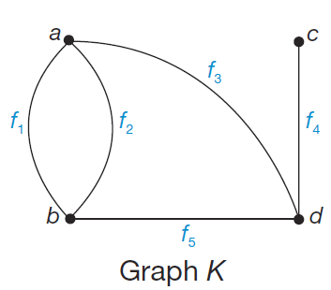
Example 2: Identifying Parts of a Graph (cont.)
Therefore, there are no loops in graph K.

Slide 12
Example 2: Identifying Parts of a Graph (cont.)
b. In graph L, label the five vertices with lowercase letters. We use v, w, x, y, and z. Since there is at most one edge between any pair of vertices, we can label the edges using either format. This time, we will use the pairing method to label the edges. Note that there are only five vertices and not six, remembering that there is not a vertex every time edges intersect.

Slide 13
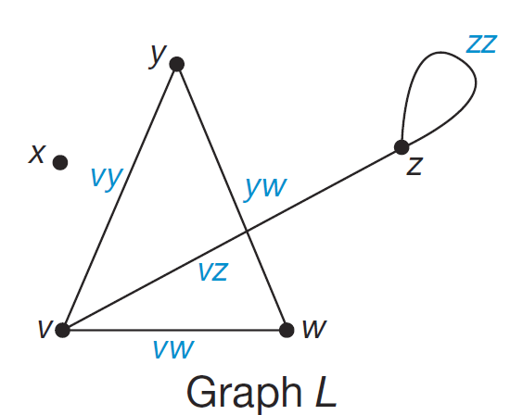
Example 2: Identifying Parts of a Graph (cont.)
Notice that edge zz begins and ends at vertex z, and is, therefore, a loop.

Slide 14
Walk
Walk
A walk in a graph is a finite list of alternating vertices and connecting edges that begins and ends with a vertex.

Slide 15
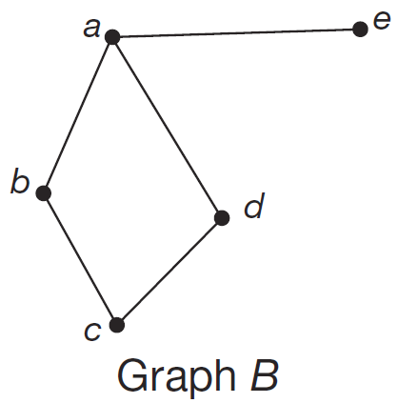
Example 3: Identifying a Walk
Use graph B to answer the following questions.
a. Identify a walk of length 2 that starts at vertex a and ends at vertex c.
b. Is the walk you just found a closed walk?

Slide 16
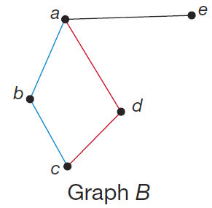
Example 3: Identifying a Walk (cont.)
Solution
a. There are two possible walks that start at vertex a, end at vertex c, and have a length of 2. The walk a, b, c is highlighted in blue and the walk a, d, c is highlighted in red. Either is an acceptable answer.

Slide 17
Example 3: Identifying a Walk (cont.)
b. Because the walks do not start and end at the same vertex, neither walk is closed.

Slide 18
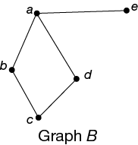
Skill Check #1
Skill Check #1
Identify a walk of length 3 in the graph B in Example 3. Start the walk at vertex c.
Answer: Any of the following: c, b, a, e; c, b, a, d; c, b, a, b; c, b, c, b; c, d, a, e; c, d, a, b; c, d, a, d; c, d, c, d

Slide 19
Path
Path
A path is a walk with no repeated edges or vertices.

Slide 20
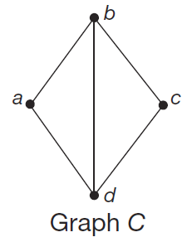
Example 4: Identifying a Path
Identify a path of length 3 starting at vertex a and ending at vertex d in graph C.

Slide 21
Example 4: Identifying a Path (cont.)
Solution
Since the path must be of length 3 and start at vertex a and end at d, we cannot go straight to d. We need to move from a to b. From there, if we move to d next, we still only have a path of length 2. Instead, we need to move from b to c and then to d.

Slide 22
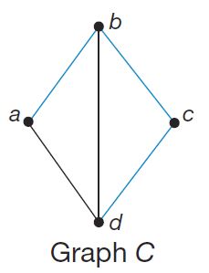
Example 4: Identifying a Path (cont.)
This walk a, b, c, d, is a walk of length 3 and only crosses each vertex once and never duplicates an edge. Therefore, it is the required path.

Slide 23
Connected and Disconnected Graphs
Connected and Disconnected Graphs
A graph is connected if there is at least one path connecting each pair of distinct vertices. A graph is disconnected if a pair of vertices exists so that there is no path between them.

Slide 24
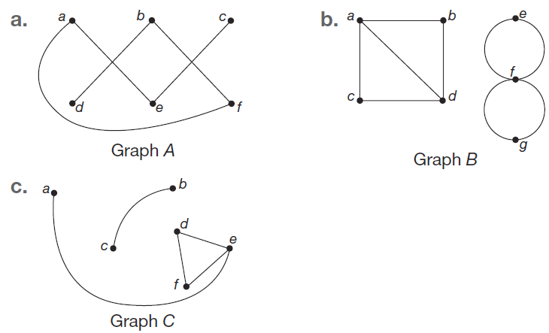
Example 5: Identifying Connected and Disconnected Graphs
Label each graph as connected or disconnected.

Slide 25
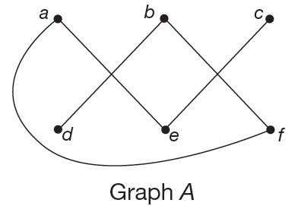
Example 5: Identifying Connected and Disconnected Graphs (cont.)
Solution
a. Even though each vertex is not directly connected with every other vertex by single edges, this graph is connected because there are paths between each pair of vertices.

Slide 26
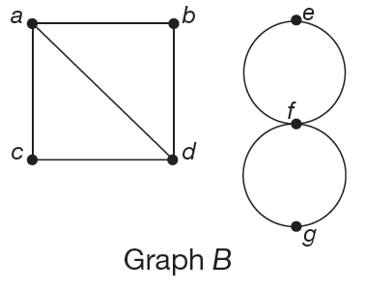
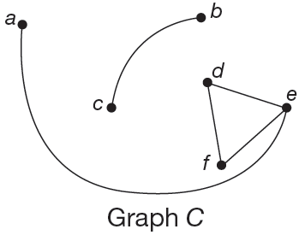
Example 5: Identifying Connected and Disconnected Graphs (cont.)
b. Because there is no path connecting vertex b to vertex e, the graph is disconnected. Only one example is needed to show that a graph is disconnected.
c. This graph is disconnected because there is no path between vertices a and c.

Slide 27
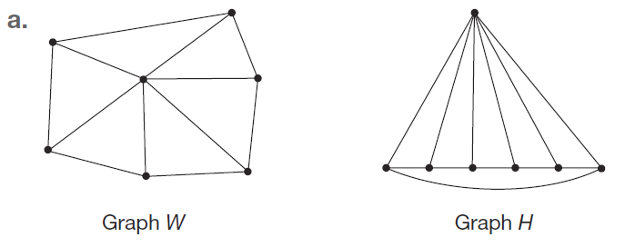
Example 6: Identifying Different Views of the Same Graph
Decide whether the pairs of graphs shown could be different views of the same graph or not.

Slide 28
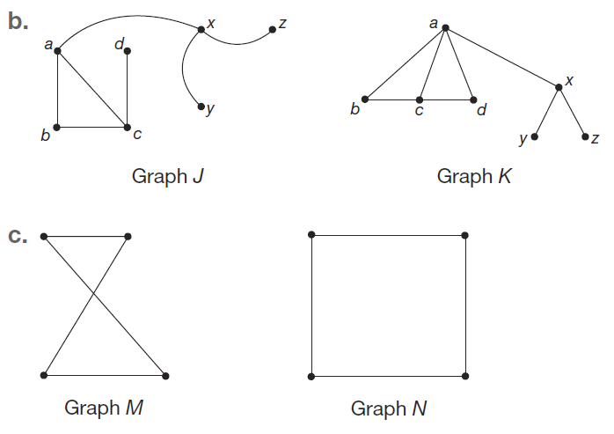
Example 6: Identifying Different Views of the Same Graph (cont.)

Slide 29
Example 6: Identifying Different Views of the Same Graph (cont.)
Solution
a. In both graphs W and H, there are seven vertices. If you think of numbering the vertices 1 through 7, you can check that the edges join the same vertices in both diagrams.

Slide 30
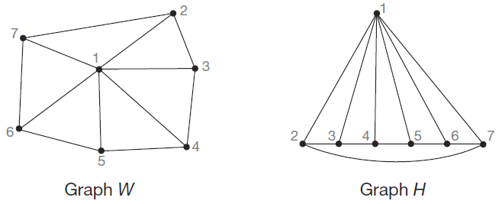
Example 6: Identifying Different Views of the Same Graph (cont.)
Check this for yourself in the following figure. Therefore, these are different views of the same graph.

Slide 31
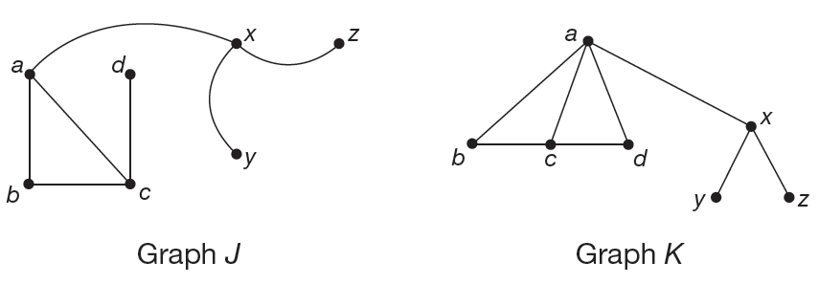
Example 6: Identifying Different Views of the Same Graph (cont.)
b. Graphs J and K are not the same. Graph J does not include an edge between the vertices a and d, however, graph K does. Therefore, graphs J and K cannot be different views of the same graph.

Slide 32
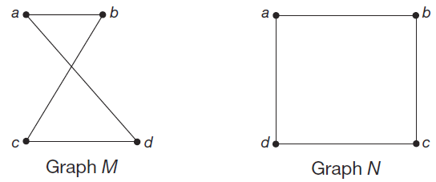
Example 6: Identifying Different Views of the Same Graph (cont.)
c. Both graphs M and N contain four vertices. If you label each graph, you can see that the edges join the same vertices. Therefore, these are different views of the same graph.

Slide 33
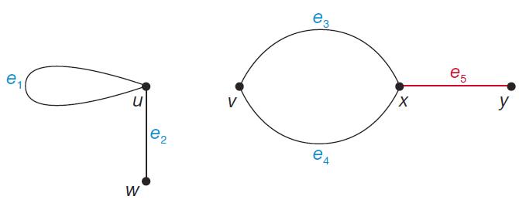
Skill Check #2
Skill Check #2
Identify all pairs of adjacent vertices and all pairs of incident edges in Figure 10.
Figure 10: Graph G
Answer: Adjacent vertices: x and y; u and w; v and x; Incident edges: e₁ and e₂; e₃ and e₄; e₃ and e₅; e₄ and e₅

Slide 34
Adjacent
Adjacent
Two vertices that share an edge are adjacent.

Slide 35
Incident
Incident
Two edges that share a vertex are incident to one another. Also, we say that a vertex is incident to the edges that have that vertex as an endpoint.

Slide 36
Degree
Degree
The degree of a vertex u is the number of edges that are incident to u and is notated by d(u).

Slide 37
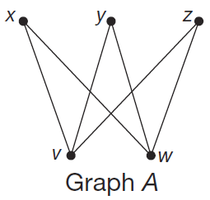
Example 7: Identifying Parts of a Graph
Use Graph A to solve the following problems.
a. Determine the degree of each of the vertices.
b. Name the pairs of vertices that are adjacent.
c. Name the pairs of edges that are incident.

Slide 38
Example 7: Identifying Parts of a Graph (cont.)
Solution
a. To determine the degree of each vertex, we simply count the number of edges incident to it. Therefore,
d (x) = 2; d (y) = 2; d (z) = 2; d (v) = 3; and d (w) = 3.

Slide 39
Example 7: Identifying Parts of a Graph (cont.)
b. Two vertices are adjacent if they are ends of the same edge. Therefore, all the following pairs of vertices are adjacent.
x, v
x, w
y, v
y, w
z, v
z, w

Slide 40
Example 7: Identifying Parts of a Graph (cont.)
c. Two edges are incident if they share a common vertex. Therefore, all of the following sets of edges are incident.
xv, xw
yv, yw
zv, zw
xv, yv, zv
xw, yw, zw

Slide 41
Example 8: Drawing a Graph Given the Edges
a. Draw a five point star; that is, a graph with five vertices, v₁, v₂, v₃, v₄, and v₅, whose edges are v₁v₃, v₃v₅, v₅v₂, v₂v₄, and v₄v₁.
b. Determine the degree of each vertex.
c. Redraw the graph without edges crossing.
d. Determine the degree of each vertex in the new drawing.

Slide 42
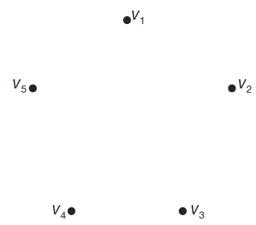
Example 8: Drawing a Graph Given the Edges (cont.)
Solution
a. Begin by placing the five vertices on the page and labeling them v₁ through v₅. Remember, the placement of the vertices is not important.

Slide 43
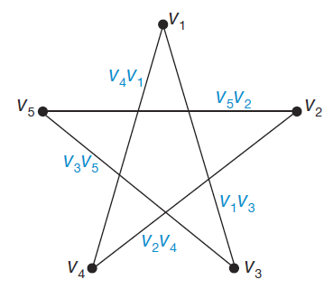
Example 8: Drawing a Graph Given the Edges (cont.)
Now, connect the vertices with the given edges. In other words, edge v₁v₃ connects vertex v₁ with vertex v₃. The following graph shows the completed graph.

Slide 44
Example 8: Drawing a Graph Given the Edges (cont.)
b. To determine the degree of each vertex, count the number of edges incident to each vertex. Therefore we have
d(v₁) = 2; d(v₂) = 2;
d(v₃) = 2; d(v₄) = 2;
and d(v₅) = 2.

Slide 45
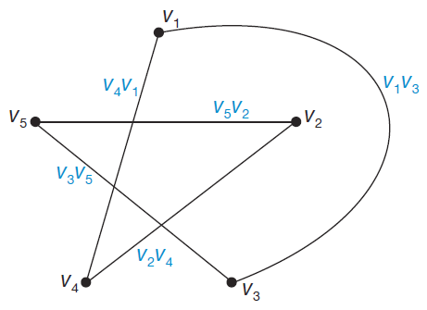
Example 8: Drawing a Graph Given the Edges (cont.)
c. To redraw the graph without edges crossing, think of “pulling” edge v₁v₃ to the outside of the graph as shown in the following figure.

Slide 46
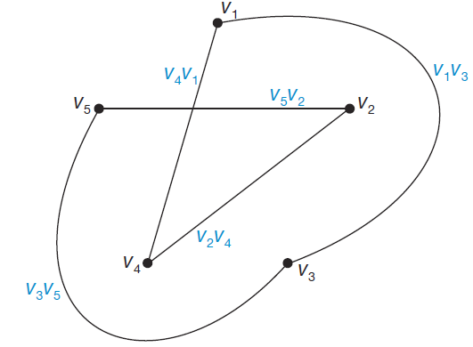
Example 8: Drawing a Graph Given the Edges (cont.)
Next, do the same with edge v₃v₅.

Slide 47
Example 8: Drawing a Graph Given the Edges (cont.)
The last thing to do is to pull vertices v₂ and v₄ out of the middle. When you do, think of flipping their position, as shown in the following graph. Check for yourself that the edges are all still the same in this new layout.

Slide 48
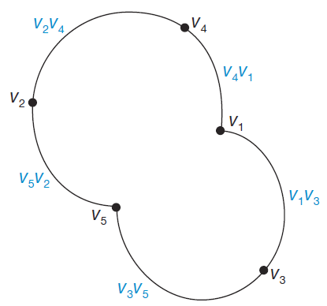
Example 8: Drawing a Graph Given the Edges (cont.)
The graph is now drawn without any edges crossing. You can see that the “star” now looks more round.

Slide 49
Example 8: Drawing a Graph Given the Edges (cont.)
d. The degree of each vertex does not change when the graph is redrawn. Each vertex still has the same edges connected to it and, hence, the same degree. (This will always be the case with any graph.) Therefore, all vertices in this graph still have degree 2.

Slide 50
Example 9: Drawing a Graph without Edges Predetermined
A research chemist is analyzing the structure of compounds of aluminum, iron, and oxygen. Each aluminum atom makes three chemical bonds, each oxygen atom makes two chemical bonds, and each iron atom makes six chemical bonds. Create a possible form for a molecule of two aluminum atoms, two oxygen atoms, and one iron atom where no atom makes a chemical bond to itself.

Slide 51
Example 9: Drawing a Graph without Edges Predetermined (cont.)
Solution
To create the structure of the molecule, we will represent the atoms and their bonds as a graph. Each vertex will represent an atom and each edge will represent a chemical bond that joins one atom with another. So, we have to draw a graph with no loops that has two vertices of degree 3, two vertices of degree 2, and one of degree 6.

Slide 52
Example 9: Drawing a Graph without Edges Predetermined (cont.)
Unlike the previous example, there are many graphs that meet the requirements given for the graph since there are no restrictions on which vertices must be joined together by edges. We will show one possible form for a molecule of this type.

Slide 53

Example 9: Drawing a Graph without Edges Predetermined (cont.)
First notice that there must be a total of five vertices, one for each atom. Place the vertices on the graph.

Slide 54
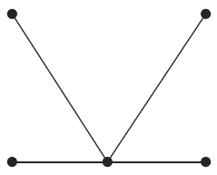
Example 9: Drawing a Graph without Edges Predetermined (cont.)
Let’s begin with the vertex with the highest degree of degree 6. Recall that the degree of a vertex is the number of edges that are connected to it, not the number of vertices. Because there are no loops allowed, the vertex must have six edges joined to it. We’ll join each of the other four vertices to it, giving us a vertex of degree 4.

Slide 55
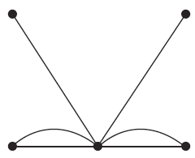
Example 9: Drawing a Graph without Edges Predetermined (cont.)
To get to degree 6, we’ll need to draw two more edges somewhere. We’ll choose to give the bottom two vertices on either side another edges with our central vertex, as shown.
Let’s stop and determine what the graph looks like so far. We have a graph with five vertices: one of degree 6, two with degree 2, and two with degree 1.

Slide 56
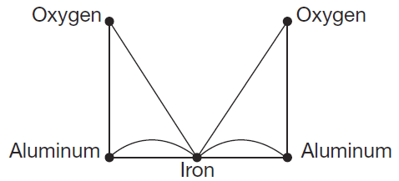
Example 9: Drawing a Graph without Edges Predetermined (cont.)
Notice that we have several possible ways to complete our graph here. One way is to join each vertex of degree 1 to a vertex of degree 2, which increases each of their degrees by one, giving us the desired degree count. Our final graph for the molecule’s form is as follows.

Slide 57
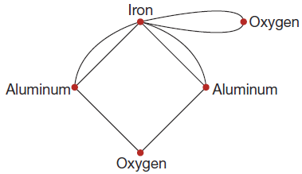
Skill Check #3
Skill Check #3
Draw a different graph with the same restrictions as in Example 9: no loops, having two vertices of degree 3, two vertices of degree 2, and one of degree 6.
Answer: Answers will vary. For example,

Slide 58
Vertex Cover
Vertex Cover
A vertex cover is a set of vertices A, so that every vertex in the graph is either in A or adjacent to a vertex in A.

Slide 59
Minimum Vertex
Minimum Vertex
Cover When a vertex cover A is as small as possible, A is called a minimum vertex cover.

Slide 60
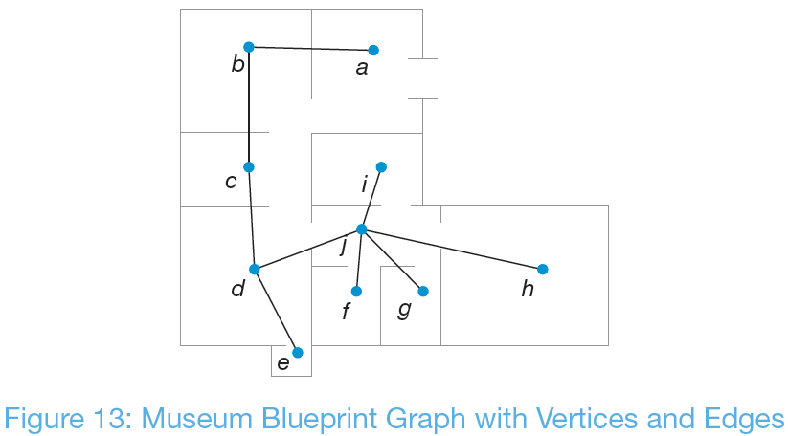
Example 10: Finding a Minimum Vertex Cover
Using the graph we created in Figure 13, determine the minimum number of security guards that would be needed if a guard can secure their room and all the rooms adjacent to it.

Slide 61
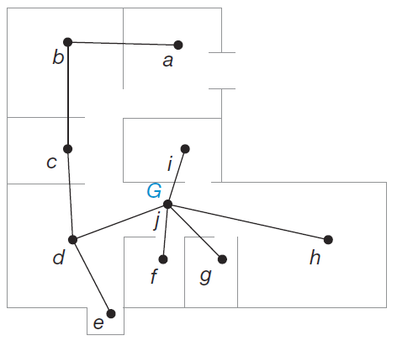
Example 10: Finding a Minimum Vertex Cover (cont.)
Solution
We can begin by placing a guard in room j, represented by a blue G. That way, rooms d, f, g, h, and i are all covered since they are adjacent to j.
That way, rooms d, f, g, h, and i are all covered since they are adjacent to j.

Slide 62
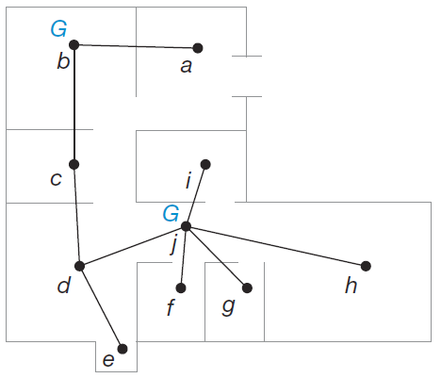
Example 10: Finding a Minimum Vertex Cover (cont.)
Then, we have the remaining four rooms a, b, c, and e that need a guard. Since these four rooms are connected in a row, this will require a minimum of two guards. One guard in room b who can cover room b as well as a and c, and one guard in either room d or e.

Slide 63
Example 10: Finding a Minimum Vertex Cover (cont.)
Here’s where we can use our best judgment for the scenario. Although room d is secured by the guard in room j, the guard in room j might be a little overworked with all the rooms assigned to his position. We could technically place a second guard in room e and accomplish our objective. Placing the guard in room d might be a more sensible solution, helping to ease the job of the guard in room j. Unless, of course, room e contains an incredibly valuable jewel. Either way, the minimum number of guards needed to cover every room in the museum is three.

Slide 64
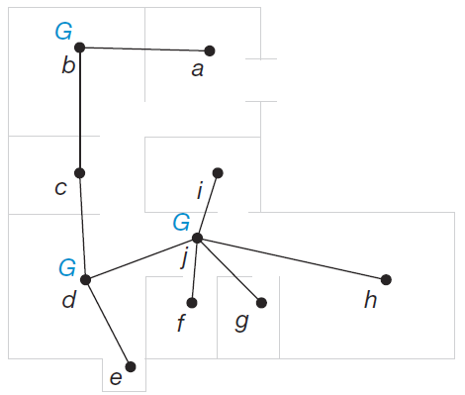
Example 10: Finding a Minimum Vertex Cover (cont.)
The set of vertices that form the guards’ post assignments, A = {b, d, j}, is a minimum vertex cover for the museum graph.

Slide 65
Skill Check #4
Skill Check #4
Find another minimum vertex covering for the museum graph from Example 10.
Answer: B = {b, e, j }

Slide 66
Vertex Coloring
Vertex Coloring
A vertex coloring of a graph is an assignment of colors to the vertices of the graph so that adjacent vertices receive different colors.

Slide 67
Chromatic Number
Chromatic Number
When the number of colors used in a vertex coloring is as small as possible, this number is called the chromatic number of a graph and is denoted 𝜒(G), read “chi of G.”

Slide 68
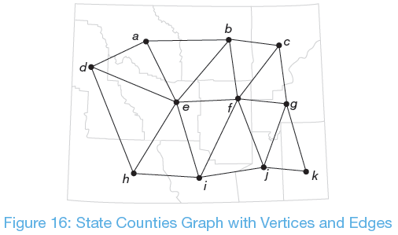
Example 11: Finding a Vertex Coloring
Suppose a cell phone company needs to place cell towers in all counties of the state shown in Figure 16 in such a way that the frequencies for each tower do not interfere with each other. A vertex in the graph represents a county and an edge represents a shared border between counties.

Slide 69
Example 11: Finding a Vertex Coloring (cont.)
When two cell towers are placed in adjacent counties, they interfere with each other’s signal unless they are on different frequencies. Of course the cell phone company could place a different frequency in each county and have 11 frequencies for the state. However, to minimize their costs, the cell phone company needs to use as few frequencies as possible. Find the chromatic number of the graph and determine the best arrangement of the frequencies of the cell towers for the cell phone company.

Slide 70
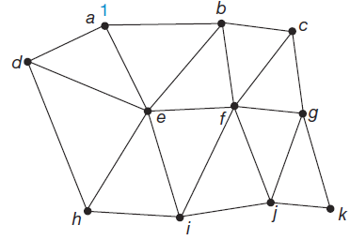
Example 11: Finding a Vertex Coloring (cont.)
Solution
We can represent the frequencies of a cell tower by using a number. Let’s begin by putting the first frequency in county a, as shown in blue on the graph.

Slide 71
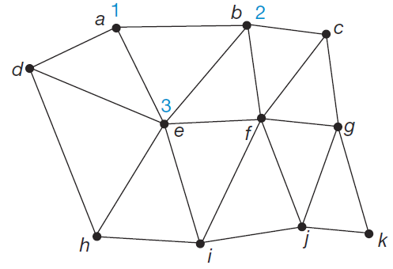
Example 11: Finding a Vertex Coloring (cont.)
Every county (vertex) adjacent to county a is not allowed to use frequency 1. So, the counties b, d, and e all need new frequencies. Start by giving county b frequency 2. Notice, that county e can’t be on 1 or 2 since it connects to both a and b, so we need to give it frequency 3. Here’s how the graph looks so far.

Slide 72
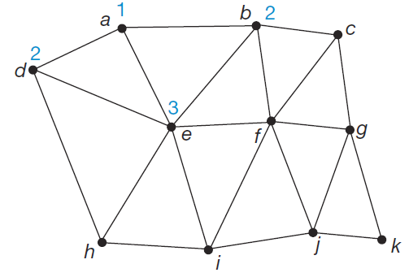
Example 11: Finding a Vertex Coloring (cont.)
Returning to county d, we know that it cannot be the same as either of the adjoining counties a and e, which have frequencies 1 and 3 respectively. Since frequency 2 is available, we’ll use it again as we are trying to use as few frequencies as possible.

Slide 73
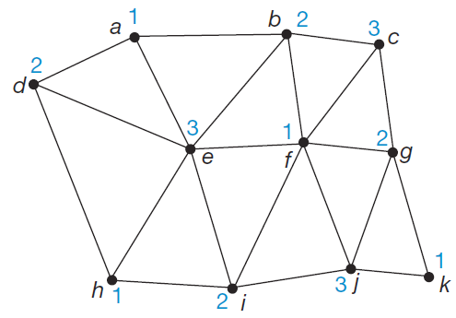
Example 11: Finding a Vertex Coloring (cont.)
Continue in the same manner until all vertices are numbered.
You can see that we needed three different frequencies to cover all the counties without interference.
Therefore, the county graph has a chromatic number of 3; that is, 𝜒(G) = 3.

Slide 74
Cycle
Cycle
A cycle is a closed walk; that is, a cycle starts and ends at the same vertex and has no edges or vertices repeated except for the starting vertex.

Slide 75
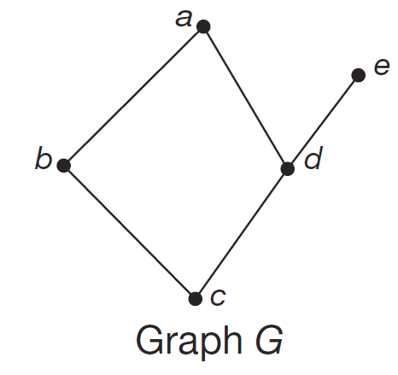
Example 12: Identifying a Cycle in a Graph
Identify a cycle in graph G and determine its length.

Slide 76
Example 12: Identifying a Cycle in a Graph (cont.)
Solution
The only cycle in graph G is the cycle among the vertices a, b, c, and d. To refer to the cycle we can begin at any of the vertices and list them in order as we trace the cycle. For instance, beginning with vertex b, the cycle is b, c, d, a. Because the cycle has four vertices and four edges, the cycle has length 4.

Slide 77
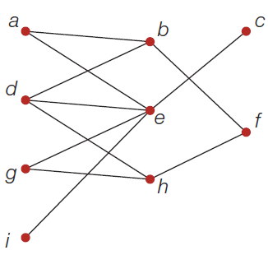
Skill Check #5
Skill Check #5
Identify a cycle of length 6 in the following graph.
Answer: Answers will vary. For example, a, b, d, h, g, e; g, e, a, b, f, h; b, f, h, d, e, a; d, e, g, h, f, b.

