Slide 1
Section 13.2
Trees

Slide 2
Objectives
Know the properties of trees
Find a spanning tree in a graph

Slide 3
Trees
Some of the simplest graphs that we can consider have no cycles. Graphs without cycles prove to be convenient models for many real-life scenarios: family trees, finding shortest routes between cities, maximizing flow of pipes in a network, or minimizing cost for laying cable between states. All of these instances can be modeled using a type of graph called a tree.

Slide 4
Tree
Tree
A connected graph with no cycles is called a tree.

Slide 5
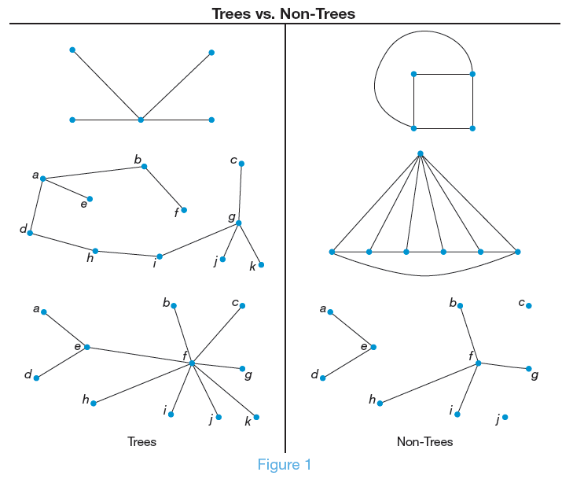
Figure 1: Trees vs. Non-Trees

Slide 6
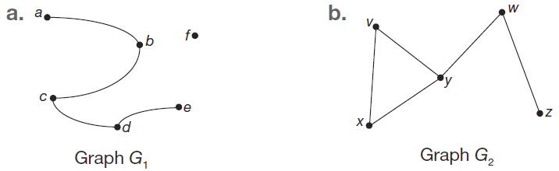
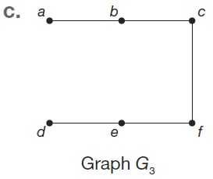
Example 1: Identifying Trees
Determine if each of the following graphs is a tree.

Slide 7
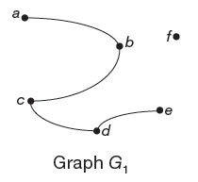
Example 1: Identifying Trees (cont.)
Solution
a. Although G₁ does not have a cycle in it, it is not a connected graph because there is not a path between vertex f and other vertices. Therefore, it is not a tree.

Slide 8
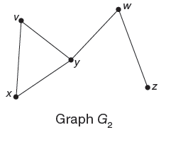
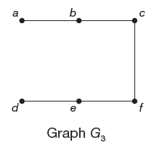
Example 1: Identifying Trees (cont.)
b. G₂ is not a tree because there is a cycle among the vertices v, x, and y.
c. G₃ is a tree because it is a connected graph without any cycles.

Slide 9
Tree Theorem
Tree Theorem
Let graph T be a tree on v vertices. Then, graph T has
v – 1 edges.

Slide 10
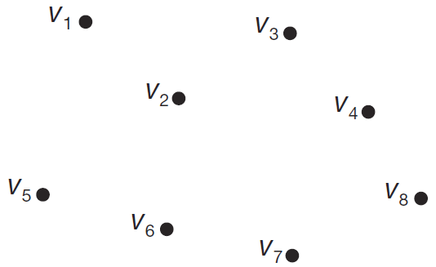
Example 2: Determining the Number of Edges Needed for a Tree
Determine the number of edges needed to connect the given vertices so that the resulting graph is a tree.

Slide 11
Example 2: Determining the Number of Edges Needed for a Tree (cont.)
Solution
To determine the number of edges needed to construct a tree from the given vertices, we simply need to subtract 1 from the number of vertices. Since there are 8 vertices, the number of edges needed is 8 – 1 = 7.

Slide 12
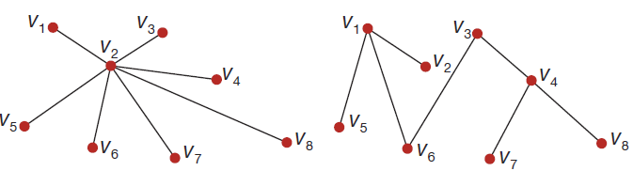
Skill Check #1
Skill Check #1
Construct two different trees with the vertices in Example 2.
Answer:

Slide 13
Spanning Tree
Spanning Tree
A spanning tree is a subgraph of a connected graph, which is itself connected and contains all the vertices of the original graph, but has no cycles.

Slide 14
Steps for Constructing a Spanning Tree
Steps for Constructing a Spanning Tree
In a connected graph G, identify a cycle. If more than one cycle exists, choose one at random.
Choose an edge from the cycle selected and delete it from the graph.
While the graph contains a cycle, repeat Steps 1 and 2.

Slide 15
Example 3: Using Spanning Trees
In an interview in Premier Magazine in 1994, Kevin Bacon commented that he had acted together with almost everyone in Hollywood. The game “Six Degrees of Kevin Bacon” was invented based on this comment. The goal is to link any named actor to Kevin Bacon by beginning with the named actor and naming no more than six actors, ending with Kevin Bacon, where each successive pair of actors have appeared in a movie together.

Slide 16
Example 3: Using Spanning Trees (cont.)
Find a spanning tree for the following graph, in which the vertices are actors, and two actors are joined by an edge if they appeared together in a movie where the edges are labeled with the movie.

Slide 17
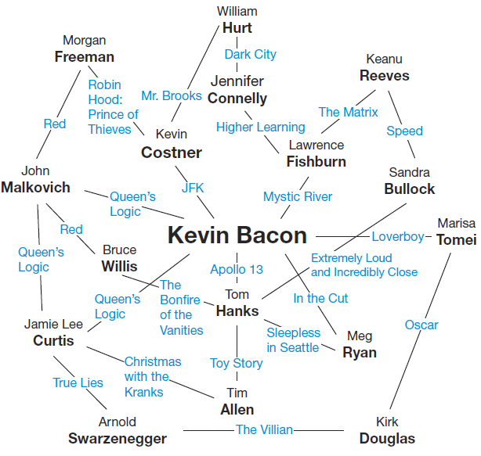
Example 3: Using Spanning Trees (cont.)

Slide 18
Example 3: Using Spanning Trees (cont.)
Solution
The algorithm says that we have to identify cycles one by one, and eliminate edges until no more cycles remain. There are lots of cycles to choose from here, but let’s begin with the following cycle.
Kevin Bacon, Lawrence Fishburne, Keanu Reeves, Sandra Bullock, Tom Hanks
Do you see this cycle on the graph? We are free to delete any of the edges of this cycle to construct the spanning tree. Let’s remove Speed.

Slide 19
Example 3: Using Spanning Trees (cont.)
The next cycle we’ll consider is the following.
Kevin Bacon, Lawrence Fishburne, Jennifer Connelly, William Hurt, Kevin Costner
This time let's remove the Mr. Brooks edge. While we’re at it, let’s also remove the edge that joins Kevin Costner to Morgan Freeman. That eliminates the cycle
Kevin Bacon, Kevin Costner, Morgan Freeman,
John Malkovich.

Slide 20
Example 3: Using Spanning Trees (cont.)
We can eliminate the cycle,
Kevin Bacon, Marisa Tomei, Kirk Douglas, Arnold Schwarzenegger, Jamie Lee Curtis
by removing the The Villain edge that joins Kirk Douglas to Arnold Schwarzenegger.
Although Jamie Lee Curtis and John Malkovich were both in Queen’s Logic with Kevin Bacon, let’s remove the edge that joins Jamie Lee Curtis and John Malkovich to break that cycle of length three. Now, there are three cycles that remain. Can you see them?

Slide 21
Example 3: Using Spanning Trees (cont.)
Kevin Bacon, John Malkovich, Bruce Willis, Tom Hanks
forms a cycle, so let’s delete the The Bonfire of the Vanities edge.
Kevin Bacon, Tom Hanks, Tim Allen, Jamie Lee Curtis
also forms a cycle, so we’ll delete the Toy Story edge. Finally, there is one cycle remaining:
Kevin Bacon, Meg Ryan, Tom Hanks.
We will remove this cycle by deleting the In the Cut edge. Now, we have the following spanning tree.

Slide 22
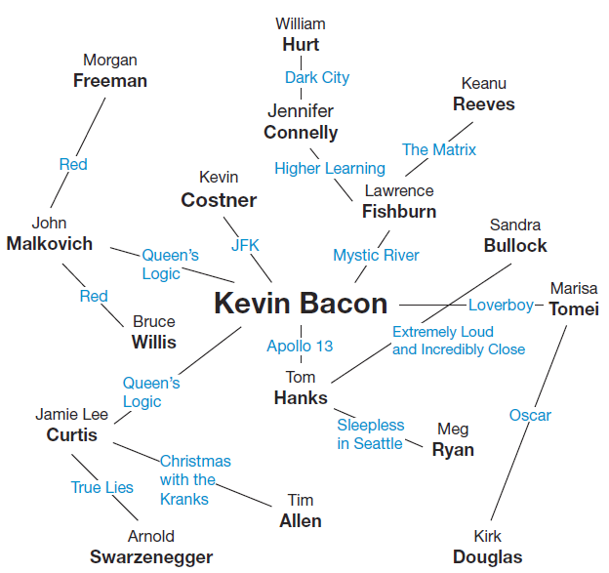
Example 3: Using Spanning Trees (cont.)

Slide 23
Skill Check #2
Skill Check #2
Find another spanning tree for the Kevin Bacon graph in Example 3 by deleting a different set of edges.
Answer: Answers will vary.

Slide 24
Steps for Constructing a Minimum-Weight Spanning Tree
Steps for Constructing a Minimum-Weight
Spanning Tree
Consider each edge in the graph in order of descending weight.
If the edge being considered is part of a cycle, remove it. If not, it must remain in the graph, and you can move on to the next edge.
Repeat Steps 1 and 2 until all edges have been considered.

Slide 25
Example 4: Constructing a Minimum‑Weight Spanning Tree
SpeedFirst Telecommunications is going to run its fiber optic cable in a new development. The edges in the given graph represent the possible ways that the cable can be run. The weight of each edge is the length of the cable needed, in meters. Obviously, SpeedFirst would like to find the most cost efficient way to lay the cable. Find the minimum spanning tree using the algorithm to obtain the most efficient process for SpeedFirst. What is the minimum amount of cable that SpeedFirst will need to run in the new development?

Slide 26
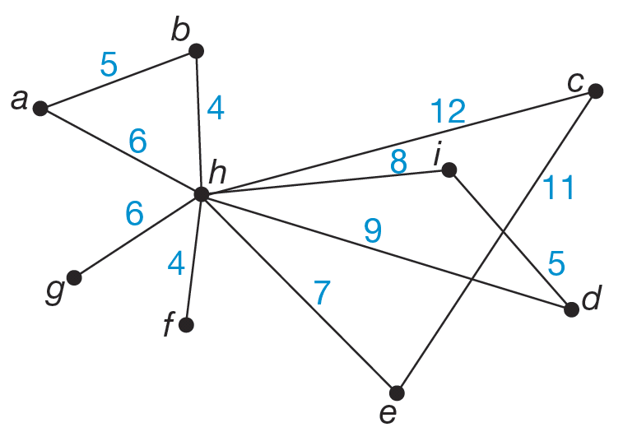
Example 4: Constructing a Minimum‑Weight Spanning Tree (cont.)
Solution
We begin with the edge with the largest weight, which is the edge hc = 12. Since it has the highest weight and is part of cycle h, c, e, remove it as shown.

Slide 27
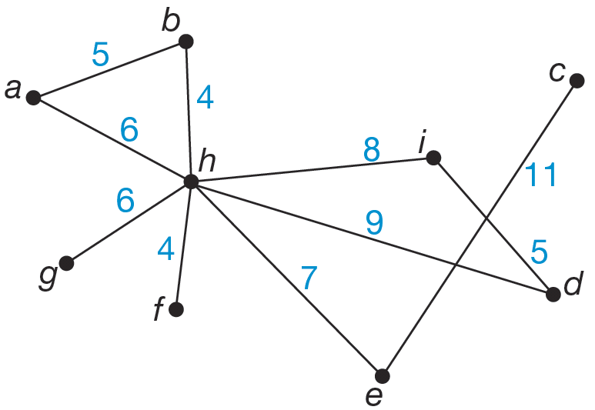
Example 4: Constructing a Minimum‑Weight Spanning Tree (cont.)
Next, look at edge ec = 11. This edge is no longer part of a cycle since the edge hc was removed, so this edge must remain in order to connect vertex c to the graph.

Slide 28
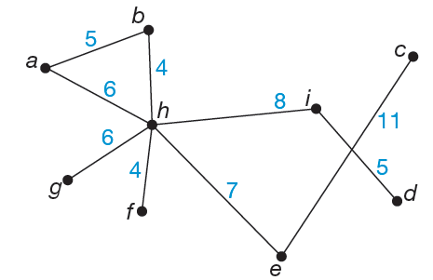
Example 4: Constructing a Minimum‑Weight Spanning Tree (cont.)
The next highest weighted edge is hd = 9. This edge is part of the cycle h, d, i, so we remove this edge. The figure shows the graph as it stands now.

Slide 29
Example 4: Constructing a Minimum‑Weight Spanning Tree (cont.)
Edge hi = 8 has the next highest weight. This is not part of a cycle since the edge hd was removed, so this edge remains to connect vertex i.
Next, we consider he = 7. This edge is not part of a cycle since the edge hc was removed, so it must remain to connect the vertex e.

Slide 30
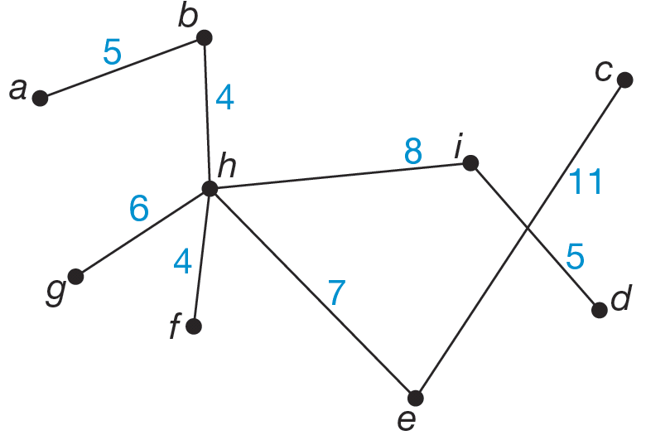
Example 4: Constructing a Minimum‑Weight Spanning Tree (cont.)
Look at edges ah = 6 and gh = 6. Edge ah is part of cycle a, h, b, so it will be removed. Edge gh is not part of a cycle, so it must remain to connect the vertex g.

Slide 31
Example 4: Constructing a Minimum‑Weight Spanning Tree (cont.)
Next, we consider edges ab = 5 and id = 5. Both of these edges must remain to connect vertices a and d since they are not part of any cycles once the other edges were removed.
Finally, we look at edges bh = 4 and fh = 4. Again, neither of these edges are part of any cycles, so they must remain to connect vertices b and f.

Slide 32
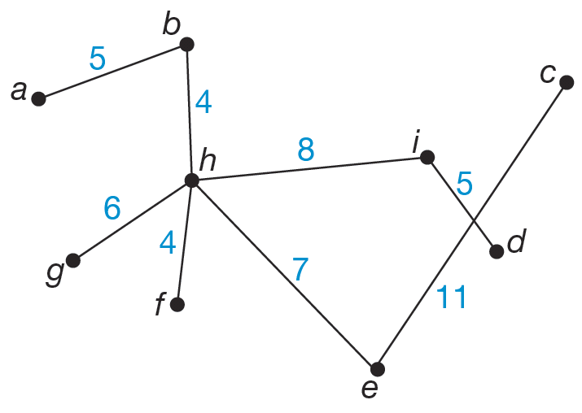
Example 4: Constructing a Minimum‑Weight Spanning Tree (cont.)
We have considered all edges in G, so we are done. Thus, our minimum-weight spanning tree is the following.

Slide 33
Example 4: Constructing a Minimum‑Weight Spanning Tree (cont.)
We can determine the minimum length of cable that SpeedFirst will need to run by adding together all of the weights in the minimum spanning tree.
Minimum length of cable = 4 + 4 + 5 + 5 + 6 + 7 + 8 + 11
= 50 meters.

Slide 34
Leaf
Leaf
A vertex of degree 1 in a tree is called a leaf.

Slide 35
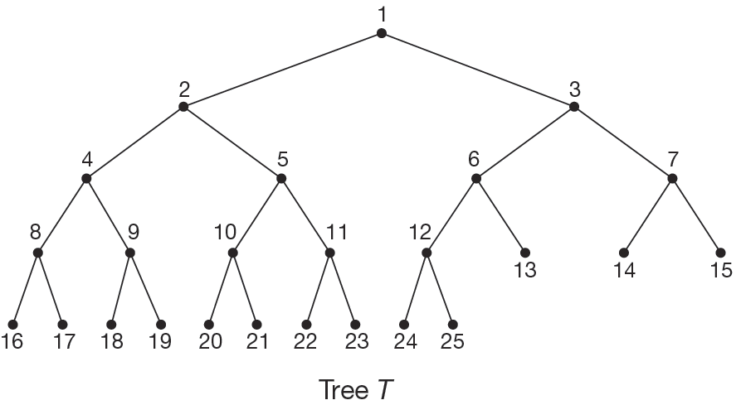
Example 5: Determining the Number of Leaves on a Tree
Determine the number of leaves on the tree T.

Slide 36
Example 5: Determining the Number of Leaves on a Tree (cont.)
Solution
To find the leaves in T, we need to look for vertices of degree 1. These will be vertices with only one edge connected to them. We’ve circled the leaves in the following diagram.

Slide 37
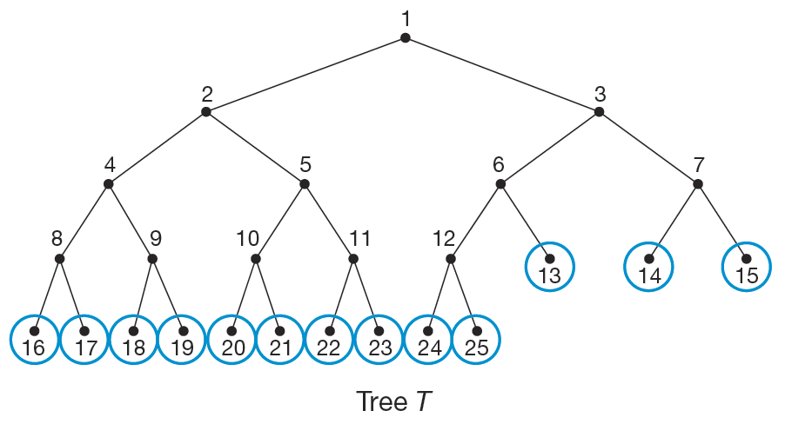
Example 5: Determining the Number of Leaves on a Tree (cont.)
There are 13 leaves on tree T.

Slide 38
Number of Leaves on a Tree
Number of Leaves on Tree
If a tree has k vertices with degrees d₁, d₂, . . . , d_{k}, each greater than 1, then the number of leaves on the tree
is

Slide 39
Example 6: Determining the Number of Leaves on a Tree
Governor Airlines has airport hubs in seven cities. Those seven cities have connecting flights to 2, 3, 6, 8, 7, 4, and 5 cities respectively. If the graph formed by joining each pair of available flights is a tree, how many different destinations does Governor Airlines fly to?
Solution
The total number of destinations is the number of vertices in the tree. That number of vertices consists of the number of leaves on the tree as well as the internal vertices.

Slide 40
Example 6: Determining the Number of Leaves on a Tree (cont.)
We know that there are seven internal vertices representing the seven airport hubs. To complete the number of destinations, we need to know the number of leaves.
The formula for the number of leaves is
where k is the number of vertices with degree greater than 1.

Slide 41
Example 6: Determining the Number of Leaves on a Tree (cont.)
So, the number of leaves will be calculated as follows.
Adding this to the number of airport hubs, the total number of destinations the airline serves is 23 + 7 = 30.

