Slide 1
Section 13.3
Matchings

Slide 2
Objectives
Determine if a graph is bipartite
Find a matching in a bipartite graph

Slide 3
Matchings
Whether it is high school students pairing up with prom dates that they know, students enrolling in classes, or telephone connections on a switchboard, these are all examples of things that have to be paired, or matched up. These types of problems require a graph with two groups of vertices. We call a graph in two parts like this a bipartite graph.

Slide 4
Bipartite Graph
Bipartite Graph
A bipartite graph is a graph in which the vertices can be partitioned into precisely two subsets so that every edge joins a vertex in one subset to a vertex in the other subset.

Slide 5
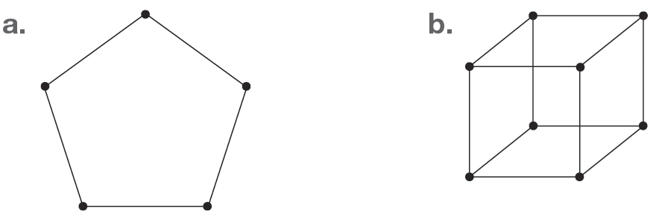
Example 1: Identifying Bipartite Graphs
Determine if the following graphs are bipartite.

Slide 6
Example 1: Identifying Bipartite Graphs (cont.)
Solution
a. To determine if the graph is bipartite, we need to show that the vertices can be divided into two groups. Let's assume there are two groups, the left-side group and the right‑side group. Begin by labeling the vertices either L for the left-hand side or R for the right‑hand side. We will start at the top and label the vertices alternately as we go clock-wise around the graph. If vertices are adjacent, they cannot have the same label.

Slide 7
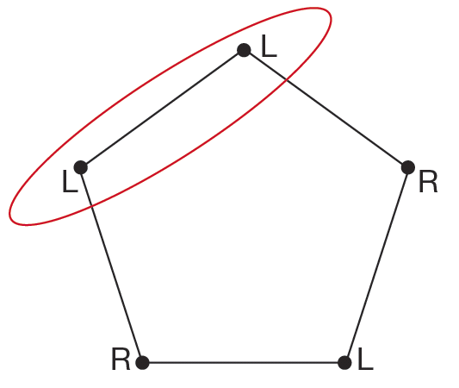
Example 1: Identifying Bipartite Graphs (cont.)
Notice that we end up with two adjacent vertices both labeled L. Therefore, this graph is not bipartite.

Slide 8
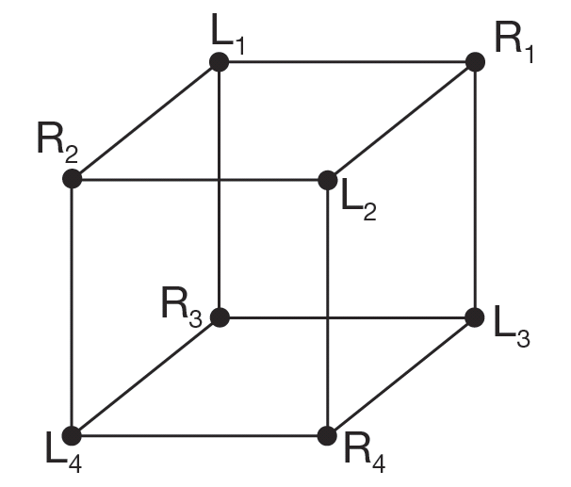
Example 1: Identifying Bipartite Graphs (cont.)
b. We can carry out the same process of labeling vertices with either L or R for the cube. We’ve also numbered each vertex to help keep track of them.

Slide 9
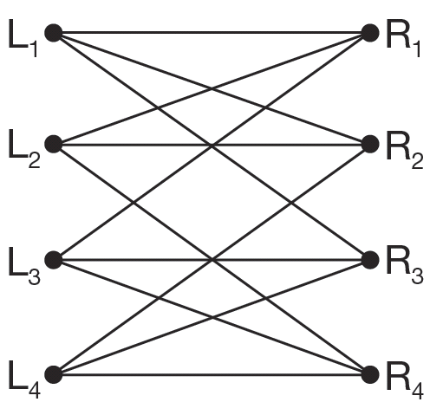
Example 1: Identifying Bipartite Graphs (cont.)
Notice that no adjacent vertices have the same label. Therefore this graph is bipartite. The next is an alternate drawing showing the vertices on their left and right sides.

Slide 10
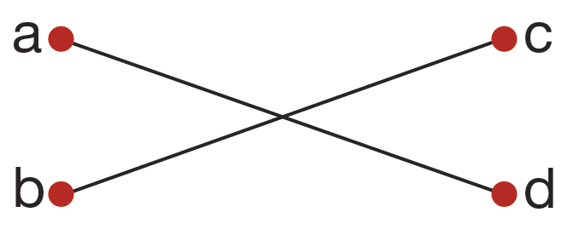
Skill Check #1
Skill Check #1
Determine if the following graph is bipartite.
Answer:
Yes, the graph is bipartite, since a and b can be the left-hand side and c and d can be the right-hand side.

Slide 11
Matching
Matching
A matching is a subset of edges in a graph so that each vertex is incident with only one edge.

Slide 12
Neighborhood
Neighborhood
If we have a set of vertices A, then the neighborhood of A, denoted N(A), is the set of all vertices connected to a vertex in A.

Slide 13
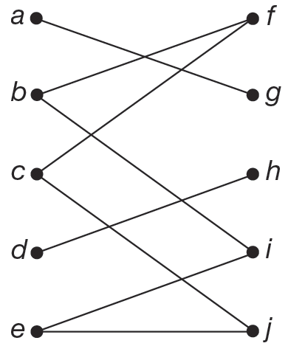
Example 2: Identifying a Neighborhood
Let A be the set of vertices {d, e}. Identify the neighborhood of A.

Slide 14
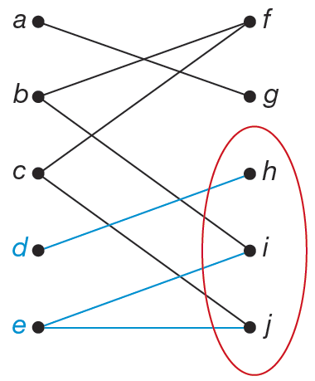
Example 2: Identifying a Neighborhood (cont.)
Solution
To find the neighborhood of A, we need to find all the vertices on the right‑hand side that are incident to the vertices in A. Vertex d is incident to vertex h on the right‑side and vertex e is incident to both vertices i and j.
So, N(A) = {h, i, j}.

Slide 15
Skill Check #2
Skill Check #2
Let B be the set of vertices {a, b} from the graph in Example 2. Identify the neighborhood of B.
Answer: N(B) = {f, g, i}

Slide 16
Hall’s Marriage Theorem
Hall’s Marriage Theorem
Let G be a bipartite graph. Then there is a matching of the left-hand vertices into the right‑hand vertices if and only if for every subset of left‑hand vertices A, the number of vertices in N(A) is at least as large as the number of vertices in A.

Slide 17
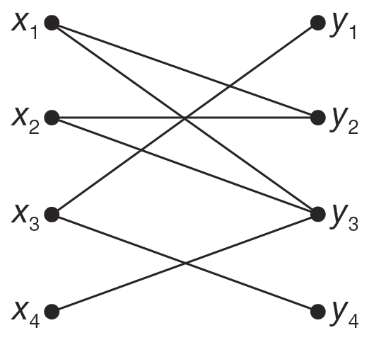
Example 3: Determining if a Matching is Possible
Use Hall’s Marriage Theorem to determine if a matching is possible for the following graphs.
a.

Slide 18
Example 3: Determining if a Matching is Possible (cont.)
b. Bill, Bob, and Benny are looking for dates for the prom. They have Gill, Grace, and Gabi in mind. Bill feels that he is friendly enough with Gill and Grace to ask either of them. However, Bob only feels comfortable asking Gabi, and Benny only feels comfortable asking Gill. Is there a way for each boy to ask a different girl to the prom?

Slide 19
Example 3: Determining if a Matching is Possible (cont.)
Solution
a. Hall’s Marriage Theorem says that for there to be a matching, whichever subset of vertices we choose on the left, their neighborhood on the right must be at least as large. For several subsets of vertices on the left this property is satisfied. For instance, consider A = {x₃}, which has N(A) = {y₁, y₄}.

Slide 20
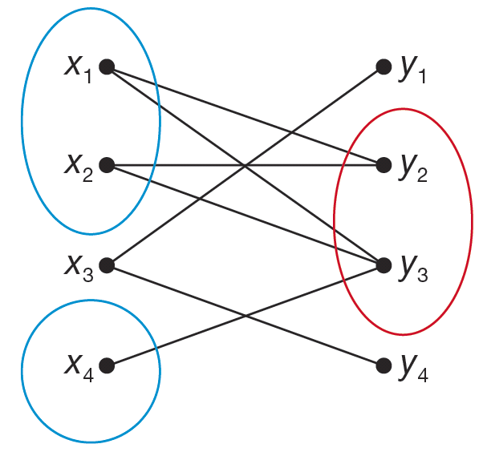
Example 3: Determining if a Matching is Possible (cont.)
But if we look at A = {x₁, x₂, x₄}, the neighborhood is N(A) = {y₂, y₃}, which violates Hall’s Marriage Theorem and shows that a matching is not possible.

Slide 21
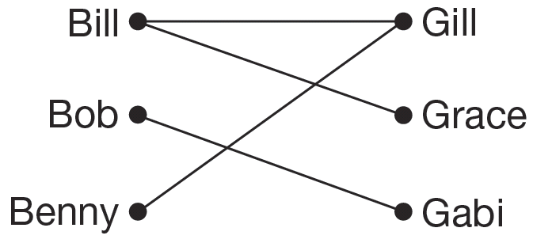
Example 3: Determining if a Matching is Possible (cont.)
b. To begin represent the boys and girls as a graph with the boys on the left and the girls on the right.

Slide 22
Example 3: Determining if a Matching is Possible (cont.)
A matching from the left into the right is a way for each boy to ask a different girl to the prom. You can probably see that this can be done by looking at the graph, but let’s see how Hall’s Marriage Theorem also establishes this.
To use Hall’s Marriage Theorem we need to consider each possible subset of boy vertices and check the size of the neighborhood. We have seven subsets to work through. We will deal with them one at a time.

Slide 23
Example 3: Determining if a Matching is Possible (cont.)
1. A = {Bill} N(A) = {Gill, Grace}
2. A = {Bob} N(A) = {Gabi}
3. A = {Benny} N(A) = {Gill}
4. A = {Bill, Bob} N(A) = {Gill, Grace, Gabi}
5. A = {Bill, Benny} N(A) = {Gill, Grace}
6. A = {Bob, Benny} N(A) = {Gill, Gabi}
7. A = {Bill, Bob, Benny} N(A) = {Gill, Grace, Gabi}

Slide 24
Example 3: Determining if a Matching is Possible (cont.)
As we can see, for each subset the number of elements in N(A) is greater than or equal to the number of elements in A. Therefore, Hall’s Marriage Theorem ensures that there is a matching, and a way for each boy to ask a different girl to the prom.

Slide 25
Regular Graph
Regular Graph
A regular graph is a graph where every vertex has the same degree.

Slide 26
Regular Bipartite Graph
Regular Bipartite Graph
A regular bipartite graph is a regular graph with the same number of vertices on both the left-hand side as the right-hand side.

Slide 27
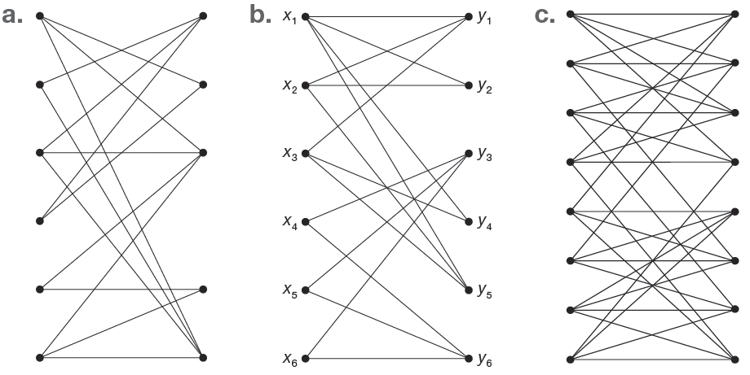
Example 4: Identifying a Regular Bipartite Graph
Determine whether each graph is a regular bipartite graph.

Slide 28
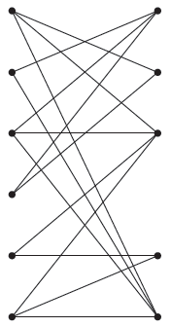
Example 4: Identifying a Regular Bipartite Graph (cont.)
Solution
a. A regular bipartite graph always has the same number of vertices on the left and right‑hand sides. This graph has six vertices on the left‑hand side and five on the right. Therefore, this graph is not a regular bipartite graph.

Slide 29
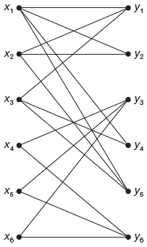
Example 4: Identifying a Regular Bipartite Graph (cont.)
b. This graph has six vertices on the left and right‑hand sides, but in a regular bipartite graph every vertex also has the same degree. Among lots of other differences, vertex x₁ has degree 4, but vertex x₂ has degree 3. Therefore, this graph is not a regular bipartite graph.

Slide 30
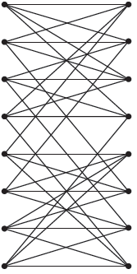
Example 4: Identifying a Regular Bipartite Graph (cont.)
c. This graph has eight vertices on each side, and every vertex has degree 4. Therefore, it is a regular bipartite graph.

Slide 31
Regular Bipartite Graph Theorem
Regular Bipartite Graph Theorem
A regular bipartite graph has a matching.

Slide 32
Example 5: Deciding if a Matching is Possible
Let’s consider the following scenario. At the British Museum in London, multimedia tours are offered in English, Korean, Arabic, French, German, Italian, Japanese, Mandarin, Russian, and Spanish. A group of ten students go to the museum. The graph shows which languages each student can understand. Determine if the graph has a matching.

Slide 33
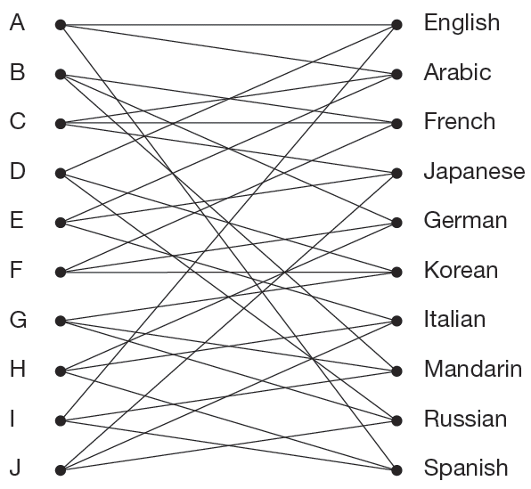
Example 5: Deciding if a Matching is Possible (cont.)

Slide 34
Example 5: Deciding if a Matching is Possible (cont.)
Solution
To determine if the graph has a matching, we need to determine if it is a regular bipartite graph. To do this, we need to check for two things:
1. All vertices must have the same degree.
2. The number of vertices on the left-hand side must be the same as the number of vertices on the right-hand side.

Slide 35
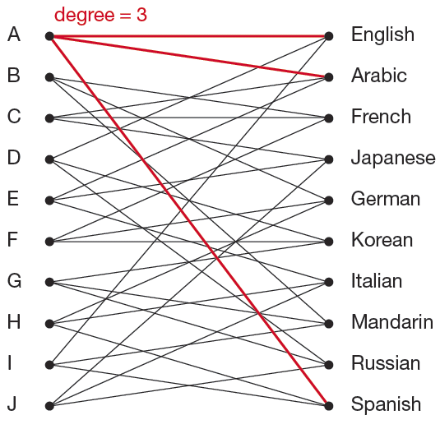
Example 5: Deciding if a Matching is Possible (cont.)
First to determine the degree of each vertex, we need to count the number of edges incident to each vertex on both sides of the graph.
We see that all vertices have degree 3, so the first criterion is met.

Slide 36
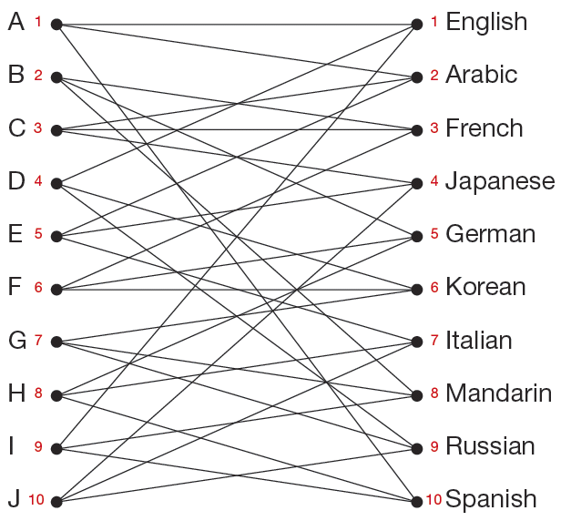
Example 5: Deciding if a Matching is Possible (cont.)
We can count the number of vertices on each side of the graph to make sure there are equal numbers in each.
Since this graph is a regular bipartite graph, we know from the theorem that it has a matching.

Slide 37
Schriver’s Algorithm
Schriver’s Algorithm
Given a regular bipartite graph G, give every edge in G a weight of 1.
Let C be a cycle in the edges of positive weight.
Number the edges of C successively in turn.
Increase the weight of the even-numbered edges by 1.
Decrease the weight of the odd-numbered edges by 1.
Repeat Step 2 until the edges with positive weight contain no cycle.
The positively weighted edges form a matching.

Slide 38
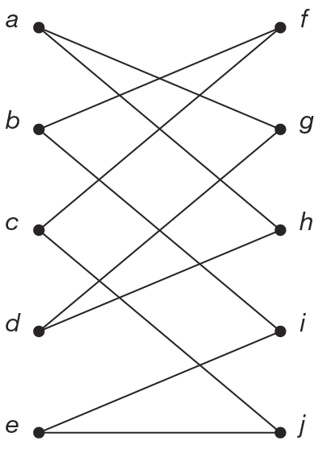
Example 6: Finding a Matching
Find a matching for the following regular bipartite graph.

Slide 39
Example 6: Finding a Matching (cont.)
Solution
We’ll use Schriver’s Algorithm to find a matching. Let every edge have a weight of 1. Now, find a cycle in the graph. Take a moment and see if you can find one first before looking at the next figure that shows the cycle. Sometimes the hardest part is finding the first cycle.

Slide 40
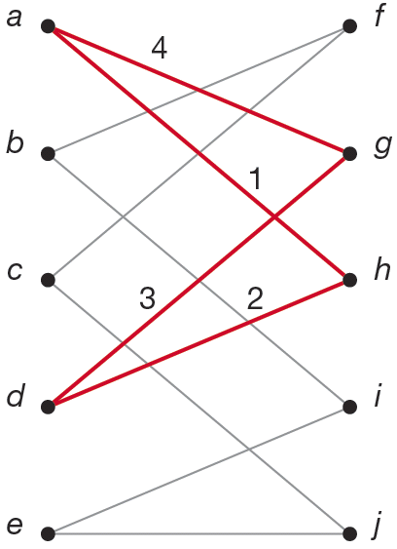
Example 6: Finding a Matching (cont.)
After finding a cycle, label the edges consecutively. The next figure shows the cycle a, h, d, g with the edges labeled in order, not by weight.

Slide 41
Example 6: Finding a Matching (cont.)
The next step is to increase the weights of the even numbered edges 2 and 4 by 1, which means they will now each have a weight of 2. We then decrease the odd numbered edges 1 and 3 by 1, which means they have a weight of 0 and can no longer be considered in the algorithm because only positive weighted edges are considered. In the next graph, the edges with positive weights are shown and the edges with zero weights are removed since they are not part of the matching.

Slide 42
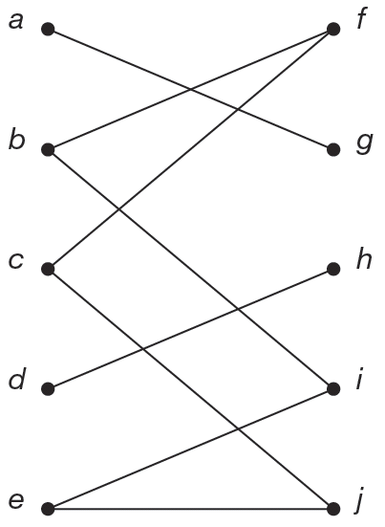
Example 6: Finding a Matching (cont.)

Slide 43
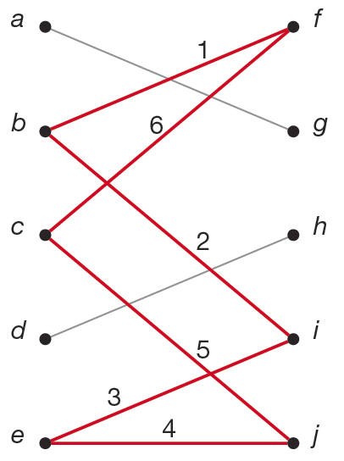
Example 6: Finding a Matching (cont.)
We begin again at Step 2 by finding a cycle from the edges with positive weights. The only remaining cycle is f, b, i, e, j, c. Label the cycle with consecutive numbers.

Slide 44
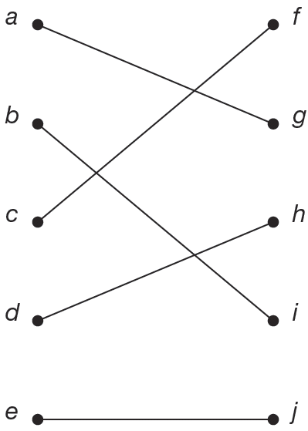
Example 6: Finding a Matching (cont.)
Once again, increase the weight of the even numbered edges by 1 and decrease the odd edges by 1. The only remaining positive weighted edges give us the following graph.
Because there are no more cycles, we can stop. The remaining edges form the matching we required.

Slide 45
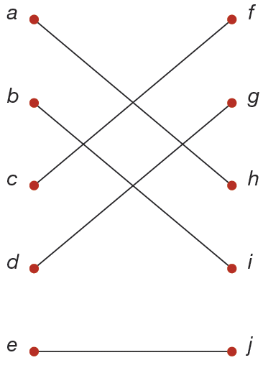
Skill Check #3
Skill Check #3
Find a different matching for the graph in Example 6.
Answer: Answers will vary. For example,

