Slide 1
Section 13.4
Planar Graphs

Slide 2
Objectives
Know the properties of planar graphs
Use Euler’s formula for planar graphs

Slide 3
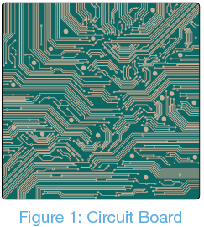
Planar Graphs
Recall from the definition of a graph that not every place where two edges cross is a vertex. In such graphs, edges that cross have no consequences. However, it’s not always the case that we want graphs to allow crossings. For instance, consider a circuit board. If the connections that join the components on a circuit board cross, it could cause the circuit board to malfunction.

Slide 4
Planar Graphs
Planar Graphs
Graphs that can be drawn on a plane without edge crossings are called planar graphs.

Slide 5
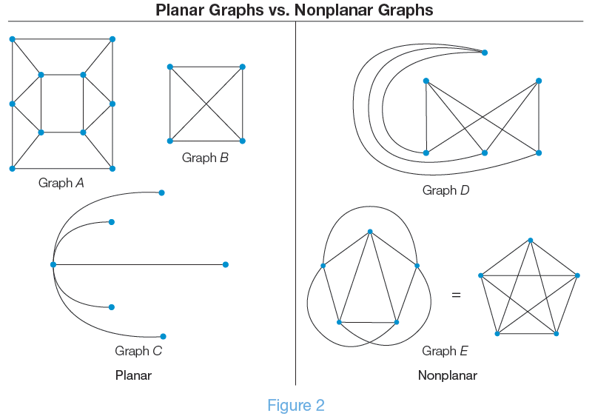
Planar Graphs vs. Nonplanar Graphs

Slide 6
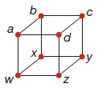
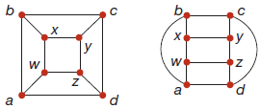
Skill Check #1
Skill Check #1
Draw the following planar graph without any edge crossings.
Answer: Answers will vary. Two possibilities are as follows.

Slide 7
Face
Face
In a planar graph, a face is a region inside a cycle of edges or the infinite exterior region on the outside of the graph. We denote the number of faces of a graph by f.

Slide 8
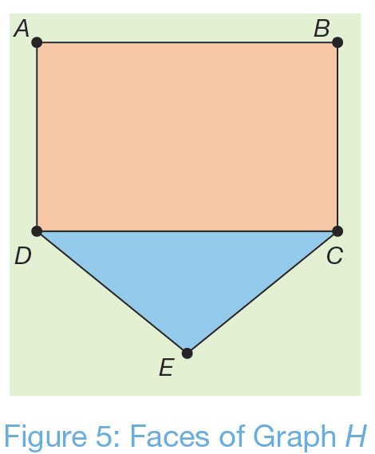
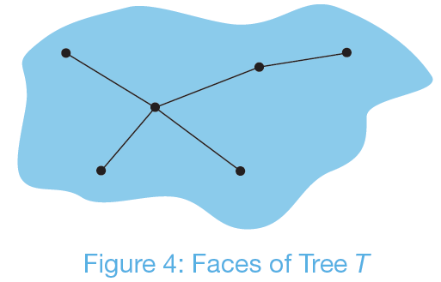
Examples of Faces of a Graph

Slide 9
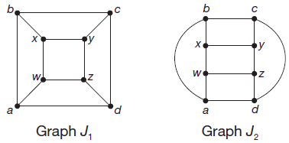
Example 1: Determining the Number of Faces in a Planar Graph
Two drawings of the same graph J are shown. Verify that both drawings have the same number of faces.

Slide 10
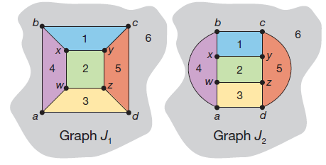
Example 1: Determining the Number of Faces in a Planar Graph (cont.)
Solution
We can count each of the faces by counting the contained spaces in the graph as well as the exterior face. We’ve numbered the spaces for each graph in the following figure.

Slide 11
Example 1: Determining the Number of Faces in a Planar Graph (cont.)
You can see that f = 6 in both diagrams. In fact, graph J will always have six faces no matter how we draw it.

Slide 12
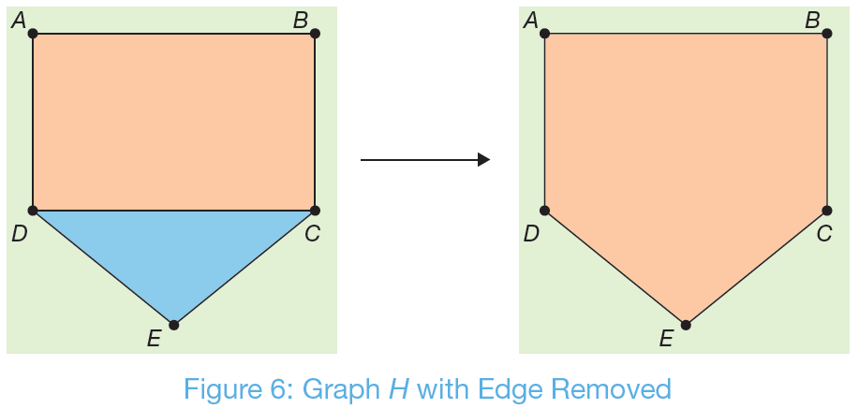
Removing an Edge from a Graph
Removing any edge from a cycle in a graph will decrease the number of faces by one.

Slide 13
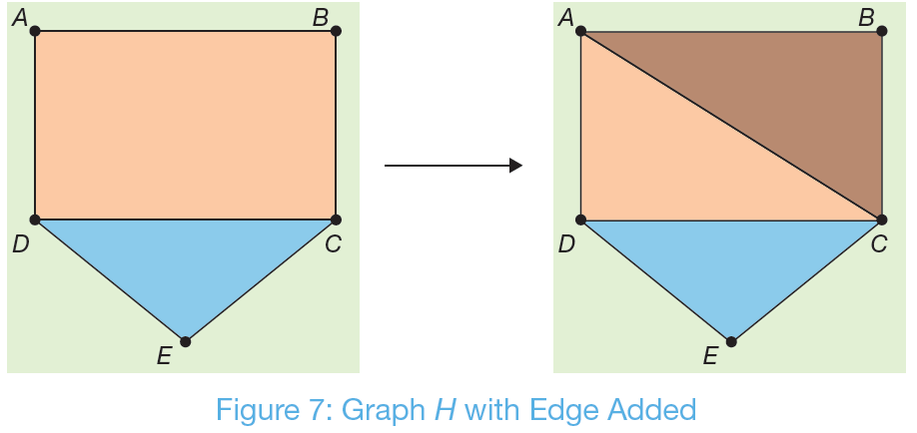
Adding an Edge to a Graph
Adding an edge to a graph will increase the number of faces by one.

Slide 14
Skill Check #2
Skill Check #2
a. What would happen if we removed the edge CE from the original graph H in Figure 5?
b. What would happen if we add the edge BD to the original graph H in Figure 5?
Answer:
a. There would then only be two faces.
b. We’d split the orange face in two, creating four faces in total.

Slide 15
Euler’s Formula
Euler’s Formula
If G is a connected planar graph with v vertices, e edges, and f faces, then
v + f − e = 2.

Slide 16
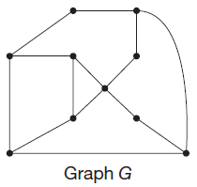
Example 2: Verifying Euler’s Formula for a Graph
Confirm Euler's formula for the planar graph G.
Solution
We can see that G has 10 vertices and 14 edges. All that remains is to find the number of faces.

Slide 17
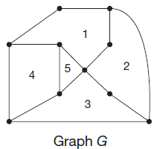
Example 2: Verifying Euler’s Formula for a Graph (cont.)
It has 5 internal faces, as indicated in the graph.
However, we must also remember to include the external face. That makes a total of 6 faces.
So, now we have that v = 10, e = 14, and f = 6.

Slide 18
Example 2: Verifying Euler’s Formula for a Graph (cont.)
Substituting into Euler's formula, we can confirm that the number of vertices plus the number of faces minus the number of edges is equal to 2.
v + f – e = 10 + 6 – 14 = 2.

Slide 19
Example 3: Applying Euler’s Formula
A soccer ball traditionally consists of hexagonal, white faces and pentagonal, black faces. Suppose that we use a box cutter and cut out one of the white, hexagonal faces from the ball to make a hole. Now, imagine that we could stretch the ball covering outward at the hole we made, so that it lies completely flat in a plane as shown. How many black pentagonal faces are there?

Slide 20
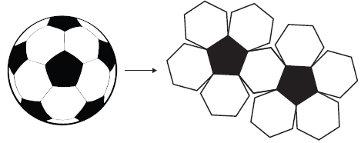
Example 3: Applying Euler’s Formula (cont.)
Solution
Remember that Euler's formula says that the number of vertices plus the number of faces minus the number of edges in a planar graph must equal 2. To use Euler’s formula, we need to find a way to express the number of vertices, edges, and faces in a soccer ball, and then substitute them into the formula.

Slide 21
Example 3: Applying Euler’s Formula (cont.)
Let’s tackle the vertices first. On the soccer ball, each black pentagon has five vertices, and of course, each white hexagon has six vertices. We can count the total number of vertices on the entire ball one face at a time by counting 5 for every black pentagon and 6 for every white hexagon. So, if we let P represent the number of pentagonal faces, we can multiply it by 5. Similarly, we’ll let H represent the number of hexagonal faces and multiply it by 6. Then, the total number of vertices can be represented by the sum 5P + 6H.

Slide 22
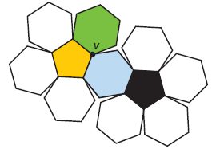
Example 3: Applying Euler’s Formula (cont.)
However, notice that every vertex on the soccer ball is a vertex of three adjacent faces. The following diagram shows how vertex v is adjacent to the three faces colored yellow, green, and blue.

Slide 23
Example 3: Applying Euler’s Formula (cont.)
So, if we claim the number of vertices on the soccer ball is 5P + 6H, we end up counting each vertex multiple times. Look at vertex v in the previous figure again. It will be counted as part of each of the three faces in which it lies. In fact, every vertex lies in three faces, which means every vertex will be counted three times as we count around the faces. So, we must divide the number of vertices by 3 to give us

Slide 24
Example 3: Applying Euler’s Formula (cont.)
We can do the same to count the number of edges on the soccer ball. Every black pentagon has five edges, and every white hexagon has six edges. Again, we must be careful not to over count the edges. Notice that every edge is on the boundary of two faces. For instance, the edge highlighted is on the boundary of the yellow face as well as the green face.

Slide 25
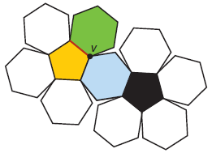
Example 3: Applying Euler’s Formula (cont.)
So, the number of edges is given by the following.

Slide 26
Example 3: Applying Euler’s Formula (cont.)
Now that we’ve found expressions for the number of vertices and edges, we just need to express the number of faces. The total number of faces will be the number of black pentagons P plus the number of white hexagons H. (Recall that we cut out one of the white hexagonal faces, which counts as the exterior face. As a result, we do not need to count an exterior face.)

Slide 27
Example 3: Applying Euler’s Formula (cont.)
Substituting these expressions into the formula we have the following.
Next, simplify this equation by removing the fractions and combining like terms together.

Slide 28
Example 3: Applying Euler’s Formula (cont.)

Slide 29
Example 3: Applying Euler’s Formula (cont.)
This means that no matter how many hexagons there are, there must always be precisely 12 black pentagons on the soccer ball.

Slide 30
Corollary of Euler’s Formula
Corollary of Euler’s Formula
A planar graph G with v vertices has at most 3v − 6 edges. That is, e ≤ 3v − 6.

Slide 31
Example 4: Number of Edges in a Planar Graph
If graph G has 13 vertices, what is the greatest number of edges that graph G can have and be a planar graph?
Solution
If graph G is to be a planar graph, then the number of edges can be at most 3v – 6. Since we know that graph G has 13 vertices, v = 13. Therefore, in graph G the number of edges, e, can be at most

Slide 32
Skill Check #3
Skill Check #3
What is the maximum number of edges that a five-vertex graph can have and still be planar? (Hint: Draw a graph to help you find the answer.)
Answer: Nine edges

Slide 33
Complete Graphs
Complete Graphs
A complete graph is a defined to be a graph in which all vertices are connected to all other vertices. We denote a complete graph by K_{n}, where n is the number of vertices in the graph.

Slide 34
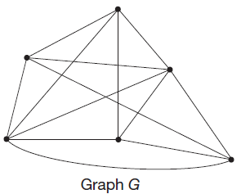
Example 5: Establishing That a Graph Is Not Planar Using Euler’s Corollary
Use the corollary of Euler's formula to establish that graph G is not planar.

Slide 35
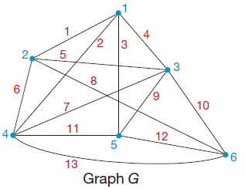
Example 5: Establishing That a Graph Is Not Planar Using Euler’s Corollary (cont.)
Solution
To use the corollary of Euler's formula, we need to count the number of edges and the number of vertices in graph G. There are six vertices (numbered in blue) and 13 edges (numbered in red) as labeled in the following graph.

Slide 36
Example 5: Establishing That a Graph Is Not Planar Using Euler’s Corollary (cont.)
So v = 6 and e = 13. Now we can substitute these values into the corollary to see if graph G meets the restriction to be planar.
The number of edges is too large, therefore it is not possible for G to be planar.
?
?
?

Slide 37
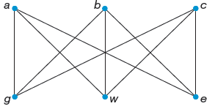
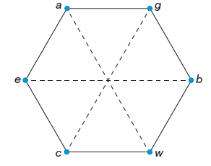
K_{3,3}
K_{3,3} is a regular bipartite graph where each vertex has degree 3. It has six vertices, three on the top and three on the bottom.
K_{3,3} satisfies the corollary of Euler’s Formula, but cannot be redrawn without edges crossing. Therefore, K_{3,3} is not a planar graph.

Slide 38
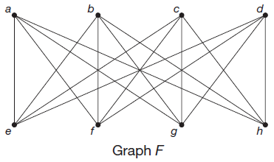
Example 6: Classifying Graphs as Planar or Not
Decide whether graph F is planar or not.
Solution
Graph F has v = 8 vertices and e = 16 edges.
Let’s first check that this satisfies the corollary of Euler's formula.

Slide 39
Example 6: Classifying Graphs as Planar or Not (cont.)
It does satisfy the inequality. However, that doesn’t guarantee that graph F is planar.
?
?
?

Slide 40
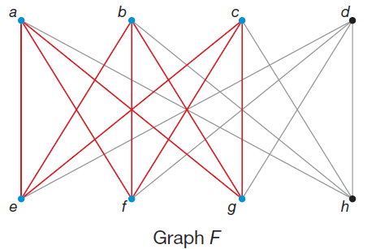
Example 6: Classifying Graphs as Planar or Not (cont.)
Instead, notice that graph F has a subgraph on a, b, c, e, f, g that is the same as K_{3,3}, which we saw is not planar.
So, since we can’t draw K_{3,3} without edges crossing, then graph F cannot be planar.

Slide 41
Planar Subgraph Theorem
Planar Subgraph Theorem
Graph G is not planar if any subgraph of G is not planar.

Slide 42
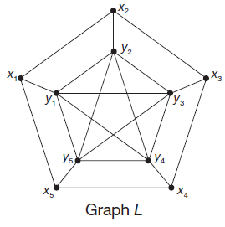
Example 7: Establishing that a Graph is Not Planar Using Subgraphs
Use the theorem to show that the graph L is not planar by finding a suitable subgraph.

Slide 43
Example 7: Establishing that a Graph is Not Planar Using Subgraphs (cont.)
Solution
In order to show that graph L is not planar, it is enough to find either a K₅ or K_{3,3} subgraph. Let’s consider the five vertices in the middle of the graph labeled y₁, y₂, y₃, y₄, and y₅. If they form the graph K₅, meaning each vertex is connected to all other vertices, then the graph is not planar.

Slide 44
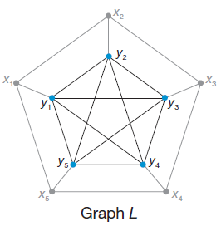
Example 7: Establishing that a Graph is Not Planar Using Subgraphs (cont.)
Notice that each of the vertices y₁ through y₅ have degree 4 and are all connected to each other. Check this for yourself. The existence of this subgraph is sufficient to say that graph L is not planar.

Slide 45
Planar Graph Theorem
Planar Graph Theorem
G is planar if and only if G has neither K_{3,3} nor K₅ as a minor.

Slide 46
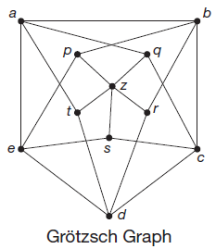
Example 8: Classifying Graphs as Planar or Not
The following is a famous graph called the Grötzsch graph. Show that it is not planar by finding a K₅ minor of the graph.

Slide 47
Example 8: Classifying Graphs as Planar or Not (cont.)
Solution
In order to show that the Grötzsch graph is not planar, we need to show that it contains a K₅ minor. Without stronger algorithms that are beyond the scope of this text, we need to simply “find” a minor by a process of deleting vertices, deleting edges, or using edge contractions. Remember that looking for a K₅ minor means that we are looking for five vertices that are all connected to each other.

Slide 48
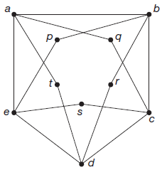
Example 8: Classifying Graphs as Planar or Not (cont.)
Obviously, there are too many vertices in the original graph, so we’ll begin by deleting the middle vertex z. When we delete a vertex from a graph, all edges connected to it also get deleted because they no longer have a vertex at both of their ends.
The following graph shows the Grötzsch graph after deleting z.

Slide 49
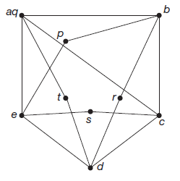
Example 8: Classifying Graphs as Planar or Not (cont.)
Can you begin to see where the five vertices in the minor might come from? If we can eliminate the inner vertices, we might just have the graph we are seeking. Begin by contracting edge aq so that the vertices a and q become one.
We now have one edge between aq and c as the following graph shows.

Slide 50
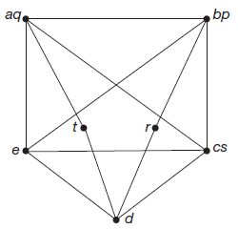
Example 8: Classifying Graphs as Planar or Not (cont.)
In the same manner, we can contract the edge pb as well as edge sc. Here’s the contracted graph so far.

Slide 51
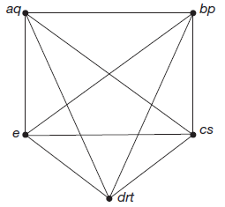
Example 8: Classifying Graphs as Planar or Not (cont.)
What remains is to contract edges td and rd. Once this is done, we have the following graph of five vertices of degree 4 all connected together. In other words, a K₅ minor of the Grötzsch graph.
Hence, we have shown that the Grötzsch graph is not planar since it contains a K₅ minor.

