Slide 1
Section 14.1
Prime Numbers

Slide 2
Objectives
Identify prime numbers
Find the greatest common divisor of numbers

Slide 3
Prime Numbers
Number theory looks at the properties of families of numbers and how they interconnect. One of the fundamental building blocks of this interconnection is the set of prime numbers. Just as all matter is built up from the elements of the periodic table, we will see that every number can be built up from the “mathematical periodic table” of prime numbers.

Slide 4
Prime Numbers
Prime Numbers
A prime number is a positive integer that has precisely two divisors: 1 and itself.

Slide 5
Composite Numbers
Composite Numbers
A composite number is a positive integer that has more than two divisors.
Note: The numbers 0 and 1 are neither prime nor composite.

Slide 6
Sieve of Eratosthenes
Sieve of Eratosthenes
Write out all positive integers up to N.
Starting with 2, highlight the 2 and cross out all other multiples of 2.
The next smallest number not crossed out is a prime number. Highlight this number and cross out all other multiples of this number.
Repeat Step 3 until all numbers are either highlighted or crossed out.

Slide 7
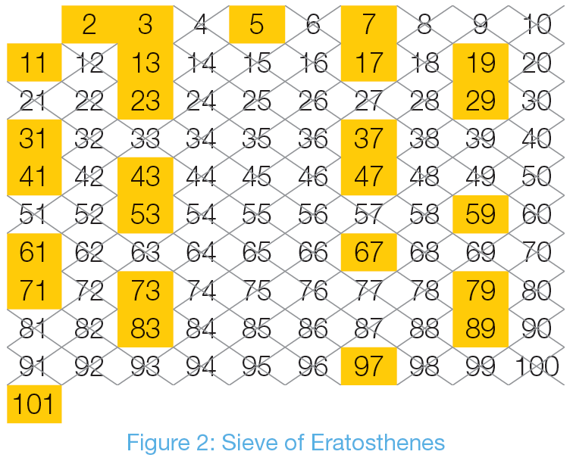
Sieve of Eratosthenes for Numbers up to 101

Slide 8
Table 1: Divisibility Rules
Table 1: Divisibility Rules
Divisor | Test | Example
2 | The number is even. | The number 391,574 is divisible by 2 because it is even.
3 | When the digits of the number are added together, the resulting number is divisible by 3. | 87,408 is divisible by 3 because 8 + 7 + 4 + 0 + 8 = 27 and 27 is divisible by 3.
4 | The last 2 digits of the number form a number divisible by 4. | 316 is divisible by 4 because 16 is divisible by 4.

Slide 9
Table 1: Divisibility Rules
Table 1: Divisibility Rules (cont.)
Divisor | Test | Example
5 | The number ends in a 0 or a 5. | 29,345 is divisible by 5 because it ends in a 5.
6 | The number is divisible by both 2 and 3. | 628,116 is divisible by 6 because it’s divisible by 2, since it’s even, and 3, since 6 + 2 + 8 + 1 + 1 + 6 = 24 and 24 is divisible by 3.

Slide 10
Table 1: Divisibility Rules
Table 1: Divisibility Rules (cont.)
Divisor | Test | Example
7 | Double the last digit, then subtract it from the remaining digits of the number. If the answer is divisible by 7, then so is the original number. | 819 is divisible by 7 since 2 · 9 = 18 and 81 − 18 = 63. 63 is divisible by 7, so 819 is also.
8 | The last 3 digits of the number form a number divisible by 8. | 2160 is divisible by 8 because 160 is divisible by 8.

Slide 11
Table 1: Divisibility Rules
Table 1: Divisibility Rules (cont.)
Divisor | Test | Example
9 | When the digits of the number are added together, the resulting number is divisible by 9. | 189 is divisible by 9 because 1 + 8 + 9 = 18 and 18 is divisible by 9.
10 | The number ends in a 0. | 9,145,830 is divisible by 10 because it ends in a 0.

Slide 12
Example 1: Classifying a Number as Prime or Composite
Determine if the following numbers are prime or composite using the divisibility rules.
a. 312
b. 101
c. 2,344,017
Solution
a. Since the number 312 is even, we know that it is divisible by 2. It is enough to stop here and know that the number is composite, but we’ll continue on to determine if there are other small divisors of 312.

Slide 13
Example 1: Classifying a Number as Prime or Composite (cont.)
If we add the digits together, we get 3 + 1 + 2 = 6. Because 6 is divisible by 3, 312 is also divisible by 3.
In addition, the last 2 digits form the number 12, which is divisible by 4, so we know that 312 is also divisible by 4.
Although we have plenty of examples to show us the number is composite, one last point to notice is that because 312 is divisible by 2 and by 3, it must also be divisible by 6.

Slide 14
Example 1: Classifying a Number as Prime or Composite (cont.)
b. Since 101 is odd, it is not divisible by any of the even divisors: 2, 4, 6, 8, or 10. 1 + 0 + 1 = 2, which is not divisible by 3, so 101 is not divisible by 3, 6, or 9. That leaves 5 and 7 to check. 101 is not divisible by 5 because it does not end in 0 or 5. Lastly, 2 ∙ 1 = 2 and 10 − 2 = 8. 8 is not divisible by 7, so 101 is not either.

Slide 15
Example 1: Classifying a Number as Prime or Composite (cont.)
That eliminates all of the small divisors, but to establish that 101 is prime, we have to deal with all divisors smaller than 101. Notice that if both a and b are integers bigger than 10, then a ⋅ b ≥ 121. So if 101 had divisors a and b, one of them must be smaller than 10. Since we’ve already established that there are no divisors smaller than 10, 101 is prime.
While 101 was shown to be prime earlier in the text, testing for factors is a method for checking without making a sieve or memorizing the list of primes.

Slide 16
Example 1: Classifying a Number as Prime or Composite (cont.)
c. We know that the number 2,344,017 is not divisible by 2, 4, 6, 8, or 10 since it is not even. Adding the digits together gives us 2 + 3 + 4 + 4 + 0 + 1 + 7 = 21, which is divisible by 3, so the number is divisible by 3. Again, although we now know the number is composite, we’ll continue to show how to check for other small divisors.
2,344,017 is not divisible by 5 since it does not end in a 5 or 0.

Slide 17
Example 1: Classifying a Number as Prime or Composite (cont.)
Doubling the last digit we have 7 ⋅ 2 = 14. Then, 234,401 − 14 = 234,387. This is still a large number, so we can apply the rule again to check if it’s divisible by 7. Continue repeating this process until we are able to definitively say if a number is divisible by 7.

Slide 18
Example 1: Classifying a Number as Prime or Composite (cont.)
Since 12 is not divisible by 7, our original number is not divisible by 7. (Although we used the divisibility rule for 7 here, it may have been quicker to use long division and see if the number has a remainder when divided by 7.)
The only other number left in our list to check is 9. Adding the digits together, as we did earlier, we have 21. Since 21 is not divisible by 9, the number 2,344,017 is not divisible by 9.
However, we know that 2,344,017 is composite because it divisible by the number 3.

Slide 19
Skill Check #1
Skill Check #1
Determine if 3,743,216 is prime or composite.
Answers: It’s even, so it's composite.

Slide 20
Fundamental Theorem of Arithmetic
Fundamental Theorem of Arithmetic
Every positive integer greater than 1 is either a prime number or can be written as a unique product of prime numbers. This unique product of prime numbers is called its prime factorization.

Slide 21
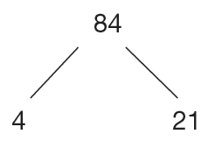
Example 2: Using a Factor Tree to Find a Prime Factorization
Use a factor tree to determine the prime factorization of the number 84.
Solution
Start by choosing any pair of factors you like, other than 1 and 84. We’ll use the pair 4 and 21, as shown here.

Slide 22
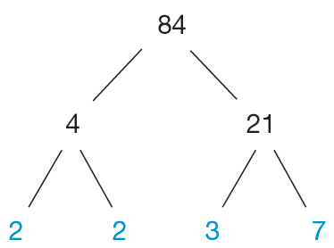
Example 2: Using a Factor Tree to Find a Prime Factorization (cont.)
Next, notice that both of the numbers 4 and 21 also have factors. Branching each off into its own factors, we have the following.
This time, as we look across the bottom row of factors, we can see that they are all prime. Thus, the prime factorization of 84 is 2 ⋅ 2 ⋅ 3 ·7.

Slide 23
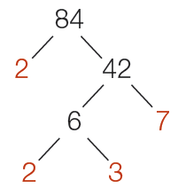
Skill Check #2
Skill Check #2
Use a factor tree to find the prime factorization of 84 by starting with the pair of factors 2 and 42. Although your factor tree may not look identical to a tree drawn by someone else, the prime factorization of the number 84 will be identical.
Answer:

Slide 24
Example 3: Classifying a Number as Prime or Composite
Determine whether 197 is prime or composite.
Solution
If 197 is composite, it must have a prime divisor that is less than The prime numbers less than 14 are 2, 3, 5, 7, 11, and 13.
197 is not even, so it is not divisible by 2. 1 + 9 + 7 = 17 and 17 is not divisible by 3, which eliminates 3. 197 doesn’t end in 0 or 5, which eliminates 5, and 19 − (7 ∙ 2) = 5 and 5 is not divisible by 7, which eliminates 7.

Slide 25
Example 3: Classifying a Number as Prime or Composite (cont.)
All that remains is to check 11 and 13.
This gives that 197 is prime.

Slide 26
Greatest Common Divisor (GCD)
Greatest Common Divisor (GCD)
The largest integer that divides two numbers without a remainder is called the greatest common divisor (GCD). If the GCD = 1 for a pair of numbers, the numbers are said to be relatively prime.

Slide 27
Example 4: GCD Using Factor Trees
Use factor trees to find the greatest common divisor of 40 and 60.
Solution
Begin by constructing the factor trees of 40 and 60 as shown.

Slide 28
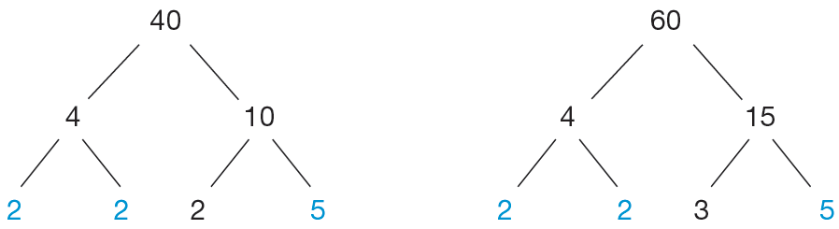
Example 4: GCD Using Factor Trees (cont.)
Notice that both 40 and 60 have the factors 2 and 5 in common. In fact, both numbers have two 2s in common as well as one 5. So, the GCD of 40 and 60 is
2 ⋅ 2 ⋅ 5 = 20.

Slide 29
Example 5: Using the GCD
One way that the Manna Café Pantry serves the hungry of Clarksville, TN, is by distributing boxes of food each week to the local shelters. As part of the stipulation for receiving local governmental funds, all boxes must contain the same number of items from each of the following categories: pasta, canned vegetable, and canned meat. This week, the pantry has the following in supply: 360 pasta items, 540 canned vegetables, and 240 canned meats.

Slide 30
Example 5: Using the GCD (cont.)
a. Using all of the food, what is the maximum number of food boxes that Manna Café can distribute this week?
b. How many of each item will be in each box?
Solution
a. In order to distribute all of the food items evenly among the food boxes, the number of boxes must be a divisor of 360, 540, and 240.

Slide 31
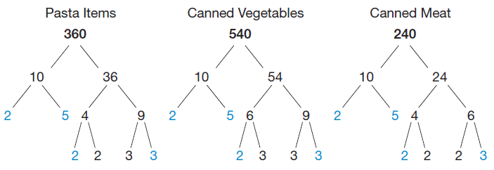
Example 5: Using the GCD (cont.)
To find the maximum number of food boxes that can be made from all of the pantry supplies, we need to find the GCD of the three numbers. First, find the prime factorization of each number. We'll do this by constructing factor trees of each number.

Slide 32
Example 5: Using the GCD (cont.)
The GCD of 360, 540, and 240 is 2 ·2 ·3 ·5 = 60. Therefore, the pantry can give out 60 food boxes to the local shelters this week.
b. In order to find how many of each item will be in the boxes, we can use the prime factorizations that we found in part a. For each food category, if we remove the GCD from the prime factorization, the remaining factors will tell us how many of each item needs to go in a box.

Slide 33
Example 5: Using the GCD (cont.)
Each prime factorization with the GCD marked out is as follows.
Therefore, we can see that there will be 2 · 3 = 6 pasta items, 3 · 3 = 9 canned vegetables, and 2 · 2 = 4 canned meats in each box.

Slide 34
Steps for Using Euclid’s Algorithm
Steps for Using Euclid’s Algorithm
Divide the larger of the given numbers by the smaller (the divisor) and note the remainder.
Divide the original divisor (the smaller of the given numbers) by the remainder found in Step 1.
Continue dividing the previous divisor by the previous remainder until the remainder is 0.
The last nonzero remainder is the GCD of the given numbers.

Slide 35
Example 6: Finding the GCD Using Euclid’s Algorithm
Use Euclid’s Algorithm to find the greatest common divisor of 88 and 300.
Solution
Begin with the two numbers 88 and 300. Divide the larger number by the smaller number and note the remainder.
Our next division will use the remainder that we just found, 36, and the original divisor, 88.

Slide 36
Example 6: Finding the GCD Using Euclid’s Algorithm (cont.)
Again, divide the larger by the smaller and note the remainder. Continue until we get a remainder of zero.
Since 4 is the last nonzero remainder, it is the GCD of 88 and 300.

Slide 37
Example 7: Relatively Prime Numbers Using Euclid’s Algorithm
Use Euclid’s Algorithm to show that 88 and 17 are relatively prime.
Solution
Divide the larger number by the smaller number and note the remainder.
Our next division will use the remainder we just found and the divisor. Repeat this process until the remainder is zero.

Slide 38
Example 7: Relatively Prime Numbers Using Euclid’s Algorithm (cont.)
The last nonzero remainder is 1, so the GCD of 88 and 17 is 1, which means that these numbers are relatively prime.

Slide 39
Euclid’s Proof of Infinitely Many Primes (A Summary)
Suppose that p₁, p₂, p₃, …, p_{k} is a complete, finite list of all the prime numbers that exist.
Take a look at the number n, the number you get by multiplying all of those primes together and adding 1.
n = p₁ ⋅ p₂ ⋅ p₃ ⋅⋅⋅ p_{k} + 1
If n is composite, then it must have a prime divisor. Since p₁, p₂, p₃, …, p_{k} are all the primes that exist, the divisor must be one of the numbers in the list.

Slide 40
Euclid’s Proof of Infinitely Many Primes (A Summary) (cont.)
By our definition of n, there is a remainder of 1 when n is divided by any of the primes on the list. So the divisor cannot be on our finite list of primes.
Therefore, n must be an even bigger prime that we left off the list.
Because we can continue to play this game, there must be infinitely many primes.

