Slide 1
Section 14.2
Modular Arithmetic

Slide 2
Objectives
Use modular arithmetic

Slide 3
Modular Arithmetic
The operation modulo (or “mod” for short) is simply the remainder when dividing. For example, 4 mod 3 means “the remainder when 4 is divided by 3.” We use the following notation in modular arithmetic to denote the procedure.
4 mod 3 = 1 or 4 ≡ 1 (mod 3)
The sign ≡ is read “is congruent to.”

Slide 4
Modular Arithmetic
Modular Arithmetic
In modular arithmetic, a number n is congruent to the remainder r when it is divided by a fixed number m. We write n ≡ r (mod m). Note that m is referred to as the modulus.

Slide 5
Example 1: Completing the Modular Congruence Table
Complete the following table for modulo 5.
Table 3: Modulo 5
Number | Remainder When Divided by 5 | Congruence
0 | 0 | 0 ≡ 0 (mod 5)
1 | 1
2 | 2
3 | 3
4 | 4
5 | 0
6
7
8
9

Slide 6
Example 1: Completing the Modular Congruence Table (cont.)
Solution
The cycle of remainders for modulo 5 will consist of 0, 1, 2, 3, and 4. Because the cycle returns to 0 after reaching 4, we can complete the second column with the cycle. The last column of Table 4 is the notation that represents these remainders.

Slide 7
Example 1: Completing the Modular Congruence Table (cont.)
Table 4: Modulo 5
Number | Remainder When Divided by 5 | Congruence
0 | 0 | 0 ≡ 0 (mod 5)
1 | 1 | 1 ≡ 1 (mod 5)
2 | 2 | 2 ≡ 2 (mod 5)
3 | 3 | 3 ≡ 3 (mod 5)
4 | 4 | 4 ≡ 4 (mod 5)
5 | 0 | 5 ≡ 0 (mod 5)
6 | 1 | 6 ≡ 1 (mod 5)
7 | 2 | 7 ≡ 2 (mod 5)
8 | 3 | 8 ≡ 3 (mod 5)
9 | 4 | 9 ≡ 4 (mod 5)

Slide 8
Example 2: Finding Modular Congruence
Evaluate the following.
a. 15 mod 6
b. 72 mod 13
Solution
a. To find 15 mod 6, we need to divide 15 by 6 and find the remainder.

Slide 9
Example 2: Finding Modular Congruence (cont.)
b. To find 72 mod 13, we need to divide 72 by 13 and find the remainder.

Slide 10
Example 3: Modular Operations
Evaluate each of the following.
a. (12 + 7) mod 5
b. (21 – 18) mod 6
c. (35 ·22) mod 10
Solution
a. In order to calculate the sum of (12 + 7) (mod 5), we can either calculate (19) (mod 5) or we can calculate the individual pieces first and then add them together.

Slide 11
Example 3: Modular Operations (cont.)
Since the numbers in this example are small, there is little difference between calculating
(12 mod 5) + (7 mod 5) and 19 mod 5, although both return the same result. However, as we will see later, this way of breaking things down is useful with larger numbers.

Slide 12
Example 3: Modular Operations (cont.)
b. We can perform subtraction in the same manner as addition by calculating the individual pieces and then subtracting.

Slide 13
Example 3: Modular Operations (cont.)
c. Multiplication is consistent with both addition and subtraction, in that you can find the modular congruences and then multiply.

Slide 14
Example 4: Modular Addition
Calculate each of the following and compare the answers.
a. (10 mod 4) + (17 mod 4)
b. (10 + 17) mod 4
Solution
a. In order to find (10 mod 4) + (17 mod 4), we need to find each modulo first as we did in Example 3.

Slide 15
Example 4: Modular Addition (cont.)
b. For (10 + 17) mod 4, we can either add the numbers in the brackets together first and then apply the modulus or we can find each individual modulus and then add them together as we did in part a. We will add the numbers first since they are small.
Comparing answers in parts a. and b., we can see that they provide equivalent solutions using modular arithmetic.

Slide 16
Skill Check #1
Skill Check #1
Show that (16 mod 2) · (3 mod 2) is the same as
(16 · 3 ) mod 2.
Answers:

Slide 17
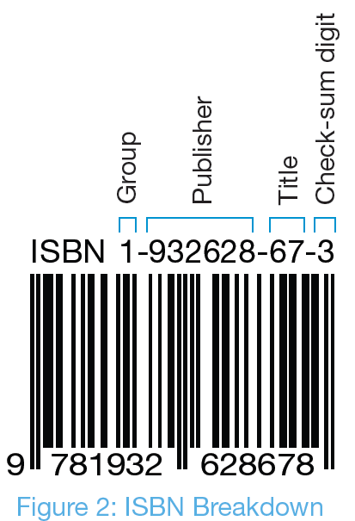
Modular Arithmetic and Bar Codes
The bar code on a book contains a string of numbers called the International Standard Book Number (ISBN) that is unique to each book title and conveys such information as the publisher and country of origin.
The 10th number in a 10-digit ISBN is referred to as the check-sum digit.

Slide 18
Process for Finding the Check-Sum Digit for a
10-digit ISBN
Multiply the 1st digit by 10.
Multiply the 2nd digit by 9.
Multiply the 3rd digit by 8.
Multiply the 4th digit by 7.
Multiply the 5th digit by 6.
Multiply the 6th digit by 5.
Multiply the 7th digit by 4.
Multiply the 8th digit by 3.
Multiply the 9th digit by 2.

Slide 19
Process for Finding the Check-Sum Digit for a
10-digit ISBN (cont.)
Add the multiples together.
The check-sum digit (or 10th digit) is then chosen so that the total of all of these numbers is
0 modulo 11.

Slide 20
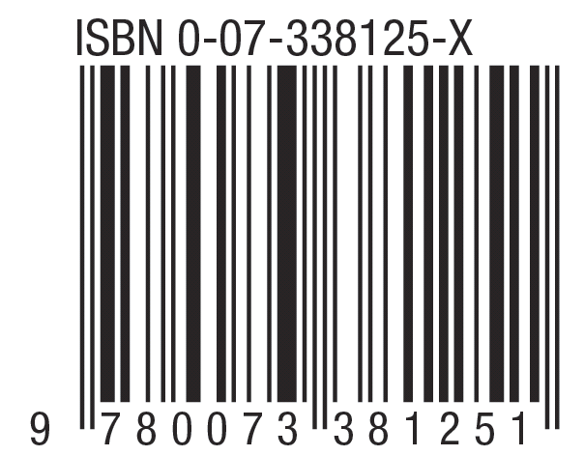
Example 5: Verifying the Validity of a 10-digit ISBN
Verify the validity of the ISBN shown here by performing the process described for finding the check-sum digit.

Slide 21
Example 5: Verifying the Validity of a 10-digit ISBN (cont.)
Solution
To verify the ISBN (0-07-338125-X), we need to find the various multiples of the first 9 digits in the number, and add them together with the check-sum digit. Remember, the sum should be congruent to 0 mod 11.
First, we’ll find the multiples of the first 9 digits.

Slide 22
Example 5: Verifying the Validity of a 10-digit ISBN (cont.)
Next, we add 155 and 10, since X represents the number 10.
155 + 10 = 165
Finally, we need to find 165 (mod 11).
165 ≡ 0 (mod 11)
Because the sum is congruent to 0 (mod 11), the ISBN is indeed valid.

Slide 23
Skill Check #2
Skill Check #2
Verify that the following is a valid 10-digit ISBN.
ISBN 0-306-40615-2
Answers:

Slide 24
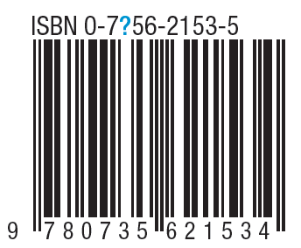
Example 6: Finding a Missing Digit of a 10-digit ISBN
What should the 3rd digit of the ISBN number be for the following barcode? The check-sum number is 5.

Slide 25
Example 6: Finding a Missing Digit of a 10-digit ISBN (cont.)
Solution
The ISBN we were given is 07?5621535.
We can set up the equation for the multiplication as follows, using x to represent the missing digit.

Slide 26
Example 6: Finding a Missing Digit of a 10-digit ISBN (cont.)
Simplifying, we have
To make things easier on ourselves here, we can go ahead and evaluate 174 modulo 11 and substitute that value into our equation.

Slide 27
Example 6: Finding a Missing Digit of a 10-digit ISBN (cont.)
So, now we have 8x + 9 ≡ 0 (mod 11).
This tells us that the third digit in the ISBN number x, will need to be multiplied by 8. This number, when added to 9, must be congruent to 0 (mod 11).
Now, we need to use a bit of trial and error to find the missing digit. We know that the digit must be a number between 0 and 10, inclusive. So, we can begin trying numbers, starting with 0. Substituting x = 0 in our equation gives the following.

Slide 28
Example 6: Finding a Missing Digit of a 10-digit ISBN (cont.)
Since this is not congruent to 0 (mod 11), the third digit cannot be a 0.
Next, suppose the third digit was a 1. Let’s substitute
x = 1, in our equation.

Slide 29
Example 6: Finding a Missing Digit of a 10-digit ISBN (cont.)
Since this is not congruent to 0 (mod 11), the third digit cannot be a 1.

Slide 30
Example 6: Finding a Missing Digit of a 10-digit ISBN (cont.)
Now let x = 2.
Again, we do not have a value equivalent to 0 (mod 11), so we still have not found our number.

Slide 31
Example 6: Finding a Missing Digit of a 10-digit ISBN (cont.)
Let x = 3.
Since 11 modulo 11 is congruent to 0, we have found our missing digit!
The third digit in the ISBN number is 3.

