Slide 1
Section 14.4
Fermat’s Little Theorem and
Public‍-Key Encryption

Slide 2
Objectives
Verify possible public-key encryption values

Slide 3
Fermat’s Little Theorem and Public-Key Encryption
Secret codes, or encryptions, have been around since the beginning of history. Over time, codes have become more and more advanced and harder to break. One of the most widely used coding techniques today is called public-key encryption.

Slide 4
Lawson’s Explanation of Public-Key Encryption
Two professors, Professor More and Professor Erasmus, want to exchange private documents via the public mail system.
Both professors buy a padlock and send the open padlocks (without keys) to the other.
Professor More puts the document in a box and locks it with Professor Erasmus’ lock.
Upon receiving the package, Professor Erasmus can us his own key, which he kept, to unlock it.

Slide 5
Lawson’s Explanation of Public-Key Encryption
If Professor Erasmus chooses to send something back, he uses Professor More’s lock to secure the document.
Neither professor has risked someone intercepting the package or stealing the key, since the keys never left he possession of the owner.
The padlocks are analogous to the “public key” that only allows someone to encode a message.
The private keys are essential bits used to decode the message.

Slide 6
Euler’s Theorem
Euler’s Theorem
where p and q are prime numbers, n = pq, and x and a are any positive integers.

Slide 7
Example 1: Verifying Euler’s Theorem
Verify Euler’s Theorem with the prime numbers p = 3 and q = 5. Let x = 2 and a = 1.
Solution
We are told to use the prime numbers 3 and 5. Therefore, n = 3 ⋅ 5 = 15. We can substitute these values into the formula as follows.

Slide 8
Example 1: Verifying Euler’s Theorem (cont.)
Just as with Fermat’s Little Theorem in the previous section, there is nothing special about the numbers we chose, other than the fact that 3 and 5 are both prime.

Slide 9
Skill Check #1
Skill Check #1
Verify Euler’s Theorem with the prime numbers p = 2 and q = 3. Let x = 2 and a = 1.

Slide 10
Table 1: Fermat’s Little Theorem vs. Euler’s Theorem
Table 1: Fermat’s Little Theorem vs. Euler’s Theorem
Fermat’s Little Theorem | Euler’s Theorem
p is prime | p and q are prime, n = pq

Slide 11
Euler’s Theorem (Rearranged Version)
Euler’s Theorem (Rearranged Version)
where p and q are prime numbers, n = pq, and x and a are any positive integers.

Slide 12
Table 2: Summary of the Variables Used in Public-Key Encryption
Table 2: Summary of the Variables Used in Public-Key Encryption
Variable | Definition
p and q | prime numbers
a | any positive integer
e and d | factors of a(p − 1)(q − 1) + 1
n | the product pq
e and n | the public key
p, q, and d | the private key

Slide 13
Example 2: Public-Key Encryption
Let C = 2 be your simple credit card number, which is the secret number. Encode C using the following public key. Let M be the new encoded credit card number.
Public Key: n = 115 and e = 17
Solution
To encode C, we have to calculate
So, our encoded credit card number is now M = 87.

Slide 14
Skill Check #2
Skill Check #2
Using the same public-key information in Example 2, encode the number C = 3.
Answer: M = 108

Slide 15
Example 3: Decoding Using Private Key Decryption
Decode the number M = 87, which is the secret number to the power e, using the private key d = 57 and n = 115.
Solution
To decode, we calculate the following.
As it stands, these numbers are too large for direct computation without an engine such as Wolfram|Alpha, so we will use the squaring method we introduced in the last section.

Slide 16
Example 3: Decoding Using Private Key Decryption (cont.)
Verify for yourself each step of the process with modular arithmetic.

Slide 17
Example 3: Decoding Using Private Key Decryption (cont.)
Now, we can once again use some rules of exponents to give us 87⁵⁷. Since we can use a combination of the numbers we have calculated, we have the following.

Slide 18
Example 3: Decoding Using Private Key Decryption (cont.)
And, just as we knew, the original credit card number is 2.
Although we have shown this long computation by hand, 87⁵⁷ (mod 115) can be evaluated in one step using WolframAlpha.com.

Slide 19
Example 4: Encoding and Decoding Using Technology
ECD Technologies uses public-key encryption to receive credit card numbers via the Internet. When an order is placed on its website, the server uses the public key n = 999,985,999,949 and e = 41 to encode the number. When ECD receives the transmission, it uses the private key d = 73,169,560,973 and n = 999,985,999,949 to retrieve the original credit card number.
a. Use Wolfram|Alpha to code the credit card number 123 456 7890 to place an order with ECD Technologies online.

Slide 20
Example 4: Encoding and Decoding Using Technology (cont.)
b. Use Wolfram|Alpha to decode the transmitted number 257,646,382,798.
Solution
a. In order to encode the credit card number, we need to raise it to the power e modulo n. In other words, we need to calculate 1234567890⁴¹ (mod 999,985,999,949).
To calculate this value, go to www.wolframalpha.com and type “1234567890^41 (mod 999,985,999,949)” into the input bar. Then, press the = button.

Slide 21
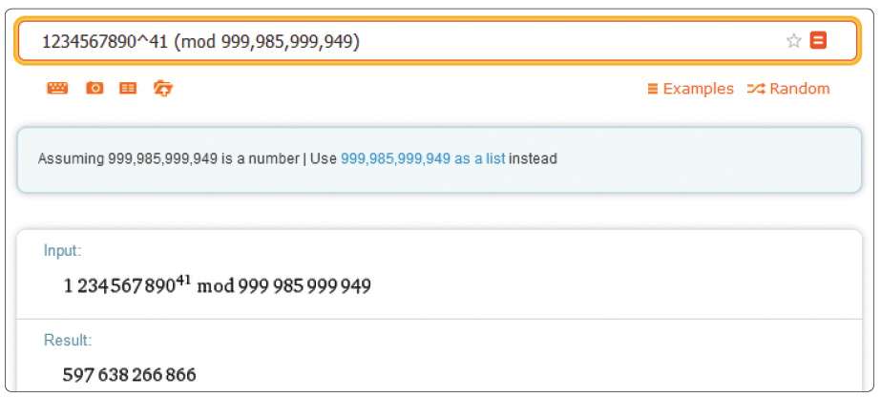
Example 4: Encoding and Decoding Using Technology (cont.)
This gives us the following encoded number, as shown in the screenshot: 597,638,266,866.

Slide 22
Example 4: Encoding and Decoding Using Technology (cont.)
b. To decode a transmitted number, we need to raise it to the power d modulo n. In other words, we need to calculate 257,646,382,798^{73,169,560,973} (mod 999,985,999,949).
To enter this into Wolfram|Alpha, type “257,646,382,798^73,169,560,973 (mod 999,985,999,949)” into the input bar. Then, click the = button.

Slide 23
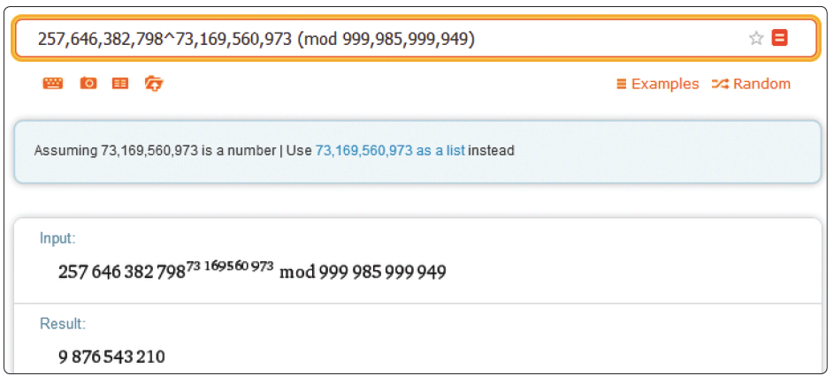
Example 4: Encoding and Decoding Using Technology (cont.)
This gives us the following decoded number as shown in the screen shot: 9,876,543,210.

