Slide 1
Section 2.2
Subsets and Venn Diagrams

Slide 2
Objectives
Use Venn diagrams to represent sets

Slide 3
Venn Diagram
One way to visualize the relationships between sets is in the form of a Venn diagram. Venn diagrams were first introduced by British logician John Venn. These diagrams are used to help conceptualize relationships in many fields, including set theory, logic, probability, statistics, and computer science.

Slide 4
Venn Diagram
Venn Diagram
A Venn diagram is a way to visualize the relationships between sets. In a Venn diagram, the sets are represented by circles (or ovals) contained within a rectangular region representing the universal set.
The ovals are often labeled with the names of the sets they represent, and the elements of a set can be listed within their set oval.

Slide 5
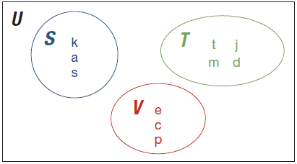
Example 1: Interpreting Venn Diagrams
The following Venn Diagram represents the sets S, T, and V within the universal set U = {x | x ∈ English alphabet}. Use the diagram to answer the following questions.

Slide 6
Example 1: Interpreting Venn Diagrams (cont.)
a. List the elements of the sets S, T, and V in roster form.
b. Find |S |, |T |, and |V |.
c. Find T ′.
d. Is S = V ? Is S ∼ V ? Explain your answers.

Slide 7
Example 1: Interpreting Venn Diagrams (cont.)
Solution
a. S = {k, a, s}
T = {t, m, j, d}
V = {e, c, p}
Remember, that the order in which the elements are listed is not important. Therefore, it is also correct to list the elements of each set in a different order.
b. In order to find the cardinal number of each set, S, T, and V, we simply need to count the number of elements in each set. Therefore |S| = 3, |T| = 4, and |V| = 3.

Slide 8
Example 1: Interpreting Venn Diagrams (cont.)
c. Recall that T ′ contains all of the elements in the universal set that are not in T. Be careful to list all elements not in T and not just the elements in the other sets. Therefore T ′ = {a, b, c, e, f, g, h, i, k, l, n, o, p, q, r, s, u, v, w, x, y, z}.
d. For S = V, they would have to have exactly the same elements. Since this is not the case, S ≠ V. However, since S and V both have a cardinality of 3, they are equivalent to one another. That is, S ∼ V.

Slide 9
Example 2: Interpreting Venn Diagrams
There is an increasing number of electric vehicles on the roads in the United States. The number of charging stations available for these cars varies from state to state. The states with the most public and private electric charging stations are California, Florida, Oregon, Texas, and Washington.

Slide 10
Example 2: Interpreting Venn Diagrams (cont.)
Let
U = {x| x ∈ all public and private electric charging stations in the United States}
C = {x | x ∈ U, x ∈ all public and private electric charging stations in California}
F = {x | x ∈ U, x ∈ all public and private electric charging stations in Florida}
O = {x | x ∈ U, x ∈ all public and private electric charging stations in Oregon}

Slide 11
Example 2: Interpreting Venn Diagrams (cont.)
T = {x | x ∈ U, x ∈ all public and private electric charging stations in Texas}
W = {x | x ∈ U, x ∈ all public and private electric charging stations in Washington}
The following Venn diagram depicts the top five states with the most electric charging stations. The cardinal number for each set is shown inside the appropriate oval.¹
1 US Department of Energy: Alternative Fuels Data Center, http://www.afdc.energy.gov

Slide 12
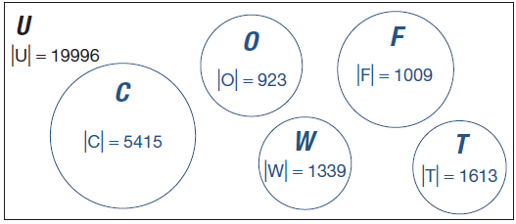
Example 2: Interpreting Venn Diagrams (cont.)

Slide 13
Example 2: Interpreting Venn Diagrams (cont.)
Use the Venn diagram to answer the following questions. Assume all questions refer to both public and private stations.
a. Which state has the most electric charging stations?
b. Which state has the second highest number of charging stations?
c. How many electric charging stations do the top five states have all together?
d. How many charging stations are in the United States, but not in one of the top five states in the diagram?

Slide 14
Example 2: Interpreting Venn Diagrams (cont.)
Solution
a. Using the Venn diagram, we can see that California has the most charging stations with 5415 in the state.
b. Don’t be fooled by the size of the circles in the diagram. Remember that the size of a circle is of no consequence in a Venn diagram. Looking at the size of the sets by their numbers, we see that Texas, with 1613 stations, has the second highest number of charging stations.

Slide 15
Example 2: Interpreting Venn Diagrams (cont.)
c. In order to determine how many combined charging stations there are in the top five states, we need to add together the size of all five sets.
Total Number
= 5415 + 1613 + 1339 + 1009 + 923 = 10,299
So the top five states have a combined total of 10,299 electric charging stations.

Slide 16
Example 2: Interpreting Venn Diagrams (cont.)
d. In order to find the total number of electric charging stations in the United States that are not in one of the top five states, we need to subtract the answer we found in part c. from the total number of charging stations in the universal set. We know the cardinal number of U is 19,996. Therefore, we have 19,996 − 10,299 = 9697 electric charging stations that are in the United States, but not in one of the top five states.

Slide 17
Subset
Subset
If A and B are sets, B is a subset of A if every element of B is also an element of A. We write B ⊆ A.

Slide 18
Example 3: Drawing a Venn Diagram with Subsets
Let
U = {x | x is a student at State University}
W = {x | x is a student at State University majoring in Computer Science with a minor in Business}
Y = {x | x is a student at State University majoring in Computer Science}
Draw a Venn diagram to represent the sets U, W, and Y at State University.

Slide 19

Example 3: Drawing a Venn Diagram with Subsets (cont.)
Solution
Begin by drawing a rectangle representing the universal set of all students at State University. This rectangle can be any size you like.

Slide 20
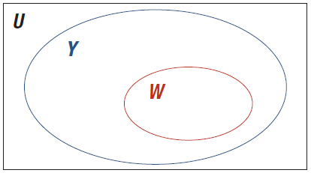
Example 3: Drawing a Venn Diagram with Subsets (cont.)
Next, we need to decide how the sets W and Y are to be drawn. Notice the set Y contains all students majoring in computer science and the set W is a more specific group of students who not only are majoring in computer science, but also are minoring in business. Therefore
W ⊆ Y. So the Venn diagram will look like the following.

Slide 21
Example 3: Drawing a Venn Diagram with Subsets (cont.)
Although, your diagram may look a little different than the one shown here, it should resemble the structure of this one. In other words, the oval representing W should be completely contained within the oval representing Y.

Slide 22
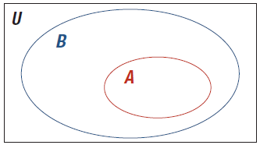
Skill Check #1
Skill Check #1
Draw a Venn diagram of the following.
U = {x | x is a computer}
A = {x | x is an iPad}
B = {x | x is a tablet computer}
Answer:

Slide 23
Proper Subset
Proper Subset
When B ⊆ A, and A contains at least one element that is not contained in B, B is said to be a proper subset of A, and is written B ⊂ A.
Another way to think of a proper subset is that B is a subset of A, but B is not equal to A. It is actually “properly contained” within A.

Slide 24
Example 4: Identifying Proper Subsets
Let X = {1, 2, 3}. List all the proper subsets of X.
Solution
All proper subsets of X must exclude at least one member of X. In our example, this means that each proper subset can have at most two elements in it. In fact, the proper subsets may contain two elements, one element, or no elements. A table listing out the possible proper subsets in order will help us.

Slide 25
Example 4: Identifying Proper Subsets (cont.)
So, there are 7 proper subsets of the set {1, 2, 3}.
Table 1 : Table Title
Proper Subsets with Precisely 2 Elements | Proper Subsets with Precisely 1 Element | Proper Subsets with Precisely 0 Elements
{1, 2} | {1} | ∅
{1, 3} | {2}
{2, 3} | {3}

Slide 26
Skill Check #2
Skill Check #2
List all of the proper subsets of the set {a, b, c, d}.
Answer: ∅, {a}, {b}, {c}, {d}, {a, b}, {a, c}, {a, d}, {b, c},
{b, d}, {c, d}, {a, b, c}, {a, b, d}, {a, c, d}, {b, c, d}

Slide 27
Number of Subsets and Proper Subsets of a Set
Number of Subsets and Proper Subsets of a Set
If the cardinal number of a set is n, then there are 2^{n} subsets and 2^{n} – 1 proper subsets of the set.

Slide 28
Example 5: Determining the Number of Subsets
Dr. Williams is eating at China Buffet one afternoon and notices a sign that says:
“So many possibilities—you could spend a lifetime eating at China Buffet and never have the same meal twice!”
He wonders how many different plates he could make from the 16 items on the buffet. He can have all, none, or some of the items. Help Dr. Williams determine the number of different plates he could make at the buffet.

Slide 29
Example 5: Determining the Number of Subsets (cont.)
Solution
When Dr. Williams makes a plate, he chooses a subset of the items from the buffet. The number of different plates that Dr. Williams could put together is the number of subsets of the 16 items on the buffet. Since there is no requirement on the number of food items he needs to have on a plate, we can use the formula for the number of subsets to determine how many different plates he could make.

Slide 30
Example 5: Determining the Number of Subsets (cont.)
Using the formula for the number of subsets, we have
This means that if Dr. Williams ate at China Buffet once a day every day, he could eat for almost 180 years without duplicating a meal. Certainly, it would seem the sign is not misleading.

