Slide 1
Section 2.4
Applications and Survey Analysis

Slide 2
Objectives
Solve problems that involve survey analysis

Slide 3
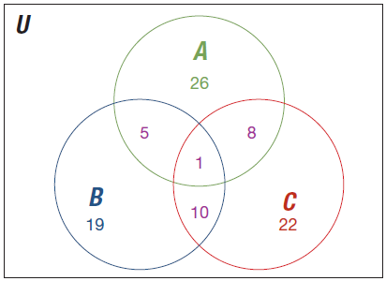
Example 1: Interpreting a Venn Diagram of Three Sets
The given Venn diagram contains the number of elements that belong to the three sets A, B, and C.
Use the information in the diagram to determine

Slide 4
Example 1: Interpreting a Venn Diagram of Three Sets (cont.)
a. |A ∩ B ∩ C | b. |A ∩ B|
Solution
a. To find |A ∩ B ∩ C |, we need to consider that the intersection of two sets, such as A and B, represents the set of elements that are in both A and B. Therefore, to find the intersection of the three sets A, B, and C, we are looking for the number of elements that are common to all three sets (the elements in the triangular middle section of the Venn diagram).

Slide 5
Example 1: Interpreting a Venn Diagram of Three Sets (cont.)
We observe in the Venn diagram that there is only one element represented in the intersection of sets A, B, and C. Thus, |A ∩ B ∩ C | = 1.
b. Working with three sets and their intersections, we need to be careful and make sure we are considering the proper intersection. For |A ∩ B|, we need to determine the number of elements in the area where sets A and B overlap. Referring to the Venn diagram, we can see that set C intersects sets A and B as well.

Slide 6
Example 1: Interpreting a Venn Diagram of Three Sets (cont.)
There are 5 elements in A ∩ B that are not in C and 1 element in A ∩ B that is also in C. Therefore, A ∩ B contains 5 + 1 = 6 elements, giving |A ∩ B| = 6.

Slide 7
Skill Check #1
Answer: a. 9 b. 11
Skill Check #1
Use the Venn diagram in Example 1 to find the following.
a. |A ∩ C|
b. |B ∩ C|

Slide 8
Example 2: Constructing a Venn Diagram of Three Sets
Consider the universal set U = {a, b, c, . . . , z}. Given subsets A = {a, e, i, o, u}, B = {a, b, c, d, e, f, g, h, i, j, k, l}, and C = {a, l, u, m, n, i}, draw a Venn diagram to represent the relationships between the sets.
Solution
When there are three sets under consideration, getting started can be confusing because there are eight possible areas to place elements in the Venn diagram. Each of the elements in the universal set may only be placed in one of these eight areas.

Slide 9
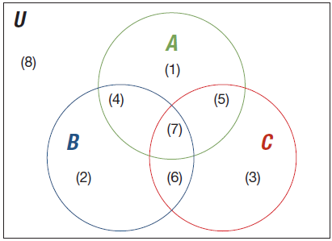
Example 2: Constructing a Venn Diagram of Three Sets (cont.)
The eight areas are: (1) set A only, (2) set B only, (3) set C only, (4) sets A and B but not C, (5) sets A and C but not B, (6) sets B and C but not A, (7) sets A and B and C, and (8) the universal set but not sets A or B or C.

Slide 10
Example 2: Constructing a Venn Diagram of Three Sets (cont.)
There are many approaches to determining the represented sets. One way is to begin with the intersection of all three sets, area (7). So, comparing the elements of sets A, B, and C, we can determine the elements common to all three sets are a and i. This gives A ∩ B ∩ C = {a, i}. We must repeat this process for each of the other seven areas while making sure to not count any element more than once.

Slide 11
Example 2: Constructing a Venn Diagram of Three Sets (cont.)
The next step is to determine the elements that belong in the different parts of set A = {a, e, i, o, u}. We compare the sets and determine that set A consists of all of the vowels of the alphabet. When compared to sets B and C, we find that the only vowel not in either B or C is o. So, the only element in area (1), set A only, is {o}. Similarly, the element in area (4), A ∩ B only, is {e} and the element in area (5), A ∩ C only, is {u}.

Slide 12
Example 2: Constructing a Venn Diagram of Three Sets (cont.)
For set B only, we consider set B = {a, b, c, d, e, f, g, h, i, j, k, l}. Some of the elements, {a, i}, of set B have already been accounted for in the intersection of all three sets. By comparing set B to set A and set C, set A also contains element {e} and set C contains element {l}. This means the only elements in area (2), set B only, are {b, c, d, f, g, h, j, k}. Similarly, the element in area (4), A ∩ B only, is {e} and the element in area (6), B ∩ C only, is {l}.

Slide 13
Example 2: Constructing a Venn Diagram of Three Sets (cont.)
For set C only, we consider set C = {a, l, u, m, n, i}. Some of the elements, {a, i}, of set C have already been accounted for in the intersection of all three sets. By comparing set C to set A and set B, set A also contains element {u} and set B contains element {l}. This means the elements in area (3), set C only, are {m, n}.

Slide 14
Example 2: Constructing a Venn Diagram of Three Sets (cont.)
The elements of the alphabet not accounted for in any of sets A, B, or C are the elements {p, q, r, s, t, v, w, x, y, z}, which go in area (8). We are now ready to draw our Venn diagram.
We find the solution by placing each of the letters from each set in the appropriate areas within a Venn diagram. A ∩ B ∩ C = {a, i}, only A = {o}, only B = {b, c, d, f, g, h, j, k}, only C = {m, n}, only A ∩ B = {e}, only A ∩ C = {u}, and only B ∩ C = {l}. Then the solution is shown in the following diagram.

Slide 15
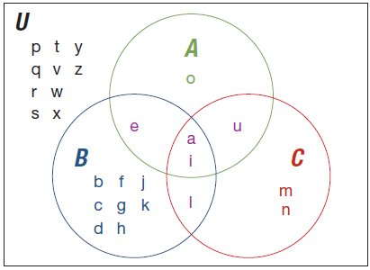
Example 2: Constructing a Venn Diagram of Three Sets (cont.)

Slide 16
Survey Analysis
Survey Analysis
Survey analysis is the analysis of responses to a list of questions.

Slide 17
Example 3: Drawing a Venn Diagram for Survey Analysis
A survey of 500 students showed that 350 listen to jazz, 300 listen to classical, and 200 listen to both. Draw a Venn diagram to illustrate this survey.
Solution
We are given that the number of students that listen to jazz and classical music is 200 students. We must notice that each of the students that like both types of music are also counted in the categories for their respectful types of music.

Slide 18
Example 3: Drawing a Venn Diagram for Survey Analysis (cont.)
Recall from the previous section the inclusion-exclusion principle, which states that we must subtract the students that have been counted twice.

Slide 19
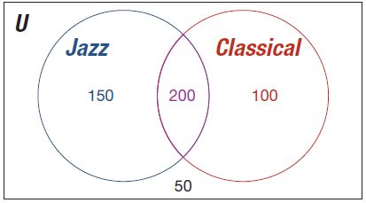
Example 3: Drawing a Venn Diagram for Survey Analysis (cont.)
The resulting Venn diagram shows that 150 students like only jazz, 100 students like only classical, 200 students like both types of music, and 50 students don’t like either type of music.

Slide 20
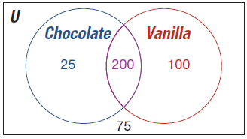
Skill Check #2
Skill Check #2
A survey of 400 customers at an ice cream shop showed that 225 customers like chocolate ice cream, 300 customers liked vanilla, and 200 customers liked both. Draw a Venn diagram to illustrate this survey.
Answer:

Slide 21
Example 4: Drawing a Venn Diagram for Survey Analysis
Students majoring in international relations are polled on whether they take courses in any of three languages: French, German, and Russian. No student who took French also took Russian, but 39 who took French also took German. Eighty‑four who took German also took Russian. All together, 55 reported taking French, 141 reported taking German, and 92 reported taking Russian. Draw a Venn diagram to illustrate this poll.

Slide 22
Example 4: Drawing a Venn Diagram for Survey Analysis (cont.)
Solution
Recall that there are eight possible areas to place elements in the Venn diagram when there are three sets of consideration. Each of the student responses may only be placed in one of the eight areas. The eight areas are students taking: (1) French only, (2) German only, (3) Russian only, (4) French and German but not Russian, (5) French and Russian but not German, (6) German and Russian but not French, (7) French and German and Russian, and (8) None.

Slide 23
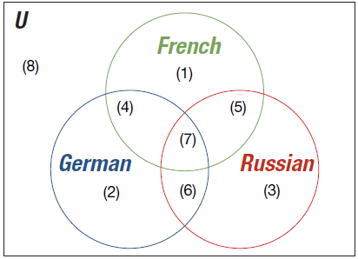
Example 4: Drawing a Venn Diagram for Survey Analysis (cont.)
We will start with the intersection of all three sets to begin. We are told that no student who took French also took Russian. Therefore, we know that no students could have taken all three languages.

Slide 24
Example 4: Drawing a Venn Diagram for Survey Analysis (cont.)
The next step is to determine the elements that belong in the each of the groups.
We are given that 39 students took French and German. Since we are given that 55 students took French, of which 39 also took German, we can remove the students that have been counted twice to determine that 55 − 39 = 16 students took only French.

Slide 25
Example 4: Drawing a Venn Diagram for Survey Analysis (cont.)
There were 141 students that took German. Of those students, 84 students also took Russian and 39 also took French. Therefore, 141 − 84 − 39 = 18 students took only German.
Lastly, 92 students reported taking Russian. Of those students, 84 also took German and 0 students took French and Russian. Thus, 92 − 84 = 8 students took only Russian.
We can place our information into a Venn diagram for a visual representation of the solution.

Slide 26
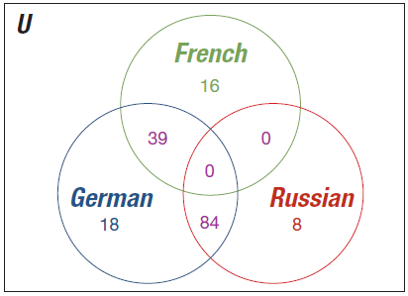
Example 4: Drawing a Venn Diagram for Survey Analysis (cont.)

Slide 27
Skill Check #3
Skill Check #3
A survey of shoppers at a grocery store found that 225 shoppers like bananas, 198 like apples, and 180 like grapes. Twenty-five shoppers like all three fruits. There are 110 shoppers that like bananas and apples, 58 that like apples and grapes, and 55 that like bananas and grapes. Draw a Venn diagram to illustrate this poll.

Slide 28
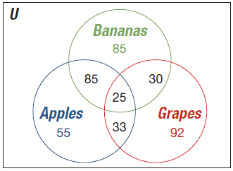
Skill Check #3
Answer:

