Slide 1
Section 4.3
Proportions and Percentages

Slide 2
Objectives
Calculate proportions and percentages

Slide 3
Proportion
Proportion
A proportion is a fraction of a whole.

Slide 4
Proportions
Proportions are often written as percentages. Percentages give us a common way to compare fractions. When fractions don’t have the same denominator, it is sometimes difficult to compare them. However, with percentages, the denominator is always 100, lending itself easily to comparison.

Slide 5
Converting Fractions to Percentages
To convert a fraction to a percentage, we divide the numerator by the denominator and multiply by 100%. Fractions, percentages, and decimals are all ways of expressing proportions.
The fraction is the same as the decimal 0.375, which is the same as the percentage 37.5%.

Slide 6
Car Sales Data
Consider the following information regarding car sales in April 2014.
Table 1: April 2014 Car Sales
Car Type | # of Cars Sold
Midsize | 311,328
Small | 267,651
Luxury | 97,007
Large | 288
Total | 676,274
Source: The Wall Street Journal, “What’s Moving: U.S. Auto Sales,” accessed May 2014, http://online.wsj.com/mdc/public/page/2_3022-autosales.html

Slide 7
Car Sales Data
The proportion of midsize cars sold in April is the fraction that compares the numbers of midsize cars to the total number of cars sold in April 2014.
The proportion of midsize car sales is therefore
Since both of the numbers in the proportion are divisible by 2, the fraction can be rewritten as

Slide 8
Example 1: Changing Fractions to Percentages
Change the fraction of midsize car sales to a percentage.
Solution
Divide the numerator by the denominator and multiply by 100% to find the percentage.
This tells us that in Table 1, 46.04% of the cars sold were midsize cars. In other words, about 46 out of every 100 cars sold were midsize cars.

Slide 9
Skill Check #1
Skill Check #1
Change the fraction to a percentage.
Answer: 32.05%

Slide 10
Example 2: Finding Proportions and Percentages
The following sample of adults between the ages of 25 and 34 reported whether they had a college degree or not. What proportion of these adults reported having a college degree? Convert the proportion to a percentage.
Table 2: Adults Between the Ages of 25 and 34
 | Have College Degree?
Yes | 373
No | 629
Total | 1002

Slide 11
Example 2: Finding Proportions and Percentages (cont.)
Solution
The proportion of adults age 25 to 34 with a college
degree is
To write this proportion as a percentage, we calculate

Slide 12
Example 3: Using Proportions to Find Quantities
The proportion of people who are left-handed is approximately If there are 45 people in a room, estimate how many of them are left-handed.
Solution
We want to know what of 45 is. Remember that of in mathematics implies multiplication. So, we can simply multiply the two quantities together.
In other words, we would expect there to be about 4 left-handed people in a room of 45.

Slide 13
Example 4: Working with Ratios and Proportions
Recall Example 1 in Section 4.2 about the university campus, which had a new freshman class with a ratio of 2 : 3, men to women. University-wide, 53% of the campus population is men. Is the proportion of men in the freshman class different from that of men campus‑wide?

Slide 14
Example 4: Working with Ratios and Proportions (cont.)
Solution
In order to solve this problem we need to compare the percentage of men in the freshman class to that of the entire campus. We know the entire campus has 53% men. To begin, we need to find the proportion of freshmen men. We can do this using the number of men and the total number of students in the freshman class, or we can do this with ratios.

Slide 15
Example 4: Working with Ratios and Proportions (cont.)
Because we know the ratio of men to women in the freshman class is 2 : 3, we know that out of every
2 + 3 = 5 students in the freshman class, 2 of them are men. Therefore, the proportion of men in the freshman class is
Now we can compare the percentage of men in the incoming freshman class to the percentage of men campus-wide, which is 53%. It is now clear that the proportion of men is smaller in the freshman class.

Slide 16
Example 5: Using Proportions and Percentages
The Earth consists of three parts: crust, mantle and core. The Earth’s core makes up 31.5% of the Earth’s mass. The mantle makes up 68.1% of its mass. Although 20 to 30 miles thick, the crust of the Earth only makes up a small proportion of its mass — the remaining 0.4%. If the total mass of the Earth is
what is the mass of the Earth’s crust?

Slide 17
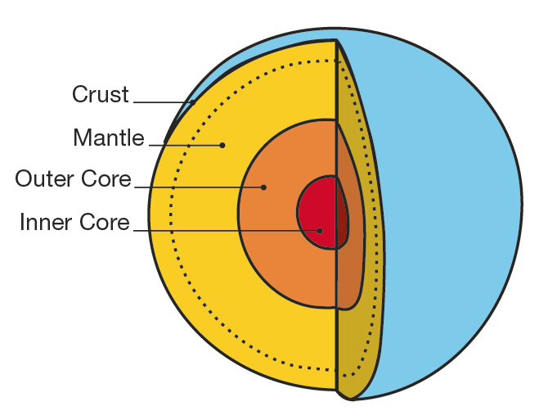
Example 5: Using Proportions and Percentages (cont.)

Slide 18
Example 5: Using Proportions and Percentages (cont.)
Solution
We are given the fact that the Earth has a total mass of
kg, and its crust is 0.4% of the overall mass. We simply need to multiply the two quantities together to find the amount of mass that is crust. Because we are given the crust as a percentage, we need to first write it as a decimal before multiplying the two together.

Slide 19
Example 5: Using Proportions and Percentages (cont.)
So, the Earth’s mass is comprised of 23,896,800,000,000,000,000,000 kg of crust, which is a mere 0.4% of its total mass!

Slide 20
Example 6: Finding Proportions and Ratios
Suppose you earned a B on your last History 102 test by getting 80% of the questions correct.
a. If there were 60 equally weighted questions on the test, how many did you answer correctly?
b. What was your ratio of correct to incorrect answers on the test?

Slide 21
Example 6: Finding Proportions and Ratios (cont.)
Solution
a. Since there were 60 questions on the test, we need to find 80% of 60. To do this, we first change 80% to a decimal, and then multiply.
Therefore, you answered 48 questions correctly on the test.

Slide 22
Example 6: Finding Proportions and Ratios (cont.)
b. Since we know from part a. that you answered 48 questions correctly, we can subtract this from the total number of questions to find the number of questions that you answered incorrectly.
Therefore, the ratio correct : incorrect would be written 48 : 12 or 4 : 1.

Slide 23
Example 7: Using Percentages
Elaine was very excited to find that the watch she has wanted was on sale for $66.50. The sale price indicated that it was 30% off of the original price. Find the original price of Elaine's watch.
Solution
If the watch is discounted 30%, then Elaine will only pay 70% of the original price of the watch. We can set up a proportional equation to find the original price x of the watch.

Slide 24
Example 7: Using Percentages (cont.)
By solving this equation, we can find the original price.
So the watch was originally $95.00.

