Slide 1
Section 5.2
Linear Growth

Slide 2
Objectives
Demonstrate an understanding of linear functions and linear growth
Model data with linear functions

Slide 3
Linear Growth
We must begin our exploration of mathematical growth with a couple of questions:
What is mathematical growth?
Why does understanding growth matter when understanding mathematics and the mathematical world we live in?
To answer each of these questions, we need to first have a better understanding of “growth” in the context of mathematics.

Slide 4
Proportions
Proportions
The relationship between quantities that vary at the same rate, or varies directly with each other, are known as proportions and can be written as linear functions.

Slide 5
Direct Variation
Direct Variation
When two expressions are proportional, we say that there is a direct variation among the expressions. In other words, this means that as the value of one expression increases, the value of the other expression also increases.

Slide 6
Example 1: Using Direct Variation
Jessica is interested in purchasing a new video game that costs $60. If she has a job that pays $7.50 per hour, find a linear equation for her income and determine the number of hours she must work in order to have enough money to buy the game.

Slide 7
Example 1: Using Direct Variation (cont.)
Solution
You might need to ask yourself what we are looking for as the final answer. We are looking for the number of hours Jessica must work in order to earn $60. Let Jessica’s total pay be represented by the variable p. We can determine the value of p by taking the number of hours worked w and multiplying it by the pay per hour s, which is $7.50 per hour. Translating this situation into an algebraic equation, we get the following.

Slide 8
Example 1: Using Direct Variation (cont.)
Let’s start with a chart to organize our thoughts. The chart consists of the number of hours Jessica worked and her income based on the number of hours worked.

Slide 9
Example 1: Using Direct Variation (cont.)
Table 1: Amount Earned
Hours Worked (w) | Income in Dollars (p)
1 | 7.50
2 | 15.00
3 | 22.50
4 | 30.00
5 | 37.50
6 | 45.00
7 | 52.50
8 | 60.00

Slide 10
Example 1: Using Direct Variation (cont.)
Continuing the chart of Jessica’s pay tells us that she must work 8 hours to make $60.00. That is the solution to our problem. We have translated the idea that hourly pay multiplied by the hour number of hours worked yields the total pay into an algebraic expression where the total pay is directly proportional to the number of hours worked at a given pay rate. Take a look at the following graph to see a visual representation of the relationship between the two variables.

Slide 11
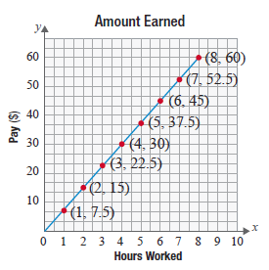
Example 1: Using Direct Variation (cont.)
We can see from both the table and the graph that Jessica must work 8 hours to earn enough money to buy the video game.

Slide 12
Skill Check #1
Skill Check #1
If Andrew earns $6.75 for every dozen oysters that he catches, how many dozen oysters must he collect to accumulate $215? Find a linear equation to determine the number of dozen oysters Andrew needs to catch.
Answer: 32 dozen; y = 6.75x

Slide 13
Slope
Slope
The slope of a line is defined as the ratio of the change in the y-values (“rise”) divided by the change in the x-values (“run”) between two points. The slope of a line is defined by the following formula.

Slide 14
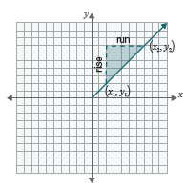
Slope
Slope (cont.)
When given two points and the slope of the line connecting them is calculated using the following formula.

Slide 15
Linear Function
Linear Function
The graph of a function that creates a line with a constant rate of change is a linear function.

Slide 16
Example 2: Applying Linear Functions
Assume you have $20,000 in a bank account that you will use to pay your college tuition. If the cost of your college tuition is $2500 per semester, use a linear function to find the number of semesters it would take for the account to have a balance of $0. Assume that this bank account does not earn interest.

Slide 17
Example 2: Applying Linear Functions (cont.)
Solution
First, determine what the variables are. You should notice that the number of semesters that you take classes can vary. Unlike the previous problem, you should recognize that when we are starting at time 0, we have a value of $20,000. How does this compare to the previous example? Let’s use a table again to find the equation that models this scenario.

Slide 18
Example 2: Applying Linear Functions (cont.)
Table 2: College Tuition Cash
Time (t) (in Number of Semesters) | Account Value (V) (in Dollars)
0 | 20,000
1 | 17,500
2 | 15,000
3 | 12,500
4 | 10,000
5 | 7500
6 | 5000
7 | 2500
8 | 0

Slide 19
Example 2: Applying Linear Functions (cont.)
As you can see in the table, the bank account will reach a value of $0 after 8 semesters. Also, the rate at which the value of the money in the account is decreasing is constant because we are removing the same amount, $2500, each semester. Therefore, this is a linear function where the value V of the account is based on the time t that has passed.

Slide 20
Example 2: Applying Linear Functions (cont.)
Since the value of the bank account is decreasing at a constant rate of $2500 per semester, the slope should be negative. In the previous example, we established that when the slope is positive, the values of both variables are increasing. When the slope is negative, as in this example, the value of one variable is increasing while the other is decreasing. We call this association a negative association and measure this association using the slope.

Slide 21
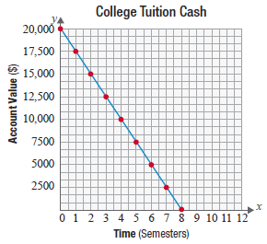
Example 2: Applying Linear Functions (cont.)
Now let’s look at the graph of the value of the account as it relates to the number of semesters.
We can see from the graph that the account will be empty in 8 semesters.

Slide 22
x- and y-Intercepts
x- and y-Intercepts
The x-intercept is the point where the graph intersects the x-axis (horizontal axis) and the y-intercept is the point where the graph intersects the y-axis (vertical axis).

Slide 23
Slope Intercept Form
Slope-Intercept Form of a Linear Equation
The slope-intercept form of a linear equation is
y = mx + b,
where m represents the slope of the line and b is the value where the graph crosses the y-axis. In other words, the point (0, b) is the y-intercept.

Slide 24
Example 3: Finding Linear Equations
Assume Jeffrey has an uncle that puts away $10 in a shoebox on the day he is born and adds $5 to the shoebox on his birthday every year. If this trend continues, use a linear equation to find the amount of money in the shoe box on Jeffrey’s 18th birthday.
Solution
Let’s begin our solution with the notion of what happens each year by looking at a chart of values.

Slide 25
Example 3: Finding Linear Equations (cont.)
Table 3: Jeffrey’s Shoebox Money
Age (Years) | Accumulated Amount ($)
0 | 10
1 | 15
2 | 20
3 | 25
4 | 30

Slide 26
Example 3: Finding Linear Equations (cont.)
Now, let’s find the equation of the line. Since the beginning amount is $10 at time t = 0, we know this is our y-intercept. The only thing we need now is the slope of the line. We can determine the slope by recognizing that the amount of change in the accumulated amount each year is constant. This tells us the slope is constant. So, m = 5. Knowing this, the equation of the line is
y = 5x + 10.

Slide 27
Example 3: Finding Linear Equations (cont.)
If we want to know what the amount will be when Jeffrey is 18, we can evaluate the function when x = 18.
So Jeffrey will have $100 when he turns 18.

Slide 28
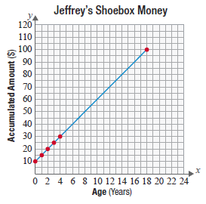
Example 3: Finding Linear Equations (cont.)
Looking at the graphical representation, we see that this relationship is linear since the change from year to year is constant.

Slide 29
Skill Check #2
Skill Check #2
Cindy is starting a business selling T-shirts. Each T-shirt in an order costs $9 and there is an artwork fee of $12.75 per order. Find a linear function that could be used to represent the cost of each T-shirt order.
Answer: c = 9t + 12.75

