Slide 1
Section 5.4
Exponential Growth

Slide 2
Objectives
Demonstrate an understanding of exponential functions and exponential growth
Model data with exponential functions

Slide 3
Exponential Growth
So far, we have studied growth that occurs at a constant rate with linear functions and growth that occurs with projectile-type motion, or quadratic growth. Now we turn our attention to relative growth.

Slide 4
Example 1: Introducing Exponential Growth
On the day Jeffrey was born, his aunt put $1 in a shoebox for him. Each year on his birthday, she decides she wants to put away double the amount from the previous year. So she puts in $2 on his first birthday and $4 on his second birthday. On his third birthday, she continues the trend and doubles what she put away on his second birthday, so she puts $8 in the shoebox. If she continues this trend, how much money will she place in Jeffrey’s shoebox on his 18th birthday?

Slide 5
Example 1: Introducing Exponential Growth (cont.)
Solution
Here is a chart to represent the data.
Table 1: Jeffrey’s Shoebox Money
Age (Years) | Amount on Birthday ($) | Accumulated Amount ($)
0 | 1 | 1
1 | 2 | 3
2 | 4 | 7
3 | 8 | 15
4 | 16 | 31
5 | 32 | 63
6 | 64 | 127

Slide 6
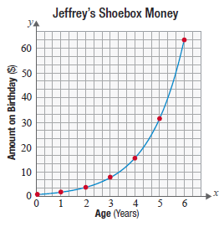
Example 1: Introducing Exponential Growth (cont.)
Now, let’s look at a graph of the data.

Slide 7
Example 1: Introducing Exponential Growth (cont.)
What is different about the change in this situation compared to the example in Section 5.2? What do we need to know in order to develop a formula that models this growth?
In order to establish a formula for the pattern, consider the change taking place. Instead of the change being constant each year, the change each year is dependent on the amount from the previous year. In other words, each year’s growth is proportional to the previous year’s growth.

Slide 8
Example 1: Introducing Exponential Growth (cont.)
We begin building the function by starting with the information given. Since the initial amount of money at time t = 0 is $1, this is the y-intercept. We recognize that this amount will double each year. So, the amount put away in any given year is represented as a double of the previous year. This can be done mathematically by looking at “doubles” such as:

Slide 9
Example 1: Introducing Exponential Growth (cont.)
Notice that the change in value (in years) occurs in the exponent. So, the function for the amount the aunt adds to the shoebox on Jeffrey’s x^{th} birthday can be built with a function where the exponent is the variable.

Slide 10
Example 1: Introducing Exponential Growth (cont.)
To answer our original question, we can insert the value of 18 for the value of x to find how much money would be placed into the shoebox on Jeffrey’s 18th birthday.
Notice that the amount deposited on Jeffrey’s 18th birthday alone is $262,144 while the total amount deposited by the uncle after 18 years was only $100.

Slide 11
Skill Check #1
Skill Check #1
Assume that on the day you were born your parents deposited $1 in a shoebox for you. On your 1st birthday, they deposit $3. On your 2nd birthday, they deposit $9. On your 3rd birthday, they deposit $27. Write a function to represent this situation. How much would they deposit on your 12th birthday?
Answer:

Slide 12
Exponential Function
Exponential Function
An exponential function is a function of the form where b > 0, b ≠ 1, and x is any real number.

Slide 13
Example 2: Application of Exponential Functions
A certain bacteria reproduces in such a way that every minute, the number of bacteria doubles. So at 8:00 a.m., or time t = 0, suppose we place a single bacterium in a jar. At 8:01 a.m., there are 2 bacteria in the jar and at 8:02 a.m., there are 4 bacteria in the jar. Assume the bacteria continue to reproduce in this manner, with no loss in the number of bacteria, and that the jar is full of bacteria at 8:30 a.m.

Slide 14
Example 2: Application of Exponential Functions (cont.)
a. At what time will the jar be half full of bacteria?
b. Using what you already know, can you develop a formula to model this data?
Solution
Let’s take a look at a table to see the pattern of growth. In the table, time t = 0 represents the starting time of 8:00 a.m. At 8:01 a.m., one minute of time will have elapsed. So, at 8:01 a.m., t = 1. This continues for the entire 30 minutes of the example.

Slide 15
Example 2: Application of Exponential Functions (cont.)
Table 2: Bacteria Growth
Time (Minutes) | Number of Bacteria
0 | 1
1 | 2
2 | 4
3 | 8
4 | 16
5 | 32

Slide 16
Example 2: Application of Exponential Functions (cont.)
a. If you take the time to plot the growth on a graph, you will quickly see the pattern again does not grow linearly or as a quadratic, but rather exponentially. It is a good question to ask why this example is exponential and not quadratic. The answer is that, since the growth is proportional to the previous amount, the growth must be exponential.

Slide 17
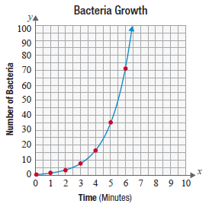
Example 2: Application of Exponential Functions (cont.)

Slide 18
Example 2: Application of Exponential Functions (cont.)
Let’s explore a little more about the pattern and what it represents.
At what time will the jar be half full of bacteria?
Careful here. Many will jump to the conclusion that the jar will be half full halfway through the time period, at 8:15 a.m. This is incorrect. Since the bacteria double every minute, the jar is actually half full at 8:29 a.m.
Also, the jar is full at 8:28, full at 8:27, full at 8:26, etc.

Slide 19
Example 2: Application of Exponential Functions (cont.)
b. The data can be modeled by the function This is very similar to the previous example. You should notice that the base of each is 2 because the amount doubles every unit of time and that at time

Slide 20
General Form of an Exponential Function
General Form of an Exponential Function
The general form of an exponential function is
where b, the base, is a positive number not equal to 1, a is the initial value, and x is any real number.
For example, when b is 2, the function doubles with every unit increase in x, when b is 3, the population triples with every unit increase in x.

Slide 21
Example 3: Application of Exponential Functions
The sales data for a certain company for 8 years can be modeled by the data in Table 3.
A plot of the data with an exponential model fitted to the data shows that the function that best represents the sales of the company is
where x represents the number of years.
Table 3: Sales Data
Year | 1 | 2 | 3 | 4 | 5 | 6 | 7 | 8
Total Sales ($) | 55 | 162 | 300 | 580 | 1050 | 1872 | 3454 | 5165

Slide 22
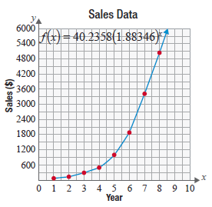
Example 3: Application of Exponential Functions (cont.)
What are the projected sales in year 15?

Slide 23
Example 3: Application of Exponential Functions (cont.)
Solution
The function that represents sales for the company is So, the number of sales in year 15 would be the following.
So, the projected sales in year 15 would be $535,745.66.

Slide 24
Example 4: Percent Increase
A certain town had a population of 2000 in 2001. If the population is increasing at a rate of 2% per year, what will the population be in 2021?
Solution
Using our formula for the percentage change in a population, where r = 0.02, a = 2000, and x = 20, we can find the population.

Slide 25
Example 4: Percent Increase (cont.)
This means that the population after 20 years would be about 2972 people.

