Slide 1
Section 6.1
Everyday Geometry and Applications

Slide 2
Objectives
Demonstrate an understanding of points, lines, and planes
Apply the concepts of parallel and perpendicular
Demonstrate an understanding of angle measure, angle sum, and applications of angles
Demonstrate an understanding of sine, cosine, and tangent functions

Slide 3
Everyday Geometry and Applications
Geometry is one of the most useful topics for real life that you will ever study. Its use in the construction of houses, buildings, and roads is almost limitless. The use of geometry in art, music, and other fields of humanities means that geometry is involved in most of the subjects you will study.
We begin this chapter with an overview of basic definitions and ideas needed to apply the concepts of geometry.

Slide 4


Table 1: Summary of Points, Lines, and Planes
Term/Example | Definition
Point | A point has no length, width, or shape. A point is denoted by an uppercase letter.
Line | A line is a collection of points that extends infinitely in opposite directions, and will always be assumed to be straight. A line is denoted by two points, such as

Slide 5

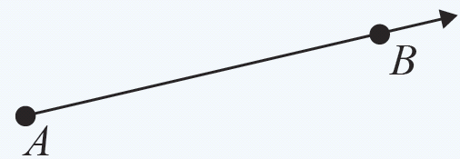
Table 1: Summary of Points, Lines, and Planes (cont.)
Term/Example | Definition
Line Segment | A line segment is the portion of a line that lies between two specified points called endpoints. A line segment is denoted by its end points, such as
Ray | A ray is a half-line with an endpoint A with directionality through point B. A ray is denoted by its endpoint and one other point on the line, such as

Slide 6
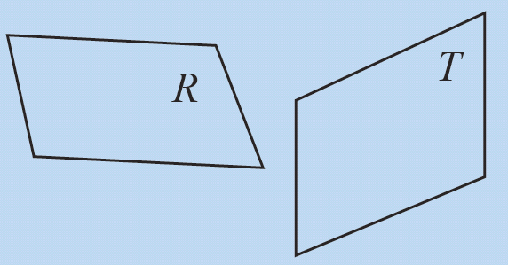
Table 1: Summary of Points, Lines, and Planes (cont.)
Term/Example | Definition
Plane | A plane is a flat surface with no thickness, depth, or boundaries that extends indefinitely in all directions. A plane is denoted by an uppercase letter.

Slide 7
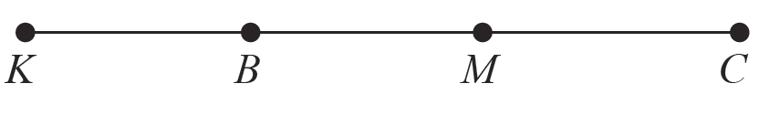
Example 1: Determining the Length of a Line Segment
Given KB = 10 inches, BM = 12 inches, and MC = 13 inches, find the length KC.
Solution
A line segment can be made up of other line segments. Since the measure of each smaller segment is given, we can find the measure of segment KC by adding the lengths of all segments together.

Slide 8
Example 1: Determining the Length of a Line Segment (cont.)
KB + BM + MC = KC
10 inches + 12 inches + 13 inches = 35 inches
This gives that KC = 35 inches.

Slide 9
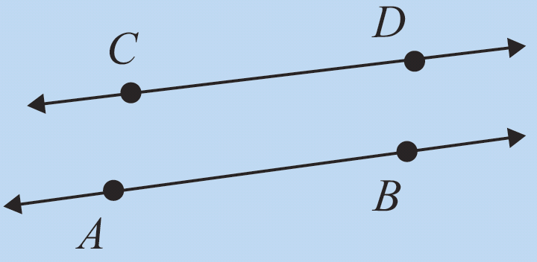
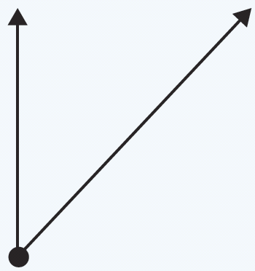
Table 2: Summary of Parallel Lines and Angles
Term/Example | Definition
Parallel Lines | Two lines, in the same plane are parallel if they never intersect, no matter how far they extend, and can be denoted by
Vertex | The vertex is the common endpoint of two line segments or rays.

Slide 10
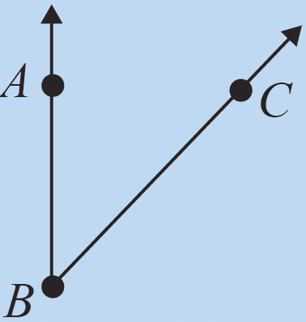
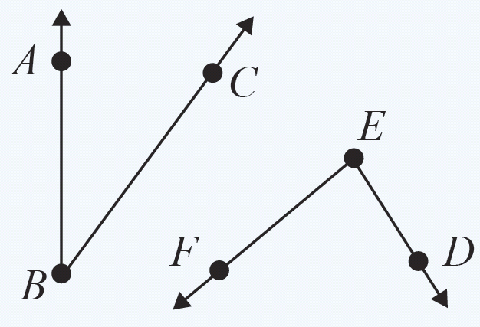
Table 2: Summary of Parallel Lines and Angles (cont.)
Term/Example | Definition
Angle | An angle is the union of two rays at a common vertex. The measure of an angle is the number of degrees (°) that separate the two rays. An angle is denoted by ∠ABC, where B is the vertex.
Acute Angle | An acute angle has a measure greater than 0° but less than 90°.

Slide 11
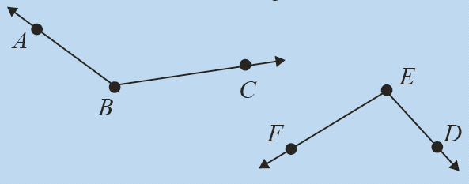
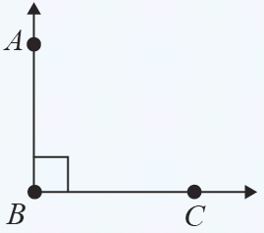
Table 2: Summary of Parallel Lines and Angles (cont.)
Term/Example | Definition
Obtuse Angle | An obtuse angle has a measure greater than 90° but less than 180°.
Right Angle | A right angle has a measure equal to 90°. In a figure, the right angle is usually denoted by the symbol , which is placed near the vertex of the angle.

Slide 12
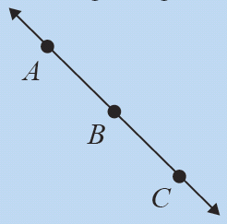
Table 2: Summary of Parallel Lines and Angles (cont.)
Term/Example | Definition
Straight Angle | A straight angle has a measure equal to 180°.

Slide 13
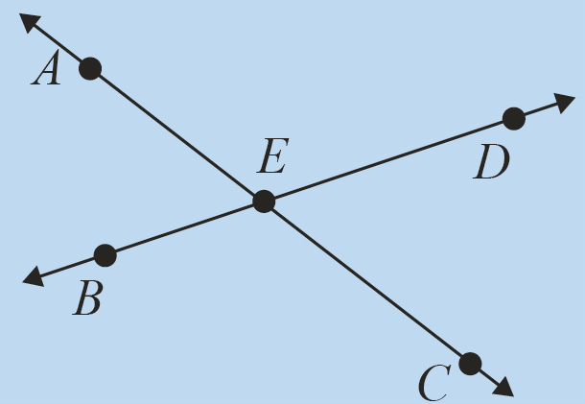
Table 3: Summary of the Properties of Angles and Perpendicular Lines
Term/Example | Definition
Adjacent Angles | When two lines in the same plane intersect, four angles are formed. Two angles are adjacent if they have a common vertex and a common ray. In the example, two adjacent angles are ∠BEA and ∠AED.

Slide 14
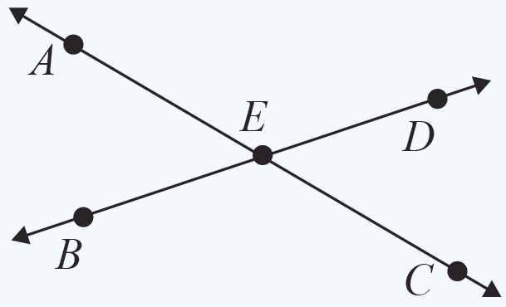
Table 3: Summary of the Properties of Angles and Perpendicular Lines (cont.)
Term/Example | Definition
Opposite Angles | When two lines in the same plane intersect, four angles are formed. Two angles are opposite if they are opposite of each other, that is they share a vertex but do not have any rays in common. In the example, two opposite angles are ∠AEB and ∠CED.

Slide 15
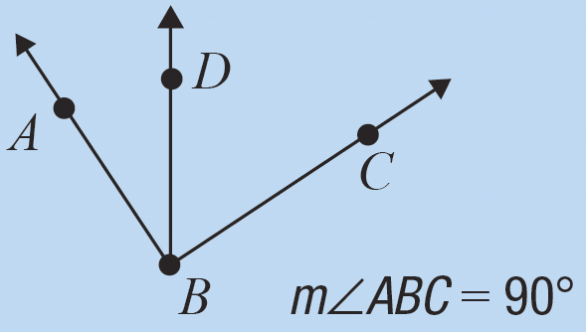
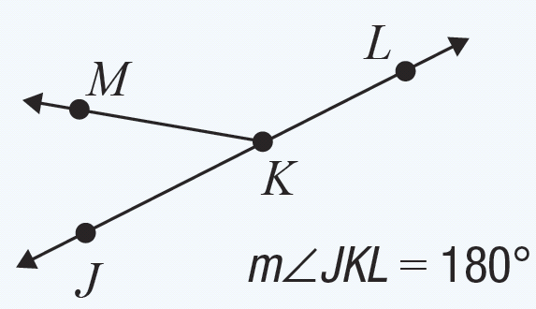
Table 3: Summary of the Properties of Angles and Perpendicular Lines (cont.)
Term/Example | Definition
Complementary Angles | Two angles are called complementary if the sum of their measures is 90°. In the example given, ∠ABD and ∠DBC are complementary.
Supplementary Angles | Two angles are supplementary if the sum of their measures is 180°. In the example given, ∠JKM and ∠MKL are supplementary.

Slide 16
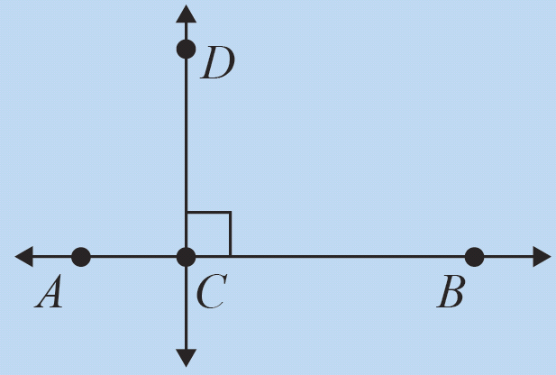
Table 3: Summary of the Properties of Angles and Perpendicular Lines (cont.)
Term/Example | Definition
Perpendicular Lines | Two lines, in the same plane are perpendicular if the angles formed at their intersection are right angles, and can be denoted by

Slide 17
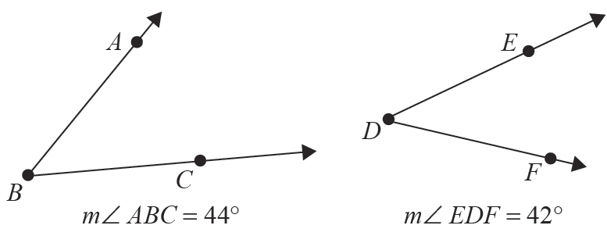
Example 2: Complementary Angles
Determine if the following angles are complementary.

Slide 18
Example 2: Complementary Angles (cont.)
Solution
The definition of complementary angles says that two angles are complementary if the sum of the angle measures is equal to 90°. We have that m∠ABC = 44° and m∠EDF = 42°, so the sum of the angles is
44° + 42° = 86°. Since the sum is not equal to 90°, the angles are not complementary.

Slide 19
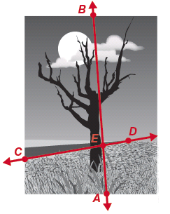
Example 3: Supplementary Angles
In the following figure, the road is represented by line
while the trunk of the tree is represented by line
The point of intersection of the two lines is labeled as E. Use the definitions given in Table 3 to show that ∠BED is supplementary to ∠DEA.

Slide 20
Example 3: Supplementary Angles (cont.)
Solution
By definition, two angles are said to be supplementary if the sum of their measures is 180°. A straight angle has an angle measure of 180°. Since the combination of the two angles forms the line the angles are supplementary.

Slide 21
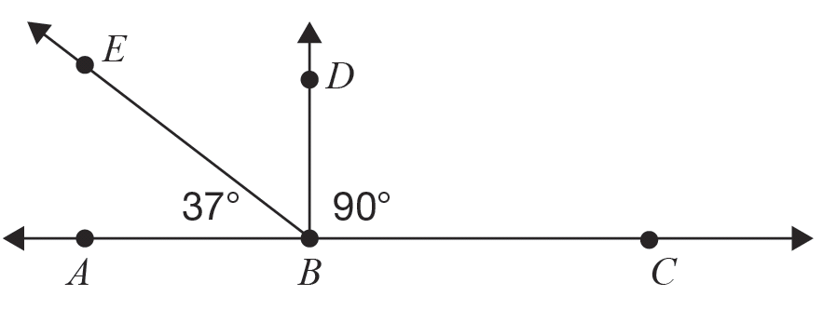
Example 4: Complementary and Supplementary Angles
Given the figure, find m∠EBD.

Slide 22
Example 4: Complementary and Supplementary Angles (cont.)
Solution
Since ∠ABC is a straight angle and we are given that ∠DBC is a right angle, we know that ∠ABD also forms a right angle since the two angles are supplementary. This means that ∠ABE and ∠EBD are complementary angles, whose measures add to 90°. So,

Slide 23
Skill Check #1
Skill Check #1
If two angles are supplementary and the measure of one of the angles is 113°, find the measure of the missing angle.
Answer: 67°

Slide 24

Longitude and the Prime Meridian
Longitude and the Prime Meridian
Longitude lines connect the north and south poles of the Earth and give us the positioning of east and west. With a longitudinal measure of 0°, the prime meridian is the starting point that divides the eastern and western hemispheres.

Slide 25
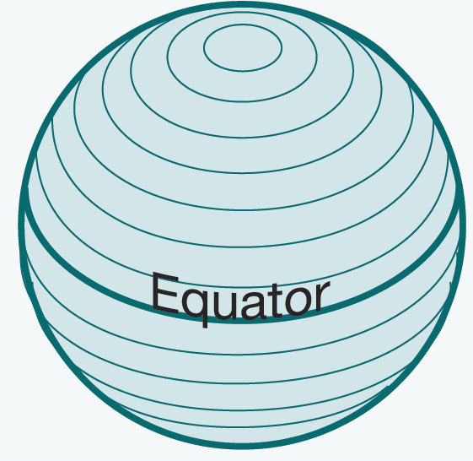
Latitude and the Equator
Latitude and the Equator
Latitude lines are used to measure the north and south locations on the surface of the Earth. With a latitudinal measure of 0°, the equator is the starting point that divides the northern and southern hemispheres.

Slide 26
Degrees, Minutes, Seconds
Degrees, Minutes, Seconds
Lines of latitude and longitude are measured in degrees, minutes, and seconds. Degree, minute, and second are defined as follows.
1 degree (denoted by °) = 60 minutes
1 minute (denoted by ′) = 60 seconds
1 second (denoted by ″) = 61.6 feet

Slide 27
Example 5: Converting Decimal Degrees to Degrees, Minutes, and Seconds
Convert 17.78° to degrees/minutes/seconds format.
Solution
First note that in the expression, 17 is already in degrees, so we need only need to convert the decimal portion of the expression. We know that 1° = 60 min, so we can use dimensional analysis to write the decimal part of 17.78° in minute form as follows.

Slide 28
Example 5: Converting Decimal Degrees to Degrees, Minutes, and Seconds (cont.)
When we convert the portion of a degree 0.78°, our result does not yield a whole number of minutes. For this reason, we need to calculate the number of seconds represented by 0.8′. So,
This means that 17.78° = 17° + 46′ + 48″ = 17°46′48″.

Slide 29
Example 6: Converting Degrees, Minutes, and Seconds to Decimal Degrees
Convert 56°26′23″ to decimal degrees.
Solution
We begin by writing 56°26′23″ in expanded form. So,
56°26′23″ = 56° + 26′ + 23″.
Notice that 56° will be the whole number portion of the decimal degrees form. Our first step is to calculate the total number of seconds:
26′23″ = 26 ⋅ 60 seconds + 23 seconds = 1583 seconds.

Slide 30
Example 6: Converting Degrees, Minutes, and Seconds to Decimal Degrees (cont.)
The decimal part is the total number of seconds divided by 3600 since there are 60 · 60 = 3600 seconds in
1 degree.
Add fractional degrees to whole degrees to produce the final result.
56 + 0.44 = 56.44°
Therefore, the final answer is 56.44°.

Slide 31
Skill Check #2
Skill Check #2
Convert 125.345° to degrees/minutes/seconds format.
Answer: 125°20´42˝

Slide 32
Example 7: Application of Angles
A rocket will be launched making an angle of θ with the moon that is positioned directly overhead. Given that the rocket travels at 18,000 mph and the moon completes a circular orbit of radius 240,000 miles approximately every 30 days, at what angle should the rocket be fired so that the rocket will intercept the moon?

Slide 33
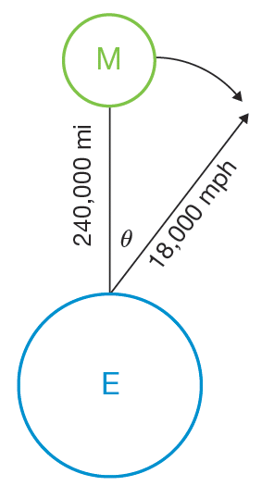
Example 7: Application of Angles (cont.)
Solution
We must employ several problem-solving strategies here in order to solve this problem efficiently. First, we need a picture to help us see the situation. In the figure, E represents the Earth and M represents the moon.

Slide 34
Example 7: Application of Angles (cont.)
Recall that the relationship among the variables for distance, rate, and time is represented by the equation distance = rate ⋅ time, or d = rt.
Remember that we are looking for θ. To find this value, we can use our known values for the rocket speed (rate, r = 18,000 mph), the distance of the moon (distance, d = 240,000 miles) and the time it takes the moon to make one orbit (time, t = 30 days).

Slide 35
Example 7: Application of Angles (cont.)
First, let’s calculate the time required for the rocket to travel the required 240,000 miles to reach the moon’s orbit.
So the rocket will reach a distance of 240,000 miles after traveling for approximately 13.33 hours.

Slide 36
Example 7: Application of Angles (cont.)
Now, we need to consider that the moon is moving on an arc of 360° every 30 days. There are 720 hours in 30 days, so we can use this proportional relationship to determine the value for theta.

Slide 37
Example 7: Application of Angles (cont.)
So, the rocket must be fired at an angle of 6.665°.

Slide 38
Example 8: Determining Location
If your location is given in GPS coordinates of 32.75° north −79.98° west, determine whether you are located in the northern or southern hemisphere, and whether you are located in the western or eastern hemisphere.

Slide 39
Example 8: Determining Location (cont.)
Solution
Since the location has a positive value for latitude, the location is located in the northern hemisphere. Since the location has a negative value of −79.98° for longitude, we can conclude that the location must be in the western hemisphere. (Notice that if the negative value had an absolute value greater than 180°, then it would be located in the eastern hemisphere.)

Slide 40
Longitudinal Adjustment Factor
Longitudinal Adjustment Factor
The longitudinal adjustment factor (LAF) is used to find the distance between lines of longitude at a certain latitude measure. LAF is calculated by the formula

Slide 41
Example 9: Using GPS to Determine Location and Distance
If Amanda starts at GPS location 32.75° north
−79.98° west, how far, in miles, is Amanda away from her destination of 35.15° north −90.06° west?
Solution
Our solution will begin with drawing the locations in a right triangle format. Recall that the Pythagorean Theorem states that the hypotenuse of a right triangle can be found if we know the length of the other two sides.

Slide 42
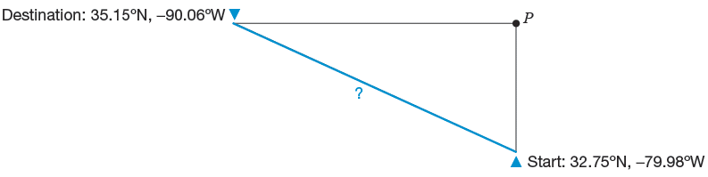
Example 9: Using GPS to Determine Location and Distance (cont.)
We need to know the distance from the starting location to point P and the distance from P to the ending location. Once we know those, we can find the distance from Amanda’s starting position to her destination.

Slide 43
Example 9: Using GPS to Determine Location and Distance (cont.)
To find the legs of the triangle, we can see that the change in latitude between the starting position and P is
35.15° − 32.75° = 2.4°.
Since each degree represents 69 miles, the distance from the starting point to P would be
Similarly, the change in longitude is
90.06° − 79.98° = 10.08°.

Slide 44
Example 9: Using GPS to Determine Location and Distance (cont.)
To find the distance between longitude lines at 35.15 degrees above the equator, we apply the LAF as follows.

Slide 45
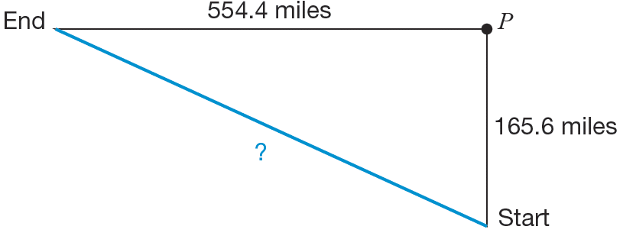
Example 9: Using GPS to Determine Location and Distance (cont.)
Each degree of longitude would represent approximately 55 miles. Therefore, the distance from P to the destination would be 55 ⋅ 10.08 = 554.4 miles.

Slide 46
Example 9: Using GPS to Determine Location and Distance (cont.)
Using the Pythagorean Theorem, we find the direct distance to be
Therefore the distance between the two cities is about 578.60 miles.

Slide 47
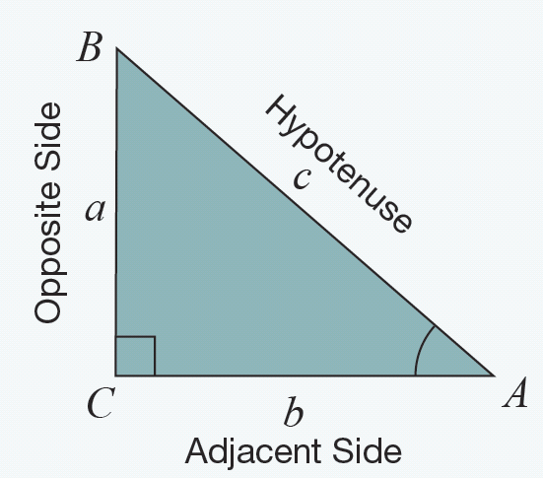
Sine, Cosine, and Tangent
Sine, Cosine, and Tangent

Slide 48
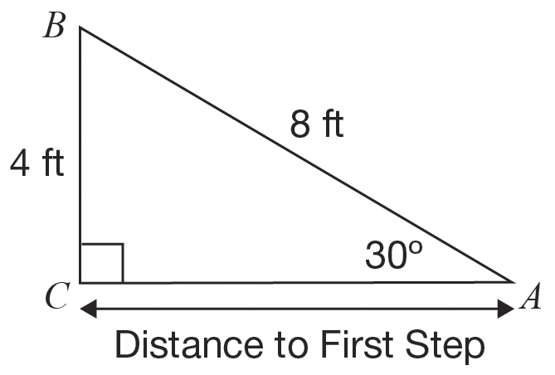
Example 10: Calculating Trigonometric Values
Sam is building a deck on the back of his house. The deck is 4 feet off the ground. According to the building code, the maximum angle for the incline of the steps for the deck is 30° and the maximum length of the step incline can be 8 feet. Using the given figure, determine the minimum distance the landing step (Point A) must be from the house.

Slide 49
Example 10: Calculating Trigonometric Values (cont.)
Solution
Using the information given and trigonometric ratios, we can determine the minimum distance from A to C. First, we verify that the angle of 30° is accurate for the height of the deck and the length of the incline. It is always true that so we need to verify that the trigonometric ratio is also equal to Therefore,

Slide 50
Example 10: Calculating Trigonometric Values (cont.)
Now, to find the minimum distance AC, which we will denote by x, we can use the cosine function. The adjacent side to the angle is represented by x and the hypotenuse of the triangle is 8 feet. Substituting the values into the trigonometric ratio for cosine, we get the following.

Slide 51
Example 10: Calculating Trigonometric Values (cont.)
So, the distance from the deck (Point C ) to Point A is about 6.93 feet. We can confirm this value by using the tangent function.

Slide 52
Skill Check #3
Skill Check #3
Use the Pythagorean Theorem and the result from Example 10 to confirm that the side lengths form a right triangle.
Answer: 4² + b² = 8²; b² = 48; b ≈ 6.928

Slide 53
Example 11: Using Trigonometric Functions
A hiker knows that the distance from a point, A, on a map to another point, B, is 7 miles. She began at point A and headed west until she was due south of point B, and is now at point C. She needs to determine her distance from both point A and point B, given that the heading of her route from point A was at a 46° angle from the line between points A and B, as shown in the figure. When she arrives at point B, she also needs to know what angle she will need to make with her due-north route to return directly to point A.

Slide 54
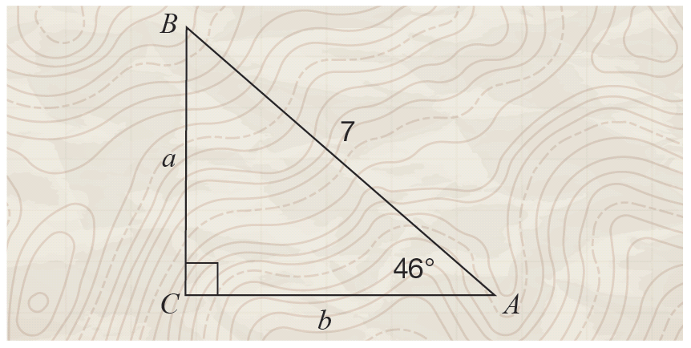
Example 11: Using Trigonometric Functions (cont.)

Slide 55
Example 11: Using Trigonometric Functions (cont.)
Solution
We need to find the length of sides a and b, and the measure of angle B in the figure. We know that
which Using a scientific calculator and a little algebra, we can solve for a to obtain the following.
So, a ≈ 5.04.

Slide 56
Example 11: Using Trigonometric Functions (cont.)
Now that we know a, we can find the value of b using the Pythagorean Theorem.

Slide 57
Example 11: Using Trigonometric Functions (cont.)
Now we have a, b, and c, as well as two angles. To determine the third angle, recall that the sum of the interior angles of a triangle is 180°. So, we subtract the two known angles from 180°.
So, she has traveled 4.86 miles due west of point A and she will need to walk 5.04 miles due north to point B. After she faces south, she can turn 44° to walk the 7 miles back to point A.

Slide 58
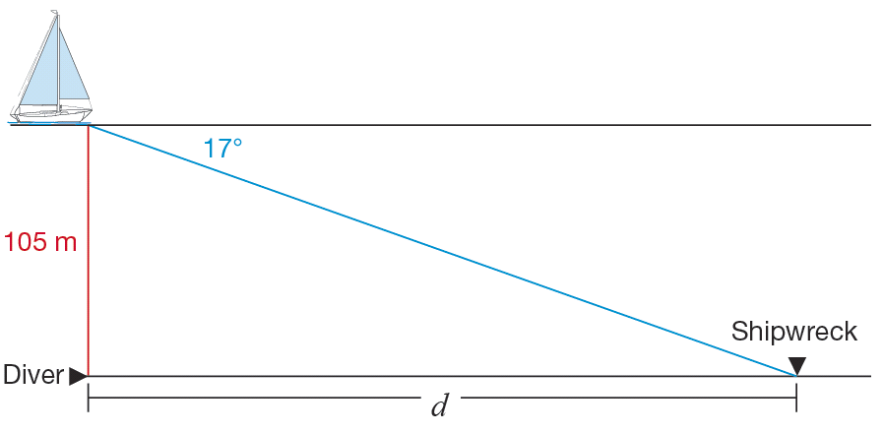
Example 12: Using Trigonometry
A ship’s sonar locates a wrecked ship at a 17° angle of depression. A diver is lowered 105 meters to the ocean floor. How far does the diver need to travel along the ocean floor to get to the wreckage?
Solution
Make a sketch to
illustrate the situation.

Slide 59
Example 12: Using Trigonometry (cont.)
If we assume that the ocean floor is parallel to the surface of the water so that the angle of elevation from the wreckage to the ship is equal to the angle of depression from the ship to the wreckage.
The distance the diver is lowered (105 m) is the length of the leg opposite the 17° angle of elevation. The distance the diver must walk, d, is the length of the leg adjacent to the 17° angle. This means we need to use the tangent ratio to find the length the diver must travel.

Slide 60
Example 12: Using Trigonometry (cont.)
Therefore, the diver must walk approximately 343 m to the wreckage.

