Slide 1
Section 6.2
Circles, Polygons, Perimeter, and Area

Slide 2
Objectives
Explore the properties of polygons
Apply the concepts of similar triangles
Apply the concepts of perimeter and area

Slide 3
Circles, Polygons, Perimeter, and Area
We begin this section with a brief review of plane geometry. Plane geometry refers to objects like circles, polygons, and triangles, which have measurements such as perimeter and area. These ideas are quite useful in everyday life.

Slide 4
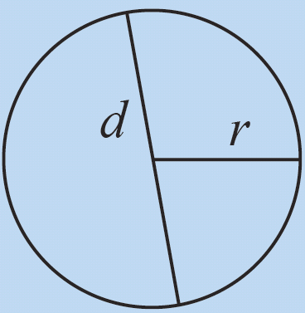
Table 1: Circles and Polygons
Object/Example | Definition | Basic Attributes
Circle | A circle is the set of all points in a plane that are a certain distance from a fixed center point. | The distance from the center to any point on the circle is called the radius, r. The diameter, d, is the length of a line segment that passes through the center of the circle and intersects the circle at two points.

Slide 5
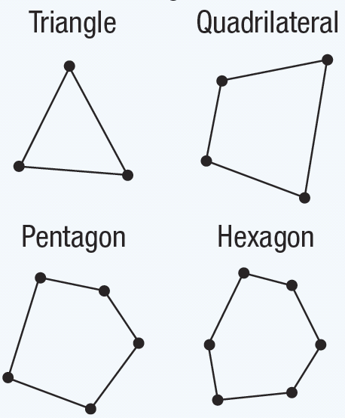
Table 1: Circles and Polygons (cont.)
Object/Example | Definition | Basic Attributes
Polygons | A polygon is a closed figure that is determined by three or more straight line segments. | Two line segments of a polygon intersect to form a vertex. A diagonal of a polygon is a line segment joining two nonconsecutive vertices.

Slide 6
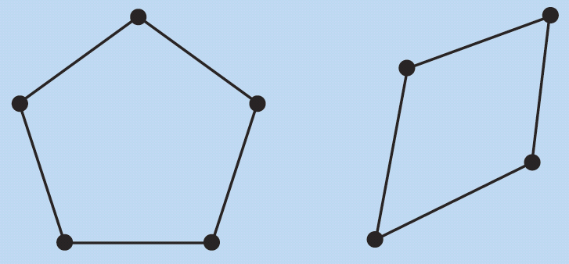
Table 1: Circles and Polygons (cont.)
Object/Example | Definition | Basic Attributes
Convex Polygons | A convex polygon is a polygon in which all of the interior angles measure less than 180°. | Every diagonal of a convex polygon remains inside or on the boundary of the polygon.

Slide 7
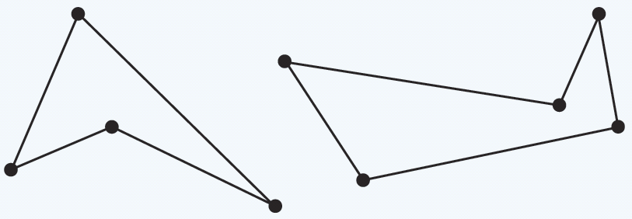
Table 1: Circles and Polygons (cont.)
Object/Example | Definition | Basic Attributes
Concave Polygons | A concave polygon is a polygon with one or more interior angles that measure greater than 180°. Note that a triangle can never be concave. | The diagonals of a concave polygon might lie outside the polygon and might not intersect.

Slide 8
Table 2: Interior Angle Sum for Any Polygon Based on the Number of Sides
Sides | Number of Triangles | Sum of the Measures of the Interior Angles
3 | 1 | 1 · 180 = 180°
4 | 2 | 2 · 180 = 360°
5 | 3 | 3 · 180 = 540°
6 | 4 | 4 · 180 = 720°

Slide 9
Sum of the Measures of the Interior Angles of a Polygon
Sum of the Measures of the Interior Angles of a Polygon
The sum of the measures of the interior angles of an n‑sided polygon is (n − 2) ⋅ 180°.

Slide 10
Skill Check #1
Skill Check #1
What is the sum of the measures of the interior angles of an octagon?
Answer: 1080°

Slide 11
Similar Triangles
Similar Triangles
Two triangles are similar if the corresponding angles are congruent and the ratio of the lengths of the corresponding sides are equal.

Slide 12
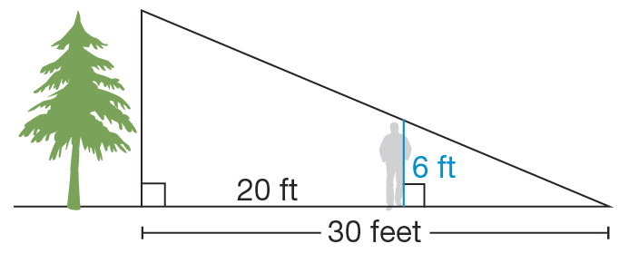
Example 1: Using Similar Triangles
Suppose a man who is 6 feet tall is standing 20 feet from the base of a tree. The sun shines on the tree and the man, and casts a 30-foot shadow, as seen in the figure. How tall is the tree?

Slide 13
Example 1: Using Similar Triangles (cont.)
Solution
By drawing the figure, it is easier for us to see that the triangles created by this situation are indeed similar. The large triangle with the tree on the left and the small triangle with the man on the left both contain right angles. Since they also share a common angle, we know the triangles are similar and the lengths of corresponding sides are proportional. Begin by letting the height of the tree equal x.

Slide 14
Example 1: Using Similar Triangles (cont.)
Since the distance from the tree to the man is 20 feet and the total distance is 30 feet, the length of the man’s shadow is 10 feet. Then, we can set up a ratio, as we did in Chapter 4.

Slide 15
Example 1: Using Similar Triangles (cont.)
We can solve by multiplying both sides by the LCD to obtain the following.
So the height of the tree is 18 feet.

Slide 16
Perimeter
Perimeter
The perimeter P of a polygon is the sum of the lengths of the sides of the polygon.

Slide 17
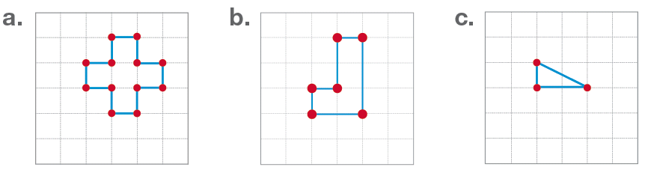
Example 2: Finding Perimeter
Each of the figures represents a polygon of some kind. Assume that the distance between two grid lines, either horizontally or vertically, is one unit. What is the perimeter of each figure?

Slide 18
Example 2: Finding Perimeter (cont.)
Solution
a. We can count the units and determine that the figure has a perimeter of 12 units.
b. Similarly, we can count the units and find that the figure has a perimeter of 10 units.
c. Since the figure is a right triangle, we can use the Pythagorean Theorem to find the length of the hypotenuse. We can see that the lengths of the two legs of the triangle are 1 unit and 2 units.

Slide 19
Example 2: Finding Perimeter (cont.)
Using these values, we find c as follows.
This means the perimeter of the triangle is

Slide 20
Area
Area
The area A of a polygon is defined as the number of square units required to cover the polygon.

Slide 21
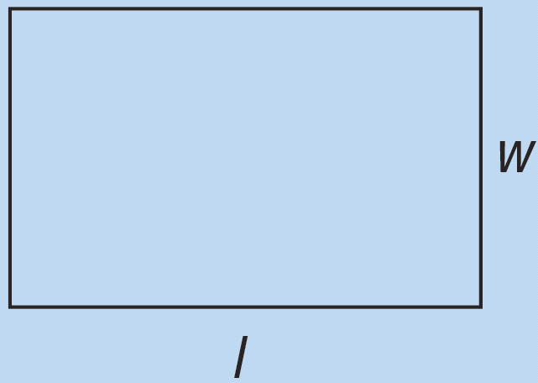
Table 3: Summary of Perimeter and Area Formulas
Shape | Definition | Formula for Perimeter | Formula for Area
Rectangle | A rectangle is a quadrilateral with two pairs of parallel sides and four right angles. We denote the longer side as the length l and the shorter side as the width w.

Slide 22
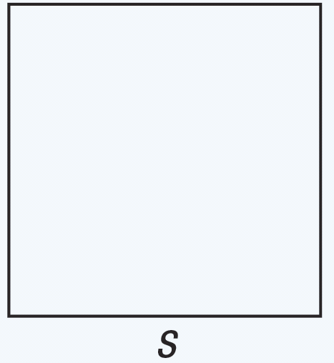
Table 3: Summary of Perimeter and Area Formulas (cont.)
Shape | Definition | Formula for Perimeter | Formula for Area
Square | A square is a quadrilateral with two pairs of parallel sides, all four sides are congruent, and four right angles. We denote the side length as s. Note that all squares are also rectangles.

Slide 23
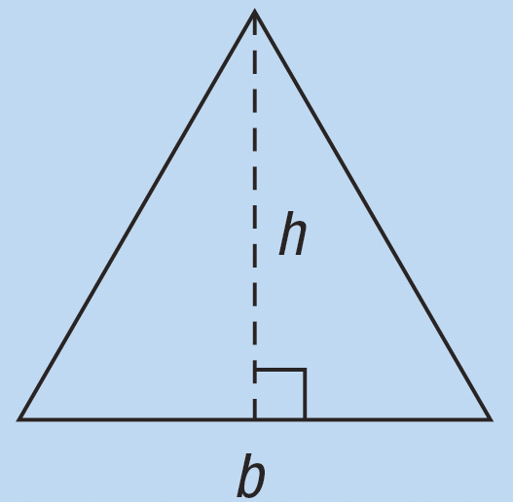
Table 3: Summary of Perimeter and Area Formulas (cont.)
Shape | Definition | Formula for Perimeter | Formula for Area
Triangle | A triangle is a three-sided polygon that is identified by its base b and height h.

Slide 24
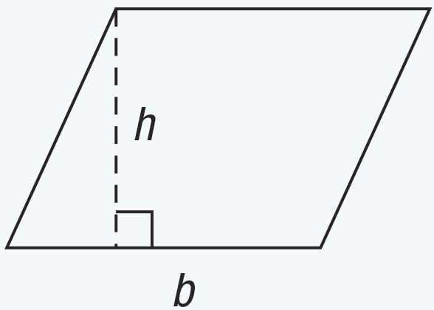
Table 3: Summary of Perimeter and Area Formulas (cont.)
Shape | Definition | Formula for Perimeter | Formula for Area
Parallelogram | A parallelogram is a quadrilateral with two pairs of parallel sides. The base of the parallelogram is denoted by b and the height by h.

Slide 25
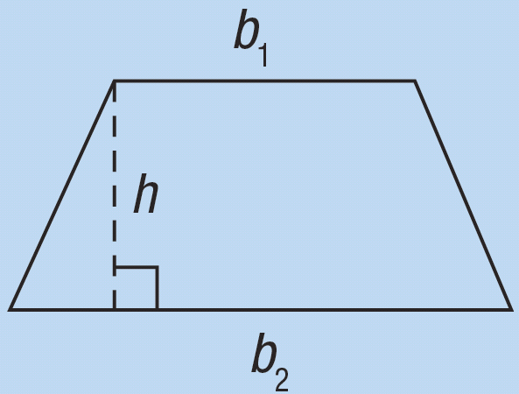
Table 3: Summary of Perimeter and Area Formulas (cont.)
Shape | Definition | Formula for Perimeter | Formula for Area
Trapezoid | A trapezoid is a quadrilateral with exactly one pair of parallel sides. The sides that are parallel are called bases and are denoted b₁ and b₂. The height is denoted by h.

Slide 26
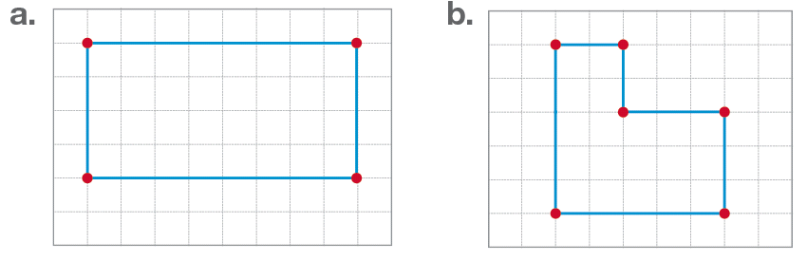
Example 3: Finding Area
Jim wants to build a garden in his back yard. Three different configurations that he is considering for the shape of the garden are given. Determine the area of each of the configurations, assuming the grid lines are each 1 foot apart.

Slide 27
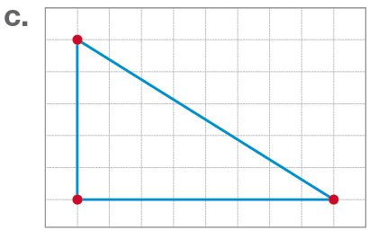
Example 3: Finding Area (cont.)

Slide 28
Example 3: Finding Area (cont.)
Solution
a. This figure is a rectangle with length 8 feet and width 4 feet. We can use the formula to find the area as follows.

Slide 29
Example 3: Finding Area (cont.)
b. This figure can be broken into two pieces: a square with sides of length 2 feet and a rectangle with length 5 feet and width 3 feet. Therefore we have the following area.

Slide 30
Example 3: Finding Area (cont.)
c. This figure is a triangle with a base of length 8 feet and height of length 5 feet. We then use the formula to obtain the following area.

Slide 31
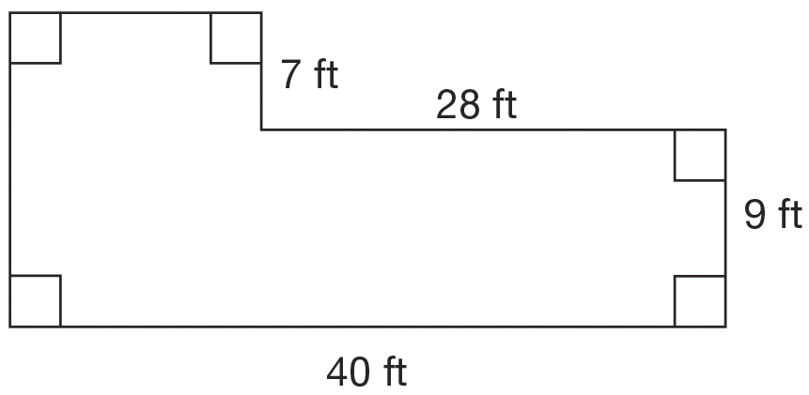
Example 4: Solving Problems Involving Area
You wish to paint the floor shown in the figure.
a. Determine the area to be painted.
b. If a gallon of paint will cover 350 ft², how many gallons of paint are needed?

Slide 32
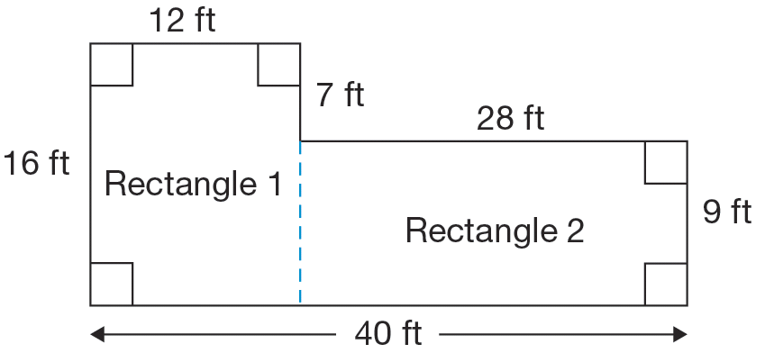
Example 4: Solving Problems Involving Area (cont.)
Solution
a. We have established that the area of a rectangle can be found using the formula A = lw. Since we have a formula for rectangles, we need to divide our figure into rectangles, if possible. Using dashed lines, consider the following rectangles.

Slide 33
Example 4: Solving Problems Involving Area (cont.)
Now, we have two rectangles for which we can find the area. Once we have the area of each, we can find the sum of the areas to determine the total area to be painted.
Rectangle 1: Area₁ = lw = (16 ft)(12 ft) = 192 ft²
Rectangle 2: Area₂ = lw = (28 ft)(9 ft) = 252 ft²
Area of floor = Area₁ + Area₂ = 192 ft² + 252 ft² = 444 ft²

Slide 34
Example 4: Solving Problems Involving Area (cont.)
b. Since a gallon of paint will cover 350 ft², we can determine the total number of gallons needed by dividing the total area to be painted by the number of square feet that a gallon of paint will cover.
Since we are unable to purchase partial gallons at this paint store, we will need to purchase two gallons of paint to complete the project.

Slide 35
Skill Check #2
Skill Check #2
If carpeting costs $2 per square foot and we wish to carpet rooms of size 12 ft by 16 ft and 15 ft by 20 ft, how much would it cost to carpet these two rooms?
Answer: $984

Slide 36
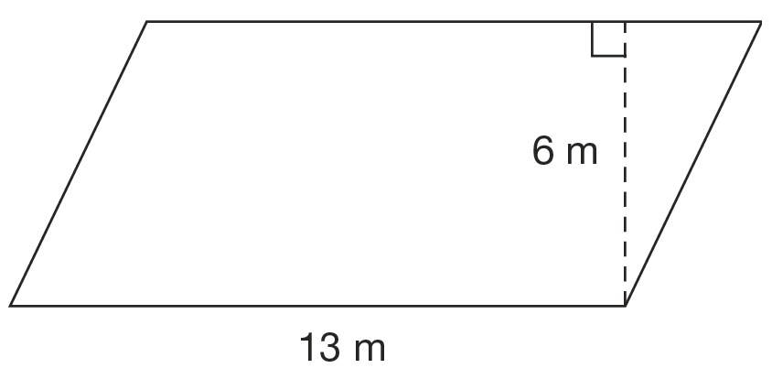
Example 5: Finding the Area of a Parallelogram
A new bridge consists of trusses that are parallelograms. The given figure shows an outline of one of the trusses. Find the area of each of the trusses.

Slide 37
Example 5: Finding the Area of a Parallelogram (cont.)
Solution
From the figure, we can see that the base b of the parallelogram is 13 meters and the height h is 6 meters. This means the area would be
So, the area of each truss is 78 m².

Slide 38
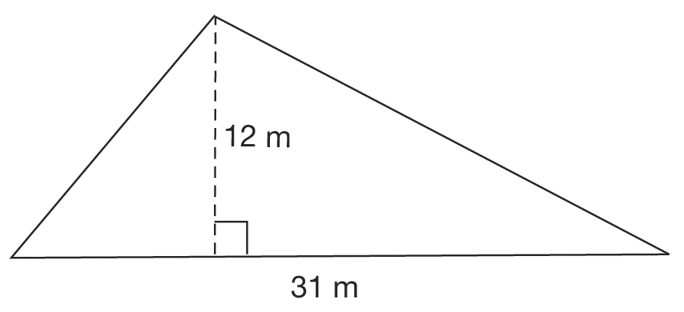
Example 6: Finding the Area of a Triangle
A triangular plot of land has dimensions as shown in the figure. A farmer wishes to fertilize the plot for spring planting. If one bag of fertilizer will cover 15 m², how many bags of fertilizer are needed?

Slide 39
Example 6: Finding the Area of a Triangle (cont.)
Solution
We begin by finding the area of the triangular plot.
Now that we know the area is 186 m², we can determine the amount of fertilizer to purchase. Since one bag will cover 15 m², we know that to fertilize the
whole plot will require bags. Since the
farmer can’t purchase part of a bag, 13 bags of fertilizer will be purchased.

Slide 40
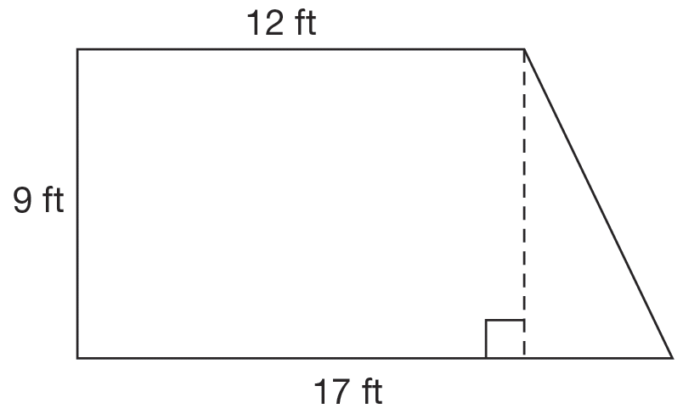
Example 7: Finding the Area of a Trapezoid
Find the area of the trapezoid in the figure.

Slide 41
Example 7: Finding the Area of a Trapezoid (cont.)
Solution
The area formula for the trapezoid is where the bases measure b₁ = 12 ft and b₂ = 17 ft, and the height measures h = 9 ft. So,
So the area of the trapezoid is 130.5 ft².

Slide 42
Circumference of a Circle
Circumference of a Circle
The perimeter of a circle is called the circumference and is defined by C = 2π r, which can also be written as C = π d.

Slide 43
Area of a Circle
Area of a Circle
The area of a circle is defined by the number of square units inside the circle and is calculated using the formula A = π r².

Slide 44
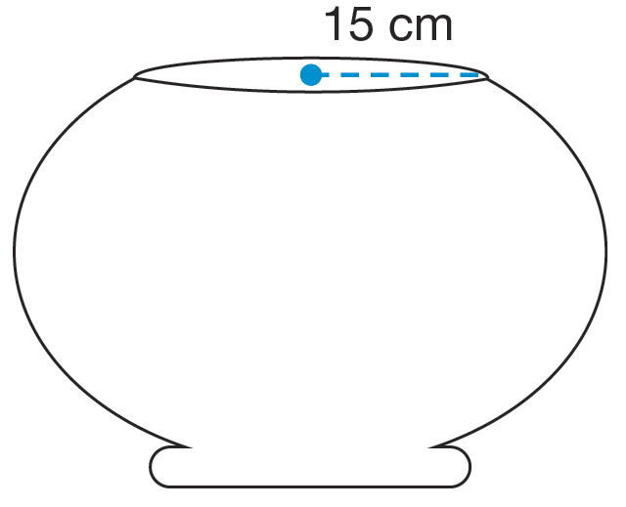
Example 8: Area and Circumference of Circles
A fish tank has a circular top with a radius of 15 cm. Jeff wants to cut a cover for the fish tank out of glass. Find the area and circumference of the cover of the tank.

Slide 45
Example 8: Area and Circumference of Circles (cont.)
Solution
Using the formula for the area of a circle, we can calculate the area using the formula A = π r² with r = 15 cm as follows.

Slide 46
Example 8: Area and Circumference of Circles (cont.)
To find the circumference, we can use the formula C = 2π r with r = 15 cm to obtain the solution as follows.
The glass cover will have an area of 706.5 cm² and a circumference of 94.2 cm.

Slide 47
Skill Check #3
Skill Check #3
Find the area and circumference of a circle with a diameter of 10 inches.
Answer: A = 78.5 in.²; C = 31.4 in.

Slide 48
Example 9: Using Area
Consider the size of the lawn at a local park. The park consists of a grassy rectangular area determined by the dimensions 228 feet by 380 feet. We need to install circular sprinklers in the park in order to cover the grassy areas for the most complete coverage of the park grounds. A sprinkler has a maximum radius of
38 feet and the sprinklers will be placed in a grid-like pattern as seen in the figure. If we have 15 sprinklers, how much of the grass will not get water?

Slide 49
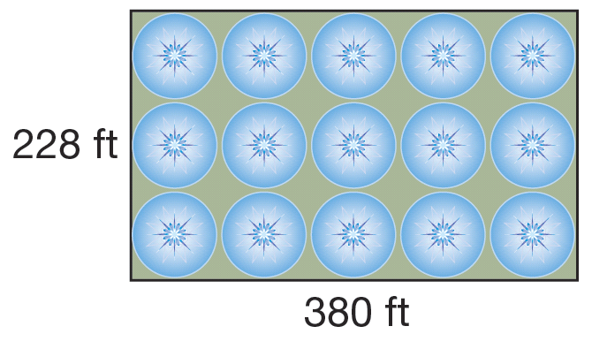
Example 9: Using Area (cont.)

Slide 50
Example 9: Using Area (cont.)
Solution
Using a drawing of the park, we can use what we know about the area of rectangles and circles to find the amount of grass that will not be watered. We will place our sprinklers in a grid-like pattern as shown in the figure. Now, to calculate how much of the park is being watered and how much is not being watered, we need to use a combination of the areas of rectangles and circles.

Slide 51
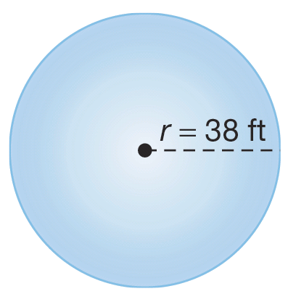
Example 9: Using Area (cont.)
Using the given figure and the area formula for a rectangle, we calculate the total area of the park to be
With the indicated position of the sprinklers, we can see that there are 15 sprinklers spread throughout the park. Each sprinkler makes a circular pattern with a radius of
38 feet.

Slide 52
Example 9: Using Area (cont.)
So the area watered by each sprinkler is as follows.

Slide 53
Example 9: Using Area (cont.)
Then the total area watered is calculated as follows.
This result indicates that the amount of the grass not watered will be
With 15 sprinklers, 18,627.6 ft², or about 21.5% of the grass, is not watered.

