Slide 1
Section 6.3
Volume and Surface Area

Slide 2
Objectives
Apply the concepts of surface area and volume

Slide 3
Volume and Surface Area
In the previous sections, we discussed 2-dimensional figures and their attributes. Now, we transition to figures in three dimensions by looking at their respective volumes and surface areas.

Slide 4
Volume
Volume
The volume of a 3-dimensional object is the amount of space occupied or consumed by a solid object, and is measured in cubic units.

Slide 5
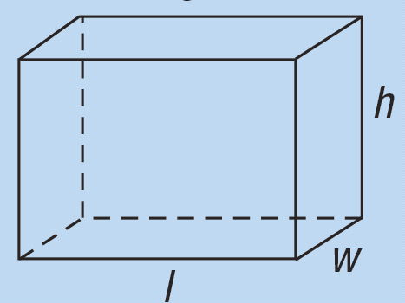
Table 1: Summary of Volume Formulas
Shape | Definition | Volume Formula
Rectangular Solid | A rectangular solid is a 3-dimensional figure that has six faces, all of which are rectangles. We denote the longer side of the base as the length l and the shorter side as the width w. The height is h. | V = lwh

Slide 6
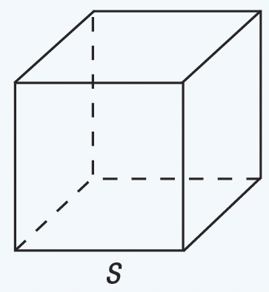
Table 1: Summary of Volume Formulas (cont.)
Shape | Definition | Volume Formula
Cube | A cube is a rectangular solid that is made of six congruent squares. The side length is denoted by s. | V = s³

Slide 7
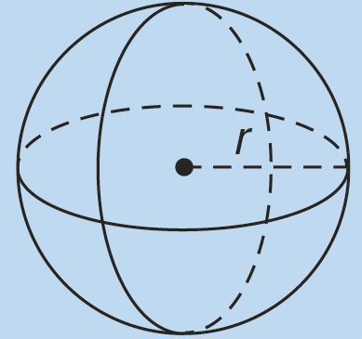
Table 1: Summary of Volume Formulas (cont.)
Shape | Definition | Volume Formula
Sphere | A sphere is a the set of all points in a 3-dimensional space that are a certain distance from a fixed center point. The radius is denoted by r.

Slide 8
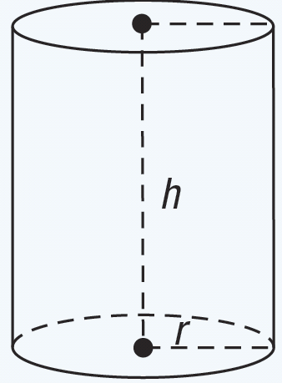
Table 1: Summary of Volume Formulas (cont.)
Shape | Definition | Volume Formula
Right Circular Cylinder | A right circular cylinder is a cylinder where the bases are circles with a radius of r and are perpendicular to the height h of the cylinder.

Slide 9
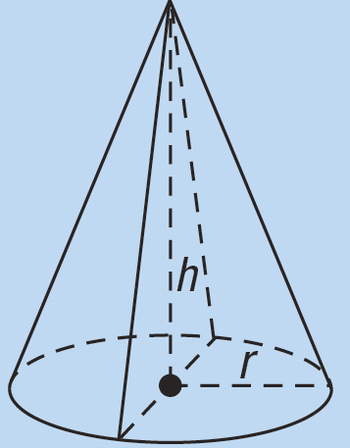
Table 1: Summary of Volume Formulas (cont.)
Shape | Definition | Volume Formula
Right Circular Cone | A right circular cone is a figure with a circle base with radius r tapering to a point. The height is denoted by h.

Slide 10
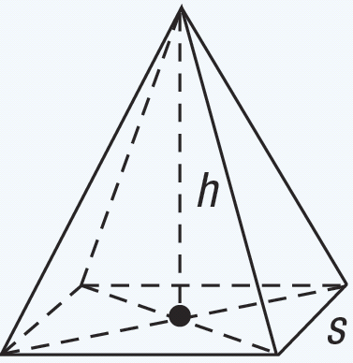
Table 1: Summary of Volume Formulas (cont.)
Shape | Definition | Volume Formula
Square Pyramid | A square pyramid is a figure with a square base with sides s and four triangular sides that taper to a point. The height is denoted by h.

Slide 11
Example 1: Determining Volume
Assume you want to build a concrete patio in the back of your house. The patio is to be 18 feet long, 12 feet wide, and 6 inches deep.
a. How many cubic yards of concrete are needed to build the patio?
b. If a concrete mixer truck holds 5 cubic yards of concrete, how many truckloads of concrete will be needed?

Slide 12
Example 1: Determining Volume (cont.)
Solution
a. The volume of the concrete patio is determined by the formula V = lwh.
Before we substitute the values in the formula, notice that not all of our dimensions are in the same units. Because we should always work with dimensions that are in the same units, we need to first convert some of the measurements. The easiest option in this example is to convert the depth, which is given in inches, into feet.

Slide 13
Example 1: Determining Volume (cont.)
Therefore, the depth is So, the total volume is

Slide 14
Example 1: Determining Volume (cont.)
We can calculate the number of cubic yards required by recalling that 1 yd = 3 ft and cubing both sides to get
Multiplying by
gives us the following.
Therefore, our patio requires 4 cubic yards of concrete to construct.

Slide 15
Example 1: Determining Volume (cont.)
b. Because we need less than 5 cubic yards of concrete, only one truckload of concrete would be needed to pour the patio.

Slide 16
Example 2: Using Volume to Meet Restrictions
Suppose you want to build a swimming pool in your backyard. The city in which you live has a restriction on the volume of water that the pool can hold. The restriction is that pools may contain at most 4800 cubic feet of water. Your plans are to a build a pool that is 16 feet wide, 24 feet long, and has a depth that varies from 2 feet to 12 feet on a constant slope. Does the pool meet the restrictions required by the city?

Slide 17
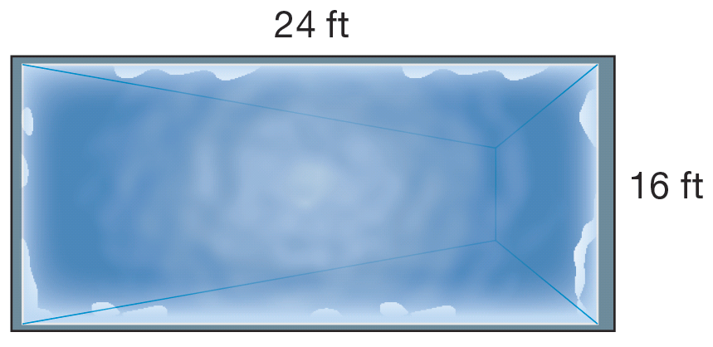
Example 2: Using Volume to Meet Restrictions (cont.)
Solution
To begin our solution, let’s recall some of our problem-solving techniques from Chapter 1. By drawing a picture of the pool with views from both the top and side, we can better understand what is being asked. The following figure shows the top view of the swimming pool.

Slide 18
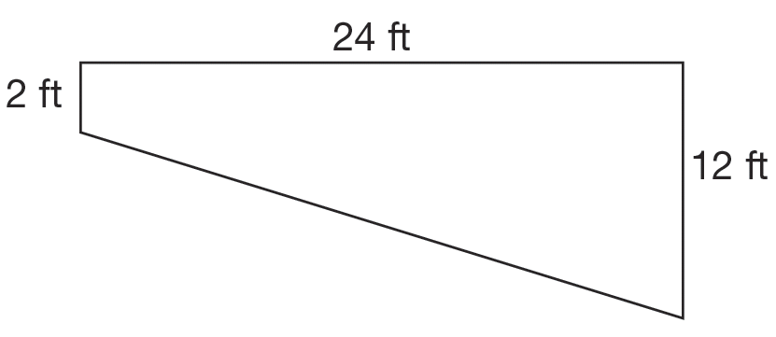
Example 2: Using Volume to Meet Restrictions (cont.)
You can see that the top view of the pool shows that the pool is rectangular with a width of 16 ft and a length of 24 ft. Now let’s take a look at a side view of the pool.

Slide 19
Example 2: Using Volume to Meet Restrictions (cont.)
The side view of the pool is actually a trapezoid. The formula for the area of a trapezoid is
where b₁ and b₂ are the lengths of the bases. In our case, the lengths of the bases are 2 ft and 12 ft. The height, or h, would be 24 ft. So, its area would be

Slide 20
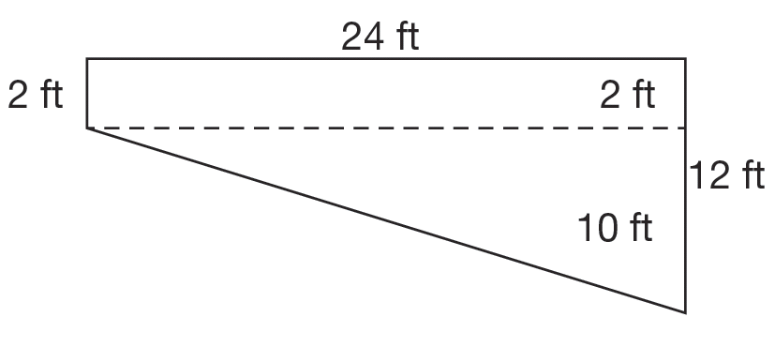
Example 2: Using Volume to Meet Restrictions (cont.)
Another way—though unnecessary since we know the formula—to find this side view area would be to break the trapezoid into pieces.

Slide 21
Example 2: Using Volume to Meet Restrictions (cont.)
Here, we cut the side view of the trapezoid into a small rectangle and a triangle. We know the formula for the area of each shape. So, if we combine the two areas, we will have the area of the trapezoid.
You can see that either way we calculate it, the area of the trapezoid is 168 ft².

Slide 22
Example 2: Using Volume to Meet Restrictions (cont.)
Finally, we can find the volume of the pool. The volume will be equal to the product of the area of the trapezoidal side view and the width of the pool. Take a moment to make sure you understand we have taken all three dimensions (length, width, and height) of the pool into account. The final volume of the pool will be

Slide 23
Example 2: Using Volume to Meet Restrictions (cont.)
Now to answer our initial question of whether or not we can build the pool. The answer is yes because we are under the maximum allowable volume for swimming pools.

Slide 24
Example 3: Finding the Volume of a Sphere
Whitt is filling balloons with an air pump.
a. If after 2 pumps of air a balloon has a radius of 2 inches, find the volume of air contained in the balloon.
b. Whitt wants to make the balloon bigger, so he puts in 2 more pumps of air and the volume of air doubles. How much volume of air is in the balloon now?
c. How big is the balloon's radius after the 4 pumps of air?

Slide 25
Example 3: Finding the Volume of a Sphere (cont.)
d. By what percentage does the radius increase when Whitt goes from 2 pumps of air to 4 pumps?
Solution
a. We know that the volume can be determined by
where r = 2 inches.

Slide 26
Example 3: Finding the Volume of a Sphere (cont.)
b. The volume doubles after 2 more pumps of air, so the volume after 4 pumps is as follows.
c. To find the new radius, we can substitute the known values into the volume formula and solve for r.

Slide 27
Example 3: Finding the Volume of a Sphere (cont.)

Slide 28
Example 3: Finding the Volume of a Sphere (cont.)
Taking the cube root of each side gives r ≈ 2.52 in. This means that the radius of the balloon after 4 pumps is approximately 2.52 in.

Slide 29
Example 3: Finding the Volume of a Sphere (cont.)
d. Finally, we can find the percentage increase of the radius as follows.

Slide 30
Example 3: Finding the Volume of a Sphere (cont.)
We can see that although the volume doubled (that is, it increased by 100%) between the two measurements, the radius only increased by 26 percent.

Slide 31
Example 4: Finding the Volume of a Right Circular Cylinder
The sound a drum makes varies according to the diameter and depth of the drum (assuming that the materials for the make of the drum remain the same).
a. Find the volume of air in a snare drum that has a diameter of 14 inches and a depth 5 inches.
b. A tom-tom drum has a radius of 5 inches and a depth of 8 inches. Find the volume of air in the tom-tom.

Slide 32
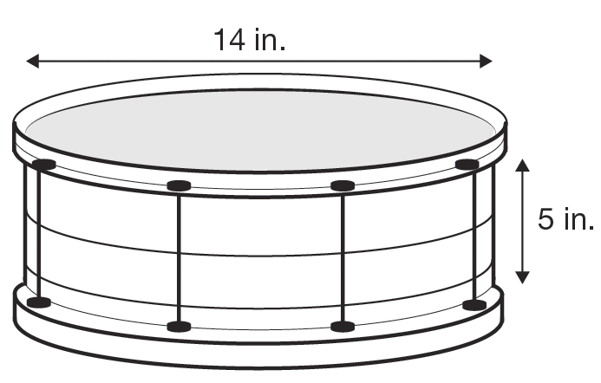
Example 4: Finding the Volume of a Right Circular Cylinder (cont.)
Solution
a. Using the formula for the volume of a right circular cylinder, V = πr²h, with r = 14 ÷ 2 = 7 inches and h = 5 inches, we compute the volume of the snare drum as follows.

Slide 33
Example 4: Finding the Volume of a Right Circular Cylinder (cont.)
So, the approximate volume of the snare drum is 769.3 in.³.

Slide 34
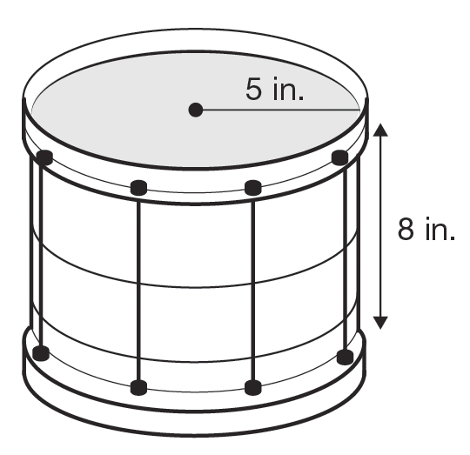
Example 4: Finding the Volume of a Right Circular Cylinder (cont.)
b. To find the volume of air in the tom-tom drum, we use the same formula, with r = 5 and h = 8.

Slide 35
Example 4: Finding the Volume of a Right Circular Cylinder (cont.)
So, the approximate volume of the tom-tom drum is 628 in.³.

Slide 36
Example 5: Finding the Volume of a Right Circular Cone
E.D.’s Candy Shoppe is creating a new solid chocolate in the shape of a right circular cone. The height of the chocolate cone is 2 cm and the diameter of the base is 1.2 cm.
a. Find the volume of the new chocolate candy.
b. A rectangular block of chocolate measuring 22 cm by 10 cm by 10 cm is melted down and used to make a number of the new candies. Find the maximum number of candies that can be made from the block of chocolate.

Slide 37
Example 5: Finding the Volume of a Right Circular Cone (cont.)
Solution
a. The formula for the volume of a right circular cone is given as So, we can calculate the volume of the cone using this formula with r = 1.2 ÷ 2 = 0.6 cm and h = 2 cm.
The volume of the new chocolate is approximately 0.75 cm³.

Slide 38
Example 5: Finding the Volume of a Right Circular Cone (cont.)
b. We begin by finding the volume of the chocolate block.
Now we divide this total volume by the amount of chocolate it takes to make one of the new candies to find out how many candies can be made from one block.

Slide 39
Example 5: Finding the Volume of a Right Circular Cone (cont.)
Since we are asked to find the maximum number of chocolates that can be made from one bar, we need to round the number down to the nearest whole number. So, a maximum of 2933 candies can be made from the block of chocolate.

Slide 40
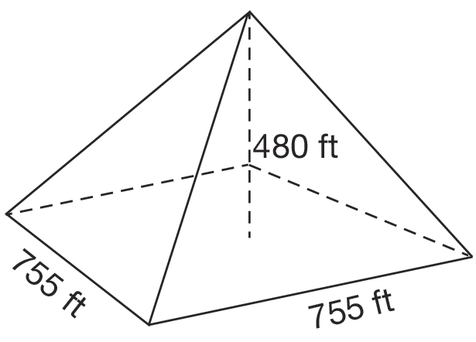
Example 6: Finding the Volume of a Square Pyramid
The Great Pyramid of Giza was originally about 480 ft tall with a square base whose sides measured about 755 ft long.
a. Find the volume of the Great Pyramid of Giza.
b. A scale model of the Great Pyramid is made out of sand. If the model has a ratio of 1 : 100, what is the volume of sand needed to build the model?

Slide 41
Example 6: Finding the Volume of a Square Pyramid (cont.)
Solution
a. The given formula for the volume of a square pyramid is So, the volume of the Great Pyramid can be calculated as follows.
Therefore, the volume of the Great Pyramid of Giza was about 91,204,000 ft³.

Slide 42
Example 6: Finding the Volume of a Square Pyramid (cont.)
b. Using our knowledge of ratios, we know that if the scale model has a ratio of 1 : 100, then we need to divide by 100. We can do this in one of two ways. We can either divide each of the original length measurements by 100, and then multiply them together, or we can divide the volume by 100³ = 1,000,000. Either calculation will give the same result.

Slide 43
Example 6: Finding the Volume of a Square Pyramid (cont.)
The following shows the volume method. We leave the other method as an exercise. We take the volume of the Great Pyramid and divide by 100³ = 1,000,000 as follows.
Therefore, the model pyramid will require 91.204 ft³ of sand.

Slide 44
Skill Check #1
Skill Check #1
Show that dividing the original measurements in Example 6 by 100 produces the same volume as given in part b.
Answer:

Slide 45
Surface Area
Surface Area
The surface area of a 3-dimensional object is the area required to cover the outside surfaces of the object and is measured in square units.

Slide 46
Rectangular Solids
Surface Area of a Rectangular Solid
The surface area of a rectangular solid with length l, width w, and height h can be computed by the formula 2lw + 2lh + 2wh.

Slide 47
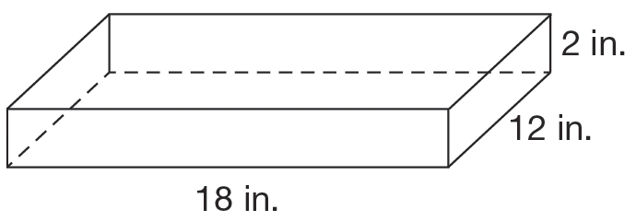
Example 7: Finding the Surface Area of a Rectangular Solid
Aimee is icing a cake for her sister’s birthday. It’s a half‑sheet cake and measures 12 in. by 18 in. by 2 in.
a. Find the surface area of the cake that will need icing.
b. If the cake is cut into pieces that are 2-inch squares, how many pieces of cake can be served?

Slide 48
Example 7: Finding the Surface Area of a Rectangular Solid (cont.)
Solution
a. We recognize that the rectangular solid has length l = 18 in., width w = 12 in., and height h = 2 in. Using our formula, we calculate the surface area as follows.

Slide 49
Example 7: Finding the Surface Area of a Rectangular Solid (cont.)
Therefore, the total surface area of the cake is 552 in.² However, remember the bottom of the cake will not be iced, so we need to subtract off the area of the bottom of the cake. The area for the bottom of the cake is found by multiplying the length times the width. Hence, it is 12 · 18 = 216 in.² So, the surface area of the cake that needs icing is
552 in.² − 216 in.² = 336 in.²

Slide 50
Example 7: Finding the Surface Area of a Rectangular Solid (cont.)
b. To find the number of 2-inch square servings in the cake, we only need to consider the top of the cake. We know that the top area of the cake is the same as the bottom, which we have already calculated as 216 in.² So, we can divide the top area of the cake by the top area of a single slice, 2 in. · 2 in. = 4 in.², and obtain the following.

Slide 51
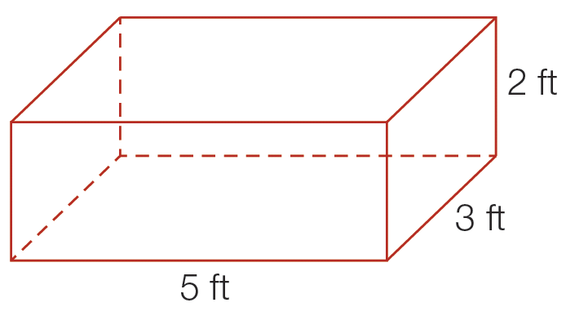
Skill Check #2
Skill Check #2
Find the volume and surface area for the given box.
Answer:

Slide 52
Cubes
Surface Area of a Cube
The surface area of a cube with side s can be computed by the formula SA = 6s².

Slide 53
Sphere
Surface Area of a Sphere
The surface area of a sphere with radius r can be computed by the formula SA = 4π r².

Slide 54
Example 8: Calculating Surface Area
Tyson's Athletic Gear, Inc. manufactures baseballs, among other things.
a. If a baseball has a diameter of 9.2 in., what is the surface area of the baseball?
b. If the quota for a day is to make 225 baseballs, what is the minimum amount of covering material needed to meet the quota in square feet?

Slide 55
Example 8: Calculating Surface Area (cont.)
Solution
a. Since the diameter of a circle is twice the radius, the radius will be 9.2 ÷ 2 = 4.6 in. Now using the formula, we can calculate the surface area of the baseball.
So, the surface area of the baseball is approximately 265.77 in.²

Slide 56
Example 8: Calculating Surface Area (cont.)
b. To find the amount of material needed to cover the baseballs, we can multiply the surface area by 225 to give
265.77 in.² · 225 = 59,798.25 in.²
To find the amount of material in square feet, we use the fact that 1 ft = 12 in. and square both sides to get 1 ft² = 144 in.²

Slide 57
Example 8: Calculating Surface Area (cont.)
Therefore, we can divide the total material by 144 to give
So the amount needed to meet a day’s quota is 415.27 ft² of material.

Slide 58
Right Circular Cylinder
Surface Area of a Right Circular Cylinder
The surface of a right circular cylinder with radius r and height h can be computed by the formula SA = 2π r² + 2π rh.

Slide 59
Example 9: Finding the Surface Area of a Right Circular Cylinder
Find the surface area of a cylinder with a radius of 4 cm and a height of 10 cm.
Solution
The formula for the surface area of a cylinder is SA = 2π r² + 2π rh. So, the surface area of this cylinder can be calculated as follows.

Slide 60
Example 9: Finding the Surface Area of a Right Circular Cylinder (cont.)

Slide 61
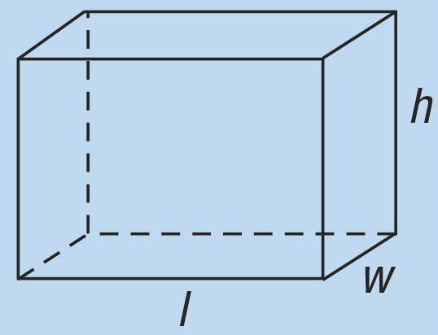
Table 2: Summary of Volume and Surface Area Formulas
Shape | Volume Formula | Surface Area Formula
Rectangular Solid

Slide 62
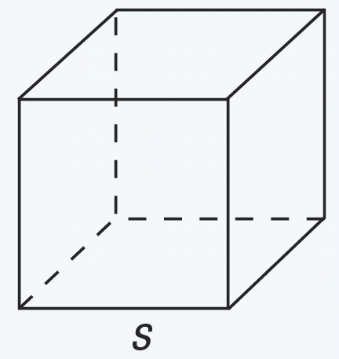
Table 2: Summary of Volume and Surface Area Formulas (cont.)
Shape | Volume Formula | Surface Area Formula
Cube

Slide 63
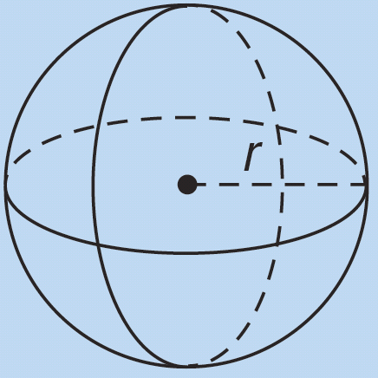
Table 2: Summary of Volume and Surface Area Formulas (cont.)
Shape | Volume Formula | Surface Area Formula
Sphere

Slide 64
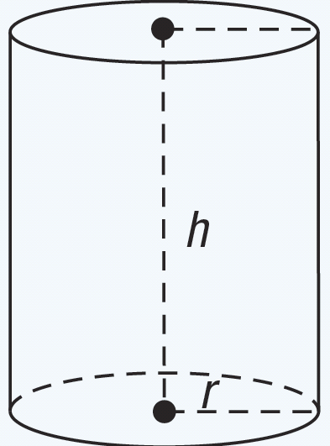
Table 2: Summary of Volume and Surface Area Formulas (cont.)
Shape | Volume Formula | Surface Area Formula
Right Circular Cylinder

Slide 65
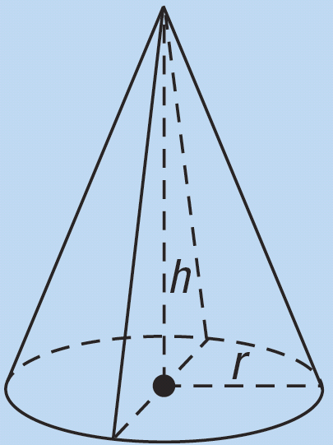
Table 2: Summary of Volume and Surface Area Formulas (cont.)
Shape | Volume Formula | Surface Area Formula
Right Circular Cone

Slide 66
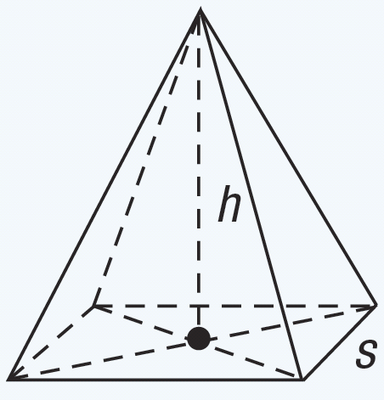
Table 2: Summary of Volume and Surface Area Formulas (cont.)
Shape | Volume Formula | Surface Area Formula
Square Pyramid

Slide 67
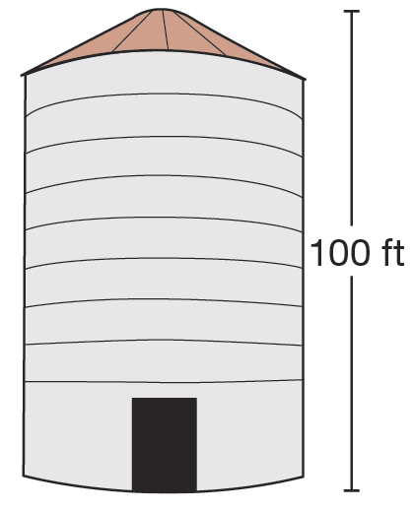
Example 10: Using Volume
A farmer wishes to build a grain silo that can hold 400,000 cubic feet of grain. There is a limit to the height of the silo of 100 feet. Find an example of a silo that meets the necessary requirements for the farmer’s needs.

Slide 68
Example 10: Using Volume (cont.)
Solution
A silo is in the shape of a right circular cylinder. Note that we are asked to find an example, not the example. As the radius and height of the silo can vary, there are many differently sized silos that meet the criteria.
Using what we know about the volume of right circular cylinders, the height of the silo, and the required volume, we can find the solution using V = πr²h, where r is the radius of the silo, h is the height of the silo, and V represents the volume.

Slide 69
Example 10: Using Volume (cont.)
We are given that the farmer wants the silo to be able to hold 400,000 cubic feet of grain and that the height is to be no more than 100 feet. There are many possible answers to this question since the height can be any number between 0 and 100 feet. We are going to assume that the height is 100 feet. That means we only need to find the radius to determine the full dimensions of the silo. Using the formula for the volume of a cylinder, we can calculate the radius as follows.

Slide 70
Example 10: Using Volume (cont.)

Slide 71
Example 10: Using Volume (cont.)
Using a calculator, we calculate that the radius would be r ≈ 35.69 ft.
Thus, at 100 feet tall, in order for the silo to hold 400,000 cubic feet of grain, the radius should be approximately 35.69 feet.

Slide 72
Example 11: Using Surface Area
You have decided to paint the exterior of your house, and you need to determine the amount of paint required to complete the job. Assume your house is a one-story rectangular building with a length of 87 feet and a width of 45 feet. The height of each wall to be painted is 10 feet. There are 6 windows of size 30 inches by 36 inches and two doors, each measuring 30 inches by 84 inches. The gable end (triangular portion) of the house will not be painted.

Slide 73
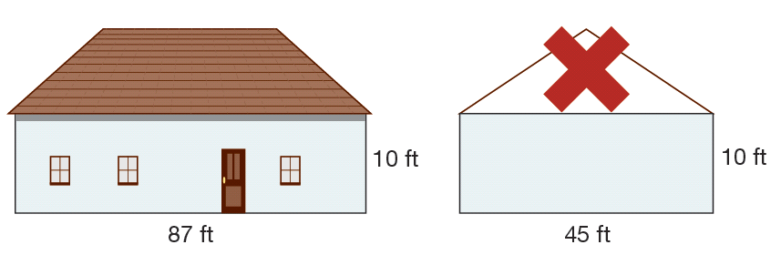
Example 11: Using Surface Area (cont.)
Assuming a gallon of paint will cover 400 square feet of surface area, and that you will apply two coats, how much paint do you need to paint your house?

Slide 74
Example 11: Using Surface Area (cont.)
Solution
There are several aspects that need to be considered to determine the surface area to be painted and the amount of paint required to do so. Let’s begin by finding the total surface area to be painted. There are two “long” sides to the house and two “short” sides to the house, all of which are rectangular. Therefore the total wall area can be calculated by
2 · (Area of the long side) + 2 · (Area of the short side).

Slide 75
Example 11: Using Surface Area (cont.)
The total area of the two long sides can be calculated as follows.
The total area of the two short sides is
Notice that we did not calculate the area for the top or bottom of the rectangular solid that is our house, since we will not be painting those sides.

Slide 76
Example 11: Using Surface Area (cont.)
Since we will not be painting the windows and doors, the amount of surface area they take up should be calculated and removed from our surface area to be painted. Each of these is a rectangle as well. For ease of computation, we need to convert the size of each from inches to feet. This means each window is 2.5 feet by 3 feet (30 in. = 2.5 ft and 36 in. = 3 ft), and each door is 2.5 feet by 7 feet (30 in. = 2.5 ft and 84 in. = 7 ft). Since there are six windows, the total window area is

Slide 77
Example 11: Using Surface Area (cont.)
Since there are two doors, the total door area is
We have now taken into account all sides to be painted and the spaces to be eliminated. The total area to be painted can now be found by finding the sum of the exterior walls and subtracting the areas that will not be painted (doors and windows).

Slide 78
Example 11: Using Surface Area (cont.)

Slide 79
Example 11: Using Surface Area (cont.)
This indicates that there are 2560 ft² to be painted for one coat. Since we want to have two coats of paint, we will need to paint a total of 2560 ft² · 2 = 5120 ft². Considering that each gallon will cover 400 ft², we must buy
Since we are unable to purchase partial gallons, we will need to purchase 13 gallons of paint to complete the job.

Slide 80
Example 12: Using Volume
The I Scream, U Scream Ice Cream shop is famous for their 0.5 L ice cream sundae. They had a special cup (instead of a cone) created just for them that enhances the flavor of their ice cream. The cup is in the shape of a conical frustum. (If we cut the top—or bottom depending on the orientation—off of a cone, we get a conical frustum, as shown in the figure where the top radius is R₁, the bottom radius is R₂, and the height is h.)

Slide 81
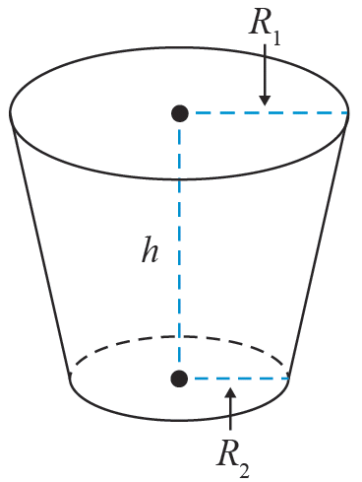
Example 12: Using Volume (cont.)
The original cup has dimensions of R₁ = 4.5 cm, R₂ = 3 cm, and h = 11 cm. Recently, the owner decided that he wanted to break the world record for the size of a sundae, which currently is approximately 37,500 L of ice cream.

Slide 82
Example 12: Using Volume (cont.)
He needs to enlarge his special cup in order to achieve the goal of breaking the world record. The cup for breaking the world record has a constraint that R₁ = 2.25 meters and R₂ = 1 meter. The owner wants the final amount of ice cream that will fit in the cup to be 38,000 L. If the volume of a frustum can be found using the formula what should the dimensions of the enlarged cup be?

Slide 83
Example 12: Using Volume (cont.)
Solution
We are given that the formula
can be used to find the volume of a frustum. Now, to find our missing value of h, we simply need to input values for V, R₁, and R₂ and solve for h. If we use the fact that 1000 L = 1 m³, we obtain the following.

Slide 84
Example 12: Using Volume (cont.)

Slide 85
Example 12: Using Volume (cont.)
So, the new cup to be built to hold 38,000 L of ice cream will have a top radius of 2.5 meters, a bottom radius of 1 meter, and a height of about 3.72 meters.

