Slide 1
Section 8.2
Displaying Data

Slide 2
Objectives
Interpret different types of graphs

Slide 3
Displaying Data
Once we have gathered data from the sample, our attention turns to how to communicate the results. It’s important to display data so that it is organized clearly and it effectively conveys the intended message.

Slide 4
Frequency Distribution
Frequency Distribution
A frequency distribution is a count of every member of the data set and how often each value occurs, that is, the frequency of the data value.

Slide 5
Example 1: Interpreting a Frequency Distribution
The following frequency distribution shows the number of crashes with roadside objects along State Route 3 in the state of Washington. After looking over the table, answer the questions that follow.
Table 1: Crashes with Roadside Objects Along State Route 3, Washington
Roadside Object | Number of Crashes (% of total)
Guardrail | 57 (15.36)
Earth Bank | 55 (14.82)
Ditch | 42 (11.32)

Slide 6
Example 1: Interpreting a Frequency Distribution (cont.)
Table 1: Crashes with Roadside Objects Along State Route 3, Washington (cont.)
Roadside Object | Number of Crashes (% of total)
Tree | 42 (11.32)
Concrete Barrier | 38 (10.24)
Over Embankment | 31 (8.36)
Utility Pole | 20 (5.39)
Wood Sign Support | 19 (5.12)
Bridge Rail | 17 (4.58)
Culvert | 7 (1.89)
Boulder | 6 (1.62)
Luminaire | 6 (1.62)

Slide 7
Example 1: Interpreting a Frequency Distribution (cont.)
Table 1: Crashes with Roadside Objects Along State Route 3, Washington (cont.)
Roadside Object | Number of Crashes (% of total)
Mailbox | 5 (1.35)
Fence | 5 (1.35)
Building | 5 (1.35)
Other Object | 16 (4.31)
Source: Jinsun Lee and Fred Manning. “Analysis of Roadside Accident Frequency and Severity and Roadside Safety Management.” Washington State Transportation Commission. December 1999. http://www.wsdot.wa.gov/research/reports/fullreports/475.1.pdf

Slide 8
Example 1: Interpreting a Frequency Distribution (cont.)
a. What do the numbers in the parentheses represent?
b. Which roadside object was involved in the most crashes?
c. How many total crashes did the survey cover?

Slide 9
Example 1: Interpreting a Frequency Distribution (cont.)
Solution
a. The numbers in parentheses represent the relative frequency of each class; that is, the number of crashes in a particular category as a percentage of the total number of crashes. For example, there were 57 crashes involving a guardrail. Crashes involving a guardrail account for 15.36% of the total crashes along State Route 3.

Slide 10
Example 1: Interpreting a Frequency Distribution (cont.)
b. Because the “Guardrail” category has the highest frequency listed, guardrails were involved in the most crashes.
c. By adding up the frequencies of all the different categories, we can see that there were 371 crashes involving roadside objects.

Slide 11
Example 2: Constructing a Frequency Distribution
The number of household pets for 52 families is recorded. Construct a frequency distribution of the data collected.
Solution
List each possible value for the number of household pets in the “Number of Pets Per Household” column and the number of times that particular data value occurs in the “Number of Households” column.
0 | 1 | 0 | 2 | 0 | 0 | 3 | 1 | 1 | 1 | 2 | 3 | 1 | 0 | 0 | 2 | 0 | 3 | 4 | 2 | 0 | 1 | 2 | 5 | 1 | 3
1 | 3 | 2 | 1 | 1 | 2 | 2 | 2 | 0 | 0 | 0 | 0 | 1 | 6 | 1 | 2 | 2 | 1 | 0 | 0 | 0 | 1 | 0 | 1 | 2 | 2

Slide 12
Example 2: Constructing a Frequency Distribution (cont.)
Table 2: Number of Household Pets
Number of Pets Per Household | Number of Households
0 | 16
1 | 15
2 | 13
3 | 5
4 | 1
5 | 1
6 | 1

Slide 13
Skill Check #1
Skill Check #1
What is the most popular number of household pets in the data given in Example 2?
Answer: 0 pets

Slide 14
Grouped Frequency Distribution
Grouped Frequency Distribution
In a grouped frequency distribution, the data is grouped into different categories, called classes. Each class must have the same width, called the class width, and the classes cannot overlap. The lowest value in a class is called the lower class limit. The highest value in a class is called the upper class limit.

Slide 15
Example 3: Constructing a Grouped Frequency Distribution
The number of text messages used per month for 52 individuals was recorded and is listed. Construct a grouped frequency distribution for the data.
357 | 239 | 379 | 381 | 298 | 377 | 130 | 312 | 333 | 287 | 389 | 357 | 328
345 | 301 | 278 | 222 | 388 | 391 | 295 | 342 | 327 | 276 | 289 | 367 | 399
265 | 298 | 326 | 301 | 333 | 344 | 313 | 389 | 372 | 369 | 328 | 337 | 317
352 | 189 | 355 | 318 | 272 | 361 | 340 | 322 | 371 | 358 | 266 | 345 | 207

Slide 16
Example 3: Constructing a Grouped Frequency Distribution (cont.)
Solution
The first thing we need to do is identify the smallest and largest pieces of data to ensure that our distribution will include all of the data values. The smallest number of text messages used was 130 and the largest was 399. When choosing the number of classes, we don’t want too many or too few class divisions. Remember, if we have too many divisions, we might as well have listed out each individual piece of data, which is overwhelming.

Slide 17
Example 3: Constructing a Grouped Frequency Distribution (cont.)
However, if we have too few classes, then the data are all lumped together and don't tell us much. A good rule of thumb is to aim for somewhere between 5 and 20 classes. Since our data set covers a spread of almost 270, a class width of 50 is a good place to start. If our classes each have a width of 50, where should the first class start? Let’s try with the smallest data value. By adding the width to 130, we can find each of the lower class limits. Keep adding classes until all data values can be tallied in the distribution. We then have the following start to our table.

Slide 18
Example 3: Constructing a Grouped Frequency Distribution (cont.)
Table 4: Number of Text Messages Used Per Month
Number of Text Messages Used Per Month | Frequency
130-
180-
230-
280-
330-
380-
430-

Slide 19
Example 3: Constructing a Grouped Frequency Distribution (cont.)
Since our largest data point is 399, it will safely fall into the class that has a lower limit of 380, since we can now see that the following class would start at 430. Therefore, we do not actually need to add the class beginning with 430, and we can stop with 6 classes. Next, in order to find upper class limits, we can use the lower limits. For the first upper limit, simply count backwards one unit from the lower limit of the second class, making sure the classes don’t overlap with one another.

Slide 20
Example 3: Constructing a Grouped Frequency Distribution (cont.)
For example, the first upper class limit will be
180 – 1 = 179. We could continue this same process of subtraction to obtain the remaining upper limits. Alternatively, we can simply add the class width of 50 to the upper limit we just found. Either method produces identical upper limits.

Slide 21
Example 3: Constructing a Grouped Frequency Distribution (cont.)
We then have the following table.
Table 5: Number of Text Messages Used Per Month
Number of Text Messages Used Per Month | Frequency
130–179
180–229
230–279
280–329
330–379
380–429

Slide 22
Example 3: Constructing a Grouped Frequency Distribution (cont.)
The only remaining thing to do is to tally the frequencies of each class as shown in Table 6.
Table 6: Number of Text Messages Used Per Month
Number of Text Messages Used Per Month | Frequency
130–179 | 1
180–229 | 3
230–279 | 6
280–329 | 16
330–379 | 20
380–429 | 6

Slide 23
Example 4: Interpreting a Frequency Distribution
The San Francisco Bay Area surveyed their residents about the nearly 17 million intraregional daily trips the population makes. Along with other data that they collected, they asked people to identify where their trips originated and how long they traveled. Table 7 organizes the travel data by trip purpose and travel time. The trip purposes recorded in the survey were work, shop, social/recreational, and school. Home-based trips were those that either started or ended at the residence of the trip maker. Non-home based trips were those that neither started nor ended at the residence.

Slide 24
Example 4: Interpreting a Frequency Distribution (cont.)
Answer the following questions about the frequency chart and its data.
Table 7: Number of Intraregional Trips
Travel Time (in Minutes) | Home-Based Work | Home-Based Shop (Other) | Home-Based Social/Rec. | Home-Based School | Non-Home Based | Total Purposes
0–5.0 | 269,350 | 807,952 | 272,973 | 242,906 | 953,920 | 2,547,101
5.1–10.0 | 416,075 | 881,203 | 357,196 | 282,305 | 917,191 | 2,853,970
10.1–15.0 | 886,859 | 1,217,440 | 491,636 | 434,810 | 1,206,126 | 4,236,871
15.1–20.0 | 440,776 | 316,201 | 137,957 | 139,623 | 331,661 | 1,366,218
20.1–25.0 | 283,777 | 200,142 | 84,876 | 103,114 | 213,205 | 885,114
25.1–30.0 | 807,327 | 391,393 | 228,241 | 211,851 | 455,129 | 2,093,941

Slide 25
Example 4: Interpreting a Frequency Distribution (cont.)
Table 7: Number of Intraregional Trips (cont.)
Travel Time (in Minutes) | Home-Based Work | Home-Based Shop (Other) | Home-Based Social/Rec. | Home-Based School | Non-Home Based | Total Purposes
30.1–35.0 | 155,706 | 53,270 | 27,501 | 40,179 | 71,154 | 347,810
35.1–40.0 | 169,675 | 50,564 | 34,060 | 38,579 | 79,675 | 372,553
40.1–45.0 | 327,028 | 101,392 | 60,827 | 69,478 | 150,929 | 709,654
45.1–50.0 | 88,325 | 25,253 | 16,074 | 11,509 | 30,240 | 171,401
50.1–55.0 | 56,228 | 15,686 | 10,876 | 13,804 | 25,282 | 121,876
55.1–60.0 | 227,844 | 76,162 | 48,138 | 38,221 | 94,638 | 485,003
60.1–65.0 | 45,851 | 10,352 | 5287 | 3284 | 16,144 | 80,918
65.1–70.0 | 42,824 | 11,974 | 7697 | 3952 | 14,434 | 80,881
70.1–75.0 | 81,350 | 20,182 | 14,642 | 10,800 | 35,675 | 162,649

Slide 26
Example 4: Interpreting a Frequency Distribution (cont.)
Table 7: Number of Intraregional Trips (cont.)
Travel Time (in Minutes) | Home-Based Work | Home-Based Shop (Other) | Home-Based Social/Rec. | Home-Based School | Non-Home Based | Total Purposes
75.1–80.0 | 22,123 | 5876 | 3311 | 3321 | 9344 | 43,975
80.1–85.0 | 13,594 | 3852 | 3121 | 2495 | 4950 | 28,012
85.1–90.0 | 50,220 | 13,375 | 12,996 | 4947 | 27,684 | 109,222
90 + | 68,457 | 29,496 | 26,402 | 9446 | 47,242 | 181,043
Total | 4,453,389 | 4,231,765 | 1,843,811 | 1,664,624 | 4,684,623 | 16,878,212
Source: National Transportation Library. “San Francisco Bay Area 1990 Regional Travel Characteristics - WP #4 - MTC Travel Survey.” http://ntl.bts.gov/DOCS/SF.html

Slide 27
Example 4: Interpreting a Frequency Distribution (cont.)
a. How many classes are there in the frequency distribution?
b. Find the class width. (Exclude the first and last classes.)
c. Which guideline is ignored in this published frequency distribution? What sorts of questions arise from this inconsistency?
d. Which class contains the largest number of school-related trips, and what is its frequency?

Slide 28
Example 4: Interpreting a Frequency Distribution (cont.)
e. Is the statement “Most people take 10−15 minutes to travel to school in the San Francisco Bay Area” a true statement?
Solution
a. There are 19 classes in this frequency distribution. This can be found by counting the number of data rows in the frequency chart.

Slide 29
Example 4: Interpreting a Frequency Distribution (cont.)
b. The class width is 5 minutes and can be found by finding the difference between the lower class limits (or the upper class limits) of two consecutive classes, excluding the first and last class.
c. The classes are not all of equal width. In fact, the last class might go on forever! Since this class contains more than 181,000 pieces of data (more than some of the other classes) it cannot be ignored. However, we don’t know if the data lie within 5 minutes, 10 minutes, or 2 hours of the 90-minute mark. From the table, there is no way to know.

Slide 30
Example 4: Interpreting a Frequency Distribution (cont.)
d. The class with the largest number of trips that are school related is the 10.1–15.0 minute class with a frequency of 434,810.
e. Although it is the largest class in that category, in order to say “most people” the class would need to contain more than half of all the people who travel to school. Since we can see that a total of 1,664,624 people travel to school each day, 434,810 is not more than half of these. Therefore, the statement is not true. Would you fall into the trap of saying that statement yourself?

Slide 31
Skill Check #2
Skill Check #2
Use the frequency distribution from Example 4 to determine how many people take between 10.1 and 25 minutes to travel.
Answer: 6,488,203 people

Slide 32
Pie Chart
Pie Chart
A pie chart shows how large each category is in relation to the whole.

Slide 33
Bar Graph
Bar Graph
A bar graph is a chart of categorical data in which the height of the bar represents the amount of data in each category.

Slide 34
Example 5: Interpreting Bar Graphs
The following horizontal bar graph shows the percentage of adults in each of four generational categories who think the United States is the greatest country in the world.³ According to the bar graph, which generation has the largest percentage of approval amongst its age group? Which generation has the second largest approval?
3 Pew Research Center, http://www.people-press.org

Slide 35
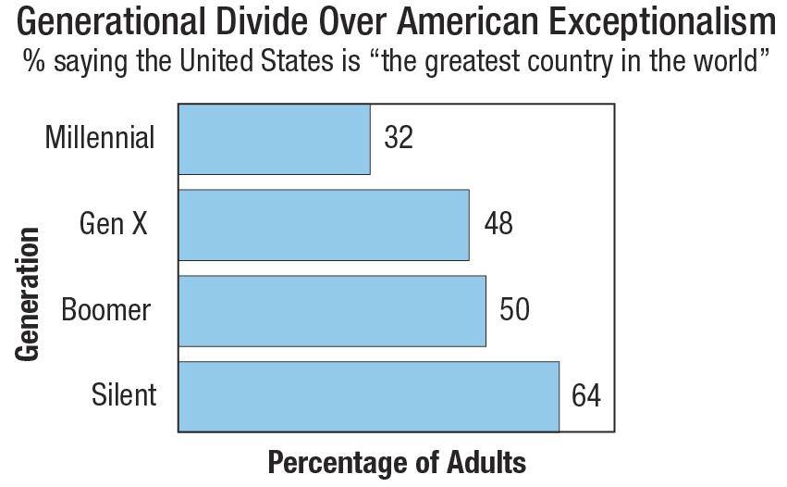
Example 5: Interpreting Bar Graphs (cont.)

Slide 36
Example 5: Interpreting Bar Graphs (cont.)
Solution
We can easily scan the graph to see that the Silent generation has the largest percentage of approval amongst its age group. 64% of people in the Silent generation feel that the United States is the greatest country in the world.

Slide 37
Example 5: Interpreting Bar Graphs (cont.)
Which generation has the second largest percentage of approval? To answer this question, we’ll need to look a little closer at the labels on the ends of the bars to know the precise percentage of each category. The Boomer generation was second with 50% of its generation believing that the United States is the greatest country in the world.

Slide 38
Side-by-Side Bar Graph
Side-by-Side Bar Graph
A side-by-side bar graph is a bar graph in which the bars are placed next to one another to show the similarities and/or differences between populations.

Slide 39
Example 6: Interpreting Bar Graphs with Multiple Populations
The Surveillance, Epidemiology, and End Results (SEER) Program of the National Cancer Institute works to provide information on cancer statistics in an effort to reduce the burden of cancer among the US population.⁴ In order for the results of their studies to have the best impact, SEER researchers need representative samples of the US population.
4 Surveillance, Epidemiology, and End Results Program, http://seer.cancer.gov

Slide 40
Example 6: Interpreting Bar Graphs with Multiple Populations (cont.)
The following side‑by‑side bar graph shows the demographic breakdown of participants in a SEER study versus the same demographic breakdown in the overall US population. Which two sub‑populations are more represented in the SEER group?

Slide 41
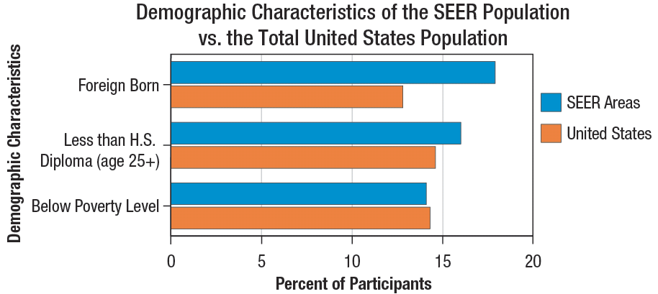
Example 6: Interpreting Bar Graphs with Multiple Populations (cont.)

Slide 42
Example 6: Interpreting Bar Graphs with Multiple Populations (cont.)
Solution
The bars are obviously longer for SEER than for the United States in both the Foreign Born category and the High School Diploma category, meaning that these have more representation in the SEER group than the general US population. However, if we look carefully at the Poverty Level category, although the percentages are very close, the SEER group slightly under represents this demographic.

Slide 43
Stacked Bar Graph
Stacked Bar Graph
A stacked bar graph is a bar graph in which the bars from each population are stacked on top of one another. This bar graph not only compares different categories, but how the whole of each category is broken down.

Slide 44
Histogram
Histogram
A histogram is a special type of bar graph that displays the frequency distribution of numerical classes. The height of each bar in a histogram represents the frequency of the corresponding classes. Because the bars represent classes, and class limits are consecutive numbers, the bars in a histogram touch.

Slide 45
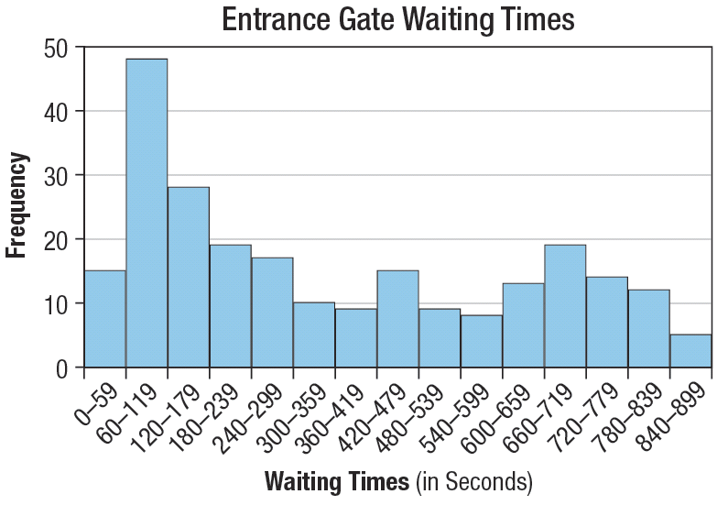
Example 7: Interpreting a Histogram
The following histogram displays data collected from delivery truck drivers. They were asked to record their wait times when an address had a closed entrance gate. Use the histogram to answer the questions that follow.

Slide 46
Example 7: Interpreting a Histogram (cont.)
a. Determine approximately how many truck drivers were in the survey?
b. Approximately how many drivers waited between 60 seconds and 180 seconds?
c. Approximately how many drivers waited more than 7 minutes?
d. Is it accurate to say that about half the drivers waited more than 420 seconds? Why?

Slide 47
Example 7: Interpreting a Histogram (cont.)
Solution
a. To determine the number of drivers surveyed, add together each of the frequencies for the different classes. We’ll approximate the frequency of each class first and then add them together.
Table 8: Entrance Gate Waiting Times
Class | Frequency
0–59 | 15
60–119 | 48
120–179 | 28

Slide 48
Example 7: Interpreting a Histogram (cont.)
Table 8: Entrance Gate Waiting Times (cont.)
Class | Frequency
180–239 | 19
240–299 | 17
300–359 | 10
360–419 | 9
420–479 | 15
480–539 | 9
540–599 | 8
600–659 | 13

Slide 49
Example 7: Interpreting a Histogram (cont.)
Table 8: Entrance Gate Waiting Times (cont.)
Class | Frequency
660–719 | 19
720–779 | 14
780–839 | 12
840–899 | 5
Total | 241
So, we estimate that there were approximately 241 truck drivers in the survey. We’ll use these estimates in the following questions.

Slide 50
Example 7: Interpreting a Histogram (cont.)
b. To determine how many drivers waited between 60 and 180 seconds, we need to add together the estimated frequencies of each of the bars between those times. Approximately 48 drivers waited between 60 and 120 seconds, and approximately 28 drivers waited between 120 and 180 seconds. Therefore, we can estimate that about 48 + 28 = 76 drivers waited between 60 seconds and 180 seconds.

Slide 51
Example 7: Interpreting a Histogram (cont.)
c. To approximate the number of drivers who waited more than 7 minutes, we need to add together all of the bars to the right of 7 minutes. We know that 7 minutes is 420 seconds, so we’ll add the frequencies of the last eight bars together.
15 + 9 + 8 + 13 + 19 + 14 + 12 + 5 = 95
Therefore, there were an estimated 95 drivers who waited more than 7 minutes at the entrance gates.

Slide 52
Example 7: Interpreting a Histogram (cont.)
d. Although 420 seconds represents the middle waiting time for the classes, it is inaccurate to say that half of the drivers recorded times less than this time and half recorded longer times. Instead, we need to think about the numbers of drivers. If there were approximately 241 drivers, then half would be around 120 drivers. We can add together the class frequencies until we reach approximately 120 and then note the waiting time.

Slide 53
Example 7: Interpreting a Histogram (cont.)
The first two classes added together are 15 + 48 = 63.
Adding the third class gives us 63 + 28 = 91.
Continuing with the fourth class, we get 91 + 19 = 110.
This is not quite the 120 that we’re looking for, so we can include the fifth class as well: 110 + 17 = 127. The fifth class has a lower limit of 240 seconds, so it is more accurate to say that about half of the drivers waited more than 240 seconds at entrance gates.

Slide 54
Line Graph
Line Graph
A line graph shows how data changes over time. The horizontal axis of a line graph represents time and the vertical axis represents the variable being measured. Each point on a line graph represents a data value, and then the points are joined together with line segments so changes over time are more easily observed.

Slide 55
Table 9: Census of 1860
No. | States | Free Population | Slave Population | Total Population | % of Slaves
1 | South Carolina | 301,271 | 402,541 | 703,812 | 57.2
2 | Mississippi | 354,700 | 436,696 | 791,396 | 55.1
3 | Louisiana | 376,280 | 333,010 | 709,290 | 47
4 | Alabama | 529,164 | 435,132 | 964,296 | 45.1
5 | Florida | 78,686 | 61,753 | 140,439 | 43.9
6 | Georgia | 595,097 | 462,232 | 1,057,329 | 43.7
7 | North Carolina | 661,586 | 331,081 | 992,667 | 33.4
8 | Virginia | 1,105,192 | 490,887 | 1,596,079 | 30.7
9 | Texas | 421,750 | 180,682 | 602,432 | 30
10 | Arkansas | 324,323 | 111,104 | 435,427 | 25.5

Slide 56
Table 9: Census of 1860 (cont.)
No. | States | Free Population | Slave Population | Total Population | % of Slaves
11 | Tennessee | 834,063 | 275,784 | 1,109,847 | 24.8
12 | Kentucky | 930,223 | 225,490 | 1,155,713 | 19.5
13 | Maryland | 599,846 | 87,188 | 687,034 | 12.7
14 | Missouri | 1,067,352 | 114,965 | 1,182,317 | 9.7
15 | Delaware | 110,420 | 1,798 | 112,218 | 1.6
 |  | 8,289,953 | 3,950,343 | 12,240,296 | 32.2
Source: NOAA Office of Coast Survey, “Map Showing the Distribution of the Slave Population of the Southern States ofthe United States 1860,” http://historicalcharts.noaa.gov/historicals/preview/image/CWSLAVE

Slide 57
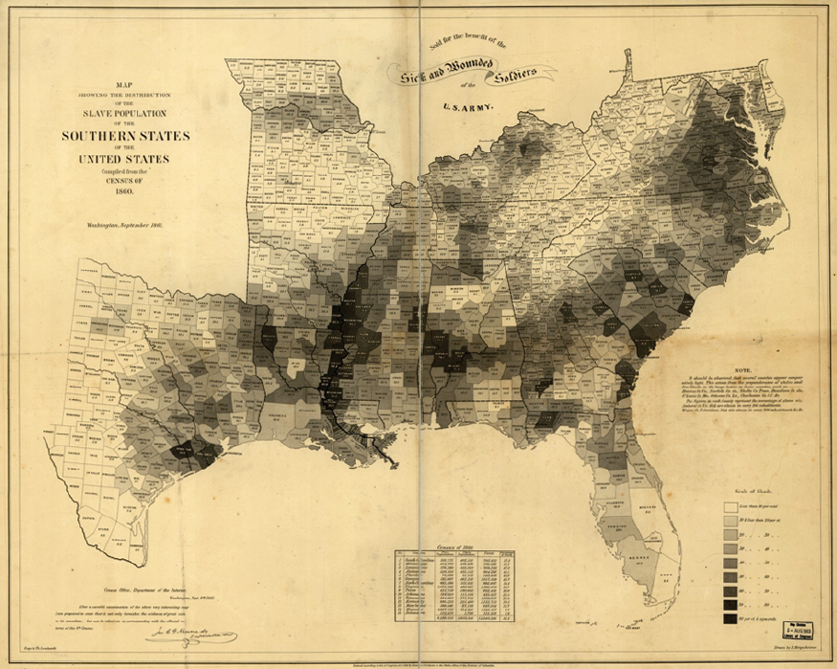
Figure 8: Distribution of the Slave Population of the United States, 1861
Courtesy of NOAA

Slide 58
Example 8: Reading Graphs
Considering the map of the distribution of the slave population of the Southern United States in Figure 8 and the data in Table 9, answer the following questions. The darker the shading is on the map, the higher the slave population was in that area.
a. Which states had a higher slave population than free population in the 1860 census?
b. Which state had the highest number of slaves in 1860?

Slide 59
Example 8: Reading Graphs (cont.)
c. One of the reasons that made the map so popular was the visual account of slavery by shading. Which areas had the heaviest concentration of slaves?
Solution
a. Using the frequency distribution of the 1860 census found on the bottom part of the map, we can see that South Carolina and Mississippi had a higher slave population than free population.

Slide 60
Example 8: Reading Graphs (cont.)
b. Although only 30.7% of its population was slaves, Virginia had the highest slave population at 490,887.
c. The darkest shadings occur along the Mississippi River, along the coast of South Carolina, in central Alabama, and in the middle of Georgia.

