Slide 1
Section 8.5
Linear Regression

Slide 2
Objectives
Calculate and interpret the correlation between two variables
Calculate and appropriately use the linear regression line for a given set of data

Slide 3
Linear Regression
The last bit of data analysis we’re going to look at involves evaluating the relationship between two variables. For example, we could compare the heights and weights of a sample of teenage boys. Just as before, let’s start by visualizing the data.

Slide 4
Scatter Plot
Scatter Plot
A scatter plot is a graphical display that is most commonly used to show two variables and how they might relate to one another. It is a graph on the coordinate plane that contains one point for each pair of data values.

Slide 5
Correlation
Correlation
When data are plotted in a scatter plot and there appears to be an upward trend, that is, as one variable increases the other increases as well, we say there is a positive correlation between the variables. If the scatter plot trends downward, that is, as one variable increases the other decreases, we say there is a negative correlation between the variables.

Slide 6
Example 1: Identifying Correlations
Consider the relationship between the following variables and what kind of correlation might show up in a scatter plot of the data. Decide if the variables would likely have a positive correlation, negative correlation, or no linear correlation.
a. The number of cigarettes smoked and the probability of lung cancer
b. The number of minutes spent on social media sites by college students and their first semester grades

Slide 7
Example 1: Identifying Correlations (cont.)
c. The amount of credit card debt incurred by college freshmen and their IQ score
Solution
a. As the number of cigarettes smoked increases, so does the chance of lung cancer. Thus, the scatter plot is likely to have upward-trending data points. The variables would be positively correlated.

Slide 8
Example 1: Identifying Correlations (cont.)
b. As the number of minutes (or hours) spent on social media sites increases, your grades are likely to decrease. This would result in a downward-trending scatter plot and a negative correlation between the amount of time spent on social media sites and grade point average.

Slide 9
Example 1: Identifying Correlations (cont.)
c. The scatter plot for these variables would likely contain a wide range of credit card debt and a wide range of IQ scores. It would be unlikely that there is a linear relationship between these two variables. Thus, they are neither positively or negatively correlated.

Slide 10
Skill Check #1
Skill Check #1
Identify two variables that would likely have a positive correlation.
Answer :
Answers will vary. Examples may include: The number of candy bars consumed daily and weight gain or the distance between two locations and the length of time it takes to drive between the two.

Slide 11
Pearson Correlation Coefficient
Pearson Correlation Coefficient
The Pearson correlation coefficient, rounded to the nearest thousandth, is a value between −1 and 1 that measures the strength of a linear correlation. For a sample, it is represented by the variable r.
If there is a very strong positive correlation, r will be close to 1. If there is a strong negative correlation, r will be close to −1. The closer r is to 0, the less correlation there is between the variables.

Slide 12
Example 2: Using a TI-84 Calculator to Find the Pearson Correlation Coefficient
The following is a small sample of data collected from male participants in a 161 km trail ultramarathon. The survey collected the BMI (Body Mass Index) of each participant and their age. A table of the data, along with the scatter plot of the data, is given. Use your calculator to find the correlation coefficient r between the variables.

Slide 13
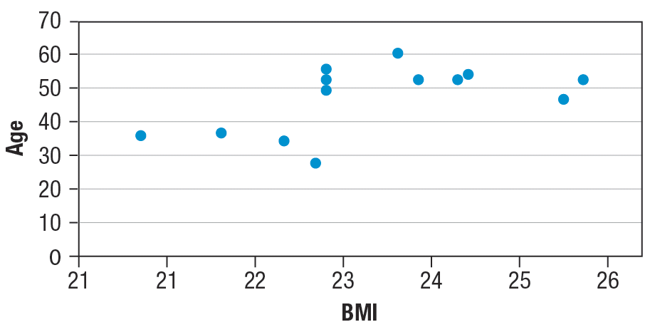
Example 2: Using a TI-84 Calculator to Find the Pearson Correlation Coefficient (cont.)
Table 1: BMI vs. Age for Men in a 161 km Trail Ultramarathon
BMI | Age
23.4 | 53
25.7 | 47
23.3 | 28
25.9 | 52
24.1 | 60
23.0 | 34
22.4 | 39
21.6 | 36
23.4 | 52
24.8 | 54
24.3 | 53
24.7 | 53

Slide 14


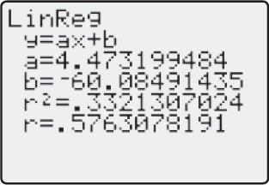
Example 2: Using a TI-84 Calculator to Find the Pearson Correlation Coefficient (cont.)
Solution
Begin by pressing and then 1:EDIT. Enter the values for the BMI’s in L1 and the values for the ages in L2. Then press and choose CALC and option 4:LinReg(ax+b). Press twice. The output should appear as shown in the screen shot below.

Slide 15
Example 2: Using a TI-84 Calculator to Find the Pearson Correlation Coefficient (cont.)
Since r = 0.5763078191, we know that there is a weak positive correlation between the male participant’s BMI and their age.

Slide 16
Level of Confidence and Level of Significance
Level of Confidence and Level of Significance
The level of confidence c is the probability that the assertions made about the data are correct.
The level of significance α is the probability that the assertions made about the data are incorrect.
c + α = 1.

Slide 17
Table 2: Critical Values of the Pearson Correlation Coefficient
Table 2: Critical Values of the Pearson Correlation Coefficient
n | α = 0.05 | α = 0.01
4 | 0.950 | 0.990
5 | 0.878 | 0.959
6 | 0.811 | 0.917
7 | 0.754 | 0.875
8 | 0.707 | 0.834
9 | 0.666 | 0.798
10 | 0.632 | 0.765
11 | 0.602 | 0.735
12 | 0.576 | 0.708

Slide 18
Statistically Significant
Statistically Significant
If |r| is greater than the critical value listed in the table, then r is statistically significant, which means it is unlikely to have occurred by chance.

Slide 19
Example 3: Identifying Statistical Significance
Use the critical values in Table 2 to determine if the correlation between BMI and age in the previous example is statistically significant. Recall that r = 0.5763078191. Use a 0.05 level of significance.
Solution
There are twelve pairs of data in Example 2, so n = 12. By looking along the row where n = 12 and down the column where α = 0.05, the critical value is 0.576.

Slide 20
Example 3: Identifying Statistical Significance (cont.)
Comparing this critical value to the correlation coefficient we found for the data in the previous example, we have |r| ≈ 0.5763 > 0.576. So the linear relationship between the variables is statistically significant at the 0.05 level of significance. Therefore, we have enough evidence to conclude that a linear relationship exists between BMI and age for male ultramarathoners.

Slide 21
Regression Line
Regression Line
The regression line, also known as the line of best fit, is a particular line that most closely “fits” the data points on the scatter plot. The regression line can be represented by
ŷ = ax + b,
where a is the slope of the line and b is the y-intercept.

Slide 22
Example 4: Predictions Using the Regression Line
A recent study sought to find if any correlation existed between childhood weight and self‑esteem. Children between the ages of 9 and 11 were surveyed. Weight was measured in pounds, while self-esteem was measured based on the average of the answers to 15 questions asking the participant to rate themselves on a scale of 1 to 5—where higher scores mean higher self-esteem. Here’s the data for 12 cases.

Slide 23
Example 4: Predictions Using the Regression Line (cont.)
Table 4: Self-Esteem in Children
Weight | Self-Esteem
54.3 | 2.6
62.0 | 4.6
88.1 | 1.0
61.8 | 3.7
69.0 | 4.7
55.8 | 2.9
77.2 | 1.5
66.4 | 4.8
63.3 | 3.9
75.2 | 1.1
79.0 | 1.9
68.3 | 2.9

Slide 24
Example 4: Predictions Using the Regression Line (cont.)
a. Is r statistically significant at the 0.05 level? How about the 0.01 level?
b. Write down the linear regression line in the form ŷ = ax + b.
c. If appropriate, predict the value for the level of self-esteem given that the child weighs 64.1 pounds.
d. If appropriate, predict the value for the level of self-esteem given that the child weighs 45.0 pounds.

Slide 25
Example 4: Predictions Using the Regression Line (cont.)
e. If appropriate, predict the value for the level of self-esteem given that the 13-year-old weighs 88.0 pounds.
Solution
a. Begin by putting both sets of data into your calculator as shown in the earlier examples. Input the weights in L1 and the self-esteem score in L2. After having the calculator compute the statistics for us, we can see that r = −0.6051.

Slide 26
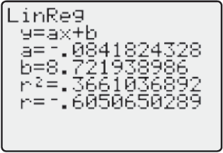
Example 4: Predictions Using the Regression Line (cont.)
Looking at the Pearson correlation coefficient critical value table with n = 12 and α = 0.05, we see that |r| = 0.6051 > 0.576, and is therefore statistically significant. However, with α = 0.01, |r|= 0.6051 < 0.708, and hence is not statistically significant.

Slide 27
Example 4: Predictions Using the Regression Line (cont.)
b. Using the values from the calculator which were calculated in the previous step, we know that the slope is a = −0.084 and the y-intercept is b = 8.722. So, the linear regression line, or line of best fit, is ŷ = −0.084x + 8.722.
c. Because the data are statistically significantly correlated at the 0.05 level, it is appropriate for us to consider the linear regression for predictions.

Slide 28
Example 4: Predictions Using the Regression Line (cont.)
Substituting x = 64.1 into the equation of the line written in the previous step, we have the following.
So, when a child’s weight is 64.1 pounds, we can predict that his or her self-esteem score would be around 3.3.

Slide 29
Example 4: Predictions Using the Regression Line (cont.)
d. The weight is outside of the range of the original data since it is smaller than any of the other data pieces, so it is not appropriate to use the regression line for prediction.
e. Once again it is not appropriate to use the regression line for predictions in this case. The study included only children between the ages of 9 and 11. A 13-year-old is not in the same population as the study and cannot be assumed to have the same characteristics.

