Slide 1
Section 9.1
Understanding Personal Finance

Slide 2
Objectives
Create a budget
Calculate sales prices and discounts
Calculate percentage increase/decrease

Slide 3
Understanding Personal Finance
As adults we all face financial challenges that affect our decisions in daily life. This section will introduce you to some basic concepts of personal finance that can be used for a lifetime.

Slide 4
Steps to Create a Budget
Steps to Create a Budget
Calculate monthly and periodical income.
Calculate monthly and periodical expenses.
Subtract total expenses from income.
Allocate any remaining funds to savings, long-term goals, or an emergency fund.

Slide 5
Net Income
Net Income
Net income is equal to total, or gross, income minus all taxes.

Slide 6
Example 1: Determining Federal Income Tax
Jamie graduated from college in 2013 with a degree in accounting. Her first job pays an annual salary of $52,000. How much should Jamie expect to pay in federal income tax for this salary if the federal tax rate is 15%?
Solution
According to the 2013 tax rates, Jamie should expect to pay about 15% of her salary in federal income tax.
$52,000 ⋅ 15% = $52,000 ⋅ 0.15 = $7800

Slide 7
Example 1: Determining Federal Income Tax (cont.)
Therefore, Jamie can expect to pay about $7800 in federal income tax each year at her current salary.

Slide 8
Example 2: Determining Monthly Take Home Pay
Pria just graduated from a liberal arts college and acquired a job as a sociologist. Her yearly salary is $34,500. If the federal tax rate is 15%, the social security tax rate is 6.2%, and the unemployment tax rate is 6%, determine the following.
a. Pria’s yearly taxes.
b. Pria’s monthly take home pay.

Slide 9
Example 2: Determining Monthly Take Home Pay (cont.)
Solution
a. Pria’s salary of $34,500 means that her income tax rate is 15%, social security tax is 6.2%, and unemployment tax is 6%. Therefore, Pria’s yearly taxes would be as follows.

Slide 10
Example 2: Determining Monthly Take Home Pay (cont.)
So, Pria can expect to pay approximately $9384 in taxes for the year.
b. Pria’s monthly take home pay would be equal to her yearly salary minus her yearly taxes divided over the 12 months of the year. So,
Therefore, Pria’s monthly take home pay is $2093.

Slide 11
Example 3: Budgeting on a Given Income
In Example 2, Pria had a monthly net income of $2093. Use the steps to create a budget to allocate Pria’s monthly income if her expenses consist of the following.

Slide 12
Example 3: Budgeting on a Given Income (cont.)
Solution
The steps to create a budget indicate that we need to do the following.
  1. Determine monthly income.
  2. Determine total monthly expenses.
  3. Subtract the amount from Step 2. from the amount from Step 1.
4. Allocate additional funds to savings.

Slide 13
Example 3: Budgeting on a Given Income (cont.)
In Example 2, we calculated Pria’s monthly income to be $2093. Given Pria’s total monthly expenses of $1810, we can now find the difference between monthly income and total monthly expenses to obtain
$2093 – $1810 = $283.

Slide 14
Example 3: Budgeting on a Given Income (cont.)
This means that Pria has $283 of remaining income each month that she can put toward savings, long-term goals, or an emergency fund. Making a sound financial decision would mean that Pria should understand that she may not always have an extra $283 each month. Therefore, instead of spending the funds, placing the money into a savings account would be a financially responsible decision.

Slide 15
Example 4: Creating a Budget with a Spreadsheet
Gail works for an art gallery with an annual income of $44,000. Her net monthly pay is $2,669.33. Her basic monthly expenses are the following.

Slide 16
Example 4: Creating a Budget with a Spreadsheet (cont.)
In addition, Gail receives $30 a week on average from a side consulting job and gives $45 a month to charities. Use a spreadsheet, such as Microsoft Excel, to create a budget for Gail. How much does she have each month for expenses not listed in her budget?

Slide 17
Example 4: Creating a Budget with a Spreadsheet (cont.)
Solution
Creating a budget using a spreadsheet allows us to let the computer do the arithmetic. This means that even though expenses might change month-to-month or new incomes are introduced, we can easily add them to the spreadsheet and the budget will be adjusted accordingly. Recall that to prepare a budget, we need to add both the income and expenses separately.

Slide 18
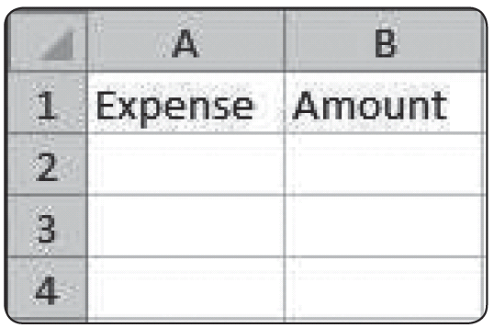
Example 4: Creating a Budget with a Spreadsheet (cont.)
Because spreadsheets can only perform calculations on numbers and not words, we need to list the numerical figures in one cell and their labels in another. Therefore, we’ll create a column for expenses and one for incomes. Let’s start with expenses. In cell A1 of the spreadsheet, type “Expense”, and in the adjacent cell, B1, type “Amount”. The spreadsheet should look like the following screenshot.

Slide 19
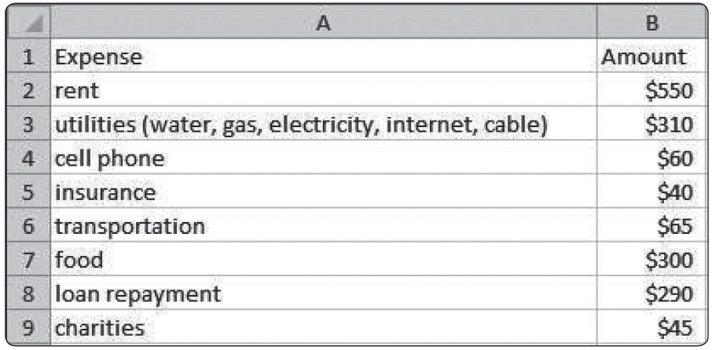
Example 4: Creating a Budget with a Spreadsheet (cont.)
Under the column labeled “Expense” enter the name of each of Gail’s expenses and under the column labeled “Amount” enter the amount associated with each expense. The new spreadsheet should now look like the following.

Slide 20
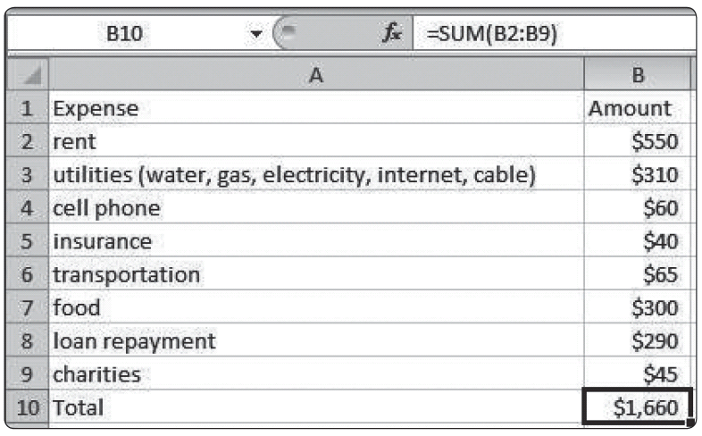
Example 4: Creating a Budget with a Spreadsheet (cont.)
To obtain the total amount of expenses, we need a place for the total on row 10. Enter “Total” in A10. In B10, we’ll put a formula that will sum the expenses. Enter “= sum(B2:B9)”, which instructs the computer to add together the data from column B, row 2 through column B, row 9.

Slide 21
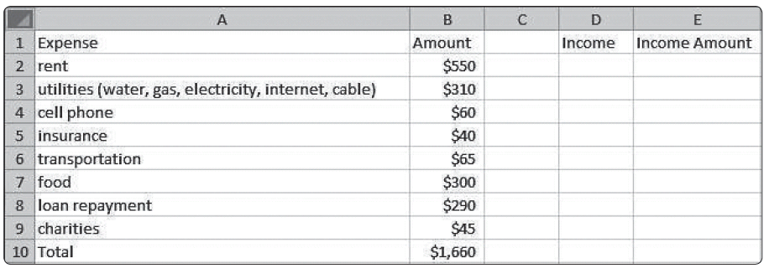
Example 4: Creating a Budget with a Spreadsheet (cont.)
The spreadsheet calculates that Gail has monthly expenses of $1,660.
Next, we’ll follow the same process for Gail’s income. Create a set of columns for Income and Income Amount in columns D and E. (We’ve intentionally left column C blank for clarity.)

Slide 22
Example 4: Creating a Budget with a Spreadsheet (cont.)
Enter Gail’s income labels in column D and the amount in column E. Note that when we enter the amount for her consulting income, we’ll need to write a formula for the monthly income, since we’re given the weekly amount. The formula will multiply the weekly amount by 4; that is, “= 30*4”. (Note that during some months, Gail will be paid 5 times for her side consulting job.) Doing it this way means that if the amount Gail receives each week changes, she can simply replace the number 30 with the new weekly income, and the spreadsheet will adjust the monthly amount accordingly.

Slide 23
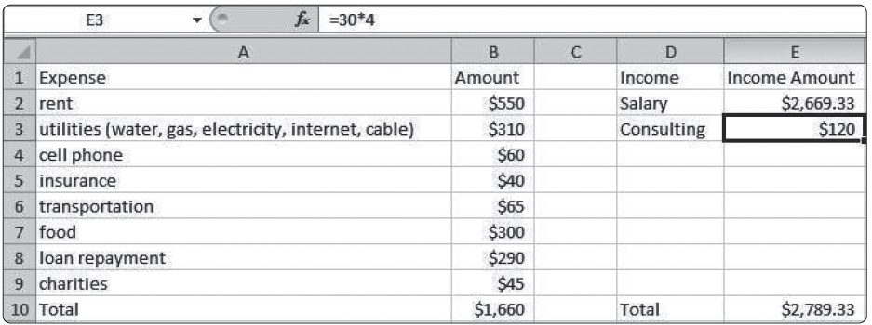
Example 4: Creating a Budget with a Spreadsheet (cont.)
To calculate Gail's total income for the month, enter
“= sum(E2:E3)” into cell E10. The budget spreadsheet now looks like the following.

Slide 24
Example 4: Creating a Budget with a Spreadsheet (cont.)
Finally, we need to subtract the Expense Total from the Income Total to find the remaining funds that Gail has available. We’ll put this in column G; again, leaving a blank column F for the sake of clarity. We need to tell the spreadsheet to subtract the expense total from the income total by directing it to the cells that contain the total for expenses and incomes. The formula will be in the form income total - expense total, so type the formula “= E10-B10” into cell G10.

Slide 25
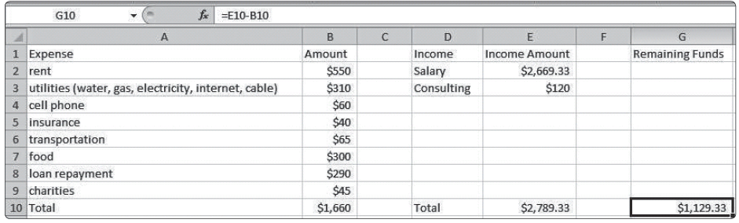
Example 4: Creating a Budget with a Spreadsheet (cont.)
We can now see that Gail has $1,129.33 to put towards expenses not in her budget each month. One of the values of using a spreadsheet like this is that if any of the expenses or incomes change, the spreadsheet automatically adjusts the final calculation for us.

Slide 26
Skill Check #1
Skill Check #1
Using the spreadsheet from Example 4, find Gail’s remaining income if her utilities increase by $50 a month.
Answers: $1079.33

Slide 27
List Price
List Price
The price of an item as it is listed for public sale is the list price.

Slide 28
Discount
Discount
The discount is the reduction from the list price. This is usually given as a percentage of the list price.

Slide 29
Sale Price
Sale Price
The sale price, sometimes called the net price, is the actual cost of an item after a discount of some kind is applied.
sale price = list price − discount

Slide 30
Example 5: Finding the Sale Price
Tennis Star Shoes is having a sale. A pair of tennis shoes has a list price of $129.99. The store is offering a discount of 25% off of the list price. Determine the sale price of the shoes before taxes.
Solution
We are to find the sale price of the shoes after a discount of 25% is taken. Since the list price is $129.99, the discount amounts to 25% of $129.99. Remembering our rules of problem‑solving from Chapter 1, this indicates that
25% of $129.99 = 0.25($129.99) = $32.50.

Slide 31
Example 5: Finding the Sale Price (cont.)
So, the discount amounts to $32.50. Now, the final price before taxes is determined by subtracting the discount from the list price.
The sale price of the pair of shoes is $97.49 before taxes.

Slide 32
Example 6: Determining a Discount
Andrea bought a stereo on sale for $198.45. The list price of the stereo was $330.75. What percentage is the discount?
Solution
We begin by recognizing that a percentage off the list price leads to our sale price. A discount of x% is subtracted from the original amount of $330.75. This means that the amount of the discount is
$330.75 – $198.45 = $132.30. So, what we really need to know is what percentage $132.30 is of $330.75.

Slide 33
Example 6: Determining a Discount (cont.)
Mathematically we can interpret the problem as the following.
So, the amount of the discount represents a 40% discount.

Slide 34
Skill Check #2
Skill Check #2
Max bought a computer on sale for $427. The original price of the computer was $1220. What percentage is the discount?
Answer: 65%

Slide 35
Percentage Change
Percentage Change
The percentage change over a period of time can be calculated by the following formula.

Slide 36
Example 7: Computing Percentage Decrease
Freddie bought a tablet PC for $1200. One year later, the same tablet PC costs $900. Determine the percentage decrease for the price of the tablet PC.
Solution
To find the percentage change, we need to compare the difference between the values (that is,
new price – old price) and divide by the reference value (old price). So, the percentage change is calculated as follows.

Slide 37
Example 7: Computing Percentage Decrease (cont.)
This means the price of the tablet has decreased 25% over the last year. Note that if the percentage change in price was an increase of the price, then the percentage change would be positive.

Slide 38
Skill Check #3
Skill Check #3
Zola bought a camera for $1125. If the price of the camera six months later was $761, what is the percentage decrease?
Answer: −32.36%, or a 32.36% decrease

Slide 39
Example 8: Computing Percentage Increase
Pear Bike Company uses a 40% profit margin to determine the list price of their products. If the company buys a bike at a wholesale price of $450, what would be the list price for the bike?
Solution
To determine a percentage increase, we need to recognize that the final price will be equal to the original price of $450 increased by 40%. So, the amount of the increase is
$450 (0.40) = $180.

Slide 40
Example 8: Computing Percentage Increase (cont.)
This means the total price for the bike would be
$450 + $180 = $630.

Slide 41
Skill Check #4
Skill Check #4
Use the list price of $630 for the bike in Example 8 to find the sale price if the bike was reduced 40%. Compare the 40% reduction in price to the wholesale price in Example 8.
Answer:
$378; It is less than the wholesale price in Example 8.

